Slide 1
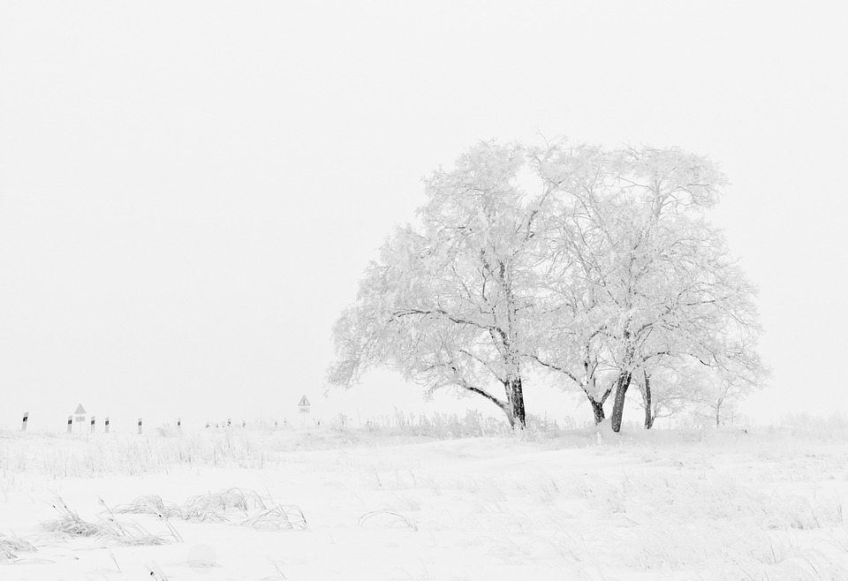
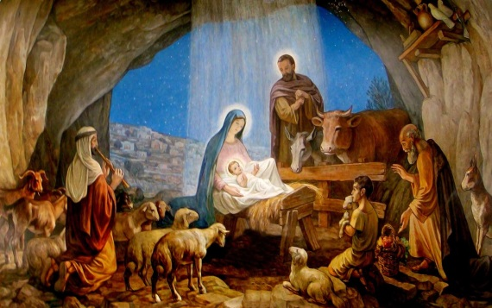
Born in a stable
L-1
S-01
Notes:
Use this slide as a focussing strategy to introduce the lesson topic. Read the title together and invite children to share something they know about where Jesus was born and the first Christmas crib.

Slide 2
Learning Intentions
The children will:
1)
describe the setting where Jesus was born
2)
retell the story of the first Christmas crib
L-1
S-02
Click the borders to reveal text
Notes:
Read through the Learning Intentions with the class and identify some ideas/questions that might be explored in the lesson.

Slide 3
The Season of Christmas is a celebration season
Look at the Liturgical Year and point to the season of Advent.
Move on to the next section on the calendar, read its name and notice its colour.
What colour is it and why?
What season comes after Advent – point to it.
X
L-1
S-03
Click the I-button to reveal information. Click the blue button twice to show you where to point
Notes:
Talk about what the Liturgical Calendar is and what we mean by a celebration season – celebrating a special feast of Jesus’ birth.
Work through the bullets on the pop up and use the blue button to point to Advent and Christmas.
Explain what they are and what a feast and season mean.

Slide 4
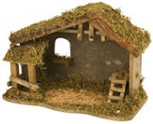
What do you know about a stable?
What is a stable used for?
What are stables in Aotearoa New Zealand used for?
Why was Jesus born in a stable?
What would it be like to be born in a stable?
L-1
S-04
Click in a white box underneath a question to type answer
Notes:
Read the questions and record children’s answers.
Children share stables they know about or have been to.

Slide 5
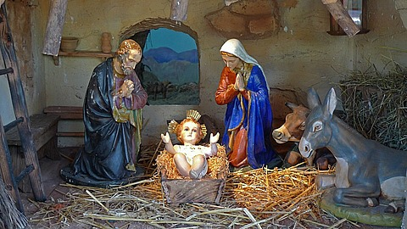
What is a Christmas crib?
A crib is set of figures which are models of the characters in the Christmas story that are displayed in homes and churches during Advent and Christmas.
To start with, the crib always includes Mary, Joseph and the animals that belong in the stable.
Last of all, the three wise men are added to complete the nativity scene.
The figures are usually set in the model of a stable or cave that reminds people about where the original story took place.
Then as the story continues Jesus is added, then the shepherds and the angels are placed in the crib.
L-1
S-05
Click the pins on the right to reveal post-it notes.
Notes:
Read each post it note and talk about what it means.
Use a crib to explain what it is and let children handle the figures and as the crib is set up tell the Christmas story.

Slide 6
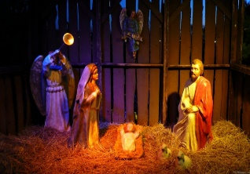
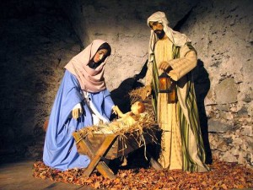
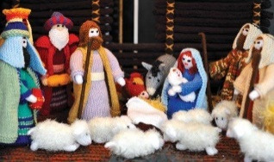
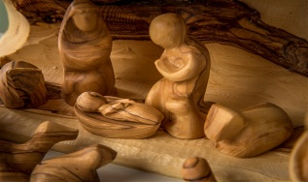
Cribs can be made of different materials
Why do we have Christmas cribs?
We have cribs to help us to remember and celebrate the story of Jesus’ birth at Christmas over 2000 years ago.
Where do we see Christmas cribs?
People set up Christmas cribs in homes, schools, churches and even in shop windows.
What are Christmas cribs made from?
Christmas cribs are made from many different materials including wood, pottery, porcelain or wool.
Why do they put the Christmas crib figures in a stable or a cave?
The Christmas crib figures are set up in a stable or a cave to make them look like the real Christmas story when Jesus was born in Bethlehem.
L-1
S-06
Click on image to reveal a line of text
Notes:
Share ideas about why we have cribs.
Look closely at all the cribs in the image. Children make comments on them and say what they are made from and who might have made them. Reveal the text, read it and discuss what it means. . Answer the questions.

Slide 7
People love Christmas cribs
People love setting up a Christmas crib to celebrate the birth of Jesus.
Having a crib is a Christmas tradition which means something that is done year after year.
A Christmas crib is an important tradition because it helps us to re-live the Christmas story as if we were there. Does your family have a Christmas crib?
The Christmas crib is not a decoration – it is a place where we can kneel and pray.
L-1
S-07
Click the down-button to move the blind down.
Notes:
Talk about why people love Christmas cribs.
Use the blind and read the reveals.
Children talk about their experience of Christmas cribs and where they have seen them.
Suggest they ask their family to get a crib for a family Christmas present that everyone can enjoy.

Slide 8
Telling the story using the Christmas crib
Look at your Christmas crib figures.
Put the stable in place.
Start telling the story – Joseph and Mary were looking for …
Move the figures as you continue. What happened next?
Who came to the stable? Let the characters speak.
Add the last group of visitors.
Sing a Christmas carol to finish the story.
Pray together thanking Jesus for being the best Christmas gift ever!
L-1
S-08
Click on image to reveal text
Notes:
Using a crib follow the text to help set up the crib.
Tell the story as you go and move the figures accordingly.
Use the Original home activity available in the Teachers book p.21 or on the lesson home page

Slide 9
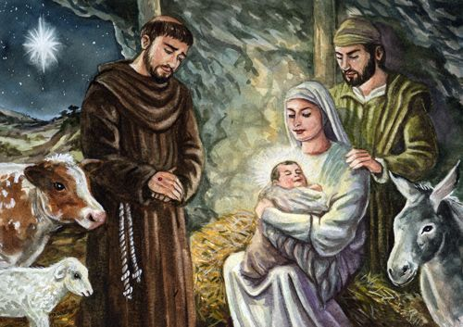
The first Christmas crib
Read ‘St Francis of Assisi and the first Christmas crib’
The first Christmas crib was made by
St. Francis of Assisi
Francis wanted the people to see
what the birth of Jesus was really like
Francis and John put real animals in a
cave with a manger and made the first crib
Seeing the crib helped the people to
understand the Christmas story very well
The Christmas crib is a tradition that
people still like to use today
understand the Christmas story very well
St. Francis of Assisi
what the birth of Jesus was really like
people still like to use today
cave with a manger and made the first crib
L-1
S-09
Click a sentence from the list to correctly position it in the sentence. Click on video button to play video
Notes:
After the children have heard the story of the first Christmas crib they read the sentence starters and suggest a statement in the white box to complete the sentence. Check using floaters and read complete sentence.
Answers 1) – d, 2) – b, 3) – e, 4) – a, 5) – c
Read the story in Teachers book, p.20 or on lesson home page.
Watch the clip
The Holy Night in Greccio 7:46 minutes
https://www.youtube.com/watch?v=ujDe-46-4qQ
Who else do you know who is called Francis?

Slide 10
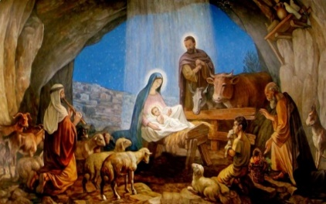
Check Up
1)
Draw a picture of the stable with the manger.
2)
Tell a partner how the first Christmas crib came to be.
3)
Who do you know who is called after St. Francis?
4)
Which activity do you think helped you to learn best in this lesson?
5)
Questions I would like to ask about the topics in this lesson are
L-1
S-10
Click the borders to reveal text
Notes:
This formative assessment strategy will help teachers to identify how well children have achieved the Learning Intentions of the lesson.
Teachers can choose how they use the slide in their range of assessment options.
A worksheet of this slide is available for children in Years 5-8 to complete.
The last two items are feed forward for the teacher.
Recording the children’s responses to these items is recommended as it will enable teachers to adjust their learning strategies for future lessons and target the areas that need further attention.

Slide 11
Time for Reflection
L-1
S-11
Click the audio button to stop reflective music
Click the audio button to play reflective music
Notes:
The MP3 is played to help create a reflective atmosphere and bring the children to stillness and silence as the teacher invites them to think about how a Christmas crib brings to life the greatest story ever told – the Christmas story when Jesus who was God’s only son came to live in the world to show us how to live with kindness and love.

