Slide 1
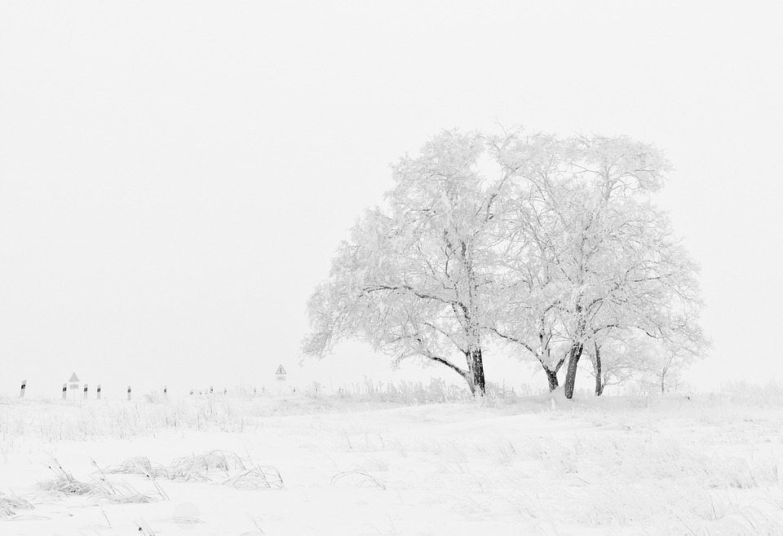
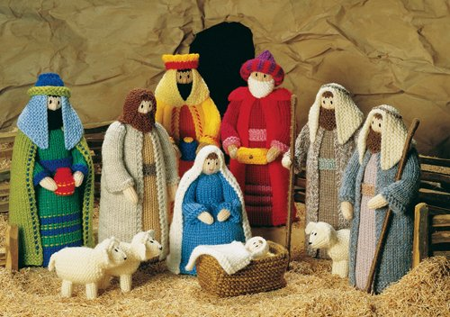
Cribs tell the Christmas story
L-2
S-01
Notes:
Use this slide as a focussing strategy to introduce the lesson topic. Read the title together and invite children to share something they know about how cribs help people to tell the Christmas story.

Slide 2
Learning Intentions
The children will:
1)
identify all the Christmas crib figures and symbols including the wise men.
2)
explain the part each character and symbol plays in the story.
L-2
S-02
Click the borders to reveal text
Notes:
Read through the Learning Intentions with the class and identify some ideas/questions that might be explored in the lesson.

Slide 3
Name the characters in the Christmas story
L-2
S-03
Click on blue button to point to characters
Notes:
Move the blue button to point to each character in the crib and say who each one is – this is Mary and she is Jesus’ mother.
Set up a crib in the classroom and let children handle it and decide about setting it up. Retell the story as this is done. Talk about what cribs can be made from.

Slide 4
What part did Mary play in the story?
Mary said …
L-2
S-04
Click in the word balloon to type text
Notes:
Children share their ideas about the part Mary played when Jesus was born.
What Mary said and did is recorded in the word balloon.

Slide 5
What part did Joseph play in the story?
Joseph said …
L-2
S-05
Click in the word balloon to type text
Notes:
Children share their ideas about the part Joseph played when Jesus was born.
What Joseph said and did is recorded in the word balloon.

Slide 6
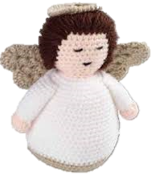
What part did the angels play in the story?
The angels said …
L-2
S-06
Click in the word balloon to type text
Notes:
Children share their ideas about the part the angels played when Jesus was born.
What the angels sung and did is recorded in the word balloon.

Slide 7
What part did the shepherds play in the story?
The shepherds said …
L-2
S-07
Click in the word balloon to type text
Notes:
Children share their ideas about the part the shepherds played when Jesus was born.
What the shepherds said and did is recorded in the word balloon.

Slide 8
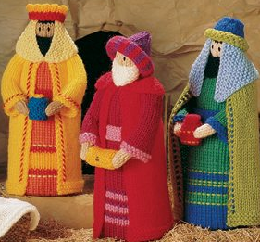
What part did the wise men play in the story?
The wise men said …
L-2
S-08
Click in the word balloon to type text
Notes:
Children share their ideas about the part the wise men played when Jesus was born.
What the wise men said and did is recorded in the word balloon.

Slide 9
What part did the animals play in the story?
The animals said …
L-2
S-09
Click in the word balloon to type text
Notes:
Children share their ideas about the part the animals played when Jesus was born.
What the animals said and did is recorded in the word balloon.

Slide 10
What part did the stars play in the story?
The stars said …
L-2
S-10
Click in the word balloon to type text
Notes:
Children share their ideas about the part the stars played when Jesus was born.
What the star said and did is recorded in the word balloon.
Children share ideas about how a Christmas crib helps children learn the Christmas story.

Slide 11
What part did Jesus play in the story?
And Jesus said …
L-2
S-11
Click in the word balloon to type text
Notes:
Children share their ideas about the part Jesus played in the Christmas story.
What Jesus said and did is recorded in the word balloon.
Children talk about what the best part of the story is.

Slide 12
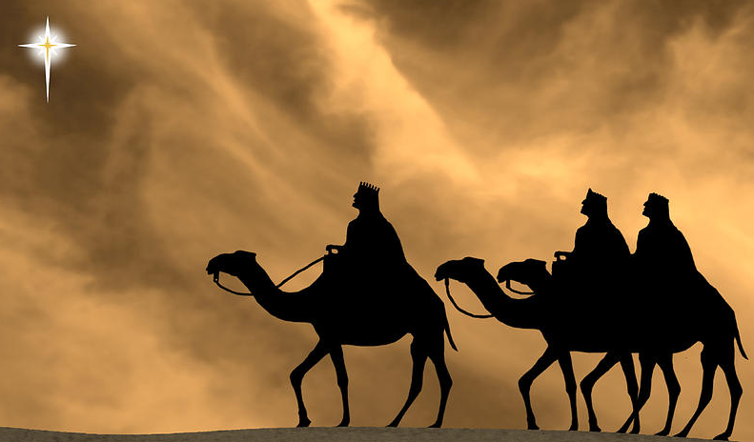
The story of the day the 3 wise men arrived to honour the baby King of the Jews
How did the 3 wise men know a baby king had been born?
What sort of king was Herod?
Why did the 3 wise men go home a different way?
X
Listen to the story in the overview about the coming of the three wise men
L-2
S-12
Click the I-button to reveal information. Click on video button to play video.
Notes:
Read the story of the wise men arriving to honour Jesus
The text of the story can be read from here
In the time of King Herod after Jesus was born in Bethlehem, wise men from the East came to Jerusalem. They asked “Where is the child who has been born kings of the Jews? We have seen his star as it rose and we have come to pay him honour.
When Herod heard this, he was frightened, and all the people of Jerusalem were frightened too. They called together the chief priests and scribes and asked them where the Messiah was to be born. They said in Bethlehem of Judea as this had been written by the prophet. Then Herod sent for the wise men and they told him the time and place the star had appeared. Herod told them to let him know when they found the king as he would go and pay honour to him too.
The kings left and followed the star until it stopped over the place where the child was. They were overwhelmed with joy. They went into the house and they saw the child with Mary his mother. They knelt down and paid him homage. Then opening their treasure chests they offered him gifts of gold, frankincense and myrrh. They left for their own country by another road because they had been warned in a dream not to return to Herod.
When the story is finished answer the questions on the pop up.
Watch the clip
The Wise Men – HeartFelt Bible 3:42 minutes – Scripture text
https://www.youtube.com/watch?v=7mocxuLzUmU
Alternative clip
The Wise Men from the Nativity movie 5:45 minutes
https://www.youtube.com/watch?v=gzIESPA_-Uw

Slide 13
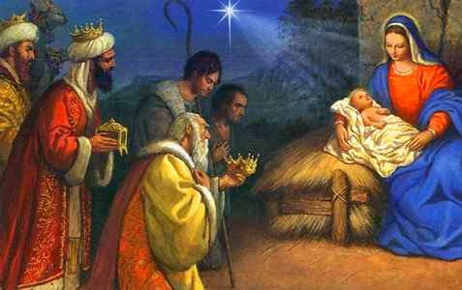
There is a special feast that celebrates the wise men paying homage to Jesus
The gifts we bring to Jesus are trying to be our best selves and doing our best work.
Paying homage to someone means honouring them in a special way.
We celebrate the day the wise men paid homage to Jesus and we call it the Epiphany.
The wise men knew Jesus was God’s son and that is why they adored him.
L-2
S-13
Click the pins on the right to reveal post-it notes.
Click the audio button to stop ‘Song of Light’
Click the audio button to play ‘Song of Light’
Notes:
Explain what paying homage means.
Read each post it note and talk about what it is about.
Sing using the MP3 ‘Song of Light’.
Use the Original home activity available in the Teachers book p.23 or on the lesson home page.

Slide 14
Check Up
1)
Name all the characters in the Christmas story and tell the story.
2)
Choose your favourite character – draw them and write about their part in the Christmas story.
3)
Explain why St Francis made the first Christmas crib.
4)
Which activity do you think helped you to learn best in this lesson?
5)
Questions I would like to ask about the topics in this lesson are …
L-2
S-14
Click the borders to reveal text
Notes:
This formative assessment strategy will help teachers to identify how well children have achieved the Learning Intentions of the lesson.
Teachers can choose how they use the slide in their range of assessment options.
A worksheet of this slide is available for children in Years 5-8 to complete.
The last two items are feed forward for the teacher.
Recording the children’s responses to these items is recommended as it will enable teachers to adjust their learning strategies for future lessons and target the areas that need further attention.

Slide 15
Time for Reflection
L-2
S-15
Click the audio button to stop reflective music
Click the audio button to play reflective music
Notes:
The MP3 is played to help create a reflective atmosphere and bring the children to stillness and silence as the teacher invites them to wonder about what the first Christmas night was like when Jesus was born. Talk to Jesus in their heart about how they love him and want to be a loving, kind person like he was.
The MP3 is played to help create a reflective atmosphere and bring the children to stillness and silence as the teacher invites them to.

Slide 16
Sharing our Learning about CHRISTMAS with family whānau
Use your family Christmas crib to share the Christmas story with a family whānau member.
Draw or make a stable then use it to share your learning about what a stable is for and how Jesus came to be born in one.
Tell someone the story about St Francis of Assisi and the first Christmas crib. Show them the you tube clip https://www.youtube.com/watch?v=ujDe-46-4qQ
If your family doesn’t have a Christmas crib yet ask if you can have one as a Christmas present and set it up to share with your family and use it to illustrate the Christmas story with them.
Share the story of the three wise men visiting Jesus after he was born. Share the you tube clip the wise men https://www.youtube.com/watch?v=7mocxuLzUmU and talk about the characters in the story and what they were like. Explain what paying homage to someone means.
Make up your own way of showing and sharing what you have learned and decide who you would like to share it with.
L-2
S-16
Click on worksheet button to go to worksheet
Notes:
This slide provides some choices for children to show and share what they have learned. Examples could be photographed as evidence of children’s learning.
You may like to put a copy of the Sharing our Learning page in children’s RE Learning Journals. You could talk through the choices using the slide and let children make their choice from their own copy.
Children could work on their choice at school and/or at home and you may like to set a day for sharing. Please let parents and whānau know what you expect them to do with this.
The slide is focussed on Christmas Year 2 Achievement Objective which is covered in Lessons 1-2
Year 2 AO Children will be able to: recognise that setting up a crib is a Christmas tradition and identify the meaning behind each symbol.

Slide 17
Sharing our Learning about CHRISTMAS with family whānau
Use your family Christmas crib to share the Christmas story with a family whānau member.
Draw or make a stable then use it to share your learning about what a stable is for and how Jesus came to be born in one.
Tell someone the story about St Francis of Assisi and the first Christmas crib. Show them the you tube clip https://www.youtube.com/watch?v=ujDe-46-4qQ
If your family doesn’t have a Christmas crib yet ask if you can have one as a Christmas present and set it up to share with your family and use it to illustrate the Christmas story with them.
Share the story of the three wise men visiting Jesus after he was born. Share the you tube clip the wise men https://www.youtube.com/watch?v=7mocxuLzUmU and talk about the characters in the story and what they were like. Explain what paying homage to someone means.
Make up your own way of showing and sharing what you have learned and decide who you would like to share it with.
L-2
S-16
Worksheet
Click the up arrow to return to the presentation
Notes:
This worksheet relates to slide 16

