Slide 1


Giving Gifts
L-2
S-01
Notes:
Slide 1 Giving gifts
Use this slide as a focussing strategy to introduce the lesson topic. Read the title together and invite children to share something they know about the story of St Nicholas, the real Santa Claus who gives gifts, and ways people can give gifts of love to others.

Slide 2
Learning Intentions
Placeholder
for
Key Image
1)
  recall the story of St Nicholas, the real Santa Claus, as a gift giver.
2)
name ways people can give gift of love aroha to others.
L-2
S-02
Notes:
Slide 2 Learning Intentions
Read through the Learning Intentions with the class and identify some ideas/questions that might be explored in the lesson.
The children will:
1. recall the story of St Nicholas, the real Santa Claus, as a gift giver.
2. name ways people can give gift of love aroha to others.

Slide 3

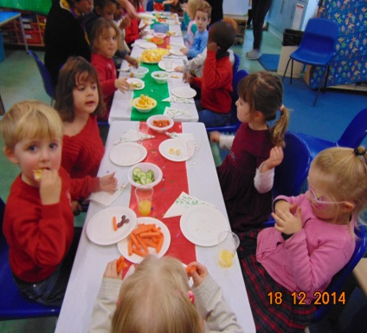
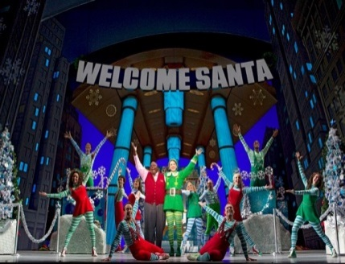
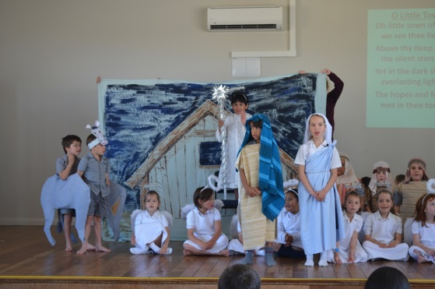

Special ways we celebrate Christmas
What special events do you have to celebrate Christmas?
ActiveX Control
“embedded” in a shape
How do these events help you to celebrate the real meaning of Christmas?
L-2
S-03
Click in the yellow box and write your text
Notes:
Slide 3 Special ways we celebrate Christmas
Children look at each image and say what it is and how it helps people to celebrate Christmas.
Answer the questions and record children’s responses.

Slide 4

St. Nicholas – did you know?...
He was born in Turkey and his parents died when he was a little boy.
When he was an adult he became a bishop.
He loved children very much.
L-3
S-04A
Click an image to reveal a text line
Notes:
Slide 4 A St. Nicholas – did you know?
What do you know about St. Nicholas?
Read the sentences.
What sort of person was St. Nicholas?

Slide 5
St. Nicholas – did you know?...
He was very generous and gave money to people in need.
He saw this as giving a gift of love.
He saw all gifts as signs of love.
Can you explain how he became known as Santa Claus?
Click an image to reveal a text line
L-2
S-04B
Click the video button to play ‘The Story of Saint Nicholas’
Notes:
Slide 4 B St. Nicholas – did you know?
Watch the clip
https://www.youtube.com/watch?v=C1Wq4mb2Sbg
The story of Saint Nicholas – the real Santa Claus 6:18 minutes
What 3 new things did you learn about St. Nicholas?
You could read the story on the Teacher Resource p18 or the lesson home page

Slide 6

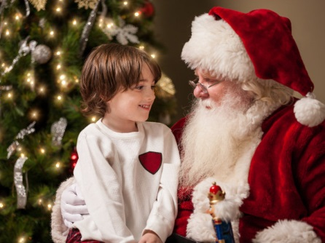
The tradition of telling Santa Claus what you would like for Christmas
Saint Nicholas loved children very much. He gave gifts to children in need.
Saint Nicholas knew that people show their love for God best by showing love aroha for others.
Saint Nicholas told children that giving gifts of love like helping others sharing, using our actions and words to show God’s love to others were the best gifts of all.
He was well known for his generosity so when he became known as Santa Claus, children would tell him what they would like for Christmas.
L-2
S-05
Click top card to flip the page
Notes:
Slide 5 The tradition of telling Santa Claus what you would like for Christmas
Use the flip book to retell the story of St. Nicholas.
When you go to see Santa Claus this Christmas - remember the story of St. Nicholas and the generous person he was.
Try to be a generous person by giving time to help others this Christmas.

Slide 7
What is the true meaning of Christmas?
Highlight TRUE or FALSE
1 We have Christmas so the shops can make a lots of money.
2 The real meaning of Christmas is getting loads of presents to play with.
3 Helpful actions are not really enough for a present to give at Christmas.
4 Jesus is the reason we give presents at Christmas.
5 You don’t need fancy food and presents to celebrate Christmas.
6 The spirit of Christmas is the spirit of Jesus which is the spirit of love.
7 Only gifts that cost a lot of money are worth giving at Christmas.
8 The first Christmas gift was Jesus.
9 Kind words and caring actions are the best gifts we can give Jesus.
10 Christmas gifts don’t have to be wrapped up in fancy paper and ribbons.
T/F
T/F
T/F
T/F
T/F
T/F
T/F
T/F
T/F
T/F
L-2
S-06
Drawing Tool
Click the worksheet button to go to the worksheet
Notes:
Slide 6 What is the true meaning of Christmas?
Work through each item on the screen then children complete their worksheets.
Answers: 1F, 2F, 3F, 4T, 5T, 6T, 7F, 8T, 9T,10T
Feedback on your score:
1-4 Tell yourself – Jesus is the reason for the season
5-7 Keep trying to remember the real meaning of Christmas.
8-10 You have true spirit of Christmas in your heart!

Slide 8

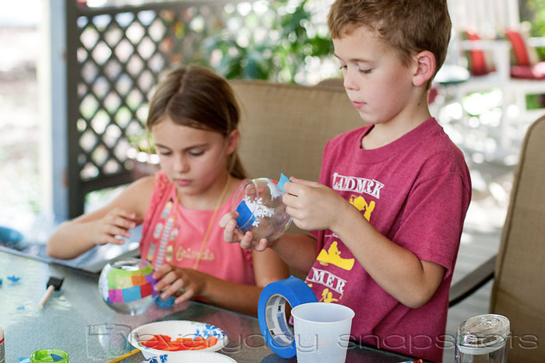
Giving gifts of love
Plan the gifts of love you can give someone on Christmas day
Here are our favourite ideas:
ActiveX Control
“embedded” in a shape
Research some ideas on the internet – think about how you can make them full of love
Click in the yellow box and write your text
L-2
S-07
Click the audio button to stop ‘Gifts for a King’
Click the audio button to play ‘Gifts for a King’
Notes:
Slide 7 Giving gifts of love
Adapt Teaching and Learning Experiences 5 & 6
Follow the directions on the slide.
Sing using the MP3 ‘Gifts for a King’
You may like to use the Children’s Home activity on p20 of the Teacher’s book or on the lesson home page.

Slide 9

Check Up
1)
Tell a partner 3 things you have learned about St Nicholas and why we call him Santa Claus…
2)
Give 3 examples of gifts of love children of your age can give at Christmas…
3)
Explain what the real meaning of Christmas is...
4)
What sort of gifts do you like to receive. Give your reasons...
5)
Which activity do you think helped you to learn best in this lesson?
6)
Questions I would like to ask about the topics in this lesson are…
L-2
S-08
Click in each caption space to reveal text
Notes:
Slide 8 Check Up
This formative assessment strategy will help teachers to identify how well children have achieved the Learning Intentions of the lesson.
Teachers can choose how they use the slide in their range of assessment options.
A worksheet of this slide is available for children in Years 5-8 to complete.
The last two items are feed forward for the teacher.
Recording the children’s responses to these items is recommended as it will enable teachers to adjust their learning strategies for future lessons and target the areas that need further attention.
Check up:
1. Tell a partner 3 things you have learned about St Nicholas and why we call him Santa Claus…
2. Give 3 examples of gifts of love children of your age can give at Christmas…
3. Explain what the real meaning of Christmas is...
4. What sort of gifts do you like to receive. Give your reasons...
5. Which activity do you think helped you to learn best in this lesson?
6. Questions I would like to ask about the topics in this lesson are…

Slide 10
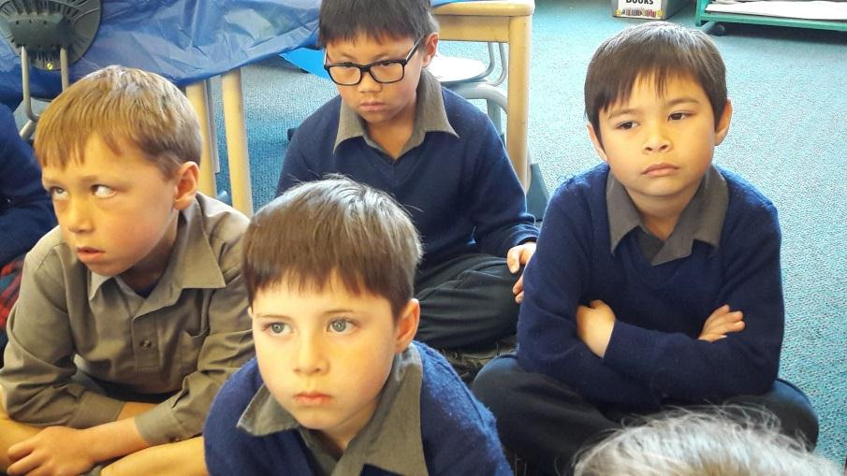

Time for Reflection
L-2
S-09
Click the audio button to stop reflective music
Click the audio button to play reflective music
Notes:
Slide 9 Time for Reflection
The MP3 is played to help create a reflective atmosphere and bring the children to stillness and silence as the teacher invites them to think about generous people in their life who will give them the gift of their time and attention this Christmas. Plan how they could pass this gift on to someone else in their family this Christmas.
Original children’s activities in Teachers book or on lesson home page.

Slide 11

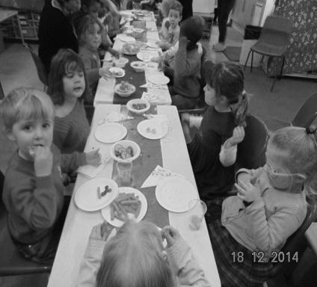
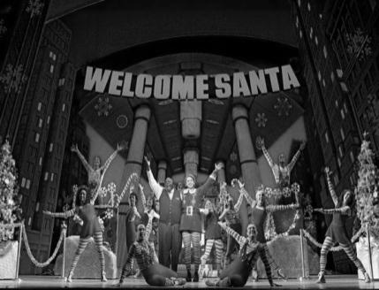
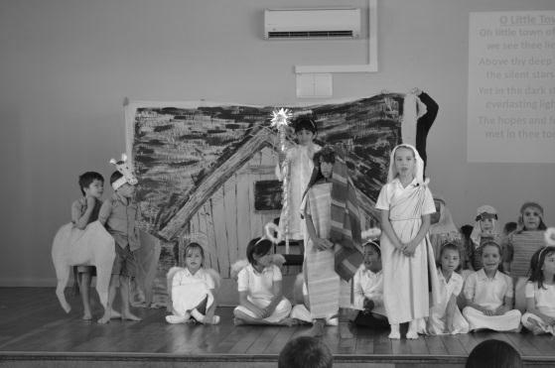

What is the true meaning of Christmas?
Highlight TRUE or FALSE
1 We have Christmas so the shops can make a lots of money.
2 The real meaning of Christmas is getting loads of presents to play with.
3 Helpful actions are not really enough for a present to give at Christmas.
4 Jesus is the reason we give presents at Christmas.
5 You don’t need fancy food and presents to celebrate Christmas.
6 The spirit of Christmas is the spirit of Jesus which is the spirit of love.
7 Only gifts that cost a lot of money are worth giving at Christmas.
8 The first Christmas gift was Jesus.
9 Kind words and caring actions are the best gifts we can give Jesus.
10 Christmas gifts don’t have to be wrapped up in fancy paper and ribbons.
T/F
T/F
T/F
T/F
T/F
T/F
T/F
T/F
T/F
T/F
Name:
Date:
L-2
S-06
Worksheet
Click the up arrow to return to the lesson
Notes:
(6) Copy worksheet template
Some slides will be used as worksheets by the students.
A copy worksheet is a black & white version of the colour slide which is here, for reference purpose, called the original.
(please refer to the worksheet template on how to create a worksheet).
Tip: create the worksheet immediately after you have created the original slide and place it at the end of the presentation before configuring the worksheet button.
If a slide is designated to be a worksheet, it should have the Worksheet button positioned on the bottom right.
The exact position depends on the buttons that are available on the slide (refer to General Information section for the position of buttons).
If the Worksheet button is the only button on the slide, the position of the button on this template is correct.
Configuring the Worksheet button.
The following procedure can be used to configure the worksheet button:
Right-click the button and chose: “Edit Hyperlink”;
On the Mouse click tab chose: “Hyperlink to:”;
From the drop down chose: “slide”;
Pick the correct slide number of the worksheet slide:
The worksheet slide should be position at the end of the presentation (if there is more than 1 worksheet, place them in order of appearance);
Don’t worry if you add slides between the original and the worksheet, the worksheet button will automatically be updated to point to the correct slide;
Don’t forget to have the document button on the worksheet slide pointing to this original slide.
Next to the content specified in Anne’s instructions this worksheet must have the following objects: Identification field, back button, tool instructions and worksheet indication.
For configuration information on these objects please refer to the General Information and Structure sections.
Adjust the tool instruction to match the purpose of the slide.

