Slide 1

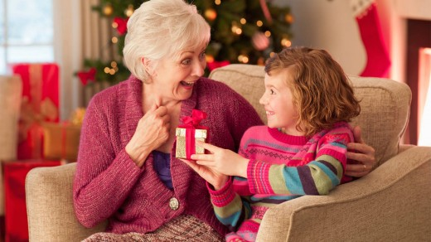
Receiving gifts taonga
L-3
S-01
Notes:
Slide 1 Receiving gifts Taonga
Use this slide as a focussing strategy to introduce the lesson topic. Read the title together and invite children to share something they know about how to receive gifts graciously and how celebrating Eucharist is a good part of celebrating Christmas.

Slide 2
Learning Intentions
Placeholder
for
Key Image
The children will:
1)
demonstrate gracious ways to receive gifts.
2)
explain why celebrating Eucharist is a good way to celebrate Christmas.
L-3
S-02
Notes:
Slide 2 Learning Intentions
Read through the Learning Intentions with the class and identify some ideas/questions that might be explored in the lesson.
The children will:
1. demonstrate gracious ways to receive gifts.
2. explain why celebrating Eucharist is a good way to celebrate Christmas.

Slide 3

Gifts – the attitude of the giver
People who give you gifts usually go to a lot of trouble.
They think about what you would like.
They wrap the gift in your favourite colour paper and tie it with beautiful ribbons.
They are excited to see your reaction when they give you the gift.
What attitudes does the giver have who has done this?
What are these attitudes a sign of?
L-3
S-03
Notes:
Slide 3 Gifts – the attitude of the giver
Children share what people have in their hearts when they share gifts.
Work through the bullet points and invite children to comment on each one. Share responses to the last 2 questions.

Slide 4
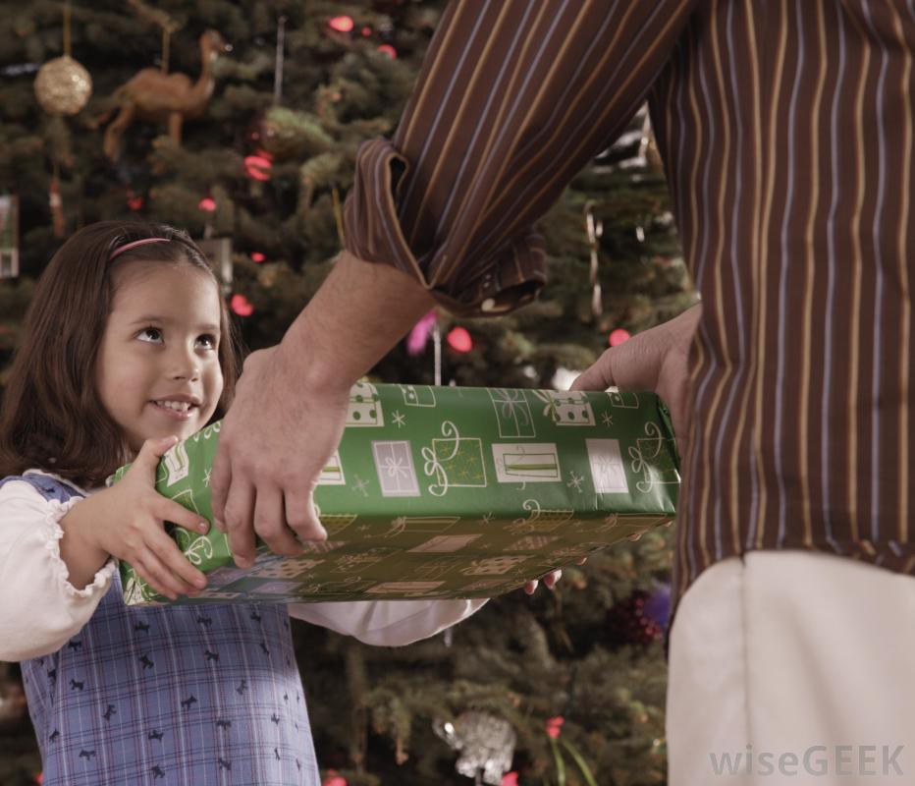

Gifts – the attitude of the receiver
People who receive a gift are usually delighted and sometimes surprised
to receive it.
They show their delight by opening
it and saying how much they like it.
It may be just what they wanted but sometimes it is not.
L-3
S-04A
Click the circle icon to reveal a text line
Notes:
Slide 4 A Gifts – the attitude of the receiver
Children share how people respond to receiving a gift.
Read each item and share experiences about each one.
What do you do when you are disappointed with a gift you receive?

Slide 5
Gifts – the attitude of the receiver
They may feel disappointed but they
show appreciation for the trouble
the giver has gone to.
What attitudes does the receiver
have who has done this?
L-3
S-04B
Click the circle icon to reveal a text line
Notes:
Slide 4 B Gifts – the attitude of the receiver
Discuss people’s reactions when they receive a gift that disappoints them. What and who do you have to think about when this happens?
Share your responses to the question on the slide.
What can you do with a gift you are disappointed with?

Slide 6

When you give a gift what is
the right thing to do?
Circle the right things to
do when you give a gift
1) I don’t bother to wrap it
2) I leave it on the table for the receiver to pick up
3) I put it in their hands and look in their eyes
4) I don’t say anything I just give it to them
5) I say, “This is for you I hope you like it!”
6) I spend time thinking about what they would like
7) I just buy anything and give it in the shop bag
8) I give it to the person and walk away
9) I drop it off without seeing them
10) I wrap it up with care, decorate it and write on the card
L-3
S-05A
Click the worksheet button to go to the worksheet.
Notes:
Slide 5 A When you give a gift what is the right thing to do?
Look at the image and discuss the ‘rule’ for gift giving – do you agree with it? Say why or why not. Share any rules your family has for gift giving. Work through each item and children can give a ‘thumbs up or down’ to show their response.
Children work through the worksheet and discuss items and share their comments about the best way to give a gift.

Slide 7
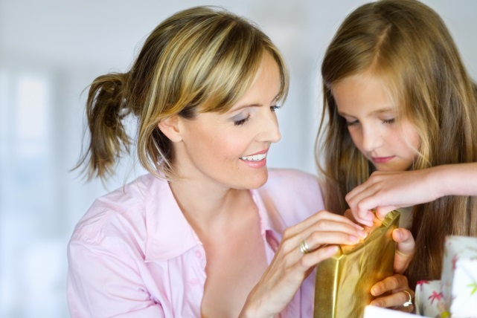
When you receive a gift what is the right thing to do?
Circle the right
things do when you
receive a gift
1) I look at the person and say thank you.
2) I put it on the table and see if there are any more gifts for me.
3) I rip the paper off and say, “I have one of these already!”
4) I open it and say, “I am delighted with this.”
5) I open it and hold it and then give the giver a hug.
6) I say, “This was a great choice, thanks a lot.”
7) I say, “This is just what I didn’t want!”
8) I leave the gift on the floor and go out to play.
L-3
S-05B
Click the worksheet button to go to the worksheet.
Notes:
Slide 5 B When you receive a gift what is the right thing to do?
Work through each item and children can give a ‘thumbs up or down’ to show their response.
Children work through the worksheet and discuss items and share their comments about the best way to receive a gift.
Talk about what you do with the gift tells the giver something about your attitudes as a receiver. Share experiences you have had as a gift giver and a receiver of gifts.

Slide 8

God gives us many gifts
Name 5 gifts God has given us.
Name 3 ways we show God we are grateful for the gifts God has given us.
What is the best way we give thanks to God for the gifts?
Why is Christmas a special time to go to Eucharist?
ActiveX Control
“embedded” in a shape
L-3
S-06
Click in the yellow box to write your text
Notes:
Slide 6 God gives us many gifts
Read and share ideas about the meaning of the Scripture quote from St. James’ letter.
Children share responses to each item and record the best of them.

Slide 9
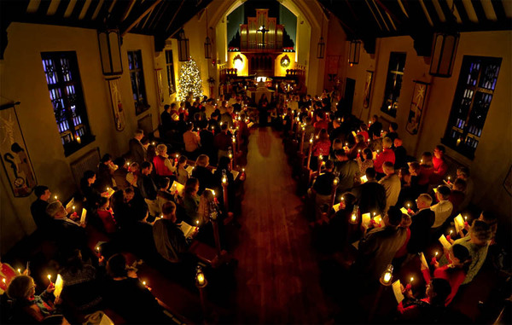
Going to Eucharist at Christmas is a special way to celebrate God’s gift of Jesus because …
First sentence that wraps at the end of the textbox and thus spreads out over two lines
Second sentence that wraps at the end of the textbox and thus spreads out over two lines
Third sentence covering one line only
Fourth sentence that wraps at the end of the textbox and thus spreads out over two lines
We join together as God’s family to give thanks to God for the gift of Jesus.
Sample text line that is displayed on the blind.
We remember that it is through Jesus that we share in God’s life, God’s Tapu and Mana
We show God our love and gratitude by trying to be kind and loving to others like Jesus was.
We meet Jesus in special ways in the Eucharist especially in his Word and in the bread and wine which becomes the Body and Blood.
L-3
S-07
Click the down-button to move the blind down.
Notes:
Slide 7 Going to Eucharist at Christmas is a special way to celebrate God’s gift of Jesus because …
Look closely at the picture and talk about what is happening.
Read the title and use the blind reveal as starters for conversations about why celebrating Eucharist at Christmas help people remember that this season is all about Jesus being God’s gift to us so we can share in God’s own life Tapu

Slide 10

The tradition of Kristkindl and
how it works
Children write their names on small pieces of paper.
The papers are put into a pottle and children
draw one out but keep the name secret.
The child whose name it is becomes their Kristkindl their Christ child.
L-3
S-08A
Click the oval images to reveal a text line
Notes:
Slide 8 A The tradition of Kristkindl – how it works
Kristkindl is a simple but great tradition to get the class into the spirit of Christmas. Kristkindl comes from an old German tradition which has been adapted down through the years.
Use the reveals on Slides 8 A& B to get started.

Slide 11
The tradition of Kristkindl and
how it works
Each child tries to do loving and kind things for his or her Kristkindl without being found out.
Children reveal themselves to their Kristkindl at the end of the Kristkindl time and show their gratitude for the little acts of love and kindness from their ‘Christ child’.
L-3
S-08B
Click the oval images to reveal a text line
Notes:
Slide 8 B The tradition of Kristkindl – how it works
Encourage children in the ways they are taking part and share some examples of what you are noticing.
Use the last day of the Kristkindl as a celebration of the friendship and kindness of the children in the class which shows how they are making room for Jesus to be part of their Christmas celebrations.

Slide 12
Check Up
Placeholder
for
Key Image
1)
imagine you have to teach your class about ways to receive gifts taonga. You can use Slides 4&5 to help you do this.
2)
celebrating Eucharist is a good way to celebrate Christmas because … (See Slide 7)
3)
which activity do you think helped you to learn best in this lesson?
4)
we show God our love and gratitude by trying to be kind and loving to others like Jesus.
L-3
S-09
Click in each caption space to reveal text
Notes:
Slide 9 Check Up
This formative assessment strategy will help teachers to identify how well children have achieved the Learning Intentions of the lesson.
Teachers can choose how they use the slide in their range of assessment options.
A worksheet of this slide is available for children in Years 5-8 to complete.
The last two items are feed forward for the teacher.
Recording the children’s responses to these items is recommended as it will enable teachers to adjust their learning strategies for future lessons and target the areas that need further attention.
Check up:
1. imagine you have to teach your class about ways to receive gifts taonga. You can use Slides 4&5 to help you do this.
2. celebrating Eucharist is a good way to celebrate Christmas because … (See Slide 7)
3. which activity do you think helped you to learn best in this lesson?
4. we show God our love and gratitude by trying to be kind and loving to others like Jesus.

Slide 13

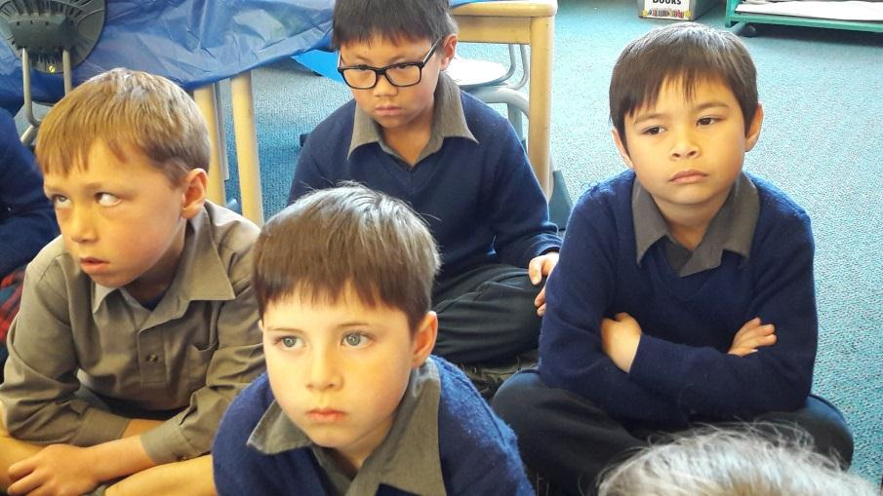

Time for Reflection
L-3
S-10
Click the audio button to stop reflective music
Click the audio button to play reflective music
Notes:
Slide 10 Time for Reflection
The MP3 is played to help create a reflective atmosphere and bring the children to stillness and silence as the teacher invites them to think about how they receive gifts and what attitudes they will demonstrate this Christmas when opening their presents. Give thanks in their heart for Jesus, God’s greatest gift.
Original Children’s Activities available on lesson home page

Slide 14

Sharing our Learning about CHRISTMAS with family whānau
Use the Liturgical Year Calendar to illustrate what you have learned about the Liturgical Year and what you know about the seasons of Advent and Christmas.
Make a poster to share at home about why we give gifts at Christmas.
Create a celebration for Jesus’ birthday that your class could be part of.
Make a power point about the life of Saint Nicholas and why he became the first Santa Claus.
Share with a younger class good ways to give and receive gifts. Demonstrate gracious ways of doing this and let children practise how to do it.
Make up your own way of showing and sharing what you have learned and decide with whom you would like to share it.
L-3
S-11
Click the worksheet button to go to the worksheet.
Notes:
Slide 11 Sharing our Learning about CHRISTMAS with family whānau
This slide provides some choices for children to show and share what they have learned. Examples could be photographed as evidence of children’s learning.
You may like to put a copy of the Sharing our Learning page in children’s RE Learning Journals. You could talk through the choices using the slide and let children make their choice from their own copy.
Children could work on their choice at school and/or at home and you may like to set a day for sharing. Please let parents and whānau know what you expect them to do with this.
The slide is focussed on Year 3 CHRISTMAS Achievement Objective which is covered in Lessons 1-3
CHRISTMAS AO Yr 3 Children will be able to: develop an understanding of the Christmas tradition of gift giving in relation to the birth of Jesus as a gift, so people could share in God’s life.

Slide 15
When you give a gift what is the right thing to do?
Circle the right things do when you give a gift
1) I don’t bother to wrap it
3) I put it in their hands and look in their eyes
5) I say, “This is for you I hope you like it!”
7) I just buy anything and give it in the shop bag
9) I drop it off without seeing them
2) I leave it on the table for the receiver to pick up
4) I don’t say anything I just give it to them
6) I spend time thinking about what they would like
8) I give it to the person and walk away
10) I wrap it up with care and decorate it and write on the card
Add your own comments about the best way to give a gift here …
Circle the attitudes and write the statement number that demonstrates them
Grateful Rude Polite Selfish Well mannered Lazy Respectful
Appreciative Ungrateful Thoughtless Hurtful Thoughtful
L-3
S-05A
Worksheet
Name:
Date:
Click the up arrow to return to the lesson
Notes:
(6) Copy worksheet template
Some slides will be used as worksheets by the students.
A copy worksheet is a black & white version of the colour slide which is here, for reference purpose, called the original.
(please refer to the worksheet template on how to create a worksheet).
Tip: create the worksheet immediately after you have created the original slide and place it at the end of the presentation before configuring the worksheet button.
If a slide is designated to be a worksheet, it should have the Worksheet button positioned on the bottom right.
The exact position depends on the buttons that are available on the slide (refer to General Information section for the position of buttons).
If the Worksheet button is the only button on the slide, the position of the button on this template is correct.
Configuring the Worksheet button.
The following procedure can be used to configure the worksheet button:
Right-click the button and chose: “Edit Hyperlink”;
On the Mouse click tab chose: “Hyperlink to:”;
From the drop down chose: “slide”;
Pick the correct slide number of the worksheet slide:
The worksheet slide should be position at the end of the presentation (if there is more than 1 worksheet, place them in order of appearance);
Don’t worry if you add slides between the original and the worksheet, the worksheet button will automatically be updated to point to the correct slide;
Don’t forget to have the document button on the worksheet slide pointing to this original slide.
Next to the content specified in Anne’s instructions this worksheet must have the following objects: Identification field, back button, tool instructions and worksheet indication.
For configuration information on these objects please refer to the General Information and Structure sections.
Adjust the tool instruction to match the purpose of the slide.

Slide 16
When you receive a gift what is the right thing to do?
Circle the right things do when you receive a gift
1) I look at the person and say thank you.
3) I rip the paper off and say, “I have one of these already!”
5) I open it and hold it and then give the giver a hug.
7) I say, “This is just what I didn’t want!”
2) I put it on the table and see if there are any
more gifts for me.
4) I open it and say, “I am delighted with this.”
6) I say, “This was a great choice, thanks a lot.”
8) I leave the gift on the floor and go out to play.
Add your own comments about the best way to give a gift here …
Circle the attitudes and write the statement number that demonstrates them
Grateful Rude Polite Selfish Well mannered Lazy Respectful
Appreciative Ungrateful Thoughtless Hurtful Thoughtful
L-3
S-05B
Worksheet
Name:
Date:
Click the up arrow to return to the lesson
Notes:
(6) Copy worksheet template
Some slides will be used as worksheets by the students.
A copy worksheet is a black & white version of the colour slide which is here, for reference purpose, called the original.
(please refer to the worksheet template on how to create a worksheet).
Tip: create the worksheet immediately after you have created the original slide and place it at the end of the presentation before configuring the worksheet button.
If a slide is designated to be a worksheet, it should have the Worksheet button positioned on the bottom right.
The exact position depends on the buttons that are available on the slide (refer to General Information section for the position of buttons).
If the Worksheet button is the only button on the slide, the position of the button on this template is correct.
Configuring the Worksheet button.
The following procedure can be used to configure the worksheet button:
Right-click the button and chose: “Edit Hyperlink”;
On the Mouse click tab chose: “Hyperlink to:”;
From the drop down chose: “slide”;
Pick the correct slide number of the worksheet slide:
The worksheet slide should be position at the end of the presentation (if there is more than 1 worksheet, place them in order of appearance);
Don’t worry if you add slides between the original and the worksheet, the worksheet button will automatically be updated to point to the correct slide;
Don’t forget to have the document button on the worksheet slide pointing to this original slide.
Next to the content specified in Anne’s instructions this worksheet must have the following objects: Identification field, back button, tool instructions and worksheet indication.
For configuration information on these objects please refer to the General Information and Structure sections.
Adjust the tool instruction to match the purpose of the slide.

Slide 17

Placeholder for thumbnail of main image on slide
Sharing our Learning about CHRISTMAS with family whānau
Use the Liturgical Year Calendar to illustrate what you have learned about the Liturgical Year and what you know about the seasons of Advent and Christmas.
Make a poster to share at home about why we give gifts at Christmas.
Create a celebration for Jesus’ birthday that your class could be part of.
Make a power point about the life of Saint Nicholas and why he became the first Santa Claus.
Share with a younger class good ways to give and receive gifts. Demonstrate gracious ways of doing this and let children practise how to do it.
Make up your own way of showing and sharing what you have learned and decide with whom you would like to share it.
Worksheet
L-3
S-11
Click the up arrow to return to the lesson
Notes:
(37) Specific worksheet Template
A specific worksheet is designed and created by the designer related to a particular slide according to Anne’s instructions. Specific worksheets are usually one offs.
Instructions on how to do this are given below.
Next to the content specified in Anne’s instructions this worksheet must have the following objects: Identification field, back button, tool instructions and worksheet indication.
For configuration information on these objects please refer to the General Information and Structure sections.
Creating a worksheet from an existing slide.
The following procedure can be used to create a worksheet:
Make a copy of the slide that needs to be converted to worksheet:
Select the slide in the Slides/Outline panel, right click it and use the copy/paste or duplicate slide option to create a copy;
Paste or drag the slide to the end of the presentation;
Remove the background of the slide. The slides background should be white;
Remove any objects that are not required or add object according to Anne’s instructions;
Remove any colour (background, border of text) from the objects;
Convert images to black & white:
The easiest way to do this is to use: Right-click the image and chose: Format Picture/Picture Colour then set the saturation to 0%;
If the slide has images (for design/decoration purpose) then create a thumbnail of the main image on the slide with the following seize: Height=86 mm, Width=64 mm;
Move this thumbnail to the following position on the slide: Horizontal=185 mm, Vertical=12 mm;
Copy the Identification field, back button and worksheet indication from this template and paste them on the worksheet;
Configure the back button to point to the original (colour) slide:
Right-click the button and chose: “Edit Hyperlink” and on the Mouse click tab chose: “Hyperlink to:” and from the drop down chose: “slide” the pick the correct slide number of the original slide;
Don’t forget to have the document button on the original slide pointing to this worksheet slide.

