Slide 1
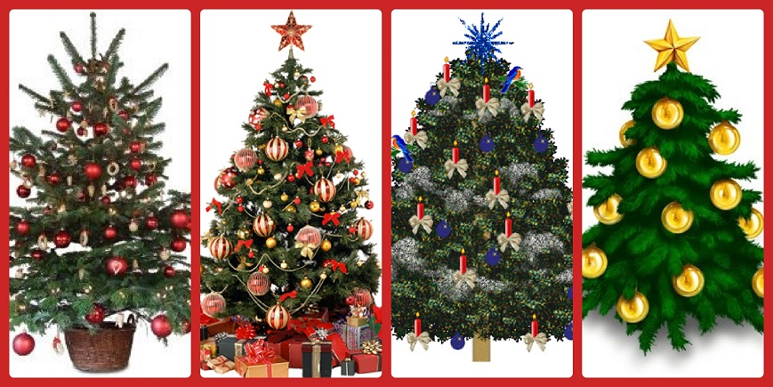
Christmas Trees
L-2
S-01
Notes:
Use this slide as a focussing strategy to introduce the lesson topic. Read the title together and invite children to share something they know about the tradition of Christmas trees.

Slide 2
Learning Intentions
The children will:
1)
explain the tradition of the Christmas tree.
2)
identify Christmas tree decorations which relate to the Christmas story.
3)
name the New Zealand Christmas tree.
L-2
S-02
Click the boxes to reveal text.
Notes:
Read through the Learning Intentions with the class and identify some ideas/questions that might be explored in the lesson.

Slide 3
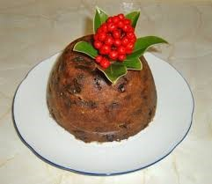
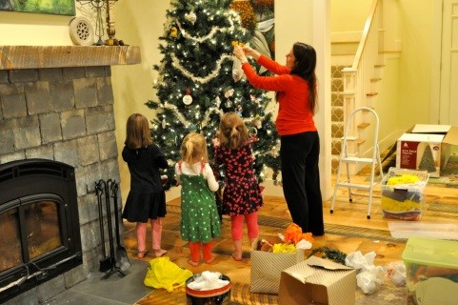
Traditions are part of celebrating Christmas
Traditions are things people keep doing at particular times or on special occasions.
Some traditions are old and have been passed down through families.
Some families make new traditions or adapt old ones to suit them now.
Traditions help people remember special events and special people in their lives.
Some traditions are associated with particular people, places, food, music, symbols or activities. Can you share some examples of traditions?
L-2
S-03
Click on images to reveal text
Notes:
Look at the image and name the tradition the people are carrying on.
Look at the icon and recognise it as another tradition. Explain that traditions add meaning to special occasions and are a way of passing on stories, faith, values and customs.

Slide 4
Families have lots of Christmas traditions
Complete the sentences
In our family at Christmas we…
On our Christmas dinner table we…
We make…
We open our presents…
We invite…
We always play…
We go to…
We remember…
One thing I would like to say about family traditions is…
L-2
S-04
Push the red button to move the arrow through the lines.
Notes:
Use the arrow to work through the sentence starters together.
Children complete their worksheets.

Slide 5
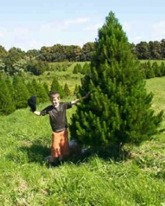
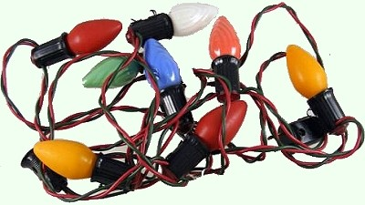
How did Christmas trees become a tradition?
When people left to make their homes in other parts of the world they took the tradition of Christmas trees with them to places such as America and Aotearoa. Now there are Christmas trees all over the world in people’s homes and outdoors in towns and cities for people to gather around and sing carols. When electric Christmas tree lights were invented they replaced the candles.
Over the years children persuaded their parents to bring a tree into their homes and decorate it with fruit and sweets – this soon became a family tradition. Lights were added and the tree was adapted to be part of the Christian celebrations with the lights being a symbol of Jesus bringing light into the world on the feast of his birth.
About 180 years ago people in England picked up the idea of having Christmas trees. They cut down fir trees because they were evergreen trees and decorated them with lighted candles – which were dangerous! Why would they be dangerous?
They made the branches of the trees into wreaths and hung them on their doors to welcome people at Christmas.
For thousands of years people in the northern hemisphere had used branches of fir trees to decorate their homes during the dark winter to remind them that spring would come. The greenery helped the people to have hope – green is the colour of hope.
The tradition of Christmas trees began in Germany about 800 years ago. The tree was placed outside in the village square where people sang and danced around it and performed plays in front of it. It was decorated with apples and called a Paradise Tree – can you remember who lived in the garden of paradise and what the paradise play might have been about?
L-2
S-05
Push red button to move through the pages (there are 3 pages).
Click the audio button to play ‘O Christmas Tree’
Click the audio button to stop ‘O Christmas Tree’
Notes:
Use the arrow as a guide as the story of the tradition of having a Christmas tree is read. NB PRESS THE RED BUTTON TO BRING UP PAGES 2&3 TO COMPLETE THE STORY.
Sing using the MP3 ‘O Christmas Tree’

Slide 6
A few interesting facts about Christmas trees
The greatest number of electric lights on a Christmas tree at one time is 194, 672!
In 1885 candles on a Christmas tree in a hospital in Chicago started a fire that burned the hospital down
The first strips of tinsel were made from real silver.
One of the most famous Christmas trees is in Trafalgar Square in London and every year it is given to the people in England by the people of Norway as a ‘thank you’ present for helping them in World War II.
The tallest artificial Christmas tree was 52m! It was called the ‘Peace Tree’ and was displayed in Moinhos de Vento Park, Porto Alegre, Brasil from 1st December 2001 until 6th January 2002.
Aotearoa New Zealand has it’s own Christmas tree. Can you name it and describe it for someone who has not seen it? You might like to do some research to find out more about the Pohutakawa tree and share it at school.
L-2
S-06
Click the down-button to move the blind down. Click video button for video.
Notes:
Read the facts and comment on them. Children complete the worksheet.
Watch the clip – this is an imaginary story
The First Christmas Tree (A Short Christmas Story) 7.11 minutes
https://www.youtube.com/watch?v=jYRhFMbaUac

Slide 7
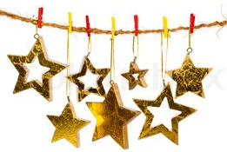
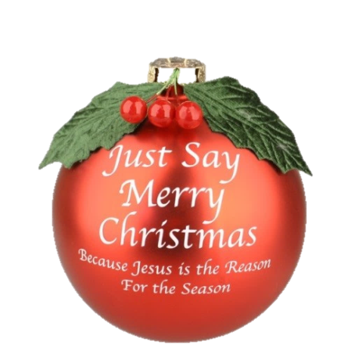
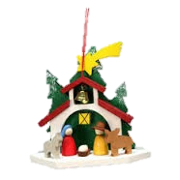
Christmas decorations that tell about the Christmas story
Christmas bells ring out to tell the world of the birth of Jesus, the Saviour of the world.
Stars shone in the sky on the first Christmas night lighting the way for the shepherds to follow to where Jesus was born.
Christmas tree decorations remind people that Jesus is the reason for the season.
The nativity scene of the first Christmas night when Jesus whose birth in Bethlehem over 2000 years ago changed the world forever.
L-2
S-7A
Click images to reveal text
Notes:
Invite children to share examples of Christmas decorations that tell the Christmas story.
Click on the examples on the slide and read the explanations.

Slide 8
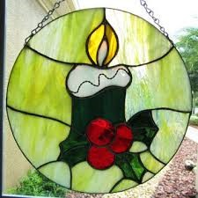
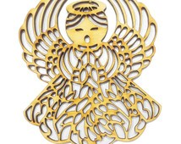
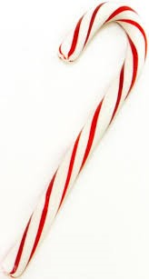
Christmas decorations that tell about the Christmas story
The Christmas wreath reminds people that God is like the evergreen circle with no beginning and no end and green is the colour of hope.
The candle is the symbol of Christ who brought light back into the world and helped people to be friends with God and with each other.
The angels were God’s messengers who came to tell the shepherds the good news of Jesus’ birth.
Christmas candy sticks remind us of the crooks that the shepherds carried as they made their way to the stable to see Jesus, the new born king.
My favourite decoration is…
I say that because…
L-2
S-7B
Click images to reveal text
Notes:
Click on the examples on the slide and read the explanations.
Children share their favourite decoration and the reasons for their choice.
Ask children to explain the connection between their choice and the Christmas story. Explain to the children that Christmas decorations need to be about the Christmas story not just any story.

Slide 9
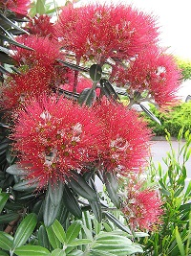
The Aotearoa New Zealand Christmas tree
T | C | H | R | I | S | T | M | A | S
E | T | E | O | A | T | H | B | W | E
Y | H | U | L | L | F | E | B | A | S
L | R | E | D | L | L | L | K | K | U
T | O | E | S | E | O | O | D | A | M
H | U | K | V | O | W | E | E | T | M
G | G | A | M | N | E | T | L | U | E
I | H | S | W | R | R | H | L | H | R
R | W | I | T | H | S | A | A | O | U
B | R | I | G | H | T | T | C | P | P
We have our own Christmas tree called the Pohutakawa that blooms brightly with bright red flowers all through Summer.
L-2
S-08
Click words in the sentence to display in the Word Find
Notes:
Find each word in the sentence on the matrix and highlight it in the sentence and in the Word Find.
Children complete their worksheets, check them out with the word find on the screen and add them to their RE Learning Journals as evidence of their learning.
Make a copy for each child of the Christmas Family Whānau Christmas Quiz in the Teacher’s book p22 or on the lesson home page to take home and share with their family.

Slide 10
Check Up
1)
Use your worksheet on slide 6 to explain the traditions of the Christmas tree.
2)
Draw, name and explain three Christmas decorations that tell about the Christmas story.
3)
Explain why you think the Pohutakawa was chosen to be the New Zealand Christmas tree.
4)
Name three New Zealand Christmas traditions your family has.
5)
Which activity do you think helped you to learn best in this lesson?
6)
Questions I would like to ask about the topics in this lesson are…
L-2
S-09
Click in each caption space to reveal text
Notes:
This formative assessment strategy will help teachers to identify how well the children have achieved the Learning Intentions of the lesson.
Teachers can choose how they use the slide in their range of assessment options.
A worksheet of this slide is available for children in Years 5-8 to complete.
The last two items are feed forward for the teacher.
Recording the children’s responses to these items is recommended as it will enable teachers to adjust their learning strategies for future lessons and target the areas that need further attention.

Slide 11
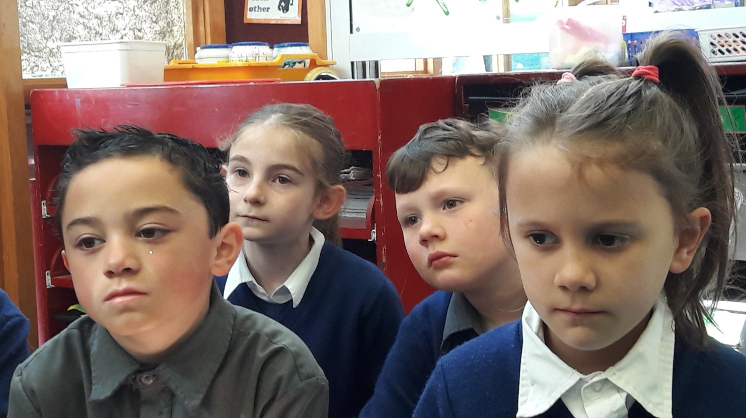
Time for Reflection
L-2
S-14
Click the audio button to stop Reflective Music
Click the audio button to play Reflective Music
Notes:
The MP3 is played to help create a reflective atmosphere and bring the children to stillness and silence as the teacher invites them to reflect on all the songs, symbols and traditions that help people to recall the birth of Jesus. Talk to Jesus and tell him how much you want to celebrate the day of his birth by keeping in mind the connections between Christmas traditions and the person you want to grow close to and follow in your life.

Slide 12
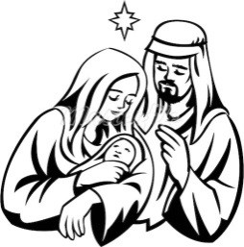
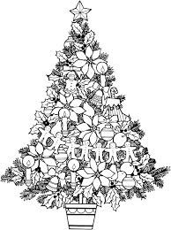
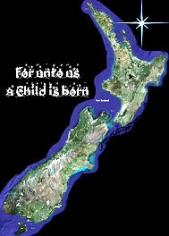
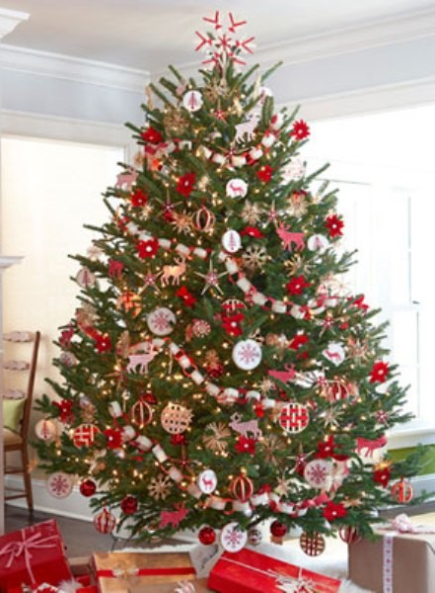
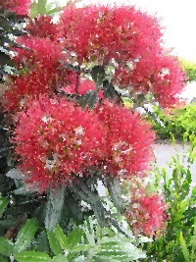
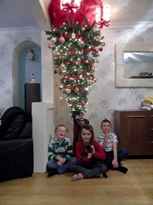
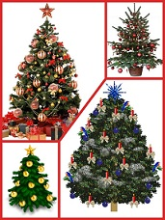
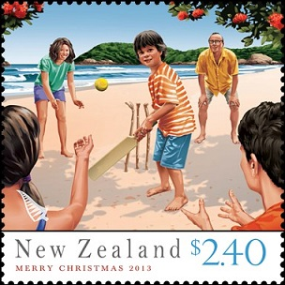
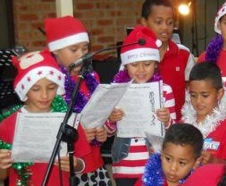
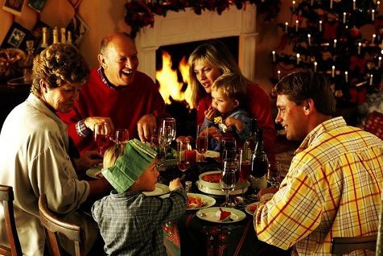
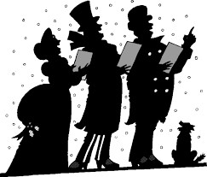
Sharing our Learning about CHRISTMAS with family whānau
Make up your own way of showing and sharing what you have learned and decide with whom you would like to share it.
Invite people in your class to join a choir with you and practise singing the carols you learned. Ask other classes if you could come and share them. Introduce each carol and say something you have learned about it.
Create an artwork of the New Zealand Christmas tree, frame it and give it to someone for Christmas.
Make a list of family Christmas traditions with your family and share some of the interesting facts you have learned about Christmas trees with them. Talk about the Christmas traditions your parents and grandparents had when they were children. Record them to share with your class.
Share the Family Whānau Christmas Quiz (on the Teacher Resource page 22 or on the lesson home page) Report back on how they did and how much you could teach them.
Share the worksheets from Slide 6 with a younger class to teach them about how Christmas trees came to be, and invite questions and comments about Christmas trees of the past and the present and what they might be like in the future.
Create a visual history of the Christmas tree that shows how it developed from the Paradise tree decorated with apples to a modern day tree with decorations and lights. Share this with other classes.
Design a Christmas decoration for a Christmas tree in Aotearoa and research how it could be made. Share this with your class- and hang it on your Christmas tree.
Explain to someone at home or on skype how the words of Christmas carols tell the Christmas story, sing a New Zealand carol for them and share what it means.
L-2
S-11
Click the red button to move through pages (there are 9) click back arrow to start again
Notes:
This slide provides some choices for children to show and share what they have learned. Examples could be photographed as evidence of children’s learning.
You may like to put a copy of the Sharing our Learning page in children’s RE Learning Journals. You could talk through the choices using the slide and let children make their choice from their own copy.
Children could work on their choice at school and/or at home and you may like to set a day for sharing. Please let parents and whānau know what you expect them to do with this.
The slide is focussed on Year 4 CHRISTMAS Achievement Objective which is covered in Lessons 1 & 2.
Year 4 CHRISTMAS Children will be able to: understand the traditions of carol singing and Christmas trees in relation to the celebration of Jesus Christ’s coming at Christmas.

Slide 13
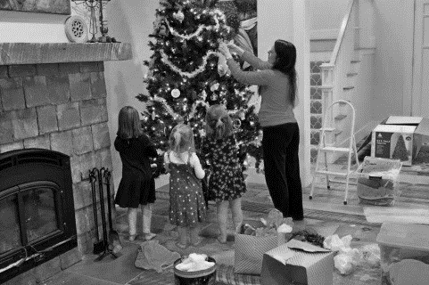
Families have lots of Christmas traditions
Name___________________________ Date_______________
In our family at Christmas we
On our Christmas dinner table we
We make
We open our presents
We invite
We always play
We go to
We remember
One thing I would like to say about family traditions is…
L-2
S-4
Worksheet
Click the up arrow to return to the lesson
Notes:
This worksheet relates to slide 4

Slide 14
How Christmas trees we have today came to be
Name___________________________ Date_______________
Paradise tree | An olden day Christmas tree | A Christmas tree today
This tree… | This tree… | This tree…
My favourite fact about Christmas trees is number___
Here are three tips to take note of when decorating a Christmas tree
(1)
(2)
(3)
L-2
S-6
Worksheet
Click the up arrow to return to the lesson
Notes:
This worksheet relates to slide 6
Children refer to the Christmas tree facts on the slide and add the number of their favourite.
The WORKSHEET is referred to in the Check up and in Sharing our Learning

Slide 15
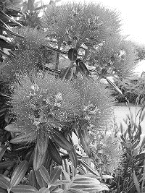
The Aotearoa New Zealand Christmas tree
Name___________________________ Date_______________
T | C | H | R | I | S | T | M | A | S
E | T | E | O | A | T | H | B | W | E
Y | H | U | L | L | F | E | B | A | S
L | R | E | D | L | L | L | K | K | U
T | O | E | S | E | O | O | D | A | M
H | U | K | V | O | W | E | E | T | M
G | G | A | M | N | E | T | L | U | E
I | H | S | W | R | R | H | L | H | R
R | W | I | T | H | S | A | A | O | U
B | R | I | G | H | T | T | C | P | P
We have our own Christmas tree called the Pohutakawa that blooms brightly with bright red flowers all through summer
L-2
S-8
Worksheet
Click the up arrow to return to the lesson
Notes:
This worksheet relates to slide 8
Find each word in the sentence on the matrix and highlight it in the sentence and in the Word-Find.
Children can add worksheets to their RE Learning Journals as evidence of their learning.

Slide 16
Sharing our Learning about CHRISTMAS with family whānau
Name___________________________ Date_______________
Explain to someone at home or on skype how the words of Christmas carols tell the Christmas story, sing a New Zealand carol for them and share what it means.
Design a Christmas decoration for a Christmas tree in Aotearoa and research how it could be made. Share this with your class- and hang it on your Christmas tree.
Create a visual history of the Christmas tree that shows how it developed from the Paradise tree decorated with apples to a modern day tree with decorations and lights. Share this with other classes.
Share the worksheets from Slide 6 with a younger class to teach them about how Christmas trees came to be, and invite questions and comments about Christmas trees of the past and the present and what they might be like in the future.
Share the Family Whānau Christmas Quiz (on the Teacher Resource page 22 or on the lesson home page) Report back on how they did and how much you could teach them.
Make a list of family Christmas traditions with your family and share some of the interesting facts you have learned about Christmas trees with them. Talk about the Christmas traditions your parents and grandparents had when they were children. Record them to share with your class.
Create an artwork of the New Zealand Christmas tree, frame it and give it to someone for Christmas.
Invite people in your class to join a choir with you and practise singing the carols you learned. Ask other classes if you could come and share them. Introduce each carol and say something you have learned about it.
Make up your own way of showing and sharing what you have learned and decide with whom you would like to share it.
L-2
S-11
Worksheet
Click the up arrow to return to the lesson
Notes:
This worksheet relates to slide 11

