Slide 1
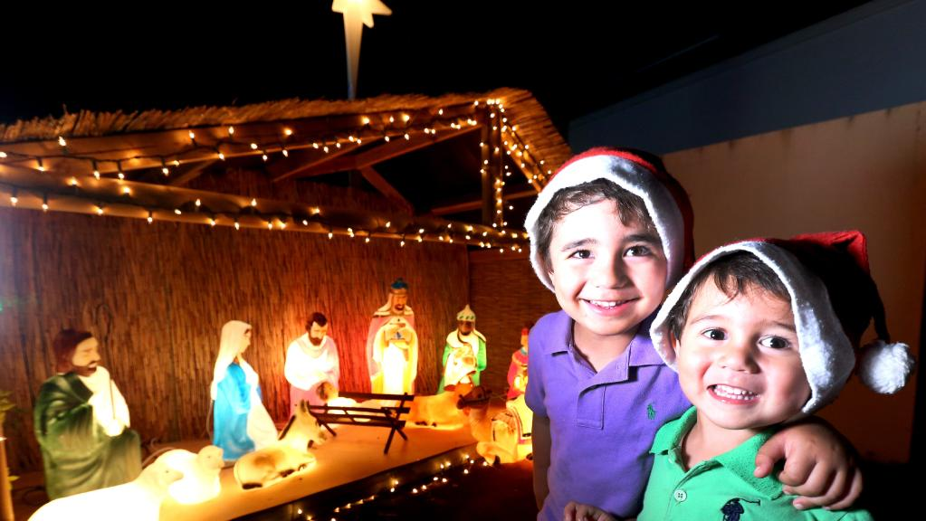
Making room for Christ in Christmas
L-1
S-01
Notes:
Use this slide as a focussing strategy to introduce the lesson topic. Read the title together and invite children to share something they know about making room for Christ in Christmas so he can be part of their lives and their celebrations especially in the Christmas season.

Slide 2
Learning Intentions
The children will:
1)
identify ways people can make room for Christ in their lives at Christmas
L-1
S-02
Notes:
Read through the Learning Intentions with the class and identify some ideas/questions that might be explored in the lesson.

Slide 3
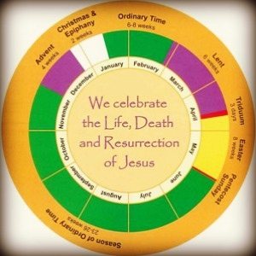
Christmas is a feast and a season
Can you explain the difference?
Refer to the Liturgical Calendar on the screen. Colour the Liturgical Calendar on your worksheet and complete it.
Complete the sentences below:
There are ______ weeks in the season of Advent.
There are ______ weeks in the season of Christmas.
There are ______ weeks in the season of Lent
There are ______ weeks in the season of Easter
There are ______ weeks in Ordinary Time.
L-1
S-03
Click on the worksheet button to go to the worksheet
Notes:
Adapt Teaching and Learning Experiences 1 & 2 A feast is one day and a season is the time surrounding the solemn feast during the season. Easter, Christmas and Pentecost are the most solemn feasts in the Liturgical Year.
Answers – Weeks in Advent – 4, Christmas -2, Easter – 7, Lent - 6, Ordinary Time – 6 + 22-26, these numbers vary and are approximates.
Children record their ideas on their worksheets.

Slide 4
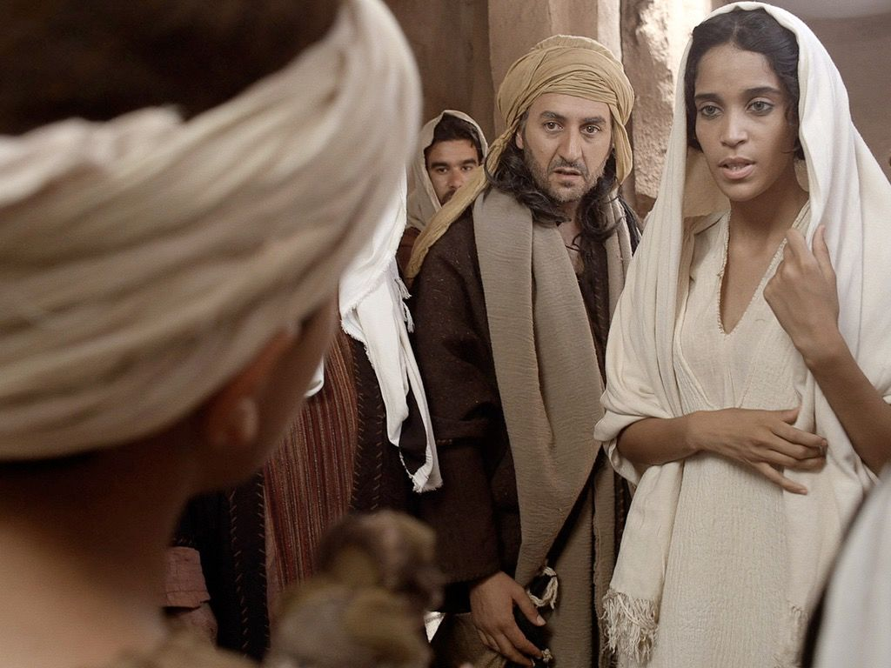
The story of the birth of Jesus
Read Luke 2:1-7
Reflect on the story and the feelings of each of the characters.
What message does this story have for Christians today?
L-1
S-04
Notes:
Adapt Teaching and Learning Experience 3
Follow the slide instructions – look closely at the faces of the people and share what feelings you can see in them.
Joseph felt …
Mary was feeling ...
Think about how this story is true today.

Slide 5
Read the message on the slide
What can you do or not do to make more room for Jesus in your life?
What might you have to do less of to make more room to spend time with Jesus?
Who or what helps you to decide if there is enough room for Jesus at Christmas?
What sort of innkeeper are you?
X
L-1
S-05
Click the I-button to reveal information
Notes:
Respond to each item on the pop up and share your ideas in groups.
Decide as a class what you can do together to help each other make room for Jesus this Christmas and beyond.
Suggest ways: quiet time, kindness time, generous time, noticing time, prayer time, volunteering time, sharing time, other ideas?

Slide 6
Making room for Jesus
L-1
S-06
Click the worksheet button to go to the worksheet
Notes:
Note this image set in a cave is a more authentic one than a stable.
Adapt Teaching and Learning Experience 5.
The worksheet T charts could be enlarged and worked on in groups. Children could share them in their class and school and display them in the school or church foyer.

Slide 7
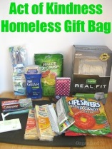
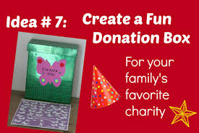
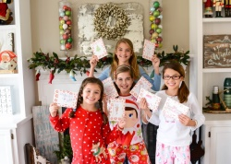
Reaching out to others helps families whānau to make room for Jesus at Christmas by …
Limiting the number of presents that are given to each family member.
Using money to give someone in your street who is lonely at present
is making room for Jesus.
Making time to do something for others. Preparing some gift bags for people
at the shelter is making room for Jesus.
Inviting each family member to donate something to give to a needy family.
Sharing presents with families in need is making room for Jesus.
Making and giving Christmas cards to elderly people in rest homes.
Using your own time and resources for the good of others is making room for Jesus.
What can children of your age do to make room for Jesus?
L-1
S-07
Click an image to reveal a text line
Notes:
Read each reveal and talk about the ideas in each one.
The advice in the first one regarding the number of gifts – one you want, one you need, one to wear and one to read maybe one to discuss with your family.

Slide 8
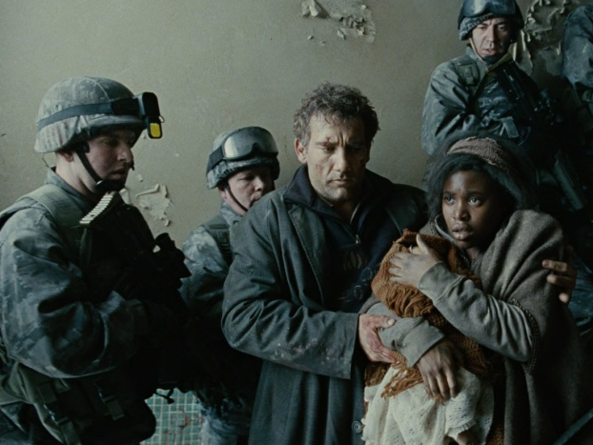
Who are the people in today’s world that need an innkeeper to make room for them?
People who are loving, helpful, forgiving, peaceful, generous and friendly are people who have made room for Jesus in their lives. This means they talk to him, listen to him, try to be like him and encourage others to do the same so his ways become their ways too.
Share what you have noticed about people who are kind and caring to others. What do you think is helping them to be like that?
When people make room for Jesus and spend time with him the Spirit helps them to find ways to help those in need especially at Christmas.
Share what you know about people in our neighbourhoods who cannot find work and do not have enough money to live on.
When Christ is in our hearts his love overflows into our words and actions and we support people, who like Mary and Joseph, need shelter and care.
Share what you know about people right now who have had to leave their homes to find a safe place to live.
L-1
S-08
Click top card to discard it. Click the video button to play a video.
Notes:
The other Christmas gift 3:17 minutes
https://www.youtube.com/watch?v=OnZfRh_7tzw
Watch the clip and discuss how the children showed a true Christmas spirit in what they did. Listen closely to what the children say and share how their actions and words showed they made room for others and when you make room for others you make room for Jesus in your life. Read the messages on the flip cards and take time to think about their message and share your ideas about them.

Slide 9
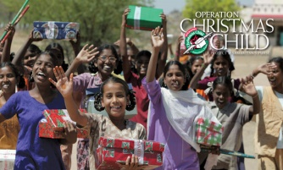
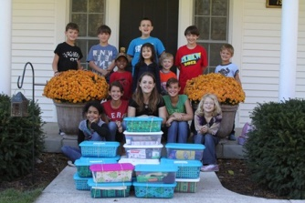
How can children of your age help to make Christmas a season of love, peace and joy for others?
L-1
S-09A
Notes:
Adapt Teaching and Learning Experience 7
Use the idea on Slide 9B about making Christmas boxes for needy children or make up some other way children could do something for others this Christmas.

Slide 10
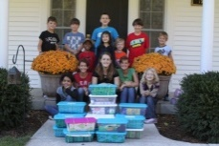
How can children of your age help to make Christmas a season of love, peace and joy for others?
How to make a Christmas Box for children who need some treats at Christmas:
STEP 1) Check with a Christian agency in your local area and get the Christmas box distribution details.
STEP 2) Ask children to form themselves into groups and bring shoe boxes to fill.
STEP 3) Decide on the age and gender of the children the boxes are for and make a list of suitable items they would like. Things to think about the gifts: size, suitability to travel, packaging, plan for a variety of items including angels and other Christmas things, write notes, make cards, include photos of your school and class, send your school information book, something special from New Zealand and anything else you know children would like.
STEP 4) Set a dispatch date, pack your boxes, decorate them and send them with love and imagine the joy they will bring – look at the pictures on the slide of the givers and the receivers!
The Christmas box is one suggestion – you can use your own ideas about making room for Jesus and sharing Christmas with other people!
L-1
S-09B
Press the green button on the right to advance through each line of text. Click on the worksheet button to go to the worksheet
Notes:
Work through the information using the green pointer and decide with the children what they could do.

Slide 11
Check Up
1)
Write 3 things you know about the Liturgical Year
2)
What does it mean by saying people “make room in their lives for Jesus at Christmas”?
3)
What can families do to make room for Jesus to be part of their family at Christmas?
L-1
S-10A
Click in each caption space to reveal text
Notes:
This formative assessment strategy will help teachers to identify how well children have achieved the Learning Intentions of the lesson.
Teachers can choose how they use the slide in their range of assessment options.
A worksheet of this slide is available for children in Years 5-8 to complete.
The last two items are feed forward for the teacher.
Recording the children’s responses to these items is recommended as it will enable teachers to adjust their learning strategies for future lessons and target the areas that need further attention.

Slide 12
Check Up
4)
What can children of your age do to show you have made room for Jesus in your heart this Christmas?
5)
Which activity do you think helped you to learn best in this lesson?
6)
Questions I would like to ask about the topics in this lesson are …
L-1
S-10B
Click on the worksheet button to go to the worksheet
Notes:
This formative assessment strategy will help teachers to identify how well children have achieved the Learning Intentions of the lesson.
Teachers can choose how they use the slide in their range of assessment options.
A worksheet of this slide is available for children in Years 5-8 to complete.
The last two items are feed forward for the teacher.
Recording the children’s responses to these items is recommended as it will enable teachers to adjust their learning strategies for future lessons and target the areas that need further attention.

Slide 13
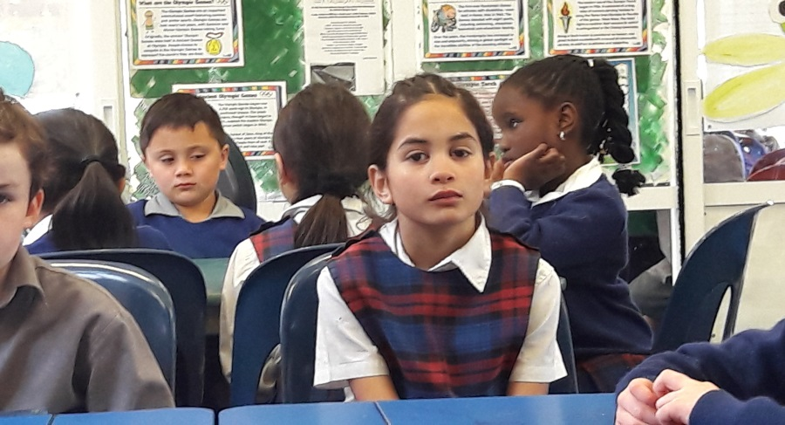
Time for Reflection
L-1
S-11
Click the audio button to stop reflective music
Click the audio button to play reflective music
Notes:
The MP3 is played to help create a reflective atmosphere and bring the children to stillness and silence as the teacher invites them to spend some quiet time thinking about the goodness that Jesus shared with people who had struggles in their lives and how his love for them enabled them to pass love on to others. Wonder about how you could pass on your love to others this Christmas.
Original Children’s Activities available on lesson home page.

Slide 14
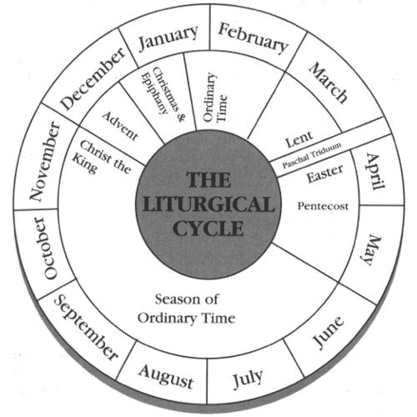
Christmas is a feast and a season
Can you explain the difference?
Refer to the Liturgical Calendar on the screen. Colour the Liturgical Calendar on your worksheet and complete it.
Complete the sentences below:
There are ______ weeks in the season of Advent.
There are ______ weeks in the season of Christmas.
There are ______ weeks in the season of Lent
There are ______ weeks in the season of Easter
There are ______ weeks in Ordinary Time.
Name:____________________________
Date:____________
L-1
S-03
Worksheet
Click the up arrow to return to the presentation
Notes:
This worksheet relates to slide 3.

Slide 15
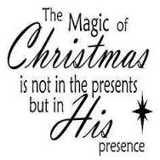
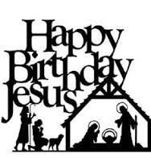
Making room for Jesus at Christmas
Looks like
Sounds like
Name:____________________________
Date:____________
L-1
S-06
Worksheet
Click the up arrow to return to the lesson
Notes:
This worksheet relates to slide 6.

Slide 16
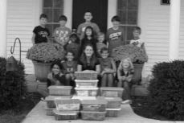
How can children of your age help to make Christmas a season of love, peace and joy for others?
How to make a Christmas Box for children who need some treats at Christmas:
STEP 1) Check with a Christian agency in your local area and get the Christmas box distribution details.
STEP 2) Ask children to form themselves into groups and bring shoe boxes to fill.
STEP 3) Decide on the age and gender of the children the boxes are for and make a list of suitable items they would like. Things to think about the gifts: size, suitability to travel, packaging, plan for a variety of items including angels and other Christmas things, write notes, make cards, include photos of your school and class, send your school information book, something special from New Zealand and anything else you know children would like.
STEP 4) Set a dispatch date, pack your boxes, decorate them and send them with love and imagine the joy they will bring – look at the pictures on the slide of the givers and the receivers!
The Christmas box is one suggestion – you can use your own ideas about making room for Jesus and sharing Christmas with other people!
Name:________________________
Date:____________
L-1
S-09
Worksheet
Click the up arrow to return to the lesson
Notes:
This worksheet relates to slide 9.

Slide 17
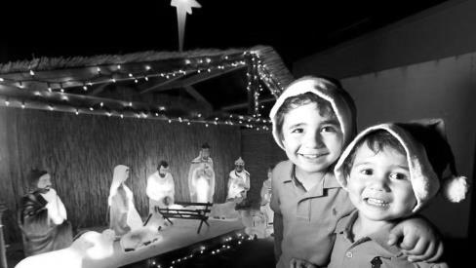
Check Up
1)
Write 3 things you know about the Liturgical Year
2)
What does it mean by saying people ‘make room in their lives for Jesus at Christmas’?
3)
What can families do to make room for Jesus to be part of their family at Christmas?
4)
What can children of your age do to show you have made room for Jesus in your heart this Christmas?
5)
Which activity do you think helped you to learn best in this lesson?
6)
Questions I would like to ask about the topics in this lesson are …
Name:____________________________
Date:____________
L-1
S-10
Worksheet
Click the up arrow to return to the presentation
Notes:
This worksheet relates to slide 10.

