Slide 1
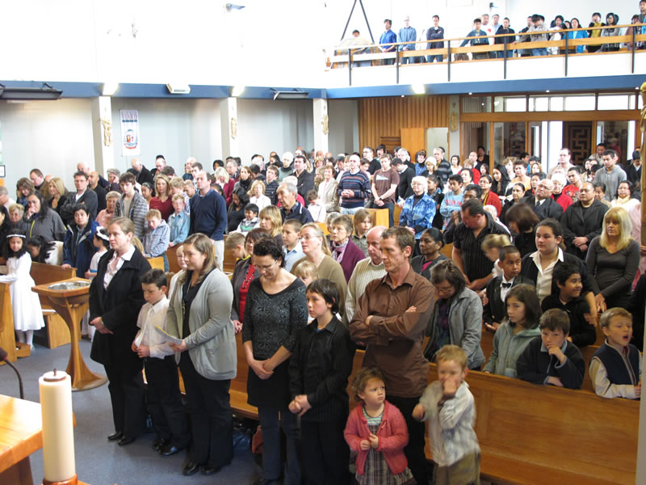
Christmas is a Holy Day of Obligation
L-2
S-01
Notes:
Use this slide as a focussing strategy to introduce the lesson topic.
Read the title together and invite children to share something they know about what holy days of obligation are and how they are celebrated.

Slide 2

Learning Intentions
The children will:
1)
recognise that Sunday is the chief holy day
of obligation in the Church
2)
explain what it means that Christmas is a
holy day of obligation
3)
identify how the Church is prepared for the celebration of the Eucharist at Christmas
L-2
S-02
Click in each caption space to reveal text
Notes:
Read through the Learning Intentions with the class and identify some ideas/questions that might be explored in the lesson.

Slide 3

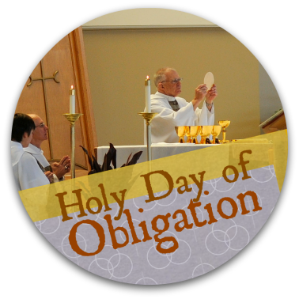
What is a Holy Day of Obligation?
Holy Days of Obligation are holy days on which people who belong to the Church are expected to come together to celebrate the Eucharist.
Sunday is the chief holy day of obligation. All Sundays are holy days of obligation.
In Aotearoa New Zealand there are 2 other holy days which are also holy days of obligation – Christmas Day on December 25 and the Feast of the Assumption of Mary on August 15.
Having only two of these additional holy days of obligation now might be an added reason to celebrate them well. These days are holy days of obligation regardless of whenever they fall, including Saturdays and Mondays.
L-2
S-03
Click an icon on the left to reveal a text line
Notes:
Adapt Teaching and Learning Experience 1.
Work through each reveal and discuss what they mean.
When this is completed ask children to explain to a partner what a holy day of obligation is and how they are celebrated.

Slide 4
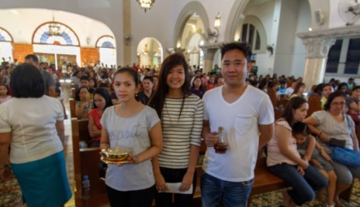
Sunday is the chief Holy Day of Obligation
Sunday is like having Easter Sunday every week as it recalls
the day Christ rose from the dead.
Sunday is a day of resurrection joy
and Christians can bring this joy into the world for everyone to share.
Joy and happiness can be shared
as people gather to celebrate Eucharist together.
as people gather to celebrate Eucharist together.
and Christians can bring this joy into the world for everyone to share.
the day Christ rose from the dead.
L-2
S-04A
Click a sentence from the list at the bottom or click an empty text box to match the sentences.
Notes:
Children select the correct completion for each statement and use the floaters to check them.
Ask children how many holy days of obligation are there in each year? (2 + 52 = 54) Easter and Christmas day and 52 Sundays.

Slide 5
Sunday is the chief Holy Day of Obligation
At every Sunday Eucharist the followers of Jesus
give praise and thanks to God for all God has done, is doing and will do.
Sunday is a day when families get together
especially with older members to build deeper relationships with them.
Taking time to rest and relax on Sunday
helps people to enjoy the company of family and friends.
especially with older members to build deeper relationships with them.
helps people to enjoy the company of family and friends.
give praise and thanks to God for all God has done, is doing and will do.
L-2
S-04B
Click a sentence from the list at the bottom or click an empty text box to match the sentences.
Notes:
Children select the correct completion for each statement and use the floaters to check them. Ask children how many holy days of obligation are there in each year? (2 + 52 = 54) Easter and Christmas day and 52 Sundays.

Slide 6
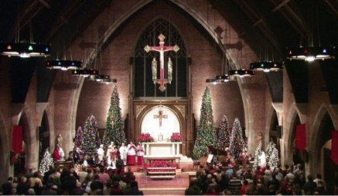
In Aotearoa Christmas Day is a
Holy Day of Obligation
Write a question for the answer
Q1:
A1: Christmas Day is like a Sunday because it is the day people are expected
to gather to celebrate Eucharist.
Q2: Why would Christmas Day be a great day for Jesus’ followers to gather
as his community?
A2:
Q3:
A3: The community celebrates that Jesus is present among the people,
in their lives and in their community.
L-2
S-05A
Notes:
Work through each Q+A on the slide – children record their ideas on the worksheet.

Slide 7
In Aotearoa Christmas Day is a
Holy Day of Obligation
Write a question for the answer
Q4:
A4: In Eucharist the people look forward to the future when Jesus will come
again at the end of time.
Q5:
A5: Christmas Masses are full of joy and beauty with special decorations
to show the importance of the feast.
L-2
S-05B
Click on the worksheet button to go to the worksheet
Notes:
Work through each Q+A on the slide – children record their ideas on the worksheet.

Slide 8

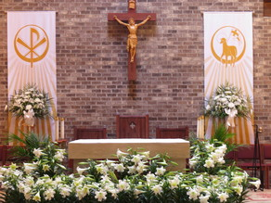
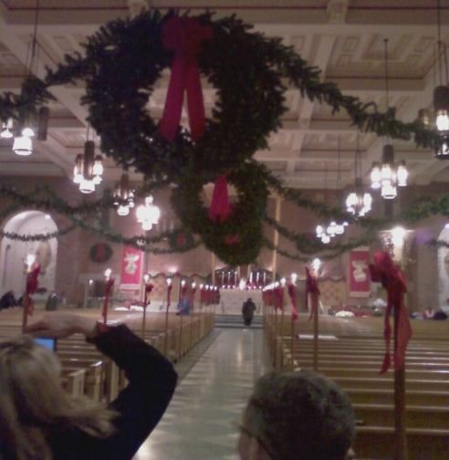

Christmas Masses celebrate the end of the Advent waiting season
The word Christmas gets its name from Christ Mass. Christmas gets its name from the Mass that celebrates the birth of Christ.
In some parishes the Christ Child is placed in the crib during the Christ Mass. This fills people’s hearts with Christmas joy and happiness. What other special things happen at the Christ Mass
in your parish?
Can you recall the special decorations in the church where you celebrate the Christ Mass?
Often the Advent symbols that have helped people countdown to Christmas are still in the church, such as the Advent wreath and Jesse tree, to remind people the waiting is over – Jesus has come!
L-2
S-06
Click the pins on the right to reveal post-it notes.
Notes:
Read through each post it note and respond to it.
Ask children to remind themselves to notice the way the church is decorated to celebrate the Christ mass on Christmas day.

Slide 9


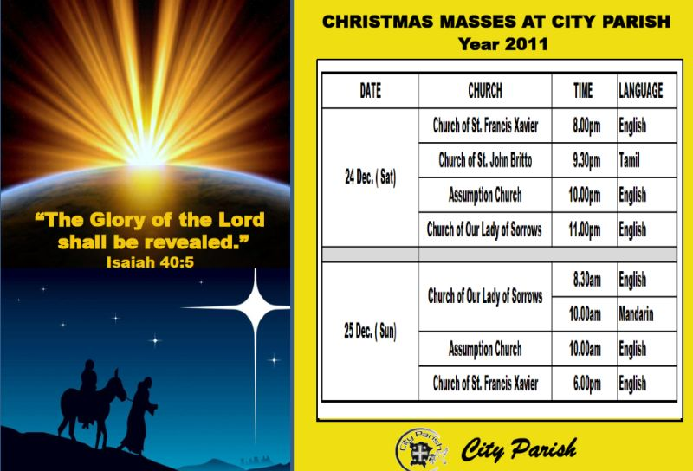
Celebrating the Christ Mass with your family
Share your own ideas about how you can prepare to celebrate Christmas.
You may like to get involved in the Mass by joining the choir or taking part in some of the other ministries children can do. The more you do to prepare for the Christ Mass and Christmas the more you are making room for Jesus to come and share his birthday with you and your family.
Christmas is a very busy time so you could offer to help with younger family members, or to prepare some food or wrap presents. All of these things will lead up to going to Mass together to celebrate the birth of Jesus.
You could help to create a Christmas atmosphere at home by helping to decorate the house, setting up the Christmas crib or playing a Christmas CD to get people in a Christmas mood.
You could read younger family members the Christmas story and talk about it. This will help them to recognise the story when it is read at mass.
You can encourage your parents and other family members to come to Mass as part of their Christmas celebration.
Children of your age can help your family whānau to plan and prepare to celebrate Christmas Mass by finding out the times of the Masses in your parish or pastoral area. Most churches put the times on their web sites.
Click the top card to discard it.
Click the audio button to stop the music
L-2
S-07
Click the top card to discard it.
Click the audio button to play the music
Notes:
Children notice the bulletins on the slide and discuss the times for the Christmas masses in their parish and pastoral area.
Adapt Teaching and Learning Experiences 4 & 5 .
Share each flip card and discuss the suggestions that children of your age can do to help your family let Christ be more part of your lives and your Christmas celebrations. Sing using the MP3 “O Come all ye Faithful’

Slide 10

Check Up
1)
Tell a partner 3 ways you can make room for Jesus
and what you can do to help others do this too.
2)
How can families prepare to celebrate the true meaning of Christmas?
3)
What is a Holy Day of Obligation and how do you celebrate it?
L-2
S-08A
Notes:
This formative assessment strategy will help teachers to identify how well students have achieved the Learning Intentions of the lesson.
Teachers can choose how they use the slide to assess each item.
A worksheet of this slide is available as an option for students to complete.
The last two items are feed forward for the teacher.
Recording the students’ responses to these items is recommended as it will enable teachers to adjust their learning strategies for future lessons and target the areas that need further attention.

Slide 11
Check Up
4)
Why is going to Christmas Mass an important part of families’ Christmas celebrations?
5)
Which activity do you think helped you to learn best
in this lesson?
6)
Questions I would like to ask about the topics
in this lesson are …
L-2
S-08B
Click the worksheet button to go to the worksheet
Notes:
This formative assessment strategy will help teachers to identify how well students have achieved the Learning Intentions of the lesson.
Teachers can choose how they use the slide to assess each item.
A worksheet of this slide is available as an option for students to complete.
The last two items are feed forward for the teacher.
Recording the students’ responses to these items is recommended as it will enable teachers to adjust their learning strategies for future lessons and target the areas that need further attention.

Slide 12








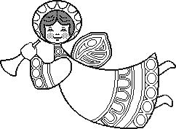

Find out the time of the Christmas masses in your parish and pastoral area and talk to your family about what time would suit for everyone to attend. Make a memo for your family.
Use the Liturgical Year Calendar to illustrate what you have learned about the Liturgical Year and what you know about the seasons of Advent and Christmas.
Make a poster about Making Room for Christ in Christmas. Explain what it means and include some ideas for people to do this. Share it in classes around your school and with your teachers. Display the posters around your school and in your church.
Debate the idea that ‘Celebrating the Christ Mass makes Christmas celebrations complete.’
L-2
S-09A
Notes:
This slide provides some choices for children to show and share what they have learned. Examples could be photographed as evidence of children’s learning.
You may like to put a copy of the Sharing our Learning page in children’s RE Learning Journals. You could talk through the choices using the slide and let children make their choice from their own copy.
Children could work on their choice at school and/or at home and you may like to set a day for sharing. Please let parents and whānau know what you expect them to do with this.
The slide is focussed on Year 5 CHRISTMAS Achievement Objective which is covered in Lessons 1&2
CHRISTMAS AO) Children will be able to: identify ways people can make room for Christ in their lives at Christmas.

Slide 13
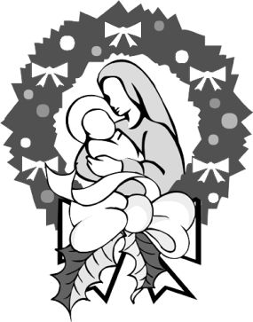
Make up a parody on a well-known Christmas carol with words that tell how families make room for Jesus to be present in their lives at Christmas and throughout the year. Refer to Lesson 1 slides 6,7,8 & 9 for ideas. Make copies of the words so your class can learn the carol and share it with your school and parish. (A parody is when you make up words to fit a familiar tune.)
Design a sticker with the words – How are you making room for Christ at Christmas? Copy the sticker and distribute them around your school, family and friends. Be prepared to explain what it means to make room for Christ at Christmas and have some suggestions ready if people need them. Refer to Lesson 1 slides 5&6.
Make a power point to explain what a Holy Day of Obligation means and what the followers of Jesus are expected to do on these special days. Explain about Sunday as the chief holy day of obligation and make a slide for each of the other 2 days to draw attention to the feasts they celebrate. Share this with your family and other classes. Refer to Lesson 2 slides 3 & 4 for information if you need to. Do some of your own research about this to include as well.
Make up your own way of showing and sharing what you have learned and decide with whom you would like to share it.
L-2
S-09B
Click the worksheet button to go to the worksheet

Slide 14
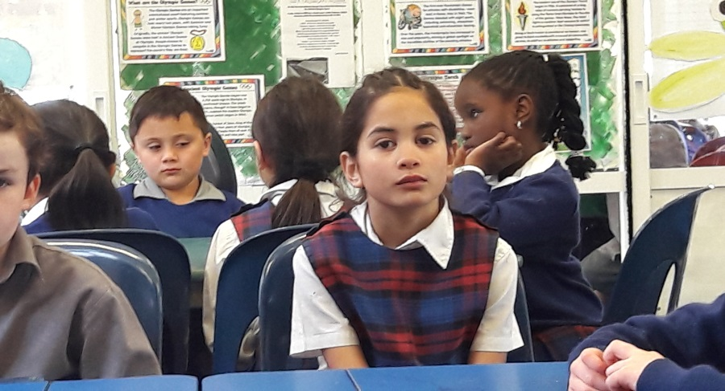

Time for Reflection
L-2
S-10
Click the audio button to stop reflective music
Click the audio button to play reflective music
Notes:
The MP3 is played to help create a reflective atmosphere and bring the children to stillness and silence as the teacher invites them to reflect on what they can do to make room for Jesus in their lives by spending time with him- decide on a time each day to do this and notice how much closer you feel to him as Christmas gets closer.
Original Children’s Activities available on lesson home page

Slide 15
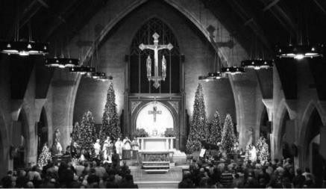
In Aotearoa Christmas Day is a
Holy Day of Obligation
Write a question for the answer
Q1:
A1: Christmas Day is like a Sunday because it is the day people are expected
to gather to celebrate Eucharist.
Q2: Why would Christmas Day be a great day for Jesus’ followers to gather
as his community?
A2:
Q3:
A3: The community celebrate that Jesus is present among them,
in their lives and in their community.
Q4:
A4: In Eucharist the people look forward to the future when Jesus will come
again at the end of time.
Q5:
A5: Christmas masses are full of joy and beauty with special decorations
to show the importance of the feast.
Name:_________________
Date:__________________
L-2
S-05
Worksheet
Click the up arrow to return to the lesson
Notes:
This worksheet relates to slide 5.

Slide 16
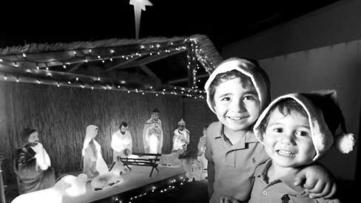
Check Up
1)
Tell a partner 3 ways you can make room for Jesus and what you can do to help others do this too.
2)
How can families prepare to celebrate the true meaning of Christmas?
3)
What is a holy day of obligation and how do you celebrate it?
4)
Why is going to Christmas Mass an important part of families’ Christmas celebrations?
5)
Which activity do you think helped you to learn best in this lesson?
6)
Questions I would like to ask about the topics in this lesson are …
Name:____________________________
Date:____________
L-2
S-08
Worksheet
Click the up arrow to return to the presentation
Notes:
This worksheet relates to slide 8.

Slide 17
Find out the time of the Christmas masses in your parish and pastoral area and talk to your family about what time would suit for everyone to attend. Make a memo for your family.
Use the Liturgical Year Calendar to illustrate what you have learned about the Liturgical Year and what you know about the seasons of Advent and Christmas.
Make a poster about Making Room for Christ in Christmas. Explain what it means and include some ideas for people to do this. Share it in classes around your school and with your teachers.
Display the posters around your school and in your church.
Debate the idea that ‘Celebrating the Christ Mass makes Christmas celebrations complete.’
Make up a parody on a well-known Christmas carol with words that tell how families make room for Jesus to be present in their lives at Christmas and throughout the year. Refer to Lesson 1 slides 6,7,8 & 9 for ideas. Make copies of the words so your class can learn the carol and share it with your school and parish.
(A parody is when you make up words to fit a familiar tune.)
Design a sticker with the words – How are you making room for Christ at Christmas? Copy the sticker and distribute them around your school, family and friends. Be prepared to explain what it means to make room for Christ at Christmas and have some suggestions ready if people need them. Refer to Lesson 1 slides 5&6.
Make a power point to explain what a holy day of obligation means and what the followers of Jesus are expected to do on these special days. Explain about Sunday as the chief holy day of obligation and make a slide for each of the other 2 days to draw attention to the feasts they celebrate. Share this with your family and other classes. Refer to Lesson 2 slides 3 & 4 for information if you need to. Do some of your own research about this to include as well.
Make up your own way of showing and sharing what you have learned and decide with whom you would like
to share it.
Name:____________________________
Date:____________
L-2
S-09
Worksheet
Click the up arrow to return to the presentation
Notes:
This worksheet relates to slide 9.

