Slide 1
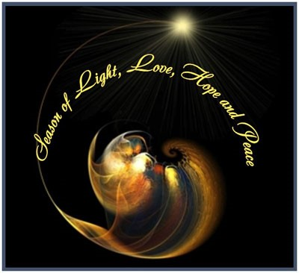
Christmas throughout the world
L-1
S-01

Slide 2
Learning Intentions
The children will:
1)
recognise that the feast of Christmas is celebrated throughout the Christian world.
identify ways varying cultures celebrate Christmas and explain how the custom relates to the significance of Christ’s birth.
2)
L-1
S-02
Click the boxes to reveal the learning intentions

Slide 3
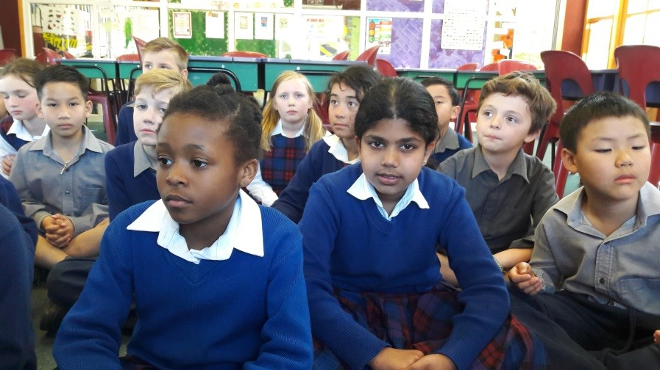
Sharing how Christmas is celebrated
in your family and your culture
L-1
S-03
Click the worksheet button to go to the worksheet
Notes:
Children share a family or cultural custom, ritual or tradition then complete their worksheet and share it with their class.

Slide 4
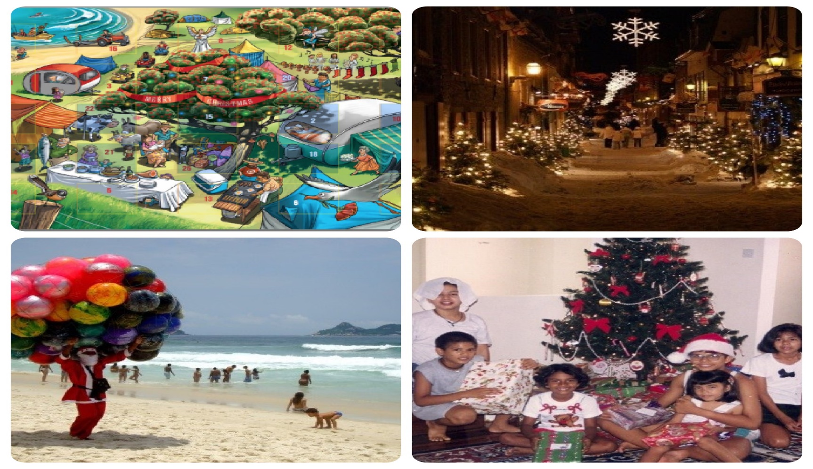
Comparing Christmas celebrations in different cultures
L-1
S-04
Click the worksheet button to go to the worksheet
Notes:
On the Venn diagram record in the left space what your family’s Christmas celebrations include, on the right record what is included in another culture you are familiar with and in the middle space record what is common to both.

Slide 5
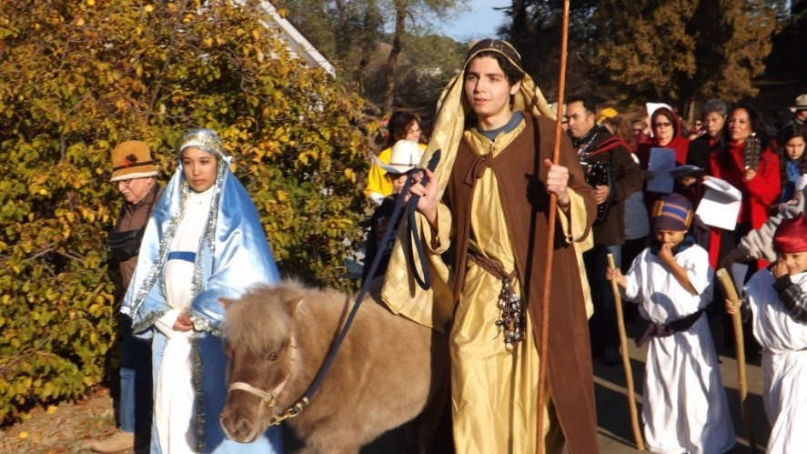
Christians throughout the world celebrate Christmas with different customs – Mexico Las Posadas
L-1
S-05
Click the video button to play a video
Notes:
Watch the clip
Feliz Navidad and Las Posadas 2:27 minutes
https://www.youtube.com/watch?v=s4zCOn3TaT8
Las Posadas (Spanish for ‘The Inns’) is a religious festival celebrated in Mexico between December 16 and 24. Las Posadas commemorates the journey that Joseph and Mary made from Nazareth to Bethlehem in search of a safe refuge where Mary could give birth to the baby Jesus. When they were unable to find lodging in Bethlehem, Joseph and Mary were forced to seek shelter in a stable, where the Christ child was born.
Las Posadas is celebrated in cities and towns across Mexico. Each evening during the festival, a small child dressed as an angel leads a procession through the streets of the town. The procession is primarily made up of children dressed in silver and gold robes carrying lighted candles and images of Mary and Joseph riding a donkey. Adults, including musicians, follow the procession, which visits selected homes and asks for lodging for Joseph and Mary. Traditionally, the procession is always refused lodging, though the hosts often provide refreshments. At each stop, passages of scripture are read and Christmas carols are sung.

Slide 6
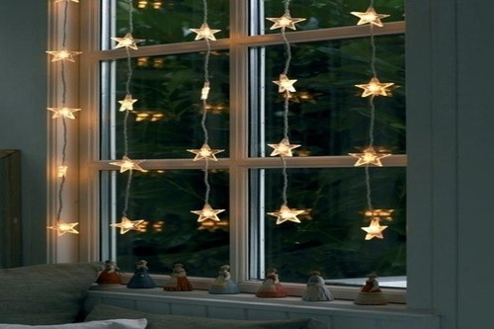
Christians throughout the world celebrate Christmas with different customs – Ireland Christmas lights in windows
Priests hid in forests and caves and secretly visited the farms and homes to say Mass there during the night. It was the dearest wish of every Irish family that at least once in their lifetimes a priest would arrive at Christmas to celebrate Mass on this Holy Night.
Silently he entered through the unlatched door and was received with gratitude into their home that became a church for the night.
The candles are now strings of electric lights which remind people that Jesus is the light of hope and peace that is born on Christmas night.
The English authorities, finding this Irish "superstition" harmless, did not bother to suppress it. The candles in the windows have always remained a cherished practice of the Irish which they brought with them as they immigrated to other countries.
To justify this practice in the eyes of the English soldiers, the Irish people used to explain: "We burn the candles and keep the doors unlocked, so that Mary and Joseph, looking for a place to stay, will find their way to our home and be welcomed with open doors and open hearts."
When Christmas came, they left their doors unlocked and placed burning candles in the windows so that any priest who happened to be in the vicinity could be welcomed and guided to their home through the dark night.
Ireland Christmas lights in windows
The custom of placing lighted candles in the windows at Christmas was brought to America by the Irish. The historical background of this custom is interesting. When religion was suppressed through Ireland during the English persecution, the people had no churches.
L-1
S-06
Click top card to discard it
Click the replay button to restart the cards
Notes:
The customs of placing lighted candles in the windows at Christmas was brought to America by the Irish. The historical background of this custom is interesting. When religion was suppressed through Ireland during the English persecution, the people had no churches. Priests hid in forests and caves and secretly visited the farms and homes to say Mass there during the night. It was the dearest wish of every Irish family that at least once in their lifetimes a priest would arrive at Christmas to celebrate mass on this Holy Night. When Christmas came, they left their doors unlocked and placed burning candles in the windows so that any priest who happened to be in the vicinity could be welcomed and guided to their home through the dark night. Silently he entered through the unlatched door and was received with gratitude into their home that became a church for the night. To justify this practice in the eyes of the English soldiers, the Irish people used to explain: "We burn the candles and keep the doors unlocked, so that Mary and Joseph, looking for a place to stay, will find their way to our home and be welcomed with open doors and open hearts." The English authorities, finding this Irish "superstition" harmless, did not bother to suppress it. The candles in the windows have always remained a cherished practice of the Irish which they took with them as they immigrated to other countries. The candles are now strings of electric lights which remind people that Jesus is the light of hope and peace that is born on Christmas night.

Slide 7
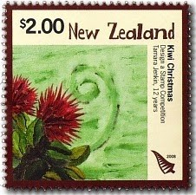
Christians throughout the world celebrate Christmas with different customs – Aotearoa New Zealand Kiwi Christmas Tree
The Pohutakawa is a native tree of Aotearoa New Zealand which blooms with bright red flowers throughout the summer Christmas season. It is a Christmas symbol that reminds people that the season is a time to gather together and enjoy the love and friendship of family whānau.
Because many New Zealanders are on their summer holiday in December it is a time when families whānau get together to celebrate and relax outdoors in the warmth of the sun and the good will of the season.
Both of these trees are referred to as the New Zealand Christmas tree because of their cheerful, bright red flowers.
Although the Pohutakawa is more abundant in the North Island, the Southern Rata in the South Island looks very similar.
Click the buttons to learn about the New Zealand Christmas tree
L-1
S-07
Click the buttons beside the boxes to make the pointer appear and move

Slide 8
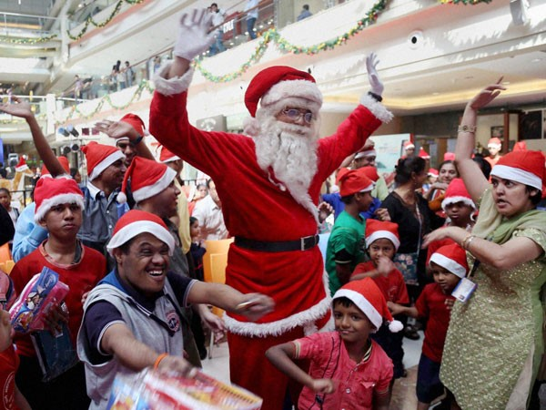
Christmas celebrations may not always
reflect the Christian meaning
Although Christmas is a Christian celebration that is celebrated widely in many countries across the world the celebration may not always reflect the Christian meaning of the feast. Why might that be?
Food is an important part of Christmas celebrations because when families gather they like to eat and drink and share memories and stories of Christmases past.
Many of the traditions families share at Christmas relate to food and customs that have been passed down and are connected to cultural celebrations rather than Christian ones. Can you name some examples of these traditions?
Can you share a story of a special food that your family shares at Christmas and explain its meaning and connection with your family now and in the past?
How do your families’ Christmas celebrations reflect your Christian belief that Jesus is the reason for the season? What signs, symbols, music and activities would make this evident?
L-1
S-08
Click the audio button to stop ‘All the people on Earth’
Click the pins on the right to reveal post-it notes.
Click the audio button to play ‘All the people on Earth’
Notes:
Sing using the MP3 ‘All people on the Earth

Slide 9
Check up
1)
Imagine you are in another country for Christmas and you experience one of the special customs that is used there at Christmas. Write a description of it that would fit on a postcard to send home that would help someone to know what it was about.
2)
When I think about the traditions my family use to celebrate Christmas I think my favourite ones are …
3)
Make a comic strip to explain a Christmas tradition from another country or culture. Include how the tradition came to be and how it enriches people’s understanding of the real meaning of Christmas.
4)
Explain to someone the difference between Christian Christmas celebrations and non- Christian Christmas celebrations and give examples of both.
5)
Which activity do you think helped you to learn best in this lesson?
6)
Questions I would like to ask about the topics in this lesson are …
L-1
S-09
Click the worksheet button to go to the worksheet

Slide 10
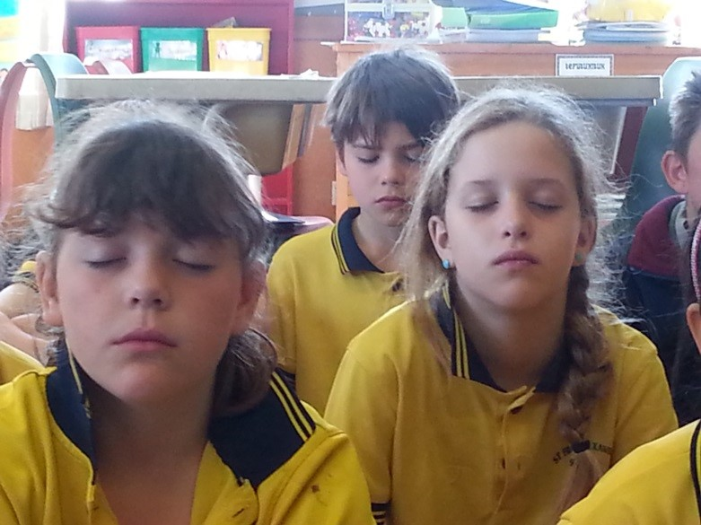
Time for Reflection
L-1
S-10
Click the audio button to stop reflective music
Click the audio button to play reflective music

Slide 11
Sharing how Christmas is celebrated
in your family and your culture
Name:
Date:
1 | 2 | 3
4 | What I know about our family or cultural Christmas customs, rituals or traditions | 5
6 | 7 | 8
L-1
S-03
Worksheet
Click the up arrow to return to the lesson
Notes:
Children share a family or cultural custom, ritual or tradition then complete their worksheet and share it with their class.
Adapt Teaching and Learning Experience 2

Slide 12
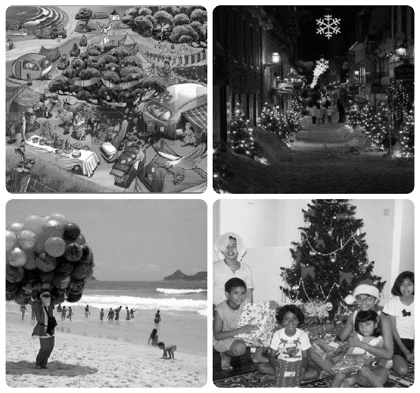
Comparing Christmas celebrations in different cultures
Name:____________________________
Date:____________
On the Venn diagram record in the left space what your family’s Christmas celebrations include, on the right record what is included in another culture you are familiar with and in the middle space record what is common to both.
L-1
S-04
Worksheet
Click the up arrow to return to the lesson

Slide 13
Check up
Name:____________________________
Date:____________
1) Imagine you are in another country for Christmas and you experience one of the special customs that is used there at Christmas. Write a description of it that would fit on a postcard to send home that would help someone to know what it was about.
2) When I think about the traditions my family use to celebrate Christmas I think my favourite ones are …
3) Make a comic strip to explain a Christmas tradition from another country or culture. Include how the tradition came to be and how it enriches people’s understanding of the real meaning of Christmas.
4) Explain to someone the difference between Christian Christmas celebrations and non- Christian Christmas celebrations and give examples of both.
5) Which activity do you think helped you to learn best in this lesson?
6) Questions I would like to ask about the topics in this lesson are …
L-1
S-09
Worksheet
Click the up arrow to return to the presentation

