Slide 1
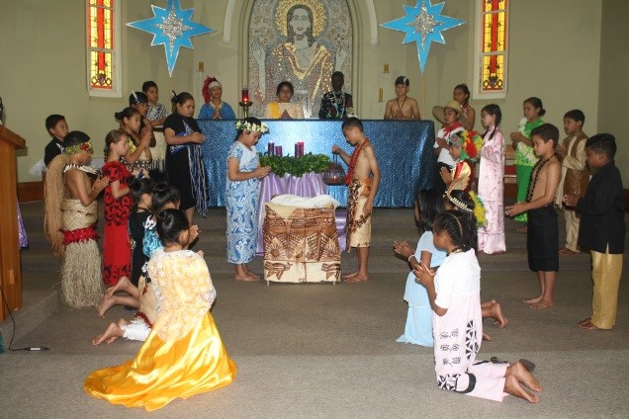
Celebrating the Christ Mass
L-2
S-01

Slide 2
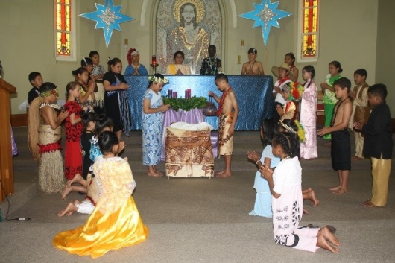
Learning Intentions
The children will:
1)
identify what is being celebrated at Christmas and why this is significant for Christians.
recognise in all cultures Catholics publicly celebrate Christ’s birth by gathering together for the Eucharist.
2)
L-2
S-02
Click the boxes to reveal the learning intentions

Slide 3
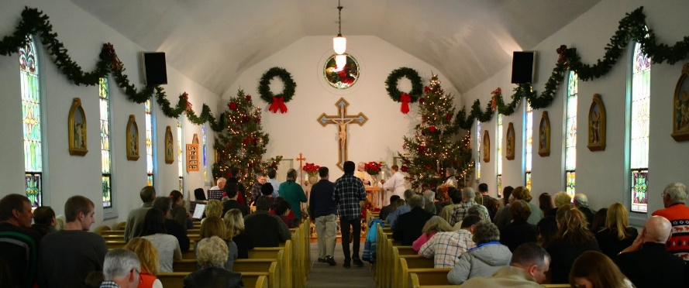
All over the world Catholics gather on Christmas Day to celebrate the Christ Mass
Christmas day.
The English word for Christmas refers to the celebration of the Eucharist – the Christ Mass on
Christians come to Mass on Christmas day to celebrate the miracle that God became a
God gave up his majesty and power so that people could see, hear and touch
At Christ mass Christians celebrate how much God loves them and
The Christ mass is significant because it reminds people that God’s son came to show them how to turn away
Over time the two words Christ mass merged into one word Christmas but the meaning
helpless human baby.
the Son of God.
desires to live with them.
from sin.
didn’t change.
from sin.
B) didn’t change.
C) the Son of God.
D) Christmas day.
E) desires to live with them.
F) helpless human baby.
L-2
S-03
Click on A B C D E or F to complete the sentences
Notes:
Answers 1) D, 2) F, 3) C, 4) E, 5) A, 6) B

Slide 4
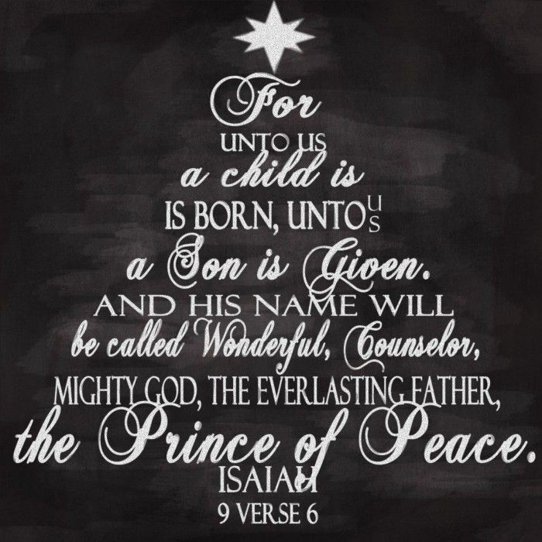
The first reading at the Christ Mass is
Isaiah’s description of Jesus
Read slowly and reflect on this on verse in the Scripture.
What makes this verse so significant for people who believe in and follow this wonderful counsellor?
The meaning of this verse changed human history.
Why was the impact of this child given to us so enormous?
This event made it possible for all humans to come to know God.
How does knowing, loving, believing and trusting in God affect our lives?
We can encounter God in the events of our lives, in our relationships, in creation - all because of the gift of Jesus his son.
Why is it that Christ masses attract many more people than the regular Sunday mass?
Christians throughout the world want to share the celebration of the birth of Jesus together.
L-2
S-04
Click the down-button to move the blind down,
click the up-button (appears at bottom) to move the blind to the top.

Slide 5
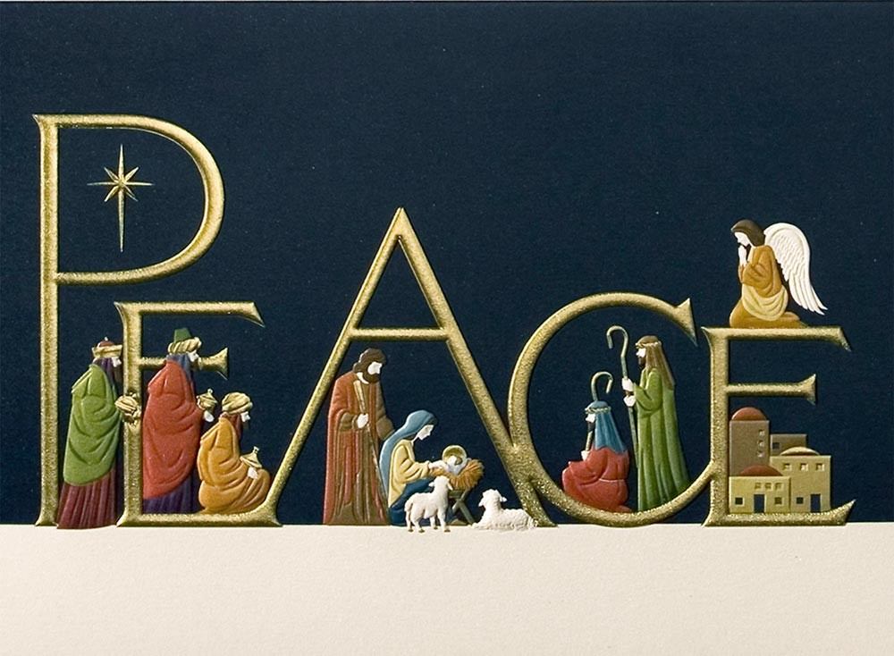
The Gospel of the Christ Mass is
Luke’s story of Jesus’ birth
Jesus was called the Prince of Peace and he came to build God’s kingdom of love aroha, peace rangimarie and justice tika on earth, he called his followers to continue this work.
How do you see yourself making a contribution to this work?
Jesus was born in a stable without the most basic things new born babies need.
What was this saying about the life Jesus was going to live?
When Joseph and Mary heard about Herod’s actions they fled to safety for themselves but most of all for the sake of their son who was God’s son. What does this say about the earthly parents God chose to care for his son?
Luke 2:1-20
The shepherds were the first to hear the news of Jesus’ birth – shepherds were not considered important in any way. What message was God sending about the sort of person his son was going to be by this action?
You will be familiar with the Christmas story as you will have heard it often at Christmas.
Look for deeper meanings as you listen. Read Luke 2:1-20
L-2
S-05
In the flip book click on the page to turn over

Slide 6
The custom of telling the
Christmas story in your school
What cultural symbols and traditions can you see in the picture?
Share some cultural symbols, customs and traditions that your school uses to highlight the season of Christmas for children and their families whānau.
Create a new tradition for your school to help make Christmas more meaningful this year – share your ideas about this with your community before you decide.
X
L-2
S-06
Click the information button to reveal the pop up
Click the audio button to stop ‘Jesus Christ is Born’
Click the audio button to play ‘Jesus Christ is Born
Notes:
Sing using the MP3 ‘Jesus Christ is born’

Slide 7
Check up
1)
List 3 points you would make in an explanation about the significance of Christmas for Christians.
2)
What happened on Christmas night that changed human history forever?
3)
Describe one of your family’s Christian traditions at Christmas.
4)
Name 3 examples of how different cultures celebrate Christmas through the Eucharist.
5)
Which activity do you think helped you to learn best in this lesson?
6)
Questions I would like to ask about the topics in this lesson are …
L-2
S-07
Click the worksheet button to go to the worksheet

Slide 8
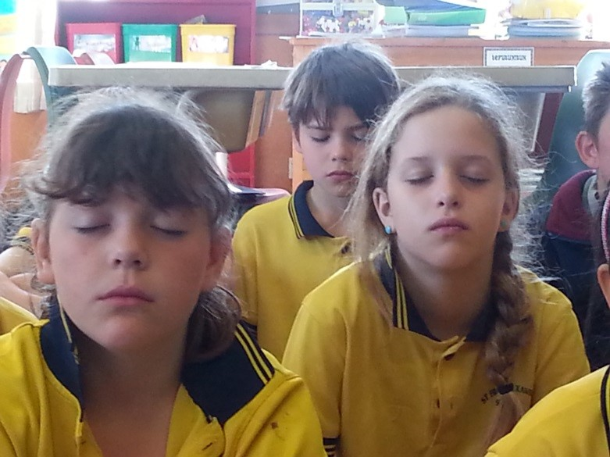
Time for Reflection
L-2
S-08
Click the audio button to stop reflective music
Click the audio button to play reflective music

Slide 9
Sharing our Learning about
Christmas with family whānau
Present a re-enactment of
Las Posadas for a younger class and explain its meaning and why people have this custom.
Make a poster
to highlight the reason why Christmas is so important for Christians
Create an art work to express how Catholics all over the world and in your parish celebrate a Christ mass to highlight the significance of Christmas for all Christians
Have a conversation
with your family whānau about rituals, traditions and customs that are part of your Christmas celebrations. Ask about when they started and by whom. Decide which ones are Christian and which are not.
Tell the story
of why we have Christmas lights in our windows to some family members.
Make up your own way of showing and sharing what you have learned and decide with whom you would like to share it.
Click the gifts to reveal ways to share our learning
L-2
S-09
Click the worksheet button to go to the worksheet
Notes:
This slide provides some choices for children to show and share what they have learned. Examples could be photographed as evidence of children’s learning.
You may like to put a copy of the Sharing our Learning page in children’s RE Learning Journals. You could talk through the choices using the slide and let children make their choice from their own copy.
Children could work on their choice at school and/or at home and you may like to set a day for sharing. Please let parents and whānau know what you expect them to do with this.
The slide is focussed on the CHRISTMAS Achievement Objective which is covered in Lessons 1-2
Yr 6 AO) Children will be able to: recognise the ways CHRISTMAS is celebrated in different cultures including the celebration of the Christ mass.

Slide 10
Check up
Name:____________________________
Date:____________
1) List 3 points you would make in an explanation about the significance of Christmas for Christians.
2) What happened on Christmas night that changed human history forever?
3) Describe one of your family’s Christian traditions at Christmas.
4) Name 3 examples of how different cultures celebrate Christmas through the Eucharist.
5) Which activity do you think helped you to learn best in this lesson?
6) Questions I would like to ask about the topics in this lesson are …
L-2
S-07
Worksheet
Click the up arrow to return to the presentation

Slide 11
Sharing our Learning
Name:____________________________
Date:____________
Make a poster to highlight the reason why Christmas is so important for Christians
Present a re-enactment of Las Posadas for a younger class and explain its meaning and why people have this custom.
Tell the story of why we have Christmas lights in our windows to some family members.
Have a conversation with your family whānau about rituals, traditions and customs that are part of your Christmas celebrations. Ask about when they started and by whom. Decide which ones are Christian and which are not.
Create an art work to express how Catholics all over the world and in your parish celebrate a Christ mass to highlight the significance of Christmas for all Christians
Make up your own way of showing and sharing what you have learned and decide with whom you would like to share it.
L-2
S-09
Worksheet
Click the up arrow to return to the presentation

