Slide 1
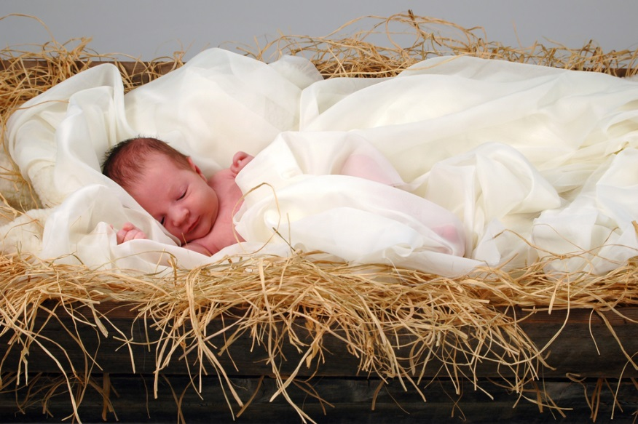
December 25
The Feast of Christmas
L-1
S-01
Notes:
Slide 1 The Feast of Christmas
Use this slide as a focussing strategy to introduce the lesson topic. Read the title together and invite students to share something they know about the feast of Christmas and the other special feasts in the Christmas season.
The feast of the Holy Innocents is dealt with on Slides 7,8,9

Slide 2
Learning Intentions
The students will:
1)
recognise that the feast of Christmas celebrates the mystery of God Te Atua becoming human tangata
2)
recognise how the feast of the Holy Innocents remembers how even at his birth Jesus was not accepted by everyone.
L-1
S-02
Click the borders to reveal text
Notes:
Slide 2 Learning Intentions
Read through the Learning Intentions with the class and identify some ideas/questions that might be explored in the lesson
Access the Liturgical Calendar worksheet from Lesson 2 Slide 4 to continue working on Slide 3 below.

Slide 3
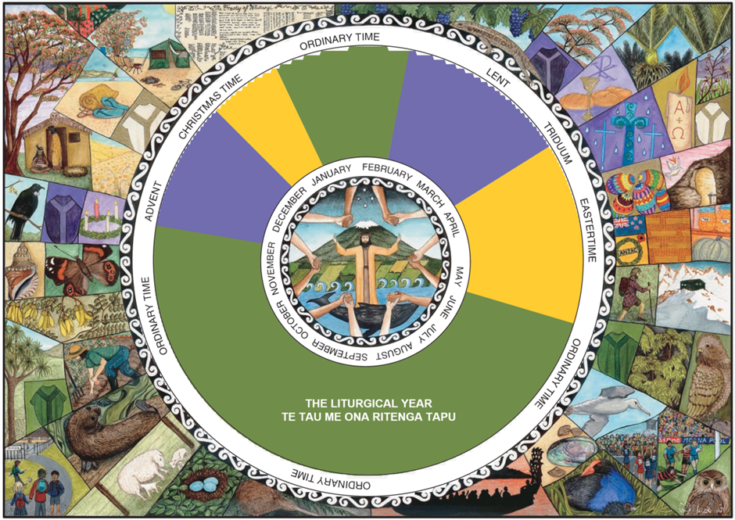
The place of Christmas in the Liturgical Year
Using your Liturgical Calendar from the Advent lessons
identify and mark the feast of Christmas – say when Christmas time begins and ends
note the colour for Christmas and say what it symbolises
mark December 28 as the feast of the Holy Innocents and draw a red vestment beside it and share what it symbolises
X
L-1
S-03
Click the I-button to reveal information
Notes:
Slide 3 The place of Christmas in the Liturgical Year
Read each item on the pop up and record your responses on the Worksheet from ADVENT Lesson 1 Slide 4.
Christmas time begins as night falls on Christmas Eve and continues until the feast of the Baptism of Jesus in January. The first Christmas Mass is celebrated during this night.

Slide 4
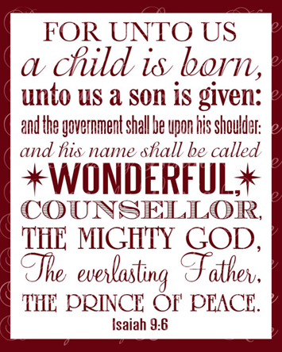
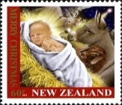
In the first reading at Mass on Christmas night Isaiah’s words tell who Jesus is
Read the verse on the image from Isaiah and note which two lines tell of the mystery of God Te Atua becoming human tangata
A child is born The mighty God
What does this tell us about Jesus?
It tells us this child is extraordinary - he is both human and divine
‘Divine’ means of God
Choose another line or one of Isaiah’s titles for Jesus and explain what it means
L-1
S-04
Click the icons to reveal a text line
Notes:
Slide 4 In the first reading at Mass on Christmas night Isaiah’s words tell who Jesus is
Adapt the Teaching and Learning Experience 2
Read the verse from Isaiah on the image on the left.
Read the instruction in the top frame then read the reveals and respond to each.
Follow instruction in frame at the foot of the slide.

Slide 5
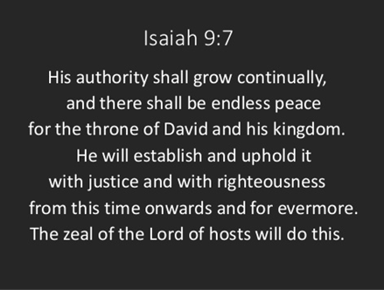
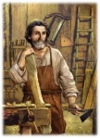
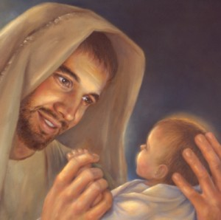
The readings tell who Jesus is
Jesus was born into the House of David because Joseph belonged to this House through Joseph
In the Old Testament God promised the Messiah would belong to the House of David.
Name one thing Isaiah recorded that Jesus the Messiah will do.
L-1
S-05
Click the icons to reveal a text line
Notes:
Slide 5 The readings tell who Jesus is
Recall what you know about Isaiah.
Read the passage from Isaiah.
Read each reveal and respond to the last reveal.

Slide 6
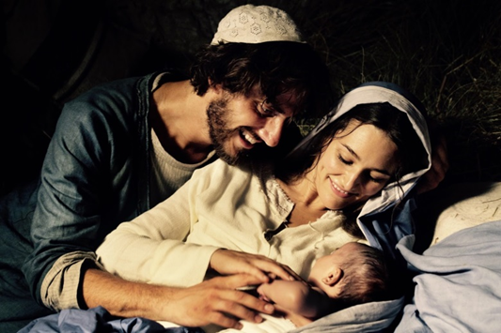
God made human tangata – Jesus the Messiah
Read Luke 2:1-14 – listen for something new you haven’t heard before in the story
Share the new thing you heard and recap the roles of the angels and the shepherds.
Shepherds were very poor lowly people – they were the first to hear about the Messiah.
What does this say about the sort of Messiah Jesus came to be?
Do you think this is the sort of person the people were expecting their new Messiah to be?
Was Jesus accepted by all the people as the Messiah who came to save the people?
L-1
S-06
Press the button to advance through the lines
Notes:
Slide 6 God made human tangata – Jesus the Messiah
Find Luke 2:1-14 and read it.
Use the arrow to point to each new item and share your responses to the questions.

Slide 7
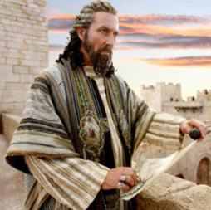
Herod, King of Judea at the time Jesus was born
Match the statements on the left with those at the bottom then read them all
1
Herod was frightened Jesus had come to take his
Herod was visited by the three wise men
The wise men followed the star and visited Herod to find
Herod asked to be informed where the baby was
The wise men found Jesus then were warned in a dream to
2
3
4
5
a)
the whereabouts of the new born king.
b)
so he too could pay him homage.
d)
who were probably astronomers.
c)
throne and become King of the Jews.
e)
return to their home land by a different route.
L-1
S-07A
Click the white buttons on the left to reveal the correct statement match
Notes:
Slide 7A Herod, King of Judea at the time Jesus was born
Read aloud the first half of the statement and indicate the correct completion – then check using the floater.
Answers
1)C, 2)D, 3)A, 4) B, 5)E
Continued on next slide

Slide 8
Herod, King of Judea at the time Jesus was born
Match the statements on the left with those at the bottom then read them all
1
Herod found out the baby was born in Bethlehem
Joseph was warned in a dream that Herod wanted to kill
Herod was so angry he gave orders for all boy babies
By doing this Herod thought the new baby king
Mary, Joseph and Jesus stayed in Egypt as refugees… …until Herod died
2
3
4
5
a)
aged two and under to be killed.
b)
would be dead and his throne would be safe.
d)
the baby so he and the family fled to Egypt.
c)
so he sent his soldiers to kill the child.
e)
and it was safe to return to Nazareth.
Click the white buttons on the left to reveal the correct statement match
Click the Worksheet button to go to the worksheet
L-1
S-07B
Notes:
Slide 7B Herod, King of Judea at the time Jesus was born
Complete the worksheet as a record of your learning.
Answers
1)C, 2)D, 3)A, 4) B, 5)E

Slide 9
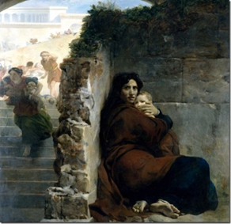
Reflecting on the story of the Holy Innocents
Share your response to the story – Look closely at the picture
This is a story about ...
I would describe King Herod as a …
There are leaders like him in the world today such as …
Can you describe the feelings and suffering of the families whose babies were killed …
It would be similar to the pain and suffering of the families today in …
This story shows that even from his birth Jesus was …
There are people in the world today who are outcasts and not accepted such as …
L-1
S-08
Press the button to move pointer to each new line
Notes:
Slide 8 Reflecting on the story of the Holy Innocents

Slide 10
The Feast of the Holy Innocents – 28 December
The Church remembers the innocent children who died because Herod did not accept Jesus.
Who are today’s holy innocents?
Reflect on how many innocent children die every day because of their religion, their culture or their colour.
Pray silently in your heart for them and their families.
L-1
S-09
Click the audio button to stop ‘There is a Child’
Click the audio button to play ‘There is a Child’
Notes:
Slide 9 The Feast of the Holy Innocents – 28 December
Share responses in groups to each item using the pointer to indicate
What can you say about historical events in Jesus’ time and in the present time?
Reflect on what it would be like to be a holy innocent.
Sing using the MP3 ‘There is a child’

Slide 11
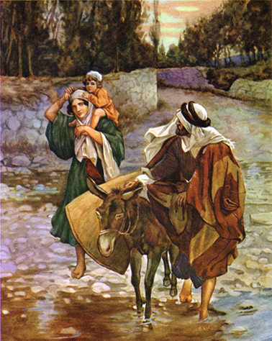
Who do Mary, Joseph and Jesus in this picture remind you of?
Where and when have you seen a picture like this recently?
Can you make comparisons with this situation in the world today?
Create an art work that captures Mary, Joseph and Jesus as refugees and the refugees of today.
Let yourself imagine the young Mary and Joseph first-time parents, living in a foreign country with no support of family and friends to help them raise their baby son.
Think about this as you create your art work.
L-1
S-10
Notes:
Slide 10 Who do Mary, Joseph and Jesus in this picture remind you of?
Read and respond to each item in groups. Share the best ideas you heard with the whole class.
Had you thought about Jesus, Mary and Joseph as refugees? Think about all the images you can see in the media at the moment as you create your art work. Can you see similarities?
Try to include them in your art work.

Slide 12
Check up
1)
Recall the words of Isaiah as you explain how Christmas is the feast that celebrates God becoming human in his son Jesus.
2)
Give 2 reasons why this is such a life changing event in history.
3)
Write a reflection on the Holy Innocents the Church remembers and the holy innocents we hear about in the news today who die because they are poor, hungry and rejected.
4)
Which activity do you think helped you to learn best in this lesson?
5)
Questions I would like to ask about the topics in this lesson are …
Click in each caption space to reveal text
Click on the worksheet button to go to the worksheet.
L-1
S-11
Notes:
Slide 11 Check Up
This formative assessment strategy will help teachers to identify how well students have achieved the Learning Intentions of the lesson.
Teachers can choose how they use the slide in their range of assessment options.
A worksheet of this slide is available for students in Years 5-8 to complete.
The last two items are feed forward for the teacher.
Recording the students’ responses to these items is recommended as it will enable teachers to adjust their learning strategies for future lessons and target the areas that need further attention.

Slide 13
Time for Reflection
L-1
S-12
Click the audio button to stop reflective music
Click the audio button to play reflective music
Notes:
Slide 12 Time for Reflection
The MP3 is played to help create a reflective atmosphere and bring the young people to stillness and silence as the teacher invites them to remember to reflect on today’s holy innocents of all ages and pray for them and imagine how Jesus would have treated them – they are not too far away from where he was a refugee.

Slide 14
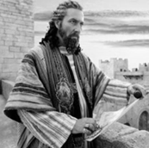
Herod, King of Judea at the time Jesus was born
Match the statements on the left with those on the right then read them all
Herod was frightened Jesus had come to take his
Herod was visited by the three wise men
The wise men followed the star and visited Herod to find
Herod asked to be informed where the baby was
The wise men found Jesus then were warned in a dream
Herod found out the baby was born in Bethlehem
Joseph was warned in a dream that Herod wanted to kill
Herod was so angry he gave orders for all boy babies
By doing this Herod thought the new baby king
Mary, Joseph and Jesus stayed in Egypt as refugees until Herod died
the whereabouts of the new born king.
so he too could pay him homage.
would be dead and his throne would be safe.
who were probably astronomers.
and it was safe to return to Nazareth.
throne and become King of the Jews.
so he sent his soldiers to kill the child. to return to their home land by a different route.
aged two and under to be killed.
the baby so he and the family fled to Egypt.
Name:_________________
Date:_______
L-1
S-07
Worksheet
Click the up arrow to return to the lesson
Notes:
Slide7 Herod, King of Judea at the time Jesus was born WORKSHEET
This worksheet relates to slide 7A & 7B

Slide 15
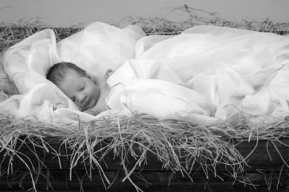
Check up
Name:__________________
Date:_______
1)
Recall the words of Isaiah as you explain how Christmas is the feast that celebrates God becoming human in his son Jesus.
2)
Give 2 reasons why this is such a life changing event in history.
3)
Write a reflection on the Holy Innocents the Church remembers and the holy innocents we hear about in the news today who die because they are poor, hungry and rejected.
4)
Which activity do you think helped you to learn best in this lesson?
5)
Questions I would like to ask about the topics in this lesson are …
L-1
S-11
Worksheet
Click the up arrow to return to the lesson
Notes:
Slide 11 Check-up WORKSHEET
This worksheet relates to slide 11

