Slide 1
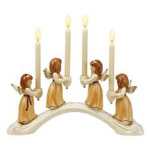
The Feasts of Christmas and the Epiphany
L-1
S-01
Notes:
Slide 1 The Feast of Christmas and the Epiphany
Use this slide as a focussing strategy to introduce the lesson topic. Read the title together and invite students to share something they know about the Feasts of Christmas and the Epiphany and what they celebrate.

Slide 2
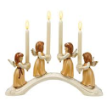
Learning Intentions
The students will:
1)
recognise that the birth of Christ reveals the love aroha of God Te Atua in human form
2)
explain what the feast of the Epiphany reveals about Jesus
L-1
S-02
Click the borders to reveal text
Notes:
Slide 2 Learning Intentions
Read through the Learning Intentions with the class and identify some ideas/questions that might be explored in the lesson.

Slide 3
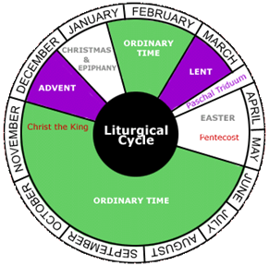
The Season of Christmas and the Feast of the Epiphany
The priest on these feasts wears the celebration colours - white, yellow or gold.
What colour vestments does the priest wear on the feasts of Christmas and the Epiphany?
The Epiphany is celebrated here on the second Sunday after Christmas.
What day is the feast of the Epiphany celebrated in Aotearoa New Zealand?
The season of Christmas begins during the night of Christmas Eve and continues until the feast of the Baptism of the Lord in January.
When does the season of Christmas begin and end?
L-1
S-03
Click top card to discard it
Notes:
Slide 3 The Season of Christmas and the Feast of the Epiphany
Adapt Teaching and Learning Experience 1
Use Liturgical Calendar to identify the Season of Christmas and the Feast of the Epiphany and share what events they celebrate.
Use the flip cards to extend students’ knowledge.

Slide 4
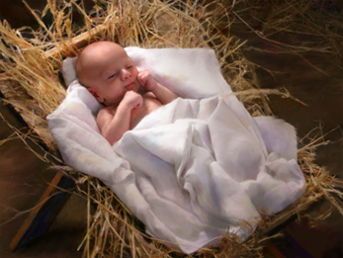
The Feast of Christmas celebrates how close God is to the world through Jesus
These things are proclaimed in the reading at Mass on Christmas Day
The first to receive the news of Christ’s birth are shepherds who are poor and powerless in society
Christmas celebrates the nearness of God to all who are open to receive God’s love and life.
Through Jesus, God is revealed as a God of mercy, love, justice and peace.
The Son is the reflection of God’s glory and the exact imprint of God’s very being.
God revealed God’s self through creation and the prophets but in the last days through a Son.
The birth of Jesus reveals the love aroha of God in human form.
L-1
S-04
Click top card to discard it
Notes:
Slide 4 The Feast of Christmas celebrates how close God is to the world through Jesus
Read the title and think about what this idea means. Explain it to a partner.
Ask the students to note something new they learned as they read through the flip cards. These ideas are spoken about in the Letter to the Hebrews.
They try to help people understand the enormity of the event of Christ’s birth and what is says about God’s great love for all people.

Slide 5
The Letter to the Hebrews – God proclaims that Jesus is an exact imprint of God’s own self
This letter of 12 chapters was written around 63 AD and it is more like a homily than a letter. Its author is unknown although it was attributed to Paul by some early writers. We hear the first verses of the letter at Mass on Christmas Day.
The letter was written in Greek to encourage the Jewish people in Jerusalem who had converted to Christianity and were wavering in their faith because of persecution, to remind them there was no going back to the old Jewish ways which were now replaced with new ways centred on Christ.
The theme of the letter is to proclaim the superiority of Jesus Christ - the final revelation of God, to declare his superiority to the ancient prophets and angels and to establish Christ’s own unique priesthood.
It clarifies that by his death Christ redeemed all of humanity and God raised him to be his firstborn heir, the second person of the Trinity, a reflection of God’s glory and the exact imprint of God’s very being.
The letter encourages the people to recognise how everything changed with the birth of Jesus and now they must look only to Christ and put aside the old prophecies, promises and practices for ‘better and superior things’ and this is mentioned 15 times in the letter.
L-1
S-05
Click the down-button to move the blind down.
Notes:
Slide 5 The Letter to the Hebrews – God proclaims that Jesus is an exact imprint of God’s own self
Adapt Teaching and Learning Experience 2
Use the blind reveal to learn some background to the Letter to the Hebrews. This letter has a very important message for all of the new early Christians because it challenges them to move away from their old Jewish ways and to take on the ways of the new Christian community that was trying to develop their own ways of doing things. They were being persecuted and some were tempted to revert to their old religious ways.
How would you have felt if you had been one of these new Christians?
Read Hebrews 1:1-6 – use it in class prayer this week.

Slide 6
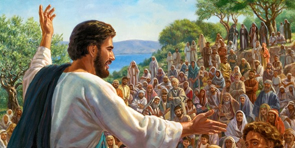
What Jesus taught about God and what this says about what God is like
1 | 2 | 3
4 | What I know about what Jesus taught and what this says about what God is like | 5
6 | 7 | 8
How does this illustrate what the Letter to the Hebrews said – Jesus is the imprint of God’s very being
L-1
S-06
Click the worksheet button to go to the worksheet
Notes:
Slide 6 What Jesus taught about God and what this says about what God is like
Students recall the gospel stories Jesus used to teach about what God was like – especially the parables.
They complete the worksheet with what they know Jesus taught about God, and what this says about what God is like. An example is - The Prodigal Son parable says God is forgiving.
Adapt Teaching and Learning Experience 2

Slide 7
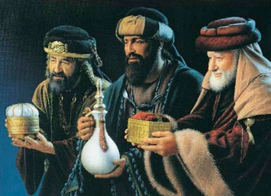
Who were the Magi or Wise Men?
The names of the Magi varied according to different cultures the most
The magi did not come from the chosen people of Israel but
They knelt to honour the king and people still use this gesture today
The gifts they brought had special significance and
A tradition continues about the magi saying that they were
well known being Caspar, Melchior and Balthazar.
from Persia, probably modern day Turkey or Iran.
to pay homage to the Christ the King in Christian worship.
they revealed a lot about who Jesus was.
so moved by their encounter with Jesus they became Christians.
A) to pay homage to the Christ the King in Christian worship.
B) they revealed a lot about who Jesus was.
C) from Persia, probably modern day Turkey or Iran.
D) so moved by their encounter with Jesus they became Christians.
E) well known being Caspar, Melchior and Balthazar.
L-1
S-07
Click a sentence-end or an empty space to correctly connect the parts.
Notes:
Slide 7 Who were the Magi or Wise Men?
Adapt Teaching and Learning Experience 3
Students share what they know already about the magi or wise men.
The select statements and use the floaters A-E to complete the sentences.
ANSWERS
1-E, 2-C, 3-A, 4-B, 5-D

Slide 8
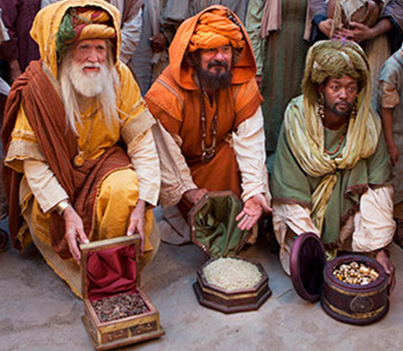
Some clarification about the visit of the Wise Men
The Bible does not specify an interval of time between Jesus’ birth and the visit of the kings, and the pictures, particularly on Christmas cards and the closeness of the traditional dates of December 25 and January 6, encourage the popular assumption that the visit took place the same winter as Jesus’ birth.
Traditional nativity scenes depict three kings visiting Jesus on the night of his birth, in a manger accompanied by the shepherds and angels, but this should be understood as an artistic convention that combines for convenience the separate groups of visitors to the stable on Christmas night.
Some traditions believed the visit took place up to two winters later. This would tie in with the reference to the wise men and Herod's decree (Matthew 2:16–18) about the Massacre of the Innocents - all boys up to two years old. (Feast December 28, see Yr 7 Lesson 1.) The star which they followed has traditionally become known as the Star of Bethlehem.
The only gospel account by Matthew simply presents an event at an unspecified point after Christ's birth in which an unnumbered party of unnamed wise men visited him in a house not a stable, with only ‘his mother’ mentioned. Note this in the clip.
Click the pins on the right to reveal post-it notes. Click the video button to watch the video.
L-1
S-08
Click the audio button to start ‘Follow the Christmas Star’
Click the audio button to stop ‘Follow the Christmas star’
Notes:
Slide 8 Some clarification about visit of the Wise Men
Read Matthew 2:1-12
Read each post it note and discuss the idea that the 3 wise men did not visit the stable when Jesus was born. Listen to the explanation of this and notice how the visit is portrayed in the clip. Notice Jesus.
Watch the clip The wise men seek Jesus 5:42 minutes
https://www.youtube.com/watch?v=fRjpf2kti08
Sing using MP3 ‘Follow the Christmas Star’

Slide 9
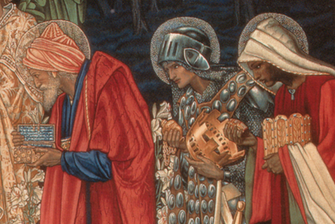
The significance of the gifts the Magi brought and what they reveal about Jesus
Gold is a precious metal and it is a symbol of divinity – a person who is both God and human. In presenting this gift the wise men recognised it is a gift for a king, Jesus Christ, the King of Kings.
Frankincense is a white resin or gum and when it was mixed with oil it was used to anoint the priests of Israel. In presenting this gift the wise men recognised Christ as our great High Priest, the one whose life was wholly acceptable and completely pleasing to God his Father.
Myrrh is a spice used in embalming people after death. Myrrh symbolizes bitterness and suffering. In presenting this gift the wise men recognised Jesus was human and like all humans he would die.
L-1
S-09
Click the icons to reveal a text line
Notes:
Slide 9 The significance of the gifts the Magi brought and what they reveal about Jesus
Adapt Teaching and Learning Experiences 3 & 4
Read the text about the meaning of each gift and discuss this.
Make an art work of the gifts of the magi that expresses what each gift reveals about Jesus

Slide 10
The Feast of the Epiphany – the revelation of Christ’s birth to the whole world
The gifts of the magi reveal that Jesus was anointed by God to be a priest, a prophet and a king – the later has yet to come about but will happen when Jesus comes again at his second coming at the end of time.
A tradition tells that the three kings became followers of Jesus and were martyred for their faith in him. The relics of their bones were transferred in 1162 to Cologne Cathedral in Germany and are held in the Shrine of the Three Kings where they are still venerated today.
The feast of the Epiphany proclaims that the coming of the magi shows that Jesus came to share his life and love not only with the chosen people of Israel but with people of every nation in the world.
The Epiphany is one of the most popular scenes captured by artists – if you are interested research this for yourself. You could also research the meaning of the word epiphany and how it is used today.
The Epiphany is one of the most popular scenes captured by artists – if you are interested research this for yourself. You could also research the meaning of the word epiphany and how it is used today.
The feast of the Epiphany proclaims that the coming of the magi shows that Jesus came to share his life and love not only with the chosen people of Israel but with people of every nation in the world.
A tradition tells that the three kings became followers of Jesus and were martyred for their faith in him. The relics of their bones were transferred in 1162 to Cologne Cathedral in Germany and are held in the Shrine of the Three Kings where they are still venerated today.
The gifts of the magi reveal that Jesus was anointed by God to be a priest, a prophet and a king – the later has yet to come about but will happen when Jesus comes again at his second coming at the end of time
L-1
S-10
Click top card to flip the page
Notes:
Slide 10 The Feast of the Epiphany – the revelation of Christ’s birth to the whole world
People use the word ‘epiphany’ in a non-religious sense today when speaking about a sudden and profound understanding of something.
Use the flip book

Slide 11
Check up
1)
What does the birth of Jesus reveal about God’s love?
2)
What did you learn about from the Letter to the Hebrews?
3)
Recall 3 new ideas you learnt about the magi and the feast of the Epiphany.
4)
Explain what the gifts of the magi reveal about Jesus.
5)
Which activity do you think helped you to learn best in this lesson?
6)
Questions I would like to ask about the topics in this lesson are …
Click in each caption space to reveal text
Click on the worksheet button to go to the worksheet.
L-1
S-11
Notes:
Slide 11 Check Up
This formative assessment strategy will help teachers to identify how well students have achieved the Learning Intentions of the lesson.
Teachers can choose how they use the slide in their range of assessment options.
A worksheet of this slide is available for students in Years 5-8 to complete.
The last two items are feed forward for the teacher.
Recording the students’ responses to these items is recommended as it will enable teachers to adjust their learning strategies for future lessons and target the areas that need further attention.

Slide 12
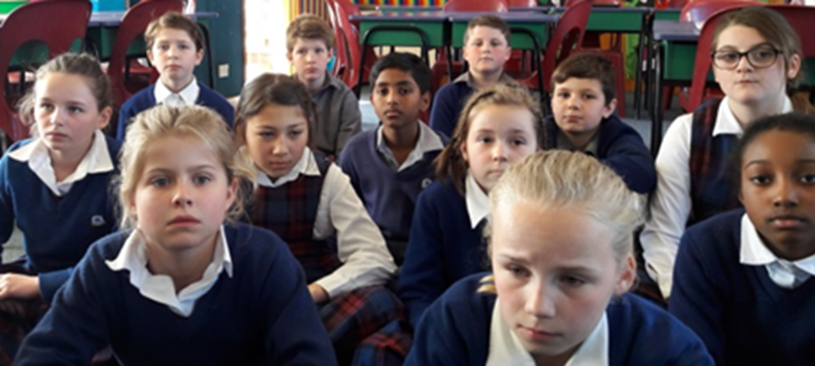
Time for Reflection
L-1
S-12
Click the audio button to stop reflective music
Click the audio button to play reflective music
Notes:
Slide 12 Time for Reflection
The MP3 is played to help create a reflective atmosphere and bring the young people to stillness and silence as the teacher invites them to reflect on the meaning of the stories of Christmas and the Epiphany and how they help us to realise how great God is and how deep God’s love is for each one of us. Sit with this and let it sink into their heart.
Original Children’s Activities available on lesson home page

Slide 13
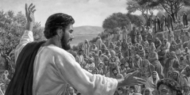
What Jesus taught about God and what this says about what God is like
Name:_____________
Date:_______
1 | 2 | 3
4 | What I know about what Jesus taught and what this says about what God is like | 5
6 | 7 | 8
How does this illustrate what the Letter to the Hebrews said – Jesus is the imprint of God’s very being
L-1
S-06
Worksheet
Click the up arrow to return to the lesson
Notes:
Slide 6 What Jesus taught about God and what this says about what God is like WORKSHEET
This worksheet relates to slide 6

Slide 14
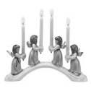
Check up
Name:_____________
Date:_______
1)
What does the birth of Jesus reveal about God’s love?
2)
What did you learn about from the Letter to the Hebrews?
3)
Recall 3 new ideas you learnt about the magi and the feast of the Epiphany.
4)
Explain what the gifts of the magi reveal about Jesus.
5)
Which activity do you think helped you to learn best in this lesson?
6)
Questions I would like to ask about the topics in this lesson are …
L-1
S-11
Worksheet
Click the up arrow to return to the lesson
Notes:
Slide 11 Check up WORKSHEET
This worksheet relates to slide 11

