Slide 1
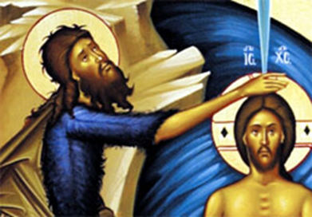
The feast of the baptism of the Lord
L-2
S-01
Notes:
Slide 1 The feast of the baptism of the Lord
Use this slide as a focussing strategy to introduce the lesson topic. Read the title together and invite students to share something they know about the Feast of the baptism of the Lord.

Slide 2
Learning Intentions
The students will:
1)
recognise how the feast of the baptism of the Lord concludes the season of Christmas
2)
explain why Jesus was baptised
L-2
S-02
Click the borders to reveal text
Notes:
Slide 2 Learning Intentions
Read through the Learning Intentions with the class and identify some ideas/questions that might be explored in the lesson.

Slide 3
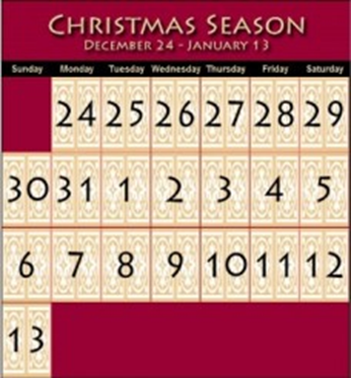
The Christmas Season
What do the major feasts and seasons in the Liturgical Year celebrate?
The Catholic Church sets aside certain days and seasons of each year to recall and celebrate various events in the life of Christ. The two major feasts and seasons are Christmas and Easter which celebrate Christ’s birth and his resurrection.
Is Christmas a feast or a season?
It is both. The season of Christmas begins at mid night on the eve of Christmas day. Christmas is more than just a day; it is also a season, sometimes called Christmastide. The Christmas season lasts from December 25th through until the Baptism of our Lord, which comes after the Epiphany.
L-2
S-03A
Click the icons to reveal text
Notes:
Slide 3A The Christmas Season
Adapt Teaching and Learning Experience 1
Look closely at the calendar image.
Discuss what is meant by a season and a feast.
Students read the questions and share responses - check responses with the information in the text boxes.
Continued on the next slide

Slide 4
The Christmas Season
What are the feasts in the Christmas season and when do they occur?
Catholics have many more days in which to celebrate special feasts in the Christmas season:
December 28 The Holy Innocents, December 30 The Holy Family,
January 1 Mary, Mother of God Sunday after January 1 the Epiphany.
The season of Christmas ends on the feast of the Baptism of the Lord on the Sunday after the Epiphany around January 6.
L-2
S-03B
Click the icon to reveal text
Notes:
Slide 3B The Christmas Season
Students read the questions and share responses - check responses with the information in the text boxes.
Test each other in pairs to name the feasts and their dates.

Slide 5
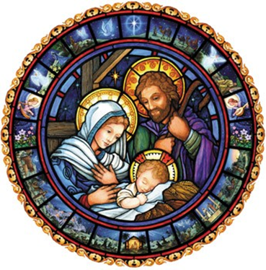
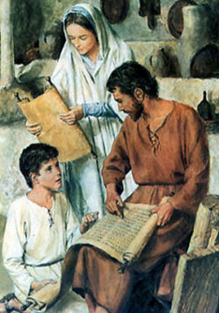
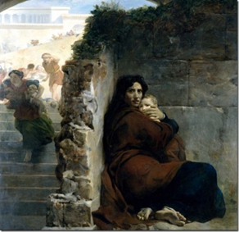
The Feasts in the Christmas season
The Feast of the Holy Innocents
December 28
The Feast of Christmas December 25
The Feast of the Holy Family
December 30
Sunday after Christmas day
Look at the images of the feasts in the Christmas season
Name each image and briefly describe what it is about.
Click to check your response
L-2
S-04A
Click the images to reveal text
Notes:
Slide 4A The Feasts in the Christmas season
Look closely at each image.
Follow the directions in the text box.

Slide 6
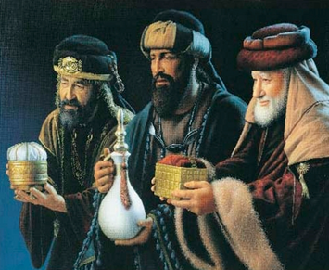
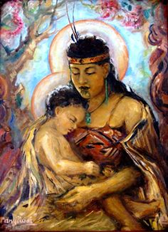
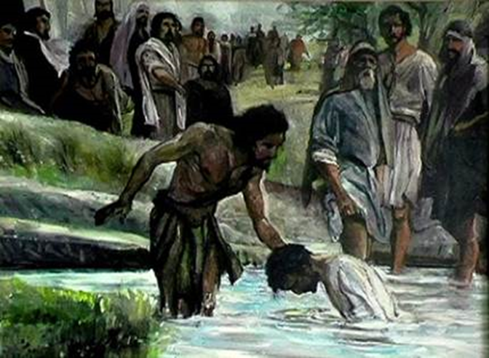
The Feasts in the Christmas season
The Feast of Mary the Mother of God
January 1
The Feast of the Baptism of the Lord
January - Sunday after the Epiphany
The Feast of the Epiphany
January 6 – Sunday after January 1
Look at the images of the feasts in the Christmas season
Name each image and briefly describe what it is about.
Click to check your response
L-2
S-04B
Click the images to reveal text
Notes:
Slide 4B The Feasts in the Christmas season
Look closely at each image.
Follow the directions in the text box.

Slide 7
Why was Christ born?
Christ was born to bring people
By the way he lived and what he taught, Christ
His message to people was to reject unkind words and actions
Jesus’ message was for all people regardless of
It was Jesus’ life that led him to his death on the cross
back into friendship with God so they can be part of God’s kingdom.
challenged people to live in a new loving way.
and to seek forgiveness and begin again with love in their hearts.
who they were or what they had done.
and through this he won back a place in God’s kingdom for everyone.
A) challenged people to live in a new loving way.
B) who they were or what they had done.
C) back into friendship with God so they can be part of God’s kingdom.
D) and to seek forgiveness and begin again with love in their hearts.
E) and through this he won back a place in God’s kingdom for everyone.
L-2
S-05
Click a sentence-end or an empty space to correctly connect the parts.
Notes:
Slide 5 Why was Christ born?
Students share their ideas about why Christ was born.
Read each statement and select from A- E to correctly complete the sentence.
Use the floaters to check.
ANSWERS
1-C, 2-A,3-D, 4-B, 5-E

Slide 8
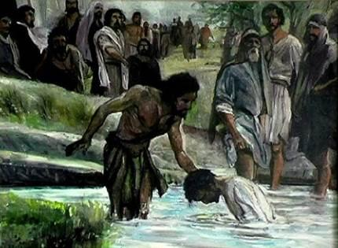
The Feast of the Baptism of the Lord
Topic: The Baptism of the Lord
What do I KNOW? | What do I WONDER? | What have I LEARNT?
L-2
S-06
Click the worksheet button to go to the worksheet
Notes:
Slide 6 The Feast of the Baptism of the Lord
Students brainstorm each question and complete the worksheet and share their responses in groups.

Slide 9
Why did Jesus want John to baptise him?
Read or retell the story of Jesus’ baptism Matthew 3:13-17
He was put to death as a sinner and a criminal so he could bring life and salvation to all people.
He empathised with the sick by touching and healing them.
It prepared him to begin his work of inviting people to belong to God’s kingdom.
He included those who were seen as unclean by spending time with them.
Jesus wanted to be baptised because it was his way of being like those who felt outside God’s kingdom.
Jesus was without sin so he did not need a baptism of repentance – what does this mean?
John’s baptism called people to repent of their sins and change their lives.
It prepared him to begin his work of inviting people to belong to God’s kingdom.
John didn’t want to baptise Jesus.
He empathised with the sick by touching and healing them.
He included those who were seen as unclean by spending time with them.
He was put to death as a sinner and a criminal so he could bring life and salvation to all people.
John didn’t want to baptise Jesus.
John’s baptism called people to repent of their sins and change their lives.
Jesus was without sin so he did not need a baptism of repentance – what does this mean?
Jesus wanted to be baptised because it was his way of being like those who felt outside God’s kingdom.
L-2
S-07
Click top card to flip the page
Notes:
Slide 7 Why did Jesus want John to baptise him?
Adapt Teaching and Learning Experiences 3 & 4
Follow the directions on the slide.
Read each page on the flip book – note the key points that are made on each
What people were outside the kingdom?
What did Jesus do after his baptism?
How did he empathise with the people who were sad and hurt?
What did these actions lead Jesus to? What is the answer to the question in the title?

Slide 10
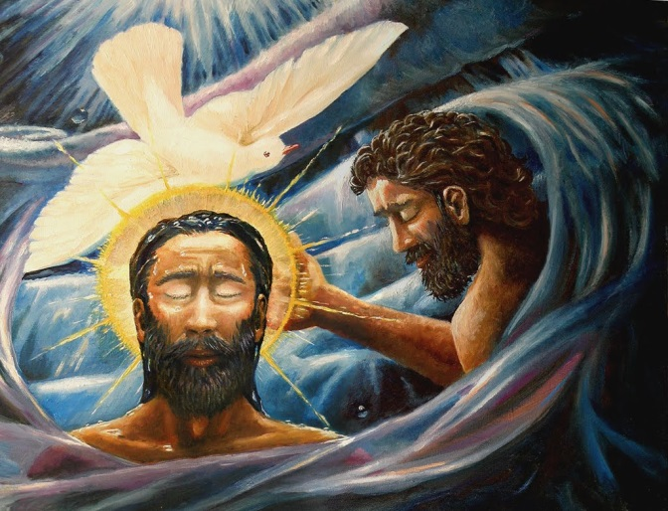
Why is Jesus’ baptism such a significant event in his life?
The baptism of Jesus is the beginning of his public life and the work God had sent him to do on earth. It celebrates the link between Christmas and Jesus’ life work.
God’s delight in Jesus was shown in his words “This is my son, the beloved, in whom I am well pleased”
God has the same delight in all who become adopted sons and daughters through water and the Holy Spirit.
At Jesus’ baptism all 3 persons of the Trinity were present - God’s voice was heard from a cloud, the dove symbolising the Holy Spirit came and rested on him and Jesus himself was present.
By celebrating the feast of Jesus’ baptism, people are reminded of their own baptism and the work they are to do for the kingdom of God Te Rangatiratanga
L-2
S-08
Click the audio button to stop ‘The Spirit of the Lord
Click the pins on the right to reveal post-it notes.
Click the audio button to play ‘The Spirit of the Lord’
Notes:
Slide 8 Why is Jesus’ baptism such a significant event in his life?
Read each post it note – after each one students share something new they learned from it.
Answer the question in the title.
Sing using the MP3 ‘The Spirit of the Lord’

Slide 11
Check up
1)
What does the birth of Jesus reveal about God’s love?
2)
Explain the link between Christmas and Jesus’ baptism.
3)
Christ was born to …
4)
Why was Jesus baptised?
5)
Which activity do you think helped you to learn best in this lesson?
6)
Questions I would like to ask about the topics in this lesson are …
Click in each caption space to reveal text
Click on the worksheet button to go to the worksheet.
L-2
S-09
Notes:
Slide 9 Check Up
This formative assessment strategy will help teachers to identify how well students have achieved the Learning Intentions of the lesson.
Teachers can choose how they use the slide in their range of assessment options.
A worksheet of this slide is available for students in Years 5-8 to complete.
The last two items are feed forward for the teacher.
Recording the students’ responses to these items is recommended as it will enable teachers to adjust their learning strategies for future lessons and target the areas that need further attention.

Slide 12
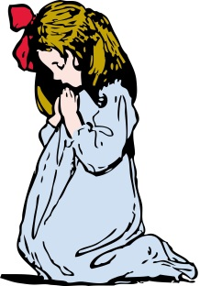
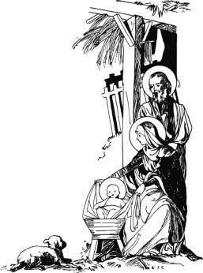
Sharing our Learning about CHRISTMAS with family whānau
Make a timeline to illustrate the connection between the events of Christmas and the Epiphany. Use the time line to share this with people at school and at home.
Create an exhibition of famous art works of the Epiphany and add the artists name and a short explanation of the work. Display this in the school or church foyer.
Write a script for a conversation between Jesus and John the Baptist at the Jordan River about baptism. Refer to the gospel story in Matthew 3:13-17. Share this in pairs and edit it to refine it before sharing it with someone at home or at school.
Create a dance sequence of the arrival of the 3 maji and the presentation of their gifts to Jesus.
Have a conversation with someone at home about what the gifts of gold, frankinsense and myrrh tell us about Jesus and why they were presented to him by the maji. Refer to Lesson 1 Slide 10 when constructing the questions and answers.
Make up a rap about why Jesus was born refer to Lesson 2 Slide 4. Share it at assembly.
Create an art work or use one by an artist of Jesus’ baptism. Include the cloud, the dove and the words God spoke to Jesus and use it to illustrate why Jesus wanted to be baptised, why his baptism was an important event in his life and point out how all the members of the holy Trinity are present.
Make up your own way of showing and sharing what you have learned and decide who you would like to share it with.
L-2
S-10
Click on the worksheet button to go to the worksheet.
Notes:
Slide 10 Sharing our Learning about CHRISTMAS with family whānau
This slide provides some choices for children to show and share what they have learned. Examples could be photographed as evidence of children’s learning.
You may like to put a copy of the Sharing our Learning page in students’ RE Learning Journals. You could talk through the choices using the slide and let children make their choice from their own copy.
Students could work on their choice at school and/or at home and you may like to set a day for sharing. Please let parents and whānau know what you expect them to do with this.
The slide is focussed on CHRISTMAS Achievement Objective which is covered in Lessons 1&2.
CHRISTMAS Year 8 Children will be able to: develop an understanding of the Feasts of the Christmas Season: Christmas, The Epiphany and the Baptism of the Lord.

Slide 13
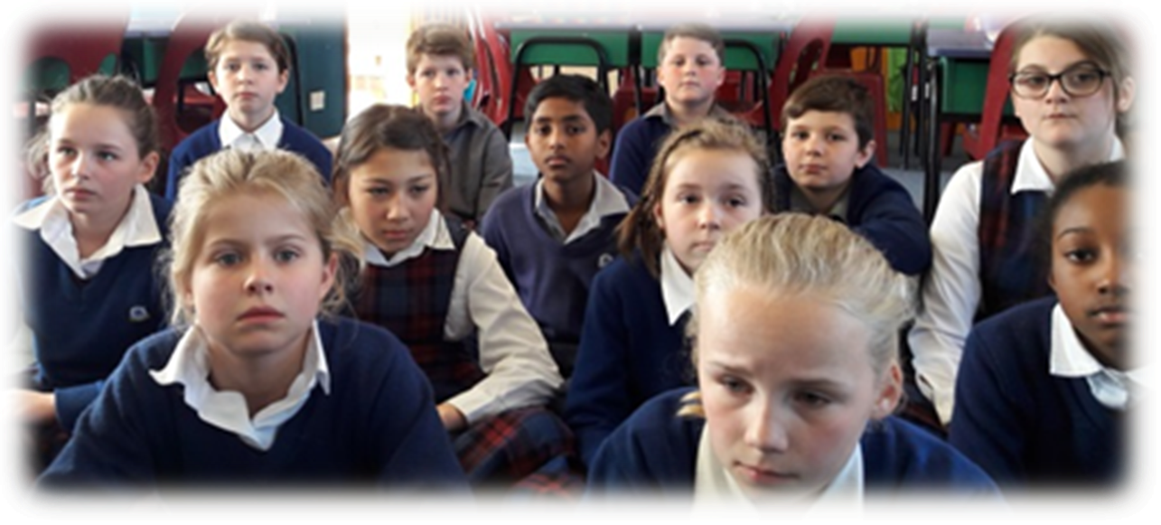
Time for Reflection
L-2
S-11
Click the audio button to stop reflective music
Click the audio button to play reflective music
Notes:
Slide 11 Time for Reflection
The MP3 is played to help create a reflective atmosphere and bring the young people to stillness and silence as the teacher invites them to reflect on how Jesus empathised with people who were outsiders in need of support and encouragement. Recall ways you empathise with people and how you do your part to build up God’s kingdom by reaching out to people who need a friend to include them and give them a hand up. Try to do this each day at home and at school.

Slide 14
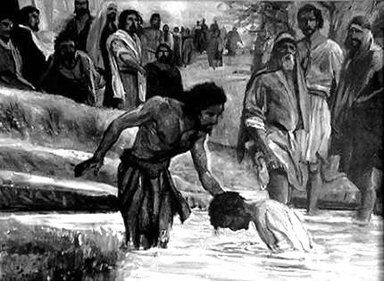
The Feast of the Baptism of the Lord
Topic: The Baptism of the Lord
What do I KNOW? | What do I WONDER? | What have I LEARNT?
Name:__________________
Date:_______
L-2
S-06
Worksheet
Click the up arrow to return to the lesson
Notes:
Slide 6 The Feast of the Baptism of the Lord WORKSHEET
This worksheet relates to slide 6

Slide 15
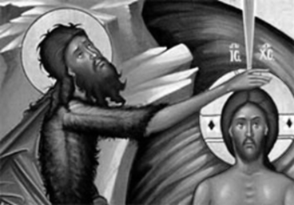
Check up
Name:_________________
Date:_______
1)
What does the birth of Jesus reveal about God’s love?
2)
Explain the link between Christmas and Jesus’ baptism.
3)
Christ was born to …
4)
Why was Jesus baptised?
5)
Which activity do you think helped you to learn best in this lesson?
6)
Questions I would like to ask about the topics in this lesson are …
L-2
S-09
Worksheet
Click the up arrow to return to the lesson
Notes:
Slide 9 Check up WORKSHEET
This worksheet relates to slide 9

Slide 16
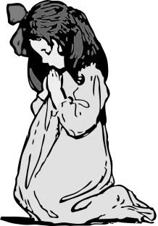
Sharing our Learning about CHRISTMAS with family whānau
Make a timeline to illustrate the connection between the events of Christmas and the Epiphany. Use the time line to share this with people at school and at home.
Create an exhibition of famous art works of the Epiphany and add the artists name and a short explanation of the work. Display this in the school or church foyer.
Write a script for a conversation between Jesus and John the Baptist at the Jordan River about baptism. Refer to the gospel story in Matthew 3:13-17. Share this in pairs and edit it to refine it before sharing it with someone at home or at school.
Create a dance sequence of the arrival of the 3 maji and the presentation of their gifts to Jesus.
Have a conversation with someone at home about what the gifts of gold, frankinsense and myrrh tell us about Jesus and why they were presented to him by the maji. Refer to Lesson 1 Slide 10 when constructing the questions and answers.
Make up a rap about why Jesus was born refer to Lesson 2 Slide 4. Share it at assembly.
Create an art work or use one by an artist of Jesus’ baptism. Include the cloud, the dove and the words God spoke to Jesus and use it to illustrate why Jesus wanted to be baptised, why his baptism was an important event in his life and point out how all the members of the holy Trinity are present.
Make up your own way of showing and sharing what you have learned and decide who you would like to share it with.
Name:_________________
Date:_______
L-2
S-10
Worksheet
Click the up arrow to return to the lesson
Notes:
Slide 10 Sharing our Learning about CHRISTMAS with family whānau WORKSHEET
This worksheet relates to slide 10

