Slide 1
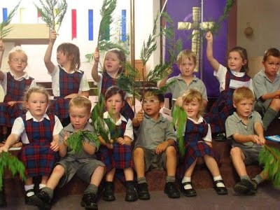
Make way for the King
R-1
S-01
Notes:
Slide 1 Make way for the King
Use this slide as a focussing strategy to introduce the resource topic. Read the title together and invite children to share something they know about Palm Sunday.
Create a Palm Sunday prayer focus the week before Palm Sunday using suitable images and symbols. Add to these as Holy Week progresses. Include the Holy Week bible stories during prayer time and let the children dramatise them and sing the songs they know.
Give children some special ‘close to Jesus’ times of quiet. You may like to create a special quiet place for children to go to look at Holy Week books.
Look at the images on the slide and talk about each one with the children and what Holy Week event they are about.
Explain that Easter Sunday is not really in Holy Week because it is the beginning of the Easter Season. Mention that Good Friday and Easter Sunday are holidays, so they learn about them before they celebrate them. Encourage the children to share what they are learning about Holy Week with their family. You may like to provide them with a copy of the parish bulletin with the times of the Holy Week and Easter ceremonies they could attend.

Slide 2
Learning Intentions
The children will:
1)
recognise Holy Week as the time when Jesus died and rose from death
2)
retell the story of Palm Sunday.
R-1
S-02
Click the boxes to reveal text.
Notes:
Slide 2 Learning Outcomes
Read through the Learning Intentions with the class and identify some ideas/questions that might be explored in the resource.

Slide 3
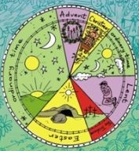
The Church has its own special Calendar for the Feasts and Seasons.
Here is the Calendar that shows the order of the feasts and seasons of the Church’s Year
Advent is the first season of the year.
Christmas is the next feast and season of the year.
Ordinary Time comes next.
Lent is the next season – it is the same colour as Advent.
Then comes Holy Week.
After Holy Week comes the season of Easter.
Then we come back to Ordinary Time.
R-1
S-03
Click the yellow button for pointer an again to move it around the Calendar. Click worksheet icon for a worksheet.
Notes:
Slide 3 The Church has its own special Calendar for the Feasts and Seasons
Children spend time looking at the Liturgical Calendar and finding out about the feasts and the seasons. Use the yellow pointer to point to each season as you read each bullet. Make up a guessing game – which season comes after Advent? Which feast comes after Holy Week? Children share something they know about the seasons.
Make a colour copy of the Liturgical Calendar worksheet for each child to colour when the season occurs and add it to their RE Learning Journal.

Slide 4
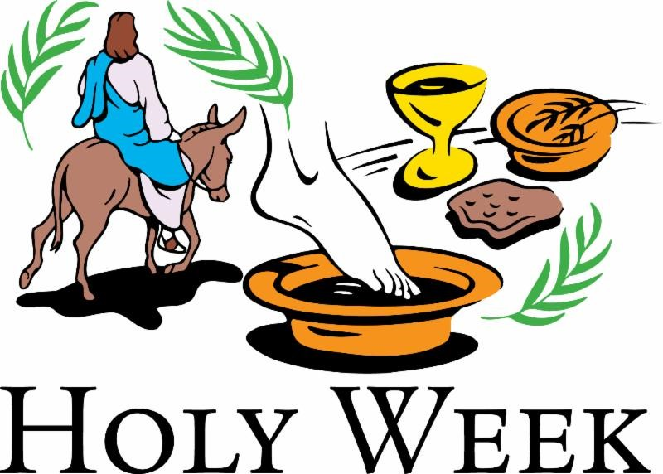
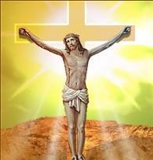
Holy Week is the most important week in the year for people who follow Jesus
Why is Holy Week holy?
Lent is the time to get ready for Holy Week.
The first day of Holy Week is Palm Sunday.
We call Friday in Holy Week Good Friday.
It is the day Jesus died for us. It is a sad day.
Because during this special week we remember that Jesus died. There are many holy days this week when we can grow closer to Jesus.
On Easter Sunday Jesus rose from the dead. Easter Sunday is not really part of Holy Week.
It is a very happy day because Jesus is alive again and the new season of Easter is beginning.
R-1
S-04
Click the pictures to reveal text.
Notes:
Slide 4 Holy Week is the most important week in the year for people who follow Jesus
Explain we call Holy Week holy because it is the week in which Jesus died. All the days in Holy Week are days to be close to Jesus. Read the captions and discuss the symbols and colours – purple for Lent, red for Holy Week, palms for Palm Sunday, Jesus on the cross for Good Friday.

Slide 5
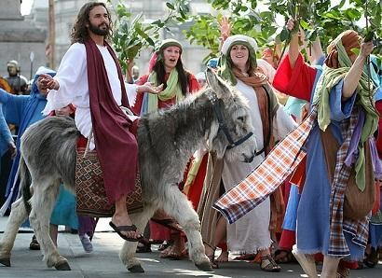
The first story of Holy Week is the Palm Sunday story
The people wanted to make Jesus their king. But not everybody liked Jesus and some of them wanted him to go away.
The Palm Sunday story happened a very long time ago in a place faraway called Judea.
Jesus lived in Judea and he had been travelling around teaching the people about God’s love for them and healing people who were sick.
The people listened to Jesus and they loved him very much. He was very kind to them and cared about them.
Jesus knew the high priests were plotting against him. He wanted to go into the big city of Jerusalem.
Jesus felt sad in his heart. He knew it would be his last meal with his friends. It would not be long before he was captured and killed by his enemies.
Jesus rode into Jerusalem and he went to a house with a big upstairs room because he was planning to have a special supper with his friends.
They even spread their coats on the ground for him to ride over. They shouted, “Hosanna, Hosanna. Welcome to our king”.
He wanted time to teach his disciples some important last lessons before he died. The room was all set up for the meal in the evening.
His friends the disciples brought a donkey for him to ride. The people were delighted to see him and they waved palms to welcome him.
Click the cards to move them out (10 total) click the arrow to start over.
Click video icon to watch “God’s Story: Palm Sunday”
R-1
S-05
Notes:
Slide 5 The first story of Holy Week is the Palm Sunday story
Use the flip cards to tell the Palm Sunday story. Read them together and talk about the story. Watch the clip
https://vimeo.com/59691514
God’s Story: Palm Sunday 2:43 Minutes

Slide 6
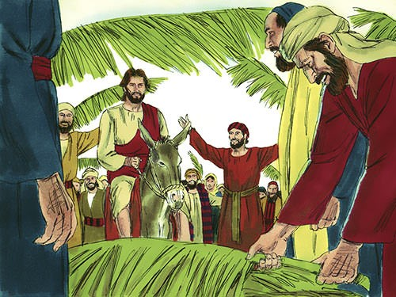
Getting to know more about Palm Sunday
The people were waiting for a new king who would save them from their mean rulers. Some of them thought Jesus was the new king. They called him their Messiah.
By waving and throwing down palm branches they were showing Jesus honour which means treating him as someone very important.
The palm branches came from a palm tree which was a tree of honour because they showed where water was in the hot sandy desert of Judea. The people wanted to show Jesus he was special and honour him.
They shouted, ‘Hosanna!’ to him as he rode along. Hosanna is a Jewish word which means ‘God save us now’. This made the high priests who did not like Jesus very angry. They did not want Jesus to be their king.
R-1
S-06
Click the pins on the right to reveal post-it notes.
Notes:
Slide 6 Getting to know more about Palm Sunday
Read the post it notes and use them to generate ideas and questions the children might have. Children might like to dramatise the story with different children taking turns to be Jesus.

Slide 7
Celebrating Palm Sunday in our school and our parish
1
Families like to join in the Palm Sunday procession in their parish. They bring branches from trees in their garden and they join in the singing as they walk together remembering the first Palm Sunday. Now they know that Holy Week has begun.
In our parish we have a procession around the streets near our church. This year we had two donkeys and lots of people came to be part of it. The man who was acting as Jesus walked beside the donkey. The people waved their palms and shouted, “Haere mai, welcome Jesus, Hosanna!”
In our school we act out the Palm Sunday story in the church. We get dressed up like the people in the time of Jesus in Judea where he lived. We feel like it is the real Palm Sunday. It is fun.
In our class we celebrate Palm Sunday by listening to the story of Jesus coming into Jerusalem. We talk about the story and wave palms just like the people did in Jerusalem and we shout, “Hosanna, Hosanna to the King!”.
R-1
S-07
Click the page with writing to move through pages (4 total).
Notes:
Slide 7 Celebrating Palm Sunday in our school and our parish
Read the flip cards about how children of your age celebrate Palm Sunday at school. Read the story about what happens in parishes when they celebrate Palm Sunday. Sometimes children in New Zealand shout “Hosanna, Haere mai to our king” because that is a special word to say welcome in Māori. When people walk in the procession on Palm Sunday they know that Holy Week has begun. They know it is a special week to talk to Jesus.

Slide 8
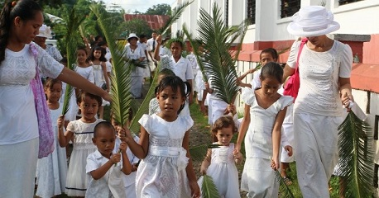
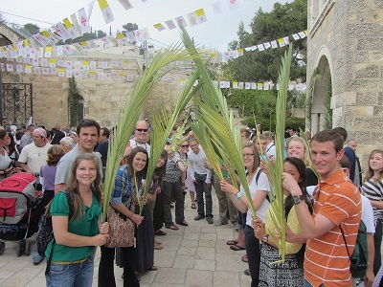
Palm Sunday is celebrated in countries all over the world
There are many people who follow Jesus in different countries all over the world. Some belong to our Church and on Palm Sunday they do just like we do. They have a procession and wave palms, they sing songs of welcome to Jesus and they remember the first Palm Sunday.
These people are in Jerusalem where the first Palm Sunday took place. They will walk in the streets that Jesus walked in a very long time ago. They will be remembering what happened in this special week in Jesus’ life.
R-1
S-08a
Click the images to reveal text.
Notes:
Slide 8a Palm Sunday is celebrated in countries all over the world
Read the text that matches the images and talk about what it means with the children. Encourage them to ask questions and make comments.

Slide 9
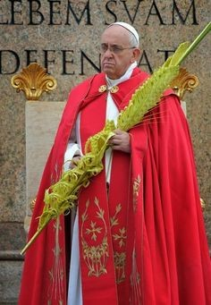
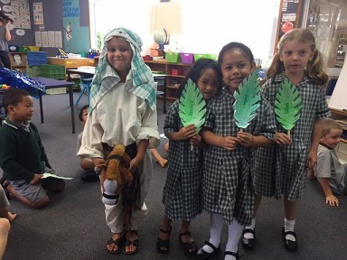
Palm Sunday is celebrated in countries all over the world
Pope Francis celebrates Palm Sunday by waving a palm and walking in a procession in Rome where he lives. He looks sad because he knows it is the beginning of Holy Week when we remember that Jesus died.
Children like you all over Aotearoa New Zealand will be learning about what happened to Jesus on Palm Sunday and telling him they love him and want to be close to him especially during Holy Week.
Click the Images to reveal text. Click the worksheet button to go to the worksheet.
R-1
S-08b
Click the audio button to stop ‘Sing Hosanna’
Click the audio button to play ‘Sing Hosanna’
Notes:
Slide 8b Palm Sunday is celebrated in countries all over the world
Read the text that matches the images and talk about what it means with the children. Encourage them to ask questions and make comments. Sing ‘Sing Hosanna’.
Make copies of the worksheet for children to complete with their families and add to their RE Learning Journal.

Slide 10
Check up
1)
Holy week is a special week because …
2)
Palm Sunday is the first day of Holy Week when …
3)
Draw a picture of the story of Palm Sunday and write a story about it.
4)
Why did the people shout, ‘Hosanna, Hosanna!”?
5)
Which activity do you think helped you to learn best in this resource?
6)
Questions I would like to ask about the topics in this resource are …
R-1
S-09
Click the boxes to reveal text.
Notes:
Slide 9 Check Up
This formative assessment strategy will help teachers to identify how well the children have achieved the Learning Intentions of the resource.
Teachers can choose how they use the slide in their range of assessment options.
A worksheet of this slide is available for children in Years 5-8 to complete.
The last two items are feed forward for the teacher.
Recording the children’s responses to these items is recommended as it will enable teachers to adjust their learning strategies for future resources and target the areas that need further attention.

Slide 11
Time for Reflection
R-1
S-10
Click the audio button to stop reflective music
Click the audio button to play reflective music
Notes:
Slide 10 Time for Reflection
The MP3 is played to help create a reflective atmosphere and bring the children to stillness and silence as the teacher invites them to think about how they can remember Jesus and talk to him anytime and know that he listens to them.

Slide 12
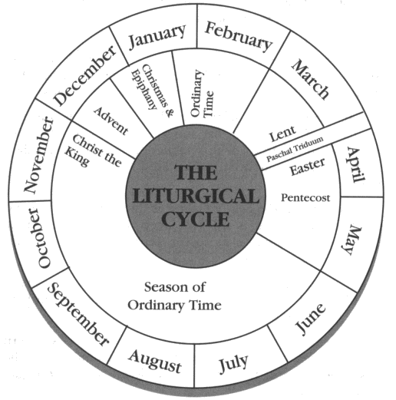
Here is the Calendar we use to show the Feasts and Seasons in Our Church
Name ________________________ Date ______
The seasons have special colours
Purple is for ADVENT
Yellow is for CHRISTMAS
Green is for ORDINARY TIME
Purple is for LENT
Red is for HOLY WEEK
Yellow is for EASTER
Worksheet
R-1
S-3
Click the up arrow to return to the presentation
Notes:
Slide 3 Here is the Calendar we use to show the Feasts and Seasons in Our Church WORKSHEET
This worksheet relates to slide 3
Make a colour copy of the Liturgical Calendar worksheet for each child to colour when the season occurs and add it to their RE Learning Journal.

Slide 13
Worksheet
R-1
S-8
Click the up arrow to return to the presentation

