Slide 1
The Last Supper
R-2
S-01
Notes:
Slide 1 The Last Supper
Use this slide as a focussing strategy to introduce the resource topic. Read the title together and invite children to share something they know about when Jesus had his last supper with his friends. Invite children to say what the children in the picture are doing.

Slide 2
Learning Intentions
The children will:
1)
recognise that the Last Supper took place the night before Jesus died
2)
retell the story of the Last Supper.
R-2
S-02
Click the boxes to reveal text.
Notes:
Slide 2 Learning Outcomes
Read through the Learning Intentions with the class and identify some ideas/questions that might be explored in the resource.
Set up a box of costumes suitable for children to dress as the disciples and Jesus, include women's clothes and something for Mary. Create a space where children could look at bibles and re-enact the Last Supper. Have a large bowl and towel for the washing of the feet, some cups, plates and jugs, include some captions with words Jesus spoke to his friends, for example “Do this and remember me.”, “Take and eat, this is my body.”. Encourage children to use this space during Holy Week to retell the stories. Remind them it is a quiet place where they can be close to Jesus.
Explain that Judas, one of Jesus’ friends, left the meal early because he had planned to tell the soldiers where Jesus was. This is how the soldiers knew where to find Jesus, arrest him and take him away.

Slide 3
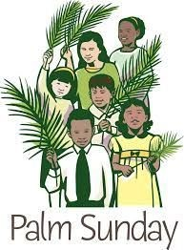
Remembering Palm Sunday
On Palm Sunday Jesus
Crowds of people cheered and
The people
Some people
Palm Sunday is
rode a donkey into Jerusalem.
waved palms to honour him.
wanted Jesus to be their king.
hated Jesus and wanted to kill him.
the first day of Holy Week.
A) waved palms to honour him.
B) hated Jesus and wanted to kill him.
C) the first day of Holy Week.
D) rode a donkey into Jerusalem.
E) wanted Jesus to be their king.
R-2
S-03
Click the end of the sentences or items on the list to reveal the statement that correctly completes the sentence.
Notes:
Slide 3 Remembering Palm Sunday
Use the activity to recap the Palm Sunday story and check it with the floaters.
ANSWERS 1) D, 2) A, 3) E, 4) B, 5) C
Use the Palm Sunday story to lead into the next Holy Week stories.
Re-tell the Palm Sunday story at morning prayer. Talk about how we make people welcome when they visit our classroom. Ask Jesus to help us to be welcoming people when visitors come to our homes or our classroom. Role play welcoming words and actions.

Slide 4
Holy Week is the last week Jesus spent on earth before he died
Look at the pictures and use them as clues to help you name the other Holy Week stories. Can you name all the Holy Week stories?
Palm Sunday
The Last Supper
Jesus is crowned with thorns
Jesus dies on the cross
R-2
S-04
Click the images to reveal text.
Notes:
Slide 4 Holy Week is the last week Jesus spent on earth before he died
Explain that after Palm Sunday come the other special days in Holy Week. They are Holy Thursday, Good Friday, Holy Saturday. Read a simple version of each story and talk about what happens on each day. Point out that Easter Sunday is not in Holy Week but is the first day if the new season – Easter. This maybe is the first-time children have learned about these stories so they will need to hear them in different ways and often. Use the images on the slides to help them recognise the clue for each story.

Slide 5
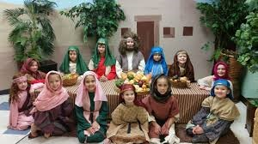
Jesus wanted to have a last meal with his friends
Click the video icon to watch clip “The Last Supper”
Record ideas by clicking the box.
R-2
S-05
Notes:
Slide 5 Jesus wanted to have a last meal with his friends Recap the story of the Last Supper. Watch the clip
https://www.youtube.com/watch?v=KywnAfLnOxw
The Last Supper 3:03 minutes
Talk about the clip and type the key ideas the children share onto the white box on screen.
Explain what an important meal this was for Jesus because he was going to die on the cross the next day. His friends didn’t really understand what Jesus was saying and doing. Jesus was teaching the disciples that they needed to do what he did – love each other and serve and help each other.
At the Last Supper Jesus took and blessed the bread and wine and gave it to the disciples saying it was his body and blood. When we go to Mass the priest does what Jesus did and then he shares Jesus’ body and blood with the people. This is holy food and drink that will make people holy and close to God as Jesus is. We call it Holy Communion. Children receive Holy Communion when they are about 7 or 8. Children share what they know about this.

Slide 6
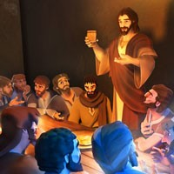
At the Last Supper Jesus said, “Remember me.”
Jesus asked his friends to remember what he had done while he lived with them and to treat other people lovingly as he had treated them. How did Jesus treat people?
Jesus knew he was going to leave his friends the next day when he was going to die on the cross. What do we call the day Jesus died?
He wanted them to remember him so he took some bread and wine which when it was blessed became his body and blood and this would help them to remember him. Do you think what Jesus did helps us to remember him?
Followers of Jesus remember today to do what Jesus did at the Last Supper. At Mass they eat the bread and drink the wine and through this they become very like Jesus – kind and loving to others. Have you seen people at Mass doing what Jesus did?
R-2
S-06
Click the pins on the right to reveal post-it notes.
Notes:
Slide 6 At the Last Supper Jesus said, “Remember me.” Adapt Teaching and Learning Experiences 4 & 6. Read through the post its together, talk about the text and use the questions as conversation starters.

Slide 7
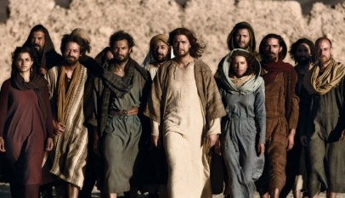
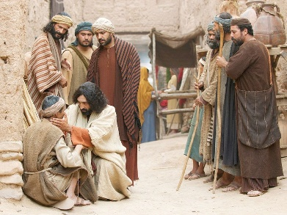
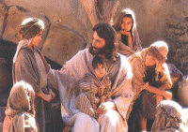
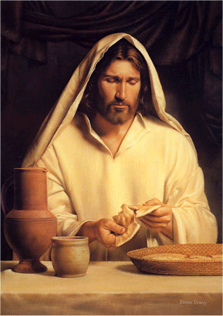
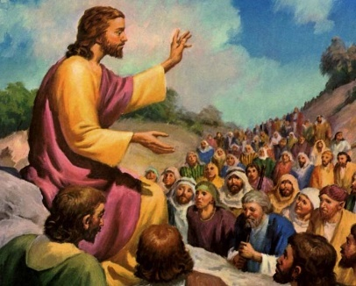
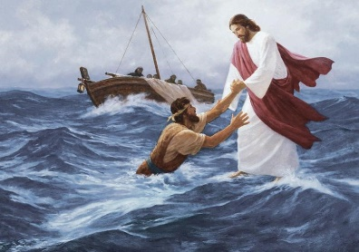
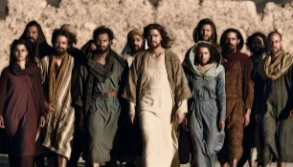
What else did Jesus want the people to remember about him?
Jesus wanted the people to remember that he loved them. |  | Jesus wanted the people to remember that he healed sick people. |  | Jesus wanted the people to remember that he loved to be with children.
Jesus wanted the people to remember that he taught them about God. |  | Jesus wanted people to remember that he saved them when they were in danger. |  | Jesus wanted people to remember him so he gave them his body and blood.
R-2
S-07
Click the empty boxes or the images at the bottom to match pictures.
Notes:
Slide 7 What else did Jesus want the people to remember about him? Read the text in the top left box to start and click the space next to it, look closely at the pictures and talk about how it matches the picture. Repeat as you move along the top and bottom lines.
What do you remember about Jesus and what he did?

Slide 8
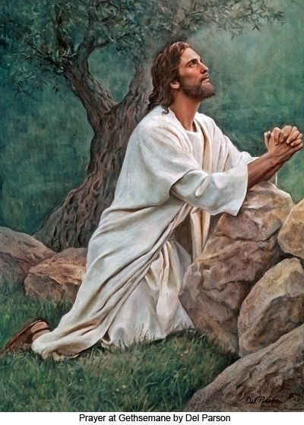
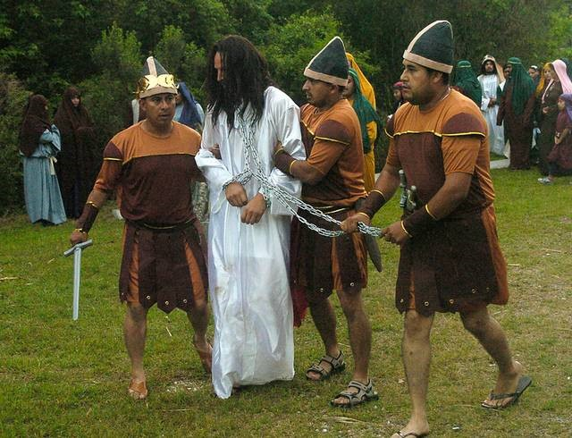
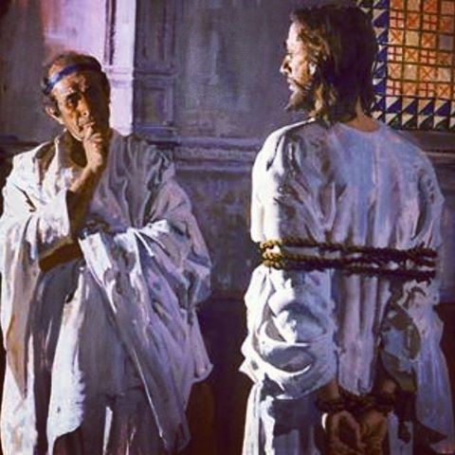
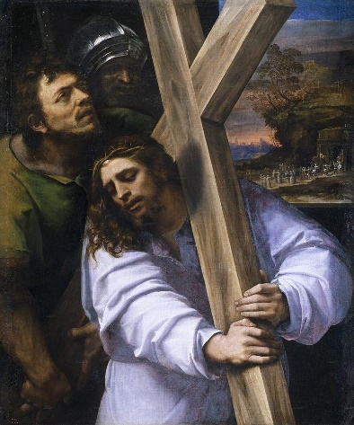
What happened after the Last Supper?
Jesus left the supper room and went out into the garden to pray. He was very sad and he prayed to God his Father. His friends went to sleep and left him all alone.
Later the soldiers came to arrest Jesus. They knew where he was because Judas had told them. The soldiers led him away.
Jesus was brought before Pilate. Pilate was the Roman governor. He asked Jesus many questions. Then Pilate handed Jesus over to the soldiers to be put to death.
On Good Friday the soldiers put a crown of thorns on Jesus’ head and made him carry his cross up the hill called Calvary.
R-2
S-08
Click the images to reveal text.
Notes:
Slide 8 What happened after the Last Supper?
Recap briefly what happened at the Last Supper and then use the pictures and text to share what happened next. Give the children time to look at the pictures and ask questions about them.

Slide 9
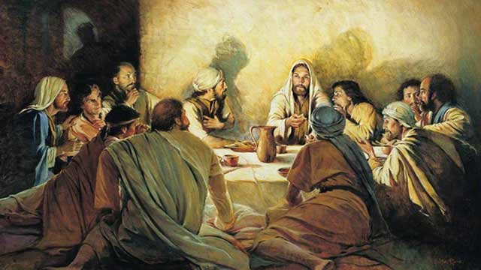
Jesus had his Last Supper with his friends on Holy Thursday
Find each word in the sentence below on the matrix and highlight it in the sentence and in the Word Find
F | J | E | S | U | S | O | A
R | H | A | D | L | U | N | E
I | Q | M | I | A | P | W | H
E | Z | H | I | S | P | K | I
N | W | E | S | T | E | V | S
D | I | P | L | Y | R | T | H
S | T | H | O | L | Y | G | U
T | H | U | R | S | D | A | Y
Jesus had his last supper with his friends on Holy Thursday.
Click the words in the sentence to reveal their position in the word find.
Click the worksheet icon for a worksheet.
R-2
S-09
Notes:
Slide 9 Jesus had his Last Supper with his friends on Holy Thursday
Make a copy of the Word Find for each child to complete and add to their RE Learning Journal. Read the sentence and find each word in the sentence on the matrix and highlight it in the sentence and in the Word Find.

Slide 10
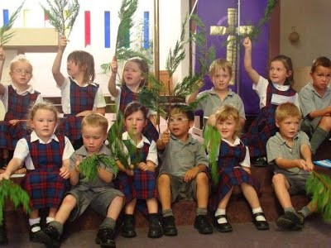
Check up
1)
Choose the right answer – Jesus had his Last Supper on –
Palm Sunday, Good Friday, His birthday, Holy Thursday
2)
The days I know in Holy Week are … (Slide 4)
3)
What did Jesus do at the Last Supper so people would remember him? (Slide 6)
4)
What do you know about Jesus when he lived on earth? (Slide 7)
5)
Which activity do you think helped you to learn best in this resource?
6)
Questions I would like to ask about the topics in this resource are …
R-2
S-10
Click the boxes to reveal text.
Notes:
Slide 10 Check Up
This formative assessment strategy will help teachers to identify how well the children have achieved the Learning Intentions of the resource.
Teachers can choose how they use the slide in their range of assessment options.
A worksheet of this slide is available for children in Years 5-8 to complete.
The last two items are feed forward for the teacher.
Recording the children’s responses to these items is recommended as it will enable teachers to adjust their learning strategies for future resources and target the areas that need further attention.

Slide 11
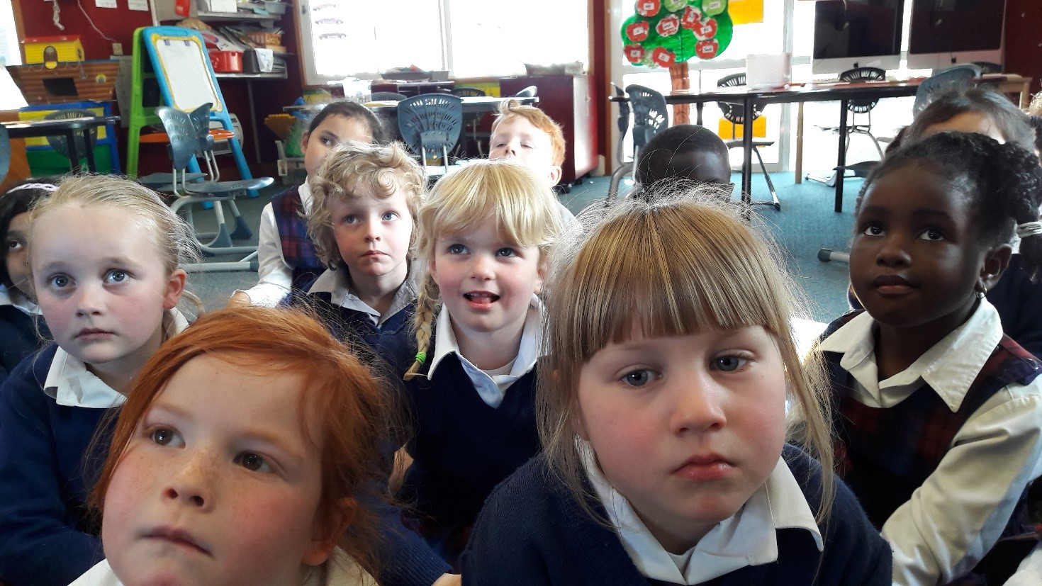
Time for Reflection
R-2
S-11
Click the audio button to stop reflective music
Click the audio button to play reflective music
Notes:
Slide 11 Time for Reflection
The MP3 is played to help create a reflective atmosphere and bring the children to stillness and silence as the teacher invites them to think about how they can remember Jesus and talk to him anytime and know that he listens to them.

Slide 12
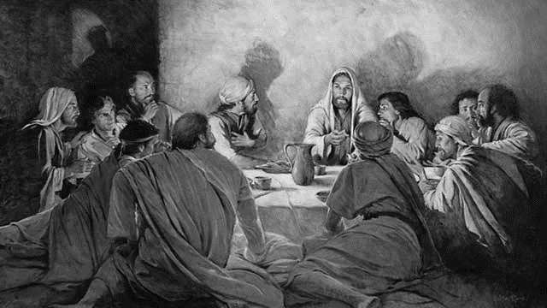
Jesus had his Last Supper with his friends on Holy Thursday
Name ________________________ Date ______
Find each word in the sentence below on the matrix and highlight it in the sentence and in the Word Find
F | J | E | S | U | S | O | A
R | H | A | D | L | U | N | E
I | Q | M | I | A | P | W | H
E | Z | H | I | S | P | K | I
N | W | E | S | T | E | V | S
D | I | P | L | Y | R | T | H
S | T | H | O | L | Y | G | U
T | H | U | R | S | D | A | Y
Jesus had his last supper with his friends on Holy Thursday
Worksheet
R-2
S-9
Click the up arrow to return to the presentation
Notes:
Slide 9 Jesus had his Last Supper with his friends on Holy Thursday WORKSHEET
This worksheet relates to slide 9
Find each word in the sentence on the matrix and highlight it in the sentence and in the Word Find.

