Slide 1
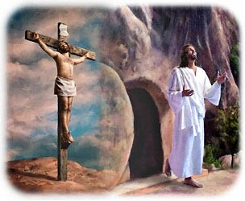
Jesus dies and Rises
R-3
S-01
Notes:
Slide 1 Jesus Dies and Rises
Use this slide as a focussing strategy to introduce the resource topic. Read the title together and invite children to share something they know about when Jesus died on the cross and rose again on Easter Sunday

Slide 2
Learning Intentions
The children will:
1)
recognise that in Holy Week Christians remember and celebrate the dying and the rising of Jesus
2)
retell the story of the dying and the rising of Jesus.
R-3
S-02
Click the boxes to reveal text.
Notes:
Slide 2 Learning Outcomes
Read through the Learning Intentions with the class and identify some ideas/questions that might be explored in the resource.
Adjust the prayer focus as Holy Week progresses. Include the Holy Week bible stories during prayer time and let the children dramatise them and sing the songs they know about them.
Give children some special ‘close to Jesus’ time of quiet. You may like to create a special quiet place for children to go to look at Holy Week books.
Look at the images on the slides and talk about each one with the children and explain what the Holy Week event they are about.
Explain that Easter Sunday is not really in Holy Week because it is the beginning of the Easter Season. Mention that sometimes Good Friday and Easter Sunday are holidays so children learn about them before they celebrate them. Encourage the children to share what they are learning about Holy Week with their family. You may like to provide them with a copy of the parish bulletin with the times of the Holy Week and Easter ceremonies they could attend.

Slide 3
Holy Week is a week to spend time with Jesus for people who are his friends
Look at the symbols for the days of Holy Week on the screen
What is the symbol for the first day? What is name of the day?
What are the symbols for the next day? What is its name?
What is the symbols for the 3rd day? What do we call this day?
What is the picture about in the last section? What day is this about?
X
Click the ‘i’ icon for information and the ‘x’ to close.
Use the yellow button to move the arrow around the images
R-3
S-03
Notes:
Slide 3 Holy Week is a week to spend time with Jesus for people who are his friends
Encourage children to look closely at the pictures and work through bullet points on the pop up using the yellow pointer button. Recap the stories that were covered in the previous resources.

Slide 4
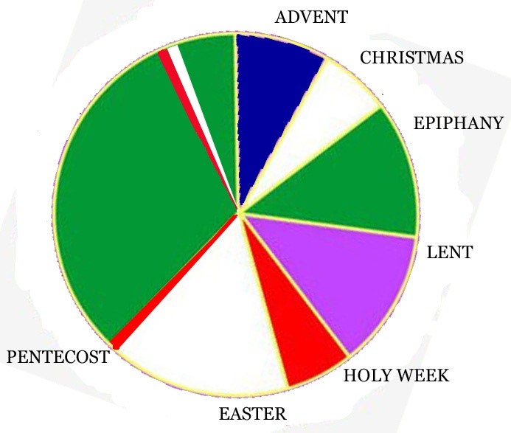
Getting to know the Calendar for the Feasts and Seasons of the Church’s Year
?
Point to Pentecost and Holy Week – what is in between?
Point to Easter – what comes before it?
Point to Advent – what comes before it?
Point to Christmas – what comes before it?
Point to Holy Week – what comes before it?
Point to Easter what comes after it?
Point to where we are this week on the calendar.
Ordinary Time is green – make a comment about it.
?
?
?
?
?
R-3
S-04
Click the yellow button to reveal arrows as you move through the questions.
Notes:
Slide 4 Getting to know the Calendar for the Feasts and Seasons of the Church’s Year
Adapt Teaching and Learning Experience 1. Revise what children learned about the Liturgical Calendar from Resource 1. Talk about why Holy Week is red. Use the yellow pointer to identify the feasts and seasons and name them on the bullet points. Revise why we call Holy Week ‘holy’ – because it is the week Jesus died for us and made it possible for us to go to heaven with him forever after we die.

Slide 5
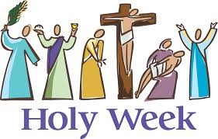
Naming the special days in Holy Week
In Holy Week we tell the stories about what happened to Jesus.
We talk to Jesus and tell him we love him and we are sorry that we are selfish sometimes.
We remember all the ways he was hurt by people especially when he died on the cross.
Point to each picture and name what is happening and the day it happened on.
We celebrate when Jesus rose from death to his new life and we sing Alleluia! Alleluia! Because Jesus died we can rise too, all because he loves us so much.
Click the yellow button to move through the Holy Week pictures
Click the crosses to reveal text..
R-3
S-05
Notes:
Slide 5 Naming the special days in Holy Week
Adapt Teaching and Learning Experience 5. Point to each picture and name it and the day it happened on. The person is waving a palm to welcome Jesus as he rides into
Jerusalem on a donkey. Jesus is blessing and sharing the bread and wine which is his body and blood at the Last Supper on Holy Thursday. Jesus has been arrested and taken by the soldiers to Pilate who hands him over to carry his cross on Good Friday morning. Jesus is put on the cross and he dies on Good Friday afternoon. Jesus is taken down from the cross and his mother Mary holds him. She is very sad. This was on the evening of Good Friday. Jesus rises to his new life on Easter Sunday morning. Easter is the beginning of the new season after Holy Week. It is a season of great joy and happiness because Jesus is alive and risen from the dead. Read what each cross reveals and talk about it. Why is the last cross yellow? Because Jesus overcame death and rose from the dead.

Slide 6
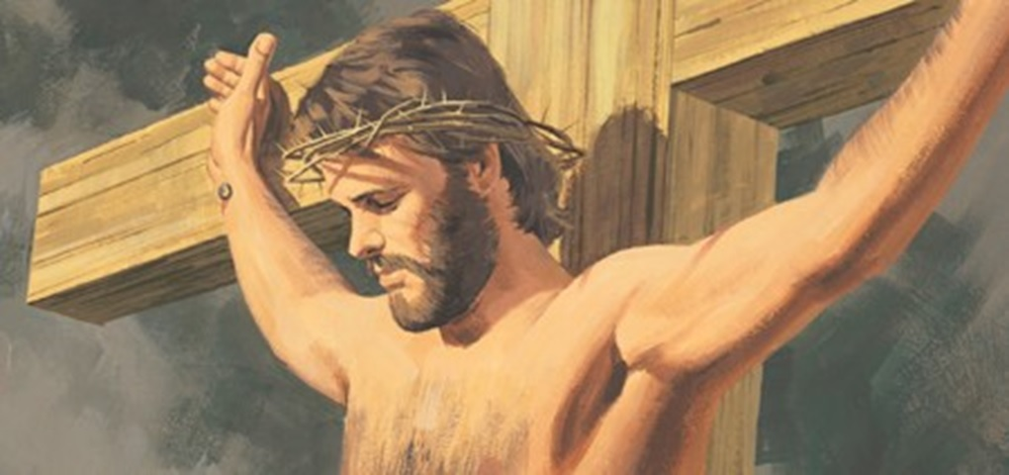
Jesus dies on the cross
The soldiers put a crown of thorns on Jesus’ head because he said he was a king. They put him on the cross.
Jesus had loved people all his life but giving up his life for them was the greatest way he showed his love for people including each of us.
Mary his mother and his friends stood nearby the cross. They saw Jesus close his eyes and die. They were very sad.
When it was almost dark they took his body down from the cross and Mary held Jesus in her arms. They washed him and laid him in a cave and placed a large rock at the entrance.
Click the green arrow to move the curtain down and reveal text. Click the red arrow to return the curtain to the top.
Click video icon to watch “The Easter Story”.
R-3
S-06
Notes:
Slide 6 Jesus dies on the cross
Adapt Teaching and Learning Experience 2, 3 & 4.
Use the arrow to reveal text and read each one slowly.
https://www.youtube.com/watch?v=SW1tZ3Iyu20
Animated The Easter Story.mp4
4:13 minutes
Jesus’ death and resurrection
This clip is in 4 parts so you may like to stop it while showing it to the children and talk about it.
It starts with a quick recap of Jesus’ life which is useful for Yr. 1 children.
Allow time for children to make comments or ask questions.
FYI if needed: An explanation about the splitting of the curtain or veil in the Holy of Holies in the Temple. This curtain was a barrier between God and ordinary people which restricted access to each other. At the moment Jesus died this barrier was removed making open access for all people to the Holy of Holies. It meant people no longer needed others to intercede for them. The curtain, which was 4 inches thick, was torn from the top to the bottom showing it was torn by God not by people. It symbolised that Jesus had made full atonement to God for the sin of the world.

Slide 7
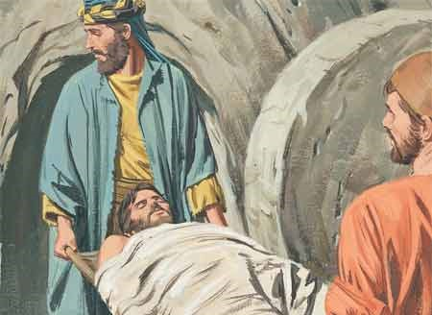
What happened after Jesus was buried?
The friends of Jesus washed his body and wrapped it in linen cloths with spices and laid it in the tomb and put a large stone in the entrance.
Mary didn’t recognise Jesus because he looked different now he has risen. She thought he was the gardener but as soon as he spoke her name “Mary” she knew it was him. (Watch out for a surprise on the next slide!)
She was crying but soon everything was about to change. She waited and then she turned around and there right before her was Jesus. He had risen and was standing right there. Jesus had come back to life.
The disciples ran to the tomb and it was empty. Jesus has risen as he had told them he would. Mary Magdalene stayed at the tomb.
Jesus lay in the tomb for 3 days until Sunday morning when Mary Magdalene, a friend of Jesus, came to the tomb and saw the stone has been rolled away.
She ran to tell Peter and the other disciples that the soldiers had taken Jesus’ body and she didn’t know where they had put him.
Mary ran to the disciples and told them she had seen Jesus and he was risen back to life. Later that day Jesus showed himself to the disciples and said, “Peace be with you”. They were all very happy to see Jesus again. All their sadness turned to joy.
R-3
S-07
Click the cards to move through (7 total). Click the arrow to restart.
Notes:
Slide 7 What happened after Jesus was buried?
Use the flip cards to help children understand the sequence of events that follow Jesus’ death, his burial leading to his resurrection. Remember there are 3 Easter resources to follow these ones.

Slide 8
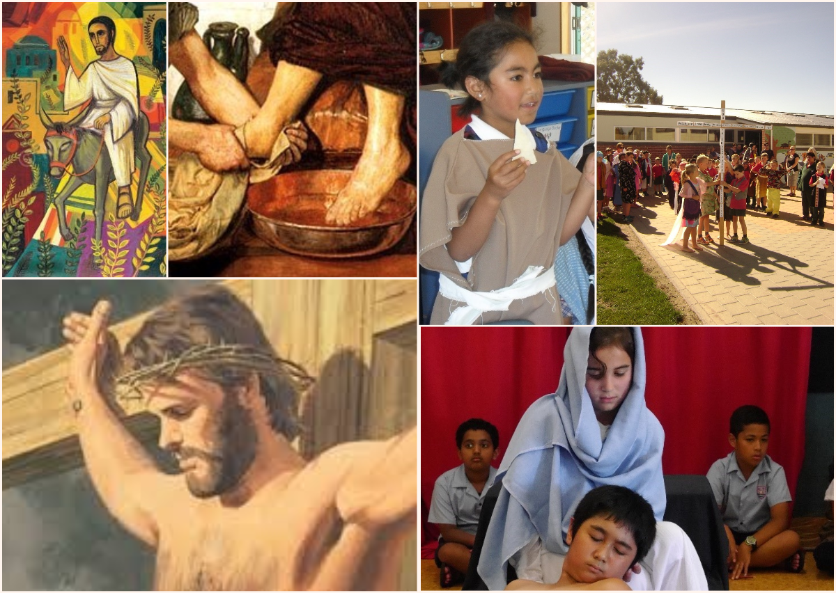
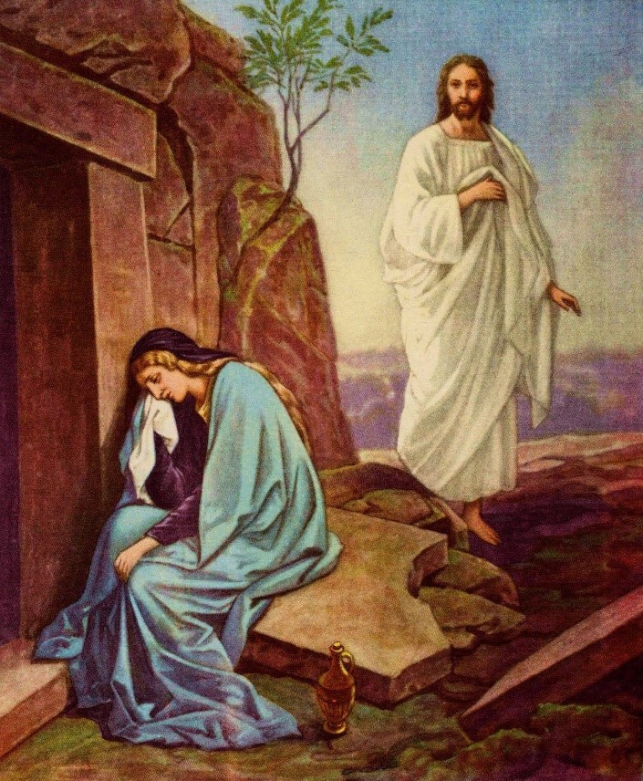
Look at the collage of the pictures of Holy Week and tell the stories in the right order
Can you say what happened next?
R-3
S-08
Click the question to reveal image.
Notes:
Slide 8 Look at the collage of the pictures of Holy Week and tell the stories in the right order
Children look at the pictures. They are in the order they happened. Children try to name each picture and say what is happening. Then focus on the question and name it and say what it is about. Point out this picture shows that Jesus was in the tomb for 3 days and then he rose from the dead. He is the only person who has ever risen from the dead.

Slide 9
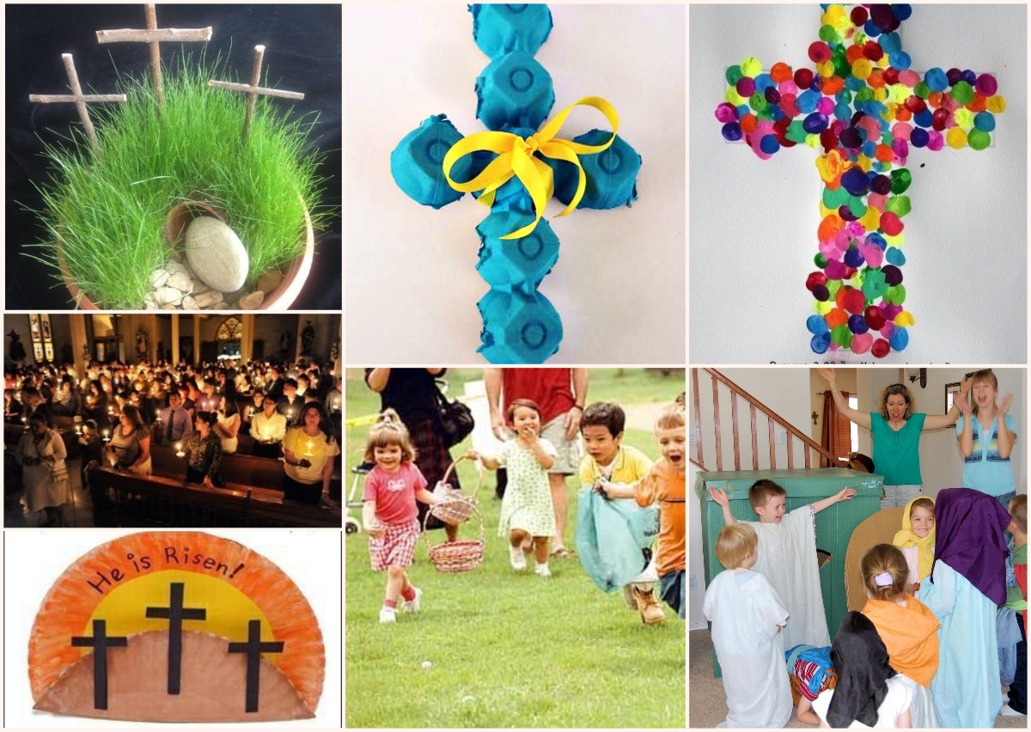
Look at the ways the people are celebrating Easter
Choose what you would like to do to celebrate Easter and tell your class about it.
R-3
S-09
Notes:
Slide 9 Look at the ways the people are celebrating Easter
You could talk about the Easter celebration images, name then and use them as a link to the 3 Easter resources. Explain to the children the decorated cross shows us that Jesus changed the sadness of the cross into joy when he rose from death.
Images top line – Easter garden, Egg carton cross, Cross of joy. Easter vigil liturgy, Paper plate construction – Jesus has overcome the cross, Easter egg hunt, dramatising the Easter story. Children read the captions and share how they would like to celebrate Easter.

Slide 10
Check up
1)
What days of Holy Week can you name? (Slides 3, 5 & 8)
2)
Tell the story of what happened to Jesus on Good Friday. (Slide 6)
3)
Carry on the Jesus story from after he died until he rose from the dead. (Slide 7)
4)
Why do the followers of Jesus feel sad on Good Friday and happy on Easter Sunday?( Slides 8&9)
5)
Which activity do you think helped you to learn best in this resource?
6)
Questions I would like to ask about the topics in this resource are …
R-3
S-10
Click the boxes to reveal text.
Notes:
Slide 10 Check Up
This formative assessment strategy will help teachers to identify how well the children have achieved the Learning Intentions of the resource.
Teachers can choose how they use the slide in their range of assessment options.
A worksheet of this slide is available for children in Years 5-8 to complete.
The last two items are feed forward for the teacher.
Recording the children’s responses to these items is recommended as it will enable teachers to adjust their learning strategies for future resources and target the areas that need further attention.

Slide 11
Time for Reflection
R-3
S-11
Click the audio button to stop reflective music
Click the audio button to play reflective music
Notes:
Slide 11 Time for Reflection
The MP3 is played to help create a reflective atmosphere and bring the children to stillness and silence as the teacher invites them to bring into their mind the love Jesus has for each of them and how he will never stop loving them. Thank him for loving them so much he died to give us a new life with him.

Slide 12
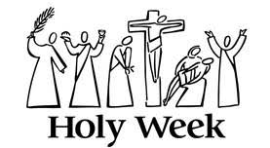
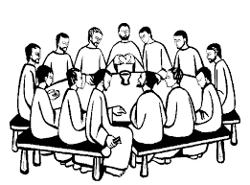
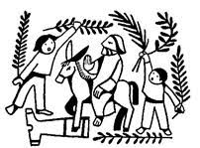
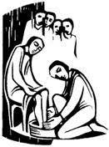
Sharing our Learning about HOLY WEEK with family whānau
Make up your own way of showing and sharing what you have learned and decide who you would like to share it with.
Have a conversation with someone at home who knows about Holy Week and plan to have a Last Supper meal together and talk about Jesus’ Last Supper with his disciples.
Make up a play about the Last Supper and act it out for people at home. You could use the bible stories to help you with the play. Set the table and prepare what you will need for the play and what actions and words will be used. Remember to include Jesus’ message about caring for others.
Talk about how your family welcomes people to your home. Share the story about how Jesus was welcomed into Jerusalem on Palm Sunday. Recall some different ways people welcome others.
Look at the image and use it to help you explain what happened on each day of Holy Week. Share it with your family whānau. Ask them to tell you what they know about the Holy Week stories.
Sharing
Our
Learning
R-3
S-12
Click the “Sharing our Learning” button to start slide. Click clouds to move through (5 total)
Notes:
Slide 12 Sharing our Learning about HOLY WEEK with family whānau
This slide provides some choices for children to show and share what they have learned. Examples could be photographed as evidence of children’s learning.
You may like to put a copy of the Sharing our Learning page in children’s RE Learning Journals. You could talk through the choices using the slide and let children make their choice from their own copy.
Children could work on their choice at school and/or at home and you may like to set a day for sharing. Please let parents and whānau know what you expect them to do with this.
The slide is focussed on Achievement Objective for Year 1 Holy Week which is covered in Resources 1, 2, 3.
Level 1 Year1 AO) Children will be able to: recognise the Holy Week stories.

Slide 13
Sharing our Learning about HOLY WEEK with family whānau
Name ________________________ Date ______
Look at the image and use it to help you explain what happened on each day of Holy Week. Share it with your family whānau. Ask them to tell you what they know about the Holy Week stories.
Talk about how your family welcomes people to your home. Share the story about how Jesus was welcomed into Jerusalem on Palm Sunday. Recall some different ways people welcome others.
Make up a play about the Last Supper and act it out for people at home. You could use the bible stories to help you with the play. Set the table and prepare what you will need for the play and what actions and words will be used. Remember to include Jesus’ message about caring for others.
Have a conversation with someone at home who knows about Holy Week and plan to have a Last Supper meal together and talk about Jesus’ Last Supper with his disciples.
Make up your own way of showing and sharing what you have learned and decide who you would like to share it with.
Worksheet
R-1
S-12
Click the up arrow to return to the presentation
Notes:
Slide 12 Sharing our Learning about HOLY WEEK with family whānau WORKSHEET
This slide provides some choices for children to show and share what they have learned. Examples could be photographed as evidence of children’s learning.
You may like to put a copy of the Sharing our Learning page in children’s RE Learning Journals. You could talk through the choices using the slide and let children make their choice from their own copy.
Children could work on their choice at school and/or at home and you may like to set a day for sharing. Please let parents and whānau know what you expect them to do with this.
The slide is focussed on Achievement Objective for Year 1 Holy Week which is covered in Resources 1, 2, 3.
Level 1 Year1 AO) Children will be able to: recognise the Holy Week stories.

