Slide 1
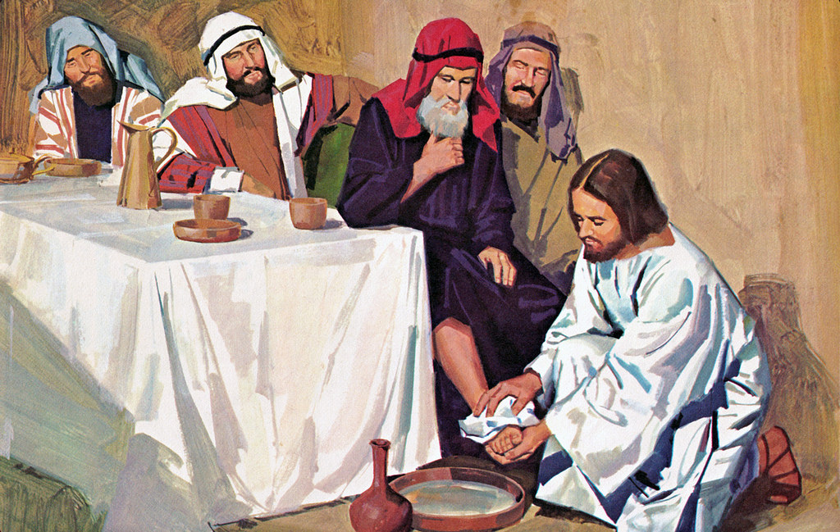
The Washing of the Feet
R-2
S-01
Notes:
Slide 1 The Washing of the Feet
Use this slide as a focussing strategy to introduce the resource topic. Read the title together and invite children to share something they know about when Jesus washed the disciples’ feet just before the Last Supper. Give children an experience of washing each other’s feet or hands – ask them to say how it feels to have someone do this for them.
Give children some special ‘close to Jesus’ time of quiet.
Look at the images on the slides and talk about them with the children.
Explain that Easter Sunday is not really in Holy Week because it is the beginning of the Easter Season. Mention that Good Friday and Easter Sunday are holidays so they learn about them before they celebrate them. Encourage the children to share what they are learning about Holy Week with their family. You may like to provide them with a copy of the parish bulletin with the times of the Easter ceremonies they
could attend.

Slide 2
Learning Intentions
The children will:
1)
identify Holy Thursday as the day Jesus washed the feet of his friends
2)
recognise the washing of the feet by Jesus shows us that people must help and manaaki care for others.
R-2
S-02
Click the borders to reveal text
Notes:
Slide 2 Learning Intentions Read through the Learning Intentions with the class and identify some ideas/questions that might be explored in the resource.

Slide 3
Our Journey through Holy Week continues
What do we know about Holy Week?
R-2
S-03
Click in the white box and write your text
Notes:
Slide 3 Our Journey through Holy Week continues
Invite children to share what they know about Holy Week and type their ideas in the white space. To help children with the order of the events ask them to name what they think happened next. Read back what is written.

Slide 4
Remembering the Palm Sunday story
The main character in the Palm Sunday story is
Peter Mary Jesus
The people welcomed Jesus by waving
Flags Palms Hats
Jesus was riding a
Motor Bike Skateboard Donkey
Jesus was on his way to
Wellington Jerusalem London
The people shouted, “Welcome to our King”
Hooray! Hosanna! Hosanna! Jesus is the best!
R-2
S-04
Click each palm to highlight correct answer.
Notes:
Slide 4 Remembering the Palm Sunday story
ANSWERS Jesus, palms, donkey, Jerusalem, Hosanna, Hosanna
Print a copy of the worksheet for each child to complete and add to their RE Learning Journal.

Slide 5
On Holy Thursday Jesus washed the Disciples’ feet
R-2
S-05
Click the video button to play “The Last Supper”
Notes:
Slide 5 On Holy Thursday Jesus washed the Disciples’ feet.
Watch the clip
https://www.youtube.com/watch?v=vScHI_fxJGM
The Last Supper (3:49 MINUTES) – pause clip at 2:00 minutes after the washing of the feet.
Explain Jesus washed the disciples’ feet just before the Last Supper. While the clip is paused give children time to share something they learned from the clip and any questions they have about it. Adapt Teaching and Learning Experience 3
Invite children to name what happened next in the Holy Week story and continue the clip.

Slide 6
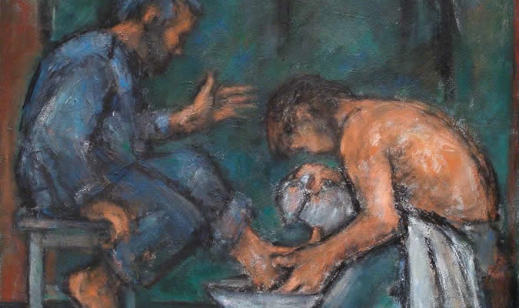
Jesus taught the disciples a special lesson when he washed their feet
When Jesus rode into Jerusalem he knew
he was going to die there.
2. On the Thursday before Good Friday Jesus called his
friends to eat their last supper together.
3. Before they sat down to eat Jesus washed the feet of
the disciples to teach them how to care and help people.
4. He taught them a very important lesson
to love one another as he had loved them.
5. Then they all sat down to eat the most important meal
they would ever eat and we still eat it today at Mass.
a) they would ever eat and we still eat it today at Mass.
b) friends to eat their last supper together.
c) to love one another as he had loved them.
d) he was going to die there.
e) the disciples to teach them how to care and help people.
R-2
S-06
Click a sentence ending from the white box to correctly position it.
Notes:
Slide 6 Jesus taught the disciples a special lesson when he washed their feet
Show the children where the story of the washing of the feet is in the bible. Read the story. Ask them to imagine they were looking in the window watching Jesus washing the feet of his friends – what would they be wondering about? What was the special lesson Jesus was teaching the disciples and all the people who follow him today?

Slide 7
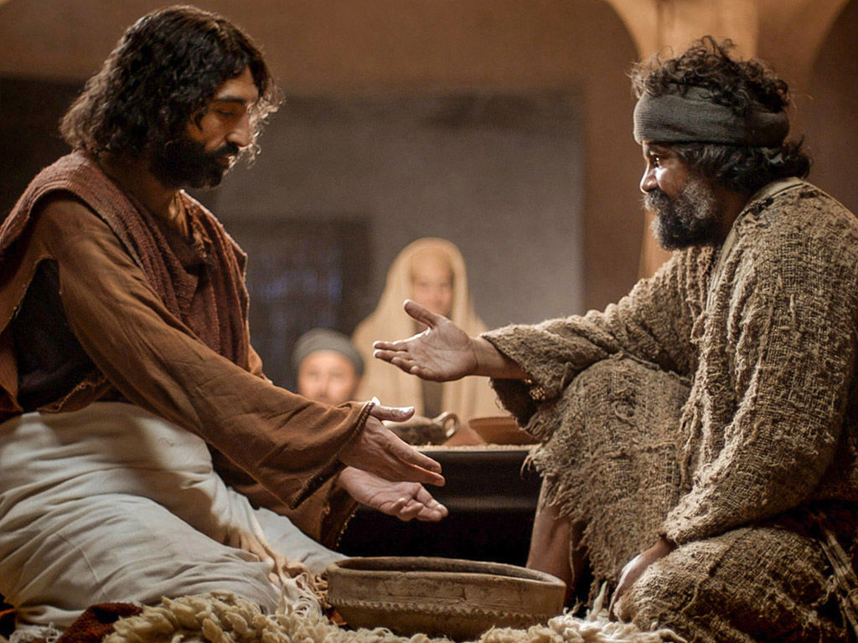
Why feet washing was important
Jesus wanted to be an example of a servant for the disciples so that they would understand that they must be
servants to others.
Jesus was trying to teach the disciples a very important lesson – helping and manaaki caring for others is what his followers must do.
Jesus told the disciples that they must be like him and be willing to do anything for others including unpleasant tasks like washing their
dirty feet.
Jesus moved around his followers and washed the feet of each disciple. When he came to Peter, he told Jesus he did not want him to wash his feet. But Jesus told him unless he washed his feet, Peter could not be his follower. Look at the image
and see this.
Washing feet was the job of the lowest of the servants not the person giving the meal. This is the reason why the disciples thought it was strange that Jesus would
wash their feet.
If they were going to eat they would also wash their hands
– just as we do.
It was the custom when guests came indoors,
their feet would need to be washed because they would be dirty and smelly after their travels.
People had to wash their feet because the country Jesus and the disciples lived in was hot, dry and the roads were very dusty.
R-2
S-07
Click top card to discard it
Notes:
Slide 7 Why feet washing was important Read the flip cards and use them to generate questions and comments from the children. Question: Would people wash people’s feet today after a journey? Why? Why not? How does your family care for others after they have travelled a long journey?

Slide 8
On the first Holy Thursday Jesus taught all his followers that
washing people’s feet is a sign of serving them
Serving someone helps them to feel more comfortable. Pope Francis washed the feet of people who were in prison as a sign that he loves and cares for them.
During Holy Week children in families wash the feet of their parents to show they love and care for them.
At Mass on Holy Thursday the priest washes the feet of people in the parish to show he loves and cares for them.
In Holy Week children wash the feet of others in their class to show they are doing what Jesus taught them to do.
Can you do the same in your class?
R-2
S-08
Click on each picture to reveal text.
Click the audio button to stop ‘Adagio for strings’
Click the audio button to play ‘Adagio for strings’
Notes:
Slide 8 On the first Holy Thursday Jesus taught all his followers that washing people’s feet is a sign of serving them
Adapt Teaching and Learning Experience 4.
Make this a quiet reflective time when children focus on what is happening and connect it with what Jesus did with his disciples. Take time to listen to children’s reactions to what it felt like.
Play reflective music during the washing of the feet.
MP3 Adagio for strings 6:59 minutes

Slide 9
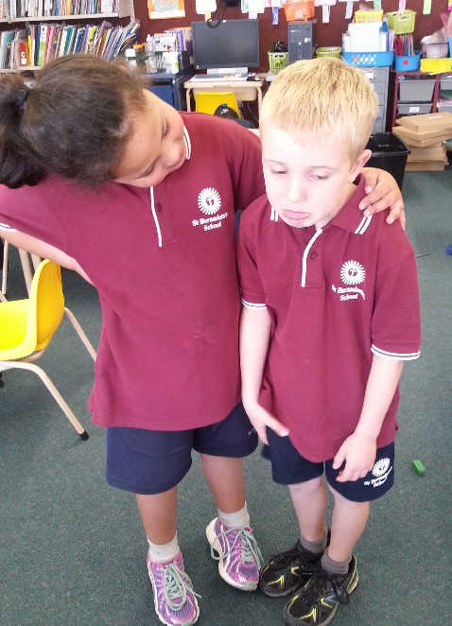
Other ways children of our age can show love
and care for others as Jesus wants us to
6 Ways we can show love aroha and care manaaki for others
Jesus wants me to show love and care for others by … | Jesus wants me to show love and care for others by … | Jesus wants me to show love and care for others by …
Jesus wants me to show love and care for others by … | Jesus wants me to show love and care for others by … | Jesus wants me to show love and care for others by …
R-2
S-09
Click the worksheet button to go to worksheet.
Notes:
Slide 9 Other ways children of our age can show love and care for others as Jesus wants us to
Print a copy of the worksheet for each child to complete and add to their RE Learning Journal. Children can complete the sentence in each box and draw a small illustration to match. They can include the example of washing the feet of someone.
Adapt Teaching and Learning Experiences 5 &6

Slide 10
Check Up
1)
What is the name of this special week and why is it special?
2)
Name the day Jesus washed the feet of his friends.
3)
What was Jesus teaching the disciples when he washed their feet?
4)
What happened after Jesus had washed the disciples’ feet?
5)
Which activity do you think helped you to learn best in this resource?
6)
Questions I would like to ask about the topics in this resource are …
R-2
S-10
Click the borders to reveal text
Notes:
Slide 10 Check Up
This formative assessment strategy will help teachers to identify how well children have achieved the Learning Intentions of the resource.
Teachers can choose how they use the slide in their range
of assessment options.
A worksheet of this slide is available for children in Years 5-8 to complete.
The last two items are feed forward for the teacher.
Recording the children’s responses to these items is recommended as it will enable teachers to adjust their learning strategies for future resources and target the areas that need further attention.

Slide 11
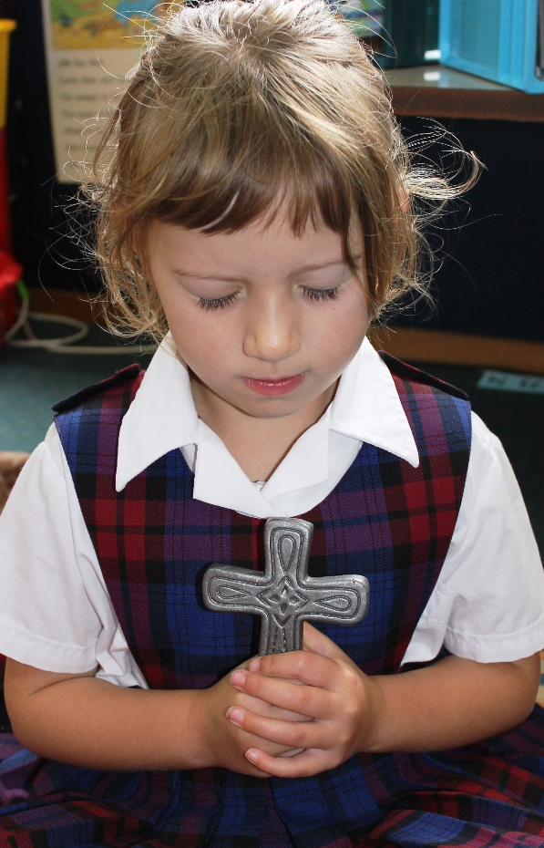
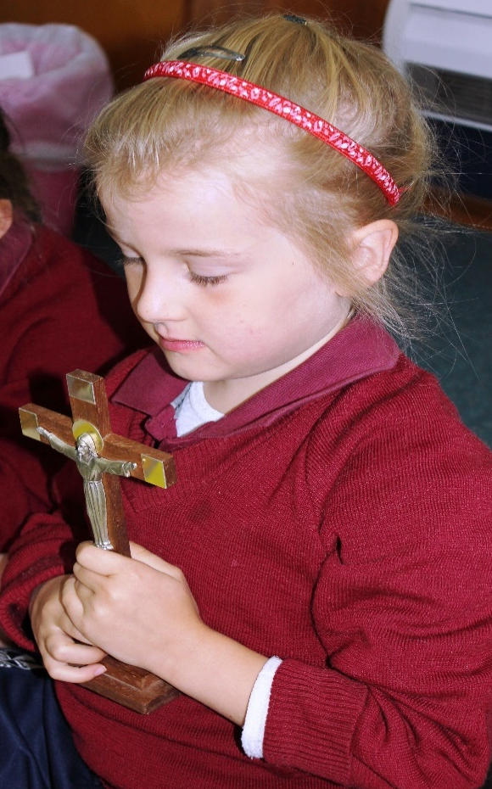
Time for Reflection
R-1
S-12
Click the audio button to stop reflective music
Click the audio button to play reflective music
Notes:
Slide 11 Time for Reflection
The MP3 is played to help create a reflective atmosphere and bring the children to stillness and silence as the teacher invites them to plan a way they can love and care for someone they know who needs some love and kindness today.

Slide 12
Remembering the Palm Sunday story
Highlight the correct answer from the options
The main character in the Palm Sunday story is
Name___________ Date_________
Peter Mary Jesus
The people welcomed Jesus by waving
Flags Palms Hats
Jesus was riding a
Motor Bike Skateboard Donkey
Jesus was on his way to
Wellington Jerusalem London
The people shouted, “Welcome to our King”
Hooray! Hosanna! Hosanna! Jesus is the best!
R-2
S-04
Worksheet
Click the up arrow to return to the lesson

Slide 13
6 Ways we can show love aroha and care manaaki for others
Name____________________ Date_____________
Jesus wants me to show love and care for others by … | Jesus wants me to show love and care for others by … | Jesus wants me to show love and care for others by …
Jesus wants me to show love and care for others by … | Jesus wants me to show love and care for others by … | Jesus wants me to show love and care for others by …
R-2
S-09
Worksheet
Click the up arrow to return to the lesson

