Slide 1
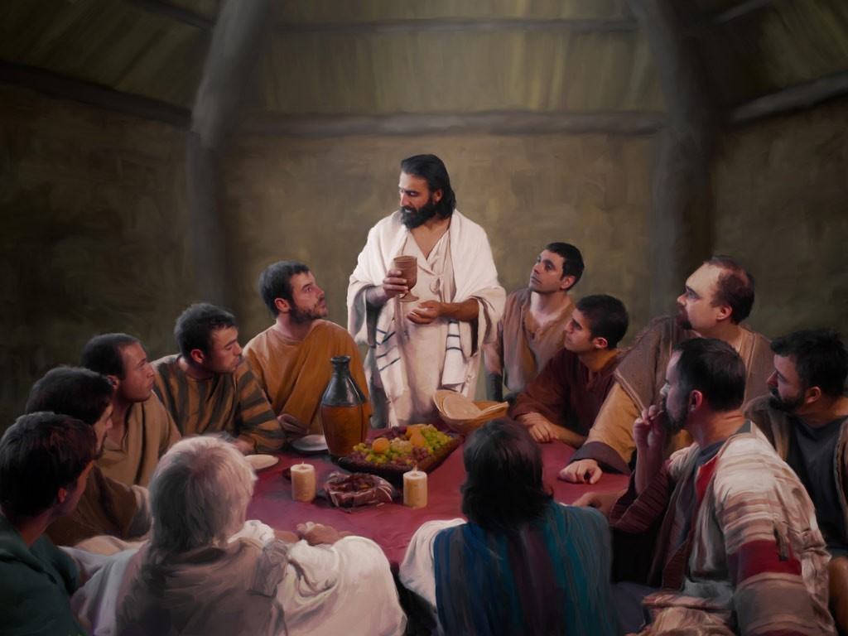
The Last Supper
R-2
S-01
Notes:
Slide 1 The Last Supper
Use this slide as a focussing strategy to introduce the resource topic. Read the title together and invite children to share something they know about what happened at the Last Supper.

Slide 2
Learning Intentions
The children will:
demonstrate an understanding of Jesus’ Last Supper as an event in Holy Week
1)
recall some of the symbols and rituals which remind us of his action of washing feet at the Last Supper.
2)
R-2
S-02
Click the box to reveal the Learning Intention
Notes:
Slide 2 Learning Intentions
On Tuesday move the Palm Sunday images and symbols to the side of the prayer focus. Add some Holy Thursday and Good Friday symbols and images as Holy Week progresses. Include the Holy Week bible stories about these days during prayer time and let the children dramatise them and sing the songs they know about them.
Give children some special ‘close to Jesus’ time of quiet. You may like to create a special quiet place for children to go to look at Holy Week books.
Look at the images on the slides and talk about each one with the children and what Holy Week event they are about.
Explain that Easter Sunday is not really in Holy Week because it is the beginning of the Easter Season. Mention that Good Friday and Easter Sunday are holidays so they learn about them before they celebrate them. Encourage the children to share what they are learning about Holy Week with their family. You may like to provide them with a copy of the parish bulletin with the times of the Easter ceremonies they could attend.

Slide 3
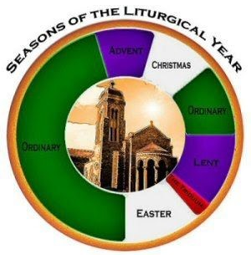
Where Holy Week fits in the Liturgical Year
What is the first day of Holy Week?
Palm Sunday is the first day of Holy Week.
What season comes before Holy Week?
Lent
What season comes after Holy Week?
Easter
Can you name 3 special days in Holy Week?
Palm Sunday, Holy Thursday, Good Friday
Why is Holy Week called ‘Holy’ Week?
Because Jesus died on the cross to save all people.
R-2
S-03
Click the icons to make the answer appear.
Notes:
Slide 3 Where Holy Week fits in the Liturgical Year
Adapt Teaching and Learning Experience 1.
Work through each item on the screen – children answer each question and check it by clicking on the icon to reveal the answer.
Children can colour Holy Week on their worksheet Liturgical Calendar from Resource 1 and refer to it while they are thinking about this slide.

Slide 4
Can you explain the symbols of Holy Week and
say what day they go with?
Can you think of some other symbols that could also be used for each day in Holy Week?
R-2
S-04
Click the box to write text in
Notes:
Slide 4 Can you explain the symbols of Holy Week and say what day they go with?
Look closely at the symbols of Holy Week and share ideas about name of symbol, day and story it relates too and what it symbolises. Teacher types children’s responses on to white space.
Adapt Teaching and Learning Experience 4.

Slide 5
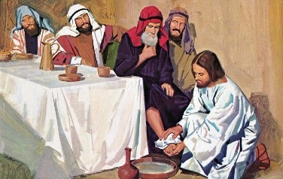
The first important thing Jesus did at the Last Supper
Jesus knew now that he would be handed over to the high priests to be put to death. He made arrangements to have a last meal with his friends.
Before the meal was served Jesus washed his friends’ feet. This was a ritual in the time and place where Jesus lived as the roads were very dry and dusty. Usually it was a servant’s job.
Jesus washed their feet to show the disciples that they must be the servants of all. They needed to be willing to do things for others.
This message that Jesus gave his first followers is also a message for all the followers who came after them – including us. We have to be prepared to be ‘servants’ whenever we can, because that’s what Jesus wants.
In Jesus’ day washing someone’s feet was a way to welcome people to your home. It was a ritual that helped people to feel more comfortable and relaxed when they arrived. What welcome rituals do you have to welcome people to your home?
Click the video button to play ‘Jesus washing feet’
R-2
S-05
Click the down-button to move the blind down,
click the up-button (appears at bottom) to move the blind to the top.
Notes:
Slide 5 The first important thing Jesus did at the Last Supper
Read and discuss the text as it is revealed. Share ideas about ways of welcoming people to your home, your classroom and your school. Talk about special ways Māori people and people from other countries welcome people to their place.
Watch the clip https://www.youtube.com/watch?v=yjogHX4TwQg
Jesus washing feet (4:37 MINUTES)

Slide 6
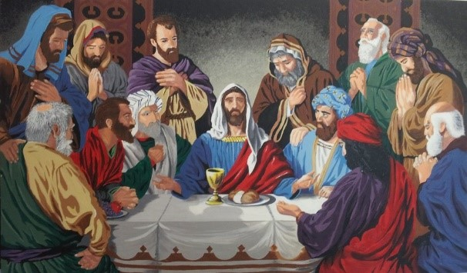
The second important thing Jesus did at the Last Supper
At the meal Jesus took some bread, broke it, blessed it and said, “Take, eat, this is my body.”
This was the way Jesus gave himself to his followers for all time. At every Mass Jesus’ followers do just as he told them to do at the Last Supper. The Last Supper was the first Mass.
Then he took some wine, gave thanks and gave the cup to them saying, “Drink from it all of you, this is my blood.”
Bread and wine were the symbols Jesus blessed and they became his body and blood. At Mass the priest blesses the bread and wine and we believe they become the body and blood of Jesus for us to eat and drink.
Click the video button to play ‘JESUS The Last Supper’
Click the audio button to play ‘The Night Before our Saviour died’
R-2
S-06
Click the audio button to stop ‘The Night Before our Saviour died’
Click the pins on the right to reveal post-it notes.
Notes:
Slide 6 The second important thing Jesus did at the Last Supper Recall the first important thing Jesus did before the Last Supper.
Ask children what was the next important thing Jesus did during the meal? Read the PINs and talk about what each one is saying. Emphasise the following: how Jesus gave himself to his followers, when and where do we see what Jesus did, explain that the Last Supper was the first Mass and what the symbols of bread and wine became. When people receive the bread and wine we believe they are receiving Jesus’ body and blood because of what he did at the Last Supper. It is holy food to help them to grow in love and kindness and become like Jesus.
Sing ‘The Night before Our Saviour died’
Watch the clip https://www.youtube.com/watch?v=r5NoANNe2DI
JESUS The Last Supper (2:55 minutes)

Slide 7
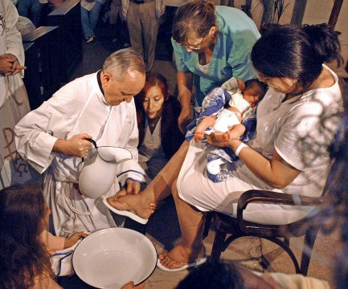
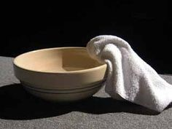
The rituals that Jesus shared at the Last Supper we repeat at Mass on Holy Thursday – the washing of the feet
The priest uses the water, the bowl and towel just as Jesus did to wash the feet of the people in his parish.
The priest is the servant of his people. He is willing to serve his people. He carries out the same ritual with the same symbols as Jesus did.
R-2
S-07
Click the icons to reveal statements
Notes:
Slide 7 The rituals that Jesus shared at the Last Supper we repeat at Mass on Holy Thursday – the washing of the feet.
Look closely at the image, read the captions then talk about what is happening. Explain that during the Mass in parishes on Holy Thursday evening the priest does just what Jesus did with his disciples in Jerusalem about 2000 years ago. The priest washes some people’s feet to show his work is to serve them. Then he blesses the bread and wine and it becomes the body and blood of Jesus that is given to the people to help them grow more like Jesus in love and kindness. We call these words and actions sacred rituals and they are repeated at every Mass all over the world. This is also called the Sacrament of the Eucharist that children of about your age will soon be preparing to share in on your First Communion day.

Slide 8
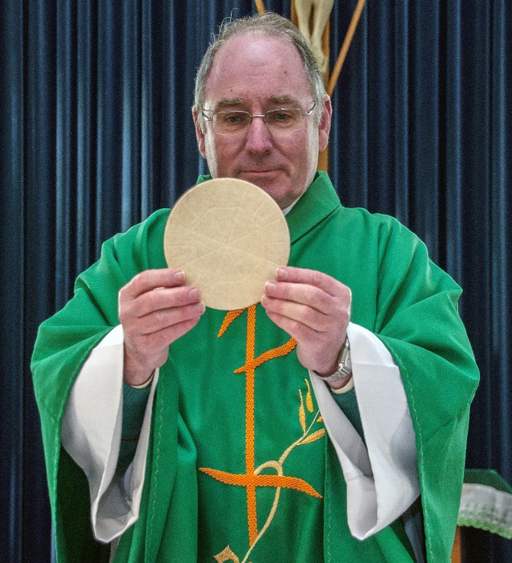
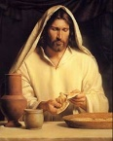
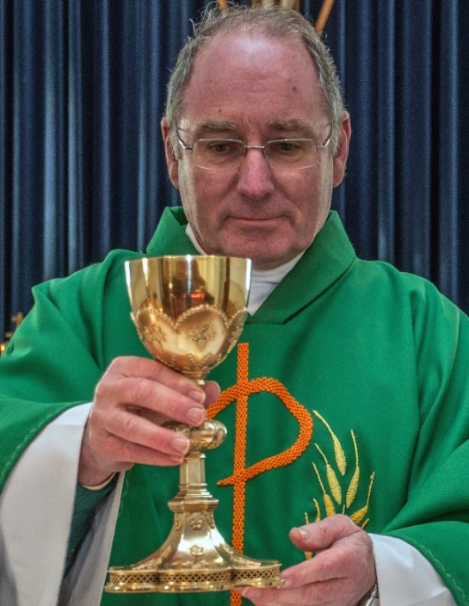
The rituals that Jesus shared at the Last Supper we repeat at Mass – the sharing of Jesus’ body and blood
Jesus is there with us because we are his followers now. He is with us in the bread and wine which have become his body and blood. This is how he helps us and makes us able to live like he did.
The priest repeats at Mass what Jesus did at the Last Supper. He uses the words that Jesus used to change the bread into his body and the wine into his blood.
We believe the wine become Jesus’ blood and when we drink it we become more like him. The Last Supper was the first Mass.
Then the priest takes the chalice or cup of wine, he gives thanks to God and says to the people, “Drink from it, all of you, for this is my blood.” and the people drink it.
We call this, receiving Holy Communion. We believe the bread becomes Jesus’ body and when we eat it we grow to be more like him.
At every Mass the priest takes the place of Jesus. He carries out the same ritual that Jesus did at the table at the Last Supper. He takes the bread, blesses it and says, “Take, eat, this is my body.” just as Jesus did, and shares it with the people.
Card 1
R-2
S-08
Click top card to discard it
Notes:
Slide 8 The rituals that Jesus shared at the Last Supper we repeat at Mass – the sharing of Jesus’ body and blood
Read the flip cards and consolidate children’s understanding of what happened at the Last Supper is repeated millions of times because that is what Jesus asked his followers to do. We are his followers who remember him today and gather at the Eucharist today to give thanks to him for giving us his body and blood so that we can grow strong and can share in his work on earth of helping others and telling people about how much God loves us.

Slide 9
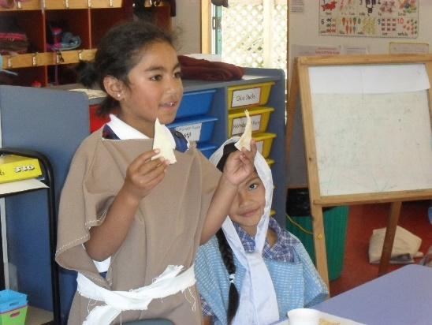
In Holy Week we act out the stories to help us understand what happened in this very special week in Jesus’ life
Before the disciples had their meal at the
Last Supper Jesus washed their feet.
Jesus wanted to show his friends how
to be servants to others.
Jesus changed the bread into his body and the
wine into his blood and gave it to the disciples.
The Last Supper was the first Mass
with the same rituals and symbols.
The priest takes the place of Jesus and he speaks
the words and does what Jesus did at the Last Supper.
A) with the same rituals and symbols.
B) to be servants to others.
C) the words and does what Jesus did at the Last Supper.
D) Last Supper Jesus washed their feet.
E) wine into his blood and gave it to the disciples.
R-2
S-09
Click a statement below to complete the sentence correctly
Notes:
Slide 9 In Holy Week we act out the stories to help us understand what happened in this very special week in Jesus’ life
Remind children that the Holy Week stories are very important to the followers of Jesus today. At Mass we re-enact them over and over so they are real to us and this helps us to understand how much Jesus loves us and wants us to close to him. Read the top statements and match them correctly with the ones below – click on them to check them with the floater. Talk about what they mean.
ANSWERS 1) D, 2) B, 3) E, 4) A) 5) C
Make a copy of ‘Symbols and Rituals of Holy Week’ for each child to complete and add to their RE Learning Journal.

Slide 10
Check up
1)
Make a comic strip and tell the story of what happened on Holy Thursday.
2)
Draw and write about 2 symbols and rituals that are part of the Holy Thursday events.
3)
Name two things that happened at the Last Supper that happen at Mass. Put arrows to show how they are alike.
4)
Make up 5 quiz questions about Holy Thursday and the Mass.
5)
Which activity do you think helped you to learn best in this resource?
6)
Questions I would like to ask about the topics in this resource are …
R-2
S-10
Click the worksheet button to go to the worksheet
Notes:
Slide 10 Check Up
This formative assessment strategy will help teachers to identify how well children have achieved the Learning Intentions of the resource.
Teachers can choose how they use the slide to assess each item.
A worksheet of this slide is available as an option for children to complete.
The last two items are feed forward for the teacher.
Recording the children’s responses to these items is recommended as it will enable teachers to adjust their learning strategies for future resources and target the areas that need further attention.

Slide 11
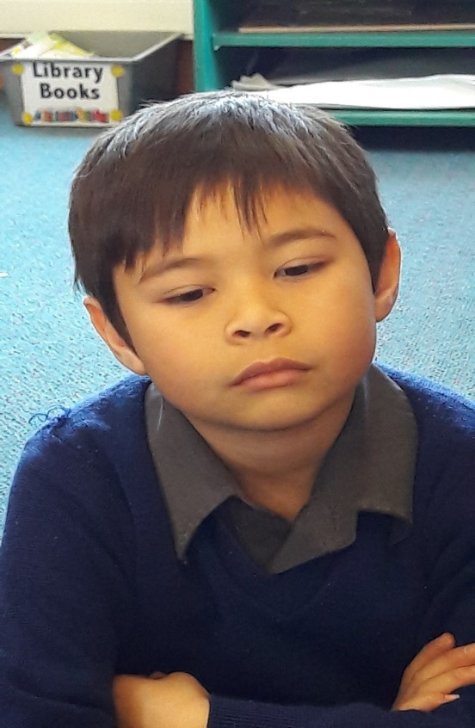
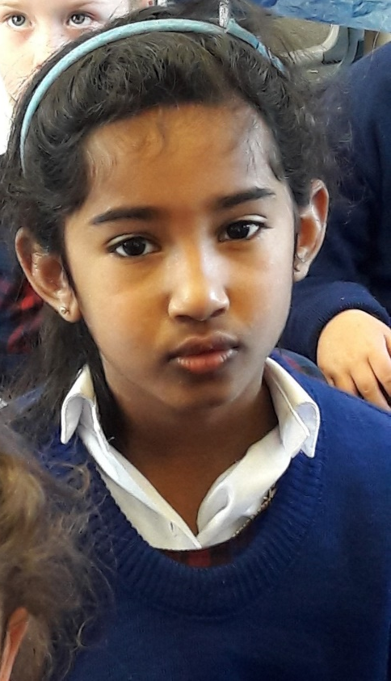
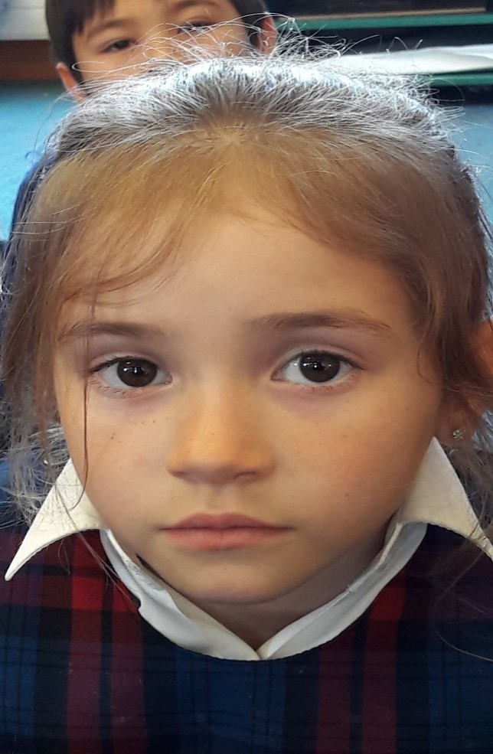
Time for Reflection
R-2
S-11
Click the audio button to stop reflective music
Click the audio button to play reflective music
Notes:
Slide 11 Time for Reflection
The MP3 is played to help create a reflective atmosphere and bring the children to stillness and silence as the teacher invites them to think about what Jesus did at the Last Supper to help the disciples remember him. Remind themselves about what the priest does at Mass with the bread and wine to help them remember Jesus. Ask Jesus to help you grow closer to him.

Slide 12
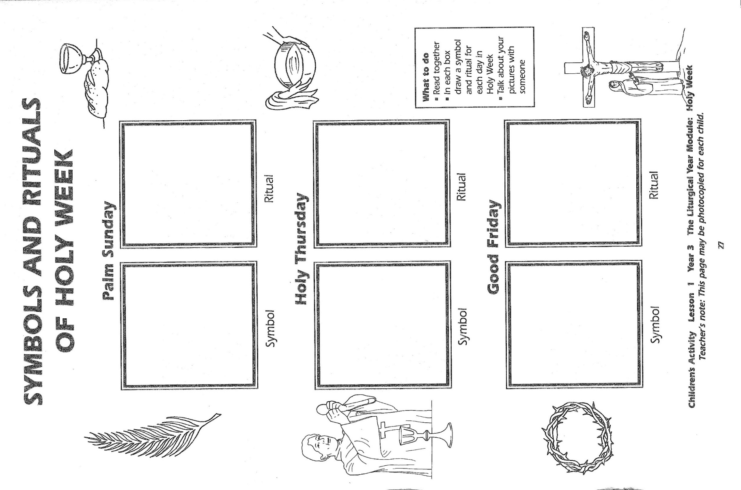
R-2
S-09
Worksheet
Click the up arrow to return to the presentation

Slide 13
Check up
Name:____________________________
Date:____________
1) Make a comic strip and tell the story of what happened on Holy Thursday.
2) Draw and write about 2 symbols and rituals that are part of the Holy Thursday events.
3) Name two things that happened at the Last Supper that happen at Mass. Put arrows to show how they are alike.
4) Make up 5 quiz questions about Holy Thursday and the Mass.
5) Which activity do you think helped you to learn best in this resource?
6) Questions I would like to ask about the topics in this resource are …
R-2
S-10
Worksheet
Click the up arrow to return to the presentation

