Slide 1
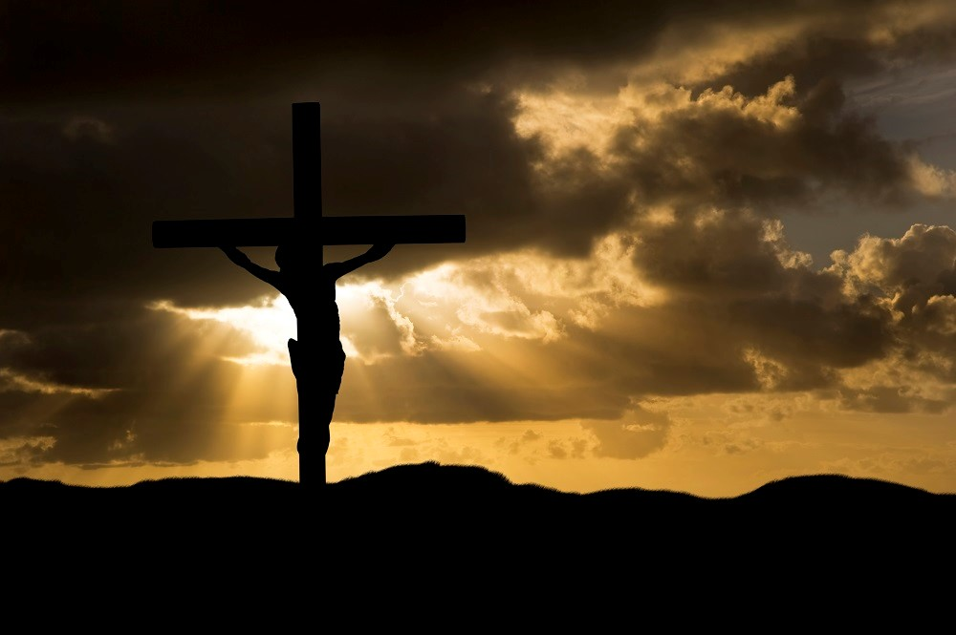
The Death of Jesus
R-3
S-01
Notes:
Slide 1 The Death of Jesus
Use this slide as a focussing strategy to introduce the resource topic. Read the title together and invite children to share something they know about what happened on Good Friday and what symbols are used to remind us of Jesus’ death in Holy Week.

Slide 2
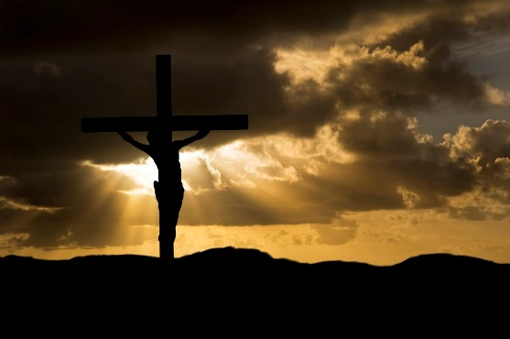
Learning Intentions
The children will:
1)
demonstrate an understanding of the death of Jesus as an event in Holy Week
2)
recall some of the rituals and symbols which we use in Holy Week to remind us of the death of Jesus.
R-3
S-02
Click the box to reveal the Learning Intentions
Notes:
Slide 2 Learning Intentions
As you move closer to Good Friday change the images and symbols on the prayer focus to create a sense of what is going to happen to Jesus on Good Friday. Use images from bible stories about Jesus’ betrayal and trial and the other events that happened after the Last Supper. Give children a time of quiet each day with some reflective music. Children need to recognise that Holy Week is different from all other weeks in the year.
Look at the images on the slides and talk about each one with the children.
Explain that Easter Sunday is not really in Holy Week because it is the beginning of the Easter Season. Mention that Good Friday and Easter Sunday are holidays, so they learn about them before they celebrate them. Encourage the children to share what they are learning about Holy Week with their family. You may like to provide them with a copy of the parish bulletin with the times of the Easter ceremonies they could attend. They will have their Sharing our Learning ideas to take home on Holy Thursday.

Slide 3
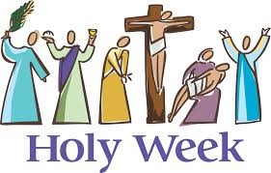
Remembering the events of the first Holy Week
Look closely at the people in the image.
Say what each one is doing
Say the name of the story and the day it took place in Holy Week.
R-3
S-03
Click the pictures to reveal
Notes:
Slide 3 Remembering the events of the first Holy Week
Follow the instructions on the slide. Then name all the days of Holy Week and have a quiet time to think about each day.
Remind the children that Easter is not in Holy Week – it is the start of the new week and the new season.

Slide 4
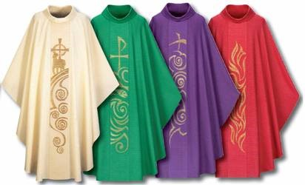
Do you know The Liturgical colours and seasons?
Each Liturgical season of the year has its own special
c_____
colour
The colours for celebration feasts and seasons are
white, gold or yellow
w___, g__ or y_____
green
The colour for ordinary time is
g____
p____ or v_____
The colour for Lent and Advent is
purple or violet
The colour for Holy Week and Pentecost is
r__
red
The priest wears vestments that are the Liturgical colours at
M___
Mass
R-3
S-04
Click the incomplete words to reveal answer
Notes:
Slide 4 Do you know The Liturgical colours and seasons?
Work through each item
Colour, white, gold, yellow, green, purple, violet, red, Mass.
Talk with children where they will see these colours in the church during the seasons of the Liturgical Year: the priest’s vestments, on the altar frontispiece and on the cloth on the lectern. Maybe on the banner, the flowers or the candles. Remind children to notice which colour the priest is wearing, and the colour of the altar frontispiece and what it tells them.

Slide 5
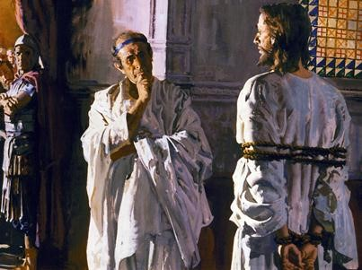
The story about what happened after the Last Supper
Many people told lies against him. The chief priests asked him questions and he did not answer. Then they said, “Are you the Messiah?” Jesus answered, “I am”.
The soldiers arrested Jesus immediately and led him away. He was taken before the chief priests. Peter watched from a distance as Jesus was accused and put on trial.
Judas went forward and kissed Jesus – this was the secret sign he would give to the soldiers so they would know which man was Jesus.
At around midnight Judas arrived with a group of soldiers with swords and clubs. Judas had betrayed Jesus and told the soldiers where Jesus was. The soldiers paid Judas 30 pieces of silver.
But they could not stay awake and all of them slept. Jesus came back and asked them again, “Could you not stay one hour with me?” This happened three times.
He took Peter, James and John further into the garden with him and he became very upset and needed his friends to support him. He said,
“I am very sad. Stay here and keep awake.”
They left the upper room and walked to a place called the Garden of Gethsemane and Jesus told the disciples to wait while he prayed.
The Last Supper finished about 9 o’clock when Jesus gave his final teaching to the disciples and they all sang a hymn together except for Judas who had left earlier.
R-3
S-05
Click top card to reveal others
Click the reset button to restart
Notes:
Slide 5 The story about what happened after the Last Supper
Use the flip cards to help the children understand what happened between the Last Supper and when Jesus died on the cross. You will notice not all incidents of the story are necessary for children at this age. (30 pieces of silver is about $600 now).

Slide 6
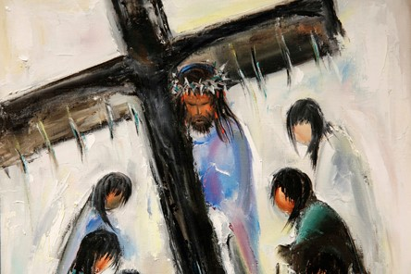
What happened on Good Friday
Early on Good Friday morning they brought Jesus before Pilate, the Roman governor, to judge Jesus. Pilate could find nothing that Jesus had done wrong.
The soldiers led Jesus away and put a crown of thorns on his head and a purple cloak around him and made fun of him saying, “Hail King of the Jews!”
But the people wanted Jesus to be crucified and they shouted, “Crucify him, crucify him!” Pilate did not want to go against the people’s wishes so he agreed Jesus should be crucified.
Then they gave Jesus his cross to carry up the hill of Calvary where he was to die.
Click the video button to play “Easter play ( crucifixion )”
R-3
S-06
Click the pins on the right to reveal post-it notes.
Notes:
Slide 6 What happened on Good Friday
Read the PINs and have a quiet time before watching the clip.
The clip is an animated version of the story for children of this age. An outline of what is covered is included below.
https://www.youtube.com/watch?v=JMVec-dUers
Animated Easter play (crucifixion)
4:02 minutes
Covers scenes about Jesus’ trial and condemnation.
Carrying of the cross
The death of Jesus
Jesus’ burial
Following the clip have a time of silence for children to reflect on the story and ask questions if they have some. You may like to take children to the church to walk around the Stations of the Cross and explain how they tell the Good Friday story for people to pray with especially in Holy Week.
Adapt Teaching and Learning Experience 6.

Slide 7
Walking with Jesus through Holy Week
R-3
S-07
Notes:
Slide 7 Walking with Jesus through Holy Week
Talk to the children about the importance of this week and especially Good Friday. Invite them to imagine that they are all going to keep Jesus company during this Holy Week as they learn about what happened to him. Remind them that they are his friends and he wants them to spend some time with him during this sad week – just like he wanted his first followers to.
In prayer this week use a red cloth and create a Holy Week Symbols display spread out on the cloth.
You can decide what symbols to include such as: palms, a purple cloth (the cloak that the soldiers put around Jesus), some nails, some pictures of various parts of the story (laminated), a cross, a crown, a small bowl and towel, 30 pieces of silver in a bag (old florins are good) some caption cards with text for the story e.g. “Crucify him. Crucify him!”; “Are you the Messiah?”; Jesus said, “I am.” or “Jesus of Nazareth. King of the Jews.”
A red cloth. A cup for a chalice and a piece of bread.
Spread the symbols out on a red cloth on the floor and have the children make a prayer circle around it. Let each child choose a symbol and retell the story starting with the palms. Include a simple prayer – Thank you Jesus for dying on the cross for us. I am sorry for the times I have been selfish and mean.
Holy Week is a very good week for saying sorry prayers to Jesus. Remind children to take time to talk to Jesus this week and be close to him. Recap what happened after the Last Supper when Jesus needed his friends to be close to him. Leave the symbols out for children to handle and reflect quietly in a special quiet place in the room.
Adapt Teaching and Learning Experience 4.

Slide 8
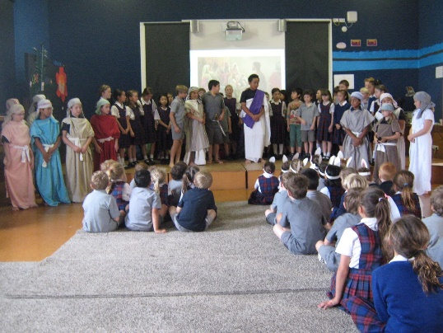
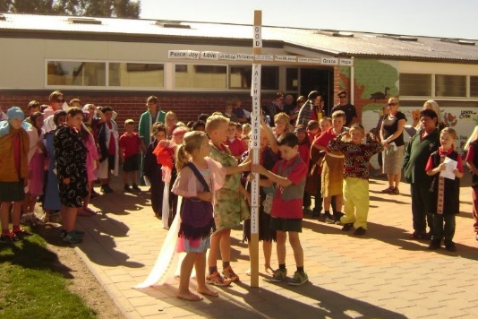
How we celebrate the events of Good Friday at school
This is a very sad part of the story.
Look at the children’s faces.
Can you say what part of the story this picture is about?
Do you know what happens next?
The children act out the parts of the story.
They portray the characters very well and their costumes make them look very realistic.
What part of the story is this picture about?
Schools dramatise the stories of Good Friday and share them with the whole school and the parish. This helps to bring the stories to life. What part of the story is this picture about?
After each story there is time to think about what it means and why we call Jesus our Saviour.
There is time for prayer and singing also.
What part of the story is this picture about and what comes next?
During the telling of the stories the children reflect on what Jesus did for all people when he died on the cross. There is time for children to be silent and pray to Jesus in their hearts.
Click pictures to reveal different text
R-3
S-08
Click text to reveal pictures
Notes:
Slide 8 How we celebrate the events of Good Friday at school Share the story in the text and look closely at the images.
Explain to the children that the cross that Jesus carried was a symbol of all crosses people have to carry in their lives. This does not mean heavy wooden crosses like Jesus carried but things that are part of their lives that are hard to cope with. Invite them to think of some examples pf hard things in their lives that they have to deal with – there might be family troubles, health problems, people who are not kind to them. Then think of the crosses children in other places in the world have to carry – having to leave their homes, not having enough food to eat, being treated badly, being frightened, sickness and death. Encourage the children to talk to Jesus about this and he will help you to cope with it and be strong.
Share how your school celebrates the events of Holy Week. Take pictures to use as a resource next year.

Slide 9
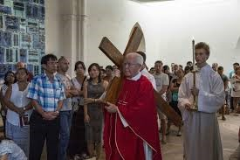
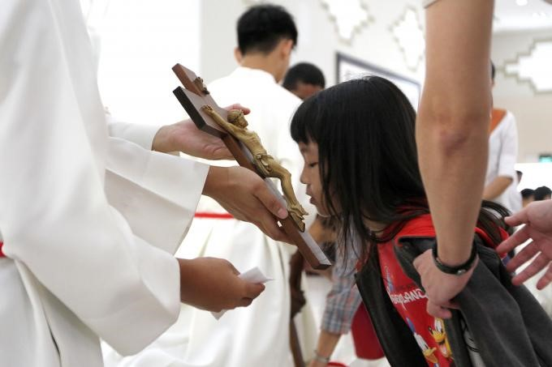
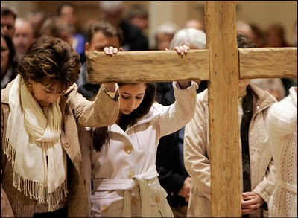
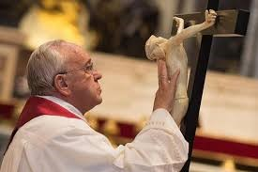
How we celebrate Good Friday in our parish
Usually there is a procession with the cross being brought into the church and placed in a place of honour. The cross used to be a sign of shame but since Jesus died on a cross it has become a holy symbol to be treated with great respect.
People come to the church to honour the cross. Parishes have their own rituals but most have a time for the people to come forward to kiss the cross to show how much they love Jesus and appreciate that he died to save us.
Sometimes people come up and place their hands on the cross to show it is a very special symbol to think about today. This is called venerating the cross. It is done in different ways by Christians all over the world on Good Friday.
Pope Francis venerates the cross and leads all the people of Rome to show special honour to Jesus on Good Friday. It is a holy day for people to be close to Jesus and remember the times they have not spoken or acted with love and to tell Jesus they are sorry for this.
R-3
S-09
Click the pictures to reveal text
Notes:
Slide 9 How we celebrate Good Friday in our parish
Children share how Good Friday is celebrated in their parish and note the time the liturgy starts – usually at 3:00 the time that Jesus died. Read the text about the parish celebration.
Remind children that Good Friday is a public holiday when most people do not go to work, and schools are closed. It is a quiet day to be at home and think about what Jesus did for us on this day and what we can do for others. Remind the children that this is not the end of the story.
Share what happens next.
Adapt Teaching and Learning Experience 5.

Slide 10
Check up
1)
Write 5 things in your RE Learning Journal you have learned about Good Friday.
2)
Make a poster with 3 symbols and rituals used in Holy Week and explain how and when they are used.
Make a list of all the things that happened after the Last Supper up until Jesus died on the cross.
3)
4)
Create a piece of art to share at home that captures what you have learned about the last week in Jesus’ life.
5)
Which activity do you think helped you to learn best in this resource?
6)
Questions I would like to ask about the topics in this resource are …
R-3
S-10
Click the worksheet button to go to the worksheet
Notes:
Slide 10 Check Up
This formative assessment strategy will help teachers to identify how well children have achieved the Learning Intentions of the resource.
Teachers can choose how they use the slide to assess each item.
A worksheet of this slide is available as an option for children to complete.
The last two items are feed forward for the teacher.
Recording the children’s responses to these items is recommended as it will enable teachers to adjust their learning strategies for future resources and target the areas that need further attention.

Slide 11
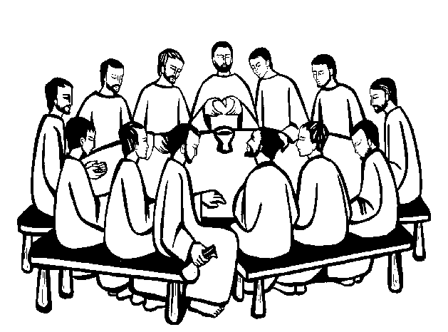
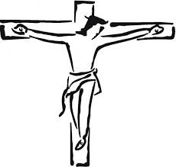
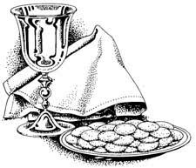
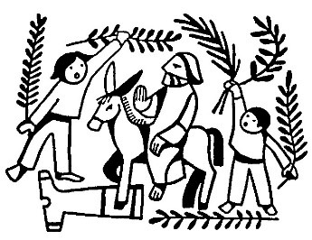
Sharing our Learning
Make up your own way of showing and sharing what you have learned and decide who you would like to share it with.
Use the Liturgical Year Calendar in your RE Learning Journal to illustrate what you have learned about Holy Week and describe where it comes in the Liturgical Year.
Display the poster you made for Check up item 3 at home and use it to explain what you learned about Holy Week to your family.
To remind your family it is Holy Week make a Holy Week centre piece on a table mat and put it on your dining room table. Put a cross in the middle, some palms, some silver coins, a glass and some bread and any other symbols you can think of. Look at the symbols at meal times and think about Jesus in his last week on earth.
Make an acrostic for HOLY WEEK – write the letters in capital letters down the left-hand side of your page and add something about Holy Week.
Decorate with Holy Week symbols. Share it with someone in your family.
Go for a walk with your family and think and talk about some things you could change at home to make time for each other and a way you could show Jesus you are grateful to be one of his followers.
Make some word balloons with some words or quotes from the Good Friday story from the Bible to share.
Click the pictures to reveal ways to share our learning
R-3
S-11
Click the worksheet button to go to the worksheet
Notes:
Slide 11 Sharing our Learning
This slide provides some choices for children to show and share what they have learned. Examples could be photographed as evidence of children’s learning.
You may like to put a copy of the Sharing our Learning page in children’s RE Learning Journals. You could talk through the choices using the slide and let children make their choice from their own copy.
Children could work on their choice at school and/or at home and you may like to set a day for sharing. Please let parents and whānau know what you expect them to do with this.
The slide is focussed on Year 3 Holy Week Achievement Objective which is covered in Resources 1-3
AO Yr. 3) Children will be able to: recall the stories and rituals of Holy Week.

Slide 12
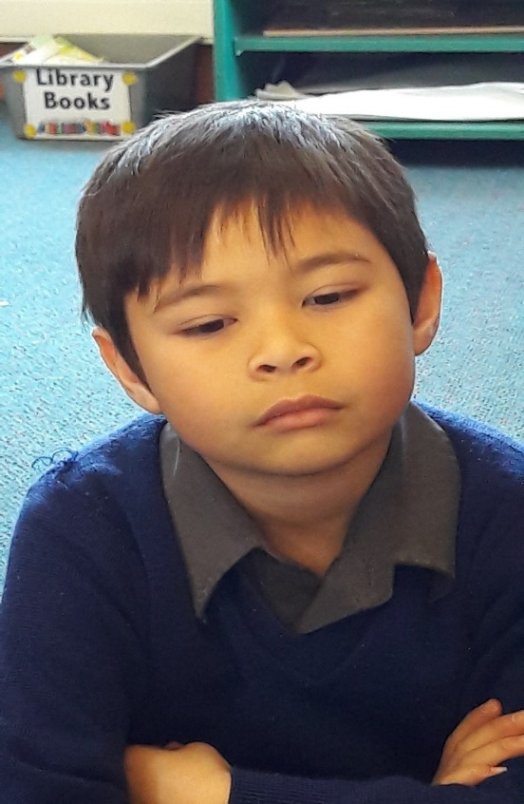
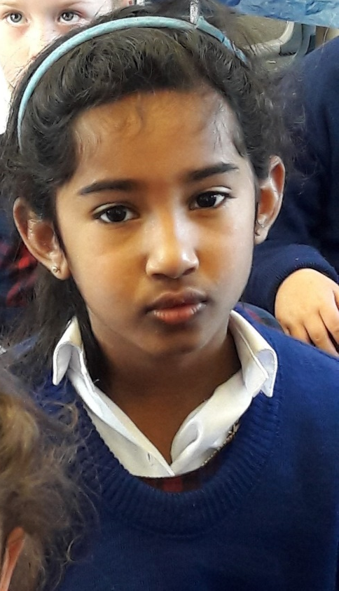
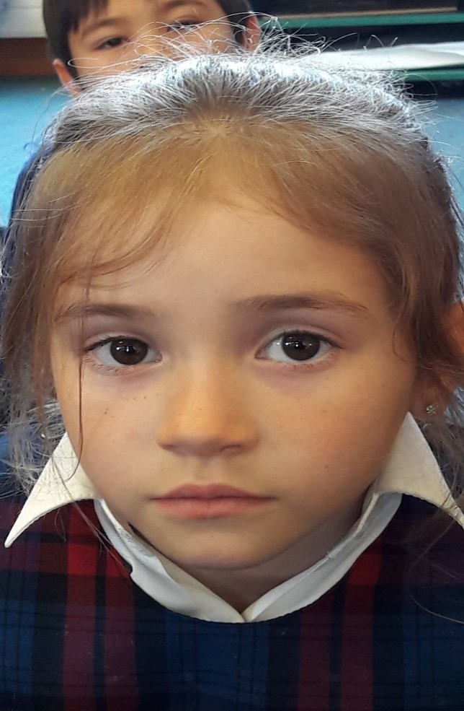
Time for Reflection
R-3
S-12
Click the audio button to stop reflective music
Click the audio button to play reflective music
Notes:
Slide 12 Time for Reflection
The MP3 is played to help create a reflective atmosphere and bring the children to stillness and silence as the teacher invites them to think about what Jesus did at the Last Supper to help the apostles remember him. Remind themselves about what the priest does at mass with the bread and wine to help them remember Jesus.

Slide 13
Check up
Name:____________________________
Date:____________
1) Write 5 things in your RE Learning Journal you have learned about Good Friday.
2) Make a poster with 3 symbols and rituals used in Holy Week and explain how and when they are used.
3) Make a list of all the things that happened after the Last Supper up until Jesus died on the cross.
4) Create a piece of art to share at home that captures what you have learned about the last week in Jesus’ life.
5) Which activity do you think helped you to learn best in this resource?
6) Questions I would like to ask about the topics in this resource are …
R-3
S-10
Worksheet
Click the up arrow to return to the presentation

Slide 14
Sharing our Learning
Name:____________________________
Date:____________
Use the Liturgical Year Calendar in your RE Learning Journal to illustrate what you have learned about Holy Week and describe where it comes in the Liturgical Year.
Display the poster you made for Check up item 3 at home and use it to explain what you learned about Holy Week to your family.
Go for a walk with your family and think and talk about some things you could change at home to make time for each other and a way you could show Jesus you are grateful to be one of his followers.
Make some word balloons with some words or quotes from the Good Friday story from the Bible to share.
Make an acrostic for HOLY WEEK – write the letters in capital letters down the left-hand side of your page and add something about Holy Week.
Decorate with Holy Week symbols. Share it with someone in your family.
To remind your family it is Holy Week make a Holy Week centre piece on a table mat and put it on your dining room table. Put a cross in the middle, some palms, some silver coins, a glass and some bread and any other symbols you can think of. Look at the symbols at meal times and think about Jesus in his last week on earth.
Make up your own way of showing and sharing what you have learned and decide who you would like to share it with.
R-3
S-11
Worksheet
Click the up arrow to return to the presentation

