Slide 1
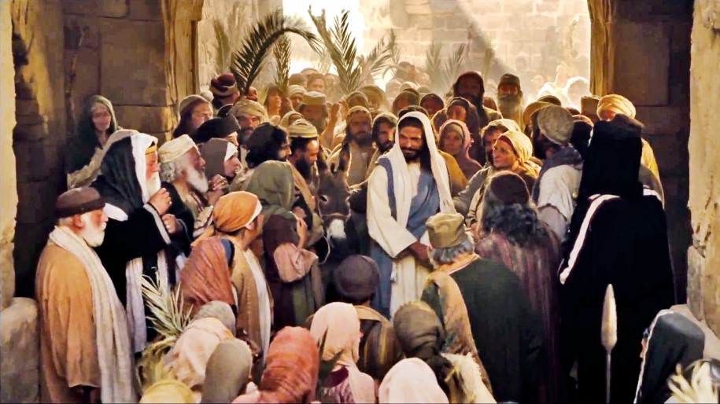
Palm Sunday – Jesus is Hailed as King
R-1
S-01
Notes:
Slide 1 Palm Sunday – Jesus is Hailed as King Use this slide as a focussing strategy to introduce the resource topic. Read the title together and invite children to share something they know about the event in Jesus’ life that is celebrated on Palm Sunday. Look at the image and ask children to describe what it is about, what is happening and where you would find this story.

Slide 2
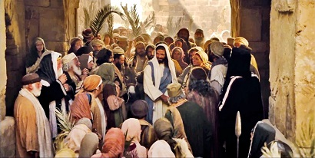
Learning Intentions
The children will:
1)
describe the event in Jesus’ life celebrated on Palm Sunday
2)
identify reasons why some people hailed Jesus as a king
3)
name ways that Christians today hail Jesus as a king on Palm Sunday.
R-1
S-02
Click the boxes to reveal text.
Notes:
Slide 2 Learning Outcomes Read through the Learning Intentions with the class and identify some ideas/questions that might be explored in the resource.
Create a Palm Sunday prayer focus the week before Palm Sunday using suitable images and symbols. Add to these during Holy Week. Read the Holy Week bible stories during prayer time and let the children dramatise them and sing the songs they know related to them.
Give children some special ‘close to Jesus’ time of quiet. You may like to create a special quiet place for children to go to look at Holy Week books and symbols.
Look at the images on the slides and talk about each one with the children to give them a sense of what the events of Holy Week are about.
Explain that Easter Sunday is not really in Holy Week because it is the beginning of the Easter Season. Mention that Good Friday and Easter Sunday are holidays, so children learn about them before they celebrate them. Encourage the children to share what they are learning about Holy Week with their family by using the Sharing our Learning worksheet (Slide 12, Resource 3). You may like to give the children a copy of the parish bulletin and work through it with them marking the times of the Easter ceremonies they could attend.

Slide 3
The first day of Holy Week is known as Passion Sunday or Palm Sunday
because it begins the week of Jesus’ Passion and death.
Palm Sunday is sometimes called Passion Sunday
Jesus had become very popular as a teacher and miracle worker
The people wanted Jesus to free them from the
The people did not realise Jesus’ message was to
On Palm Sunday the crowds welcomed Jesus like a king
and the people wanted to make him their king.
laws and taxes that made their lives so difficult.
teach them about God’s love and forgiveness of their sins.
waving palms and shouting, “Hosanna to the King!”.
waving palms and shouting “Hosanna to the King!”.
laws and taxes that made their lives so difficult.
because it begins the week of Jesus’ Passion and death.
teach them about God’s love and forgiveness of their sins.
and the people wanted to make him their king.
R-1
S-03
Click the end of the sentences or items on the list to reveal the statement that correctly completes the sentence.
Notes:
Slide 3 The first day of Holy Week is known as Passion Sunday or Palm Sunday
ANSWERS 1) C, 2) E, 3) B, 4) D, 5) A
Adapt Teaching and Learning Experience 1.
Look at the image and name the symbols and name which day in Holy Week they relate to.
Encourage the children to match the statements before they check them with the floater tool. Use the statements to generate questions and discussion.

Slide 4
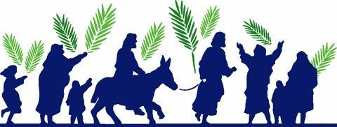
Jesus begins his last week on earth
In biblical times, the regional custom called for kings and nobles arriving in procession to ride on the back of a donkey.
Palm Sunday commemorates the triumphant entry of Jesus into Jerusalem to celebrate the Passover. The gospels record the arrival of Jesus riding into the city on a donkey, while the crowds spread their cloaks and palm branches on the street and shouted, "Hosanna!" to honour him as their long-awaited Messiah and King.
The donkey was a symbol of peace; those who rode upon them proclaimed peaceful intentions. The laying of palm branches indicated that the king or dignitary was arriving in victory or triumph.
The significance of Jesus riding a donkey and having his way paved with palm branches is a fulfilment of a prophecy spoken by the prophet Zechariah (Zechariah 9:9).
R-1
S-04
Click the pins on the right to reveal post-it notes.
Notes:
Slide 4 Jesus begins his last week on earth
Read the PINs and after each one ask if how what it said applied to Jesus?
Adapt Teaching and Learning Experiences 2, 3, 4.
Select the version of the story for the Liturgical Year you are in
Year A Matthew 21:1-11, Year B Mark: 11:1-10, or John 12:12-17, Year C Luke 19:21-40
As you read it to the class ask children to listen closely for something they hadn’t heard before. Before you start reading, share ideas about what was happening at this time and what people might be thinking and talking about. The ideas below will help children create some statements to write in their word balloons on the worksheet on the next slide.
Mary and the disciples – they were frightened for Jesus, they were unsure of what some of his warnings about the future meant, they knew he was a threat to the chief priests.
Jesus and the crowd – the crowd knew Jesus because they had heard him teaching and seen him healing people who were disabled or sick. They had learnt from him what God was like – loving, caring and wanting them to be happy. They were full of hope that he was the Messiah they had been waiting for and would change things and make their lives better.
The Roman Soldiers – The Roman soldiers thought Jesus was a trouble maker. He was popular with the people and was beginning to challenge their power and threaten their authority. It was time to do something about him.
Caiaphas and the chief priests -
This man Jesus is threatening our Jewish was of life and undermining our laws and authority. He thinks he is the Son of God the promised Messiah sent to save us. He attracts great crowds when he comes into town and people see his kindness and love and want him to be with their king. He is trouble and we need to get rid of him soon.

Slide 5
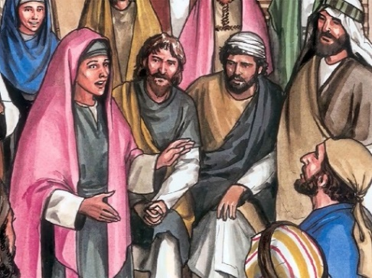
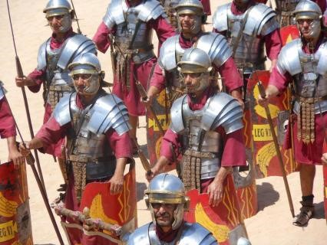
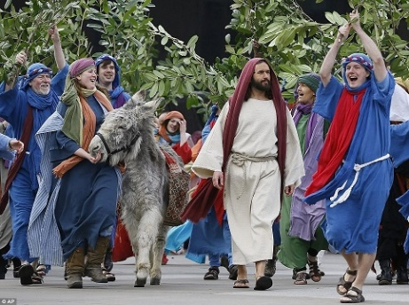
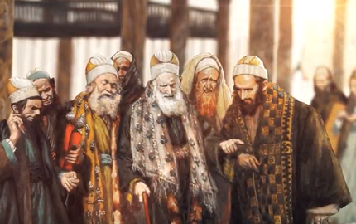
Experiencing Palm Sunday from Different People’s Point of View
Mary and the disciples
The Roman soldiers
Jesus and people in the crowd
Caiaphas and the Chief Priests
R-1
S-05
Click the speech bubbles to record ideas. Click the worksheet icon for a worksheet and video icon for “Jesus Christ Superstar – Hosanna”
Notes:
Slide 5 Experiencing Palm Sunday from Different People’s Point of View Print a worksheet for each child to complete and add to their RE Learning Journal. Explain what the title of the slide means and note the people in the images who might see what is happening differently. Discuss this and encourage children to suggest what the people in the images might be saying.
Watch the clip https://www.youtube.com/watch?v=14rSHAnFW3E
Jesus Christ Superstar – Hosanna 2: 48 minutes
Children complete the worksheet and share what they have written.

Slide 6
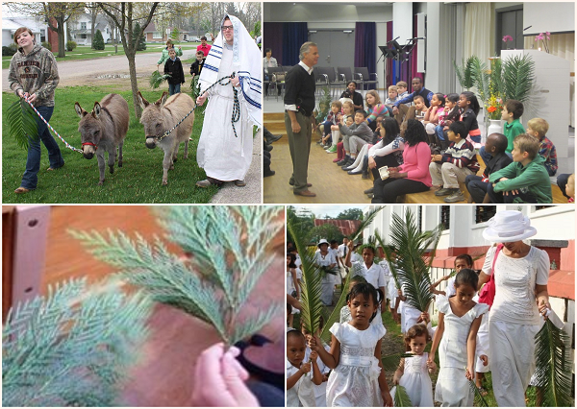
How Christians today celebrate Palm Sunday in their parish
In some parishes the children who go to the children’s liturgy group spend time re-capping what they know about Palm Sunday and preparing to join the adults for the reading of the Scripture story of Jesus’ passion which is very long.
In some Pasifika parishes the children dress in white and join in the procession of the palms around the streets near their parish church singing and waving just as the people did in Jerusalem in the time of Jesus.
The palms are cut and on Palm Sunday the priest blesses them when the people gather outside the church. The palms are distributed to everyone present and they process into the church singing “Hosanna” songs and waving their palms.
Sometimes in some parishes the procession is led by a donkey and the people follow behind singing songs of praise, hailing Jesus as a king.
R-1
S-06
Click the palms to reveal text.
Notes:
Slide 6 How Christians today celebrate Palm Sunday in their parish
Children read the text in the boxes and share their experiences of what happens in their parish on Palm Sunday.
Ask children to explain why this is done on Palm Sunday, what is going to happen next and how might the disciples be feeling?

Slide 7
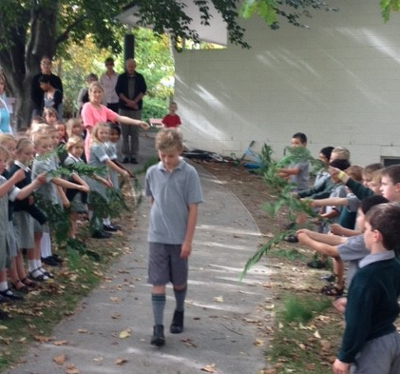
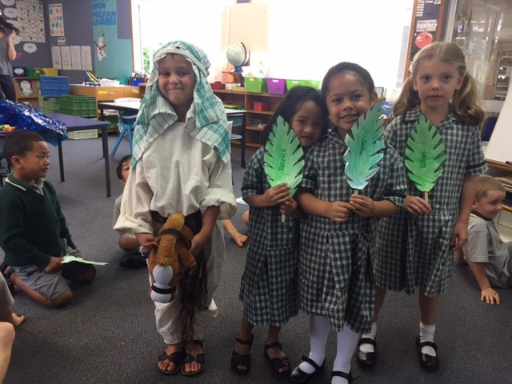
How children today celebrate Palm Sunday at school
The meaning of the Palm Sunday story is discussed with children and they draw and write about it to help them to understand.
Do you do this in your class?
Children imagine and talk about how the characters in the story are feeling, especially Jesus who knew he was going to die in a few days.
Can you name some of the characters in the story who are not mentioned but would have been watching on from the crowd?
Although Jesus was God’s Son, he was a human person and felt as humans do – he was frightened, disappointed and fearful.
Can you think of other feelings Jesus might have had as he entered Jerusalem on the first Palm Sunday?
Children re-enact the story of Palm Sunday at their school which helps them have a deeper understanding of its meaning.
Comment on the demeanor of the boy playing the part of Jesus.
Often the whole school takes part and parents come to join in. Welcome rituals from other cultures are often part of the discussion.
Can you name some that children in your class shared?
Children are reminded that this story set the scene for what is to follow during Holy Week.
Can you name some of the events that followed Jesus’ entry into Jerusalem.
The story is read from the Scripture and there are prayers and a hymn. Sing “Sing it Hosanna”
Click the images to reveal text. Click the yellow/red buttons for pointer and to move it.
R-1
S-07
Click the audio button to stop ‘Sing Hosanna’
Click the audio button to play ‘Sing Hosanna’
Notes:
Slide 7 How children today celebrate Palm Sunday at school
Read through the text using the red pointer and respond to the questions. Children share their experiences of Palm Sunday Liturgies.
Take photographs of the liturgy and make them into a book to share as a resource for future use. Record the liturgy and add it to the school website to share with family whānau.
Sing ‘Sing it Hosanna”

Slide 8
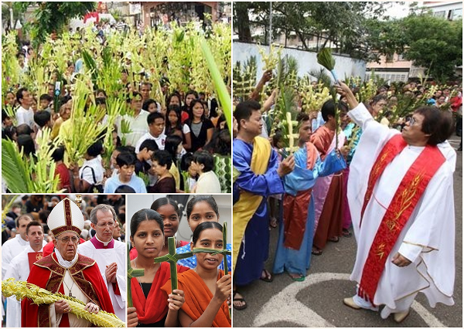
How Christians in other countries celebrate Palm Sunday
Complete the sentences
I look at these pictures and
I realise that Palm Sunday is …
I can see that Palm Sunday is celebrated …
I notice that palms …
They make me aware that the Church is …
I feel part of a very big Church and …
I am grateful for Pope Francis because he …
R-1
S-08
Click the worksheet icon for worksheet.
Notes:
Slide 8 How Christians in other countries celebrate Palm Sunday
Adapt Teaching and Learning Experiences 5, 6, 8, 9. Make a copy of the worksheet for children to complete and add to their RE Learning Journal. Children share the ideas on their worksheets.

Slide 9
BEFORE Palm Sunday, DURING Palm Sunday, AFTER Palm Sunday
Before Palm Sunday, Jesus was known to the people as a t______.
People also recognised Jesus as a man who could work m_____.
Those who knew him thought he was the long-awaited M______.
On Palm Sunday the people welcomed their new king shouting, “H_______”.
They hoped he would save them from harsh laws and heavy t____.
They greeted him as if he was their Saviour promised by G__.
The people did not realise that this was to be their king’s last week on e___.
Jesus had become a threat to the chief priests’ authority, he had to d__.
Some of the people turned against Jesus and they shouted, “C____ h__ ”.
Palm Sunday starts Holy Week, the holiest week in the y___.
eacher
iracles
essiah
osanna
axes
od
arth
ie
rucify
im!
ear
Click the first letter to reveal answer.
Click the worksheet icon for worksheet.
R-1
S-09
Notes:
Slide 9 BEFORE Palm Sunday, DURING Palm Sunday, AFTER Palm Sunday
Teachers please print a copy of the worksheet for each child. When they have completed their sheet use the screen version for them to check their responses and their spelling.
ANSWERS 1) teacher, 2) miracles, 3) Messiah, 4) Hosanna, 5) taxes, 6) God, 7) earth, 8) die, 9) Crucify him, 10) year

Slide 10
Check Up
1)
Make a list of 4 key moments in the Palm Sunday story. (Slides 3&4)
2)
Name the groups of people who wanted Jesus to be their king and the groups who did not want Jesus to be their king. (Slides 4&5)
3)
Name 3 special things people do to recall the Palm Sunday story today in their schools and parishes and write 2 sentences about your experience of this celebration. (Slide 6&7)
4)
Imagine what a photograph of the first Palm Sunday would look like and draw it. Display the pictures in your church foyer for your community to share.
5)
Which activity do you think helped you to learn best in this resource?
6)
Questions I would like to ask about the topics in this resource are …
R-1
S-10
Click the boxes to reveal text.
Notes:
Slide 10 Check Up
This formative assessment strategy will help teachers to identify how well the children have achieved the Learning Intentions of the resource.
Teachers can choose how they use the slide in their range of assessment options.
A worksheet of this slide is available for children in Years 5-8 to complete.
The last two items are feed forward for the teacher.
Recording the children’s responses to these items is recommended as it will enable teachers to adjust their learning strategies for future resources and target the areas that need further attention.

Slide 11
Time for Reflection
R-1
S-11
Click the audio button to stop reflective music
Click the audio button to play reflective music
Notes:
Slide 11 Time for Reflection
The MP3 is played to help create a reflective atmosphere and bring the children to stillness and silence as the teacher invites them to spend time this week thinking about Jesus and telling him they want to be close to him this week as he begins his journey to his cross and death. Try to focus on Jesus and spend some quiet moments this week with him.

Slide 12
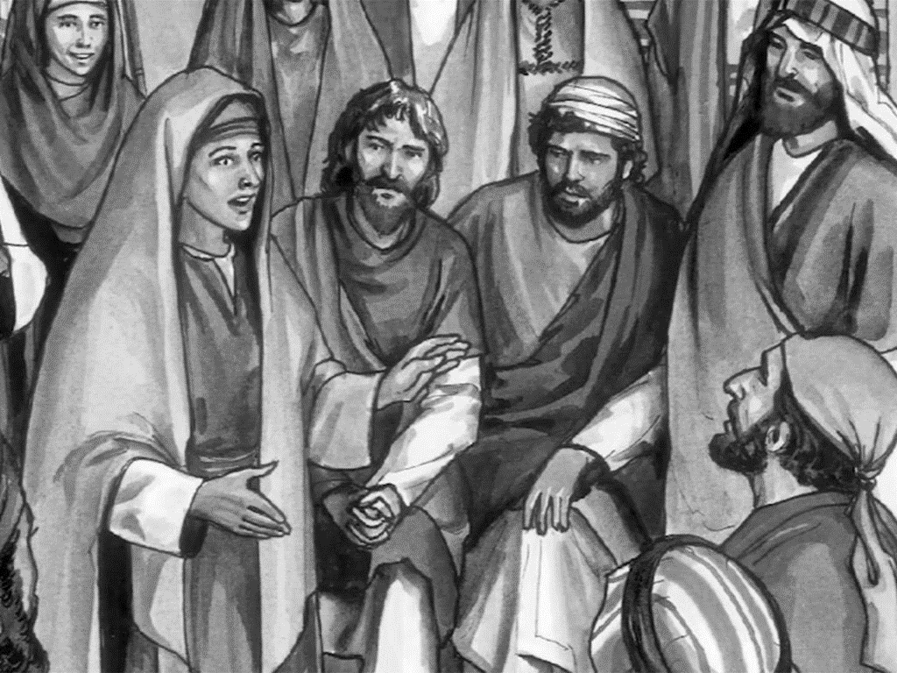
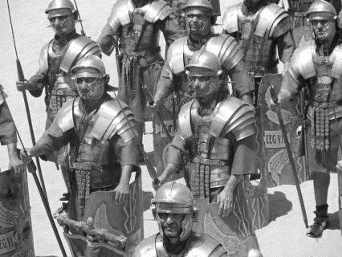
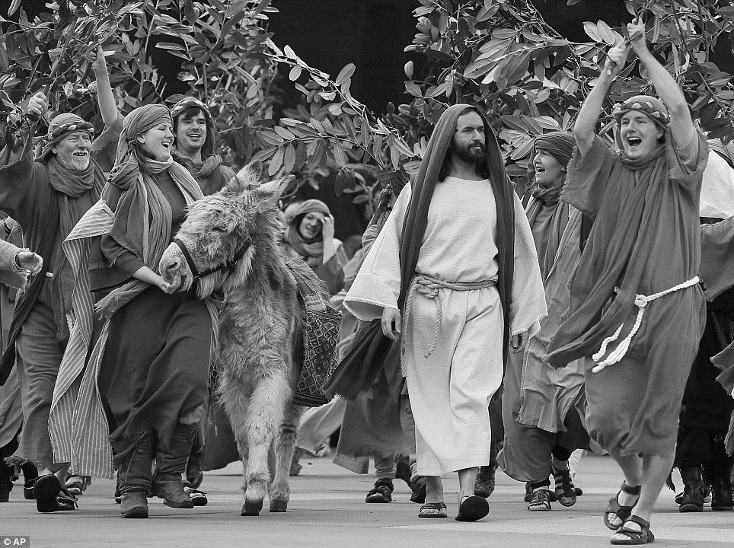
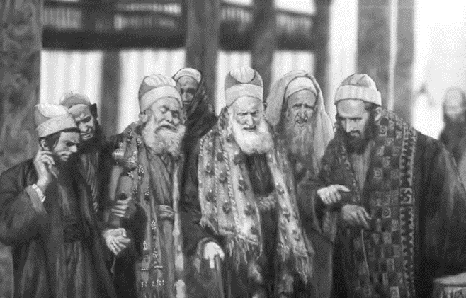
Experiencing Palm Sunday from Different People’s Point of View
Name____________________________________ Date____________
Mary and the disciples
The Roman soldiers
Caiaphas and the Chief Priests
Jesus and people in the crowd
Worksheet
R-1
S-5
Click the up arrow to return to the presentation

Slide 13
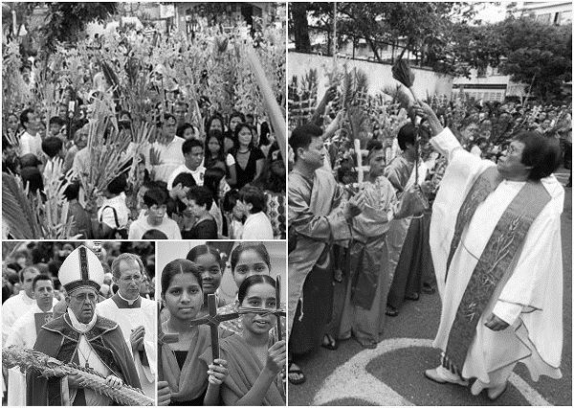
How Christians in other countries celebrate Palm Sunday
Name____________________________________ Date____________
Complete the sentences
I look at these pictures and
I realise that Palm Sunday is …
_______________________________________________
I can see that Palm Sunday is celebrated …
_______________________________________________
I notice that palms …
_______________________________________________
they make me aware that the Church is …
_______________________________________________
I feel part of a very big Church and …
_______________________________________________
I am grateful for Pope Francis because he …
_______________________________________________
Worksheet
R-1
S-8
Click the up arrow to return to the presentation

Slide 14
BEFORE Palm Sunday, DURING Palm Sunday, AFTER Palm Sunday
Name____________________________________ Date____________
Before Palm Sunday, Jesus was known to the people as a t______.
People also recognised Jesus as a man who could work m_____.
Those who knew him thought he was the long-awaited M______.
On Palm Sunday the people welcomed their new king shouting “H_______”.
They hoped he would save them from harsh laws and heavy t____.
They greeted him as if he was their Saviour promised by G__.
The people did not realise that this was to be their king’s last week on e___.
Jesus had become a threat to the chief priests’ authority, he had to d__.
Some of the people turned against Jesus and they shouted, “C____ h__ !”.
Palm Sunday starts Holy Week, the holiest week in the y___.
Worksheet
Click the first letter to reveal answer.
Click the worksheet icon for worksheet.
R-1
S-9
Click the up arrow to return to the presentation

