Slide 1
Celebrating Holy Week
R-3
S-01
Notes:
Slide 1 Celebrating Holy Week
Use this slide as a focussing strategy to introduce the resource topic. Read the title together and invite children to share something they know about the events of Holy Week and how Christians all over the world relive them today through liturgy with symbols and rituals. What city do you think this picture could be and why would it be used in Holy Week?

Slide 2
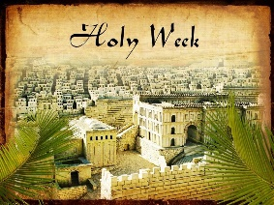
Learning Intentions
The children will:
1)
name symbols and rituals that remind people of the main events of Holy Week
2)
recognise ways Christians relive these events today through symbols and rituals
3)
identify ways that different cultures adapt these symbols and rituals.
R-3
S-02
Click the boxes to reveal text.
Notes:
Slide 2 Learning Outcomes
Read through the Learning Intentions with the class and identify some ideas/questions that might be explored in the resource.
Explain to the children that as Catholics, in Holy Week we are learning about the events of the first Holy Week. We are not celebrating the fact that the Son of God suffered and died. Rather we are remembering and honouring Jesus’ sacrifice, accompanying him spiritually and physically, as we listen to the stories and reflect on them as if we were there with him two thousand years ago. Each Holy Week our learning helps us to gradually increase our understanding of what Jesus did for us and how much he loves us.
Holy Week for all Christians is a time to recall the life of Jesus and observe the anniversary of the last days of Jesus’ life on earth—his passion, death, and resurrection. This is done with a special love and gratitude which is expressed through the liturgy, in our schools and in our parishes using the appropriate colours, symbols and rituals which help the events to become more real for us so we can participate more actively in them. Make your prayer focus a special part of your classroom this week and encourage children to spend quiet time in it with Jesus. Remind the children this week is different from all other weeks in the year.
Adapt Teaching and Learning Experiences 1, 2.

Slide 3
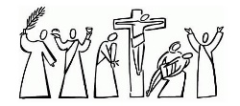
The Symbols and Rituals of Holy Week
1) Holy Week is the last week of Lent. | TRUE/FALSE | 11) It can also be a bowl, a towel and some soap. | TRUE/FALSE
2) The liturgical colour for Lent is green. | TRUE/FALSE | 12) The liturgical colour for Holy Thursday is blue. | TRUE/FALSE
3) Lent begins on Ash Wednesday. | TRUE/FALSE | 13) Rituals help us to see deeper meanings in actions | TRUE/FALSE
4) Holy Saturday is the last day of Holy Week. | TRUE/FALSE | 14) The cross is the symbol for Good Friday. | TRUE/FALSE
5) The symbol for Palm Sunday is a palm. | TRUE/FALSE | 15) Good Friday is a holiday day to have fun. | TRUE/FALSE
6) The ritual for Palm Sunday is carrying a flag. | TRUE/FALSE | 16) The colour for Good Friday is red. | TRUE/FALSE
7) The last meal Jesus had on earth he had alone. | TRUE/FALSE | 17) On Easter Saturday evening everything changes. | TRUE/FALSE
8) On Holy Thursday Jesus washed the disciples’ feet. | TRUE/FALSE | 18) Then Holy Week moves into Easter Sunday. | TRUE/FALSE
9) Jesus shared the bread and wine with his friends. | TRUE/FALSE | 19) The colours for Easter are black and orange. | TRUE/FALSE
10) The symbol for Holy Thursday is bread and a cup. | TRUE/FALSE | 20) The symbols and rituals are about light and joy. | TRUE/FALSE
Click the correct answer to confirm.
Click the worksheet icon for a worksheet and the video icon for “What is Holy Week?”
R-3
S-03
Notes:
Slide 3 The Symbols and Rituals of Holy Week
Make a copy of the worksheet for all children to complete and add to their RE Learning Journal. Discuss the title and the meaning of the words ‘symbol’ and ‘rituals’ and share examples of them.
Explain how to complete the worksheet and support any children who may struggle to read it as. Then mark it using the highlighter on the screen – see answers below.
The children may like to repeat the quiz at the end of the resource. It can be added to their RE Learning Journal.
ANSWERS FOR THE QUIZ
1)TRUE, 2) FALSE, 3) TRUE, 4) TRUE, 5) TRUE, 6) FALSE, 7) FALSE, 8) TRUE, 9) TRUE, 10) TRUE, 11) FALSE, 12) FALSE, 13) TRUE, 14) TRUE, 15) FALSE, 16) TRUE, 17) TRUE, 18) TRUE, 19) FALSE, 20) TRUE
Watch the clip to introduce/recap the topic of Holy Week
https://www.youtube.com/watch?v=KYTzVFJk-IQ What Is Holy Week? 2:23 minutes

Slide 4
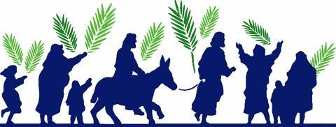
Palm Sunday- Symbols and Rituals
The symbol of the palm reminds us about …
The symbol and the ritual are carried on today because …
The ritual of Palm Sunday brings to our mind the …
The symbol and the ritual are carried on today in …
The symbol and the ritual related to Palm Sunday began on …
The symbols and the ritual are used today to help Christians to …
R-3
S-04
Click the symbols to reveal text.
Notes:
Slide 4 Palm Sunday - Symbols and Rituals
Adapt Teaching and Learning Experiences 4, 5.
Use the image and text on the slides as a starter for children to explain the symbol and ritual of the first Palm Sunday. Explain how Christians use them during liturgies in schools and parishes to help people to re capture a sense of when this event happened and Jesus was really part of it. Remind children that Jesus knew this was the first day of his last week on earth and to imagine how he might have been feeling.
The symbol of the palm reminds us about the people who waved them to welcome Jesus
The ritual of Palm Sunday brings to our mind Jesus’ joyful entry into Jerusalem
The symbol and the ritual related to Palm Sunday began on the first Palm Sunday
The symbol and the ritual are carried on today because they help people to feel part of the original event as though they were truly there.
The symbol and the ritual are carried on today in schools and parishes to help people remember the last time Jesus rode into the city he loved and what was to happen to him.
The symbols and the ritual are used today to help Christians to participate and journey with Jesus on Palm Sunday towards his death on Good Friday.

Slide 5
Holy Thursday – Using the Symbols and Rituals today
The symbols of the bread and the wine that become Jesus’ body and blood remind us about the …
The symbols of the jug and the towel bring to our mind the …
The ritual of the washing of the feet repeats what Jesus …
The ritual of sharing Jesus’ body and blood together bring into our mind …
The symbols and the ritual continue today in …
The symbols and the ritual continue today when Christians …
The symbols and the ritual are used today to help Christians understand the meaning of the message Jesus gave about …
R-3
S-05
Click the symbols to reveal text.
Notes:
Slide 5 Holy Thursday – Using the Symbols and Rituals today
Use the image and text on the slide as a starter to help children recognise the meaning of the symbols and rituals of the first Holy Thursday. Explain how liturgies in schools and parishes this week help people to develop a deeper understanding of the meaning of the symbols and actions to enable them to recapture when this event first happened and Jesus was really part of it. Remind children that Jesus knew this would be his last meal with his friends and to imagine how he might have been feeling.
The symbols of the jug and the towel bring to our mind the time when Jesus washed the feet of the disciples before he had his last meal with them.
The ritual of the washing of the feet repeats what Jesus did to show the apostles that this ritual is a humble service to others and what they must do for others. (It was the work of the servant usually.)
The symbols and the ritual continue today in the Mass of the Lord’s Supper on Holy Thursday night.
The symbols and the ritual are used today to help Christians understand the meaning of the message Jesus gave about being a humble servant to others.
The symbols of the bread and the wine that become Jesus’ body and blood remind us about what Jesus did at his last meal with his friends.
The ritual of sharing Jesus’ body and blood together brings into our minds the words and actions of Jesus as he had his last meal with his friends the day before he died.
The symbols and the ritual continue today when Christians – the followers of Jesus, gather to celebrate Eucharist together and carry out his command to do this and remember him and make him known throughout the world.

Slide 6
Good Friday – Using the Symbol and Rituals today
The symbol of Good Friday brings to our mind and helps us to relive the …
Ways children of this age can show what the symbol of the cross means to them is by …
The rituals of Good Friday help Christians today to relive the events of …
One way I could show my love and respect for Jesus and what he did for humanity this Good Friday is …
On Good Friday Christians express their love for Jesus and what he did for them through the symbol of the cross when they …
Click the symbols to reveal text.
Click the video icon for “Were You There When They Crucified My Lord?”
R-3
S-06
Notes:
Slide 6 Good Friday – Using the Symbol and Rituals today
Some suggested endings
The symbol of Good Friday brings to our mind and helps us to relive and realise what Jesus did out of love for us.
The rituals of Good Friday help Christians today to relive the events of Jesus’ journey to the cross.
On Good Friday Christians express their love for Jesus and what he did for them through the symbol of the cross when they participate in the liturgy of Good Friday and recall what Jesus did to save people from sin and death.
Ways children of this age can show what the symbol of the cross means to them is by showing respect for the symbol and what it means to all followers of Jesus.
One way I could show my love and respect for Jesus and what he did for humanity this Good Friday is to spend time with him at the Good Friday liturgy, or by reading the Scripture story of what happened to Jesus on Good Friday or talking to Jesus and thanking him for what he did to save people.
Watch the clip https://www.youtube.com/watch?v=iGQ1wEleV4I
Were You There When They Crucified my Lord?
3:25 Minutes
Adapt Teaching and Learning Experiences 6, 7.
Record the children’s ideas from the last 2 Good Friday items on the slide and convert them into a format for children to use. Print them off for each child to decorate. They could be taken home and shared with their family whānau (Sharing our Learning Slide 12, R3)
As the ‘Were you there?’ clip is played, encourage the children to sit in silence and reflect on the words of the song and what they mean.
If you are near the parish church it would be good to take the children to pray with the Stations of the Cross this week as a class.

Slide 7
Easter Sunday – Symbols and Rituals at the Easter Vigil
The Sacred Chrism During the Easter Vigil, oil is used in the Baptism and Confirmation of the newly initiated people who have just become part of God’s family in the Church. Oil symbolises these people are reborn with the new life of Christ and are being set aside and sealed to do God’s work in the world. How do you do God’s work in the world?
Baptismal waters
The newly blessed waters of the Easter font symbolise the life-giving power of Jesus, our Risen King. In baptism new Christians are cleansed by this water and given a new birth into the Church.
What symbols are being used as the baptismal water is blessed?
The Easter or Paschal Candle The Easter candle is the symbol of Christ the Light and it is a wonderful moment in the Easter Vigil when the new candle is lit. Some of the smaller candles the people are holding are lit from the Easter candle and passed on to others around the church. This symbolises that we are to share the light of Christ with the whole world. The Paschal Candle is lit at Mass throughout the Easter season. It is also used during baptisms and funerals. In both these liturgies it symbolises the Resurrection.
What do you know about the symbols on the Easter candle?
The Easter fire - the symbol of light conquering darkness.
During the Easter Vigil, when we celebrate the resurrection, we begin with the symbol of light breaking into the darkness. The community gathers in darkness around the Easter fire which is blessed and made holy. From the fire the Paschal candle is lit. Holding high ‘the light of Christ’, we process into the darkened church.
Fire is the symbol for something else – can you say what it is?
R-3
S-07
Click the right page to move through, the arrow will restart (4 total).
Notes:
Slide 7 Easter Sunday – Symbols and Rituals at the Easter Vigil
Explain that Easter is not really part of Holy Week as it is the beginning of a new week and the new season of Easter.
Encourage children to attend the Easter Vigil in their parish and after Easter take time to reflect with them on their experience of it.
Read the cards and answer the questions – answers below.
Fire is the symbol of the Holy Spirit.
The symbols on the Easter Candle are:
Alpha and omega (Christ our beginning and Christ our end)
Year inscribed on the cross
Five grains of incense to represent the wounds of Christ.
The symbol used in the blessing of the baptismal water is the Easter candle.
God’s work in the world – serving others willingly, being kind, compassionate, sensitive and encouraging to others, trying hard, being joyful and a good role model, noticing God’s presence in people and creation, challenging others when things are not just and fair.

Slide 8
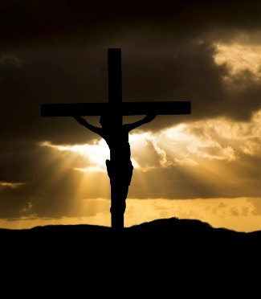
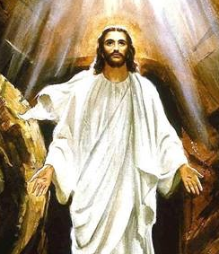
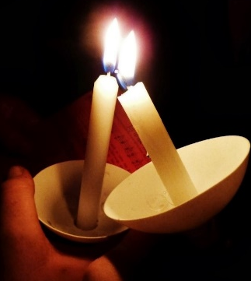
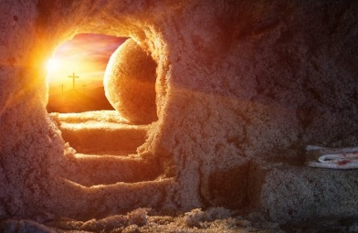
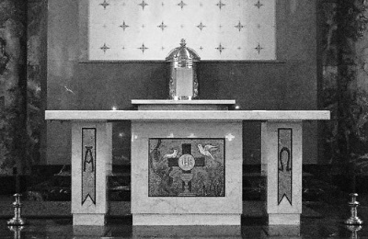
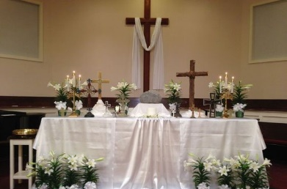
On Holy Saturday night everything changes
From the light of the
Easter Fire
To the Paschal candle and on to the peoples’ candles with which they share the light of Christ around the whole community gathered.
From death
To life
From the darkness, sadness and pain
of Good Friday.
To the light, gladness, and joy of resurrection on Easter Sunday
From the bare altar on Good Friday
To the decorated altar to celebrate the Easter Vigil and the joy of Jesus’ Resurrection.
CAN YOU SHARE OTHER EXAMPLES OF HOW CHRISTIANS RELIVE THE EVENTS OF HOLY WEEK THROUGH SYMBOLS AND RITUALS?
Click the images to reveal what comes next.
R-3
S-08
Notes:
Slide 8 On Holy Saturday night everything changes
Use the images to show how Jesus’ resurrection changes everything.

Slide 9
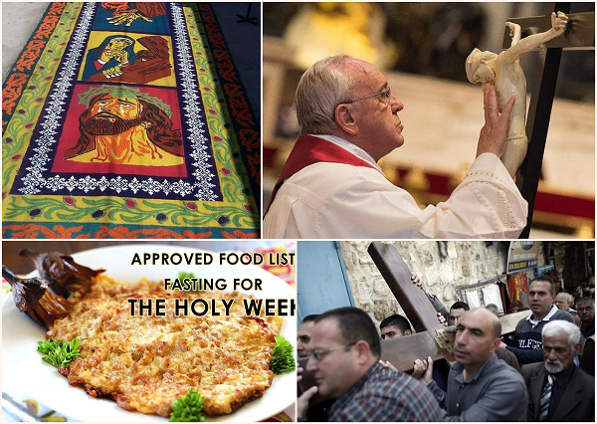
Holy Week Celebrations in different Cultures in the World
Children of cultures which have not been mentioned – please share the special ways Holy Week is celebrated in your homeland.
These are only some of the ways Holy Week is celebrated in the world. Children could research other practices and present their findings in ways that can be shared with other classes and family whānau.
Across the world for people who are not able to go out and join in the processions and other religious activities, they pray the Rosary, especially the Sorrowful Mysteries that focus on the events of the last day of Jesus’ life.
In Spain one of the most important traditions during Holy Week is the Visita Iglesia which means ‘church visits’. This is the practice of visiting seven churches on Holy Thursday to prepare them for Good Friday when they commemorate Christ's passion and death. At each church they take time to reflect and spend time with Jesus in prayer.
In some Central American countries such as Guatemala and Honduras, the people celebrate Semana Santa - Holy Week by creating beautiful street carpets made of sand and sawdust and are decorated with plants and flowers. They are called alfombras. The carpet patterns reflect the religious and cultural images of the people.
In the early part of Holy Week, parishes offer retreats. Bible sharing, family Rosary, and listening to the Seven Last Words of Jesus are common practices in many homes. In some places street plays - Senakulo about the passion of Jesus are performed. Another tradition is the Pabása ng Pasyón chanting of the story of Jesus’ passion in verse which is done over 24 hours in churches, homes and offices. Processions are also very popular.
In the Philippines many people are Catholic and much of Holy Week is spent observing traditional religious practices that enable people to be close to Jesus through spiritual reading and personal prayer. One tradition, especially in rural areas, is the observance of silence on Good Friday. People are encouraged to turn off their radios and televisions and limit conversations on the day.
In Rome on Good Friday, Pope Francis leads large crowds of people around the city as they pray the Stations of the Cross. This is also done in parish churches in New Zealand during Holy Week.
During Holy Week some families watch a religious movie about the events of the first Good Friday. This helps them to be able to visualise what Jesus did on that day. Families have a quiet day and do simple things together that focus their attention on how special this day is for people who believe in Jesus.
Processions are a popular way for people in many places to join in a religious activity that repeats what people did during the first Holy Week. People follow the cross which people take turns carrying as they walk along. Sometimes people stop and read the stories from the Scripture and sing and pray along the way.
In many countries including New Zealand, Christians use Lent and Holy Week as a time for fasting. Fasting means eating and drinking less, or maybe having less of something that gives people pleasure such as screen time. Fasting is a simple reminder of what it means to suffer and to understand in a small way the sacrifice Jesus made for humanity.
Although other practices may not be in churches they all encourage people to be more prayerful and thoughtful about Holy Week events. Many include practices that recall the events of the Holy Week and its symbols and rituals. These have been passed down through the years and they reflect the faith of the people who take part in them.
Christians celebrate Holy Week in different ways according to their culture and their country in the world. Most attend their local church services which focus on helping people to be more mindful of Jesus’ life and message and the events that led to his death on Good Friday.
R-3
S-09
Click the cards to move through, arrow starts over (13 total).
Notes:
Slide 9 Holy Week Celebrations in different Cultures in the World
Adapt Teaching and Learning Experience 9.
Read the Flip Cards for information about how Holy Week is celebrated in other countries and cultures. Use the information as conversation starters around ways Holy Week is celebrated across the world. Use the experience of children in the class who are from other countries.
Draw children’s attention to the images in the collage and how they relate to some of the cards. 1) Fasting, Card 3, 2) Procession, Card 4, 3) Sacred carpets – alfombras, Card 7 , 4) Stations of the Cross with Pope Francis, Card 6)
Note the research activity suggested on the last card is included in the Sharing our Learning on Slide 12.

Slide 10
Check Up
1)
Create an art work including the symbols and rituals for Holy Thursday and Good Friday. (Sides 5&6)
2)
Make a poster showing ways that help Christians re-live the events of Holy Week. (Slides 5,6,7,8). (Referred to in Sharing our Learning, S12, R3)
3)
Explain 2 practices that are used in different cultures that help people to grow closer to Jesus during Holy Week. (Slide 9)
4)
Write a paragraph about the Holy Week story which means most to you and give reasons for your choice. Add this to your RE Learning Journal.
5)
Three new things I have learned about Holy Week are…
6)
Which activity do you think helped you to learn best in this resource?
7)
Questions I would like to ask about the topics in this resource are …
R-3
S-10
Click the boxes to reveal text.
Notes:
Slide 10 Check Up
This formative assessment strategy will help teachers to identify how well the children have achieved the Learning Intentions of the resource.
Teachers can choose how they use the slide in their range of assessment options.
A worksheet of this slide is available for children in Years 5-8 to complete.
The last two items are feed forward for the teacher.
Recording the children’s responses to these items is recommended as it will enable teachers to adjust their learning strategies for future resources and target the areas that need further attention.

Slide 11
Time for Reflection
R-3
S-11
Click the audio button to stop reflective music
Click the audio button to play reflective music
Notes:
Slide 11 Time for Reflection
The MP3 is played to help create a reflective atmosphere and bring the children to stillness and silence as the teacher invites them to reflect on how much Jesus loved them to give his life for them and how this is the sign of a true friend. Plan to spend some quiet time with Jesus on Good Friday and remember the great love he showed for them.

Slide 12
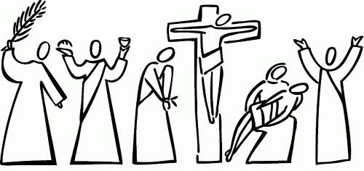
Sharing our Learning about HOLY WEEK with family whānau
Make up your own way of showing and sharing what you have learned and decide who you would like to share it with.
Write a paragraph about the Holy Week story which means most to you and give reasons for your choice. Add this to your RE Learning Journal and share it with your family.
Name which day and event in Holy Week each figure below symbolises.
Share the Holy Week Church timetable in your parish bulletin with your family and plan which liturgies you will attend.
Encourage your family to visit the Holy Week Art Exhibition at your school or church. (See Slide 4, in R2)
Make a poster to share at home about what we can do to help Christians re-live the events of Holy Week. (See Check up item 2, R3)
Use the Liturgical Year Calendar to illustrate what you have learned about the Liturgical Year and what you know about the Holy Week.
Make a power point about the events of Holy Week to share with your family whānau
Share the Holy Week Quiz with your family whānau (Slide 3, R3)
Sharing our Learning about Holy Week.
Click the yellow button to start slide. Click the small yellow button to move through cards (9 total).
Click worksheet icon for worksheet.
R-3
S-12
Notes:
Slide 12 Sharing our Learning about HOLY WEEK with family whānau
Use the yellow pointer button to read what to do.
This slide provides some choices for children to show and share what they have learned. Examples could be photographed as evidence of children’s learning.
You may like to put a copy of the Sharing our Learning page in children’s RE Learning Journals. You could talk through the choices about using the slide and let children make their choice from their own copy.
Children could work on their choice at school and/or at home and you may like to set a day for sharing. Please let parents and whānau know what you expect them to do with this.
The slide is focussed on the 2 Achievement Objectives which are covered in Year 4.
AO1 Children will be able to: explain the events of Holy Week in relation to the life of Jesus.
AO2 Children will be able to: develop an understanding of ways people can celebrate Holy Week within the school, parish and family whānau, and in various cultures.

Slide 13
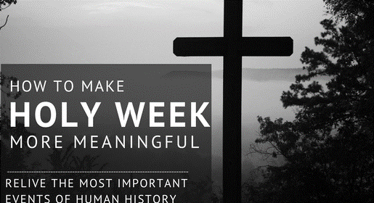
The Symbols and Rituals of Holy Week
Name ________________________ Date ______
1) Holy Week is the last week of Lent. | TRUE/FALSE | 11) It can also be a bowl, a towel and some soap. | TRUE/FALSE
2) The liturgical colour for Lent is green. | TRUE/FALSE | 12) The liturgical colour for Holy Thursday is blue. | TRUE/FALSE
3) Lent begins on Ash Wednesday. | TRUE/FALSE | 13) Rituals help us to see deeper meanings in actions | TRUE/FALSE
4) Holy Saturday is the last day of Holy Week. | TRUE/FALSE | 14) The cross is the symbol for Good Friday. | TRUE/FALSE
5) The symbol for Palm Sunday is a palm. | TRUE/FALSE | 15) Good Friday is a holiday day to have fun. | TRUE/FALSE
6) The ritual for Palm Sunday is carrying a flag. | TRUE/FALSE | 16) The colour for Good Friday is red. | TRUE/FALSE
7) The last meal Jesus had on earth he had alone. | TRUE/FALSE | 17) On Easter Saturday evening everything changes. | TRUE/FALSE
8) On Holy Thursday Jesus washed the disciples’ feet. | TRUE/FALSE | 18) Then Holy Week moves into Easter Sunday. | TRUE/FALSE
9) Jesus shared the bread and wine with his friends. | TRUE/FALSE | 19) The colours for Easter are black and orange. | TRUE/FALSE
10) The symbol for Holy Thursday is bread and a cup. | TRUE/FALSE | 20) The symbols and rituals are about light and joy. | TRUE/FALSE
Mark your quiz - If you get between 15-20 you are a Holy Week expert! Well done!
Write your score here ______ If you get 9-14 you are doing well. Keep trying.
learning about this important week in the year and that will help you.
Worksheet
R-3
S-3
Click the up arrow to return to the presentation

Slide 14
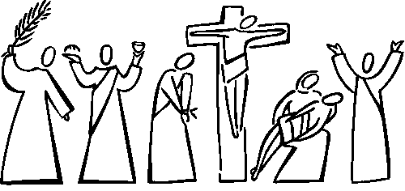
Sharing our Learning about HOLY WEEK with family whānau
Name ________________________ Date ______
Use the Liturgical Year Calendar to illustrate what you have learned about the Liturgical Year and what you know about the Holy Week.
Share the Holy Week Quiz with your family whanau. (Slide 3, R3)
Make a poster to share at home about what we can do to help Christians re-live the events of Holy Week. (See Check up item 2, R3)
Make a power point about the events of Holy Week to share with your family whanau.
Encourage your family to visit the Holy Week Art Exhibition at your school or church. (See Slide 4, in R2)
Share the Holy Week Church timetable in your parish bulletin with your family and plan which liturgies you will attend.
Name which day and event in Holy Week each figure below symbolises.
Write a paragraph about the Holy Week story which means most to you and give reasons for your choice. Add this to your RE Learning Journal and share it with your family.
Make up your own way of showing and sharing what you have learned and decide who you would like to share it with.
Worksheet
R-3
S-13
Click the up arrow to return to the presentation

