Slide 1
Holy Week begins with the Liturgy of Passion Sunday
R-1
S-01
Notes:
Use this slide as a focussing strategy to introduce the resource topic. Read the title together and invite children to share something they know about the events of Holy Week and how the Church celebrates them through liturgy.

Slide 2
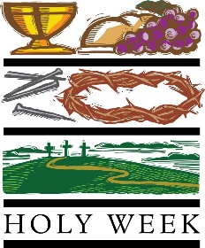
Learning Intentions
The children will:
1)
identify how Passion/Palm Sunday is celebrated in the liturgy
2)
identify the two moods of Passion/Palm Sunday.
R-1
S-02
Click in each caption space to reveal text
Notes:
Note Palm Sunday is now referred to as Passion Sunday
Refer to this clip for more information about this.
http://www.ncregister.com/blog/jimmy-akin/9-things-you-need-to-know-about-palm-passion-sunday
Create a Palm/Passion Sunday prayer focus the week before Passion Sunday using suitable images and symbols. Add to these during Holy Week. Read the Holy Week bible stories during prayer time and let the children dramatize them and sing the songs they know related to them.
Give children some time to reflect with Jesus. You may like to create a quiet place for children to go to reflect with Holy Week books and symbols.
Spend time looking at the images on the slides and talk about each one – there is a lot of learning to be done doing this and it will give the children a deeper sense of what the events of Holy Week are about. Draw their attention to the different style of art and images that the slides include. Use reflective music this week in the classroom to increase the children’s awareness of the importance of this week in the liturgical life of the Church.
Explain that Easter Sunday is not really in Holy Week because it is the beginning of the Easter Season. Mention that Good Friday and Easter Sunday are holidays so children learn about them before they celebrate them. Encourage the children to share what they are learning about Holy Week with their family by using the Sharing our Learning worksheet (Slide 12, Resource 3). You may like to give the children a copy of the parish bulletin and work through it with them marking the times of the Holy Week and Easter ceremonies they could attend.

Slide 3
We follow Jesus’ footsteps through Holy Week
Make a list of what you know about Holy Week
Watch the Holy Week clip
Add more items to your list
Share your list
R-1
S-03
Click the video button to play the video ‘Holy Week’.
Notes:
Talk about moving through the days and events of Holy Week as a journey Jesus made and now his followers make as though they are there with him.
Watch the clip
https://www.youtube.com/watch?v=HugMM_3FfnI
Holy Week in 2 minutes 2:29 minutes
Children follow the directions on the slide. As class share what they learned they tick off each item that is named. Note items that only one child learned.

Slide 4
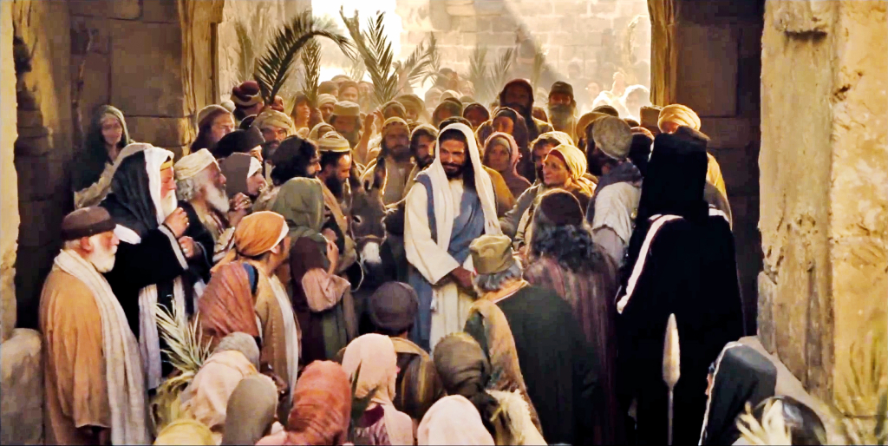
The Passion Sunday story
R-1
S-04
Click the video button to play the video ‘Jesus triumphant entry into Jerusalem’.
Notes:
Watch the clip
https://www.youtube.com/watch?v=rdyJO-_aAv8
Please Note: This clip is a combination of several clips telling the story of Palm Sunday. Jesus triumphant entry into Jerusalem [Palm Sunday] 7:26 minutes. Adapt Teaching and Learning Experience 1

Slide 5
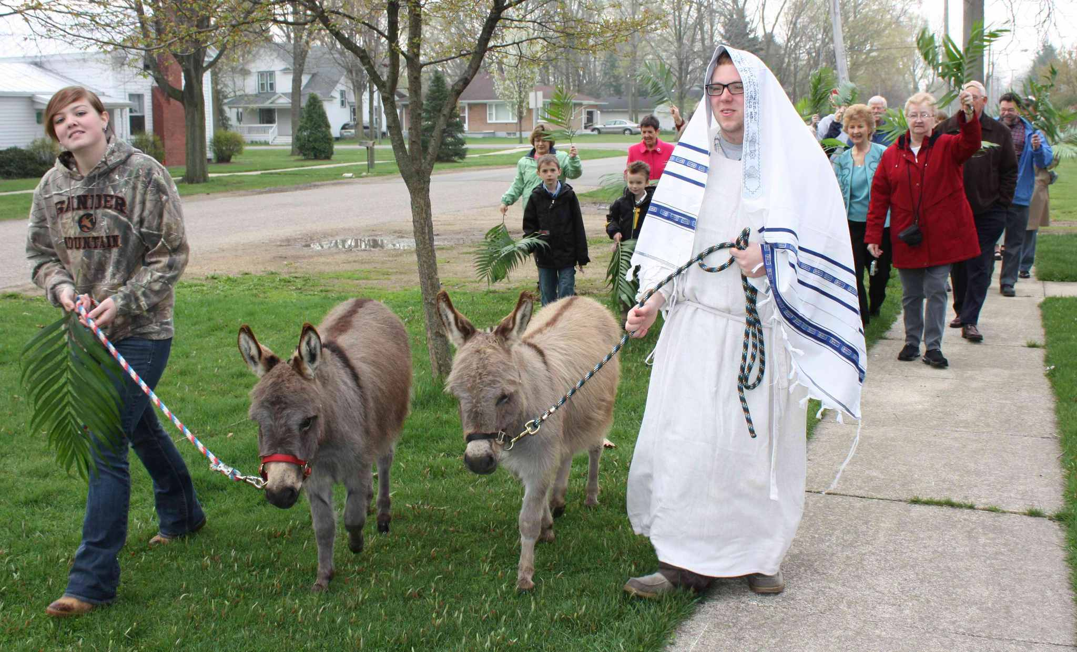
The events of Holy Week are relived each year through the liturgies that are celebrated in the Church communities
During Holy Week Christians walk with Jesus through the events that led him to his death on the cross. Because these stories are such an important part of what Christians believe happened, they want to re-live them and grow in their understanding of them.
Schools are part of the church. This is why children prepare liturgies that make the Holy Week stories more real for them and this brings the stories out of the past into the present day and place.
The liturgies in Holy Week are designed to help people come to a deeper understanding of the events and through this, their faith in Jesus is deepened and they grow closer to him as they re-live with him his last week on earth.
By making the events present again by re-enacting them, hearing the stories and the words the characters spoke, by experiencing the mood of the events, people become more connected to the them.
The more connected people feel to the events, the more they are able to empathise with Jesus and how he felt as he was cheered and praised and in a few short days he was put to death.
R-1
S-05
Click the pins on the right to reveal post-it notes.
Notes:
Read the slide title and discuss its meaning. Talk about how stories and drama help bring events alive and back into people’s minds. Read each post it note and ask children to share their own experiences about how re-enactments of events help to deepen people’s understanding of them.

Slide 6
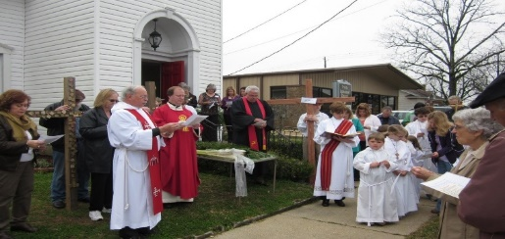
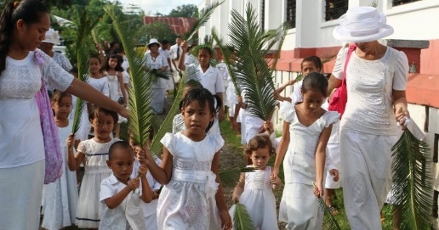
The Church makes the events leading to Jesus’ death present again for Christians to celebrate in Holy Week through liturgies in the parish and school
The Passion Sunday liturgy begins with the blessing of the palms by the priest and the reading of the gospel outside the church. Each person is given a palm and the singing begins as the procession moves around and into the church.
On Palm Sunday Pasifika Christians dress in white and wave palms and sing songs of welcome and Hosanna. They listen to the gospel story about the first Passion Sunday and re-enact it. This helps the children to feel like the people did as they welcomed Jesus as their king and their Messiah.
How does your school and your family celebrate Passion Sunday?
R-1
S-06
Click on images to reveal text. Click on the green button to advance through the lines.
Notes:
Children talk about how their school celebrates Passion Sunday and how they participate in the events of the first Passion Sunday in their school and they parish through liturgy. Use the green pointer to guide reading through the text boxes.

Slide 7
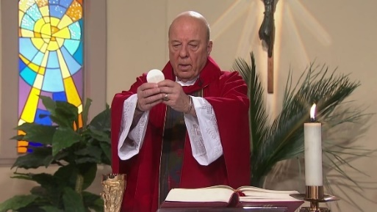
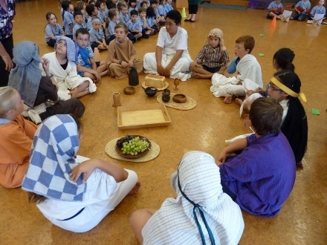
The Liturgies in Holy Week help to make Jesus’ Passion and Death real
The Holy Thursday liturgy in the parish celebrates what Jesus did on the first Holy Thursday. The priest does what Jesus did – he washes peoples’ feet, he teaches them about loving and serving one another and he shares Jesus’ body and blood with them.
At school children re-enact the story of Jesus’ Last Supper in a liturgy on Holy Thursday. Watching and listening to this important story from the Scriptures helps children like you to imagine what the actual event was like. This experience can help you to feel that Jesus is very real and it can help you to feel closer to him. This is a good time to talk to Jesus.
R-1
S-07A
Click on images to reveal text. Click on the green button to advance through the lines.
Notes:
Children take part in the Holy Thursday liturgy at school which helps them to follow more easily what happens in the liturgy at the parish on Holy Thursday evening. The mood of the Holy Thursday liturgy has an underlying sadness as Jesus knows this will be his last meal with his friends. He takes the opportunity to give them his last teaching during and after the meal. This long talk is referred to as his last “discourse” and it is recorded in St John’s gospel. After Jesus had washed the disciples’ feet and reminded them about being humble servants to others he gave them his new commandment of love. It seems he feels worried how they will continue his work when he is gone. Read through the text boxes using the green pointer button.

Slide 8
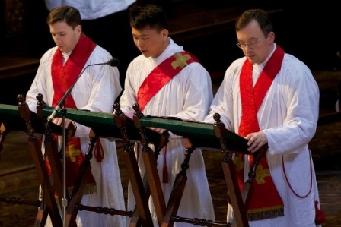
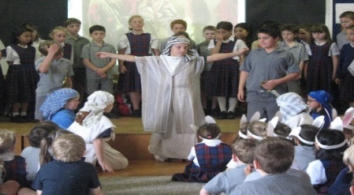
The Liturgies in Holy Week help to make Jesus’ Passion and Death real
On Good Friday the mood of the liturgy in the parish is very solemn. The story of Jesus’ passion and death on the cross is read. People venerate or honour Jesus on the cross by kissing his feet. Hearing the words of Jesus on the cross, seeing the readers in red, participating in the veneration of the cross enables people to re-live the events of this day. It helps them to have a sense of what happened to Jesus on that day.
In the liturgies that children like you in schools all over Aotearoa participate in, the events of Good Friday are acted out. As children participate in the liturgy they can appreciate in a deeper way what happened to Jesus and the sacrifice he made for all of humanity on that day. Suddenly what you see in front of you makes it seem real not just a story. This can help you to be able to draw closer to Jesus as he suffers and dies. It is a good time to reflect and talk to Jesus.
R-1
S-07B
Click on images to reveal text. Click on the green button to advance through the lines.
Notes:
Note the mood change from Holy Thursday to the most solemn mood of the Good Friday liturgy. The usual pattern of liturgy changes to draw attention to the event that is being re-enacted through the reading of John’s Gospel, the Prayers of Intercession, the Veneration of the Cross and Communion. Children could share their own experience of being part of the re-enactment of the Good Friday events in their school. Use the green pointer to guide reading through the text boxes.

Slide 9
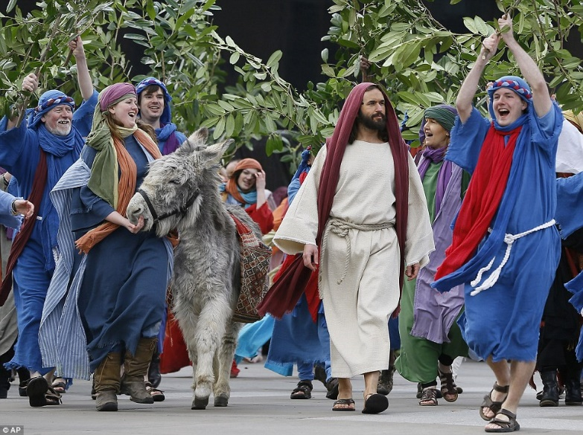
The ‘Moods’ of Passion Sunday
Look at the faces of the people in the picture who are taking part in their parish celebration of Passion Sunday and describe their moods.
Do you think these people’s faces would be like those who were present on the first Passion Sunday?
Give reasons for your responses.
What causes the people’s joy as they accompany Jesus on his ride into Jerusalem on Passion Sunday to change to such a hateful mood on Good Friday?
What moods and feelings do you think Jesus’ experienced during this time?
R-1
S-08
Click on the green button to advance through the lines.
Notes:
Talk about how the moods of liturgies change depending on the event being celebrated. Children share examples and name the liturgical mood and how this is conveyed during the liturgy e.g. through music, readings, symbols, actions and rituals.
Use the green pointer to guide reading through to work through the 5 items on the slide with the children and encourage them to recognise and empathise with how Jesus would have felt, especially as he knew what was going to happen to him on Good Friday. Remind the children that Jesus was God’s son and a human being, who had all the feelings human beings feel just as we do. Suggest children talk to Jesus about this.

Slide 10
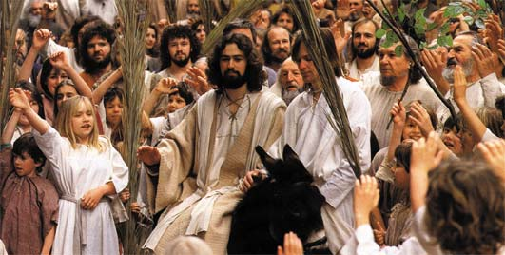
This day was once called Palm Sunday, now it is called Passion Sunday
The last Sunday of Lent was known
as Palm Sunday or the first day of Holy Week.
The gospel on this day tells the story of Jesus’ passion
that is why this Sunday is now called Passion Sunday.
Nowadays the Mass on Passion Sunday starts in a joyful way
with the reading of Jesus’ journey on the donkey into Jerusalem.
with the reading of Jesus’ journey on the donkey into Jerusalem.
as Palm Sunday or the first day of Holy Week.
that is why this Sunday is now called Passion Sunday.
R-1
S-09A
Click on a statement from the box which completes the sentence correctly
Notes:
Children suggest the statement that will complete the sentences completely and check them with the floater tool. Talk about what it means. Why do you think the name of this day has changed? (The story of Jesus’ Passion and death is read on this day). Print a copy of the worksheet on the next slide for each child to complete.

Slide 11
This day was once called Palm Sunday, now it is called Passion Sunday
It is when the gospel is read that people can sense the
change of mood as the sadness of Jesus’ passion story unfolds.
What the people did to Jesus as told in the story reminds people
today of the need to stay faithful to him all their lives.
change of mood as the sadness of Jesus’ passion story unfolds.
today of the need to stay faithful to him all their lives.
Click on a statement from the box which completes the sentence correctly. Click on the worksheet button to go to the worksheet
R-1
S-09B
Notes:
Children suggest the statement that will complete the sentences completely and check them with the floater tool. Print a copy of the worksheet for each child to complete. Children create a series of images like a film strip template (see template on copy worksheet) to tell the Passion Sunday story to younger children at home and at school. You may need to create a story board of the story to ensure the correct sequence and all the main points are covered. The work sheet could be enlarged, cut up and the pieces stuck together to look like a real film strip. Make arrangements with a teacher of a junior class for the Year 5 children to come and share their Passion Sunday film strips. Remember to give the film a suitable title. This will be used in the (Sharing our Learning Slide 11 in R3).

Slide 12
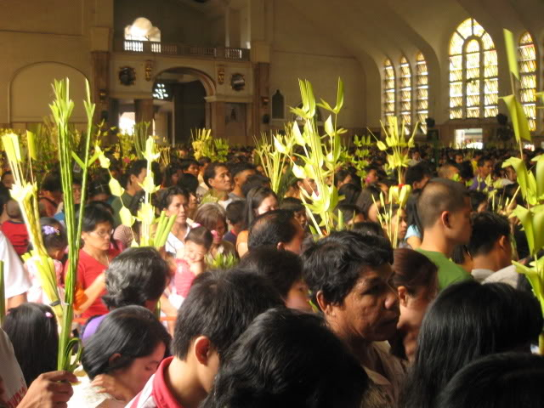
The Liturgy on Passion Sunday
The priest wearing red vestments, blesses the palms as the people hold them up.
The procession ends back in the church and the people sit as they listen to the reading of the gospel telling the story of Jesus’ passion and death.
What time is the Passion Sunday Mass in a church near your home?
The people sing, “Hosanna, blessed is he who come in the name of the Lord, Hosanna!”.
On Passion Sunday the Mass begins differently from every other Sunday.
After the Gospel is read, the people walk in a procession together waving their palms and praising Jesus as the Messiah.
The Mass continues as usual and the people take their palms home to remind them that Holy Week has begun.
The people gather outside the church before the Mass and they are given a palm.
The gospel story of Jesus’ entrance into Jerusalem as the people wave palms and welcome him as their king is read.
This is why this Sunday is known as Passion Sunday.
Read the list of the 10 parts of the Passion Sunday Liturgy and number them in the order they take place during the liturgy.
Click on the green button to advance through the lines.
Click on the worksheet button to go to the worksheet.
R-1
S-10
Click on the worksheet button to go to the worksheet.
Notes:
Print off a worksheet for each child to complete. Use the green pointer to guide reading through the parts of the Passion Sunday Liturgy. Add worksheets to RE Learning Journals.
Correct order is:
1) On Passion Sunday the mass begins differently from every other Sunday.
2) The people gather outside the church before the mass and they are given a palm.
3) The priest, wearing red vestments, blesses the palms as the people hold them up.
4) The gospel story of Jesus’ entrance into Jerusalem as the people wave palms and welcome him as their king is read.
5) When the gospel is finished the people walk in a procession together waving their palms, singing and praising Jesus as the Messiah.
6) The people sing “Hosanna, Blessed is he who come in the name of the Lord, Hosanna”
7) The procession ends back in the church and the people sit as they listen to the reading of the gospel telling the story of Jesus’ passion and death.
8) This why this Sunday is known as Passion Sunday.
9)The mass continues as usual and the people take their palms home to remind them that Holy Week has begun.
10) What time is the Passion Sunday mass in a church near your home?

Slide 13
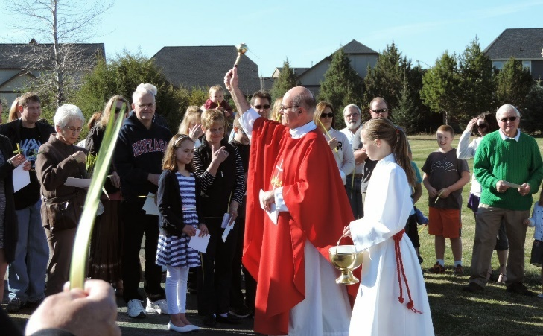
Passion Sunday then and now
M | X | J | R | M | P | A | S | S | I | O | N | R | U
W | W | S | E | N | K | A | Y | O | G | S | F | E | B
I | O | H | E | K | A | N | I | N | X | V | P | A | L
T | T | S | O | N | F | D | I | N | T | H | E | L | P
H | I | T | N | L | I | T | U | R | G | Y | P | L | E
R | S | H | F | A | E | Y | S | U | N | D | A | Y | O
A | C | E | L | E | B | R | A | T | I | O | N | M | P
J | K | T | R | K | T | H | E | Z | H | S | R | A | L
C | P | G | K | P | A | R | E | J | J | E | S | S | E
N | O | W | J | E | S | U | S | A | S | U | I | S | M
In the Liturgy on Passion Sunday the people really are greeting Jesus who is risen and with them now in the celebration of the Mass.
R-1
S-11
Click the words in the text box to reveal the position in the puzzle. Click on the worksheet button to go to the worksheet.
Notes:
Print off a worksheet for each child to complete. Then check using Word Find on the screen. Add worksheets to RE Learning Journals.
Discuss the meaning of the sentence with the children. Ask them how Jesus is really present in the mass – he is present in his Word that we listen to, in the priest who takes his place, in the people gathered who are his disciples and in the bread and wine that becomes his body and blood. Find each word in the sentence below on the matrix and highlight it in the sentence and in the Word Find.

Slide 14
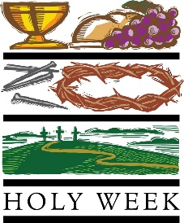
Check Up
1)
Describe 2 examples of how Passion Sunday is celebrated in the liturgy. (Slides 5,6,7)
2)
Re-enacting the stories of Holy Week helps them to …
3)
How do you react when you see the Holy Week events being dramatised in clips or in your school and/or parish?
R-1
S-12A
Notes:
This formative assessment strategy will help teachers to identify how well children have achieved the Learning Intentions of the resource.
Teachers can choose how they use the slide in their range of assessment options.
A worksheet of this slide is available for children in Years 5-8 to complete.
The last two items are feed forward for the teacher.
Recording the children’s responses to these items is recommended as it will enable teachers to adjust their learning strategies for future resources and target the areas that need further attention.

Slide 15
Check Up
4)
Name the 2 moods of Passion Sunday and describe them. (Slide 8)
5)
Which activity do you think helped you to learn best in this resource?
6)
Questions I would like to ask about the topics in this resource are …
R-1
S-12B
Click on the worksheet button to go to the worksheet
Notes:
This formative assessment strategy will help teachers to identify how well children have achieved the Learning Intentions of the resource.
Teachers can choose how they use the slide in their range
of assessment options.
A worksheet of this slide is available for children in Years 5-8 to complete.
The last two items are feed forward for the teacher.
Recording the children’s responses to these items is recommended as it will enable teachers to adjust their learning strategies for future resources and target the areas that need further attention.

Slide 16
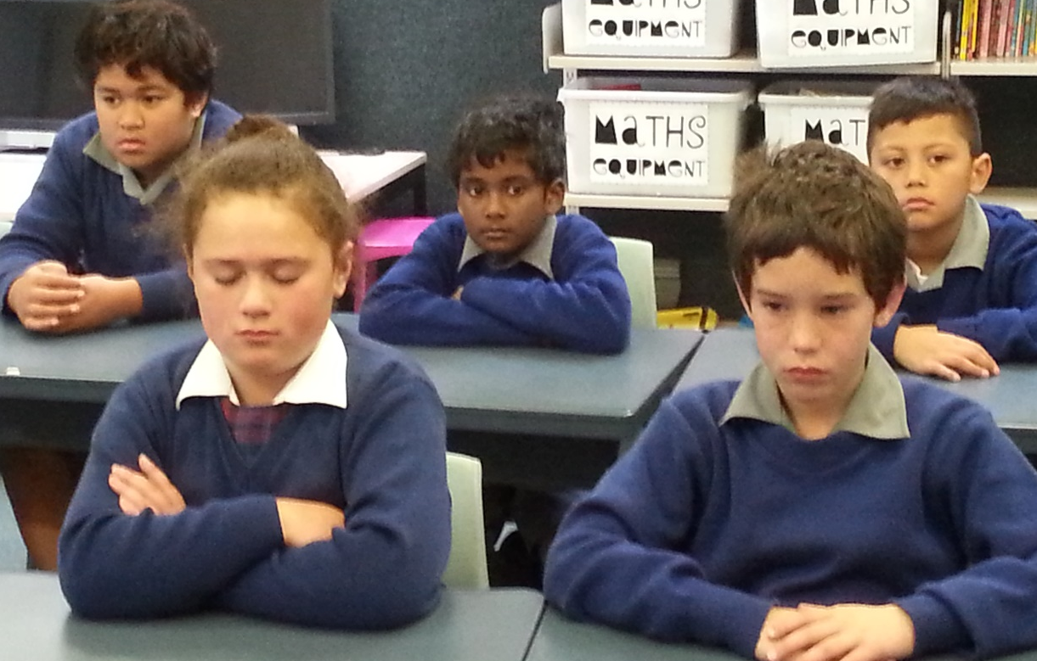
Time for Reflection
R-1
S-13
Click the audio button to stop reflective music
Click the audio button to play reflective music
Notes:
The MP3 is played to help create a reflective atmosphere and bring the children to stillness and silence as the teacher invites them to reflect on the story of Jesus’ entry into Jerusalem and how he was feeling as he knew this was the journey that would end in his death on the cross. Talk to Jesus about this as if he was there with you in your classroom.

Slide 17
The Story of Passion Sunday
Name:_________________
Date:_________________
R-1
S-09
Worksheet
Click the up arrow to return to the presentation
Notes:
This Worksheet relates to slide 9.

Slide 18
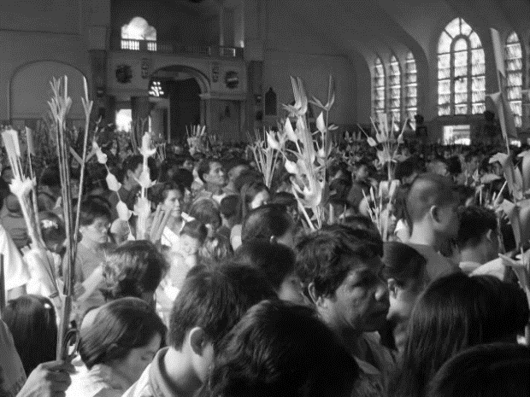
The Liturgy on Passion Sunday
The priest wearing red vestments, blesses the palms as the people hold them up.
The procession ends back in the church and the people sit as they listen to the reading of the gospel telling the story of Jesus’ passion and death.
What time is the Passion Sunday Mass in a church near your home?
The people sing, “Hosanna, blessed is he who comes in the name of the Lord, Hosanna!”.
On Passion Sunday the Mass begins differently from every other Sunday.
After the Gospel is read, the people walk in a procession together waving their palms and praising Jesus as the Messiah.
The Mass continues as usual and the people take their palms home to remind them that Holy Week has begun.
The people gather outside the church before the Mass and they are given a palm.
The gospel story of Jesus’ entrance into Jerusalem as the people wave palms and welcome him as their king is read.
This is why this Sunday is known as Passion Sunday.
Read the list of the 10 parts of the Passion Sunday Liturgy and number them in the order they take place during the liturgy.
Name:_________________
Date:_________________
R-1
S-10
Worksheet
Click the up arrow to return to the presentation
Notes:
This Worksheet relates to slide 10.

Slide 19
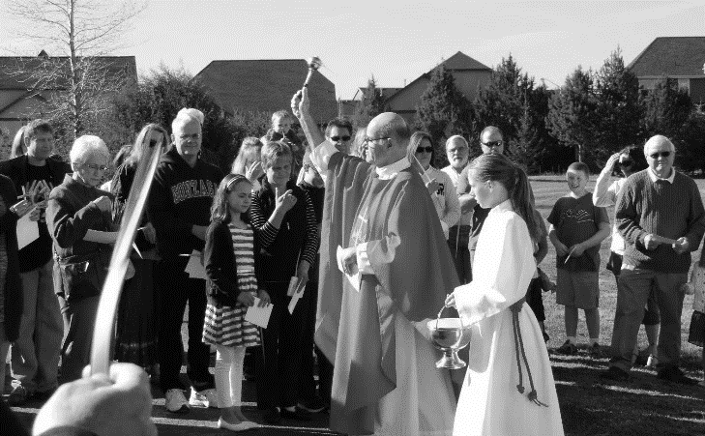
Passion Sunday then and now
Name:____________________________
Date:____________
M | X | J | R | M | P | A | S | S | I | O | N | R | U
W | W | S | E | N | K | A | Y | O | G | S | F | E | B
I | O | H | E | K | A | N | I | N | X | V | P | A | L
T | T | S | O | N | F | D | I | N | T | H | E | L | P
H | I | T | N | L | I | T | U | R | G | Y | P | L | E
R | S | H | F | A | E | Y | S | U | N | D | A | Y | O
A | C | E | L | E | B | R | A | T | I | O | N | M | P
J | K | T | R | K | T | H | E | Z | H | S | R | A | L
C | P | G | K | P | A | R | E | J | J | E | S | S | E
N | O | W | J | E | S | U | S | A | S | U | I | S | M
In the Liturgy on Passion Sunday the people really are greeting Jesus who is risen and with them now in the celebration of the Mass.
R-1
S-11
Worksheet
Click the up arrow to return to the presentation
Notes:
This Worksheet relates to slide 11

Slide 20
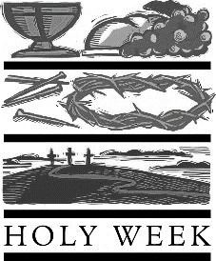
Check Up
1)
Describe 2 examples of how Passion Sunday is celebrated in the liturgy. (Slides 5,6,7)
2)
Re-enacting the stories of Holy Week helps them to …
3)
How do you react when you see the Holy Week events being dramatised in clips or in your school and/or parish?
4)
Name the 2 moods of Passion Sunday and describe them. (Slide 8)
Name:_______________
5)
Which activity do you think helped you to learn best in this resource?
Date:____________
6)
Questions I would like to ask about the topics in this resource are …
R-1
S-12
Worksheet
Click the up arrow to return to the presentation
Notes:
This Worksheet relates to slides 12A and 12B.

Slide 21
