Slide 1
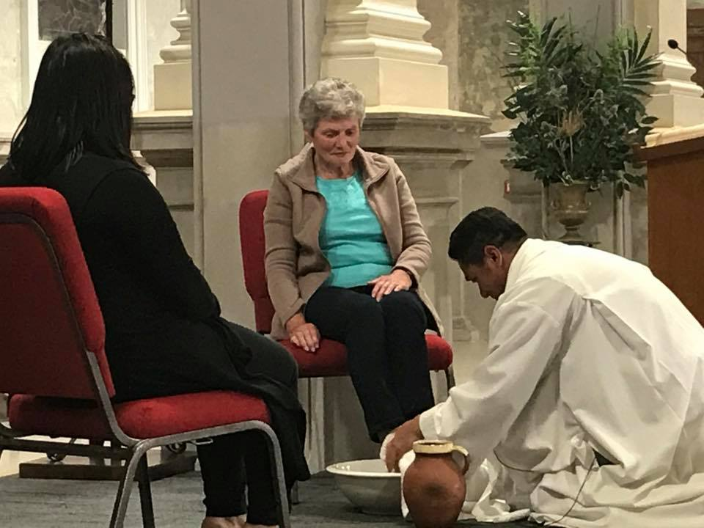
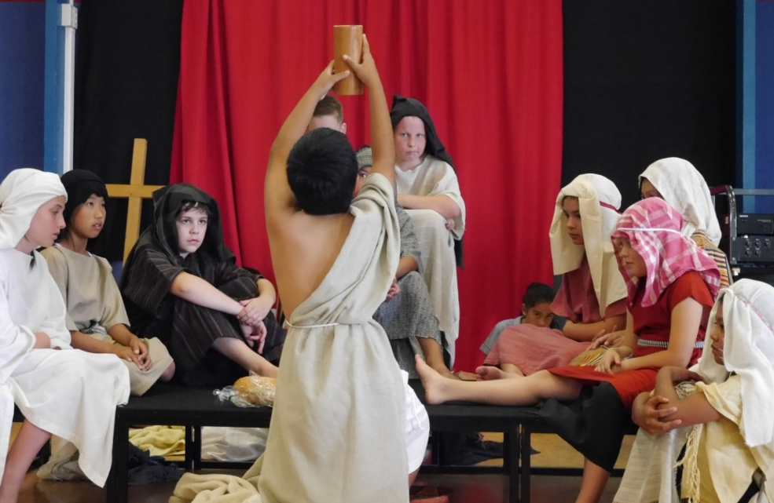
The Church celebrates Holy Thursday
R-2
S-01
Notes:
Use this slide as a focussing strategy to introduce the resource topic. Read the title together and invite children to share something they know about the events of Holy Thursday and how they are celebrated in the liturgy of the Church.

Slide 2
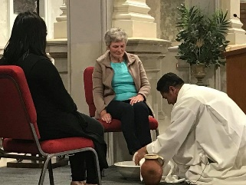

Learning Intentions
The children will:
1)
identify the themes of the readings in the Liturgy of the Word of the evening celebration of the Eucharist on Holy Thursday
2)
identify how the commands in each of the Holy Thursday readings are fulfilled by the people today.
R-2
S-02
Click in each caption space to reveal text
Notes:
Read through the Learning Intentions with the class and identify some ideas/questions that might be explored in the resource.
Remember to add some new symbols to the prayer focus - wine glass, bread, bowl, water and towel, bible open at the John 13:1-15. For class prayer with your class you may like to break bread and share a red drink to create the actions and mood of the events of Holy Thursday. Note the readings for Holy Thursday are included on the Teacher Resource pages 30-32 if they are needed. They can be found at the end of the power point.

Slide 3
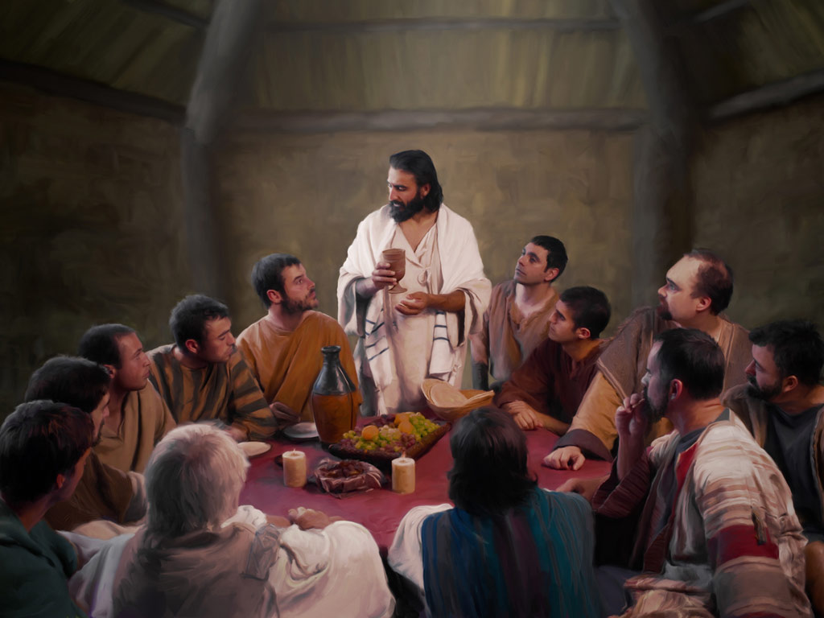
What I know already about how the
Church celebrates Holy Thursday
R-2
S-03
Click on the worksheet button to go to the worksheet
Notes:
Print off a worksheet for each child to complete and add to their RE Learning Journal. Give children time to share the items on their worksheets and add new ones.

Slide 4
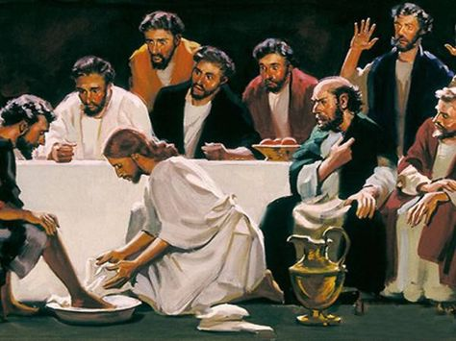
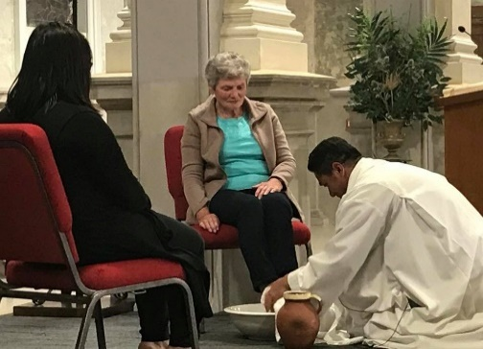


The Holy Thursday Liturgy recalls and celebrates the actual events by re-enacting them and making them real for the community
Look closely at the 4 images.
Write what you see and how the images on the left relate to those on the right.
Explain how re-enacting the actual events of the Last Supper makes them real and present for you and the community.
R-2
S-04
Notes:
Work through each bullet point and discuss what children write about how the images of the Scriptural event and the liturgical re-enactment relate to each other. Talk about why schools re-enact the Holy Week events and how they help children to understand them.

Slide 5
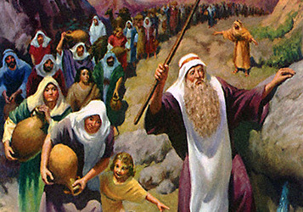
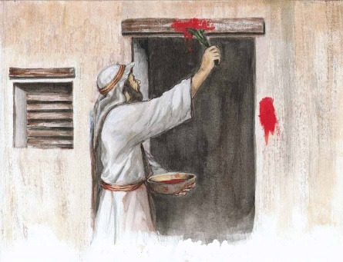
The First Reading at the Holy Thursday Mass tells about how the Passover Meal was to be celebrated
A Reading from the book of Exodus 12:1-8, 11:14
God said to Moses and Aaron in the land of Egypt:
Tell the people of Israel they are to take a lamb for each family.
The lamb is to be killed at twilight.
Some of the blood of the lamb is to be put on the doorpost of the house.
They are to eat the lamb that same night. They are to eat it roasted over the fire with unleavened bread and bitter herbs.
When you eat it you must be dressed ready to move on with sandals on your feet and a stick in your hand.
You are to eat it quickly. It is the Passover of the Lord. When I see the blood on your door posts I will pass over you and protect you when I strike the land of Egypt.
Keep remembering this day by celebrating the Passover meal. You must do it every year. When your children ask what this means, explain to them that this is God’s Passover feast, when God passed over you and the firstborn of the Egyptians was killed.
R-2
S-05
Click on the green button to advance through the lines.
Notes:
Children read the story from the Book of Exodus using the green pointer. They re-read it silently. Children then identify the instructions God gave the people about how they were to celebrate the Passover meal. Teacher highlights the instructions as they are identified using highlighter in bottom left corner of the screen. Teacher explains that Jewish people still follow these instructions as they celebrate their Passover meal today in their homes. Ask children to explain what is meant by Passover and why the meal is called the Passover meal.

Slide 6
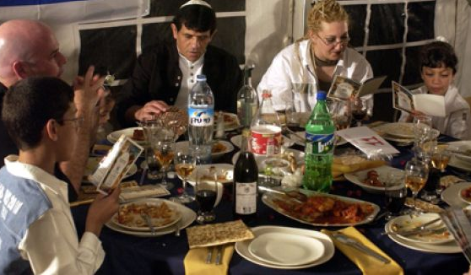
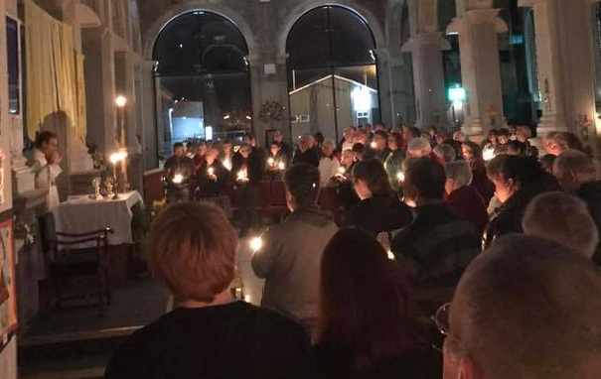
Making connections between the Jewish Passover Meal and the Christian Mass
Watch the clip and when it is finished make a list of the similarities between the Seder meal, the Last Supper and the Mass.
The Mass is not simply a remembrance of Christ’s paschal mystery, it is not a new sacrifice made every Sunday, but a sacrament in which his present-day followers sit around the table with him and participate in the event.
The concept of the Jewish Passover being made present should be familiar to Catholics. When they participate in the celebration of the Eucharist they are making Christ’s sacrifice present.
Later when we have familiarised ourselves with the ritual of the Seder, we will see how Jesus departed from that ritual, we can understand the importance of his words and deeds that evening which became the foundation of the Catholic Mass.
Regardless of whether the Last Supper was a Seder or not, Jesus used several Passover themes at his final meal.
While the Jewish and Christian Passovers are celebrations of different events, they share the same important meaning. Both Christians and Jews celebrate God’s saving love and thus commit themselves to living that love in their lives.
R-2
S-06
Click top card to discard it. Click the video button to play the video:
‘The Jewish Seder, The Last Supper and the Catholic Mass’.
Notes:
After watching the clip, read the flip cards to generate questions and discussion about the connections between the Jewish feast of Passover and the Christian mass.
Watch the clip
The Jewish Seder, The Last Supper and the Catholic Mass
https://www.youtube.com/watch?v=g97VwxJdrfM
6:03 minutes
Teacher background notes for the Feast of Passover
Passover is a Jewish holiday that celebrates the exodus of Hebrew slaves from Egypt. There is a whole book in the Old or First Testament that tells the Exodus story. Exodus means to leave. As the story goes, the Jewish people were enslaved in Egypt for generations by the Pharaoh who treated them cruelly as slaves and ordered the death of all Jewish baby boys in order to control the number of Jewish people. One brave Jewish mother broke the law and hid her baby son from the authorities by sending him floating down the Nile in a water proof basket. He was discovered in the river by Pharaoh's daughter who rescued him and named him Moses. He was raised in Pharaoh’s palace.
When Moses grew up, he recognized what terrible lives the Hebrew slaves led. One day Moses fought with an Egyptian who was beating a Hebrew slave, and he was forced to flee into the desert. God appeared to Moses in the form of a burning bush and told him he had chosen him to free the Jewish people from bondage. Moses managed to convince the Egyptian ruler to free the Hebrew slaves. Only after God sent ten plagues did the Pharaoh agree to free them. The last of the plagues, the killing of the firstborn, is where the name for the Passover holiday comes from: according to Jewish tradition, the Angel of Death “passed over” Jewish homes that night, and only Egyptian families were affected. Hurrying to escape from Egypt before Pharaoh changed his mind, the Jews didn’t have time to let their bread for the journey rise.
Today, for all of the eight days of Passover, Jews eat only ‘matzah’, unleavened or flat bread to help them remember how their ancestors fled to freedom. The feast of Passover, is usually around Easter time and it is named because the Jewish people ‘passed over’ from slavery to freedom from the Egyptians (that is why this story is read at mass on Holy Thursday evening). During their Seder meal on the first night of Passover the people recount the Exodus story. Seder is Hebrew for ‘order’, because at the meal different food is eaten in a special order. Blessings are said throughout the meal.
Passover is really a celebration of freedom, so many Jews use the holiday as a time not only to rejoice at the freedom of their ancestors, but also to recognize the hunger and pain of others still in need. Adapt Teaching and Learning Experience 5

Slide 7
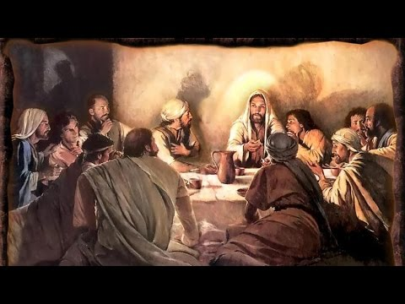
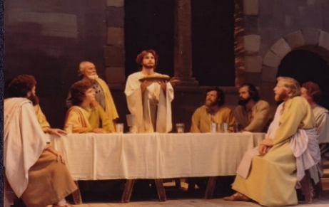
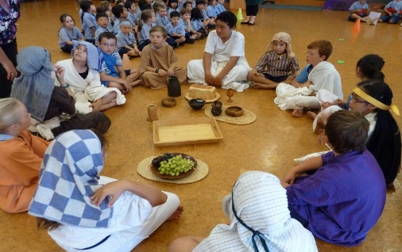
The Second Reading at the Holy Thursday Mass
A Reading from 1 Corinthians 11:23-26
On the night when Jesus was betrayed he took
a loaf of bread and when he had given thanks, he broke it and said, “This is my body which is given up for you. Do this and remember me.”
In the same way he took the cup and said,
“This is the new covenant in my blood.
Do this in remembrance of me.”
When you eat this bread and drink this cup you proclaim the Lord’s death until he comes again.
Pen/Highlighter Tool
R-2
S-07A
Click on the green button to advance through the lines.
Click on the pen tool at the bottom left, then select the highlighter tool and use it to highlight any text.
Notes:
Read the 1 Corinthians passage with the children using the pointer. Highlight the words Jesus speaks with the highlighter tool and explain these are the words of consecration when the bread is changed into Jesus’ body and the wine is changed into Jesus’ blood. Jesus gave the apostles and priests who follow on from them the power to do as Jesus did at the Last Supper. This is why this reading is part of the Holy Thursday Liturgy because Holy Thursday is the day this story took place in 33AD. Through being present at mass, seeing the priest as he says the words Jesus said at the Last Supper and holds up the bread and wine, we participate in the meal just as if we are sitting with Jesus’ disciples today around the table with the first apostles This experience makes it possible for present day Christians to participate regularly and do what Jesus asked – to remember him so we become more like him as we eat his body and drink his blood.

Slide 8


The Second Reading at the Holy Thursday Mass
This passage from St Paul describes the first time
Jesus changed the bread and wine into his body and blood.
This happened at the Last Supper Jesus had with
his friends and is continued with his friends today in the Mass.
When Jesus did this he gave the disciples and all the
priests that follow on from them the power to do this also.
his friends and is continued with his friends today in the Mass.
priests that follow on from them the power to do this also.
Jesus changed the bread and wine into his body and blood.
R-2
S-07B
Click on the statement in the box that will complete the sentence correctly.
Notes:
Use each item in the word float activity as a conversation starter about what it means. Explain to the children that the Second Reading is St Paul’s account of the Last Supper. It tells how Jesus instituted the Sacrament of the Eucharist. It reminds us that Jesus chose everyday food and drink so that whenever his disciples ate and drank together they would remember him. That was over 2000 years ago and today Jesus’ followers are still remembering him at mass and as Paul said they continue “proclaiming his death until he comes again.”
ANSWERS:
1 = 3rd line, 2 = 1st line, 3 = 2nd line.

Slide 9
The Second Reading at the Holy Thursday Mass
Every time we go to Mass the priest repeats this action
so we can remember Jesus as he asked us to at the Last Supper.
This action is called the Consecration of the bread and wine
and Jesus gave priests the power to consecrate the bread and wine also.
When we are present at Mass we participate just as if we are
present with Jesus and the disciples at the Last Supper.
so we can remember Jesus as he asked us to at the Last Supper.
present with Jesus and the disciples at the Last Supper.
and Jesus gave priests the power to consecrate the bread and wine also.
R-2
S-07C
Click on the statement in the box that will complete the sentence correctly.
Notes:
ANSWERS:
4 = 1st line, 5 = 3rd line, 6 = 2nd line.

Slide 10
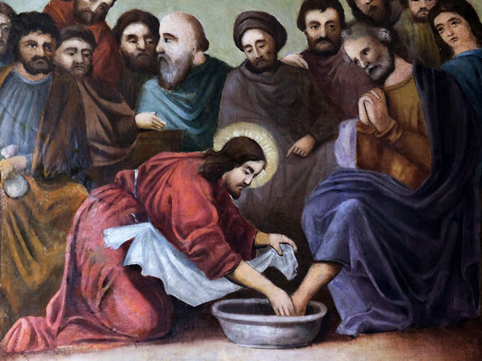
The Gospel in the Holy Thursday Liturgy
Peter: “Lord are you going to wash my feet?”
Jesus: “You do not understand what I am doing now, but later you will”.
Peter: “I will never let you wash my feet.”
Jesus: “If I don’t wash your feet it means you want nothing more to do with me.”
Peter: “If that’s what it means then wash my hands and my head too!’
Jesus: “Do you know what I have done to you? You called me Lord and Teacher and that is right, for that is what I am. So if I, your Lord and Teacher, have washed your feet you should wash one another’s feet. I have done this as an example so that you will do as I have done.”
Listen to the Gospel reading for Holy Thursday John 13:3-15
The Narrator reads the main part of the text.
Class join in the words of Jesus and Peter.
Narrator indicates when the class reads the words on the screen.
R-2
S-08
Notes:
Follow the instructions on the slide. The take time to talk with the children about the attitude people need when they want to serve others. Jesus calls is it humility or humbleness. For Christians humility or humbleness means being free from pride, recognising the gifts you have are from God – you did not earn them, God gave them freely to you. Humble people don’t mind helping to clean up a mess, do tasks that are not pleasant, do not seek revenge, don’t act like a big shot, enjoy being of service to others, are aware of their failures, apologise for their mistakes - even small ones, learn from criticism and are always willing to help, show kindness, are always forgiving and compassionate. Words like humble, humility humbleness occur 71 times in the Bible which shows how much God really wants people to learn how to be humble. An example of humbleness is when Jesus, the son of God washed the feet of the apostles. How can you cultivate an attitude of humbleness? Watch the clip on the next slide and learn from Pope Francis.

Slide 11
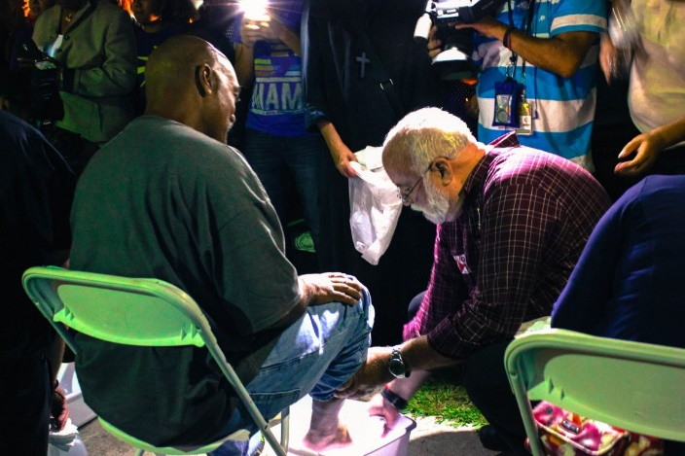

What is the meaning of the
washing of the feet?
Watch the clip then read the message on the sub-titles that Pope Francis is speaking in Italian.
It is the same message Jesus was giving to his apostles on the first Holy Thursday. What is it?
What is washing someone’s feet a symbol of?
What else could children of your age do to develop an attitude of humility and service?
Listen to the Gospel reading for Holy Thursday John 13:3-15
The Narrator reads the main part of the text.
Class join in the words of Jesus and Peter.
Narrator indicates when the class reads the words on the screen.
Arrange to have a foot washing ceremony in your class. During it explain how this very old custom was carried out by the servants of the house. Think about how you could be of humble service at home and at school.
R-2
S-09
Click the symbols to reveal text. Click the video button to play the video: ‘Pope Francis washes prisoners' feet’.
Notes:
Slide 9 What is the meaning of the washing of the feet?
Reveal the text reveals and discuss each statement and share responses to the questions.
Watch the clip
https://www.youtube.com/watch?v=4OOkBIrW60w
Pope Francis washes prisoners' feet
1:12 minutes
Children share responses to the clip and suggest ways children of their age could show a humble attitude by being of service to others. This is what Jesus is asking of all his followers. Volunteering to clean up a mess you did not make, making a drink to comfort someone who is upset and giving up what you have when there is not enough to go round are all examples of humble service.
Plan a class liturgy around the washing of the feet. It could be in your class or at lunchtime in a quiet place for anyone who would like to come. A prayerful reflective atmosphere needs to be maintained throughout. Reflective music can help with this.

Slide 12
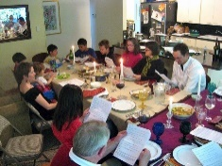
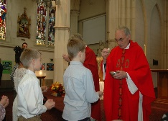
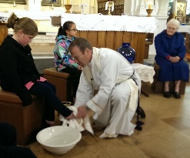
How the instructions in the Readings for the Holy Thursday Mass are fulfilled today
-Look at the picture of the priest washing the girl’s feet.
-Try to recall the instructions Jesus gave to the disciples about this.
-Refer to the Gospel Reading - John 13:3-15
-How are these instructions being fulfilled by Christians today?
-Can you identify which themes go with each reading – freedom, service, remembrance, family, sharing, showing example, keeping instructions, friendship, symbols, recognising meaning, love, sacrifice, making present.
-Look at the picture of the Jewish family at their Seder Meal.
-Try to recall the instructions God gave Moses and Aaron to prepare for the meal.
-Refer to the first Reading - Exodus 12:1- 8, 11-14 if you need to.
-How are these instructions being fulfilled today?
-Look at the picture of the priest and the children.
-Try to recall the instructions Jesus gave at the Last Supper.
-Refer to the second Reading - 1 Corinthians 11:23-26
-How are these instructions being fulfilled by these people today?
R-2
S-10
Click an image to reveal text.
Notes:
Follow the instructions in the revealed text and answer the question at the end of each one. Children could make a poster of the reading/s of their choice and illustrate it/them. On the frame write how the instructions in the readings are being fulfilled today. Add the Scripture references and discuss why these readings were chosen for Holy Thursday.

Slide 13

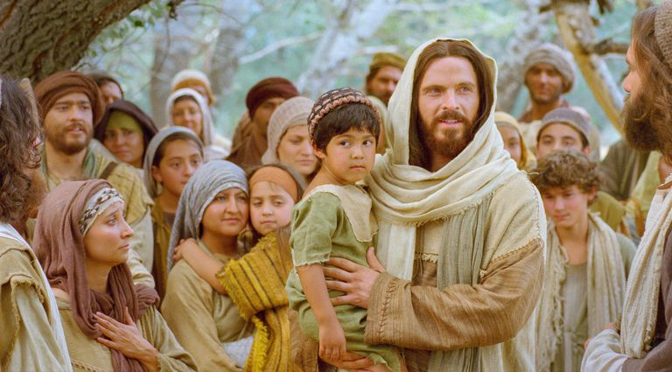

Setting Examples for People to Follow
In everything he did Jesus set examples for his disciples to use to help them become holy and more like God.
Can you name some of the ways Jesus set examples? – look at the image to get an idea.
Reflect in silence for a few minutes and decide on one way you could serve someone at home and someone at school. Ask God to help you see people in need and how you could be of service to them.
Can you name some attitudes that people who serve others have?
On Holy Thursday night the gospel highlights an example Jesus wants his followers to use. Can you name what he did to set an example? What attitudes would you need to have to do this for people in need today? Can you think of other ways you can serve others?
Who sets good examples for you about how people should be treated? Name people in your family, your class and your school. What helps you to notice when people are serving others?
R-2
S-11
Click the pins on the right to reveal post-it notes.
Notes:
Work through each PIN and respond to the instructions and the questions.

Slide 14
Check Up
1)
Write a paragraph about one of the readings, explain what it is about and why it was chosen for the Holy Thursday Mass.
2)
Name some of the themes in one of the readings and describe how people make this reading present today in liturgy.
3)
Make a picture of a Seder meal and write 3 things you learned about what it celebrates.
R-2
S-12A
Notes:
This formative assessment strategy will help teachers to identify how well children have achieved the Learning Intentions of the resource.
Teachers can choose how they use the slide in their range of assessment options.
A worksheet of this slide is available for children in Years 5-8 to complete.
The last two items are feed forward for the teacher.
Recording the children’s responses to these items is recommended as it will enable teachers to adjust their learning strategies for future resources and target the areas that need further attention.

Slide 15
Check Up
4)
Make an Acrostic for the word SERVICE – refer to Overview for instructions. Use the Acrostic in the Sharing our Learning on Slide 12, R3.
5)
Which activity do you think helped you to learn best
in this resource?
6)
Questions I would like to ask about the topics in this resource are …
R-2
S-12B
Click on the worksheet button to go to the worksheet
Notes:
Item 4 To create an acrostic, follow these easy steps:
Write your word down vertically using upper case letters.
Brainstorm words or phrases that describe your idea.
Place your brainstormed words or phrases on the lines that begin with the same letters.
Fill in the rest of the lines to create a poem.
Decorate your poem and display it in your classroom and share it with you family.

Slide 16

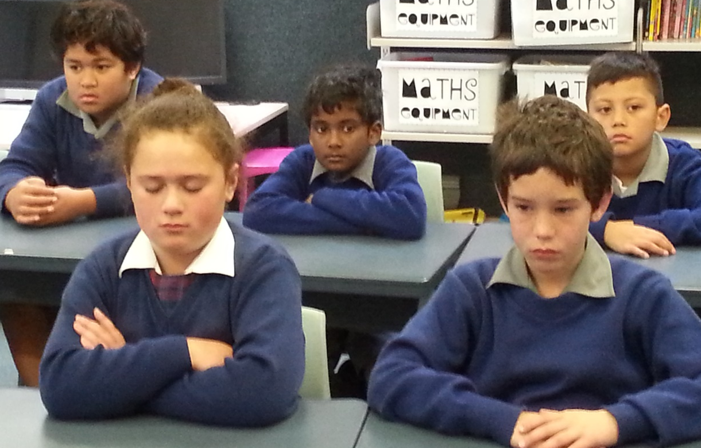

Time for Reflection
R-2
S-13
Click the audio button to stop reflective music
Click the audio button to play reflective music
Notes:
The MP3 is played to help create a reflective atmosphere and bring the children to stillness and silence as the teacher invites them to reflect on the events in the last 3 days of Jesus’ life. Bring to mind a picture of Jesus as he walked the journey to the cross. Recall his message at the Last Supper of the importance of serving others whenever they see a need. Plan some ways they could do this especially over the next week. Try to make it a habit of mind and heart as they grow to serve others as Jesus’ disciples today.

Slide 17
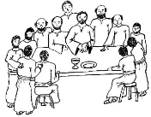
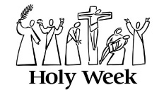
WHAT I KNOW ABOUT HOLY THURSDAY AND HOW IT IS CELEBRATED IN THE CHURCH
Name:________________________
Date:____________
Symbols I associate with Holy Thursday are …
Draw them here:
Words Jesus spoke on Holy Thursday I can recall are …
R-2
S-03
Worksheet
Click the up arrow to return to the presentation
Notes:
This Worksheet relates to Slide 3.

Slide 18
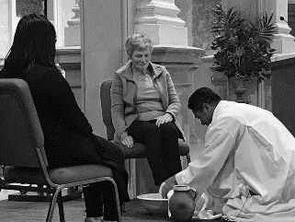
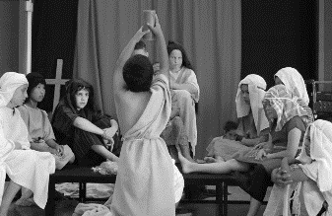
Check Up
1)
Write a paragraph about one of the readings, explain what it is about
and why it was chosen for the Holy Thursday Mass.
2)
Name some of the themes in one of the readings and describe how people make this reading present today in liturgy.
3)
Make a picture of a Seder meal and write 3 things you learned about what it celebrates.
4)
Make an Acrostic for the word SERVICE – refer to Overview for instructions. Use the Acrostic in the Sharing our Learning on Slide 12, R3.
5)
Name:_______________
Which activity do you think helped you to learn best in this resource?
Date:____________
6)
Questions I would like to ask about the topics in this resource are …
R-1
S-12
Worksheet
Click the up arrow to return to the presentation
Notes:
This Worksheet relates to slides 12A and 12B.

Slide 19
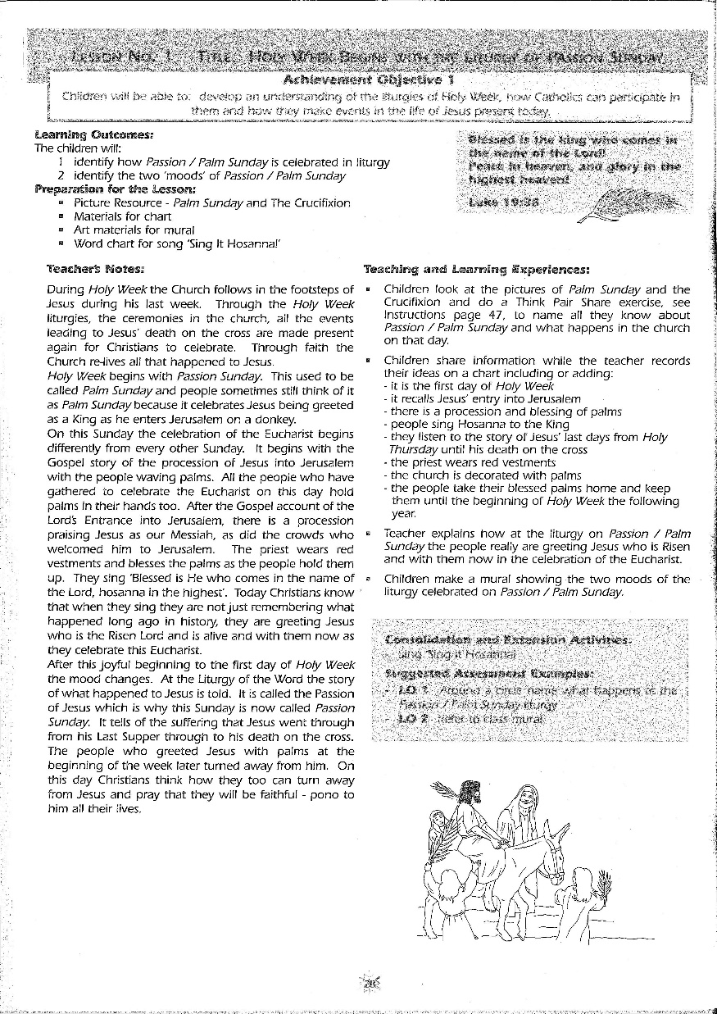
Click on the worksheet button to go to the worksheet

Slide 20
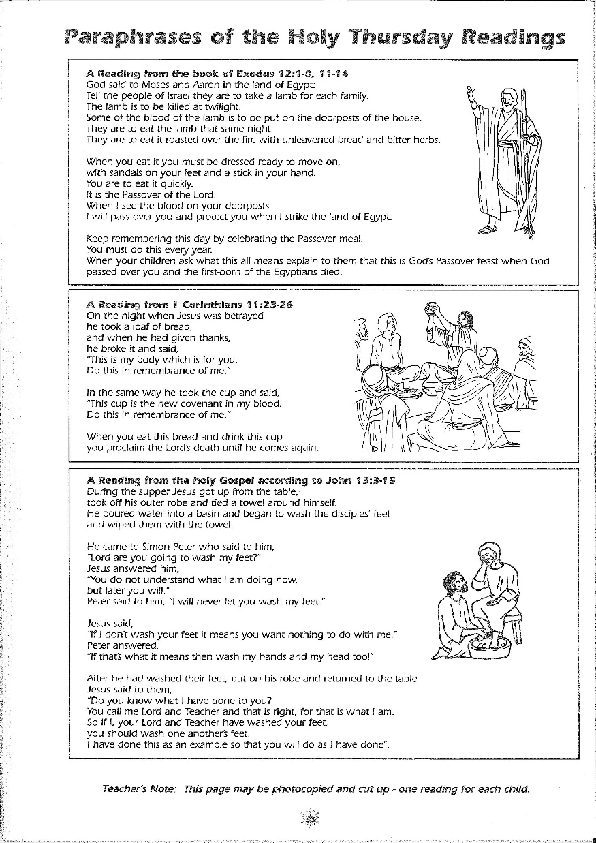
Click on the worksheet button to go to the worksheet

Slide 21
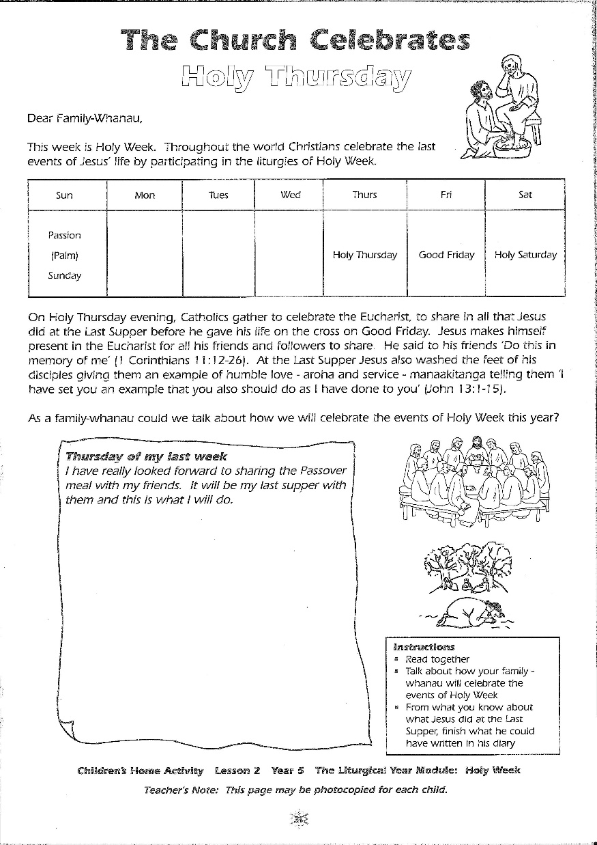
Click on the worksheet button to go to the worksheet

