Slide 1
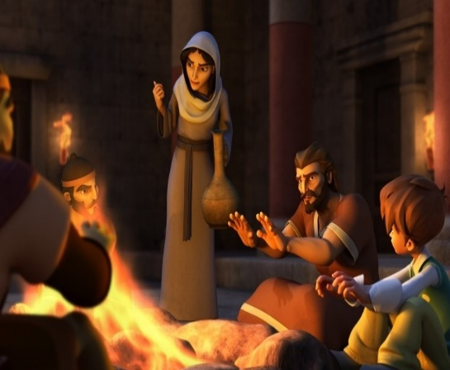
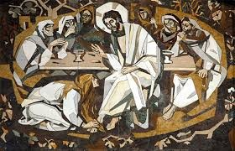
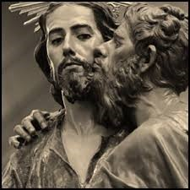
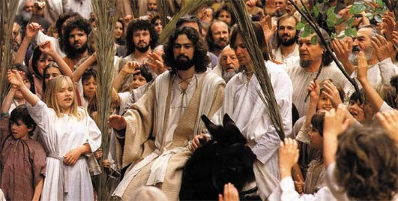
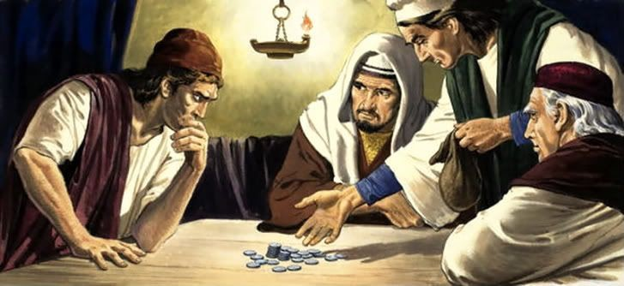
Holy Week – the first four days
R-1
S-01
Notes:
Slide 1 Holy Week – the first four days
Teachers – there is a clip available in the Overview Note on Slide 9 with further information that could help with this resource.
Look closely at the collage of images and think about what is happening in each one. Think about what part of Holy Week these images relate to – the events following Palm Sunday.

Slide 2
Learning Intentions
The children will:
identify what the Church recalls in the Gospel readings during the first four days of Holy Week.
1)
R-1
S-02
Click the box to reveal the Learning Intention
Notes:
Slide 2 Learning Intentions
Create a Palm Sunday prayer focus the week before Palm Sunday using suitable images and symbols. Add to these during Holy Week. Read the Holy Week bible stories during prayer time and let the children dramatise them and sing the songs they know related to them.
Give children some special ‘quiet time with Jesus’. You may like to create a special quiet place for children to go to reflect with Holy Week books and symbols.
Spend time looking at the images on the slides and talk about each one – there is a lot of learning to be done doing this and it will give the children a deeper sense of what the events of Holy Week are about. Draw their attention to the different styles of art and images that the slides include. Use reflective music this week in the classroom to increase the children’s awareness of the importance of this week in the liturgical life of the Church.
Explain that Easter Sunday is not really in Holy Week because it is the beginning of the Easter Season. Mention that Good Friday and Easter Sunday are holidays, so children learn about them before they celebrate them. Encourage the children to share what they are learning about Holy Week with their family by using the Sharing our Learning worksheet (Slide 12, Resource 2). You may like to give the children a copy of the parish bulletin and work through it with them marking the times of the Holy Week and Easter ceremonies they could attend.

Slide 3
Holy Week – the first four days
Name the main characters in each image and name where each incident fits into the sequence of events in the first Holy Week.
Name what these events focus on.
What events are still to come in Holy Week?
R-1
S-03
Notes:
Slide 3 Holy Week – the first four days
Work through each bullet point and use them as conversation starters about the incidents from the gospels of Holy Week.
Images from top left Peter warming himself at the fire and the woman accusing him of being a follower of Jesus. Peter denies he is. Mary anoints Jesus’ feet with expensive oil – she does not know she is anointing him for burial after his death on the cross.
Judas betrays Jesus with a kiss – a gesture of love and friendship.
Jesus is hailed as a king as he rides into Jerusalem. He knows this journey on Passion Sunday is leading him to his death on Good Friday.
Judas bargains with the chief priests over how much they will pay him for handing Jesus over to them.

Slide 4
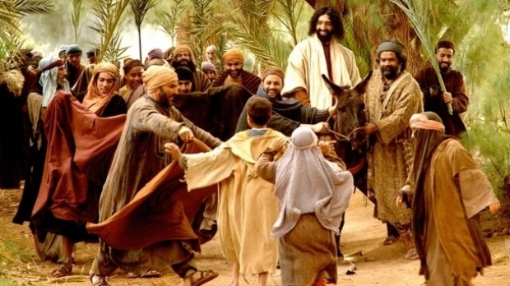
The Gospel Readings of the first four days of Holy Week
Read Palm Sunday Gospel, Matthew 21:1-11
Why is this a significant day in Holy Week and what is it sometimes called?
Passion Sunday was the beginning of Jesus’ journey to his death and resurrection.
What changes in the attitude of the crowd towards Jesus took place during the week?
The crowd was easily led to change their attitude to Jesus from cheering for him and welcoming him as their King to 4 days later shouting for him to be crucified. They forgot very quickly his teaching about God, his healing of the sick and disabled and his love and kindness to them.
Can you imagine the thoughts and feelings Jesus was having as he rode in triumph into Jerusalem?
When the crowd turned against Jesus he would have felt their rejection very deeply. Have you had an experience of being rejected by people you thought were your friends and whom you had treated with kindness? You might like to share these experiences and say how you felt.
R-1
S-04
Click the palms to reveal the answers
Notes:
Slide 4 The Gospel Readings of the first four days of Holy Week Sunday’s Gospel Matthew 21:1-11
The readings in these days of Holy Week are to help prepare people for the events marked in the Triduum.
Note each reading is introduced separately.
The Teacher Resource (p 27) can be downloaded from the resources on the front screen.
Children read each question and respond. Use the palm to add to their responses.
Adapt Teaching and Learning Experience 1.

Slide 5
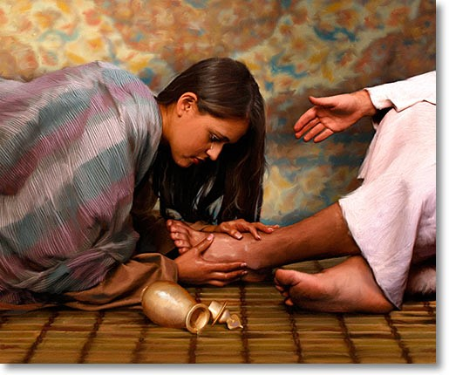
Monday‘s Gospel – Jesus is Anointed by Mary
at her home in Bethany
Jesus may still have been feeling good about the welcome he had received from the people as he rode into Jerusalem. He knew what was to happen and would have felt the shadow of the cross hanging over him.
Read John 12:1-8
Judas Iscariot, who was about to betray Jesus was present and he rebuked Mary saying the oils should have been sold and the money given to the poor.
Mary did not realise that she was anointing Jesus for his burial as she did not know he was going to die. Jesus spoke up for Mary and pointed out that although she was unware of what she was doing she had done the right thing – there would always be poor but the time Jesus would be with them was coming to an end.
Have you ever had an experience of being criticised for an act of love and kindness?
He accepted an invitation to dinner with his close friends Martha, Mary and Lazarus. Jesus was human and needed his friends nearby. During the evening Mary sensed this and anointed his feet with expensive oil and its fragrance filled the house.
R-1
S-05
Click the pins on the right to reveal post-it notes.
Notes:
Slide 5 Monday‘s Gospel – Jesus is Anointed by Mary at her home in Bethany John 12:1-8
Read the story from the bible so children can appreciate it as the sacred word of God.
There is no particular event that happened on the Monday of Holy Week. The Church retells the important story of Mary, the sister of Martha and Lazarus, anointing the feet of Jesus. Mary did not know the deeper meaning of what she was doing – her anointing was preparing Jesus for his death and burial.
Read each post it text and use it to generate discussion and questions about this reading that shows the humanity of Jesus. Listen to the children’s responses to the question on the last PIN.

Slide 6
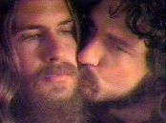
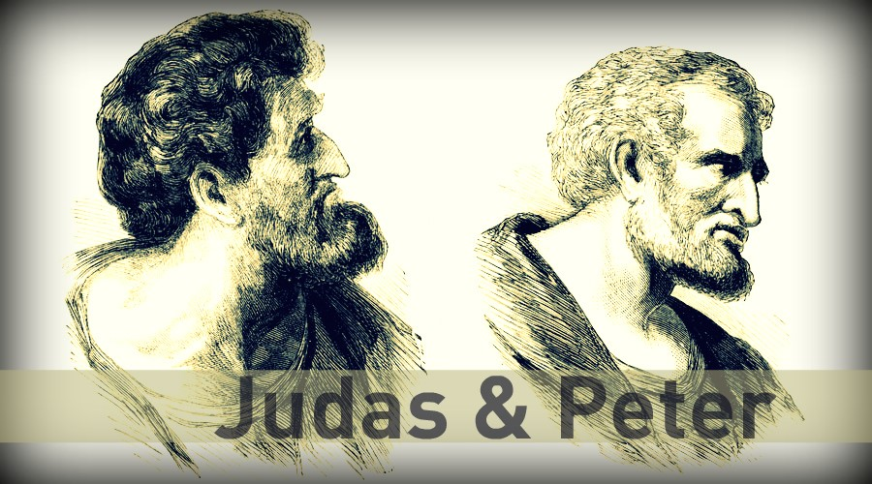
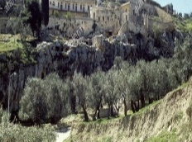
Tuesday’s and Wednesday’s Gospels – Jesus foretells Judas’ Betrayal and Peter’s Denial
How did Judas betray Jesus?
Read John 13: 21-30
Judas used a sign of love –
he betrayed Jesus with a kiss.
How much was Judas paid for betraying Jesus?
30 pieces of silver by the Jewish
chief priests.
What happened to Judas?
Watch the clip to find the answer.
Click the video button to play “Potters Field Bought - 30 Pieces of Silver”
R-1
S-06
Click the audio button to stop ‘Judas and Mary’
Click the audio button to play ‘Judas and Mary’
Click the icons to reveal the answers
Notes:
Slide 6 Tuesday’s and Wednesday’s Gospels – Jesus foretells Judas’ Betrayal and Peter’s Denial
John 13:21-30
Read the story from the bible so children can appreciate it as the word of God. Children read and respond to the questions and then add to the responses by clicking the image.
30 pieces of silver today would be worth around $600.
Watch the clip https://www.youtube.com/watch?v=HMGPVX1sBFo
Potters’ Field Bought - 30 Pieces of Silver - Matthew 27:1-10 (2:22 minutes)
Sing ‘Judas and Mary’

Slide 7
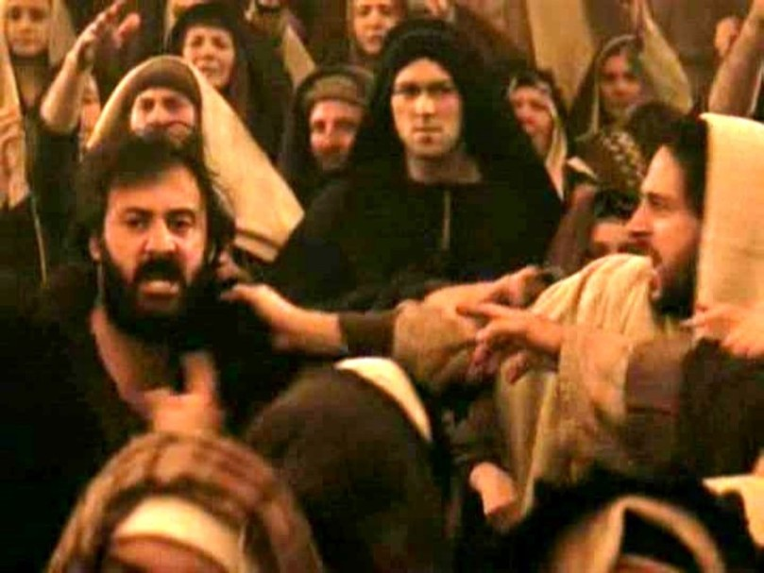
Tuesday’s Gospel – Jesus foretells Peter’s Denial, Peter denies Jesus
Read John 13: 36-38, Matthew 26: 69 -75
From the stories you have heard about Peter how would you describe him as a person?
What do you think caused Peter to deny someone he had been a friend and follower of for 3 years?
Describe Peter’s reaction when he realised that he had fulfilled what Jesus had predicted?
How did Peter die and do you think his death made up for his denial of Jesus?
Have you ever let someone you love down badly – how did you feel? How did you make up for it?
R-1
S-07
Click the red arrow to move the blind down
Click the slider to reset
Notes:
Slide 7 Tuesday’s Gospel – Jesus foretells Peter’s Denial, Peter denies Jesus John 13:36-38, Matthew 26: 69-75
Read the story from the bible so children can appreciate it as the word of God. How do you feel about Peter denying Jesus?
Have you ever done something you felt ashamed of? Remember Peter was the man Jesus chose to be the leader of his followers and he became the first Pope.
What does that say about Peter’s relationship with Jesus?
Give children a chance to respond to these questions and the ones on the screen.

Slide 8
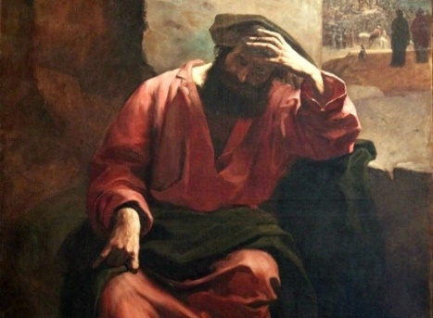
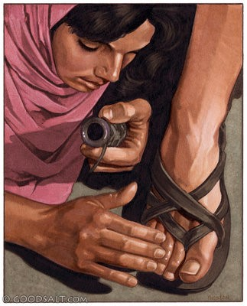
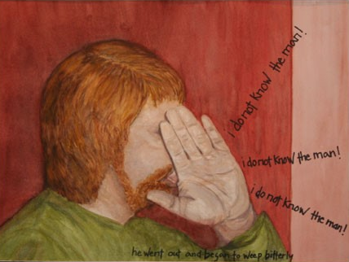
Reflecting on the Gospels for the 3 Days in Holy Week before the Triduum
Imagine you are the main character in the story
Write a diary account of what happened in the Gospel story from the perspective of your chosen character starting with - My name is …
Include your personal feelings and reactions to the events in the story and how your actions affected Jesus.
Finish with - If Jesus were here now I would say to him …
Look closely at the images – what do they tell you about the people and their actions?
Choose one incident that had a deep impact on you from the 3 Gospels
R-1
S-08
Notes:
Slide 8 Reflecting on the Gospels for the 3 Days in Holy Week before the Triduum Work through the instructions on the screen and when children have completed their diary accounts make time for them to be shared with the class.
Notice the words on the image of Peter and why do you think his hand is where it is.
Adapt Teaching and Learning Experience 3.

Slide 9
FAQs about Jesus’ life, death and resurrection
What did Jesus’ death achieve for humanity?
Jesus’ death saved the world by reconciling the loving relationship between God and people. It brought about forgiveness of sins, and the potential to live an eternal life with God. It made it possible for people to have hope, peace and freedom and brought meaning and value to human life and all living things.
10
What do we learn from
Jesus’ death?
By his death Jesus taught us how to live well, by choosing and affirming life giving things, knowing that death is not the end, there is much more to life as we know it on earth and after our death we will live in wholeness with God in heaven forever.
9
­Did Jesus have to die?
Death was the price Jesus had to pay if he was to be faithful to his mission. He did not die because God demanded suffering. He died because a sinful world fought the truth he preached and he had to be true to himself, his life and his mission.
8
So did Jesus’ mission lead him to his death?
Yes, Jesus’ life and mission led him to his death which led him to his resurrection. He did not run away or give up what he came to do. He was tempted but he resisted. He knew when he set out for Jerusalem on Palm Sunday that he could not go back and that he was facing a serious risk of death.
7
So what led to Jesus’ death?
By carrying out the mission he came to do, Jesus became very unpopular with the Jewish authorities. He challenged their religious and civil laws, their interpretation of Scripture and they worried he would stir up the Roman army against them and this would bring their anger down on Israel.
6
What did Jesus come to earth to do?
Jesus came to earth to bring good news to the poor… liberty to captives and recovery of sight to the blind, to let the oppressed go free… (Luke 4: 18-19). His mission was not about dying but about forgiveness, healing, freeing and living life to the full.
5
How was Jesus part of God’s saving plan?
God’s saving plan was brought about by his son Jesus freely offering to sacrifice himself to restore the loving friendship between God, people and creation.
4
What was God’s plan to restore his friendship with people?
But God could not abandon his people and the creation he loved so much. God devised a saving plan so that he could be reconciled with his people once and for all.
3
What went wrong and how did things change?
The first people damaged their loving relationship with God through disobedience the ‘original’ sin and everything changed. God hated injustice and sin. It interrupted his plan and it allowed death, suffering and pain to come into the world. People turned away from God and sin became part of life.
2
Was Jesus’ death part of God’s plan in the beginning?
No. God created everything in love for love. God’s plan was that all creation including people would live in a loving harmonious relationship with God, with each other and with the world.
1
R-1
S-09
Click top card to discard it
Notes:
Slide 9 FAQs about Jesus’ life, death and resurrection
Read the words on the image – where have you heard them before? What do they mean to you?
Read the Flip Cards and notice the content of this resource may encourage children to ask questions such as the FAQs on the flip cards. The explanations given are simple taking account of the age of Year 6 children. Keep a record of any further questions children ask and seek further information to respond if necessary. Remind children that the prayers in the liturgy often repeat the words that help us to make meaning of Jesus’ death and what it means for all Christians. The Creed is a good example to look at. (Find the words on www.catholic.org).
You could pray the prayer on the image and the Nicene Creed during class prayer this week.
Teachers note - This you tube clip offers further ideas to increase your understanding of this topic if needed. Allow time for discussion when it is finished.
https://www.youtube.com/watch?v=qSzNgyMF6DQ
Why Was the Cross Necessary? (Faith Seeks Understanding) 6:12 minutes

Slide 10
Check up
1)
Write a short account of Judas’ betrayal of Jesus and name 2 outcomes of his actions for himself and Jesus. (Slide 6)
2)
Explain why you think the Church chose these 3 readings to be used in Holy Week and what are these readings telling us about Jesus? (Slide 8)
3)
What does it say about Jesus when he chose Peter, who had denied him 3 times, to be the first leader and pope of the Church? (Slide 7)
4)
Make a list of the feelings Jesus might have experienced during the first 4 days of Holy Week and what could have caused them. (Slides 4, 5, 6)
5)
Which activity do you think helped you to learn best in this resource?
6)
Questions I would like to ask about the topics in this resource are …
R-1
S-10
Click the worksheet button to go to the worksheet
Notes:
Slide 10 Check Up
This formative assessment strategy will help teachers to identify how well children have achieved the Learning Intentions of the resource.
Teachers can choose how they use the slide in their range of assessment options.
A worksheet of this slide is available for children in Years 5-8 to complete.
The last two items are feed forward for the teacher.
Recording the children’s responses to these items is recommended as it will enable teachers to adjust their learning strategies for future resources and target the areas that need further attention.

Slide 11
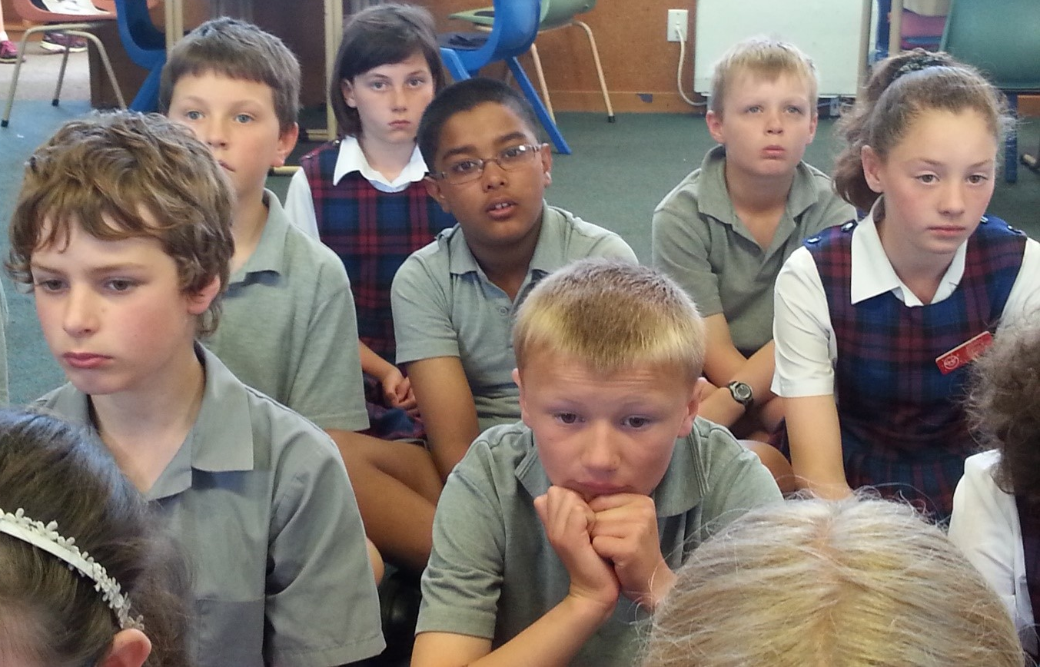
Time for Reflection
R-1
S-11
Click the audio button to stop Reflective Music
Click the audio button to play Reflective Music
Notes:
Slide 11 Time for Reflection
The MP3 is played to help create a reflective atmosphere and bring the children to stillness and silence as the teacher invites them to reflect on the people in the gospel stories they have read this week. Ask themselves if there is a little bit of Mary, Judas and Peter in everyone? Remind themselves how important it is to forgive themselves and others and to care for people you love when there is an opportunity.

Slide 12
Check up
Name:____________________________
Date:____________
1) Write a short account of Judas’ betrayal of Jesus and name 2 outcomes of his actions for himself and Jesus. (Slide 6)
2) Explain why you think the Church chose these 3 readings to be used in Holy Week and what are these readings telling us about Jesus? (Slide 8)
3) What does it say about Jesus when he chose Peter, who had denied him 3 times, to be the first leader and pope of the Church?
(Slide 7)
4) Make a list of the feelings Jesus might have experienced during the first 4 days of Holy Week and what could have caused them.
(Slides 4, 5, 6)
5) Which activity do you think helped you to learn best in this resource?
6) Questions I would like to ask about the topics in this resource are …
R-1
S-10
Worksheet
Click the up arrow to return to the presentation

