Slide 1
Remembering what Jesus did in Holy Week
R-1
S-01
Notes:
Slide 1 Remembering what Jesus did in Holy Week
Use this slide as a focussing strategy to introduce the resource topic. Read the title together and invite students to share something they know about Jesus’ life and death during Holy Week. Use the symbols in the image as prompts.

Slide 2
Learning Intentions
The students will:
1)
identify what the Church remembers of Jesus’ life and death during the days of Holy Week.
R-1
S-02
Notes:
Slide 2 Learning Intentions
Invite students to suggest ways they could create a quiet, reflective, prayerful atmosphere in the classroom during Holy Week. Provide some symbols, cloths and candles to set up a special prayer focus for Holy Week starting with Passion Sunday symbols and add symbols as the week progresses. Use the gospel readings that describe the events in class prayer each morning and use Taizé music to help continue this throughout the day. Create wall displays of appropriate images and set aside part of the classroom as a quiet prayer space that can be used during the day.
Remind the students that as Good Friday is a holiday they will need to include the symbols on the prayer focus for that day on Holy Thursday. If you have students who need more RE background on Holy Week, the Level 3 Year 6 Holy Week resources focus on the first 4 days of Holy Week and the Days of the Easter Triduum which you can access on the web.
A suggestion for Holy Thursday morning prayer https://www.youtube.com/watch?v=H-PGK4WGmLU
This is the Last Supper spoken in Hebrew with English subtitles (3:07 minutes)
Children could imagine that this is what Jesus’ voice sounded like as he prayed over the bread and wine at the Last Supper. Remember you are a spiritual guide for your class and this is the most important week of the year to let the students see this
For Slide 9 the students will need a copy of their local church Holy Week Schedule.

Slide 3
Holy Week in the Liturgical Year
Notice where Holy Week occurs in the Liturgical Year – what proceeds it and what follows it.
Reflect on what the Church remembers about the life of Jesus in Holy Week.
Complete the worksheets.
R-1
S-03
Click the worksheet button to go to the worksheet.
Notes:
Slide 3 Holy Week in the Liturgical Year
If students do not have a copy of the Liturgical Calendar print one for each student and note the colours used to reflect the feasts and seasons. Students could colour them and add them to their RE Learning Journal for reference throughout the year.
Use the pre-test on Sides 3b & 3c to focus on the areas in the Liturgical Year that need particular attention in these 2 Holy Week resources. Explain that all of the 4 gospels include the events of Holy Week so the text on the flip cards is referenced to all of them.
Answer Sheet for the Pre-test - HOW WELL DO I KNOW THE LITURGICAL YEAR?
The Liturgical Calendar is the Church’s way of re-telling the story of the life, death and resurrection of Jesus Christ
The season before Holy Week is Lent
The most solemn 3 days in Holy Week are called the Paschal Triduum
The longest season in the Liturgical Year is Ordinary Time
The Feast of Christ the King marks the end of the Liturgical Year
Lent and Advent are the Penitential Seasons of the Liturgical Year
3 major feasts in the Liturgical Year are Easter, Christmas and Pentecost
Each new Liturgical Year starts on the first Sunday of Advent
The first day of Lent is Ash Wednesday
Easter and Christmas are both celebrations feasts and seasons
The most important feast in the Liturgical Year is Easter
The Liturgical colours are purple, yellow, white or gold, green and red
The most solemn week of the Liturgical Year is Holy Week
The only day Mass cannot be celebrated during the year is Good Friday
Every Sunday is like another Easter Sunday
The events of the first Holy Week are celebrated in the Liturgy
Through the liturgy people can participate in the events of Jesus’ life as if they were actually there participating in them
Easter is not part of Holy Week because it is a new feast and season
Palm Sunday is now known as Passion Sunday
At the Last Supper Jesus gave his apostles the greatest commandment which is to love one another as he has loved them

Slide 4
Rapid Recap of Holy Week
1
On a blank sheet of paper write your name and everything you know about
HOLY WEEK
2 Watch the clip and add any further information.
3 Work with a partner and add any new ideas to your page.
4 Now work with another pair and continue to add new ideas.
5 Review your sheet and highlight what you have learned today about Holy Week.
6 What questions/ comments do you have?
R-1
S-04
Click on the video button to watch “Holy Week”
Notes:
Slide 4 Rapid Recap of Holy Week
Give each student a black sheet of A4 paper which will be added to their RE Learning Journal. Follow the directions on the slide in order and complete the process and take time to respond to the questions and comments they have about Holy Week.

Slide 5
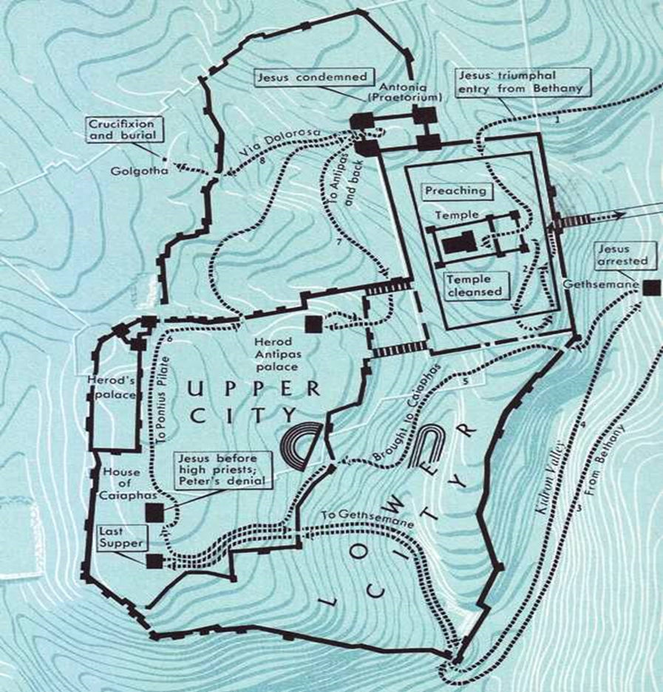
What the Church remembers in Holy Week through where the events took place
MAP OF JERUSALEM SHOWING SIGNIFICANT PLACES IN THE LAST WEEK OF JESUS’LIFE
1
Jesus is sent to Herod Antipas’ palace to be mocked and returns to Pontius Pilate
Jesus before the high priests in the house of Caiaphas and Peter’s denial
Jesus’ triumphal entry into Jerusalem
Jesus is condemned by Pontius Pilate in Antonia
2
Jesus is brought
to Pontius Pilate to Trial
Jesus arrested in the garden of Gethsemane
Journey to the Garden of Gethsemane
Return to Jerusalem from Bethany
Jesus carries his cross along Via Dolorosa
Jesus is crucified and buried at Golgotha
Jesus brought to Caiaphas
Jesus’ trial in Fort Antonia
The Temple cleansed
The Last Supper
The Temple
3
4
R-1
S-05
Click the map icon repeadtedly to point at events and places on the map and the worksheet button to go to the worksheet.
Notes:
Slide 5 What the Church remembers in Holy Week through where the events took place
Make a copy of the worksheet for students to mark as they listen to the Holy Week stories as they are told on the flip cards on the next slide - add name and date. Students could research the distances between the places mentioned in the accounts of the Holy Week events. They could also research what remains of these special places today.

Slide 6
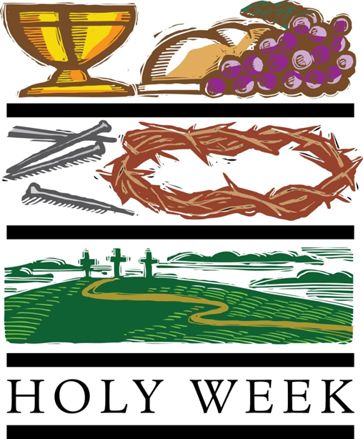
The Stories of the Events in Holy Week
-14-
All of these events are remembered in more detail in the liturgies during Holy Week when present day disciples of Jesus participate in them as though they were present at the original event.
-14-
After he died he was taken down from the cross, his body was prepared for burial and he was laid in a new tomb outside the city walls not far from where he died.
(Matthew 27:57-61)
-13-
Then Jesus was condemned to die and led away carrying his cross up what is known as the Via Dolorosa meaning ‘The Way of the Cross’ to Golgotha known as ‘The Place of the Skull.’ He hung on the cross for 3 long painful hours.
(John 19:17-24)
-12-
Pilate consulted with the Chief priests about Jesus. He said he found he had done nothing to deserve death but he had him beaten and brought him before the people who shouted, ‘Crucify him, crucify him.’
(John 19:5-7)
-11-
In the morning Jesus was taken before Pilate who questioned him.
(Luke 23:1-5)
He found no fault with him. Then he was taken before Herod who questioned him and then with his soldiers he mocked him. They put an elegant robe on him and sent him back to Pilate.
(Luke 23:6-16)
-10-
It was later in the garden that Judas came with the soldiers and he betrayed Jesus with a kiss.
(Mark 14:43-46)
Jesus was arrested and taken to the chief priests and the high priest Caiaphas’ house. Peter followed at a distance and it was in the courtyard of the house that he denied he knew Jesus 3 times. (Matthew 26:69-75)
-9- Jesus went to a garden there called Gethsemane. Here he asked Peter, James and John to keep him company but they fell asleep. Jesus prayed for his disciples. He was very troubled and sad they did not stay awake with him.
(Mark 14:32-41)
-8- During the meal Jesus took the bread, broke it and gave it to them saying, ‘Take and eat, this is my body.’ Then he took the wine and said, ‘Take and drink, this is my blood.’ (Luke 22:14-23)
After this they went out to the Mount of Olives.
-7-
Then Jesus told the disciples that he would be with them for a little bit longer but where he was going they could not come. He gave them a new commandment, ’That you love one another just as I have loved you, you also love one another, by this everyone will know that you are my disciples.’ (John 13:31-35)
-6-
On the Day of Unleavened bread Jesus and the apostles prepared for the Last Supper. This took place on Mount Zion near the Kidron Valley. The meal was held in an upstairs room and it began with Jesus washing the feet of his disciples as an example to them of what they needed to do for others.
(John 13:1-11)
-5-
Later he returned to Bethany to the house of Simon the leper. There a woman anointed him with expensive oil and Jesus was grateful and praised the woman for her care – she did not know that she was anointing Jesus’ body for burial.
(Mark 14:3-9)
-4-
As Jesus entered Jerusalem he looked over the city and he wept knowing that it would be destroyed later. (Luke 19:41-44)
He went to the Temple then he returned with the 12 apostles to Bethany. The next day he went back to the Temple and drove out the merchants and money changers.
(Luke 19:46)
-3-
As he approached the Mount of Olives great crowds greeted him and shouted, ’Hosanna! Blessed is he who comes in the name of the Lord. Hosanna in the highest heaven.’
(Luke 19:28-40)
-2-
He rode down the path to the Mount of Olives and he sent 2 disciples into the village to get the donkey he would ride into Jerusalem. (Mark 11:1-7)
-1-
The Holy Week stories start with the Palm Sunday story, now known as the Passion Sunday story. Before he rode into Jerusalem, Jesus had been staying at Bethany probably with his friends Mary, Martha and Lazarus whom he raised from the dead. Bethany was 2 miles from Jerusalem. (John 12:1-11)
R-1
S-06
Click top card to discard it
Notes:
Slide 6 The Stories of the Events in Holy Week
Students take turns at reading the story from the flip cards and as each place is mentioned they highlight it on the map.
When they have read the flip cards and marked the places on the map ask the children to make a comment about something they learned that surprised them.

Slide 7
How the Church remembers Jesus’ life and death in the Holy Week Liturgies
The action or rituals of the liturgies make the actual events present to the people gathered so they can participate in a real way as they gather as disciples today with Jesus and his first apostles. Can you describe an experience of this you have heard of or been present at?
Christians all over the world each year, journey closely with Jesus through the last week of his life as his community of disciples, as if they were present with him. This happens at the liturgies during Holy Week. Can you name some of the liturgies and how they make the stories come alive again?
The journey with Jesus through Holy Week is an outward one as Christians take part in the liturgies in their community. It is also an inward one as each person listens, watches, gets drawn into, takes part in and feels close to Jesus, sharing his pain and humiliation and being mindful that he did this because he loves each one of us. Can you reflect on your journey through Holy Week with Jesus and how you could make it a meaningful time in your spiritual life?
The Readings in the Liturgies come from the first source of information about the events – the Scriptures. The readings are enhanced by hymns, symbols and colours that reflect the themes of the event. Can you name some examples of these?
Click the pins on the right to reveal post-it notes.
Click the video button to watch “Pope Francis’ most important message during Holy Week”.
R-1
S-07
Notes:
Slide 7 How the Church remembers Jesus’ life and death in the Holy Week Liturgies.
This clip provides background information for teachers about the liturgies each day in Holy Week. You may consider parts of it suitable for your class to share. https://www.youtube.com/watch?v=KM2T9LOKW1c
Pope Francis most important message during Holy Week (6:23 minutes)
Use the clip below to help children see how the Pope connects the sufferings of Jesus on Good Friday to the sufferings of people in the world today.
https://www.youtube.com/watch?v=KM2T9LOKW1c
Pope Francis most important message during Holy Week (6:23 minutes)

Slide 8
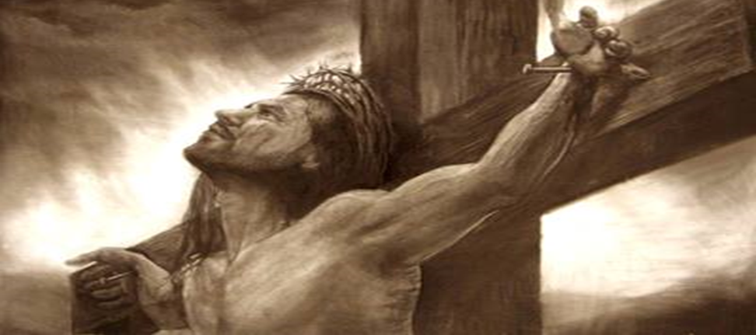
Understanding our beliefs about why Jesus died on the Cross
1. Was Jesus’ death part of God’ s plan in the beginning?
No. God created everything in love for love. God’ s plan was that all creation including people, would live in a loving harmonious relationship with God, with each other and with the earth.
2. What went wrong and how did things change?
The first people damaged their loving relationship with God through disobedience, the ‘original’ sin and everything changed. God hated injustice and sin. It interrupted his plan and it allowed death, suffering and pain to come into the world. People turned away from God and sin became part of life.
3. What was God’ s plan to restore his friendship with people?
4. How was Jesus part of God’ s saving plan?
But God could not abandon his people and the creation he loved so much. God devised a saving plan so that he could be reconciled with his people once and for all.
God’ s saving plan was brought about by his son, Jesus freely offering to sacrifice himself to restore the loving friendship between God, people and creation.
5. What did Jesus come to earth to do?
Jesus came to earth to bring good news to the poor… liberty to captives and recovery of sight to the blind, to let the oppressed go free… (Luke 4: 18-19). His mission was not about dying but about forgiveness, healing, freeing and living life to the full.
R-1
S-08
Click an image to reveal text.
Notes:
Slide 8 Understanding our beliefs about why Jesus died on the Cross
Allow time for children to make comments and ask questions about this topic which often confuses people. The explanations given are simple enough to help the children to come to understand this complex Catholic belief. Keep a record of any further questions children ask and seek further information to respond. Remind them that throughout the prayer in the liturgy we hear the words that repeat our beliefs that helps us to make meaning of Jesus’ death and what it means for all Christians. The Creed is a good example to look at.

Slide 9
Understanding our beliefs about why Jesus died on the Cross
6. So what led to Jesus’ death?
By carrying out the mission he came to do, Jesus became very unpopular with the Jewish authorities. He challenged their religious and civil laws, their interpretation of Scripture and they worried he would stir up the Roman army against them and this would bring their anger down on Israel.
7. So did Jesus’ mission lead him to his death?
Yes, Jesus’ life and mission led him to his death which led him to his resurrection. He did not run away or give up what he came to do. He was tempted but he resisted. He knew when he set out for Jerusalem on Palm Sunday that he could not go back and that he was facing a serious risk of death.
8. Did Jesus have to die?
9. What do we learn from Jesus’ death?
Death was the price Jesus had to pay if he was to be faithful to his mission. He did not die because God demanded suffering. He died because a sinful world fought the truth he preached and he had to be true to himself, his life and his mission.
By his death Jesus taught us how to live well, by choosing and affirming life-giving things, knowing that death is not the end, there is much more to life as we know it on earth and after our death we will live in wholeness with God in heaven forever.
10. What did Jesus’ death achieve for humanity?
Jesus’ death saved the world by reconciling the loving relationship between God and people. It brought about forgiveness of sins, and the potential to live an eternal life with God. It made it possible for people to have hope, peace and freedom and brought meaning and value to human life and all living things.
Click an image to reveal text.
Click the video button to watch “Why Did Jesus Have to Die the Way He Did?”
R-1
S-09
Notes:
Slide 9 Understanding our beliefs about why Jesus died on the Cross
Allow time for children to make comments and ask questions about this topic which often confuses people. The explanations given are simple enough to help the children to come to understand this complex Catholic belief. Keep a record of any further questions children ask and seek further information to respond if necessary. Remind them that throughout the prayer in the liturgy we hear the words that repeat our beliefs that helps us to make meaning of Jesus’ death and what it means for all Christians. The Creed provides good examples to name and discuss their meaning.
Teachers note - This YouTube clip offers further ideas to increase your understanding of this topic if needed: https://www.youtube.com/watch?v=CtcKV65-9uY
Why Did Jesus Have to Die the Way He Did? (4:37 minutes)

Slide 10
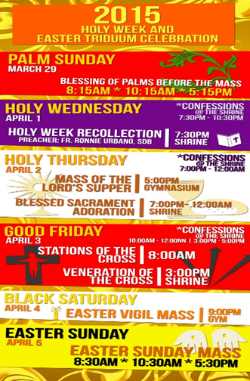
Holy Week Liturgies in a Church near you
Using your parish Holy Week Schedule create a poster to advertise when the Holy Week liturgies will take place.
Discuss with your teacher and your priest where you could display your poster to let people in your community know about the HOLY WEEK Liturgies.
Check your poster includes information about the WHAT? WHERE? WHEN? for each liturgy including the colours and symbols.
R-1
S-10
Notes:
Slide 10 Holy Week Liturgies in a Church near you
Make arrangements for the posters to be displayed in the parish, the school, the community and in homes. Check liturgy details are correct. Take time this week to pray with the Stations of the Cross in the church. You may like to include washing feet or hands in morning prayer in remembrance of the example Jesus gave to the first disciples and to us as the disciples of today.

Slide 11
Check up
1)
With a partner share the Liturgical Year quiz and note your score and what you still need to learn about. (Slide 3)
2)
Make a list of the days of Holy Week, record one event that happened on that day and how it is celebrated in Church liturgies. (Slides 5,6)
3)
Explain how the Holy Week liturgies help Jesus’ disciples today participate in the events as though they were present at them with Jesus. (Slide 7)
4)
Give 3 good reasons why it is important for Christians to be part of the Holy Week liturgies.
5)
Write 3 things you learned about our beliefs about why Jesus died on the cross. (Slide 8,9)
6)
Which activity do you think helped you to learn best in this resource?
7)
Questions I would like to ask about the topics in this resource are …
Click in each caption space to reveal text
Click on the worksheet button to go to the worksheet.
R-1
S-11
Notes:
Slide 11 Check Up
This formative assessment strategy will help teachers to identify how well students have achieved the Learning Intentions of the resource.
Teachers can choose how they use the slide in their range of assessment options.
A worksheet of this slide is available for students in Years 5-8 to complete.
The last two items are feed forward for the teacher.
Recording the students’ responses to these items is recommended as it will enable teachers to adjust their learning strategies for future resources and target the areas that need further attention.

Slide 12
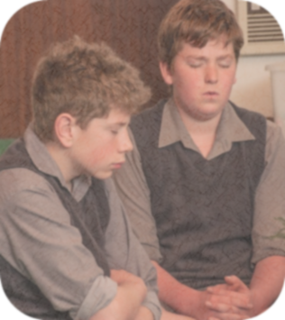
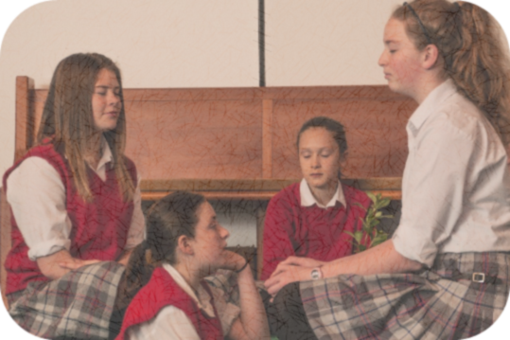
Time for Reflection
R-1
S-12
Click the audio button to stop reflective music
Click the audio button to play reflective music
Notes:
Slide 12 Time for Reflection
The MP3 is played to help create a reflective atmosphere and bring the students to stillness and silence as the teacher invites them to imagine they are in the crowd on Good Friday, they see Jesus and he looks at them with such pain in his eyes – what would they say to him? Keep these words in their heart all though Holy Week especially when they pray.

Slide 13
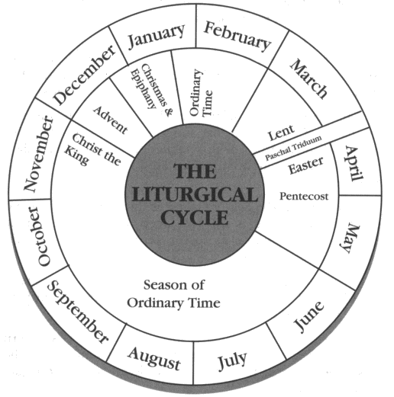
Holy Week in the Liturgical Year
Notice where Holy Week occurs in the Liturgical Year – what proceeds it and what follows it.
Reflect on what the Church remembers about the life of Jesus in Holy Week.
Complete the worksheets.
Name: _______________
Date: _________
R-1
S-03A
Worksheet
Click the arrow buttons to navigate the worksheets or return to the lesson

Slide 14
Holy Week in the Liturgical Year
HOW WELL DO I KNOW THE LITURGICAL YEAR?
The Liturgical Calendar is the Church’s way of re-telling the story of …
The season before Holy Week is …
The most solemn 3 days in Holy Week are called the …
The longest season in the Liturgical Year is …
The Feast of Christ the King marks the …
Lent and Advent are the …
3 major feasts in the Liturgical Year are …
Each new Liturgical Year starts on …
The first day of Lent is …
Easter and Christmas are both …
The most important feast in the year is …
R-1
S-03B
Worksheet
Click the arrow buttons to navigate the worksheets or return to the lesson

Slide 15
Holy Week in the Liturgical Year
HOW WELL DO I KNOW THE LITURGICAL YEAR?
The Liturgical colours are …
The most holy week of the Liturgical Year is …
The only day Mass cannot be celebrated on is …
Every Sunday is like another …
The events of the first Holy Week are celebrated in the …
In the liturgy people can participate in the events of Jesus’ life as if they were …
Easter is not part of Holy Week because …
Palm Sunday is now known as …
At the Last Supper Jesus gave the Church his greatest commandment which is …
Total correct ___ Rate yourself: VERY WELL WELL NOT SO WELL
Name: _______________
Date: _________
R-1
S-03C
Worksheet
Click the arrow buttons to navigate the worksheets or return to the lesson

Slide 16
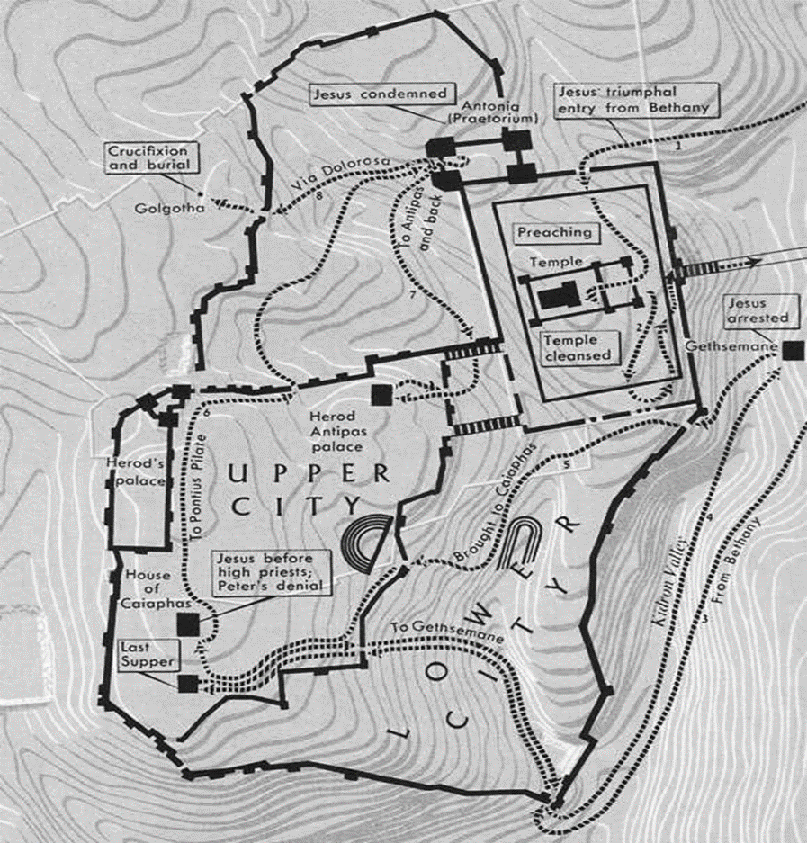
What the Church remembers in Holy Week through where the events took place
MAP OF JERUSALEM SHOWING SIGNIFICANT PLACES IN THE LAST WEEK OF JESUS’ LIFE
Name: _______________
Date: _________
R-1
S-05
Worksheet
Click the up arrow to return to the lesson

Slide 17
Check up
Name:____________________________
Date:____________
With a partner share the Liturgical Year quiz and note your score and what you still need to learn about. (Slide 3)
2. Make a list of the days of Holy Week, record one event that happened on that day and how it is celebrated in Church liturgies. (Slides 5,6)
3. Explain how the Holy Week liturgies help Jesus’ disciples today participate in the events as though they were present at them with Jesus. (Slide 7)
Give 3 good reasons why it is important for Christians to be part of the Holy Week liturgies.
5. Write 3 things you learned about our beliefs about why Jesus died on the cross. (Slide 8,9)
6. Which activity do you think helped you to learn best in this resource?
7. Questions I would like to ask about the topics in this resource are...
R-1
S-11
Worksheet
Click the up arrow to return to the lesson

