Slide 1
The Church celebrates Holy Week
R-2
S-01
Notes:
Slide 1 The Church celebrates Holy Week Use this slide as a focussing strategy to introduce the resource topic. Read the title together and invite students to share something they know about how the Church celebrates Holy Week. Look closely at the 3 images and name which Holy Week liturgy that they are part of.

Slide 2
Learning Intentions
The students will:
1)
identify how Christians celebrate Holy Week
2)
recognise that through the liturgies of Holy Week Christians share the life and love that Jesus gives at each of these events as though they were actually there.
R-2
S-02
Click the border to reveal text
Notes:
Slide 2 Learning Intentions Continue the quiet, reflective, prayerful atmosphere in the classroom during Holy Week and add to the prayer focus as the week progresses. Try to do something special for prayer each day. You could use reflective Taizé background music during the day while the class is working. Try to make the students aware that this week is different from every other week in the year. Read the LIs and discuss the concepts the resource will cover. Note the background colours and explain the mood they are trying to convey.

Slide 3
Why and How Christians Celebrate Holy Week
For Christians all over the world as Jesus’ followers today, Holy Week is the most sacred and deeply solemn week in the Liturgical Year. During this week through personal prayer and parish community celebrations people accompany Jesus through each event.
The ritual actions of the liturgies that focus on each event include prayer, Scripture readings, music, symbols and these draw people back into these events of Jesus’ life as though they were at the events as they happened over 2000 years ago.
It is in these prayerful re-enactment experiences of the events of the last week of Jesus’ life that his followers are able to participate in what truly happened during the first Holy Week. This is why Christians celebrate Holy Week so faithfully every year.
As they listen to the Scripture accounts of the passion and death of Jesus, as they look at the images of the pain Jesus suffered, Christians can receive a greater sense of the tremendous love Jesus shared so that we can be forgiven and enjoy eternal life.
As we come to realise that through celebrating these events in the liturgy, just as if we are standing at the foot of the cross, we experience his enormous love and his whole life as a model for us to live by as his 21st century followers.
R-2
S-03
Click the handle to move the blind down.
Notes:
Slide 3 Why and How Christians Celebrate Holy Week Explain to students that as young Christians celebrating Holy Week in some way is important. Christians try to focus their lives on living the teachings and the mission of Jesus in their everyday lives. It seems right that as his followers they should try to take part in some way in the celebrations of the most significant week of his life. Use the text the arrow reveals as conversation starters. Include drawing attention to the fact that millions of Christians who follow Jesus from all denominations (e.g. Catholic, Anglican, Baptist, Presbyterian, Methodist) everywhere in the world celebrate Holy Week in similar ways every year to recall the life, death and mission of Jesus Christ. Even though each country celebrates the same Holy Week events they include the different cultural and spiritual perspectives of the people. Teaching and Learning Experience.

Slide 4
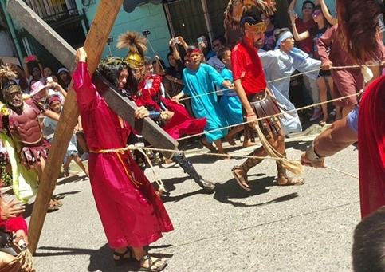
How Holy Week is Celebrated in the Philippines
In the Philippines during Semana Santa - Holy Week is celebrated widely as many people there are Christians. There are processions in the streets re-enacting the events of Good Friday. Many people fast and religious statues are dressed in purple to symbolise gloom.
Are there children in your class who have celebrated Holy Week in the Philippines who can share their experiences?
On Good Friday Mahal na Araw religious figures are carried through the towns on top of carrozas carriages. The religious images and statues are veiled in black in mourning for the death of Jesus.
Devout Catholics go to church every day. In some places radio and TV are off air and people are expected to be quiet. Many businesses are closed, so people make sure they have supplies, especially food, stocked up.
The “reading” or chanting of verses about the suffering of Christ starts on Sunday and ends on Maundy Thursday, which is the day when the washing of the feet is celebrated.
R-2
S-04
Click the pins on the right to reveal post-it notes.
Notes:
Slide 4 How Holy Week is Celebrated in the Philippines An example of Holy Week celebrations in the Philippines, where most people are Catholic, illustrates the difference in spiritual and cultural practices. Read the PINs and discuss how the HOLY WEEK celebrations in Aotearoa contrast with those in the Philippines. Note the invitation on the last PIN.

Slide 5
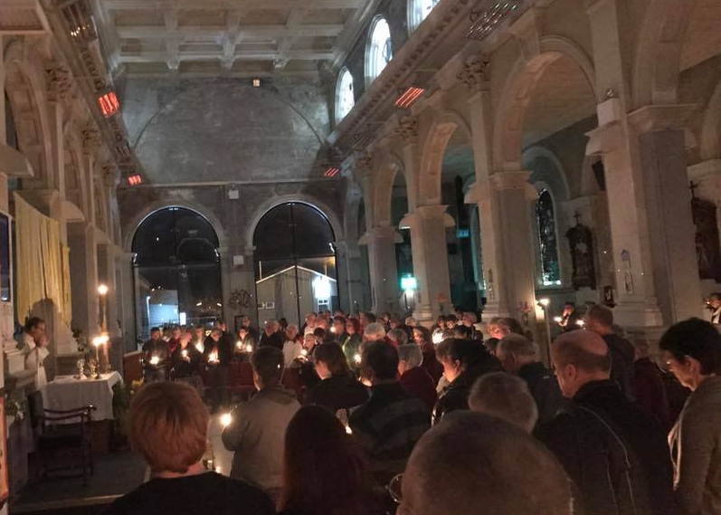
How Jesus gives his Life and Love through the Mass of the Last Supper on Holy Thursday
1. Why is the Mass that commemorates the Last Supper on Holy Thursday so significant for Catholics?
This Mass recalls and re-enacts three important aspects of the actual event of the Last Supper: the institution of the Eucharist, the institution of the priesthood, and the new commandment of love that Jesus gave his disciples.
2. How did Jesus institute the Eucharist?
Jesus took bread, blessed it, broke it and gave it to his disciples, saying, "Take and eat, this is my body." Then taking a cup of wine, blessed it, and gave it to them, saying, "All of you drink of this; for this is my blood of the new covenant which is being shed for many unto the forgiveness of sins." Finally, he gave his disciples the commission, "Do this in remembrance of Me." These words are the foundation for our belief in Jesus’ presence in the Eucharist.
How does Jesus share his love and life through the institution of the Eucharist?
3. How did Jesus institute the Ministry of Priesthood?
4. What was the other memorable part of the Last Supper?
After Jesus had washed the disciples’ feet he gave them his mandate. “You ought to wash one another’ s feet. I have given you an example. As I have done, so you should also do.” (Jn. 13:14,15) With these words and actions Jesus established the ministry of humble service by which his command was to be carried throughout all time and that we know as priesthood. How does Jesus share his love and life through the institution of priesthood?
Jesus waited to share these three important messages with his disciples until his last hours with them. After a long talk finally he said, “A new commandment I give to you, that you love one another; even as I have loved you, that you also love one another.” (Jn. 13:34) This new commandment sets a standard for how people should love one another – can you say what it is? How difficult would this be to do? Why?
R-2
S-05
Click an image to reveal text.
Notes:
Slide 5 How Jesus gives his Life and Love through the Mass of the Last Supper on Holy Thursday Explain that to ‘institute’ something means to start, begin or establish a new practice. At the Last Supper Jesus established a new practice to ensure his followers kept the memory of his life, death and resurrection alive. This sacred ritual would continue as a Sacrament and sign of his great love that would bind them together when they gathered and would nourish all who followed him down through the centuries until he came again at his Second Coming as he promised. Do you think the Sacrament Jesus instituted at the Last Supper is achieving his purpose? Children read each question and share responses. Click the symbol and read the response and use it to add to children’s understanding. Children respond to the red questions on items 2, 3, 4.
Students create an artwork highlighting the three significant things Jesus did at the Last Supper that are commemorated in the Holy Thursday Mass. Include the words from Scripture that appear on the slide. These artworks could be displayed at school or in the Church during the Triduum.

Slide 6
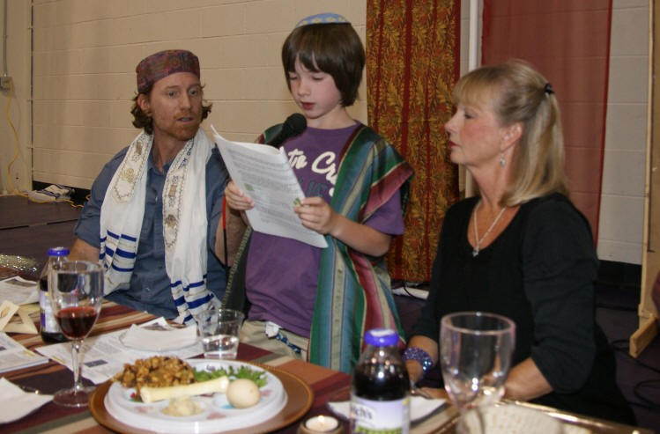
The Last Supper - was it a Passover meal?
-13-
Jesus reduced hundreds of old Jewish laws to the one he gave his followers at the Last Supper: “A new commandment I give to you, that you love one another; even as I have loved you, that you also love one another.” (Jn. 13:34).
Memorise the new commandment and use it as a benchmark for how you treat people.
-12-
The new covenant that Jesus began, also began a ‘New’ Testament.
Think about where you read the stories of Jesus’ life, death and resurrection in the Bible and the new era Jesus began.
-11-
Christians no longer celebrate the old covenant because Jesus gave them a new covenant or cc’ ontract’ that he sealed by his death which restored the relationship between God and people.
This is why we talk about Jesus as our saviour who saved us by his great love shown when he died on the cross for us.
-10-
The priest reminds the people that Jesus began a new covenant for us with God through the sacrifice of his life on the cross on Good Friday.
Think of this next time you hear the priest echoing the words of Jesus, “This cup is the new covenant in my blood, which will be shed for you.”
-9-
The Last Supper was really the first Mass. Now the priest takes the place of Jesus at the table, the altar. He says the words Jesus said at the Last Supper, he follows the actions Jesus did as he re-enacts the story.
Next time you are at Mass place yourself at the Last Supper table as you watch and listen to the ritual of Mass.
-8-
While the Passover of the old covenant focused on the flesh and blood of the lamb and the Exodus event, the new Passover focusses on the sharing of the Body and Blood of Jesus Himself, fulfilling his commandment to his followers to “Do this in remembrance of me.”
When you follow this command of Jesus it is really an invitation to you to come closer to him and be more aware that he is always with you.
-7-
Unlike the Passover lamb that was sacrificed and eaten, Jesus rose from the dead. While the Passover of the old covenant was eaten among family members with the father presiding, the new Passover is eaten among the members of the Church with Jesus presiding.
-6-
However Jesus did celebrate a Passover but it was his own new Passover. It was Jesus himself who became the sacrificial lamb when he was sacrificed on the cross. Just as the old covenant that God made in the Old Testament was sealed with the blood of the lamb, the new covenant Jesus made with God was sealed with his blood on the cross.
Listen to the prayers in the mass for references to this.
-5-
There was some confusion about whether the Last Supper was a Jewish Passover meal and although the gospels of Matthew, Mark and Luke have Jesus and the disciples eating a Passover meal, the Gospel of St. John has Jesus dying before Passover began. So it seems the Last Supper was not a Jewish Passover.
-4-
This is the origin of the Passover meal which the Jewish people still celebrate with their families each year. The people hear the same story that is read in Christian churches for people to hear. The Jewish people have very set rituals for this Passover Seder meal.
Read Exodus 12:1-8, 11-14 and you will understand this.
-3-
The Passover ritual and meal was part of the promise or covenant that God made with the Jewish people in the Old Testament. God wanted them to remember that they were spared by God and led to freedom by Moses. God wanted them to re-enact the story in the context of a special meal called ’a Seder meal’
What meal does this remind you of?
-2-
God spared his chosen people the Jews from this terrible event. He told each family to sacrifice a lamb and smear its blood on the door post so that when the angel of death came and saw the blood of the lamb, the firstborn child would be spared as the angel passed over the house because it belonged to a Jewish family.
-1-
At the Holy Thursday Mass the first reading is from Exodus 12:1-8, 11-14. This reading tells the story of the Jews’ captivity in Egypt as slaves and their final release led by Moses to the Promised Land. This came about only after 10 plagues God sent on the Egyptians – the tenth being the death of the first born in the family.
Click top card to discard it. Click the video button to watch “The Last Supper & the Passover”
R-2
S-06
Notes:
Slide 6 The Last Supper - was it a Passover meal?
Each flip card is read and explained and the red text can be used to help students make connections with the Mass and their learning experiences in this resource.
Watch the clip: https://www.youtube.com/watch?v=rlDoY6f14DE
The Last Supper & the Passover (6:36 minutes)
Students make power points and speaker notes on topics such as the Old Testament Passover, The New Testament Passover, The Passover Meal and the Mass, The Institution of the Eucharist at the Last Supper, The Institution of the Sacrament of Priesthood, and The New Commandment of love. These could be shared and used as resources for other classes.
Teachers the clips below will help to consolidate some of the ideas the students have been reading about on the flip cards. The first clip also has a reference to HOLY WEEK Year 5 Slides 4 & 5 which deals with The Jewish Seder, The Last Supper and the Catholic Mass. Slide 4 is about the First Reading Exodus 12:1-8, 11-14 at the Holy Thursday Mass. These are available on faithalive site, same password.
https://www.youtube.com/watch?v=g97VwxJdrfM The Jewish Seder, The Last Supper and the Catholic Mass (6.03 minutes)
https://www.youtube.com/watch?v=LzsuL9U1a_k The Passover Seder: What to Expect (3:57 minutes)

Slide 7
How People can share in the Life and Love of Jesus through the Good Friday Liturgy
People share in the life and love of Jesus as they
The image of Jesus on the cross as people venerate it
As we pray the words of the Intercessory Prayers they remind us of
Through the Eucharist Jesus gives us himself to eat and drink
The presence of the people participating in the rituals surrounded
listen to the story of Jesus’ passion and death.
is a powerful reminder of what Jesus did for love of humanity.
how much the world needs to share in the life and love of Jesus.
so we can absorb his life and love and become more like him.
by images, symbols and music make Jesus’ life and love truly present.
A)
is a powerful reminder of what Jesus did for love of humanity.
B)
by images, symbols and music make Jesus’ life and love truly present.
C)
listen to the story of Jesus’ passion and death.
D)
so we can absorb his life and love and become more like him.
E)
how much the world needs to share in the life and love of Jesus.
Click the statement that correctly completes the sentences.
R-2
S-07
Click the audio button to play ‘Jesu Jesu’
Click the audio button to stop ‘Jesu Jesu’
Notes:
Slide 7 How People can share in the Life and Love of Jesus through the Good Friday Liturgy
Use each statement as a conversation starter. Talk about how students can share in and pass on the examples of the love Jesus gave the world during the events of Holy Week, e.g. the ways he showed selflessness, compassion, kindness, how Jesus dealt with disappointment, pain, frustration and put downs. ANSWERS: 1) C, 2) A, 3) E, 4) D, 5) B Sing “Jesu Jesu” using the MP3

Slide 8
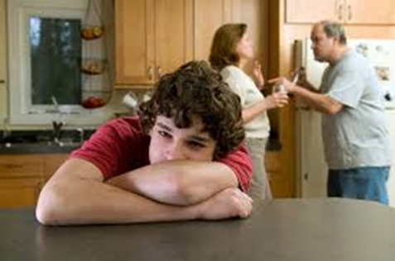
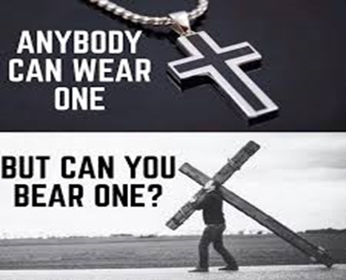
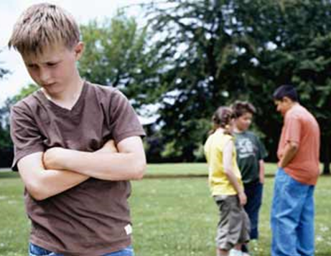
Sharing the Crosses we carry in our Lives with Jesus
There may be problems in
family relation- ships – Have you tried talking to Jesus about this? This is how he wants to share his life and love with you.
You may be treated badly by people who were once your friends – remember what Peter did to Jesus. Talk to Jesus – he knows how this feels.
You may be lonely and feel isolated. Talk to Jesus as though he were next to
you. Ask him to
help you make
friends. He knows what it is like to be alone – remember what happened in the garden after the Last Supper.
You may have a health condition that prevents you from joining in with your friends. Jesus will listen to you when you talk to him about this. Remember he treated people with health problems with great compassion.
As Christians we share in Jesus’ death on the cross when we face hard times in our lives. We can turn to Jesus and he will help us bear our cross. Reflect on the crosses you bear in your life.
R-2
S-08
Click the images to reveal text.
Notes:
Slide 8 Sharing the Crosses we carry in our own lives
Start with the image in the centre. Use the images as starters for class conversations about the crosses young people carry and how they can share them with Jesus. Remind them - He will never turn away – He is always there to listen to them with compassion and love. Give children time to talk about other crosses young people of their age may carry. Teachers - Be aware of the sensitive nature of some issues that might arise.

Slide 9
Celebrating the events of Holy Week as a disciple of Jesus today
Write a question for the answer
Q1)
A1)
For Christians, Holy Week is the most holy and significant week in the year and participating in the celebration of it helps to make the events real for people.
People can celebrate Holy Week through the special liturgies in their parish.
People can celebrate Holy Week participating in liturgies at school.
Walking the Way of the Cross in your area helps to bring the event alive.
If you can’t attend the liturgies you can read the Bible stories and pray at home.
Whatever people do it reminds them what being a disciple of Jesus is all about.
Q2)
A2)
Q3)
A3)
Q4)
A4)
Q5)
A5)
Q6)
A6)
R-2
S-09
Click the white boxes to write the answer.
Notes:
Slide 9 Celebrating the events of Holy Week as a disciple of Jesus today Sample questions to complete the worksheet. 1) Why do Christians participate in the Holy Week liturgies? 2) What is the best way to celebrate Holy Week? 3) How can your school help children to celebrate Holy Week? 4) How can you join other Christians in your area to celebrate Good Friday? 5) What are some things you can do if you cannot attend the Holy Week Liturgies? 6) What can people do during Holy Week to remember what Jesus calls them to do? Remind children that as Christians, this week is the holiest week of the whole year and a good time to talk to Jesus as one of his 21st century followers about what he would like you to do to carry on his mission in the world.
Teaching and Learning Experiences 3 & 5.

Slide 10
Check up
1)
Name 3 ways Christians celebrate Holy Week liturgies and explain why it is good to do this. (Slide 3)
2)
Name what 3 significant things are recalled and re-enacted at the Holy Thursday liturgy that bring to life what Jesus did at the Last Supper. (Slide 5)
3)
Write 5 things you learned about Passover and say that the word refers to in the Old and New Testament. (Slide 6)
4)
Name a cross some children of your age have to bear in their lives and say how you could help them to bear it.
5)
Describe how liturgies can help people feel they are part of the events they are celebrating and how this connects them more deeply to Jesus…
6)
Which activity do you think helped you to learn best in this resource?
7)
Questions I would like to ask about the topics in this resource are …
Click in each caption space to reveal text
Click on the worksheet button to go to the worksheet.
R-2
S-10
Notes:
Slide 10 Check Up
This formative assessment strategy will help teachers to identify how well students have achieved the Learning Intentions of the resource.
Teachers can choose how they use the slide in their range of assessment options.
A worksheet of this slide is available for students in Years 5-8 to complete.
The last two items are feed forward for the teacher.
Recording the students’ responses to these items is recommended as it will enable teachers to adjust their learning strategies for future resources and target the areas that need further attention.

Slide 11
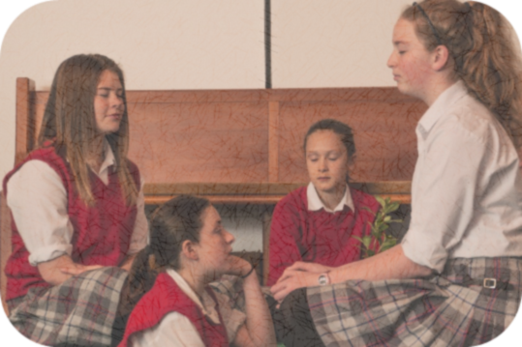
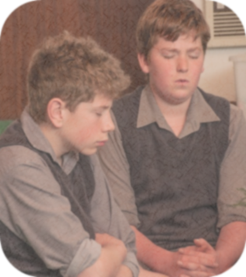
Time for Reflection
R-2
S-11
Click the audio button to play reflective music
Click the audio button to stop reflective music
Notes:
Slide 11 Time for Reflection The MP3 is played to help create a reflective atmosphere and bring the children to stillness and silence as the teacher invites them to reflect on the events of Holy Week and let the images of them pass through their minds. Talk to Jesus about his suffering and ask him to remind you that he is always with you when you face hard times.

Slide 12
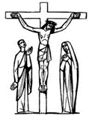
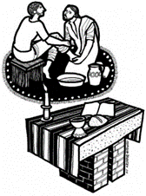
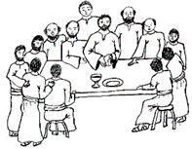
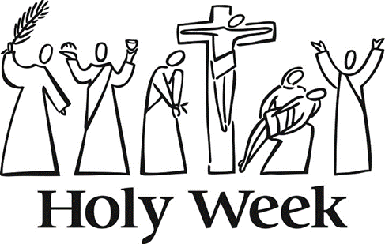
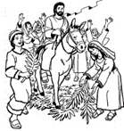
Sharing our Learning about HOLY WEEK with family whanau
Share the Liturgical Year pre-test (R1, Slide 3) to illustrate what you have learned about the Liturgical Year and what you know about Holy Week and the Liturgies that re-enact the events of the first Holy Week.
Share the poster at home that you made to advertise the Holy Week Liturgies in a parish near your home. (R1, Slide 10)
Design a sticker or a fridge magnet with a Scripture quote from one of the HOLY WEEK readings and share it at home.
Share the artwork highlighting the three significant things Jesus did at the Last Supper that are commemorated in the Holy Thursday Mass. (Slide 5)
Share your power point related to the R2 Slide 6 topics.
Share the graphic symbols of Holy Week and explain their meaning. Create your own to share.
Make up your own way of showing and sharing what you have learned and decide whom you would like to share it with.
R-2
S-12
Click worksheet button to go to the worksheet.
Notes:
Slide 12 Sharing our Learning about HOLY WEEK with family whanāu This slide provides some choices for children to show and share what they have learned. Examples could be photographed as evidence of children’s learning.
You may like to put a copy of the Sharing our Learning page in children’s RE Learning Journals. You could talk through the choices using the slide and let children make their choice from their own copy. Children could work on their choice at school and/or at home and you may like to set a day for sharing. Please let parents and whānau know what you expect them to do with this. The slide is focussed on Year 7 HOLY WEEK Achievement Objective which is covered in Resources 1&2. (HOLY WEEK AO) Students will be able to: develop an understanding of Holy Week as the week that the Church remembers Jesus’ role in liberating people from sin and death and how the Church shares in this.

Slide 13
Celebrating the events of Holy Week as a disciple of Jesus today
Write a question for the answer
Name: _______________
Date: _________
Q1) _______________________________________________________________________________
A1)
For Christians, Holy Week is the most holy and significant week in the year and participating in the celebration of it helps to make the events real for people.
People can celebrate Holy Week through the special liturgies in their parish.
People can celebrate Holy Week participating in liturgies at school.
Walking the Way of the Cross in your area helps to bring the event alive.
If you can’t attend the liturgies you can read the Bible stories and pray at home.
Whatever people do it reminds them what being a disciple of Jesus is all about.
Q2) _______________________________________________________________________________
A2)
Q3) _______________________________________________________________________________
A3)
Q4) _______________________________________________________________________________
A4)
Q5) _______________________________________________________________________________
A5)
Q6) _______________________________________________________________________________
A6)
R-2
S-09
Worksheet
Click the arrow to return to the lesson.

Slide 14
Check up
Name:________________________
Date:____________
Name 3 ways Christians celebrate Holy Week liturgies and explain why it is good to do this. (Slide 3)
2. Name what 3 significant things are recalled and re-enacted at the Holy Thursday liturgy that bring to life what Jesus did at the Last Supper. (Slide 5)
3. Write 5 things you learned about Passover and say what the word refers to in the Old and New Testament. (Slide 6)
Name a cross some children of your age have to bear in their lives and say how you could help them to bear it.
5. Describe how liturgies can help people feel they are part of the events they are celebrating and how this connects them more deeply to Jesus.
6. Which activity do you think helped you to learn best in this resource?
7. Questions I would like to ask about the topics in this resource are...
R-2
S-10
Worksheet
Click the up arrow to return to the lesson

Slide 15
Sharing our Learning about HOLY WEEK with family whanau
Share the Liturgical Year pre-test (R1, Slide 3) to illustrate what you have learned about the Liturgical Year and what you know about Holy Week and the Liturgies that re-enact the events of the first Holy Week.
Share the poster at home that you made to advertise the Holy Week Liturgies in a parish near your home. (R1, Slide 10)
Design a sticker or a fridge magnet with a Scripture quote from one of the HOLY WEEK readings and share it at home.
Share the artwork highlighting the three significant things Jesus did at the Last Supper that are commemorated in the Holy Thursday Mass. (Slide 5)
Share your power point related to the R2 Slide 6 topics.
Share the graphic symbols of Holy Week and explain their meaning. Create your own to share.
Make up your own way of showing and sharing what you have learned and decide whom you would like to share it with.
R-2
S-12
Worksheet
Click the up arrow to return to the lesson

