Slide 1
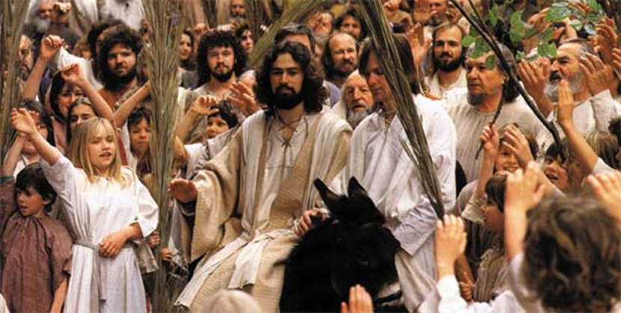
Passion Sunday
R-1
S-01
Notes:
Slide 1 Passion Sunday Use this slide as a focussing strategy to introduce the resource topic. Read the title together and invite students to share something they know about the events of Holy Week and how the Church celebrates them. Look closely at the image and share ideas of the significance of the event it portrays. (Jesus is entering Jerusalem on a donkey, welcomed by the people as their king. He knows where this is journey is leading to.) Put the event into the context of Holy Week. This event sets the scene for what unfolds during Jesus’ last week in which he is put to death on the cross. Talk together about walking with Jesus on his last journey by spending quiet time with him.

Slide 2
Learning Intentions
The students will:
1)
explain how Passion Sunday celebrates the meaning of Holy Week
2)
describe one way the Church celebrates Passion Sunday.
R-1
S-02
Click the border to reveal text
Notes:
Slide 2 Learning Intentions
Invite students to suggest ways they could create a quiet, reflective, prayerful atmosphere in the classroom during Holy Week. Provide some symbols, cloths and candles to set up a special prayer focus for Holy Week starting with Passion Sunday symbols and add symbols as the week progresses. Use the gospel readings that describe the events each morning this week and try to complete the whole Passion story on Holy Thursday. Use Taizé music throughout the day to remind children this week is different from all other weeks of the year. Create wall displays of appropriate images and set aside part of the classroom as a quiet prayer space that can be used throughout the day. Remind the students that as Good Friday is a holiday they will need to include the symbols for that day on Holy Thursday. If you have students who need more RE background on Holy Week the Level 3 Year 6 Holy Week resources focus on the first 4 days of Holy Week and the Days of the Easter Triduum which you can access on the web. A suggestion for Holy Thursday morning prayer
https://www.youtube.com/watch?v=H-PGK4WGmLU
The Last Supper story spoken in Hebrew with English subtitles (3:07 minutes)
Children could imagine that this is what Jesus’ voice sounded like as he prayed over the bread and wine at the Last Supper. Remember you are a spiritual guide for your class and this is the most important week of the year to let the students see this.

Slide 3
The Liturgical Calendar measures the seasons and feast of the Church’s Year
Colour the feasts and seasons according to their Liturgical Calendar.
Draw the vestments beside the season they are used in.
Why do you think the colours are used and where would you see them in the church during their Liturgical season?
R-1
S-03
Click the worksheet button to go to the worksheet.
Notes:
Slide 3 The Liturgical Calendar measures the seasons and feast of the Church’s Year Ensure each student has a copy of the Liturgical Calendar. Follow the directions on the slide. Complete the worksheet and add it to RE Learning Journal to be referred to throughout the year.

Slide 4
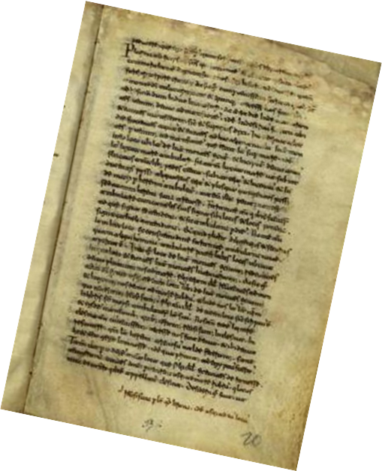
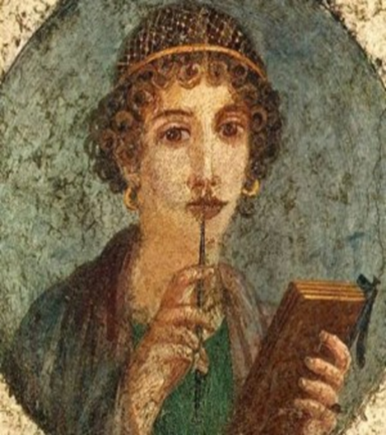
The History of the Holy Week Ceremonies
-13-
The Church celebrates the meaning of the original Holy Week events in the liturgies that make the events present in the lives of those who participate in them and they receive all the blessings that Jesus gained for them. Being present to the prayer and the action of these liturgies increases people’ personal holiness.
-12-
The restoration of Holy Week remains one of Pope Pius XII’s greatest achievements. We can thank him and the liturgists (people who study and are responsible for changes in liturgy) he wisely consulted for the spiritually meaningful ceremonies which we continue to celebrate during Holy Week.
-11-
The situation did not change until the earlier celebrations of Holy Week were restored. This important move was mandated by Pope Pius XII in 1956. The liturgical reforms of the Second Vatican Council followed a few years later.
-10-
Unfortunately, the connection between the liturgies of Holy Week and the original times and places of the sacred events became obscured in medieval times when the readings were read in Latin to small numbers of people.
-9- The Holy Week liturgies that took place in Jerusalem eventually were adopted throughout the then-Christian world. By the fifth and sixth centuries the highly influential churches of Rome and Constantinople (modern Istanbul) had adopted them and subsequently they spread to other local churches in the East and West.
-8- The Easter Vigil began in mid-afternoon on Holy Saturday, with the final preparation of the catechumens. That night, while the catechumens were being baptised, the rest of the faithful kept vigil. As soon as the newly baptised were led into the church, the celebration of the Easter Eucharist began.
-7-
On Good Friday there were four hours of veneration of the cross, beginning just before noon, followed by a solemn afternoon Liturgy of the Word that concluded with a reading of the Passion according to John.
-6-
On Holy Thursday night, after the Eucharist had been celebrated in the afternoon, the events of Jesus’ Passion were re-enacted. This included his agony in the Garden of Gethsemane, his arrest there, and his trial before Pontius Pilate.
-5-
According to Egeria, the Palm Sunday liturgy began in the afternoon with an elaborate procession which started outside of Jerusalem on the Mount of Olives. The bishop re-enacted the role of Jesus, while children waved palm branches as the procession wound its way through the entire city.
-4-
It was addressed to her 'dear ladies', the women of her spiritual community back home. Her pilgrimage lasted 3 years. The original diary was copied in the 11th century. There was a suggestion that Egeria may have been a member of a religious order.
-3-
Egeria, a wealthy, educated woman from Galacia (Eastern Europe) recorded her observations in a letter now known as Itinerarium Egeriae, "Travels of Egeria". The text is in narrative format and was apparently written at the end of Egeria's journey from notes she took en route.
-2-
Before this time persecution forced Christians to celebrate their faith in hiding. When the persecution stopped Christians began to celebrate the meaning of Jesus’ final week openly where they believed each event happened.
-1-
The way the Holy Week ceremonies are celebrated today can be traced back to the 4th century. The earliest record of the celebrations is a fourth-century travel diary kept by a European woman whose name was Egeria. She had been part of a pilgrimage to Jerusalem in the year 383.
Egeria
and a page
from her
diary
R-1
S-04
Click top card to discard it
Notes:
Slide 4 The History of the Holy Week Ceremonies Use the flip cards to generate discussion about how the ceremonies that are celebrated by Christians all over the world during Holy Week came to be.
Children create something visual to show how the Holy Week liturgies have developed to what they have today starting with Egeria (rhymes with Nigeria).

Slide 5
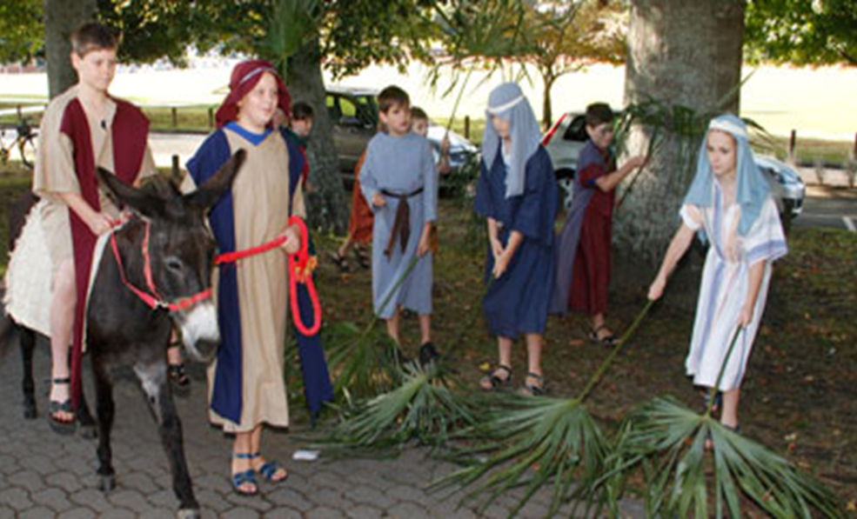
Ways Christians celebrate the Events of Passion Sunday
Christians enter into the events of Holy Week joyfully by re-enacting Christ’s triumphant entry into Jerusalem. He rides on a donkey, a Scriptural symbol of humility and service. What does this say about the sort of work Jesus was planning to do?
By re-enacting the procession with palms, Christians celebrate not only what happened in the past, they celebrate that this king is now risen from the dead and reigns as king of heaven and earth. Describe the differences in what the people in the original event celebrated and what the disciples of Jesus today celebrate.
The crowds praised Jesus enthusiastically because they believed he would overthrow Rome. They recognised him as the promised Messiah and although the people did not fully understand his mission yet, their worship honoured God. What sort of king did the people expect Jesus to be?
Jesus arrived in Jerusalem on a donkey, which was considered highly symbolic. At the time, a king riding a donkey symbolised peace, while a king on a horse symbolised war — while Jesus was not technically a king, his followers considered him to be one. How would you describe the sort of king Jesus would be, and share some evidence for your response?
Placing palms in front of a person was an ancient tradition used to honour a high-ranking person. The palm branch also signified victory. In Greco-Roman times, waving palms would have resembled a triumphal procession. How are important high-ranking people welcomed today?
R-1
S-05
Click an image to reveal text.
Click the audio button to stop ‘Jesus is our King’
Click the audio button to play ‘Jesus is our King’
Notes:
Slide 5 Ways Christians celebrate the Events of Passion Sunday
Read through the text reveals and answer the questions. Sing using the MP3 ‘Jesus is our King’
Photograph or record your school Passion Sunday Liturgy. From the images make a power point that could be used in your school or parish in the future to teach children about the meaning and importance of Passion Sunday. You could include images and explanations of how Passion Sunday is celebrated in other parts of the world – see Slide 6. This could be shared with families as a Sharing our Learning item on Slide 12.

Slide 6
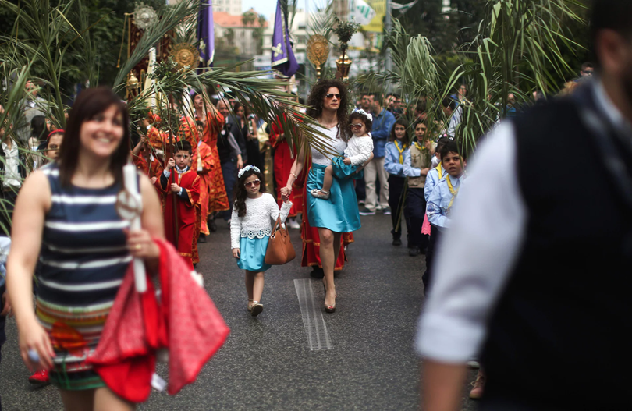
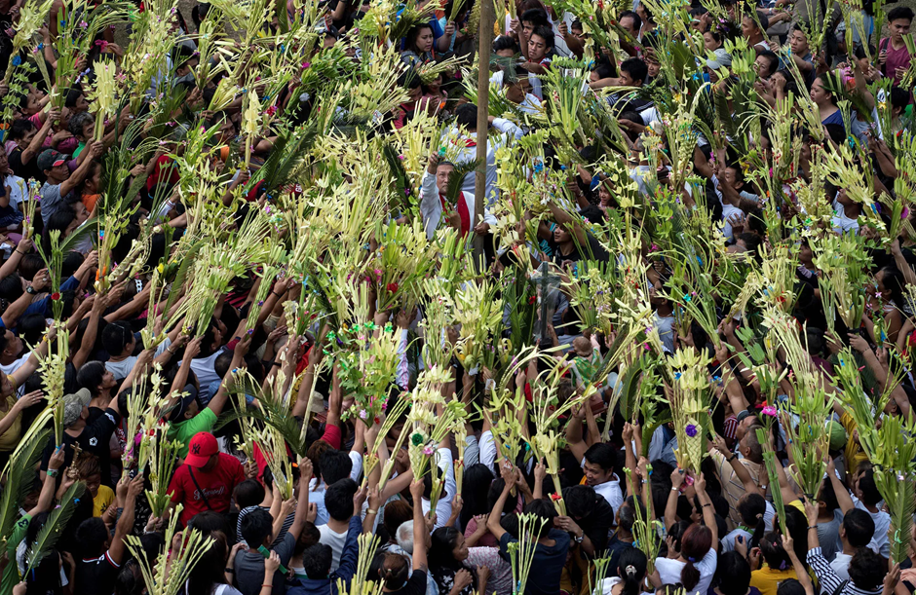
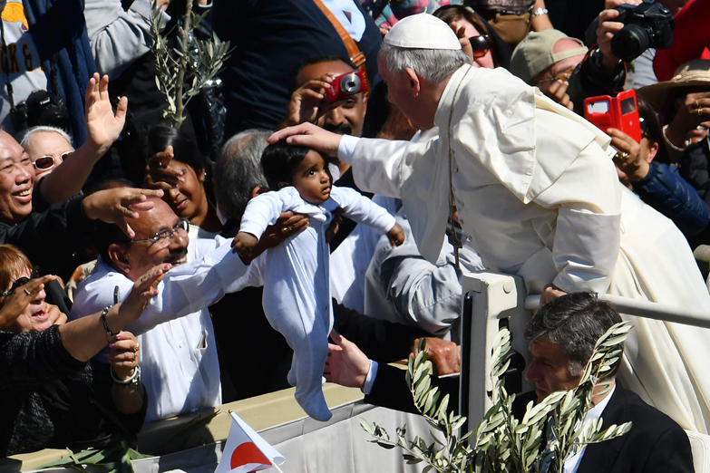
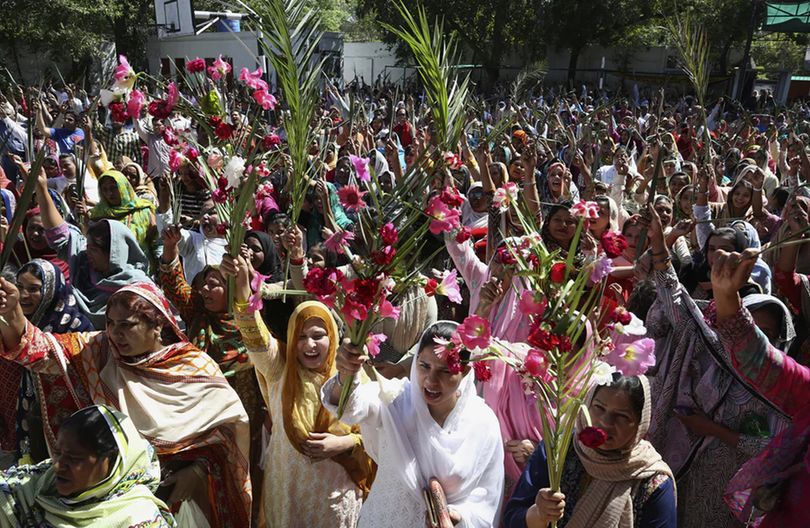
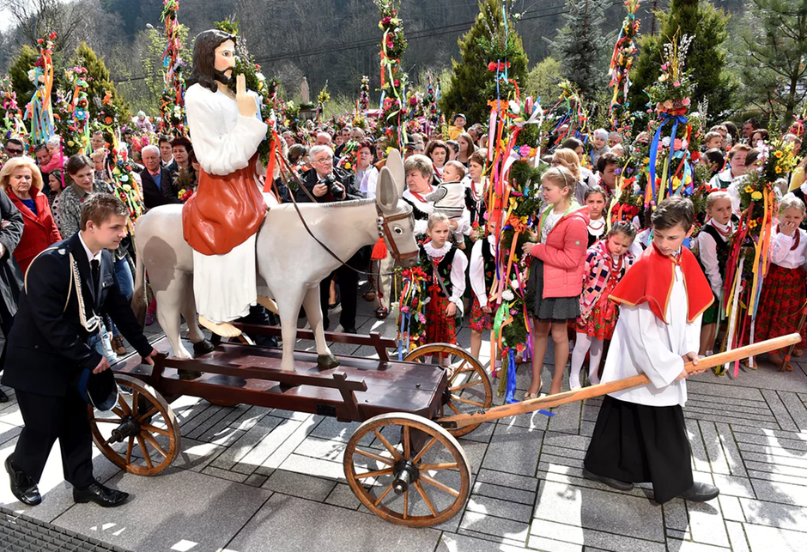
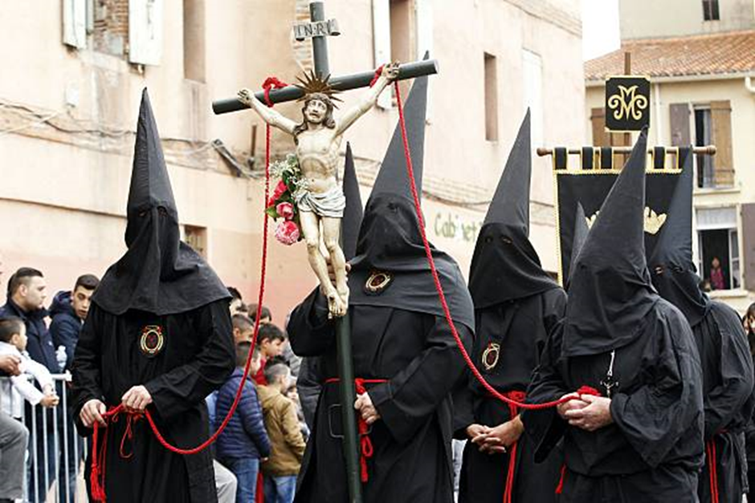
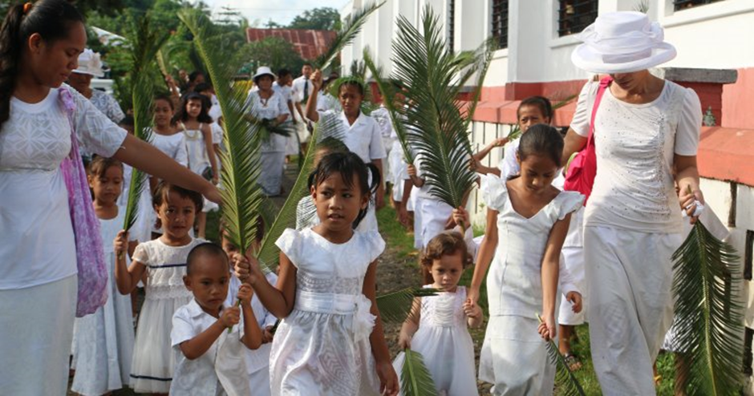
Palm Sunday Celebrations in other Countries and Cultures
In some parts of Spain
celebrations of Holy Week,
Semana Santa, are seen as a
tourist attraction.
During the week, men, or
the brotherhood as they are
referred to, maintain a
tradition of emotional
Penance processions.
They move through the towns
and cities carrying candles and
life size statues of Mary and Jesus accompanied by dramatic drum beats and mournful music. Some may even walk barefoot while wearing their heavy robes and tall pointed hats. They are called penitents because they seek forgiveness for their sins. They also wear masks so they cannot be recognised.
In the Pacific Islands
people dress in white
on Palm Sunday
because it is a
celebration colour.
Everyone has a palm
to wave as they join
the procession to
celebrate Jesus’ entry into Jerusalem. It doesn’t matter where people are in the world celebrating Palm Sunday, they all join in the procession waving palms, they all sing, “Hosanna to the Jesus the king!” and they all listen to the Gospel story of the last week of Jesus’ life leading to his death on the cross.
Many people in Poland are Catholic and big crowds take part in the Palm Sunday celebrations. It is almost spring time so the people weave spring flowers with the palms tied with coloured ribbons on to sticks to wave. A statue of Jesus on a donkey is put on a cart and leads the procession through the towns.
In Vatican City where Pope Francis lives, thousands of people gather for the Palm Sunday Mass. After the Mass Pope Francis comes down to move among the crowd and bless the children as Jesus did. People wave and cheer just as they did for Jesus on the first Palm Sunday.
In Bulacan in the Philippines, most people are Catholic. On Palm Sunday enormous crowds gather to join in processions. The palms are blessed and the people process into the church for Mass and the reading of the Passion story from the gospel.
In Beirut, the capital of Lebanon, large crowds celebrate Palm Sunday. The people process through the streets waving large palm branches and singing hymns.
In Lahore, in Pakistan, Christians gather to celebrate Palm Sunday. The people wave palms and flowers as they join in the procession before Mass.
R-1
S-06
Click the thumbnail to enlarge an image and reveal text.
Notes:
Slide 6 Palm Sunday Celebrations in other Countries and Cultures
Remind the children how re-enacting the events of Jesus’ passion makes them real and present to people and this is why people all over the world re-enact the events of Holy Week.

Slide 7
Christian are called to grow in holiness during Lent and especially in Holy Week
When we FAST our spirit becomes more open to hearing God's call to become holy, and we receive new energy for kindness and compassion for others. Through fasting our spirit becomes more open to hearing God's call to follow Jesus more closely. Fasting can apply to luxury food, television and technology.
Christians become holy through penance which includes praying, fasting and giving. These actions help people to respond to their personal call to holiness.
This is a call to change our ways, acknowledge our need for forgiveness and to follow more closely our call to live as disciples of Jesus and do what we can to build his kingdom of justice, peace and love on earth.
For Catholics there are special days and seasons the Church designates for doing penance. Lent and Holy Week are penitential times to help us to grow spiritually and become holy like God through penance.
X
When we GIVE we get in touch with the needy whom we then bring back to God in prayer. Giving asks us to put the needs of others before our own. Giving can be money, goods or time – all require us to be generous and open to serve others.
When we PRAY we praise and thank God for all God has given us. Ideally Christians pray every day because through prayer their relationship with God becomes a deeper friendship that draws them closer together. During Lent and especially in Holy Week, Christians spend more time in personal prayer and with their communities in the Liturgies that celebrate the events of Holy Week.
Click an icons to reveal text.
Click I-button to reveal additional information
R-1
S-07
Notes:
Slide 7 Christians are called to grow in holiness during Lent and especially in Holy Week
Talk with the children about making a special effort during Holy Week to do acts of charity, kindness and penance such as fasting, praying and giving and explain how this can be their response to God’s call to them to become holy. Remind children that they are not required by the church to fast until they are 14 years old. But many families fast in Holy Week regardless of age to help them to remember the sacredness of the week and what Jesus did for them during that week.

Slide 8
Responding to God’s invitation to grow in HOLINESS during Holy Week
Catholics believe that God calls everyone to holiness. When people are baptised they are called and configured towards Jesus and he brings them into life in the Trinity with God and the Holy Spirit Te Wairua Tapu.
Becoming holy is God’s business. God will show us how to be holy if we open our ears to listen and tune ourselves in to God. Listening and reading God’s word opens us up to become holy. God draws us to holiness and all we have to do is respond by participating in God’s life of prayer, the Sacraments and actions of love and justice.
Holiness means to be set apart, to belong to our God who says, “I will be your God and you will be my people.” Holiness is God’s greatest attribute. Holiness makes us whole and complete like God so we need nothing more.
Holiness means wholeness. To say that, “God is holy.” is to refer to the wholeness, the fullness and beauty of an abundant life that overflows from God. God calls us to share in this so we can live in harmony with God, with each other and the world.
God’s call to people to become holy is a call to God’s own life of loving kindness, justice, peace and compassion. It is a call to join the other holy people who are now Saints living with God in heaven. This is what God created us to become - Saints.
Click the down-button to move the blind down.
Click the worksheet button to go to the worksheet.
R-1
S-08
Notes:
Slide 8 Responding to God’s invitation to grow in HOLINESS during Holy Week
Print enough worksheets for each child to complete and share then add to their RE Learning Journal. Leave Slide 8 up as children complete their Y charts. They may find language and ideas help them to generate some deeper thinking of their own to add to their Y chart.

Slide 9
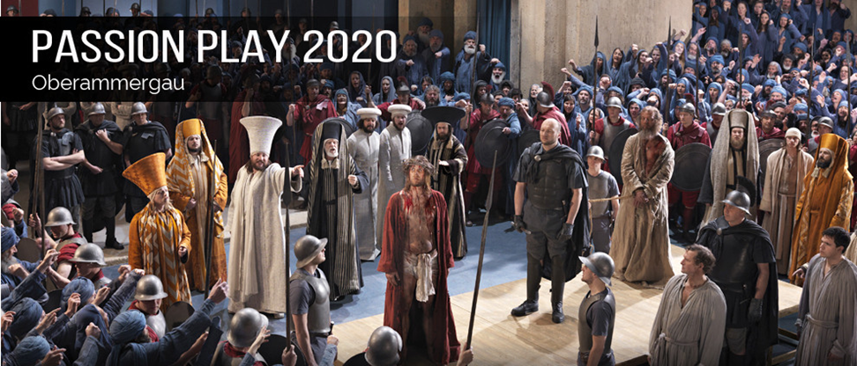
The Ultimate Live Re-enactment of Jesus’ Passion The Oberammergau Passion Play
Watch the clip closely and answer the questions
1)
Where is the play performed?
In Oberammergau, Bavaria, Germany.
2)
When was the first Passion Play performed?
In 1634.
3)
How often is the play performed?
Every 10 years.
4)
What threatened the village in 1633?
The Bubonic Plague.
5)
Why do the villagers perform the play?
In thanks to God for saving their village.
6)
What months does the play run in?
May to October.
7)
How many villagers perform in the play?
Over 2000.
First click the video button to watch “Oberammergau Passion Play” then click the numbers to reveal the answers.
Click the forward button to continue the questions (answers remain on slide)
R-1
S-09A
Notes:
Slide 9A The Ultimate Live Re-enactment of Jesus’ Passion The Oberammergau Passion Play
Introduce the Oberammergau Passion Play to the children and encourage them to find out more about it. They could enquire if there is someone they know who has been to it and talk to them about it.
Watch the clip
https://www.youtube.com/watch?v=Deblk3drJwI
Oberammergau Passion Play (9:25 minutes)
Students could use the clip and add additional information to create a presentation to share with other classes.

Slide 10
The Ultimate Live Re-enactment of Jesus’ Passion The Oberammergau Passion Play
Watch the clip closely and answer the questions
8)
What do the people have to do to prepare for the play?
They have to grow their hair and beards.
9)
What restrictions are there about who can be part of the play?
Actors must have been born in Oberammergau or have lived there for 20 years.
10)
What is the action of the play focused on?
The last week of Jesus’ life.
11)
How long does the play take to perform?
5 hours.
12)
What time do the performances start?
They start at 2:30 pm and end at 10:00 pm, with a meal break in the middle.
13)
How do you get tickets and where do people stay?
Tickets are only sold as part of package tours and accommodation is in local people’s homes and hotels.
14)
Where do the proceeds of the play go to?
The proceeds of the play go to the performers and the local village amenities.
Click the numbers to reveal the answers.
Click the forward button to continue the questions (answers remain on slide)
R-1
S-09B
Notes:
Slide 9B The Ultimate Live Re-enactment of Jesus’ Passion The Oberammergau Passion Play
Watch the clip
https://www.youtube.com/watch?v=Deblk3drJwI
Oberammergau Passion Play (9:25 minutes)
Students could use the clip and add additional information to create a presentation to share with other classes.

Slide 11
The Ultimate Live Re-enactment of Jesus’ Passion The Oberammergau Passion Play
Watch the clip closely and answer the questions
15)
Who was the most famous audience member?
Adolf Hitler.
16)
Have the performances ever been cancelled?
The performances were cancelled during the World Wars 1 & 2.
17)
Besides being performers, what other ways are the villagers involved with the play?
The villagers are musicians, costume makers, stage hands, directors.
18)
What else is Oberammergau famous for?
Wood carving, especially of religious objects.
19)
How many children act in the play?
200 children.
20)
How many centuries has the play lasted for?
4 centuries.
R-1
S-09C
Click the numbers to reveal the answers.
Notes:
Slide 9C The Ultimate Live Re-enactment of Jesus’ Passion The Oberammergau Passion Play
Watch the clip
https://www.youtube.com/watch?v=Deblk3drJwI
Oberammergau Passion Play (9:25 minutes)
Students could use the clip and add additional information to create a presentation to share with other classes.

Slide 12
Check up
1)
Write a paragraph about the origins of the Holy Week Liturgies. (Slide 4)
2)
Write a short description of how Christians in Aotearoa celebrate Holy Week through liturgy. (Slide5)
3)
Describe 3 different ways people in other cultures celebrate Holy Week. (Slide 6)
4)
Give 3 good reasons why it is important for Christians to be part of the Holy Week liturgies. (Slide 7)
5)
What is meant by God’s personal call to each person to holiness? (Slide 8)
6)
Explain what the Oberammergau Passion Play is and list what you learned about it. (Slide 9A, 9B & 9C)
7)
Which activity do you think helped you to learn best in this resource?
8)
Questions I would like to ask about the topics in this resource are …
Click in each caption space to reveal text
Click on the worksheet button to go to the worksheet.
R-1
S-10
Notes:
Slide 10 Check Up
This formative assessment strategy will help teachers to identify how well students have achieved the Learning Intentions of the resource.
Teachers can choose how they use the slide in their range of assessment options.
A worksheet of this slide is available for students in Years 5-8 to complete.
The last two items are feed forward for the teacher.
Recording the students’ responses to these items is recommended as it will enable teachers to adjust their learning strategies for future resources and target the areas that need further attention.

Slide 13
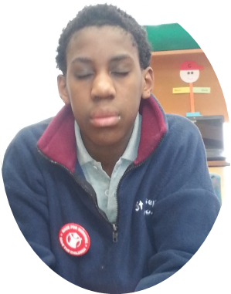
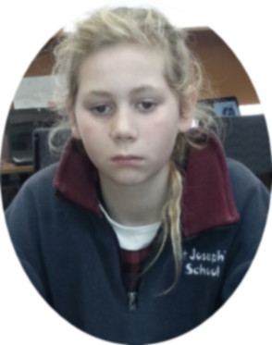
Time for Reflection
R-1
S-11
Click the audio button to stop reflective music
Click the audio button to play reflective music
Notes:
Slide 11 Time for Reflection
The MP3 is played to help create a reflective atmosphere and bring the young people to stillness and silence as the teacher invites them to recall the events of Holy Week and try to grasp the enormity of the effect they had on human history from that week in time until today. Think about what Jesus, God’s only son, suffered so that they and all people can be free from death and sin forever. Respond to this in ways they show Jesus how much they remember him and appreciate that he gave his life out of love for them and all people on Good Friday. Teacher Note – the reflective music is a Taizé song “Jesus Remember Me” which could be played throughout the day this week to help children to realise that Holy Week is a prayerful and reflective week that is different from all other weeks in the year.

Slide 14
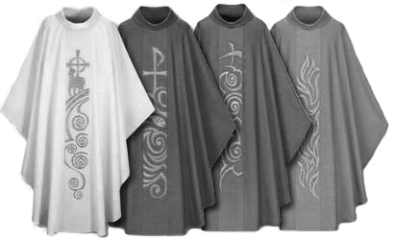
The Liturgical Calendar measures the seasons and feast of the Church’s Year
Name: _______________
Date: _________
Colour the feasts and seasons according to their Liturgical Calendar.
Draw the vestments beside the season they are used in.
Why do you think the colours are used and where would you see them in the church during their Liturgical season?
R-1
S-03
Worksheet
Click the worksheet button to go to the worksheet.
Click the up arrow to return to the lesson

Slide 15
Responding to God’s invitation to grow in HOLINESS during Holy Week
HOLINESS
Looks like
Feels like
Sounds like
Name: _______________
Date: _________
R-1
S-08
Worksheet
Click the arrow buttons to navigate the worksheets or return to the lesson

Slide 16
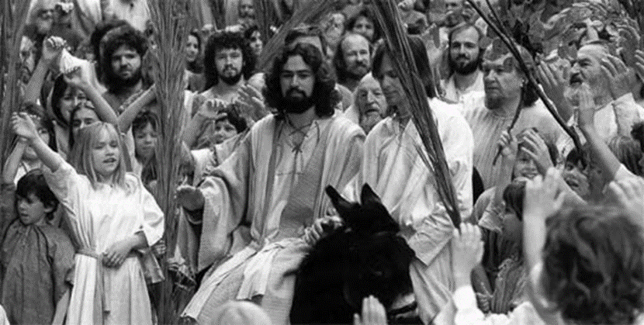
Check up
Name:____________________________
Date:____________
Write a paragraph about the origins of the Holy Week Liturgies. (Slide 4)
2. Write a short description of how Christians in Aotearoa celebrate Holy Week through liturgy. (Slide 5)
3. Describe 3 different ways people in other cultures celebrate Holy Week. (Slide 6)
Holy Week is a time to grow in holiness – explain what people can do to grow in holiness during this week. (Slide 7)
5. What is meant by God’s personal call to each person to holiness? (Slide 8)
6. Explain what the Oberammergau Passion Play is and list what you learned about it. (Slide 9A, 9B & 9C)
7. Which activity do you think helped you to learn best in this resource?
8. Questions I would like to ask about the topics in this resource are...
R-1
S-10
Worksheet
Click the up arrow to return to the lesson

