Slide 1
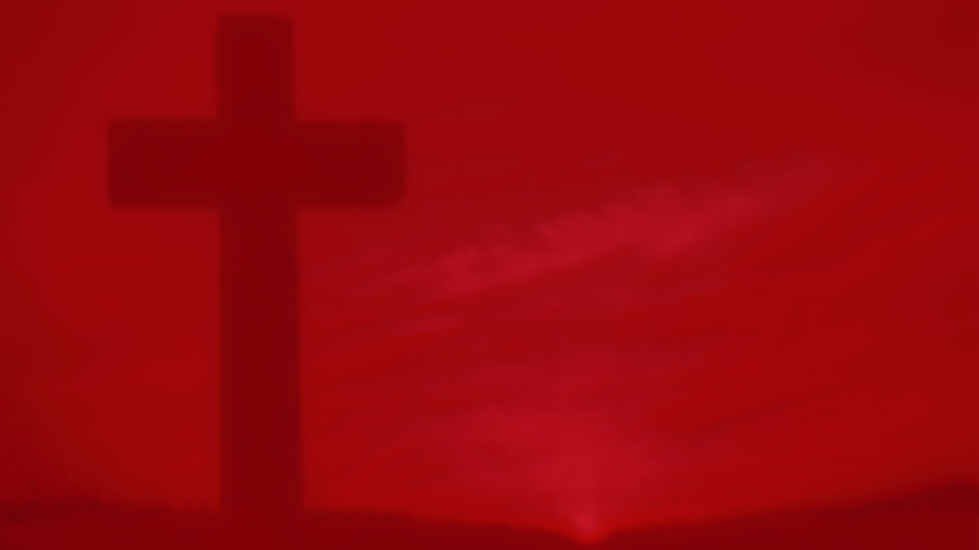
Holy Week – The Easter Triduum
R-2
S-01
Notes:
Slide 1 Holy Week – The Easter Triduum
Use this slide as a focussing strategy to introduce the resource topic. Read the title together and invite students to share something they know about what the Easter Triduum is and how the Church celebrates it.

Slide 2
Learning Intentions
The students will:
1)
identify how Christians celebrate Holy Week
2)
recognise that through the liturgies of Holy Week Christians share the life and love that Jesus gives at each of these events as though they were actually there.
Click the border to reveal text
Click the video button to play “The Last Supper” story
R-2
S-02
Notes:
Slide 2 Learning Intentions
Read through the Learning Intentions with the class and identify some ideas/questions that might be explored in the resource.
Continue the reflective, prayerful atmosphere in the classroom during Holy Week. Highlight the some symbols used during the Easter Triduum a bowl and towel, a cross and a large stone and candle, and red and yellow cloths. Use the gospel readings that describe the events each morning this week and try to complete the whole Passion story on Holy Thursday. You may like to include a time when children wash each other’s feet as Jesus did on Holy Thursday before the Last Supper. Use Taizé music throughout the day to remind children this week is different from all other weeks of the year. Create wall displays of appropriate images and set aside part of the classroom as a quiet prayer space that can be used throughout the day. Remind the students that this is their preparation for Good Friday as it is a holiday. Invite them to suggest what they could do on Good Friday to mark the day of Jesus’ crucifixion. Check the times and places where they could attend the Good Friday Liturgy or join an Ecumenical Walk of the Cross near where they will be on Good Friday.
If you have students who need more RE background on Holy Week the Level 3 Year 6 Holy Week resources focus on the first 4 days of Holy Week and the Days of the Easter Triduum which you can access on the web.
A suggestion for Holy Thursday morning prayer: https://www.youtube.com/watch?v=H-PGK4WGmLU
The Last Supper story spoken in Hebrew with English subtitles (3:07 minutes).
Children could imagine that this is what Jesus’ voice sounded like as he prayed over the bread and wine at the Last Supper. Remember you are a spiritual guide for your class and this is the most important week of the year to let the children see this.

Slide 3
FAQs about the PASCHAL or EASTER TRIDUUM?
Q1. What is the PASCHAL or EASTER TRIDUUM?
A1. The Easter Triduum is the three-day period also known as the Sacred Triduum, or Paschal Triduum that lasts from sundown on Holy Thursday to sundown on Easter Sunday and it is considered the most solemn part of the liturgical year. Triduum is Latin for 3 days. Liturgically it is one liturgy that
unfolds over 3 days that forms a unity rather than separate unconnected celebrations.
Q2. What does the Sacred Triduum celebrate?
A2. For Catholics, the Triduum is liturgically one celebration beginning at sundown on Holy Thursday with the Mass of the Lord’s Supper, continuing with the celebration of the Lord’s Passion on Good Friday and concluding with the day of the Lord’s Resurrection, which includes the Easter Vigil.
Q4. What significant events does the Church celebrate and relive at the Mass on Holy Thursday?
Q3. What happens at the Mass of the Lord’s Supper on Holy Thursday?
A4. The Church relives the institution of the Eucharist at the Mass of the Last Supper, and the institution of the priesthood which became the Sacrament of Holy Orders. At the end of the meal Jesus talked with the disciples for a long time. He began by giving them a new commandment, “Love one another just as I have loved you, you also should love on another. By this everyone will know that you are my disciples, if you love one another.” (John 13:34-35) The Latin word for commandment is “mandatum” which is why Holy Thursday is also called Maundy Thursday – the day of the new commandment.
A3. On Holy Thursday, we celebrate the Mass of the Lord’s Supper, which includes the washing of the feet. The Last Supper was a meal to mark the unity, love and shared life of Jesus and his disciples. It was at this meal that the disciples bound themselves to follow Christ wherever he went. Through our participation in this liturgy, we too bind ourselves to follow Jesus in his death and Resurrection.
R-2
S-03A
Click an image to reveal text. Click the video button to watch “Paschal Triduum”
Notes:
Slide 3A FAQs about the PASCHAL or EASTER TRIDUUM.
Watch the clip which outlines the history of the Easter Triduum celebration. Read the answers to the FAQs and let them generate further discussion about the meaning of the Easter Triduum.
Remind children that the word “paschal” comes from a Hebrew word “pesach” meaning Passover. It refers to Jesus’ suffering, death and Resurrection and is used because Jesus’ death happened at the time of Passover. The word mystery is often added to it because Jesus’ suffering, death, and Resurrection is a mystery. Triduum is a Latin word meaning 3 days. The Easter Triduum is one long liturgy celebrated over the three holiest days of the year. Each liturgy is like one act of a three-act play.
Refer to Level 4 Year 7, R1 Slide 6 The Last Supper - was it a Passover meal?
Refer to Level 4 Year 7, R2 Slide 5 How Jesus gives his Life and Love through the Mass of the Last Supper on Holy Thursday, which deals with the institution of the Sacraments of the Eucharist and Holy Orders (Priesthood).
Watch the clip: https://www.youtube.com/watch?v=_zKrBYPuZzE
Paschal Triduum (1:38 minutes)

Slide 4
FAQs about the PASCHAL or EASTER TRIDUUM?
Q5. Why does the priest wash the feet of some people from the parish?
A5. The priest washes the feet of disciples of Jesus today which is re-enacting what Jesus did and is described as “humble service” before the disciples shared their last meal with him. In the Jewish culture Jesus lived in, the lowest servant washed the feet of guests to make them comfortable. Jesus did this to show the disciples that they must become servants to all. This reminds priests that their role is also to be servants to their people.
Q6. What happens at the Liturgy of the Lord’s Passion on Good Friday?
A6. Good Friday is the day of Jesus’ crucifixion, the day he died for the sins of the world. It is a day of fasting and abstinence and the only day of the year when the Church does not celebrate Mass. The parish altar is plain and bare. At 3:00 we celebrate the Lord’s Passion. We listen as the Passion of Jesus is proclaimed. Then the Prayers of Intercession for the Church and the world are prayed followed by the Veneration of the Cross to acknowledge the cross as the means of our salvation. The Liturgy finishes with Communion and the people leave the church in silence.
Q7. Where does the Easter Vigil fit into the Sacred Triduum?
A7. The Easter Vigil is the high point of the Easter Triduum. It is the most glorious, beautiful, and dramatic liturgy the Church celebrates. It is held after nightfall on Holy Saturday, or before dawn on Easter Sunday, in celebration of the Resurrection of Jesus. It includes the blessing of the Easter fire and the Paschal candle, the singing of the Easter Proclamation, the expanded Liturgy of the Word that traces the story of our Salvation, the Liturgy of Initiation in which people become new members of the Church and the celebration of the Eucharist. During the Triduum, we celebrate the mystery of our Christian faith that is Jesus’ triumph over death and our own participation in that Resurrection. We come together in a special way to remember the saving act of Jesus and the miracle of his Resurrection and we celebrate our faith and identity as Christians.
R-2
S-03B
Click an image to reveal text.
Notes:
Slide 3B FAQs about the PASCHAL or EASTER TRIDUUM?
Refer to Level 4 Year 7, R1 Slide 6 The Last Supper - was it a Passover meal?
Refer to Level 4 Year 7, R2 Slide 5 How Jesus gives his Life and Love through the Mass of the Last Supper on Holy Thursday, which deals with the institution of the Sacraments of the Eucharist and Holy Orders (Priesthood).
You may like to repeat the clip: https://www.youtube.com/watch?v=_zKrBYPuZzE
Paschal Triduum (1:38 minutes)

Slide 5
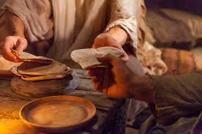
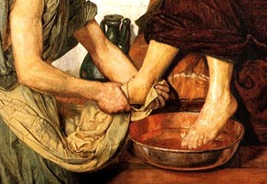
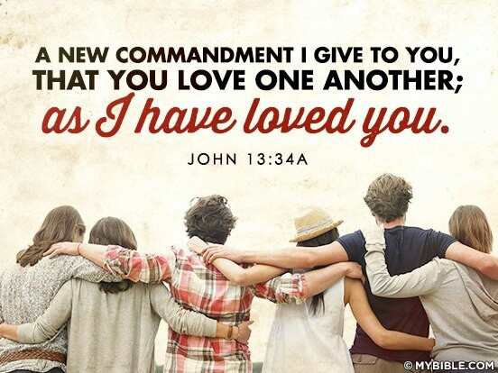
The Easter Triduum begins with Holy Thursday
This Mass does not finish with the usual dismissal, “Go in Peace”, but with The Solemn Procession of the Eucharist with the priest carrying the Eucharist in a ciborium from the altar to an altar of respose, usually on the side. This Eucharist is kept until it will be served to the people on Good Friday as there is no Mass on Good Friday. The people spend time in silent prayer at the altar watching and waiting with Jesus as though they were with him in the garden of Gethsemane. After the Mass, the community are encouraged to
keep vigil with Jesus for some time up until midnight.
The Liturgy on HOLY THURSDAY is the beginning of the Paschal or Easter Triduum that is one long continuous liturgy that celebrates the events of Jesus’ life, death and Resurrection which is referred to as the Paschal Mystery. Although the celebration is broken into liturgies that celebrate sacred moments during the three days that are set aside for this great celebration by the Church every year, the whole paschal mystery is in fact celebrated on each day of the Triduum.
The theme of the Holy Thursday liturgy is Eucharist in that it focusses on The Celebration of the Institution of the Eucharist at the Last Supper. The Ritual of the Washing of the Feet is re-enacted and used by Jesus to show the apostles that this is the model of “priesthood” they are called to. Their call is to humble service and charity. This is the central theme of St John’s gospel which is read at the Mass. It was during this first Mass that Jesus gave the disciples the new commandment, “Love another as I have loved you.” It is the greatest commandment of all.
After the procession the people watch another ancient ritual - The Stripping of the Main Altar and the sanctuary of cloths, candles and all decorations and the tabernacle door is left wide open. The altar represents Jesus’ body which was stripped bare by the soldiers before he was crucified. This is to move the focus of the liturgy to Good Friday. There is no dismissal rite and the people leave the church in silence.
R-2
S-04
Click the pins on the right to reveal post-it notes. Click the video button to watch “Pope Francis explains Holy Week”
Notes:
Slide 4 The Easter Triduum begins with Holy Thursday
The Easter Triduum Liturgy Cards Teacher Resource is included and can be printed as needed. See copy at the end of the Overview.
Adapt Teaching and Learning Experiences 2 & 4.
Watch the clip: https://www.youtube.com/watch?v=HPOPrew1gDg
Pope Francis explains Holy Week (2:40 minutes)

Slide 6
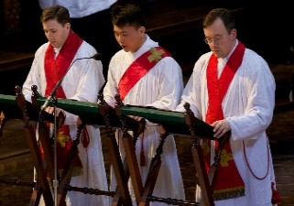
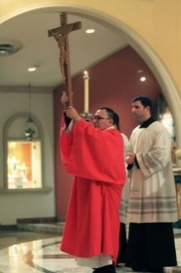
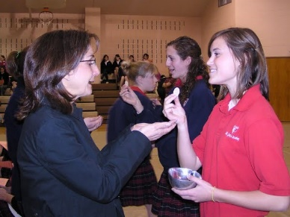
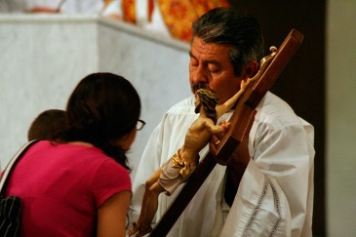
The Easter Triduum continues with Good Friday
The Liturgy of the Word tells the story of the events of the first Good Friday and is related by narrators. The priest speaks the words of Jesus and the congregation speak the words of the crowd. The General Intercessions follow the readings as part of the Liturgy of the Word. These prayers are prayed for the Church, the world and all people.
The Good Friday Liturgy is a stark reminder of the solemnity of the day as the community gather at 3pm in silence before the bare altar and empty tabernacle. There is no cross bearer, no candles, no greeting and the red vestments worn by the priests add to the mood as the Passion Narrative from John’s Gospel is dramatised.
The final part of the Good Friday Liturgy is The Communion Rite. The communion service was added to the liturgy in more recent times. It is a very simple and modest addition to the rite. The ciborium is taken
from the altar of repose where it was placed during the conclusion of the Holy Thursday Mass. The Eucharist is distributed and when all have received Holy Communion there is a simple dismissal prayer and all people leave in hopeful silence.
The liturgy continues with The Veneration of the Cross. People choose how they venerate the cross by kneeling before it, touching or kissing it. This ritual has been carried out on Good Friday since the 4th century. Before the people come up to the cross individually, the cross is shown to
the congregation by the priest as he
sings, “This is the wood of the Cross on
which hung the Saviour of the world.
Come let us worship.” This is done 3 times sometimes as part of a procession.
Click the outer images to reveal text. Start in the left top corner and move clockwise.
Click the video button to watch “Passion Song – The Story of Holy Week”.
R-2
S-05
Click the audio button to play ‘My People’
Click the audio button to stop ‘My People’
Notes:
Slide 5 The Easter Triduum continues with Good Friday
Use the clip to remind children what The Good Friday Liturgy brings to life again for Christians on this sad day.
Have time of silent reflection before.
Watch the clip: https://www.youtube.com/watch?v=MljFNaWoYEs
Passion Song - The Story of Holy Week (5:09 minutes)
Sing using the MP3 “My People”
Adapt Teaching and Learning Experience 4

Slide 7
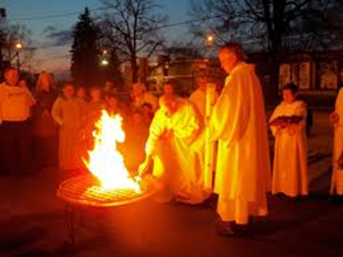
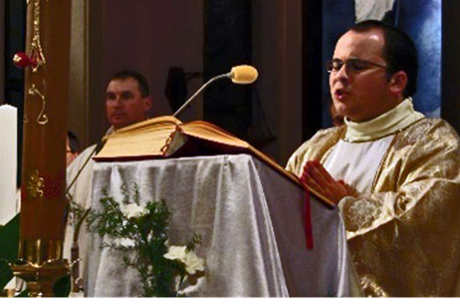
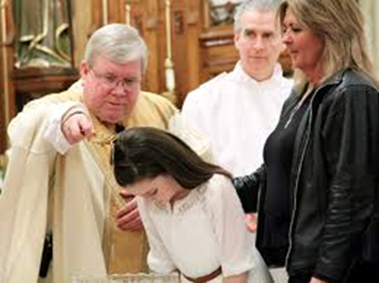
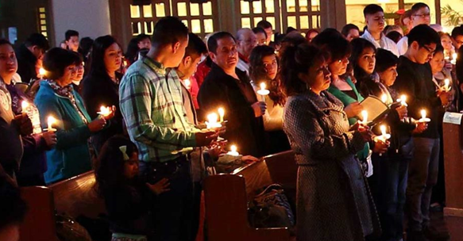
The Easter Triduum comes to its high point with the Easter Vigil
-1-
The Easter Vigil is the oldest annual liturgy in the Church calendar and the Easter Vigil today is celebrated in four parts: light, word, baptism, and Eucharist. In one sense our lives of faith are about keeping vigil as we await Christ’s second coming. The Easter Vigil liturgy begins after nightfall outside the church where a fire has been lit in a suitable place for the people to gather around and watch The Service of Light unfold.
-2-
The priest greets the people and carries the Easter candle to the Easter fire. He blesses the fire and lights the candle from it. He then holds it high as he processes into the church chanting the words, “Christ our Light.” and the people respond, “Thanks be to God.” Then the light from the Easter candle is shared as the people light their candles and pass it around the church.
-3-
The Exsultet which means “Rejoice,” also referred to as the Easter Proclamation, follows. This is a hymn that is sung by a deacon, priest, or cantor. This hymn speaks of how God has interceded on our behalf in human history. The Exsultet recalls the Holy Night when Jesus Christ rose from the dead. What makes this moment particularly dramatic is that the Exsultet is sung in a church lit only with the light of the Paschal Candle and other smaller candles lit from it, which people are holding.
-4-
The Liturgy of the Word for the Easter Vigil has nine readings and seven responsorial psalms. The first reading begins with the story of Creation and then each subsequent reading recounts the story of our faith lives through history. This includes the famous stories about people who were part of the salvation stories such as Isaac, Abraham, Moses and the Exodus story. All of these readings lead up to the singing of the Gloria when the church is flooded with lights and ringing bells to welcome the final reading - the gospel of the Resurrection of Christ.
-5-
The Baptismal Liturgy continues even if there are no candidates for Baptism, the blessing of baptismal water still takes place in parish churches usually at the baptismal font. If it cannot be seen easily a large bowl of water can be placed in the sanctuary for the blessing. Before the blessing of the water the Litany of the Saints is sung. Then any catechumens and candidates to become fully initiated into the church, by baptism and/or confirmation come forward with their god-parents.
-6-
After the celebration of The Sacraments of Initiation the whole community renew their baptismal promises. The community responds to the questions put to them as they stand and hold their lighted candles in their hands. They are then sprinkled with the newly blessed Easter water. This is done in a way that the gestures and words remind them of the Baptism they have received. The celebrating priest sprinkles the people by passing through the main part of the church. The newly baptised and confirmed are led to their place among the faithful.
-7-
Liturgy of Eucharist follows after the Prayer of the Faithful and the Offertory Procession in which the newly baptised may take part, the Liturgy of the Eucharist continues as usual. This is the first Mass of Easter Day. During the Eucharist, the newly baptised receive Holy Communion for the first time. The Mass concludes with Easter hymns and bells ringing and people singing out the joy of the Resurrection.
-8-
Throughout these three days, we experience the highs and lows in our faith, ending with the ultimate high — the new life of the Resurrection. The Easter Season begins with the Easter Vigil, and we enter a time of 50 days when endless “Alleluias” will ring out throughout all of our liturgical celebrations.
R-2
S-06
Click top card to discard it.
Notes:
Slide 6 The Easter Triduum comes to its high point with the Easter Vigil
Read the flip cards which explain each part of the Easter Vigil.
Please note - most churches do not do the entire set of nine readings (for time’s sake). But keep in mind that the point of them is to recall how God has interceded on humanity’s behalf from the very beginning of time and that through this Easter Vigil we celebrate that God is present and always working in our lives and continues to so today.

Slide 8
The Easter Triduum Liturgies – How well do you know them?
Click the images to enlarge, click the large image to go back.
Click on the worksheet button to go to the worksheet.
R-2
S-07
Notes:
Slide 7 The Easter Triduum Liturgies – How well do you know them?
Make a copy of the worksheet for each child to complete and add to their RE Learning Journal. This worksheet could be used as a post test. For re-teaching purposes return to Slides 3,4,5,6. See Answers below
Indicate which day during the Easter Triduum Liturgies when this happens – Holy Thursday (HTH), Good Friday (GF), Easter Vigil (EV)
The Easter fire is lit outside the church EV
The Passion Narrative of St John is read GF
New members are welcomed into the community at their baptism EV
The Last Supper is re-enacted HTH
The priest processes with the lighted Paschal Candle held high into the church EV
The altar is stripped bare and the tabernacle door is left open HTH
The Exsultet is sung to proclaim Jesus is risen EV
The Mass is not celebrated GF
The people are dismissed with the words “Go in the peace of Christ, Alleluia, Alleluia.” EV
The priest washes the feet of 12 parishioners HTH
The Litany of the Saints is prayed EV
The story of the Exodus when Moses led the people from slavery to freedom is read HTH
The whole community renew their baptismal promises EV
There is no dismissal prayer and the people leave the church in silence HTH / GF
The Mass ends with a procession led by the priest with the Eucharist to the side altar HTH
Alleluia songs are sung EV
The people can receive Holy Communion but there is no Mass on this day GF
Several readings from the Old and New Testament are read EV
The people venerate the cross GF
Bells are rung, candles are lit and the people sing EV

Slide 9
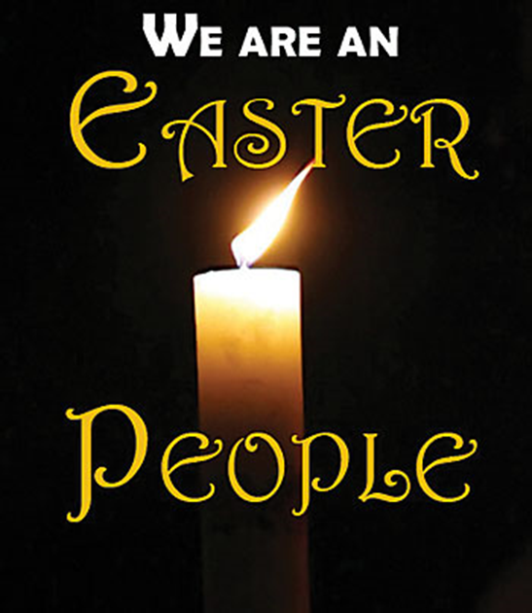
Celebrating the Easter Triduum – real life drama not to be missed
The Liturgies of the Easter Triduum tell the story that stands at the core of
The Liturgies tell the story through signs, symbols and music with ancient
The Liturgies engage the senses of those present so they become drawn into
The Liturgies retell an ancient sacred story and are a celebration of the
Try to attend the liturgies on all three days – missing one would be
The triumph of Christ’s Resurrection comes to its glorious conclusion as we realise yet again
what Christians believe as they move from death to life with Jesus.
rituals woven through them that people who are present become part of.
the action right now – this is real – it is not on a screen.
everlasting significance of these events in the lives of people today.
like missing an act of a three - act play.
we are an Easter people and we go in the peace of Christ, Alleluia, Alleluia.
A)
like missing an act of a three - act play.
B)
rituals woven through them that people who are present become part of.
C)
we are an Easter people and we go in the peace of Christ, Alleluia, Alleluia.
D)
what Christians believe as they move from death to life with Jesus.
E)
everlasting significance of these events in the lives of people today.
F)
the action right now – this is real – it is not on a screen.
R-2
S-08
Click the correct sentence ending to complete the sentences.
Notes:
Slide 8 Celebrating the Easter Triduum – real life drama not to be missed ANSWERS: 1) D, 2) B, 3) F, 4) E, 5) A, 6) C Use each sentence to generate conversations about their ideas. Adapt Teaching and Learning Experience 3.

Slide 10
Important facts about the Paschal Candle
The Paschal candle is made of pure b .
The priest i the candle with grains of incense.
The candle also shows the date of the current y to show all time belongs to Christ.
The first and last letters of the G alphabet indicate Christ is the beginning and the end.
The Easter candle is lighted each day during Mass throughout the f days of the Easter season.
The Paschal Candle is used during all B as a symbol of Christ’s R .
After P the Paschal Candle may be placed next to the baptismal font.
At f the Paschal Candle is placed next to the coffin as a reminder that the person will die and rise with Christ.
The lighted Paschal Candle is a reminder to e that they must share the light of Christ in the w .
eeswax
nscribes
ear
reek
ifty
aptisms
esurrection
entecost
unerals
veryone
orld
R-2
S-09
Click the bold letters to complete the sentences.
Notes:
Slide 9 Important facts about the Paschal Candle Make enough copies for children to complete the worksheet and add it to their RE Learning Journal. Check the answers on screen. Words to complete 1) beeswax, 2) inscribes, 3) year, 4) Greek, 5) fifty, 6) Baptisms, 7) Resurrection, 8) Pentecost, 9) funerals, 10) everyone, 11) world
Children could create their own image of the Easter candle to make a display in the church/school foyer.

Slide 11
Check up
1)
Write a paragraph explaining to a family member what the Easter Triduum is.
Make a poster to help you share all you have learned about the events of Holy Thursday and how the Liturgy of the Lord’s Supper celebrates these events.
2)
Describe the mood of the Good Friday events and how the liturgy expresses them or make a wordle using all the words you know that relate to Good Friday.
3)
Create an art work that includes elements of the original Resurrection event as well as some of the liturgical rituals that are used in the Easter Vigil celebration.
4)
Think about how the three days of the Easter Triduum form one liturgical unity and make a triptych art work (a panel painting that is divided into three sections) one for each day of the Triduum. Try to show how the 3 images form a unity.
5)
6)
Which activity do you think helped you to learn best in this resource?
7)
Questions I would like to ask about the topics in this resource are …
Click in each caption space to reveal text
Click on the worksheet button to go to the worksheet.
R-2
S-10
Notes:
Slide 10 Check Up This formative assessment strategy will help teachers to identify how well students have achieved the Learning Intentions of the resource. Teachers can choose how they use the slide in their range of assessment options. A worksheet of this slide is available for students in Years 5-8 to complete. The last two items are feed forward for the teacher.
Recording the students’ responses to these items is recommended as it will enable teachers to adjust their learning strategies for future resources and target the areas that need further attention.

Slide 12
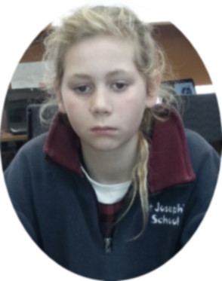
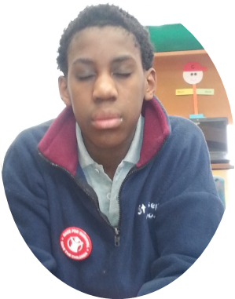
Time for Reflection
R-2
S-11
Click the audio button to play reflective music
Click the audio button to stop reflective music
Notes:
Slide 11 Time for Reflection
The MP3 is played to help create a reflective atmosphere and bring the children to stillness and silence as the teacher invites them to reflect on how the liturgies they have learned about that celebrate the Easter Triduum mirror the pattern of their lives. People live, people die, people rise again because of the life of one man - Jesus. These liturgies help to make his life and his mission real for his followers. Let a sense of gratitude for what Jesus did and continues to do for them lead to a conversation with him about his plans for them especially the part they have in carrying on in his mission on earth.

Slide 13
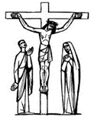
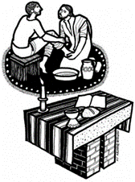
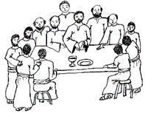
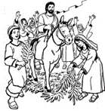
Sharing our Learning about HOLY WEEK with family whānau
Share what you have learned about the Liturgical Year with a younger child at home or at school. Make a small picture to illustrate what you are talking about. (R1, Slide 3)
Share the visual you created related to the history of the Holy Week Liturgies at home that you made starting with Egeria. (R1, Slide 4)
Share the Power Point of the Palm Sunday Liturgy at your school. At the end ask children for questions and comments. (See R1, Slides 5 & 6).
Design a sticker or a fridge magnet to remind your family how they can grow in holiness during Lent and Holy Week by FASTING, GIVING and PRAYING. (R1, Slide 7)
Create a static performance using human statues of the main characters in the scene of Jesus’ crucifixion. Photograph them and include them in a power point presentation as part of prayer time. Adapt the Scripture story to tell what happened.
R-2
S-12A
Continued on the next slide.
Notes:
Slide 12A Sharing our Learning about HOLY WEEK with family whānau
This slide provides some choices for children to show and share what they have learned. Examples could be photographed as evidence of students’ learning.
You may like to put a copy of the Sharing our Learning page in students’ RE Learning Journals. You could talk through the choices using the slide and let students make their choice from their own copy.
Students could work on their choice at school and/or at home and you may like to set a day for sharing. Please let parents and whānau know what you expect them to do with this. The slide is focussed on Year 8 HOLY WEEK Achievement Objective which is covered in Resources 1&2.
HOLY WEEK AO) Students will be able to: develop an understanding of the significance of the Holy Week events for Christians and how the Church in various cultures celebrates them.

Slide 14
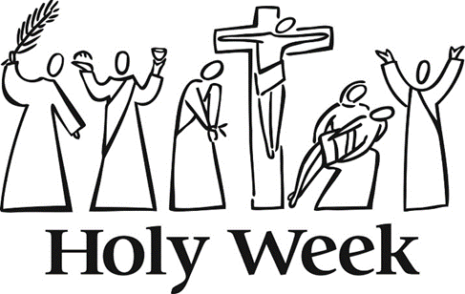
Sharing our Learning about HOLY WEEK with family whānau
Share the artworks related to the Easter Sunday Events and the Easter Vigil and the triptych with your family. (R2, Check up items 4 & 5)
Share the graphic symbols below of Holy Week and explain their meaning. Create your own to share.
Have a conversation with an adult about the Liturgies for the Easter Triduum and what you have learned about them. Share your worksheet from R2 Slide 7.
Create a display of the posters made of the Holy Thursday Liturgy related to R2 Check up item 2.
Make up your own way of showing and sharing what you have learned and decide whom you would like to share it with.
R-2
S-12B
Click worksheet button to go to the worksheet.
Notes:
Slide 12B Sharing our Learning about HOLY WEEK with family whānau
This slide provides some choices for children to show and share what they have learned. Examples could be photographed as evidence of students’ learning.
You may like to put a copy of the Sharing our Learning page in students’ RE Learning Journals. You could talk through the choices using the slide and let students make their choice from their own copy.
Students could work on their choice at school and/or at home and you may like to set a day for sharing. Please let parents and whānau know what you expect them to do with this. The slide is focussed on Year 8 HOLY WEEK Achievement Objective which is covered in Resources 1&2.
HOLY WEEK AO) Students will be able to: develop an understanding of the significance of the Holy Week events for Christians and how the Church in various cultures celebrates them.

Slide 15
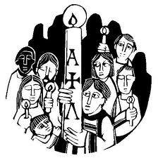
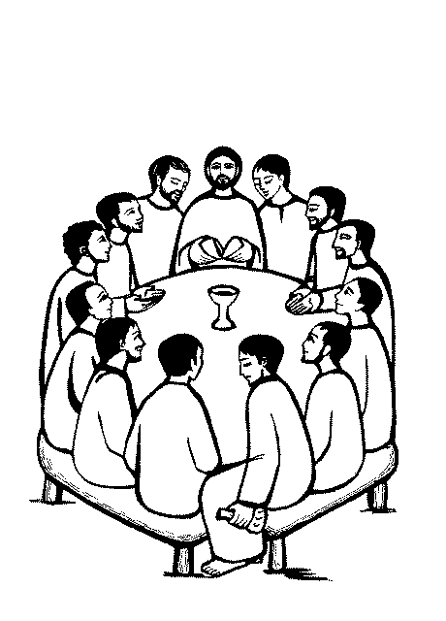
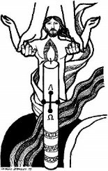
The Easter Triduum Liturgies – How well do you know them?
Circle on which day during the Easter Triduum Liturgies do these happen
(Holy Thursday = HTH, Good Friday = GF, Easter Vigil = EV)
1)
2)
3)
4)
5)
6)
7)
8)
9)
10)
The Easter fire is lit outside the church
The Passion Narrative of St John is read
New members are welcomed into the community at their baptism
The Last Supper is re-enacted
The priest processes with the lighted Paschal Candle held high into the church
The altar is stripped bare and the tabernacle door is left open
The Exsultet is sung to proclaim Jesus is risen
The Mass is not celebrated
The people are dismissed with the words, “Go in the peace of Christ, Alleluia, Alleluia.”
The priest washes the feet of 12 parishioners
HTH GF EV
HTH GF EV
HTH GF EV
HTH GF EV
HTH GF EV
HTH GF EV
HTH GF EV
HTH GF EV
HTH GF EV
HTH GF EV
Name: _______________
Date: _________
R-2
S-07A
Worksheet
Click the forward arrow to continue the questions. Click the up arrow to return to the lesson.

Slide 16
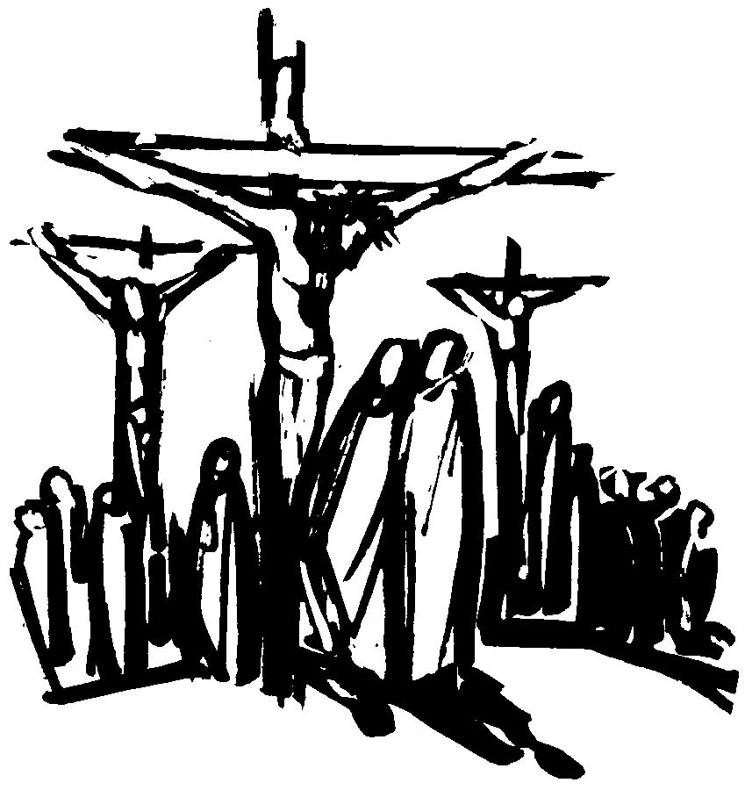
The Easter Triduum Liturgies – How well do you know them?
Circle on which day during the Easter Triduum Liturgies do these happen
(Holy Thursday = HTH, Good Friday = GF, Easter Vigil = EV)
11)
12)
13)
14)
15)
16)
17)
18)
19)
20)
The Litany of the Saints is prayed
The story of the Exodus when Moses led the people from slavery to freedom is read
The whole community renew their baptismal promises
There is no dismissal prayer and the people leave the church in silence
The Mass ends with a procession led by the priest with the Eucharist to the side altar
Alleluia songs are sung
The people can receive Holy Communion but there is no Mass on this day
Several readings from the Old and New Testament are read
The people venerate the cross
Bells are rung, candles are lit and the people sing with great joy
HTH GF EV
HTH GF EV
HTH GF EV
HTH GF EV
HTH GF EV
HTH GF EV
HTH GF EV
HTH GF EV
HTH GF EV
HTH GF EV
Name: _______________
Date: _________
R-2
S-07B
Worksheet
Click the back arrow to go to the first questions. Click the up arrow to return to the lesson.

Slide 17
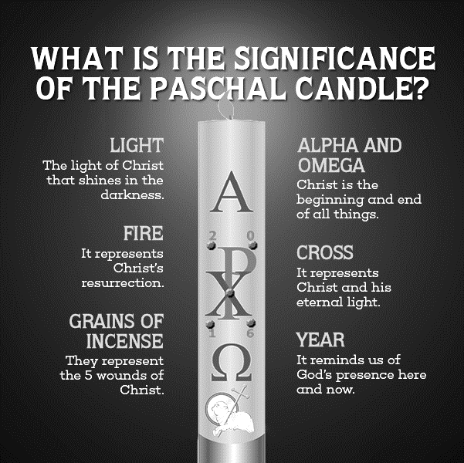
Important facts about the Paschal Candle
Name: _______________
Date: _________
The Paschal candle is made of pure b…………….
The priest i…………… the candle with grains of incense.
The candle also shows the date of the current y……. to show all time belongs to Christ.
The first and last letters of the G………. alphabet indicate Christ is the beginning and the end.
The Easter candle is lighted each day during Mass throughout the f…..… days of the Easter season.
The Paschal Candle is used during all B…………… as a symbol of Christ’s R…………………. .
After P……………… the Paschal Candle may be placed next to the baptismal font.
At f…………… the Paschal Candle is placed next to the coffin as a reminder that the person will die and rise with Christ.
The lighted Paschal Candle is a reminder to e…………….. that they must share the light of Christ in the w……. .
R-2
S-09
Worksheet
Click the bold letters to complete the sentences.
Click the arrow to return to the lesson.

Slide 18
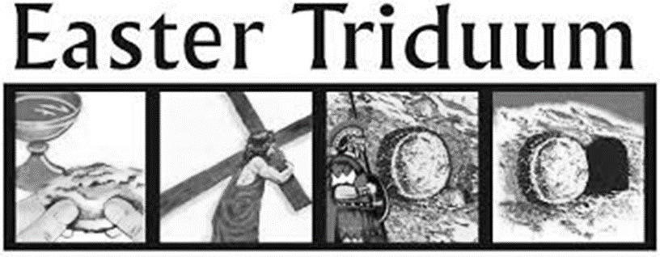
Check up
Name:________________________
Date:____________
Write a paragraph explaining to a family member what the Easter Triduum is.
2. Make a poster to help you share all you have learned about the events of Holy Thursday and how the Liturgy of the Lord’s Supper celebrates these events.
3. Describe the mood of the Good Friday events and how the liturgy expresses them OR make a wordle using all the words you know that relate to Good Friday.
Create an art work that includes elements of the original Resurrection event as well as some of the liturgical rituals that are used in the Easter Vigil celebration.
5. Think about how the three days of the Easter Triduum form one liturgical unity and make a triptych art work (a panel painting that is divided into three sections) one for each day of the Triduum. Try to show how the 3 images form a unity.
6. Which activity do you think helped you to learn best in this resource?
7. Questions I would like to ask about the topics in this resource are...
R-2
S-10
Worksheet
Click the up arrow to return to the lesson

Slide 19
Sharing our Learning about HOLY WEEK with family whānau
Share what you have learned about the Liturgical Year with a younger child at home or at school. Make a small picture to illustrate what you are talking about. (R1, Slide 3)
Share the visual you created related to the history of the Holy Week Liturgies at home that you made starting with Egeria. (R1, Slide 4)
Share the Power Point of the Palm Sunday Liturgy at your school. At the end ask children for questions and comments. (See R1, Slides 5 & 6).
Design a sticker or a fridge magnet to remind your family how they can grow in holiness during Lent and Holy Week by FASTING, GIVING and PRAYING. (R1, Slide 7)
Create a static performance using human statues of the main characters in the scene of Jesus ’crucifixion. Photograph them and include them in a power point presentation as part of prayer time. Adapt the Scripture story to tell what happened.
R-2
S-12A
Worksheet
Continued on the next slide.
Click the forward arrow to continue the worksheet. Click the up arrow to return to the lesson

Slide 20
Sharing our Learning about HOLY WEEK with family whānau
Share the artworks related to the Easter Sunday Events and the Easter Vigil and the triptych with your family. (R2, Check up items 4 & 5)
Share the graphic symbols below of Holy Week and explain their meaning. Create your own to share.
Have a conversation with an adult about the Liturgies for the Easter Triduum and what you have learned about them. Share your worksheet from R2 Slide 7.
Create a display of the posters made of the Holy Thursday Liturgy related to R2 Check up item 2.
Make up your own way of showing and sharing what you have learned and decide whom you would like to share it with.
R-2
S-12B
Worksheet
Click the back arrow to go to the previous worksheet. Click the up arrow to return to the lesson

