Slide 1
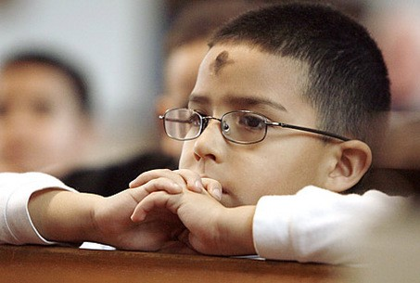
Lent is the Season to get ready for Easter
R-1
S-01
Notes:
Use this slide as a focussing strategy to introduce the lesson topic. Read the title together and invite children to share something they know about Lent and how it helps us get ready for Easter.

Slide 2
Learning Intentions
The children will:
1)
recognise Lent as the season for getting ready for Easter
2)
identify ways people can get ready for Easter
R-1
S-02
Click the boxes to reveal text.
Notes:
Read through the Learning Intentions with the class and identify some ideas/questions that might be explored in the resource.

Slide 3
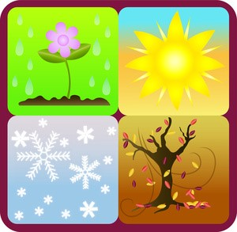
Can you say the names of the 4 natural seasons?
Spring comes after winter and the days get warmer and the flowers bloom.
Summer is the first season of the year and we are on holiday.
Winter comes after Autumn. Winter is the time for snowy, cold, wet, windy days.
Autumn comes after summer and the days get colder and the leaves fall off the trees.
R-1
S-03
Click each season’s picture to reveal text
Notes:
Adapt Teaching and Learning Experience 1
Children name the seasons using the pictures as clues.
Explain that each year the seasons follow the same cycle.
Read the text on each image and ask children to share other ideas they have about each season and invite comments and questions.

Slide 4
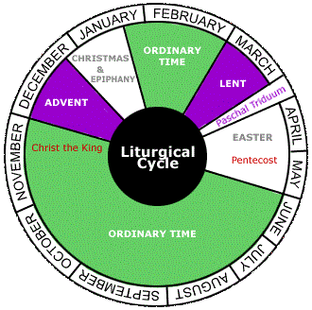
We have a Calendar to show special Church seasons
We can use the arrow to point at each season.
Now we are in O
Then we move on to L
Lent is a special s
Easter celebrates when J
T
rdinary
ime
ent
when we get ready to celebrate E
eason
aster
rose from the dead.
esus
esus
ent
eason
rdinary
aster
ime
R-1
S-04
Click the boxes in the sentences or the words on the list to add the rest of the words.
Click the red button for an arrow to point out Ordinary Time, Lent, and Easter
Notes:
Use the arrow to focus on the seasons close to Lent. Remind children we are learning about the season of Lent. Note the colour of Lent and find it on the class Liturgical Calendar.
Print off Lenten Calendar on Teacher Resource page 24 and the Children’s Activity page 25 in the Teacher’s Book or on the Resource Home page. Children can share these activities at home.
Adapt Teaching and Learning Experience 3

Slide 5
We are starting the season we call Lent
In Lent we get ready for Easter.
Purple is the colour for Lent.
In Lent we try to be good friends with Jesus.
Sometimes we give up things we like in Lent.
Can you copy the word Lent?
X
R-1
S-05
Click the I-button to reveal information; click the red button to move the arrow.
Notes:
Explain that Lent is a season or special time in our Church and it is at the same time of the year as the season of Autumn which is a season in nature.
Use the pop up to start a conversation about Lent.

Slide 6
In Lent we remember when Jesus died on the cross
Jesus died on the cross to show how much he loved us.
Our prayer table cloth is purple in Lent.
Purple is the colour that reminds us to talk to Jesus each day.
In Lent we try to show our love aroha for people by being kind.
R-1
S-06
Click the pins on the right to reveal post-it notes.
Notes:
Adapt Teaching and Learning Experience 2
Read the title and each post it note.
Explain that Lent leads up to the time when we remember that Jesus died on the cross.

Slide 7
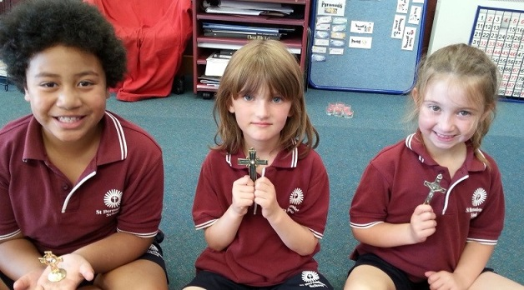
The cross helps us to remember that Jesus died on the cross
I show love when I...
When we show love to people we show love to Jesus.
In Lent we try to show love to people at home and at school.
Lent is a special time for us to get ready for Easter.
R-1
S-07
Click on each statement to move through all four. Click the arrow to restart.
Notes:
In Lent we try to be a loving person because that is what Jesus wants us to be.
Use the flip cards to help children think about how they can be a loving person in Lent. After Jesus died he rose again and that is what we are getting ready to celebrate at Easter. Easter come at the end of Lent.

Slide 8
Check Up
1)
The season we are in is…
2)
The colour for Lent is…
3)
Lent helps us get ready for…
4)
We remember that Jesus died for us on the...
5)
Which activity do you think helped you to learn best in this resource?
6)
Questions I would like to ask about the topics in this resource are…
R-1
S-08
Click in each caption space to reveal text
Notes:
This formative assessment strategy will help teachers to identify how well the children have achieved the Learning Intentions of the lesson.
Teachers can choose how they use the slide in their range of assessment options.
A worksheet of this slide is available for children in Years 5-8 to complete.
The last two items are feed forward for the teacher.
Recording the children’s responses to these items is recommended as it will enable teachers to adjust their learning strategies for future lessons and target the areas that need further attention.

Slide 9
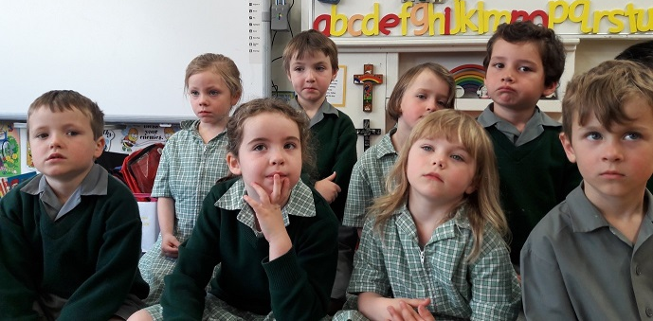
Time for Reflection
R-1
S-09
Click the audio button to stop reflective music
Click the audio button to play reflective music
Notes:
The MP3 is played to help create a reflective atmosphere and bring the children to stillness and silence as the teacher invites them to remember that Jesus died because he loved us so much. Talk to Jesus about how you are trying hard to be a loving person like him in Lent.
Original Children’s Activities available on resource home page.

