Slide 1
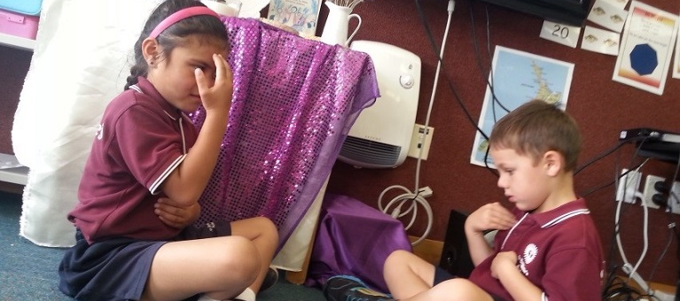
Getting ourselves ready for Easter
R-2
S-01
Notes:
Use this slide as a focussing strategy to introduce the resource topic. Read the title together and invite children to share something they know about the season of Lent is when we get ready to celebrate Easter when Jesus rose from the dead.

Slide 2
Learning Intentions
The children will:
1)
recognise that people get themselves ready for Easter by loving God and others
2)
name ways people can be more loving during Lent
R-2
S-02
Click the boxes to reveal text.
Notes:
Read through the Learning Intentions with the class and identify some ideas/questions that might be explored in the resource.

Slide 3
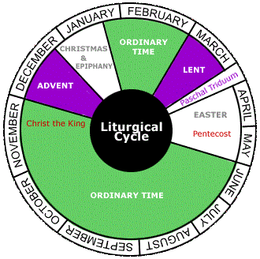
What do we know about Lent?
R-2
S-03
Click in white box to record ideas
Notes:
Read through the Learning Intentions with the class and identify some ideas/questions that might be explored in the resource.

Slide 4
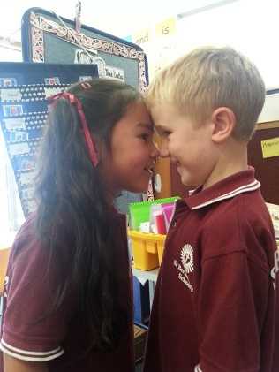
Lent is a time to get ready for Easter
We get ready for Easter by loving God when we love children in our class.
How do you show love for children in your class?
R-2
S-04
Click red arrows to reveal text
Notes:
Read revealed text and invite children to talk about what the children are doing in the image. (Hongi) Explain what this is.
Children share ways they show love for children at school and as home.

Slide 5
We get ready for Easter by taking time to be with Jesus
At prayer time we think about Jesus and talk to him.
Close your eyes and talk to Jesus now.
R-2
S-05
Notes:
Children look closely at the image and talk about what the children are doing.
Read and follow the text.
Print off copies of the Children’s Activity page 27 in the Teacher’s Book or on the Resource Home page.
Adapt Teaching and Learning Experience 2.

Slide 6
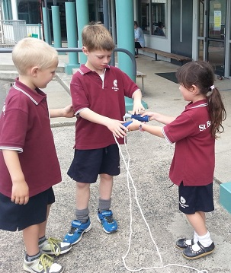
We try to follow Jesus as we get ready for Easter
Jesus didn’t leave people out, he always included them.
How are these children following Jesus?
R-2
S-06
Click yellow arrows for text
Notes:
Read and follow revealed text.

Slide 7
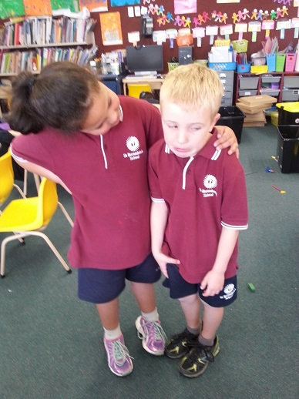
We show love to others when we notice if they are sad
Jesus always took care of people who were sad.
How is this girl showing she is like Jesus?
R-2
S-07
Notes:
Adapt Teaching and Learning Experience 3
Notice what is happening in the image.
Children make up a story about what has happened before the event, during the event and after the event. Answer the question about the girl.
When could you do what the girl is doing?

Slide 8
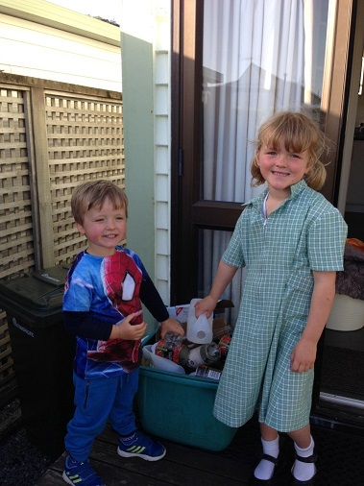
Can you name ways children can be helpful and loving in Lent?
R-2
S-08
Click white box to record ideas
Notes:
Teacher records children’s ideas that answer the title question.
Notice what is happening in the image.
How are these children being helpful?
Adapt Teaching and Learning Experience 3

Slide 9
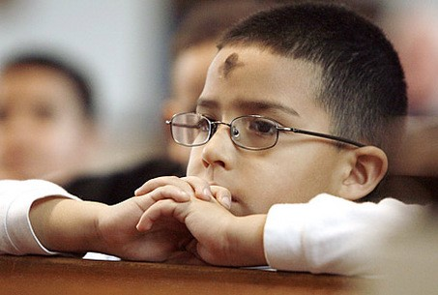
Check Up
1)
Tell a friend how you get ready for Easter during Lent.
2)
In Lent I try to help by…
3)
In Lent I try to notice when…
4)
In Lent I think about Jesus and I...
5)
Which activity do you think helped you to learn best in this resource?
6)
Questions I would like to ask about the topics in this resource are…
R-2
S-09
Click in each caption space to reveal text
Notes:
This formative assessment strategy will help teachers to identify how well the children have achieved the Learning Intentions of the resource.
Teachers can choose how they use the slide in their range of assessment options.
A worksheet of this slide is available for children in Years 5-8 to complete.
The last two items are feed forward for the teacher.
Recording the children’s responses to these items is recommended as it will enable teachers to adjust their learning strategies for future resources and target the areas that need further attention.

Slide 10
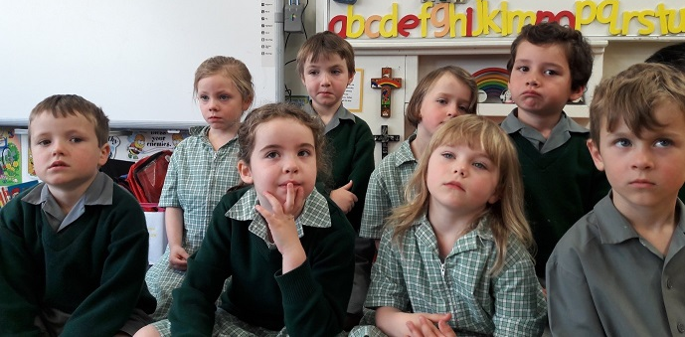
Time for Reflection
R-2
S-10
Click the audio button to stop reflective music
Click the audio button to play reflective music
Notes:
The MP3 is played to help create a reflective atmosphere and bring the children to stillness and silence as the teacher invites them to think about the ways they can show special love for people in their family during Lent using words and actions.
Original Children’s Activities available on resource home page

