Slide 1
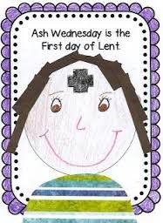
Ash Wednesday is the first day of Lent
R-3
S-01
Notes:
Use this slide as a focussing strategy to introduce the resource topic. Read the title together and invite children to share something they know about Ash Wednesday and what happens on that day.

Slide 2
Learning Intentions
The children will:
1)
name the first day of Lent
2)
recognise the Ash Wednesday ritual of the signing with ashes
R-3
S-02
Click the boxes to reveal text.
Notes:
Read through the Learning Intentions with the class and identify some ideas/questions that might be explored in the resource.

Slide 3
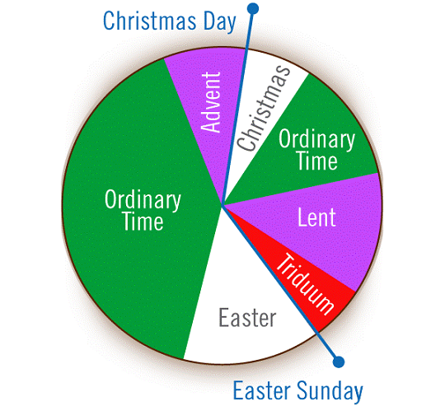
Here is the Calendar that shows the seasons we celebrate each year
Christmas and Easter are special feasts we celebrate.
Can you point to them?
Point to each season and say it’s name.
R-3
S-03
Click yellow button to point to the feasts, click red button to move the pointer through each season.
Notes:
Adapt Teaching and Learning Experience 1
Use the red button to point to each season and say its name.
Use the yellow button to point to the celebration seasons of Christmas and Easter. Explain what they celebrate.

Slide 4
Here is a Liturgical Calendar to colour
 | Colour the season of Lent purple
 | Colour the season of Easter yellow
Keep this calendar in your RE book to look at again when we get to other seasons.
R-3
S-04
Notes:
Print off a copy of the Liturgical Calendar for each child to add to their RE book.
Each child gets a purple felt or crayon. Point to the season of Lent and show them where to colour – not on the Holy Week words.
Then get a yellow felt or crayon and colour the season of Easter – not on the word Pentecost. Explain we will keep the calendar in our RE books and we will colour each season as we go through the year.

Slide 5
We call the first day of Lent Ash Wednesday
When the palms have turned to ashes and are cold we sieve them and make them into powder.
The day before Ash Wednesday we make the ashes – look closely at the picture.
Then we put them in a bowl and Father blesses them and they are ready to use on Ash Wednesday.
We burn the palms from last year and the ashes are made from them.
R-3
S-05
Click the pins on the right to reveal post-it notes.
Notes:
Look at the image and explain what is happening.
Read each post it note and talk about what Father and the children are making. Children say why ashes are needed and name the day we use them.
Remind children Ash Wednesday is the first day of Lent.
Adapt Teaching and Learning Experiences 2 & 3

Slide 6
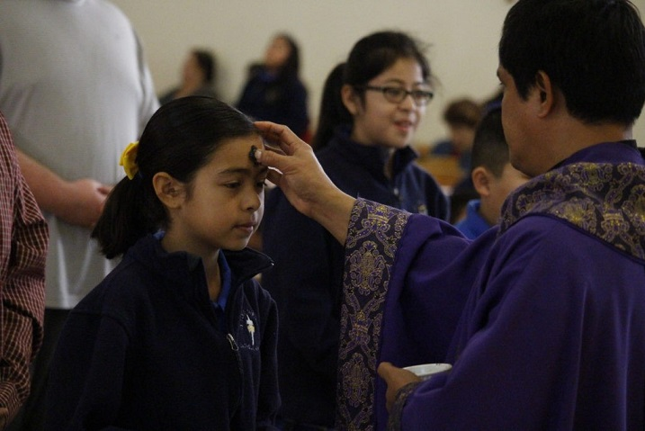
Ash Wednesday is the day we get ashes on our foreheads
(8)
Then we celebrate Easter when Jesus rises from the dead.
(7)
Lent lasts for six weeks and it ends when Jesus dies on the cross.
(6)
Lent is a time to try harder to be a loving person like Jesus.
(5)
We can say sorry for the times we have been mean and try to be kind.
(4)
The cross on our heads helps us to show we are sorry.
(3)
For a long time ashes have been a sign to say people are sorry for doing wrong things.
(2)
The ritual is the sign of the cross is made with ashes on our heads to remind us that Lent has started.
(1)
Ash Wednesday is a special day and we do something special that we call a ritual.
Restart
R-3
S-06
Click each ‘card’ to move through (8 total), click ‘Restart’ to go back to the beginning.
Notes:
Use the flip cards to help children understand the meaning of the ritual of making a Sign of the Cross with the ashes on their foreheads and why we do this.
In Lent we try to loving and caring like Jesus was when he lived on earth.

Slide 7
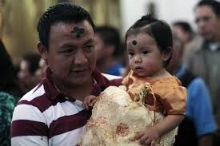
The Sign of the Cross on our head reminds us to say sorry
I say sorry when…
When someone says sorry to me I feel…
I show I am sorry by…
After I say sorry I feel…
R-3
S-07
Click the round buttons to reveal text.
Notes:
Adapt Teaching and Learning Experience 4
Children read and complete each revealed item.
Make a copy of the worksheet for each child to complete and add to their RE Learning Journal.
Remind children that it is important to say sorry and really mean it.

Slide 8
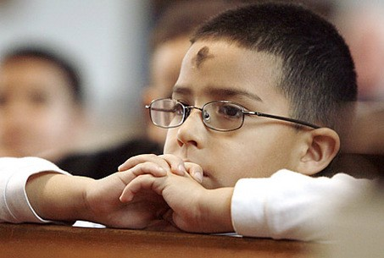
Check Up
1)
The first day of Lent is called...
2)
This is what happens on Ash Wednesday…
3)
In Lent we try to be more like Jesus by…
4)
When we have been mean we try to remember to say we are...
5)
Which activity do you think helped you to learn best in this resource?
6)
Questions I would like to ask about the topics in this resource are…
R-3
S-08
Click in each caption space to reveal text
Notes:
This formative assessment strategy will help teachers to identify how well the children have achieved the Learning Intentions of the lesson.
Teachers can choose how they use the slide in their range of assessment options.
A worksheet of this slide is available for children in Years 5-8 to complete.
The last two items are feed forward for the teacher.
Recording the children’s responses to these items is recommended as it will enable teachers to adjust their learning strategies for future lessons and target the areas that need further attention.

Slide 9
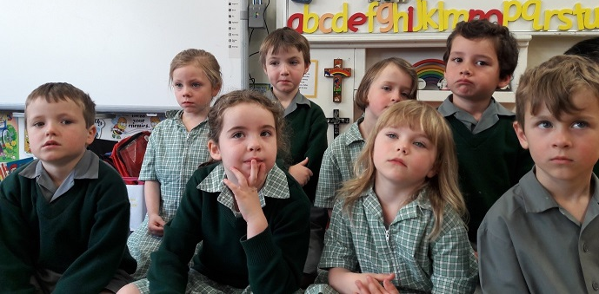
Time for Reflection
R-3
S-09
Click the audio button to stop reflective music
Click the audio button to play reflective music
Notes:
The MP3 is played to help create a reflective atmosphere and bring the children to stillness and silence as the teacher invites them to talk to Jesus in their heart and tell him they are sorry for the times they are mean or selfish to others. Tell Jesus they will try to follow him and be kind and helpful at home and at school during Lent.

Slide 10
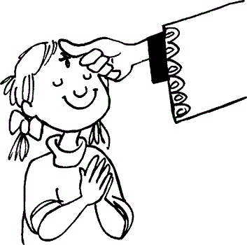
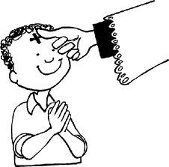
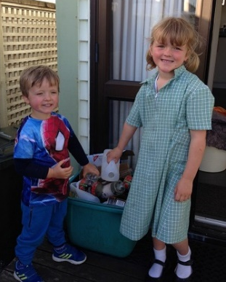
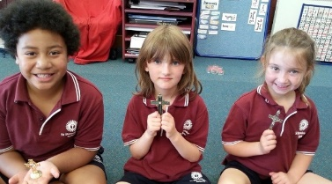
Sharing our Learning about LENT with family whānau, other classes , and parish
Make up your own way of showing and sharing what you have learned and decide with whom you would like to share it.
Make a poster or power point to share that shows that Lent is a time for – trying to be loving like Jesus, saying sorry when you have done something wrong, remembering Jesus died on the cross, getting ready for Easter when Jesus rose from the dead.
Share your worksheet (Slide 7) with another class and ask the children what they have learned about Ash Wednesday and Lent.
Ask your teacher to photograph your class with their ash crosses to display in your parish foyer. Show it to people you know in your parish and tell them everything you know about Lent.
Talk about, skype, or telephone your family to tell them about what happened on Ash Wednesday. Explain how the ashes are made and what they remind people to do.
R-3
S-10
Click red arrow to move through the five scrolls
Notes:
This slide provides some choices for children to show and share what they have learned. Examples could be photographed as evidence of children’s learning.
You may like to put a copy of the Sharing our Learning page in children’s RE Learning Journals. You could talk through the choices using the slide and let children make their choice from their own copy.
Children could work on their choice at school and/or at home and you may like to set a day for sharing. Please let parents and whānau know what you expect them to do with this.
The slide is focussed on the Year 1 LENT Achievement Objective which is covered in Resources 1-3
LENT Year 1 AO Children will be able to:
recognise LENT as a season for getting ready for Easter.

Slide 11
Here is a Liturgical Calendar to colour
Name___________________________ Date_______________
Colour the season of Lent purple
Colour the season of Easter yellow
Keep this calendar in your RE book to look at again when we get to other seasons
R-3
S-4
Worksheet
Click the up arrow to return to the lesson
Notes:
This worksheet relates to slide 4
Print off a copy of the Liturgical Calendar for each child to add to their RE book.

Slide 12
The Sign of the Cross on our heads reminds us to say sorry
Name___________________________ Date_______________
Draw a picture of your face with a cross on your forehead.
Lent is a time to try to be more loving like Jesus.
R-3
S-7
Worksheet
Click the up arrow to return to the lesson
Notes:
This worksheet relates to slide 7

Slide 13
Sharing our Learning about LENT with family whānau, other classes, and parish
Name___________________________ Date_______________
Talk about, skype or telephone your family to tell them about what happened on Ash Wednesday. Explain how the ashes are made and what they remind people to do.
Ask your teacher to photograph your class with their ash crosses to display in your parish foyer. Show it to people you know in your parish and tell them everything you know about Lent.
Share your worksheet (Slide 7) with another class and ask the children what they have learnt about Ash Wednesday and Lent.
Make a poster or power point to share that shows that Lent is a time for – trying to be kind and loving like Jesus, saying sorry when you have done something wrong, remembering Jesus died on the cross, getting ready for Easter when Jesus rose from the dead.
Make up your own way of showing and sharing what you have learned and decide with whom you would like to share it.
R-3
S-10
Worksheet
Click the up arrow to return to the lesson
Notes:
This worksheet relates to slide 4

