Slide 1
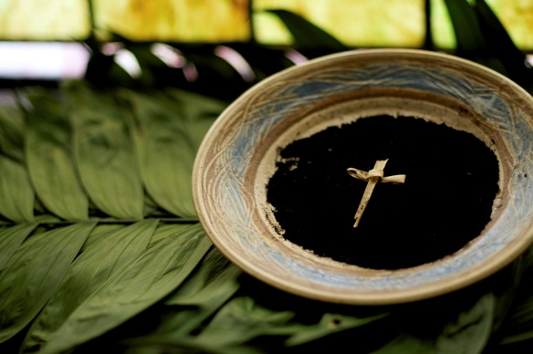
In Lent people try to follow
Jesus more closely
R-1
S-01

Slide 2
Learning Intentions
The children will:
1)
recognise that the Sign of the Cross is a reminder to live
as Jesus lived
2)
identify some practical ways people can live as Jesus lived
R-1
S-02
Click the borders to reveal text

Slide 3
The season of Lent
What we know already about the season of Lent
R-1
S-03
Click in the white box to write your text
Notes:
Teacher records children’s ideas about Lent.
Adapt Teaching and Learning Experience 1

Slide 4
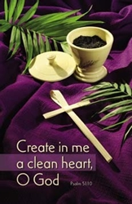
The symbols and colours of Lent
SEE – What do you see?
THINK – What do you think?
WONDER – What are you wondering about?
R-1
S-04
Notes:
Children name what they can see on the prayer table.
Share what they think about it.
Make ‘I wonder’ statements
Adapt Teaching and Learning Experience 1

Slide 5
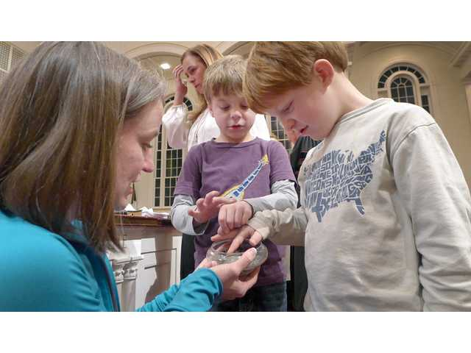
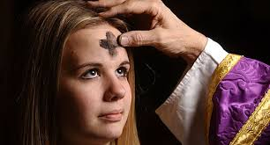
The Ashes are made from the Palms left
over from last Palm Sunday
Lent is a good time to say sorry when we know we have hurt someone or not done what we should have.
The cross is to remind people that on Good Friday at the end of Lent we remember the day Jesus died on
the cross.
Ashes have been used as a sign of saying sorry since Jesus lived on earth a long
time ago.
On Ash Wednesday a Sign of the Cross is made on people’s forehead to remind them that Lent
is starting.
After the palms are burned and cooled, they are sieved to make them into powder.
R-1
S-05
Click top card to discard it
Notes:
Adapt Teaching and Learning Experience 2

Slide 6
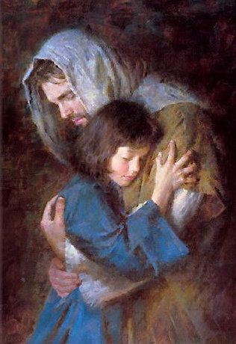
Saying sorry to people and saying sorry to Jesus
1) Lent is a good time to say
sorry
2) The Sign of the Cross reminds us to live like
Jesus
3) In Lent we try to follow Jesus more
closely
4) The first day of Lent is
Ash Wednesday
5) Living like Jesus means being
kind
Jesus
sorry
closely
kind
Ash Wednesday
R-1
S-06
Click a word from the list to correctly position a word in the sentence. Click on worksheet button to go to worksheet.

Slide 7
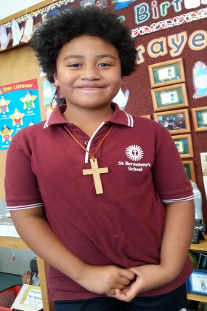
The Cross is a sign the friends and followers of Jesus wear
Write in the word balloon what the boy is saying about wearing a cross
R-1
S-07
Click in the word balloon to type text
Notes:
Adapt Teaching and Learning Experience 4

Slide 8
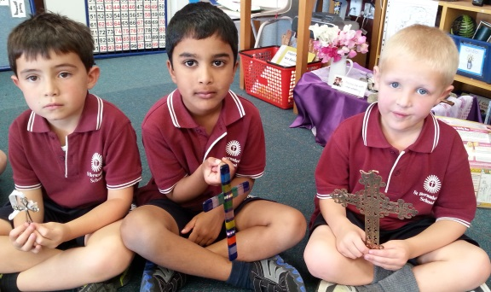
Crosses are important signs for people who follow Jesus
Look at the boys holding the crosses.
Tell a partner why the cross is an important sign for people who follow Jesus.
R-1
S-08

Slide 9
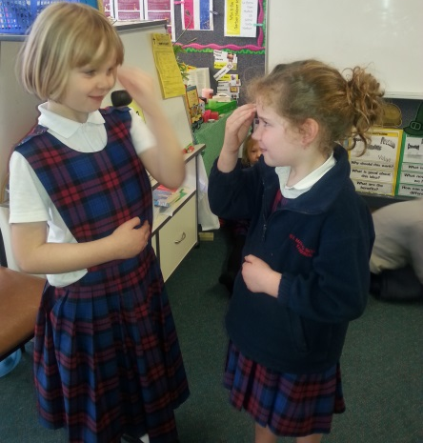
When we make the Sign of the Cross we show we want to live like Jesus
Making the Sign of the Cross shows that we believe in Jesus and we want to follow him.
Share something you do that shows that you are a follower of Jesus.
R-1
S-09

Slide 10
Our priest blesses us with the Sign of the Cross at Mass
When Father blesses us with the Sign of the Cross at Mass it reminds us that Jesus loves us and wants us to be loving, caring people like he was.
How do you show that you are a loving, caring person?
R-1
S-10

Slide 11
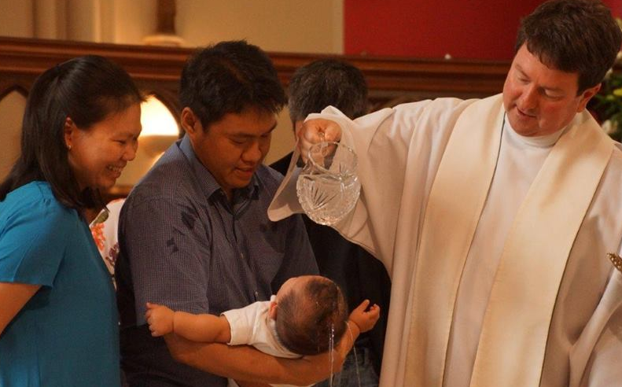
The Priest blesses us with holy water and makes the Sign of the Cross when we are baptised
Father makes the Sign of the Cross with holy water on as he baptises us.
Say the words he says,
“I baptise you in the name of the Father and or the Son and of the Holy Spirit. Amen”
This is how people become children of God in the …
R-1
S-11

Slide 12
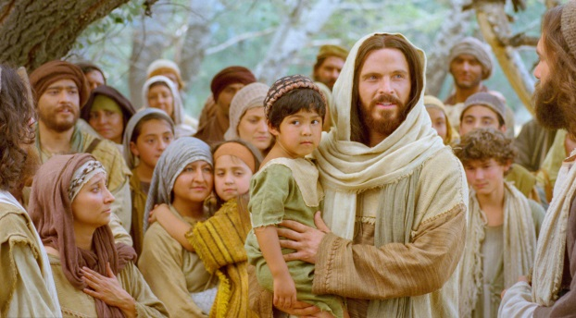
In Lent it is good to listen to stories about Jesus so we know how to follow him more closely
Jesus healed people with words and actions.
I can help people to feel better by …
Jesus fed people with loaves and fishes.
I can feed people with …
Jesus encouraged people when they felt sad.
I can cheer people up by …
Jesus prayed to God his Father.
I can pray to …
R-1
S-12
Notes:
Print off copies of the Children’s Activity page 26 in the Teacher’s Book or on the Resource Home page and add to children’s RE books.
Adapt Teaching and Learning Experience 4

Slide 13
Check Up
1)
I am trying to become more like Jesus when I …
2)
The Sign of the Cross is important for the followers of Jesus because …
3)
A cross shows that a person is …
4)
I show I believe in Jesus when I …
5)
Which activity do you think helped you to learn best in this resource?
6)
Questions I would like to ask about the topics in this resource are …
R-1
S-13
Click the borders to reveal text

Slide 14
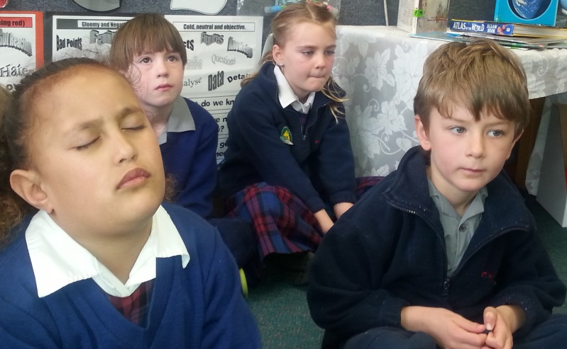
Time for Reflection
R-1
S-14
Click the audio button to stop reflective music
Click the audio button to play reflective music
Notes:
The MP3 is played to help create a reflective atmosphere and bring the children to stillness and silence as the teacher invites them to remember what Jesus did when he lived on earth and how he showed his love for people. Think about how you show your love to people at home and at school. Ask Jesus to help you grow closer to him.
Original Children’s Activities available on resource home page

Slide 15
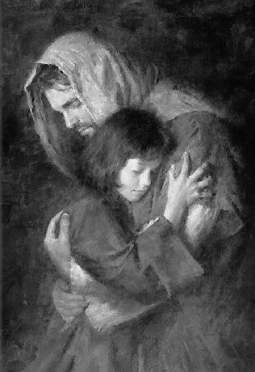
Saying sorry to people and saying sorry to Jesus
Name________________ Date____________
1) Lent is a good time to say _________
2) The Sign of the Cross reminds us to live like _______
3) In Lent we try to follow Jesus more __________
4) The first day of Lent is ______ ______________
5) Living like Jesus means being __________
Jesus
sorry
closely
kind
Ash Wednesday
R-1
S-06
Worksheet
Click the up arrow to return to the lesson

