Slide 1

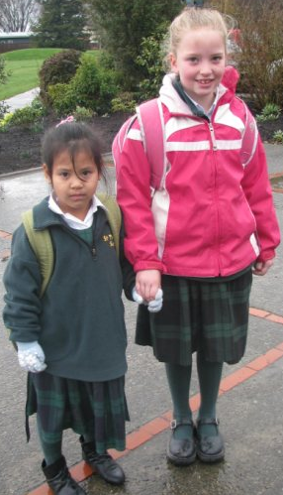
People can change to live more like Jesus lived
R-2
S-01

Slide 2
Learning Intentions
The children will:
1)
recognise that Lent is a season when people think about changing to become more like Jesus
2)
identify ways children can change to live more like Jesus lived
R-2
S-02
Click the borders to reveal text

Slide 3
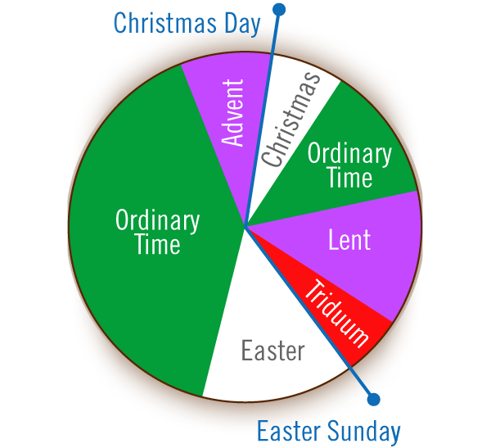
Lent is a quiet Season to prepare for Jesus’ Death and Resurrection
Point to each season or feast and say its name.
Start with Advent because that is the first season of the Church’s year.
Then point to Christmas and Ordinary Time.
The red season is the time we remember when Jesus died.
The white season that follows it is Easter when Jesus rose from the dead.
R-2
S-03
Click the I-button to reveal information. Press the blue button to move the blue arrow.
Notes:
Adapt Teaching and Learning Experience 1

Slide 4
The colours of the Feasts and Seasons on the Liturgical Calendar
Colour ADVENT purple because it is the season to prepare for CHRISTMAS.
Colour CHRISTMAS yellow because it is a great feast to celebrate.
Colour ORDINARY TIME green because it is when we do ordinary things.
Colour LENT purple because it is the season to prepare for EASTER.
Colour EASTER yellow because is the greatest feast to celebrate in the whole year.
R-2
S-04
Click on worksheet button to go to worksheet.

Slide 5
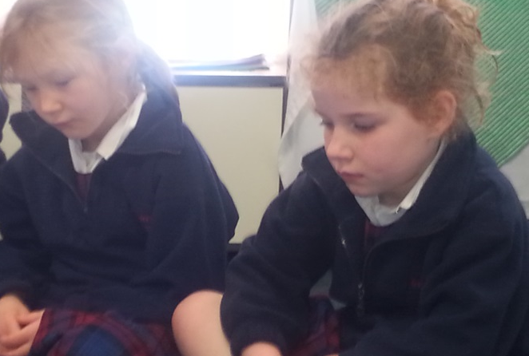
Lent is a good time to stop and think
R-2
S-05
Notes:
Adapt Teaching and Learning Experience 2
Remind children that Jesus shared himself with others and he wants us to do the same.
Teacher invites the children to sit quietly and think to themselves about these questions:
Do I share myself with others – do I join in activities?
How good am I at doing things that others need help with?
Do I just do what suits me and not bother about others?
Am I happy to stop what I am doing to help others when they need it?
How often do I offer to help others – do I always wait for someone to ask me to help?
Do I notice when others are sad and need someone to care for them?
Remind the children that when they share themselves with others they are doing what Jesus did. Jesus will help them to change and become like him.

Slide 6
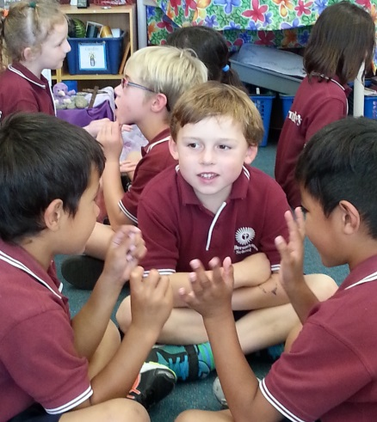
Ways children can change and share themselves with others and grow more like Jesus
How we can share ourselves with others as Jesus did:
Here are our ideas
R-2
S-06
Click in white box to type text
Notes:
Adapt Teaching and Learning Experiences 2, 3 & 4

Slide 7
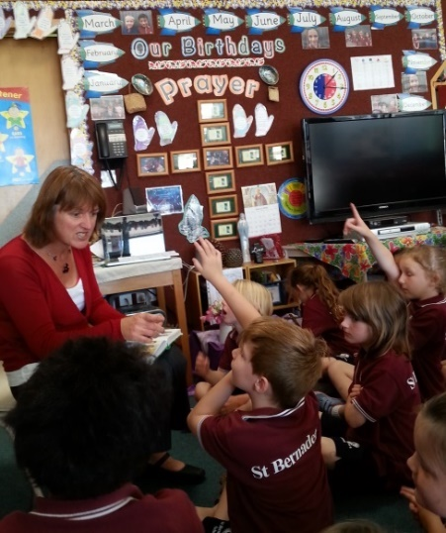
Getting to know Jesus so we can live more like him
How can we get to know Jesus more so we can live more like him?
We can talk to Jesus in our hearts and
listen when he speaks to us.
We can learn about him from our
teacher in our RE classes.
We can notice other people who
are kind like Jesus and copy them.
We can listen to our
parents when they tell us about what Jesus did.
We can read
stories about him in the Bible.
are kind like Jesus and copy them.
listen when he speaks to us.
teacher in our RE classes.
stories about him in the Bible.
parents when they tell us about what Jesus did.
R-2
S-07
Click a sentence ending from the white box to correctly position it in the sentence.

Slide 8
Check Up
1)
Name one way you can change to be more like Jesus.
2)
Tell a story that shows that Jesus was kind to people and say how you can change to be kind too.
3)
Say 3 things you have learned about Lent.
4)
Which activity do you think helped you to learn best in this resource?
5)
Questions I would like to ask about the topics in this resource are …
R-2
S-08
Click the borders to reveal text

Slide 9
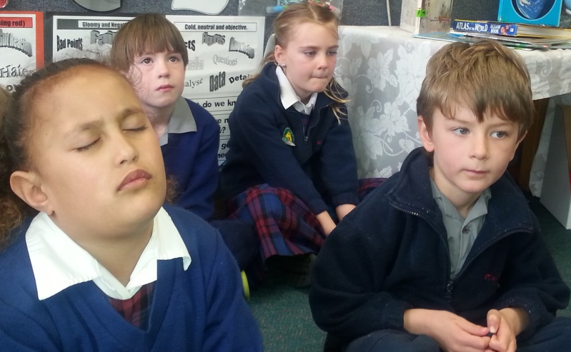


Time for Reflection
R-2
S-09
Click the audio button to stop reflective music
Click the audio button to play reflective music
Notes:
The MP3 is played to help create a reflective atmosphere and bring the children to stillness and silence as the teacher invites them to talk to
Original Children’s Activities available on lesson home page

Slide 10
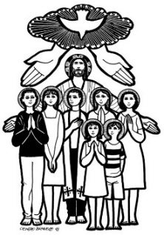

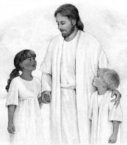

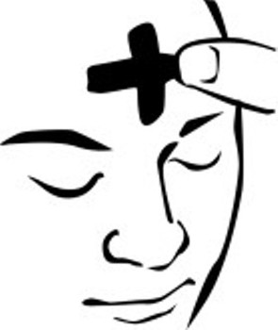
Sharing our Learning about LENT with family whānau, other classes and parish
Talk about, skype or telephone your family to tell them about what happened on Ash Wednesday and explain how the ashes are made and what they remind people to do.
Ask your teacher to photograph your class with their ash crosses to display in your parish or school foyer. Write captions that tell about how the season of Lent is when Christians try to change and live more like Jesus lived.
Share your worksheet (Slide 4) with another class to teach them about the colours of the Liturgical feasts and seasons.
Make a poster or power point to share that shows how children of your age can share themselves with others so they can change to live more like Jesus lived.
Make up your own way of showing and sharing what you have learned and decide whom you would like to share it with.
R-2
S-10
Click on worksheet button to go to worksheet.
Notes:
This slide provides some choices for children to show and share what they have learned. Examples could be photographed as evidence of children’s learning.
You may like to put a copy of the Sharing our Learning page in children’s RE Learning Journals. You could talk through the choices using the slide and let children make their choice from their own copy.
Children could work on their choice at school and/or at home and you may like to set a day for sharing. Please let parents and whānau know what you expect them to do with this.
The slide is focussed on the Year 2 LENT Achievement Objective which is covered in Resource 1-2
Year 2 LENT AO Children will be able to: identify LENT as a season when Christians try to live more like Jesus lived.

Slide 11
Sharing our Learning about LENT with family whānau, other classes and parish
Name_____________ Date___________
Talk about, skype or telephone your family to tell them about what happened on Ash Wednesday and explain how the ashes are made and what they remind people to do.
Ask your teacher to photograph your class with their ash crosses to display in your parish or school foyer. Write captions that tell about how the season of Lent is when Christians try to change and live more like Jesus lived.
Share your worksheet (Slide 4) with another class to teach them about the colours of the Liturgical feasts and seasons.
Make a poster or power point to share that shows how children of your age can share themselves with others so they can change to live more like Jesus lived.
Make up your own way of showing and sharing what you have learned and decide whom you would like to share it with.
R-2
S-10
Worksheet
Click the up arrow to return to the lesson

Slide 12
The colours of the Feasts and Seasons on the Liturgical Calendar
Colour ADVENT purple because it is the season to prepare for CHRISTMAS.
Colour CHRISTMAS yellow because it is a great feast to celebrate.
Colour ORDINARY TIME green because it is when we do ordinary things.
Colour LENT purple because it is the season to prepare for EASTER.
Colour EASTER yellow because is the greatest feast to celebrate in the whole year.
Name_____________ Date___________
R-2
S-04
Worksheet
Click the up arrow to return to the lesson

