Slide 1

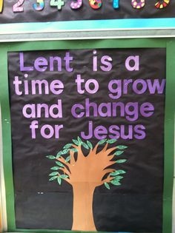
Lent is a Season of Change
R-1
S-01
Notes:
Use this slide as a focussing strategy to introduce the resource topic. Read the title together and invite children to share something they know about Lent is a time to change things we do that are not loving and how we can grow to be better friends with Jesus.

Slide 2
Learning Intentions
The children will:
name traditional signs that show Lent as a season of change
1)
identify natural signs in Aotearoa New Zealand that can be related to the season of Lent.
2)
R-1
S-02
Click in each white box to reveal the text
Notes:
Read through the Learning Intentions with the class and identify some ideas/questions that might be explored in the resource.
1. Name traditional signs that show Lent as a season of change
2. Identify natural signs in Aotearoa New Zealand that can be related to the season of Lent.

Slide 3
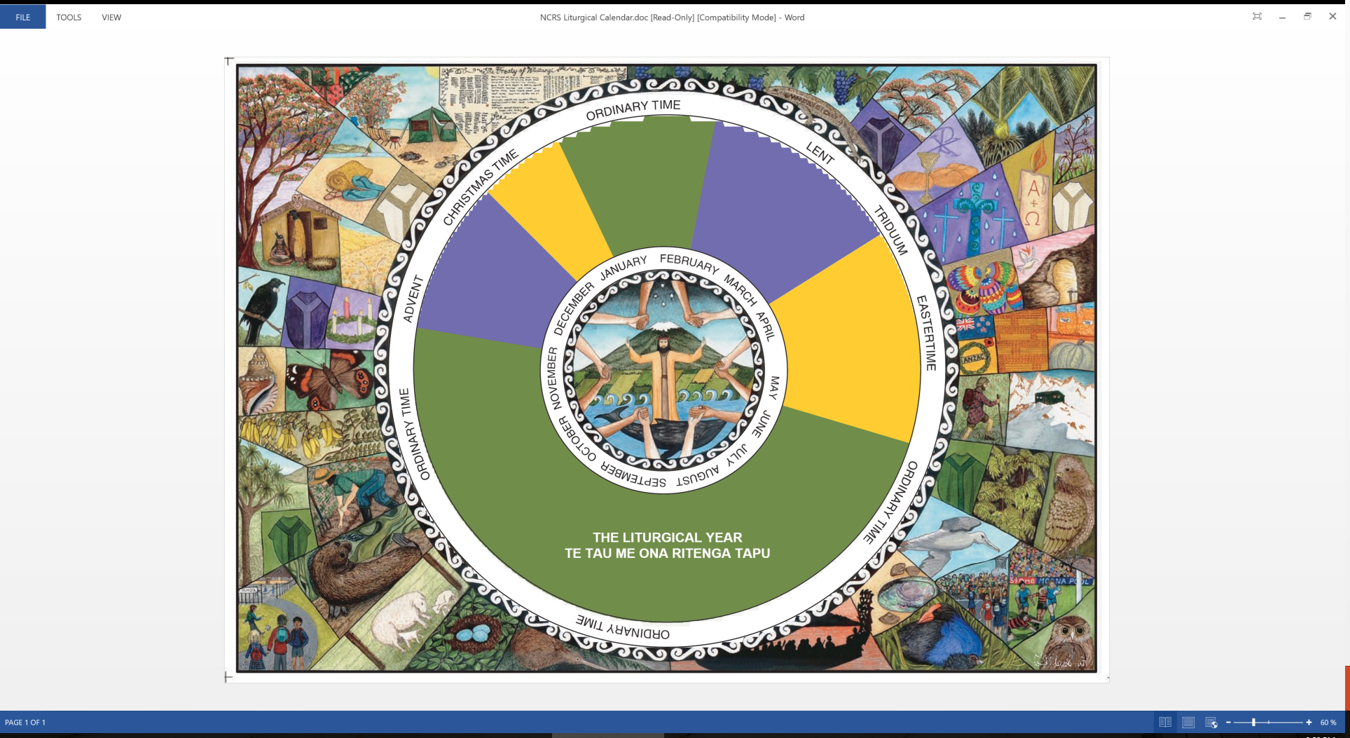
Lent is a Season in the Liturgical Year
What do you know about Lent?
ActiveX Control
“embedded” in a shape
R-1
S-03
Click in the while box and write your text
Notes:
Children share what they know already about Lent and this is recorded on the screen.

Slide 4
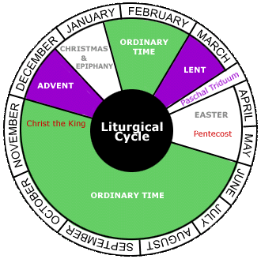
Lent is the time to prepare
for Holy Week and Easter
Lent lasts for
40 days
Lent is a time to
recognise what we need to change
Lent is when we try to
change things we do that are not loving
Lent comes during Autumn in
Aotearoa New Zealand
Lent gives us time to
prepare for Holy Week and Easter
change things we do that are not loving
40 days
recognise what we need to change
prepare for Holy Week and Easter
Aotearoa New Zealand
Match the start of the sentence with the end
of the sentence from the list
R-1
S-04
Notes:
Adapt Teaching and Learning Experience 1.
Children can suggest the words that could complete the sentence and check it out using the floater tool.

Slide 5
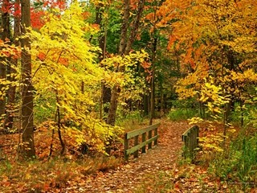
Autumn is a Season of Change
Name 2 changes you notice in the weather in Autumn.
Name some changes you notice in trees in Autumn.
Name some changes you notice in plants in Autumn.
Why do things change in Autumn?
What is good about the changes in Autumn?
R-1
S-05
Click the images to reveal a text line
Notes:
Adapt Teaching and Learning Experience 2
Children read the revealed text and respond.

Slide 6

Lent is a time to grow and change for Jesus
Lent is in Autumn in Aotearoa New Zealand and they are both seasons of change.
In Lent we spend quiet time with Jesus and ask him to show us how he wants us to change.
In Lent the Spirit of Jesus helps us to see how we can become a more loving person like Jesus.
In Lent Jesus helps us to recognise what we can do better and he helps us to do it.
Lent is a time that reminds us we need to change to make room for new things to grow.
R-1
S-06
Click the images to reveal a text line
Notes:
Children read the revealed text and make a comment or ask a question.
Children explain how Autumn and Lent are season of change and share some examples.
What new things can grow when children our age change in Lent?

Slide 7

Trees are like people - they change and grow so they can bear fruit to share with others
Notice how the tree changes to be the best it can be and bear fruit as God planned it to give. Use the image to explain what is happening in the life cycle of the apple tree.
Talk about it first.
1. The first stage is …
2. The seeds of the tree are the apple’s ...
3. The pips die in the earth and then they grow and shoots and roots appear and ...
4. The shoots change into a …
5. The seedling grows into a …
6. The young tree changes into an …
7. The adult tree bears fruit and the fruit drops to the ground and …
8. What helped the tree grow and bear fruit?
9. Do you think the changes the tree went through were good? Why?
R-1
S-07
Notes:
Adapt Teaching and Learning Experience 3
Children work through the stages of growth of the apple tree and name each stage. Children share their responses to the last 2 questions.

Slide 8
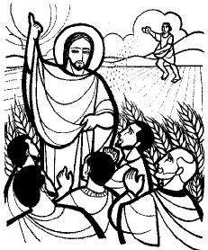
Jesus told stories about wheat seeds that die and then change
into beautiful wheat plants
Jesus said “I tell you unless a grain of wheat falls into the earth and dies, it remains just a single grain, but if it dies it bears much fruit.”
John 12:24
Jesus is telling us that we need to keep changing and growing closer to him so we can become the best person we can be.
This is why we say Lent is a time of change and growth and that is why we take time to think about our words and actions and work on what we need to change so we can take on a new life with Jesus.
We need to let go of the things we do and say that hurt others so new things can grow and we can become a kind and helpful person with a new life.
Everything has to die to its old life so it can begin to live again in a new life. This is like seeds - they die and then grow again into something new and great.
What do you see growing around you that is changing in the season of Lent?
R-1
S-08
Click top card to discard it
Notes:
Adapt Teaching and Learning Experience 4.
Children read each flip card and talk about what it means.
Think about seeds and plants that grow and change and become something great – name some examples.

Slide 9
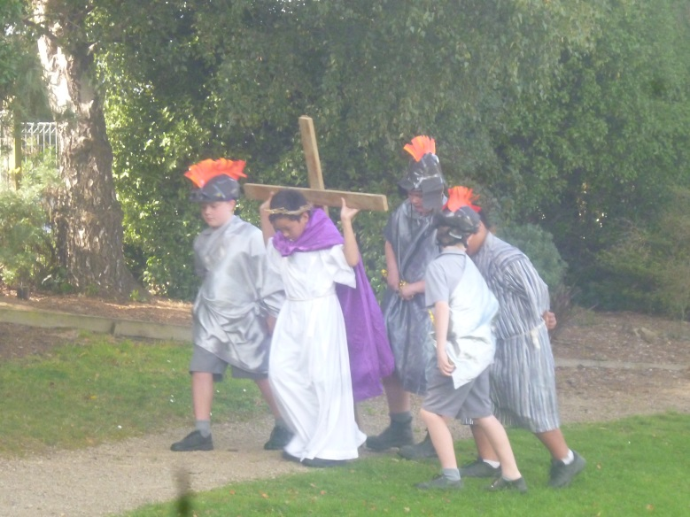
In Lent we walk with Jesus for 40 days towards his death on Good Friday
J | M | E | A | N | T | H | A | T | C
E | W | A | O | T | H | E | R | S | H
S | A | W | I | T | H | A | N | D | A
U | Y | O | F | W | A | S | B | O | N
S | E | A | S | O | N | O | V | F | G
H | R | I | D | R | L | I | V | E | E
U | N | E | W | D | L | T | O | W | E
R | C | L | O | S | E | L | Y | I | N
T | M | O | R | E | N | G | E | T | I
C | A | N | A | C | T | I | O | N | S
Find the words below in the word find
Lent is a season of change to get rid of mean words and actions that hurt others so we can live more closely with Jesus in a new way.
Click the words from the sentence to reveal
the position in the Word Find.
R-1
S-09
Notes:
Read the sentence and say who the message is for.
On their worksheet children can find each word in the sentence and highlight it in the sentence and in the Word Find
Children can add worksheets to their RE Learning Journals as evidence of their learning

Slide 10

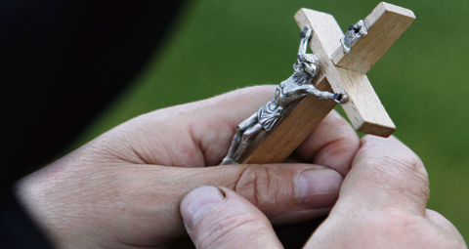

The Crucifix helps us to remember
how much Jesus loves us
Jesus wants us to grow and change and care for people as he did when he was on earth.
Jesus is our best friend and we can call on him at any time when we need help.
Jesus loves us very much and wants us to follow him and be his friend.
Jesus carried his cross and in Lent we can walk with him each day and talk to him.
Jesus walks with us on our life journey and he is very close to us when we have hard times.
R-1
S-10
Click the pins on the right to reveal post-it notes.
Notes:
Children read each post it note and share what it tells us about Jesus and us. Adapt Teaching and Learning Experience 5 to use as the class prayer focus during Lent.
Us some little shoes to move during prayer time each day along the path towards the cross.

Slide 11
Check Up
Name some signs of change you can see around you in the garden at home or at school.
1)
2)
Why is it good for people and things to change?
Name some things children of your age may need to change.
3)
Name 3 things you know about the season of Lent.
4)
Which activity do you think helped you to learn best in this resource?
5)
6)
Questions I would like to ask about the
topics in this resource are …
R-1
S-11
Click in each white box to reveal the text
Notes:
This formative assessment strategy will help teachers to identify how well children have achieved the Learning Intentions of the resource.
Teachers can choose how they use the slide in their range of assessment options.
The last two items are feed forward for the teacher.
Recording the children’s responses to these items is recommended as it will enable teachers to adjust their learning strategies for future resources and target the areas that need further attention.
1. Name some signs of change you can see around you in the garden at home or at school.
2. Why is it good for people and things to change?
3. Name some things children of your age may need to change.
4. Name 3 things you know about the season of Lent.
5. Which activity do you think helped you to learn best in this resource?
6. Questions I would like to ask about the topics in this resource are …

Slide 12

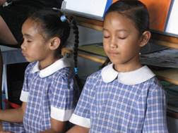

Time for Reflection
R-1
S-12
Click the audio button to stop reflective music
Click the audio button to play reflective music
Notes:
The MP3 is played to help create a reflective atmosphere and bring the children to stillness and silence as the teacher invites them to bring into their mind something they need to change that hurts others. Tell Jesus about it and ask him to help them find a way to change it during Lent.

Slide 13
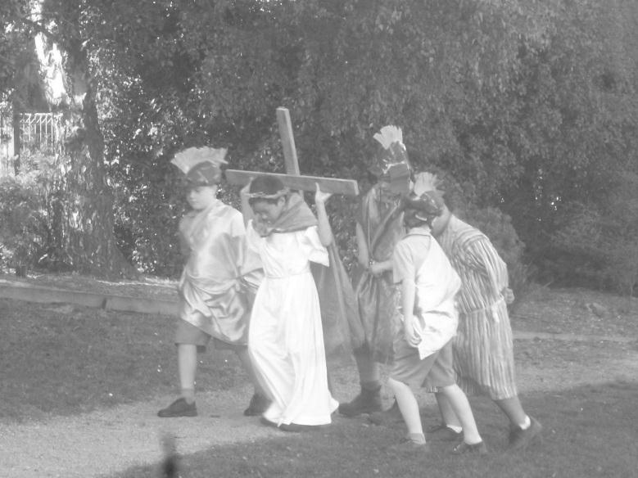
In Lent we walk with Jesus for 40 days towards his death on Good Friday
J | M | E | A | N | T | H | A | T | C
E | W | A | O | T | H | E | R | S | H
S | A | W | I | T | H | A | N | D | A
U | Y | O | F | W | A | S | B | O | N
S | E | A | S | O | N | O | V | F | G
H | R | I | D | R | L | I | V | E | E
U | N | E | W | D | L | T | O | W | E
R | C | L | O | S | E | L | Y | I | N
T | M | O | R | E | N | G | E | T | I
C | A | N | A | C | T | I | O | N | S
Find the words below in the word find
Lent is a season of change to get rid of mean words and actions that hurt others so we can live more closely with Jesus in a new way.
Name: Date:
R-1
S-09
Worksheet
Click the up arrow to return to the lesson
Notes:
This worksheet relates to slide 9
Find each word in the sentence below on the matrix and highlight it in the sentence and in the Word Find
Children can add worksheets to their RE Learning Journals as evidence of their learning.

