Slide 1
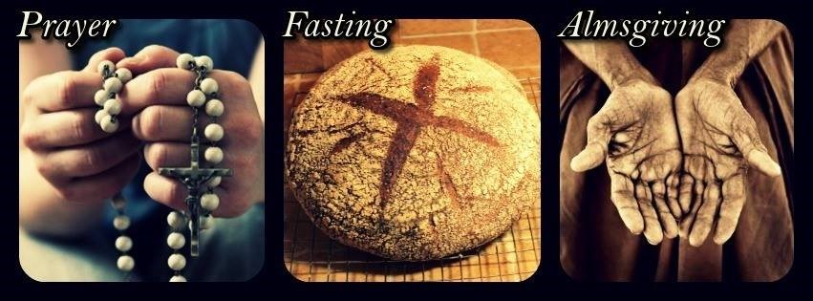
Lent is a Season for turning back to God through Fasting and Almsgiving
R-2
S-01
Notes:
Use this slide as a focussing strategy to introduce the resource topic. Read the title together and invite children to share something they know about how fasting and almsgiving helps people turn back to God in Lent.

Slide 2
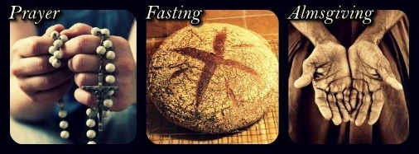
Learning Intentions
The children will…
1)
recognise Lent as a season for turning back to God through fasting and almsgiving
2)
identify ways people are helped to turn back to God during the season of Lent
R-2
S-02
Notes:
Read through the Learning Intentions with the class and identify some ideas/questions that might be explored in the resource.

Slide 3
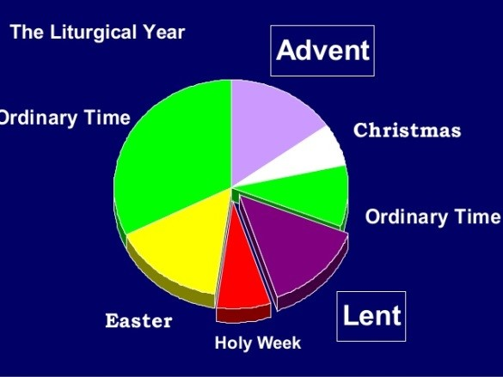
A Rapid Recap on what you know about the Season of Lent
R-2
S-03
Notes:
Adapt Teaching and Learning Experience 1
Invite the children to share what they have learned so far about Lent.
Look at the image and describe where it occurs in the Liturgical Year.
Watch the clip The Lenten Season 6:58 minutes
https://www.youtube.com/watch?v=akkQCnZAwWI
Prepare a poster board titled –What we have learned about the Season of LENT.
After watching the clip give children 3 Post it notes each and invite them to write 3 new things they learned about Lent from the clip to display on the poster board. Add the Post it notes to the poster and display in the Lenten Prayer Space.
Suggested uses for the poster board: Include in Sharing our Learning (See R2 Slide 11)
Photograph poster as a record of learning about Lent so far – suggest copy for RE Learning Journal, scan a copy and email it to parents – print copies and use as part of pre-test/post-test check.

Slide 4
Every season has its own mood or feeling
R-2
S-04
Click in white box to record ideas
Notes:
Adapt Teaching and Learning Experience 2
Invite the children to share the mood of the summer season.
Then move to the mood of Lent and record ideas – quiet time, reflective, waiting, prayerful, thoughtful, sadness, preparing for something, near Jesus, purple, in the shadow of the cross, thinking of others, changing, sacrifice, giving to others, remembering, death, journey, being with, 40 days.
When the words have been recorded children can use them to create some Acrostic poems which can be illustrated appropriately as a poster to be displayed around the school and shared – see Sharing our Learning (R2, Slide 12),
NOTE - An acrostic poem is a type of poetry where the first, last or other letters in a line spell out a particular word or phrase. The most common and simple form of an acrostic poem is where the first letters of each line spell out the word or phrase.
Adapt Teaching and Learning Experience 3

Slide 5
Fasting is one of the ways that helps people to bring God into their lives in Lent
Fasting can be giving up not only food but also words and actions that are hurtful such as bullying, meanness, laziness, swearing, stealing, excluding people and cheating.
The opposite of fasting is feasting which can mean treating others with respect and care.
Think of an example before you see the next slide – Fast from… Feast on…
Fasting is a great way to learn about self-discipline and this makes you strong and resilient which are great traits for children to have.
You can start off ‘fasting’ from what you enjoy for an hour each day and then gradually increase the fasting time until you fast for a longer time.
Fasting can also be limiting your use of something you enjoy such as television or ipads.
Try denying yourself using the screens you enjoy and you will understand how hard it is.
When we think of fasting we usually think of giving up food.
This applies to adults mainly, but children can give up treats, desserts and food they enjoy during Lent.
You could try this so you know what it feels like to say no to yourself – we say this is making a sacrifice or denying yourself something.
R-2
S-05
Click each ‘card’ to move through (4 total), click the arrow to go back to the beginning.
Notes:
Adapt Teaching and Learning Experience 5
Use the flip cards to increase children’s understanding of what fasting can include. Take time to let children make their personal responses to the ideas in the purple text.

Slide 6
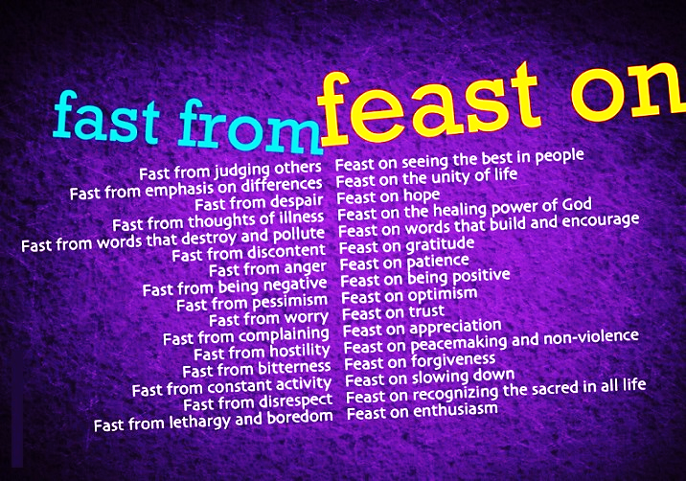
Feasting and fasting in our classroom
R-2
S-06
Click worksheet icon for worksheet.
Notes:
From the screen read the Feasting and Fasting items around the class.
Invite children to explain what each one means.
Children use their worksheet to create their own examples and share them with the class.

Slide 7
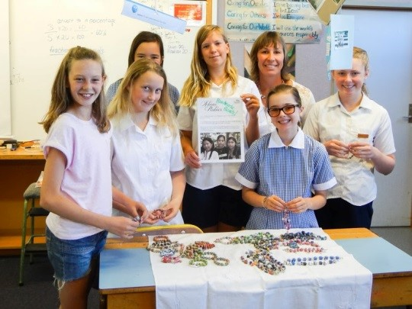
Almsgiving is another way people make God more important in their lives in Lent
What can children do to support the Caritas Lenten Appeal?
Children can organise activities in their schools and parishes to raise money so Caritas can provide for people who need help. The ‘alms’ the children give is their time and talent (see the girls on the title slide) to sell things to collect other people’s money to give as almsgiving.
What is almsgiving?
Almsgiving is often thought of as money - alms is an ancient word that means money given to the needy. But it can mean more than money.
What do you know about the Lenten Appeal in Aotearoa New Zealand?
The Lenten Appeal is developed by Caritas which is a Catholic agency that works to free the world from poverty and injustice. Every Lent they have a special project to help poor people in different parts of the world and people like us are encouraged to donate money to the appeal – appeal means a ‘call for help’.
Can you share more ways that children could help to raise money for Caritas?
It is by giving their time and using their talents for Caritas that children come to understand that doing this is being a true follower of Jesus and this helps them to grow closer to God through him.
What are the three ways people are encouraged to use in Lent that help them- to focus on living as God wants them to and say how they all connect to each other?
People are encouraged to spend time with God each day – PRAYER.
FASTING from food, treats and things they like to do that help them to develop self - discipline and generosity towards others.
People are encouraged to give money and time and talent to those in need so they get a sense of caring and compassion for them – ALMSGIVING.
R-2
S-07
Click the ‘Lenten Mission’ button to move through (5 total). Clicking the button again brings them back.
Notes:
Adapt Teaching and Learning Experiences 5 & 6
Read aloud the purple text on the flip cards. Class then read the black text silently (with help if needed) on each flip card.
Then read aloud the purple text questions on the flip cards again. Invite children to respond in their own words.

Slide 8
Find out about the Caritas Lenten Appeal for this Lenten Season
Ask you teacher if your class can use the CARITAS resources for Lent this year.
Talk to your teacher about how your class can support the CARITAS Lenten Appeal.
Use the CARITAS Prayer resources during your class prayer time in Lent.
X
R-2
S-08
Click ‘i’ button to reveal text.
Notes:
Use the ideas on the pop up to help your class decide how they will use the Caritas resources during Lent.

Slide 9
Check Up
1)
Make a diagram that shows the ways that children of your age can live more closely to God and live as God wants you to live during Lent.
2)
Write 3 ways people can fast and make sacrifices in Lent and say why this is good to do.
3)
Explain how almsgiving is not just about giving money and give an example of giving your time and talents to help others. Say why this is a good thing to do in Lent.
4)
Make a list of bullet points to record all you know about the CARITAS and the Lenten Appeal including the title of the project for this Lent.
5)
Which activity do you think helped you to learn best in this resource?
6)
Questions I would like to ask about the topics in this resource are…
R-2
S-09
Click in each caption space to reveal text
Notes:
This formative assessment strategy will help teachers to identify how well the children have achieved the Learning Intentions of the lesson.
Teachers can choose how they use the slide in their range of assessment options.
A worksheet of this slide is available for children in Years 5-8 to complete.
The last two items are feed forward for the teacher.
Recording the children’s responses to these items is recommended as it will enable teachers to adjust their learning strategies for future lessons and target the areas that need further attention.

Slide 10
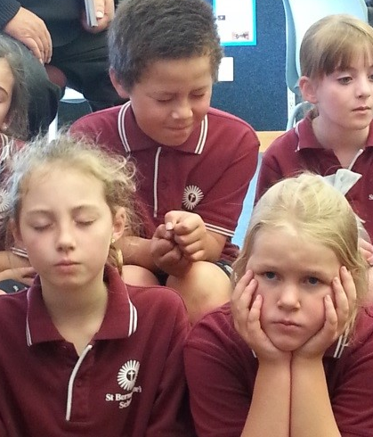
Time for Reflection
R-2
S-10
Click the audio button to stop reflective music
Click the audio button to play reflective music
Notes:
The MP3 is played to help create a reflective atmosphere and bring the children to stillness and silence as the teacher invites them to recall how praying brings them closer to God. Think about their favourite Holy Week story and recognise how praying with it helps them to notice things they need to change. Recall how reflecting on the events in Jesus’ last week before he died help them to feel closer to him like they are sharing in what is happening to him.

Slide 11
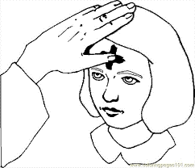
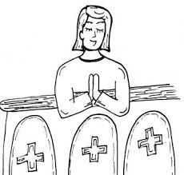
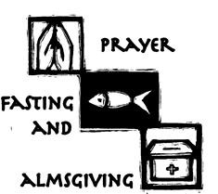
Sharing our Learning about LENT with family whānau, other classes and parish
Display posters in the church and school foyer (See R1, Slide 5) as advertisements to encourage others to walk with Jesus during Lent.
Share Acrostic poems (R2, Slide 4) to help children capture the mood and the themes of Lent as part of a ‘Learning about Lent’ sharing time with other classes.
Share the Poster Board photograph showing what we have learned about Lent to generate a discussion time with other classes and email photo to families so the discussion can continue at home. (See R2 Slide 3)
Do a tour of classrooms to share the ‘Fasting and Feasting in Lent in Our Classroom’ worksheets (R 2, Slide 7). Prepare an introduction that includes an explanation about what fasting and feasting means and how it is not all about food. Take copies of the worksheets to give to children who are interested in making their own lists.
Create some human statues to stand in the school, playground to bring to people’s attention different ways people can fast and make sacrifices in Lent and explain why this is good to do.
Share the CARITAS resources at assembly in the first week of Lent and make a power point to explain what CARITAS is and the work it does for the poor. Include an explanation of what almsgiving is and how it is more than giving money. Highlight the theme for this Lent and what children can do to be involved with CARITAS.(R2, Slide 8)
Invite other classes to come and share your ‘Lenten Prayer Space’ for morning prayer and share what your Lenten lessons are about. You could let children make a cross of ashes on their heads to remind them that the season of Lent lasts for 40 days.
Take photographs of people praying alone, with their family, in their class and in the church (R1, Slide 10). Enlarge them and make a display of them in the school foyer and add pages underneath each set of pictures for people to record what their praying preference is and give a reason for their choice. Report your findings back and remind people that prayer is a useful way to help you grow closer to God in Lent.
Make up your own way of showing and sharing what you have learned and decide with whom you would like to share it.
Visit another class at prayer time and demonstrate to the class how to pray with a Holy Week Scripture story that leads people to relate the story to their own life and let this lead into the prayer time. (R1. Slide 8)
Organise a ‘wear something purple day’ to remind people that Lent is a penitential season when Christians pray, fast and give alms to people who are needy. You could have an ‘alms’ collection for CARITAS.
RESTART
R-2
S-11
Click the clouds to move through (11 total). Click “RESTART” to start over.
Click worksheet icon for worksheet.
Notes:
This slide provides some choices for children to show and share what they have learned. Examples could be photographed as evidence of children’s learning.
You may like to put a copy of the Sharing our Learning page in children’s RE Learning Journals. You could talk through the choices using the slide and let children make their choice from their own copy.
Children could work on their choice at school and/or at home and you may like to set a day for sharing. Please let parents and whānau know what you expect them to do with this.
The resource is focussed on the Yr 4 LENT Achievement Objective which is covered in Resources 1-2
Yr 4 LENT AO Children will be able to: recognise LENT as a season for turning back to God through prayer, fasting and almsgiving.

Slide 12
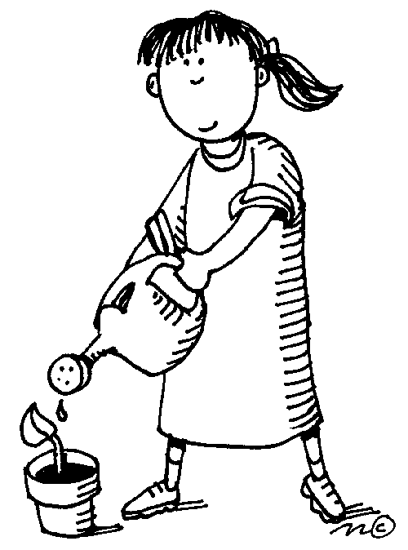
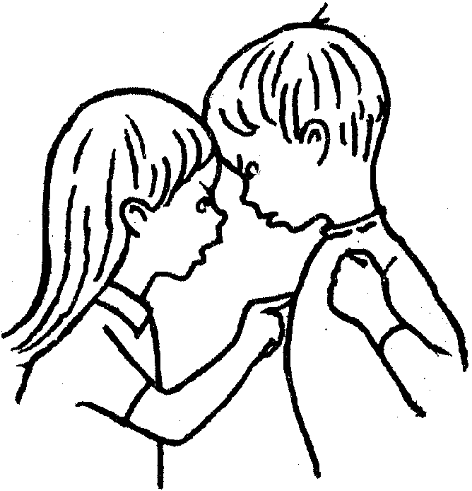
In LENT FEASTING and FASTING help us turn back to GOD
Name___________________________ Date_______________
FAST from | FEAST on
____________________________________ ____________________________________ ____________________________________ ____________________________________ ____________________________________ | _______________________________________ _______________________________________ _______________________________________ _______________________________________ _______________________________________
R-2
S-06

Slide 13
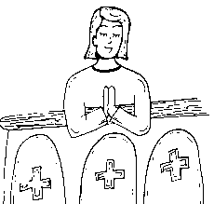
Sharing our Learning about LENT with family whānau, other classes and parish
Name___________________________ Date_______________
Share Acrostic poems (R2, Slide 4) to help children capture the mood and the themes of Lent as part of a ‘Learning about Lent’ sharing time with other classes.
Display posters in the church and school foyer (See R1, Slide 5) as advertisements to encourage others to walk with Jesus during Lent.
Organise a ‘wear something purple day’ to remind people that Lent is a penitential season when Christians pray, fast and give alms to people who are needy. You could have an ‘alms’ collection for CARITAS.
Do a tour of classrooms to share the ‘Fasting and Feasting in Lent in Our Classroom’ worksheets (R 2, Slide 7). Prepare an introduction that includes an explanation about what fasting and feasting means and how it is not all about food. Take copies of the worksheets to give to children who are interested in making their own lists.
Visit another class at prayer time and demonstrate to the class how to pray with a Holy Week Scripture story that leads people to relate the story to their own life and let this lead into the prayer time. (R1. Slide 8)
Share the CARITAS resources at assembly in the first week of Lent and make a power point to explain what CARITAS is and the work it does for the poor. Include an explanation of what almsgiving is and how it is more than giving money. Highlight the theme for this Lent and what children can do to be involved with CARITAS.(R2, Slide 8)
Invite other classes to come and share your ‘Lenten Prayer Space’ for morning prayer and share what your Lenten lessons are about. You could let children make a cross of ashes on their heads to remind them that the season of Lent lasts for 40 days.
Take photographs of people praying alone, with their family, in their class and in the church (R1, Slide 10). Enlarge them and make a display of them in the school foyer and add pages underneath each set of pictures for people to record what their praying preference is and give a reason for their choice. Report your findings back and remind people that prayer is a useful way to help you grow closer to God in Lent.
Create some human statues to stand in the school, playground to bring to people’s attention different ways people can fast and make sacrifices in Lent and explain why this is good to do.
Make up your own way of showing and sharing what you have learned and decide with whom you would like to share it.
R-2
S-11

