Slide 1

Lent begins on Ash Wednesday
R-1
S-01
Notes:
Use this slide as a focussing strategy to introduce the resource topic. Read the title together and invite children to share something they know about the season of Lent and Ash Wednesday.

Slide 2

Learning Intentions
The children will:
1)
recognise Lent as a season of 40 days
beginning on Ash Wednesday
2)
explain the meaning of receiving the ashes at the celebration of the Eucharist or in a special ceremony on Ash Wednesday
3)
identify at least one purpose of Lent
R-1
S-02
Click in each caption space to reveal text
Notes:
Read through the Learning Intentions with the class and identify some ideas/questions that might be explored in the resource.

Slide 3
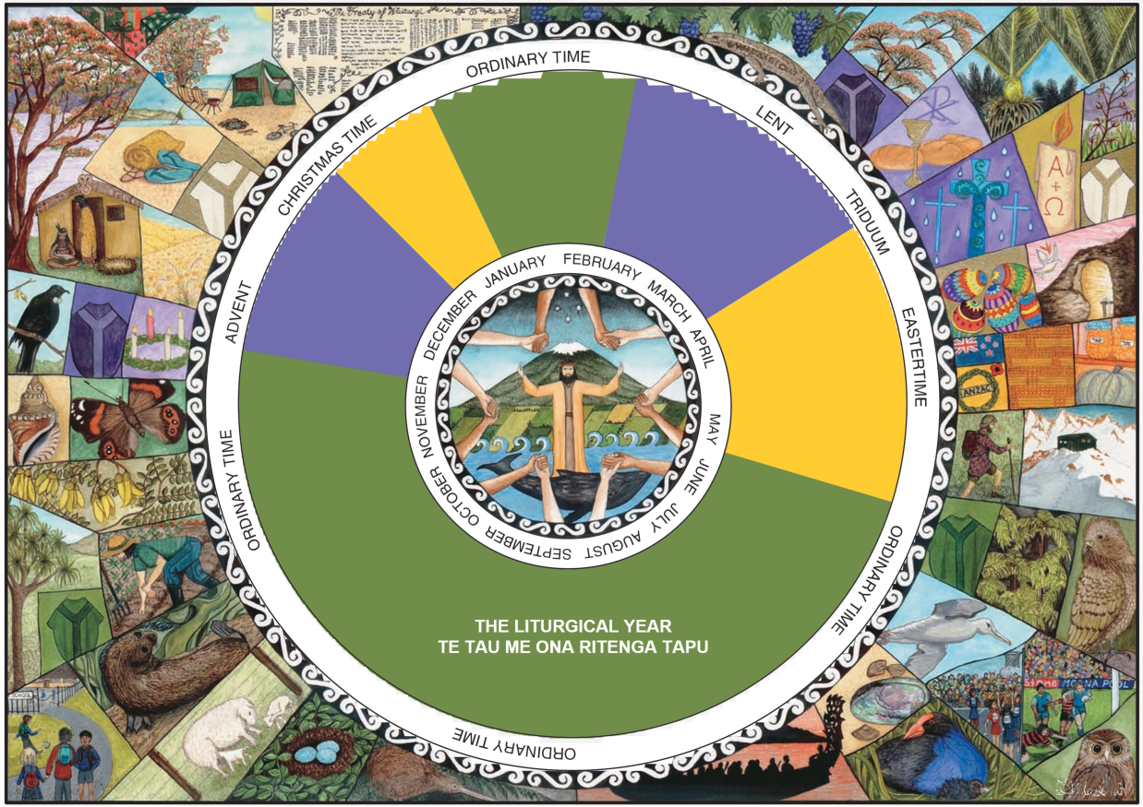
The Liturgical Year – The Season of Lent
Recap what you know about the season of Lent in the Liturgical Year.
Watch the clip and share something new you learned from it.
R-1
S-03
Click on the video button to play the video
Notes:
Watch the clip ‘So what’s the story with Lent’ 1:15 minutes
https://www.youtube.com/watch?v=zAuB-3V46zk
Follow the slide directions.
Adapt Teaching and Learning Experience 1

Slide 4
The Liturgical Year
Add this worksheet to your RE Learning Journal so you can colour each feast
and season as you celebrate it.
Colour the first season of the Liturgical Year - use the colour p ____________
because it is a season to p_____________ for a great feast.
Colour the next season using y____________ because it is a celebration.
Christmas is both a f___________ and a s ________________ to
celebrate ____________________________________
Colour Ordinary Time g __________ .
What are you doing in this Ordinary Time?
Lent is another season of p ______________ and p ________________.
Write what you know about this season:
______________________________________________________________
______________________________________________________________
______________________________________________________________
R-1
S-04
Click the worksheet button to go to the worksheet
Notes:
Work through the slide with the class and use the worksheet to consolidate children’s knowledge.
Adapt Teaching and Learning Experience 2

Slide 5
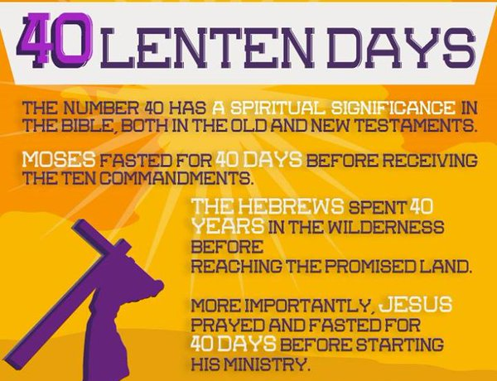

The significance of the number 40 in the Bible
Why does the season of Lent last for 40 days?
The number 40 in the Bible has special spiritual significance.
Why did the People of Israel spend 40 years wandering
in the desert?
Their journey to the Promised Land was about the chosen people learning to live God’s ways – 40 days was God’s number for a time of testing or preparation, the time necessary to achieve something important.
Why did Moses fast for 40 days before he received
the 10 Commandments?
Moses fasted in preparation to receive God’s Law when he came down from the mountain.
What happened during the 40 days Jesus spent in the desert?
Jesus was led by the Spirit into a time of solitude in the desert straight after his baptism. He lived among the wild beasts and did not eat. He was looked after by angels. He was tempted 3 times by Satan but he did not give in. He was focussed on preparing to achieve God’s plan for him to build God’s kingdom on earth.
R-1
S-05
Click an icon to reveal text
Notes:
Read the text on the image then discuss the questions and use the revealed text to extend their thinking.

Slide 6

Practices in Lent have evolved since Lent started in the early centuries of the Church
Now people are encouraged to give to the agency set up by the bishops known as CARITAS which promotes Lenten projects every year for people in need in Aotearoa New Zealand in Pascifika.
More recently the practice of giving up something has been extended to giving up something in order to give something to those who do not have enough.
Originally people were expected to fast for the full 40 days but were exempt on Sundays. Meat was not to be eaten on Fridays and Ash Wednesday but now this applies to Good Friday only.
The length of 40 days for Lent related to the 40 days Jesus spent fasting in the desert in preparation for beginning his public ministry working among the people. Fasting was always part of preparation in Bible times.
After Vatican 11 greater emphasis was given in Lent to the preparation for baptism and the renewal of the baptismal vows, penance and prayer to prepare the people for the great feast of Easter.
From its early beginnings Lent has been understood to be a special season of prayer, fasting, penance, sacrifice and good works in preparation for the celebration of Easter.
R-1
S-06
Click top card to discard it
Notes:
Read through each flip card and ask children to make a question that the flip card answers. When completed children tell a partner 3 new things they learned about Lent. Adapt Teaching and Learning Experience 3

Slide 7

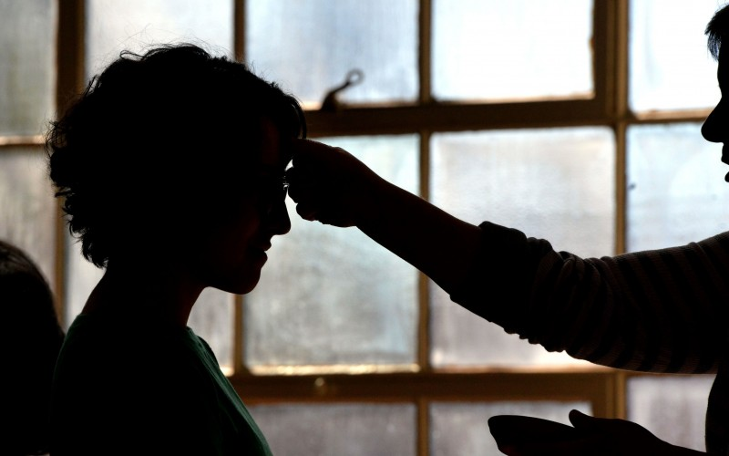

Lent begins on Ash Wednesday
Ashes were an ancient symbol of penance, repentance and sorrow used by the Jews. When people had committed a serious sin they had ashes sprinkled over them and wore sack cloth in public as a penance to show they were sorry.
The public display of repentance has died out but the marking with ashes continues to remind people of the need to seek forgiveness and express their sorrow for the times they have turned away from following Jesus.
Christians continued the practice as an external sign of repentance. People confessed their sins on the day before Lent started, then covered themselves in ashes as they carried out their penance during Lent. After 40 days of repentance they asked if they could return to be part of the community at Easter.
The practice of making a sign of the cross on the forehead evolved from this and was used on the first day of Lent which then became known as Ash Wednesday.
R-1
S-07
Click the pins on the right to reveal post-it notes.
Notes:
Read each post-it note and discuss the use of ashes by the early Christians and compare their practices with how ashes are used today as a symbol of penance, repentance and sorrow.
Prepare a presentation to show how the present day practice of signing people with ashes has evolved and present it at assembly.
Make copies to use of the Children’s Home Activity in the Teachers’ book p23, or on the resource home page as a home/school link.

Slide 8

The Purpose of Lent
Lent is a time for Christians to think…
seriously about how well they are following Jesus.
It is time to recognise your failures to love…
to change and to be sorry and repent for them.
Lent offers opportunities to spend more time in prayer …
karakia to deepen their relationship with God Te Atua.
Doing penance is another Lenten practice to help…
people turn away from sin and live the values of Jesus.
Lent is time for a change of heart and to be more…
open to celebrate the feast of Easter and a new life with Christ.
open to celebrate the feast of Easter and a new life with Christ.
karakia to deepen their relationship with God Te Atua.
to change and to be sorry and repent for them.
seriously about how well they are following Jesus.
people turn away from sin and live the values of Jesus.
R-1
S-08
Click on a sentence from the list at the bottom or click an empty text box to match the sentences.
Notes:
Think about why the Church has the season of Lent.
Read each sentence and suggest some ideas to complete them – add to your thinking using the statements in the box. Adapt Teaching and Learning Experience 4

Slide 9
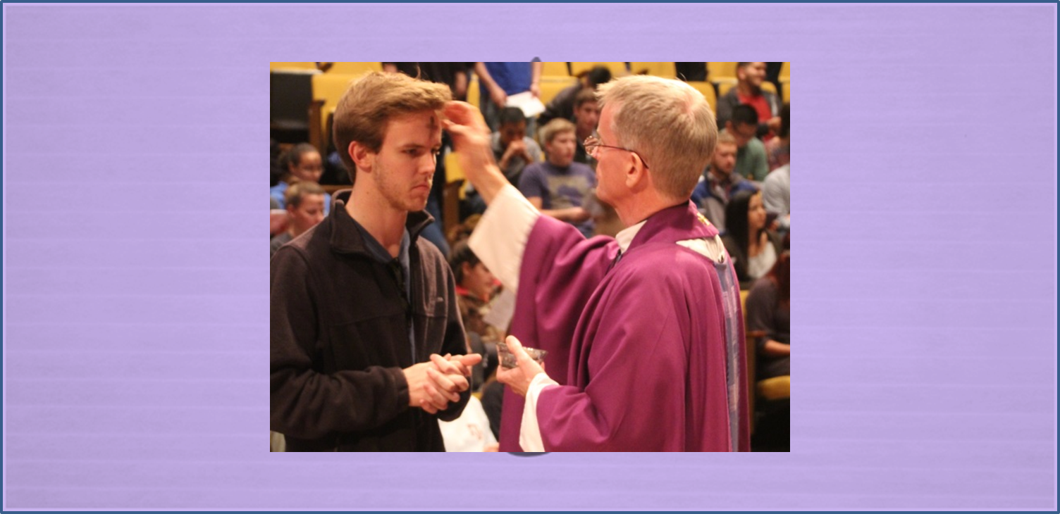
Being Signed with the Ashes
on Ash Wednesday
The ashes used on Ash Wednesday are made from last year’s
blessed palms.
They are blessed during Eucharist and then distributed to the people after the homily by the priest and members of the community.
They are also distributed during special liturgies in schools
and places where people gather on Ash Wednesday.
People wearing ashes on their forehead are showing they want
to say they are sorry for failing to follow Jesus faithfully.
R-1
S-09
Click the down-button to move the blind down, click the up-button (appears at bottom) to move the blind to the top.
Notes:
Before you use the blind ask the children where the ashes used on Ash Wednesday come from? Use the revealed text to initiate conversations about how it feels to wear ashes on your forehead and suggest what you would say to someone who asks you why you do this.
Photograph children with the ashes on their heads and add the image to the prayer focus for Lent as a reminder of the season. Discuss the words that are said as the cross is drawn on your forehead and what this means – Turn away from sin and be faithful to the gospel or Remember you are dust and to dust you shall return.
Adapt Teaching and Learning Experience 5.

Slide 10

Check Up
1)
Tell a partner 5 things you know about Lent.
2)
Make a poster to explain the meaning of ashes and their use in Lent as a sign of sorrow and repentance.
3)
Explain the reason why we have the season of Lent and name 3 ways it can help people to grow and change and follow Jesus more closely.
R-1
S-10A
Click in each caption space to reveal text
Notes:
This formative assessment strategy will help teachers to identify how well children have achieved the Learning Intentions of the resource.
Teachers can choose how they use the slide to assess each item.
A worksheet of this slide is available as an option for children to complete.
The last two items are feed forward for the teacher.
Recording the children’s responses to these items is recommended as it will enable teachers to adjust their learning strategies for future resources and target the areas that need further attention.

Slide 11
Check Up
4)
Give 3 reasons why 40 is a significant number
in the bible.
5)
Which activity do you think helped you to learn best
in this resource?
6)
Questions I would like to ask about the topics in this resource are …
R-1
S-10B
Click on the worksheet button to go to the worksheet
Notes:
Add the completed worksheet to RE Learning Journals as evidence of learning.

Slide 12

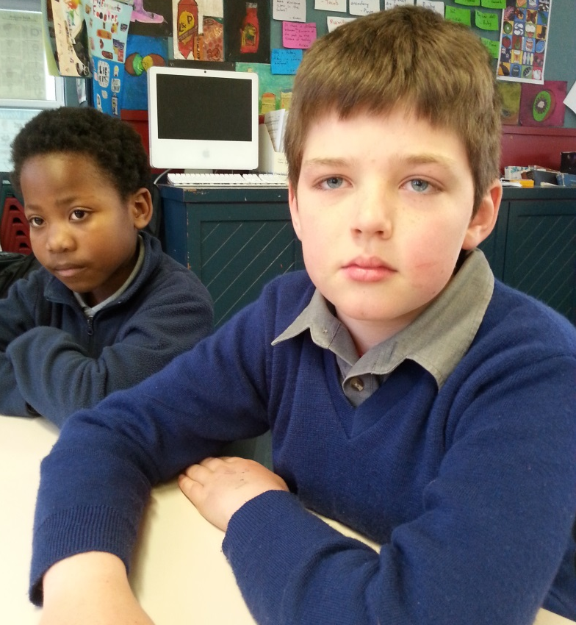

Time for Reflection
R-1
S-11
Click the audio button to stop reflective music
Click the audio button to play reflective music
Notes:
The MP3 is played to help create a reflective atmosphere and bring the children to stillness and silence as the teacher invites them to think about how they can use the 40 days of Lent to be more aware of times they are not following Jesus closely. Decide on one thing they can do to change this and try to do it each day.

Slide 13
The Liturgical Year
Add this worksheet to your RE Learning Journal so you can colour each feast
and season as you celebrate it.
Colour the first season of the Liturgical Year - use the colour p ____________
because it is a season to p_____________ for a great feast.
Colour the next season using y____________ because it is a celebration.
Christmas is both a f___________ and a s ________________ to
celebrate ____________________________________
Colour Ordinary Time g __________ .
What are you doing in this Ordinary Time?
Lent is another season of p ______________ and p ________________.
Write what you know about this season:
______________________________________________________________
______________________________________________________________
______________________________________________________________
______________________________________________________________
______________________________________________________________
______________________________________________________________
Name:____________________
Date:____________
R-1
S-04
Worksheet
Click the up arrow to return to the presentation
Notes:
This worksheet relates to slide 4.

Slide 14

Check Up
1)
Tell a partner 5 things you know about Lent.
2)
Make a poster to explain the meaning of ashes and their use in Lent as a sign of sorrow and repentance.
3)
Explain the reason why we have the season of Lent and name 3 ways it can help people to grow
and change and follow Jesus more closely.
4)
Give 3 reasons why 40 is a significant number in the bible.
5)
Which activity do you think helped you to learn best in this resource?
6)
Questions I would like to ask about the topics in this resource are …
Name:__________________
Date:____________
R-1
S-10
Worksheet
Click the up arrow to return to the presentation
Notes:
This worksheet relates to slide 10.

