Slide 1
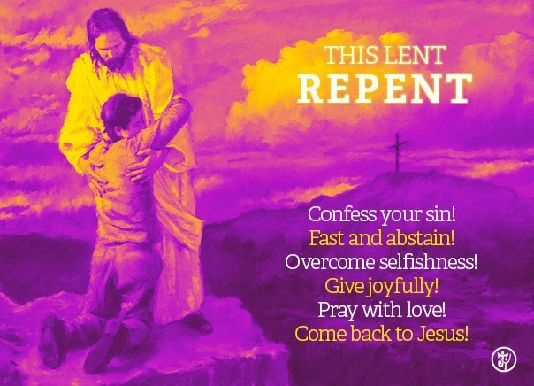
Lent – A Time to Repent and do Penance
R-2
S-01
Notes:
Use this slide as a focussing strategy to introduce the resource topic. Read the title together and invite children to share something they know about using Lent as a time to repent and do Penance. Read the text on the slide for some clues.

Slide 2
Learning Intentions
The children will:
1)
recognise that Lent is a season when Christians are reminded to repent and turn back to God Te Atua.
2)
explain why people choose to do some form of penance during Lent
R-2
S-02
Click in each caption space to reveal text
Notes:
Read through the Learning Intentions with the class and identify some ideas/questions that might be explored in the resource.

Slide 3
Recapping on the Season of Lent
R-2
S-03
Click on the video button to play the video
Notes:
Share something you know about the season of Lent and why it is part of the Liturgical Year. Adapt Teaching and Learning Experience 1. Watch the clip The Lenten Season 6:58 minutes
https://www.youtube.com/watch?v=akkQCnZAwWI
Share with a partner 3 new things you learnt about Lent from the clip.

Slide 4
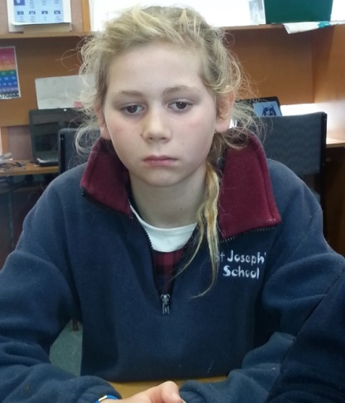
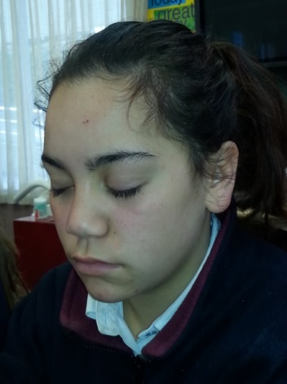
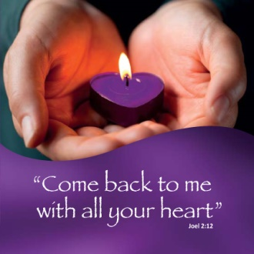
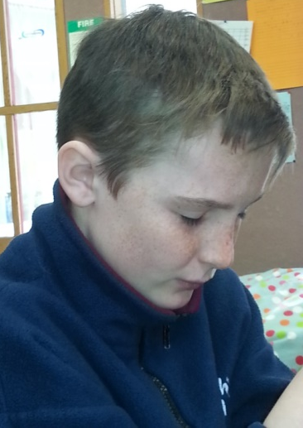
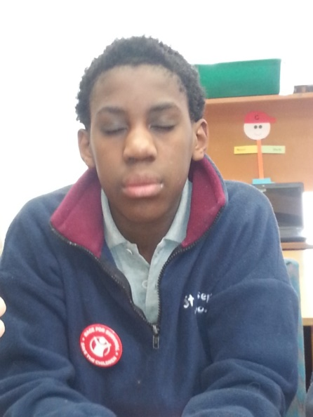
Take time to think about how you are following Jesus
Think about :
Is there something I am doing that I know is not right?
Lent is a good time to own up to this.
Lent would be a good time to change this.
Ask God to help you to turn away from what is not right.
Ask for the strength to turn back to God.
X
R-2
S-04
Click the I-button to reveal information
Notes:
Use the prompts on the slide to listen and ask God to open your minds and your hearts to recognise what you need to change. Remind children this quiet time is just between them and God so to use it wisely.
Decide how you are going to turn back to living as God wants you to.
Sing using the MP3 ‘Turn back to God’.
Use this song in class prayer during Lent.

Slide 5
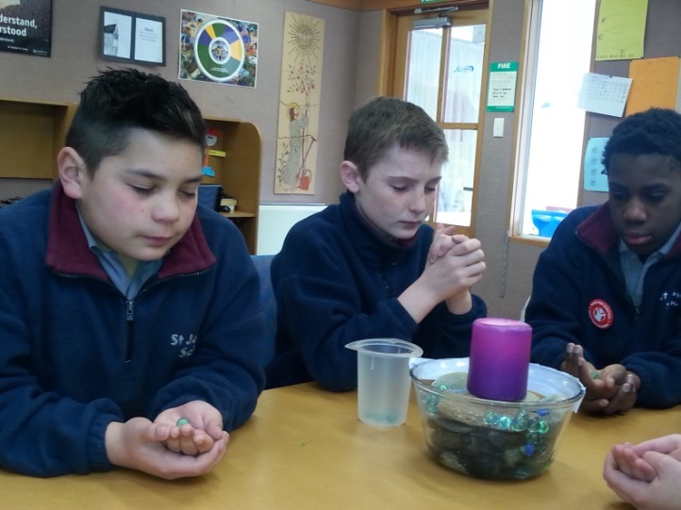
What does turning back to God LOOK like, SOUND like, FEEL like?
Noticing sin and wrong doing and trying to stop it.
Celebrating the Sacrament of Penance.
Giving praise and thanks to God at the Eucharist.
Supporting and encouraging others as they turn back to God.
Click an icon to reveal text.
Click on the worksheet button to go to the worksheet.
R-2
S-05
Notes:
Adapt Teaching and Learning Experience 2.
Children share their responses to the title question.
Use the revealed text to add ideas and extend their thinking.
Record their ideas on the worksheet Y chart.
Make a classroom display with them and refer to it during prayer time to remind children about the purpose of Lent.

Slide 6
Making the Journey through Lent to Easter meaningful
Lent is a good time for personal sacrifice because it prepares us for Good Friday when Jesus sacrificed his life to save us and bring us new life by his resurrection. Think about Jesus giving up his life for us and what we can do to show him how much we appreciate what he did for us. How can you use Lent to grow closer to Jesus and let him know you want him in your life?
Lent is the season for making sacrifices, noticing people in need and doing something about it. Think about people who are hungry and needy. What could you do to help reduce their need? What sacrifice could you make to show God’s mercy to them?
Lent is the season for joining with other people to do a penance each day to show God you are serious about wanting to change and grow in your relationship with God and become more loving like Jesus. Think about one thing you would like to change and what you can do to make this happen. What is something that you like doing that you could give up? Or something loving you could do for someone else during Lent that may involve a sacrafice.
Lent is the season for doing some kind of penance to show Jesus you are sorry for the ways you have failed to love God and the people in your life. Think about how you could make up to God for this. What could you do that would help you to stop repeating words and actions that hurt others?
Lent is a season to reflect on how you need to change your life so you can follow Jesus more closely. Think about how often Jesus comes into your thoughts each day.
What can you do to let Jesus play a more prominent part in your life?
R-2
S-06
Click top card to discard it
Notes:
Before you read the flip cards have a conversation with the class about how Lent is like a journey Christians go on to prepare for Jesus’ death and resurrection. Read each flip card and respond silently in your heart to the question it asks.

Slide 7
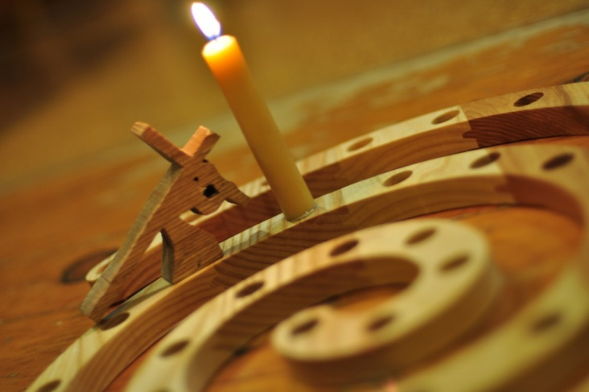
The Pathways to Easter
Here are some ideas that may help you to choose what you can do for Lent:
Reduce your screen time and offer to help with household tasks.
Give up snacks between meals and think about what it is like to feel hungry.
Focus on having a willing attitude and offer to help at home and at school.
Monitor your feedback to others and reduce negative comments and put downs.
Sacrifice your pocket money and give it to the CARITAS Lenten appeal.
Planning for a time to spend with Jesus each day – listening and talking with him.
Choosing to befriend someone in your class who is often left out.
Encouraging your family to attend Eucharist and the Sacrament of Penance.
Share what you are learning about Lent with your family.
Suggest a Family Lenten activity like no dessert, family prayer and talking time.
R-2
S-07
Press the green button to advance through the lines
Notes:
Discuss the ideas and encourage children to choose some to do in Lent.
Encourage children to record their choices in their RE Learning Journal to remind themselves about them. Adapt Teaching and Learning Experiences 3 & 4

Slide 8
Why People Choose to do
Acts of Penance in Lent
Acts of penance are a good
way of saying sorry for sin.
Doing penance helps people learn
and keep good habits of living in loving ways.
Making sacrifices is part of helping
people to turn their lives back to God.
Doing penance strengthens people’s
desire to change their attitudes and actions.
People are not alone doing penance in Lent
because Christians all over the world do it.
because Christians all over the world do it.
people to turn their lives back to God.
and keep good habits of living in loving ways.
way of saying sorry for sin.
desire to change their attitudes and actions.
R-2
S-08
Click on a sentence from the list at the bottom or click an empty text box to match the sentences.
Notes:
Adapt Teaching and Learning Activity 4
Use the slide to help children understand why Christians do acts of Penance in Lent. Share ideas about what acts of penance children of your age can do.

Slide 9
Celebrating the Sacrament of Penance
T | V | M | S | S | Q | T | T | H | E | M | Q | V | D
U | B | R | E | Q | A | P | E | N | A | N | C | E | S
X | Z | V | C | H | A | N | G | E | X | X | S | M | A
B | I | L | T | O | G | C | T | O | M | E | M | P | C
L | F | O | R | G | I | V | E | N | E | S | S | E | R
C | E | L | E | B | R | A | T | E | R | R | O | O | A
H | W | K | K | T | H | E | I | R | C | H | P | P | M
E | W | N | E | O | V | Z | H | A | Y | T | M | L | E
L | I | J | J | O | I | A | N | D | O | H | O | E | N
P | U | R | L | H | H | G | O | D | S | E | E | F | T
In the Sacrament of Penance people celebrate God’s mercy, forgiveness and love that help them to change their lives.
R-2
S-09
Click the words in the text box to reveal the position in the puzzle. Click on the worksheet button to go to the worksheet.
Click the audio button to stop ‘Turn back to God’
Click the audio button to play ‘Turn back to God’
Notes:
Find each word in the sentence on the matrix and highlight it in the sentence and in the Word Find.
Children add worksheets to their RE Learning Journals as evidence of their learning.
Sing using the MP3 ‘Turn back to God’. Use this song in class prayer during Lent.

Slide 10
Check Up
1)
Repentance means …
2)
Examples of turning back to God are…
3)
Why is Lent a good time for penance and sacrifice?
R-1
S-10A
Click in each caption space to reveal text
Notes:
This formative assessment strategy will help teachers to identify how well children have achieved the Learning Intentions of the resource.
Teachers can choose how they use the slide to assess each item.
A worksheet of this slide is available as an option for children to complete.
The last two items are feed forward for the teacher.
Recording the children’s responses to these items is recommended as it will enable teachers to adjust their learning strategies for future resources and target the areas that need further attention.

Slide 11
Check Up
4)
Why is celebrating the Sacrament of Penance in Lent a helpful thing to do?
5)
Which activity do you think helped you to learn best in this resource?
6)
Questions I would like to ask about the topics in this resource are …
R-1
S-10B
Click on the worksheet button to go to the worksheet
Notes:
Add the worksheet to the RE Learning Journal.

Slide 12
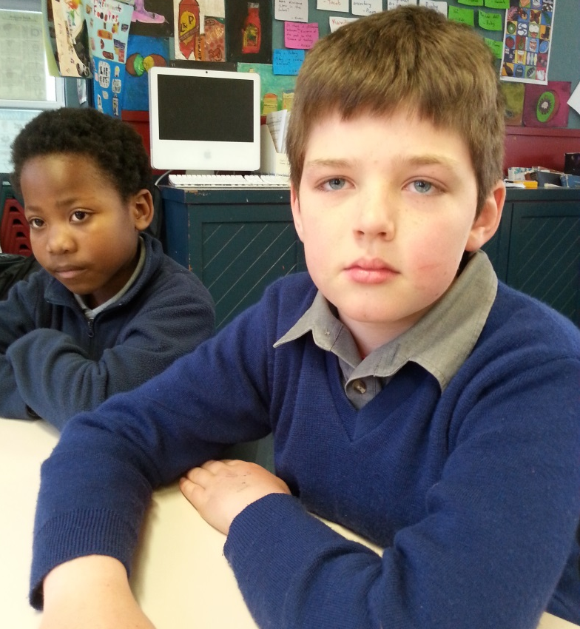
Time for Reflection
R-2
S-11
Click the audio button to stop reflective music
Click the audio button to play reflective music
Notes:
The MP3 is played to help create a reflective atmosphere and bring the children to stillness and silence as the teacher invites them to bring to their minds how they can use Lent to focus on changing something in their lives they know they need to. Think about one thing they can do to turn their lives back to God.

Slide 13
Turning back to God LOOKS like, SOUNDS like, FEELS like:
Looks like
Feels like
Sounds like
Name:__________________
Date:____________
R-2
S-05
Worksheet
Click the up arrow to return to the lesson
Notes:
This worksheet relates to slide 5.

Slide 14
Celebrating the Sacrament of Penance
T | V | M | S | S | Q | T | T | H | E | M | Q | V | D
U | B | R | E | Q | A | P | E | N | A | N | C | E | S
X | Z | V | C | H | A | N | G | E | X | X | S | M | A
B | I | L | T | O | G | C | T | O | M | E | M | P | C
L | F | O | R | G | I | V | E | N | E | S | S | E | R
C | E | L | E | B | R | A | T | E | R | R | O | O | A
H | W | K | K | T | H | E | I | R | C | H | P | P | M
E | W | N | E | O | V | Z | H | A | Y | T | M | L | E
L | I | J | J | O | I | A | N | D | O | H | O | E | N
P | U | R | L | H | H | G | O | D | S | E | E | F | T
In the Sacrament of Penance people celebrate God’s mercy, forgiveness and love that help them to change their lives.
Name:__________________
Date:____________
R-2
S-09
Worksheet
Click the up arrow to return to the lesson
Notes:
This worksheet relates to slide 9.

Slide 15
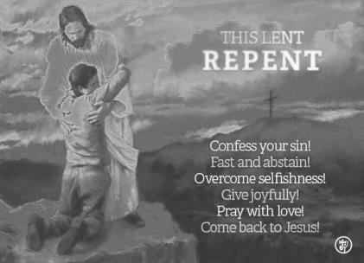
Check Up
1)
Repentance means …
2)
Examples of turning back to God are…
3)
Why is Lent a good time for penance and sacrifice?
4)
Why is celebrating the Sacrament of Penance in Lent a helpful thing to do?
5)
Which activity do you think helped you to learn best in this resource?
6)
Questions I would like to ask about the topics in this resource are …
Name:__________________
Date:____________
R-2
S-10
Worksheet
Click the up arrow to return to the presentation
Notes:
This worksheet relates to slide 10.

