Slide 1
Lent – Growing in Friendship with God through Prayer Karakia
R-3
S-01
Notes:
Use this slide as a focussing strategy to introduce the resource topic. Read the title together and invite children to share something they know about the meaning of growing in friendship with God. What message does the image give about children growing in friendship with God?

Slide 2
Learning Intentions
The children will:
1)
recognise that people can turn back to God and grow in friendship with God through prayer karakia
2)
identify different ways people can participate in prayer – personal, family and the celebration of the Eucharist
3)
recognise that the Stations of the Cross help people pray with Jesus on his way to his death
R-3
S-02
Click in each caption space to reveal text
Notes:
Read through the Learning Intentions with the class and identify some ideas/questions that might be explored in the resource.

Slide 3
Lent is a Journey Hikoi with Jesus through the Cross to Easter
The 40 day journey hikoi through Lent is made with Jesus and it leads to his death on the cross and through that on to the empty tomb and his glorious resurrection at Easter.
It is in these quiet times the Holy Spirit opens our minds and hearts to God’s plans for us. We can hear and feel God speaking to us, guiding and encouraging us to work on how we can grow in friendship with God. Lent is a good time for quiet times with God.
Christians make this journey with Jesus and it is like in the journey we take we die with him and rise with him at Easter. The journey of Lent leads us away from everything that is not of God towards everything that brings life in God Te Atua.
The journey includes acts of penance, acts of repentance and sorrow for our wrong doings and taking time to be alone with God in prayer. God loves to spend time alone with people because it is the chance to get to know them as a friend.
R-3
S-03
Click the pins on the right to reveal post-it notes.
Notes:
Read each post it note and make up a title for each one.
Identify what is hard about the Lenten hikoi?
How do people benefit when they do hard things?
How does doing hard things help people come to understand Jesus’ hikoi to the cross? Explain that because Jesus did this for all people, we can be forgiven, we can start again and when we die that is not the end because Jesus’ death earned for us a new life with God forever.
This is why what Jesus did is so important to all his followers. This is what we mean when we say Jesus saved us from sin and death.

Slide 4
People pray in different ways, at different times and in different places such as:
Find and read each Bible reference about different experiences of prayer as described in the New Testament.
Complete the sentences:
In Matthew 18:19 Jesus describes prayer as
__________________________________________________________________
__________________________________________________________________
In Matthew 6:6 Jesus talks about a different sort of prayer – describe it.
__________________________________________________________________
__________________________________________________________________
In Luke 1:10 we hear about the people praying in public and it was like this …
_________________________________________________________________
__________________________________________________________________
In Acts 2:42 Luke describes the first people who converted to Christianity
__________________________________________________________________
__________________________________________________________________
Write about your preferred way to pray and give your reasons.
R-3
S-04
Click on the worksheet button to go to the worksheet
Notes:
Follow the slide directions.
Children complete the worksheet and share it.
Adapt Teaching and Learning Experience 3.

Slide 5
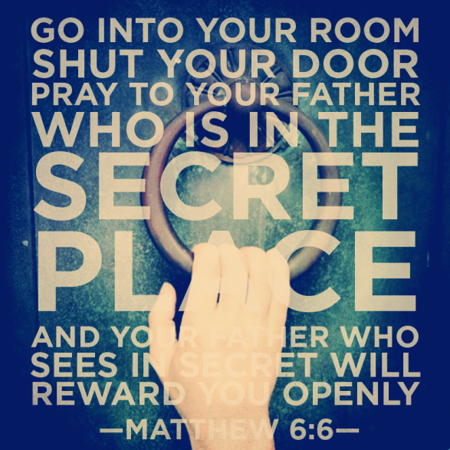
Lent is a time to grow closer to God so people are encouraged to spend time alone with God
Share what you think about praying alone with God.
Share an experience you have had of this.
X
R-3
S-05A
Click the I-button to reveal information
Notes:
Read the text on the image - look closely at the image and explain what it means. Follow the prompts on the pop up.
Adapt Teaching and Learning Experience 2

Slide 6
Lent is a time to grow closer to God so people are encouraged to spend time alone with God
G | B | Y | O | U | A | P | W | H | A | T | T | A | S
G | O | W | O | P | E | N | L | Y | R | A | E | L | F
Y | O | U | I | T | R | E | E | A | S | L | S | O | R
S | L | D | E | L | R | W | S | L | C | K | A | N | I
Q | U | I | E | T | L | A | R | E | Y | E | Y | E | E
T | P | H | E | A | R | R | F | I | N | S | D | Y | N
A | N | D | A | T | G | O | D | O | W | W | H | O | D
E | C | T | O | N | T | Y | L | L | I | I | H | U | S
A | C | A | N | H | N | O | S | Y | L | T | M | E | R
R | E | W | A | R | D | U | T | M | L | H | T | E | N
In a quiet place when you are alone with God you can talk as friends and God will hear what you say and will reward you openly.
R-3
S-05B
Click the words in the text box to reveal the position in the puzzle.
Notes:
Adapt Teaching and Learning Experience 1.
Children complete the worksheet version of the word find by highlighting each word in the sentence on the matrix and in the sentence. Check each word on the worksheet using the slide version.
Children add worksheets to their RE Learning Journals as evidence of their learning.

Slide 7
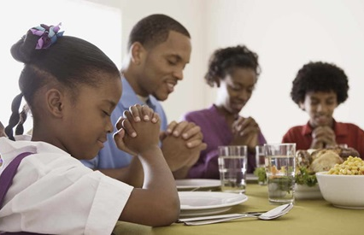
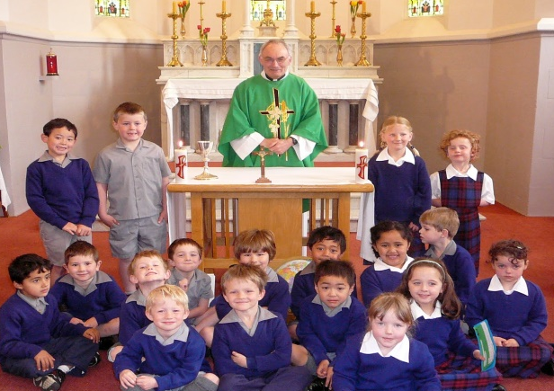
In Lent children make a special effort to pray at home and at school
Families gather at meal time to recap on their day together and give thanks to God for all they have.
In Lent they can talk about how they grow closer to Jesus as a family.
At school children often have a class Mass in Lent and they share what they are doing in Lent to grow closer to Jesus and to help others. The Eucharist is the greatest prayer of the Church because the community joins their prayer with Jesus as he offers himself to God just as he did on the cross.
R-3
S-06
Click on the images to reveal text, then click the green button to advance through the lines of text.
Notes:
Adapt Teaching and Learning Experience 3.
Children read the revealed text and share experiences they have had of praying with their families and with their class community.

Slide 8
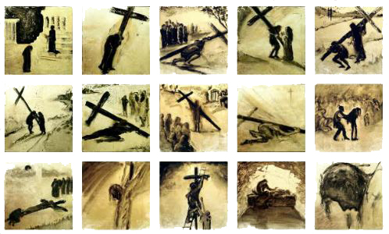
Praying with the Stations of the Cross is a special Lenten Prayer
Children can dramatize or create their own images and text for each station and add prayers related to their own Lenten journey based on each station such as times when they stumble and fall, times when they are helped by someone, times of sadness and pain. They talk with Jesus about this and know he listens to them.
There is a traditional way of praying with the Stations which is used when the community comes together to pray them.
The 14 Stations of the Cross are presented in different artistic styles and colours and they are a feature of community prayer during Lent as people pray and walk the journey with Jesus to his death on the cross on Good Friday.
The Stations of the Cross are a devotion used in Christian churches that uses pictures usually hung around the walls of the church to retell the events in the order they happened of the last day of Jesus’ life, his death and burial.
The Stations of the Cross is a devotion used in Christian Churches that uses pictures usually hung around the walls of the church to retell the events in the order they happened of the last day of Jesus’ life, his death and burial.
The 14 Stations of the Cross are presented in different artistic styles and colours and they are a feature of community prayer during Lent as people pray and walk the journey with Jesus to his death on the cross on Good Friday.
There is a traditional way of praying with the Stations which is used when the community comes together to pray them.
Children can dramatize or create their own images and text for each station and add prayers related to their own Lenten journey based on each station such as times when they stumble and fall, times when they are helped by someone, times of sadness and pain. They talk with Jesus about this and know he listens to them.
R-3
S-07A
Click top card to flip the page
Notes:
Adapt Teaching and Learning Experiences 4,5,6,7.
Read each page in the flip book and ask children to recall the Stations of the Cross in their church. Remind children to look at them when next they are in the church.

Slide 9
Praying with the Stations of the Cross is a special Lenten Prayer
The names of the Stations of the Cross are:
Jesus is condemned to death.
Jesus is given his cross to carry.
Jesus falls the first time.
Jesus meets his mother Mary.
Simon of Cyrene helps Jesus carry his cross
Veronica wipes the face of Jesus.
Jesus falls the second time.
Jesus comforts the women of Jerusalem.
Jesus falls the third time.
The soldiers take Jesus’ clothing.
Jesus is nailed on the cross.
Jesus dies on the cross.
Jesus is taken down from the cross.
Jesus is placed in the tomb.
Click the video button to play a video.
Click on the worksheet button to go to the worksheet.
R-3
S-07B
Notes:
Watch the clip ‘The Stations of the Cross’ 9:53 minutes
https://www.youtube.com/watch?v=j0qv7c4PsrA
Invite children to share something they learned about the Stations of the Cross from the clip.
Adapt Teaching and Learning Experiences 4-7
If your church is close by take the children to see the Stations of the Cross and have a time of silence with the children as they reflect on them and pray with them. Invite the children to share their reflection when they are back in the classroom.

Slide 10
How is your LENTEN MISSION going?
R-3
S-08
Click on the worksheet button to go to the worksheet
Notes:
Children could do this activity about half way through Lent. They could write one thing in the appropriate finger to show what they are doing for each Lenten action.
They could also give themselves small ticks to help them evaluate how they are going and in which area more action is needed. Make up a rubric for this together.

Slide 11
Check Up
1)
What makes prayer an important part of what people do in Lent?
2)
Share your preferred place and way of praying - personal, family or community Eucharist and give your reasons.
3)
Write 5 things you have learned about the Stations of the Cross and say why it is good to use them to pray in Lent.
R-3
S-09A
Click in each caption space to reveal text
Notes:
This formative assessment strategy will help teachers to identify how well children have achieved the Learning Intentions of the resource.
Teachers can choose how they use the slide to assess each item.
A worksheet of this slide is available as an option for children to complete.
The last two items are feed forward for the teacher.
Recording the children’s responses to these items is recommended as it will enable teachers to adjust their learning strategies for future resources and target the areas that need further attention.

Slide 12
Check Up
4)
Which activity do you think helped you to learn best in this resource?
5)
Questions I would like to ask about the topics in this resource are …
R-3
S-09B
Click on the worksheet button to go to the worksheet
Notes:
This formative assessment strategy will help teachers to identify how well children have achieved the Learning Intentions of the lesson.
Teachers can choose how they use the slide in their range of assessment options.
A worksheet of this slide is available for children in Years 5-8 to complete.
The last two items are feed forward for the teacher.
Recording the children’s responses to these items is recommended as it will enable teachers to adjust their learning strategies for future lessons and target the areas that need further attention.

Slide 13
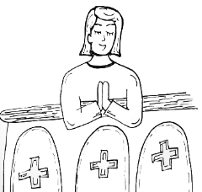
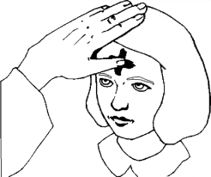
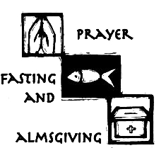
Share the poster from the 2nd Check up activity to explain the meaning of ashes and their use in Lent as a sign of sorrow and repentance. Invite people to say what children of your age can do to show they are sorry and make up for what they have done.
Make an advertisement to post around the school and parish to remind people that Lent is a good time to think about their lives and their relationship with God. Suggest they think about something they could do to turn back to God and something they could do to show God’s mercy to others. Add the time and place the Sacrament of Penance is being celebrated in the parish. (Check this with your priest).
Have a conversation with an older family member about what they did when they were children during the season of Lent, what fasting was like and other things they did during the season of Lent.
Create School liturgy to use during Lent using all the children have learned about the promises people make to help them grow closer to God, the attitudes and actions they want to change, the giving and the fasting and the repenting – owning up and saying sorry. These can be talked about, dramatized, illustrated and displayed for the community to be encouraged to use the Lenten season well. They can all be brought to prayer and song. Invite the whole community to share it.
Children share their Praying in Lent Worksheets (Slide 4, Lesson3) with other classes and generate discussion about children’s preferred places, times and with whom they pray and explain the reasons for their preferences. Record these and MP3 them for children to share with family members.
R-3
S-10A
Notes:
This slide provides some choices for children to show and share what they have learned. Examples could be photographed as evidence of children’s learning.
You may like to put a copy of the Sharing our Learning page in children’s RE Learning Journals. You could talk through the choices using the slide and let children make their choice from their own copy.
Children could work on their choice at school and/or at home and you may like to set a day for sharing. Please let parents and whānau know what you expect them to do with this.
The resource is focussed on the Yr. 5 LENT Achievement Objective which is covered in Resources 1-3.
Yr. 5 LENT AO Children will be able to:recognise LENT as a time when Christians are reminded to repent, pray and do penance as they make a forty day journey to Easter.

Slide 14
Create a Personal Prayer Plan for Lent and set up a quiet place for children to pray and give them time during the day to pray. Children can make their plan and share how they are keeping to it. Share it with other classes and explain how prayer is an important part of their Lenten Journey.
Make Lenten fridge magnets to remind family whānau to keep their Lenten promises and grow in friendship with God. Make some to share with parishioners also.
Create a presentation to share what you know about the Stations of the Cross. Explain why people pray with them during Lent. If the church is near the school the presentation could be done there and children could lead a prayer service around the stations or they could share the clip.
Make a list of things children can do during Lent to help them change bad habits, remind themselves to pray each day, ask for forgiveness when they have hurt someone, do what they are asked to do, get up when they are called and give up something for themselves so they can give something to someone in need.
Create a dance or a mime to show the message of Lent – turning away from sin and turning back to God, growing into a deeper relationship with God. Include recognising what needs to be changed, saying sorry, being forgiven and celebrating forgiveness. Share it with the parish. Record it to use next year as a Lenten teaching resource.
Make up your own way of showing and sharing what you have learned and decide who you would like to share it with.
Create a Personal Prayer Plan for Lent and set up a quiet place for children to pray and give them time during the day to pray. Children can make their plan and share how they are keeping to it. Share it with other classes and explain how prayer is an important part of their Lenten Journey.
Make Lenten fridge magnets to remind family whānau to keep their Lenten promises and grow in friendship with God. Make some to share with parishioners also.
Create a presentation to share what you know about the Stations of the Cross. Explain why people pray with them during Lent. If the church is near the school the presentation could be done there and children could lead a prayer service around the stations or they could share the clip.
Make a list of things children can do during Lent to help them change bad habits, remind themselves to pray each day, ask for forgiveness when they have hurt someone, do what they are asked to do, get up when they are called and give up something for themselves so they can give something to someone in need.
Create a dance or a mime to show the message of Lent – turning away from sin and turning back to God, growing into a deeper relationship with God. Include recognising what needs to be changed, saying sorry, being forgiven and celebrating forgiveness. Share it with the parish. Record it to use next year as a Lenten teaching resource.
Make up your own way of showing and sharing what you have learned and decide whom you would like to share it with.
R-3
S-10B
Click on the worksheet button to go to the worksheet
Notes:
Print a copy for each child to make their choices about how to share what they have learned about the season of LENT.

Slide 15
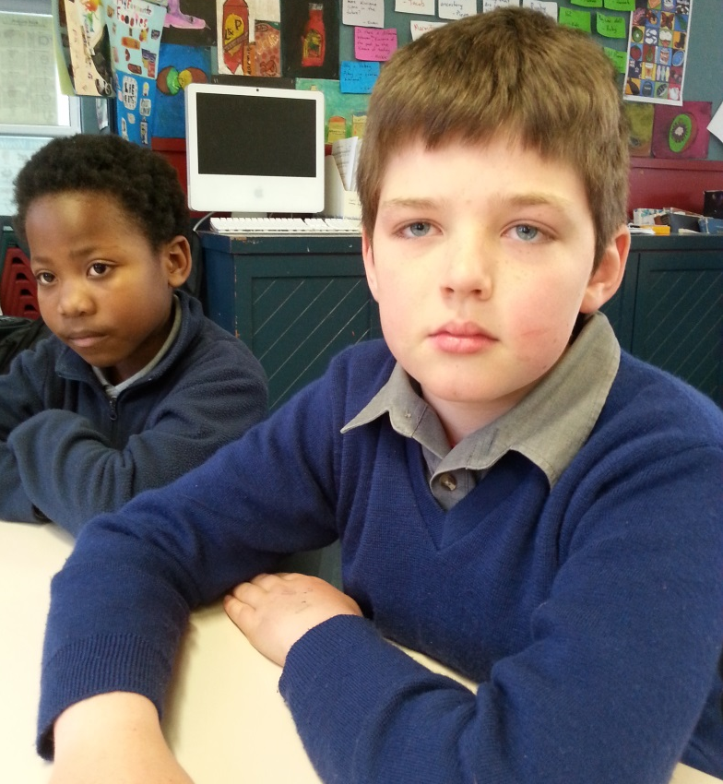
Time for Reflection
R-3
S-11
Click the audio button to stop reflective music
Click the audio button to play reflective music
Notes:
The MP3 is played to help create a reflective atmosphere and bring the children to stillness and silence as the teacher invites them to reflect on how they are sharing with Jesus the journey that he made to the cross. Ask themselves if they are making an effort to make a real difference in their own life this Lent. Have they stopped doing something wrong and started doing something new that is right and loving?

Slide 16
People pray in different ways, at different times and in different places such as:
Find and read each Bible reference about different experiences of prayer as described in the New Testament.
Complete the sentences:
In Matthew 18:19 Jesus describes prayer as
_______________________________________________________________
_______________________________________________________________
_______________________________________________________________
In Matthew 6:6 Jesus talks about a different sort of prayer – describe it.
_______________________________________________________________
_______________________________________________________________
_______________________________________________________________
In Luke 1:10 we hear about the people praying in public and it was like this …
_______________________________________________________________
_______________________________________________________________
_______________________________________________________________
In Acts 2:42 Luke describes the first people who converted to Christianity
_______________________________________________________________
_______________________________________________________________
_______________________________________________________________
Write about your preferred way to pray and give your reasons. _____________________________________________________________________________________________________________________________________________________________________________________________________________________________________________________________________________________________________________
Name:__________________
Date:____________
R-3
S-04
Worksheet
Click the up arrow to return to the presentation
Notes:
This worksheet relates to slide 4.

Slide 17
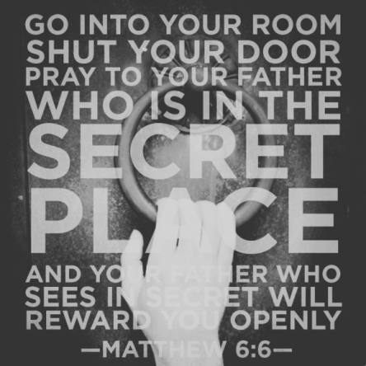
Lent is a time to grow closer to God so people are encouraged to spend time alone with God
G | B | Y | O | U | A | P | W | H | A | T | T | A | S
G | O | W | O | P | E | N | L | Y | R | A | E | L | F
Y | O | U | I | T | R | E | E | A | S | L | S | O | R
S | L | D | E | L | R | W | S | L | C | K | A | N | I
Q | U | I | E | T | L | A | R | E | Y | E | Y | E | E
T | P | H | E | A | R | R | F | I | N | S | D | Y | N
A | N | D | A | T | G | O | D | O | W | W | H | O | D
E | C | T | O | N | T | Y | L | L | I | I | H | U | S
A | C | A | N | H | N | O | S | Y | L | T | M | E | R
R | E | W | A | R | D | U | T | M | L | H | T | E | N
In a quiet place when you are alone with God you can talk as friends and God will hear what you say and will reward you openly.
Name:__________________
R-3
S-05
Worksheet
Date:____________
Click the up arrow to return to the presentation
Notes:
This worksheet relates to slide 5.

Slide 18
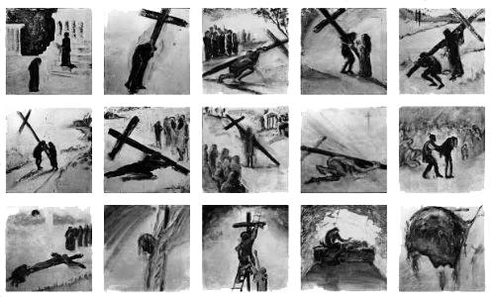
Praying with the Stations of the Cross is a special Lenten Prayer
1) Jesus is condemned to death. | 2) Jesus is given his cross to carry.
3) Jesus falls the first time. | 4) Jesus meets his mother Mary.
5) Simon of Cyrene helps to carry the cross. | 6) Veronica wipes the face of Jesus.
7) Jesus falls the second time. | 8) Jesus comforts the women of Jerusalem.
9) Jesus falls the third time. | 10) The soldiers take Jesus’ clothing.
11) Jesus is nailed on the cross. | 12) Jesus dies on the cross.
Jesus is taken down from the cross. | Jesus is placed in the tomb.
What to do:
Using a pencil the children write a small number of each station in the top left corner so the image and the title match.
Children look at each station on the image and choose one to reflect on.
Look at it and talk to Jesus about what is happening to him in it.
Remind yourself that Jesus did this because he loved us so much.
Write what you want to say to Jesus in the frame on the left.
Share your reflection if you want to. Put your worksheet in your RE Learning Journal.
Name:_____________________
R-3
S-07
Worksheet
Date:____________
Click the up arrow to return to the presentation
Notes:
This worksheet relates to slide 7.

Slide 19
The 5 Finger Lenten Check up
REPENT
CHANGE
GIVE
FAST
PRAY
The 5 Finger Lenten Check up
Name:____________________________
Date:____________
R-3
S-08
Worksheet
Click the up arrow to return to the presentation
Notes:
This worksheet relates to slide 8.

Slide 20
Check Up
1)
What makes prayer an important part of what people do in Lent?
2)
Share your preferred place and way of praying - personal, family or community Eucharist and give your reasons.
3)
Write 5 things you have learned about the Stations of the Cross and say why it is good to use them to pray in Lent.
4)
Which activity do you think helped you to learn best in this resource?
5)
Questions I would like to ask about the topics in this resource are …
Name:__________________
Date:____________
R-3
S-09
Worksheet
Click the up arrow to return to the presentation
Notes:
This worksheet relates to slide 9.

Slide 21
Share the poster from the 2nd Check up activity to explain the meaning of ashes and their use in Lent as a sign of sorrow and repentance. Invite people to say what children of your age can do to show they are sorry and make up for what they have done.
Make an advertisement to post around the school and parish to remind people that Lent is a good time to think about their lives and their relationship with God. Suggest they think about something they could do to turn back to God and something they could do to show God’s mercy to others. Add the time and place the Sacrament of Penance is being celebrated in the parish. (Check this with your priest).
Have a conversation with an older family member about what they did when they were children during the season of Lent, what fasting was like and other things they did during the season of Lent.
Create School liturgy to use during Lent using all the children have learned about the promises people make to help them grow closer to God, the attitudes and actions they want to change, the giving and the fasting and the repenting – owning up and saying sorry. These can be talked about, dramatized, illustrated and displayed for the community to be encouraged to use the Lenten season well. They can all be brought to prayer and song. Invite the whole community to share it.
Children share their Praying in Lent Worksheets (Slide 4, Lesson3) with other classes and generate discussion about children’s preferred places, times and with whom they pray and explain the reasons for their preferences. Record these and MP3 them for children to share with family members.
Name:__________________
R-3
S-10A
Worksheet
Date:____________
Notes:
This worksheet relates to slide 10A.

Slide 22
Create a Personal Prayer Plan for Lent and set up a quiet place for children to pray and give them time during the day to pray. Children can make their plan and share how they are keeping to it. Share it with other classes and explain how prayer is an important part of their Lenten Journey.
Make Lenten fridge magnets to remind family whānau to keep their Lenten promises and grow in friendship with God. Make some to share with parishioners also.
Create a presentation to share what you know about the Stations of the Cross. Explain why people pray with them during Lent. If the church is near the school the presentation could be done there and children could lead a prayer service around the stations or they could share the clip.
Make a list of things children can do during Lent to help them change bad habits, remind themselves to pray each day, ask for forgiveness when they have hurt someone, do what they are asked to do, get up when they are called and give up something for themselves so they can give something to someone in need.
Create a dance or a mime to show the message of Lent – turning away from sin and turning back to God, growing into a deeper relationship with God. Include recognising what needs to be changed, saying sorry, being forgiven and celebrating forgiveness. Share it with the parish. Record it to use next year as a Lenten teaching resource.
Make up your own way of showing and sharing what you have learned and decide who you would like to share it with.
Create a Personal Prayer Plan for Lent and set up a quiet place for children to pray and give them time during the day to pray. Children can make their plan and share how they are keeping to it. Share it with other classes and explain how prayer is an important part of their Lenten Journey.
Make Lenten fridge magnets to remind family whānau to keep their Lenten promises and grow in friendship with God. Make some to share with parishioners also.
Create a presentation to share what you know about the Stations of the Cross. Explain why people pray with them during Lent. If the church is near the school the presentation could be done there and children could lead a prayer service around the stations or they could share the clip.
Make a list of things children can do during Lent to help them change bad habits, remind themselves to pray each day, ask for forgiveness when they have hurt someone, do what they are asked to do, get up when they are called and give up something for themselves so they can give something to someone in need.
Create a dance or a mime to show the message of Lent – turning away from sin and turning back to God, growing into a deeper relationship with God. Include recognising what needs to be changed, saying sorry, being forgiven and celebrating forgiveness. Share it with the parish. Record it to use next year as a Lenten teaching resource.
Make up your own way of showing and sharing what you have learned and decide whom you would like to share it with.
Name:__________________
R-3
S-10B
Worksheet
Date:____________
Click the up arrow to return to the presentation
Notes:
This worksheet relates to slide 10B.

