Slide 1
Lent – A Time of Renewal
R-1
S-01
Notes:
Use this slide as a focussing strategy to introduce the resource topic. Read the title together and invite children to share something they know about what Lent as a time of renewal means and give some examples of how people can be renewed during Lent.

Slide 2
Learning Intention
The children will:
explain what it means that Lent is a time of renewal and spiritual growth
1)
R-1
S-02
Click the box to reveal the learning intention
Notes:
Read through the Learning Intention with the class and identify some ideas/questions that might be explored in the resource.

Slide 3
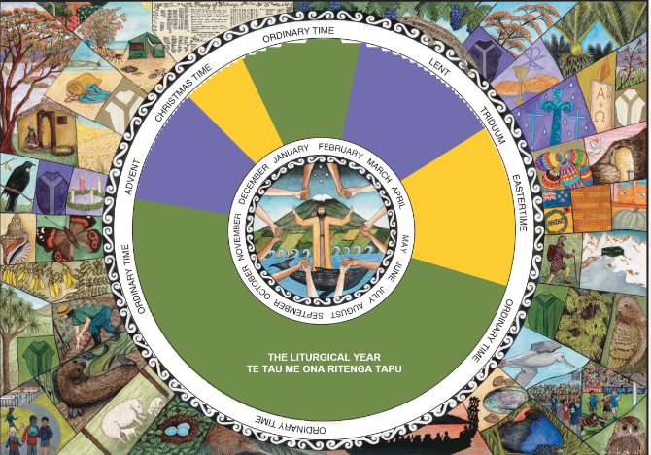
The season of Lent in the Liturgical Year
The season of Lent comes after
Ordinary Time.
Lent is a season for
prayer, almsgiving and fasting.
The other penitential season is
Advent.
Lent prepares us for the feast of
Easter.
People use Lent as a time of renewal and spiritual growth
to focus on their relationship with Jesus.
Advent.
D) prayer, almsgiving and fasting.
B) Ordinary Time.
E) to focus on their relationship with Jesus.
C) Easter.
Click the statements at the bottom to reveal the correct statement match
R-1
S-03
Notes:
Adapt Teaching and Learning Experience 1
Children read and suggest which statement completes each sentence.
Use the floaters to check
Answers 1- B, 2 – D, 3 – A, 4 – C, 5 – E

Slide 4
In what natural season of the year does Lent occur in Aotearoa New Zealand?
How does the season of Autumn symbolise the meaning of Lent?
R-1
S-04
Notes:
Adapt Teaching and Learning Experience 2.
Read through the text on the image and generate a class discussion about the ideas in each caption. Include responses to the 2 questions. Discuss the meaning of the Scripture quote.
Recognise how the Church seasons are designed for the Northern Hemisphere - recall examples of this in the Advent and Christmas resources.
Explain that our spiritual world is similar to the patterns of the natural world – time for birth, growth and renewal. We interpret the meaning and symbols of Lent in nature differently in the southern hemisphere and recognise that what is happening here is the opposite to what is happening there. This is because in ANZ Lent is in autumn when people are cleaning up their gardens, getting rid of plants that are dying off and letting the earth renew itself during winter to enable new growth to come with spring. Lent in winter is a time to reflect and prepare for the new growth that will come in spring.

Slide 5
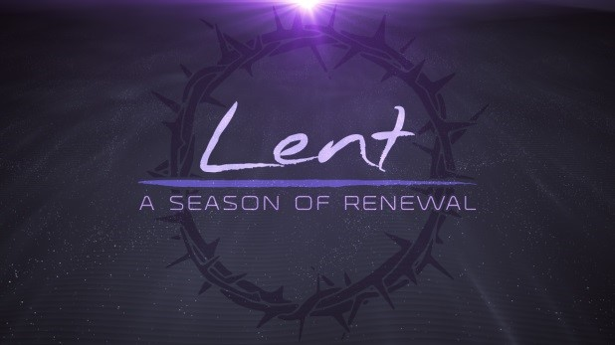
Lent is a season of renewal and spiritual growth which is a time …
to set aside for the whole Church to grow closer to God.
for making something that has got tired and worn to become new again.
for people to make their commitment to follow Jesus with more energy and focus.
to think about what their baptismal promises mean to them.
for growing in friendship with God Te Atua and others.
for listening more attentively to the prompts of the Holy Spirit whispering in their hearts.
R-1
S-05
Click the handle to move the blind
Notes:
Recap the meaning of renewal. (See Slide 7)
Talk about what it feels like to be ‘renewed’ and share an experience of this. Talk about what spiritual growth means and how it feels and how you recognise your own or someone else’s spiritual growth e.g. - more in tune with spiritual ideas and experiences such as prayer - more empathetic and sensitive – more responsive to the needs of others - more reflective about God and spiritual ideas - more prayerful.
Use the blind handle to reveal the ideas to be discussed.

Slide 6
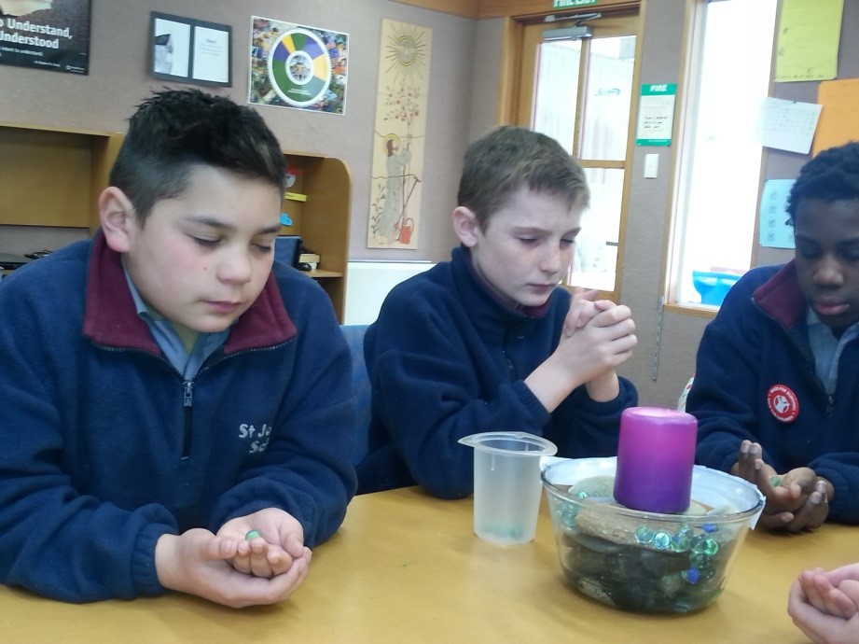
How can children our age renew their Spiritual Lives?
Make time each day for personal and community prayer karakia with God
Te Atua.
Contribute some pocket money to the Lenten appeal.
Suggest other ways to renew your spiritual life and your relationship with Jesus.
Choose to do acts of love – keeping in touch with a grandparent or friend.
Play fairly, including and encouraging everyone.
R-1
S-06
Click the pins on the right to reveal post-it notes.
Notes:
Use each post – it note to generate ideas and add to those on the notes.
Talk about how focussing on your spiritual life affects the way you live - especially in your relationship with God and with your relationships.

Slide 7
Renewal looks like, sounds like, feels like
Looks like
Feels like
Sounds like
Children brainstorm what renewal looks, sounds and feels like .
Using their Y chart worksheet they record their ideas.
R-1
S-07
Click the worksheet button to go to the worksheet
Notes:
Build on discussion from Slide 5.
Children brainstorm what renewal looks, sounds and feels like. Using their Y chart worksheet they record their ideas. Invite children to share how their learning and class relationships helps to renew their thinking and actions.

Slide 8
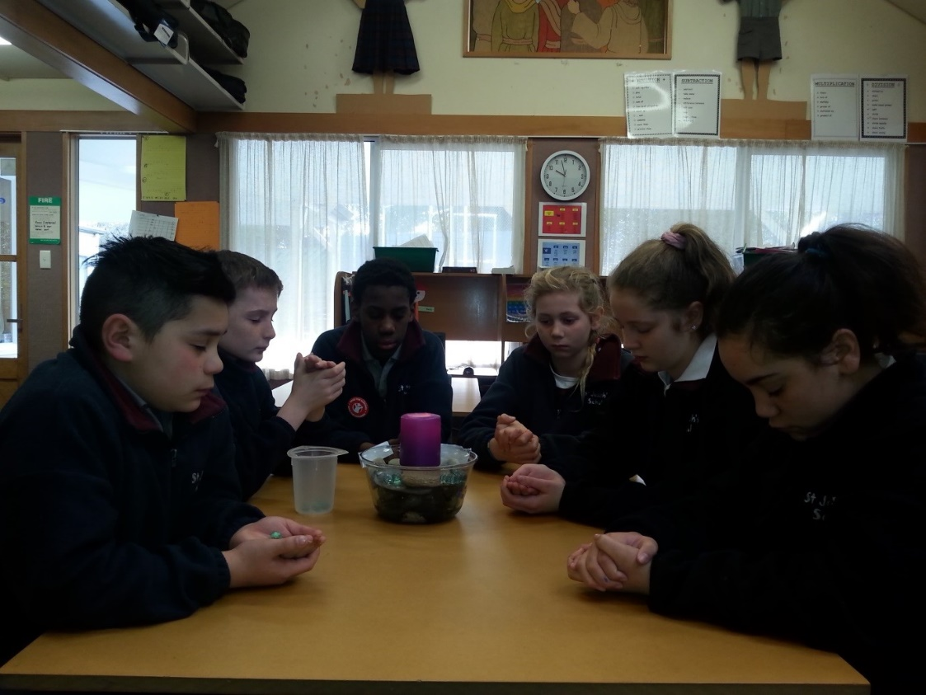
Listening to the Holy Spirit at work in your lives
The Sacrament of Penance is celebrated in Lent to help us as we look closely at the ways we are living our lives.
Lent is one of the times the Church sets aside for us to stop, take stock and see how we are getting on with God’s plan for us and make any changes that are necessary.
Once we recognise God’s plan for us, God’s grace helps us to live in ways that will achieve it.
God waits to see how we are following the plan God has for us to grow into the person we were created to be.
God wants every person to have a happy, full life so we need to give God time to let us know what God wants our life to be.
When God speaks to you, you hear your own voice speaking God’s words about how God wants you to live and what God has planned for you.
Lent is a good time to stop and take time to listen to the Holy Spirit speaking to you in your heart.
Click the audio button to play ‘Song for change”
R-1
S-08
Click the audio button to stop ‘Song for change’
Click restart shape to restart Slide
Click top card to discard it
Notes:
Read each flip card and invite children’s comments and questions after each one. Draw children’s attention to what the Holy Spirit says to them.
Talk about how this happens – a prompt, a comment from an adult or good friend, - something they see or hear that helps them to understand something more clearly, - an urge to offer help to someone, - a kind word or action that comes to you spontaneously and you wonder how it happened – an inspiration that you get and when you share it others tell you how good it is, - when you react to a situation where someone is being put down and you stand up for them. Invite children to share their own experiences of how they hear/feel the Holy Spirit guiding them in their lives.
Sing using the MP3 ‘Song for Change’ – explain that change is often a sign of growth and renewal.

Slide 9
Check up
1)
Lent is a time of renewal and spiritual growth – this means …
2)
Write a reflection about the ways you renew your relationship with God during Lent.
3)
How does the Church help people grow spiritually during Lent?
4)
Which activity do you think helped you to learn best in this resource?
5)
Questions I would like to ask about the topics in this resource are …
R-1
S-09
Click the worksheet button to go to the worksheet
Notes:
This formative assessment strategy will help teachers to identify how well students have achieved the Learning Intentions of the resource. Teachers can choose how they use the slide to assess each item. A worksheet of this slide is available as an option for children to complete.
The last two items are feed forward for the teacher.
Recording the children’s responses to these items is recommended as it will enable teachers to adjust their learning strategies for future resources and target the areas that need further attention.

Slide 10
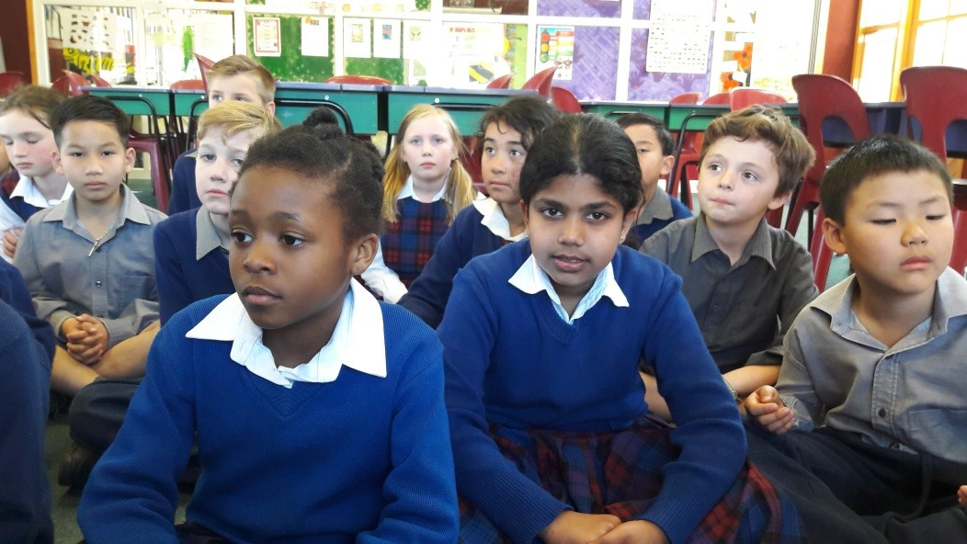
Time for Reflection
R-1
S-10
Click the audio button to play reflective music
Click the audio button to stop reflective music
Notes:
The MP3 is played to help create a reflective atmosphere and bring the children to stillness and silence as the teacher invites them to reflect on their experience of being renewed in their belief in God and in their awareness of God’s presence in their lives. Recall a time when they have sensed the presence of the Holy Spirit helping them to be aware of God’s goodness to them and urging them to share it with others.

Slide 11
Renewal looks like, sounds like, feels like
Name:
Date:
Looks like
Feels like
Sounds like
R-1
S-07
Worksheet
Click the up arrow to return to the presentation

Slide 12
Check up
Name:____________________________
Date:____________
1) Lent is a time of renewal and spiritual growth – this means …
2) Write a reflection about the ways you renew your relationship with God during Lent.
3) How does the Church help people grow spiritually during Lent?
4) Which activity do you think helped you to learn best in this resource?
5) Questions I would like to ask about the topics in this resource are …
R-1
S-09
Worksheet
Click the up arrow to return to the presentation

