Slide 1
Following Jesus by taking up your cross
R-2
S-01
Notes:
Use this slide as a focussing strategy to introduce the resource topic. Read the title together and invite children to share something they know about what taking up your cross means and how it relates to following Jesus with his cross.

Slide 2
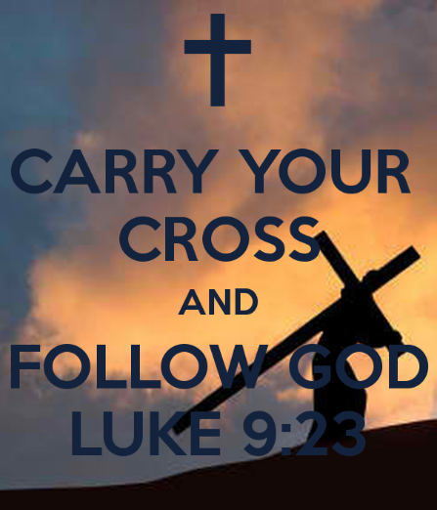
Learning Intentions
The children will:
1)
explain what Luke 9:23 means
identify the virtues people require to take up their crosses
2)
R-2
S-02
Click the box to reveal the learning intention
Notes:
Read through the Learning Intentions with the class and identify some ideas/questions that might be explored in the resource.

Slide 3
In Lent we renew our commitment
to follow Jesus
There are 3 special ways we can do this:
By doing Penance which means doing something we find hard or by giving up something we like doing.
By deliberately focussing on showing love and care manaaki for others.
By spending time in prayer, alone, and with others in the celebration of the Sacraments.
Make some suggestions that children of your age could take up during this Lent.
R-2
S-03
Click the dots to reveal the sentences.
Notes:
Recap what renewing means and how you would do this when applied to our commitment to follow Jesus. Read each of the special ways this can be done in Lent and name some ways children of your age could do this.

Slide 4
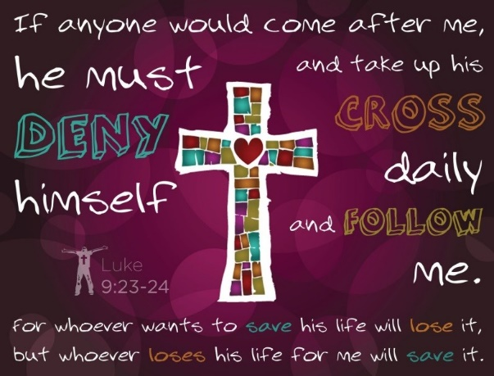
What does taking up your cross mean?
Taking up your cross means:
1) Dealing with the hard things in your life
cheerfully and asking for help when you need it.
2) Facing up to people you find difficult
with respect and including them in your group.
3) Continuing to tolerate situations
you cannot change as Jesus would want us to.
4) Recognising your own weaknesses and
trying to find ways to overcome them.
5) Overcoming a disability or a health condition you have
and accepting how it limits you and doing your best regardless.
A) and accepting how it limits you and doing your best regardless.
B) with respect and including them in your group.
C) trying to find ways to overcome them.
D) you cannot change as Jesus would want us to.
E) cheerfully and asking for help when you need it.
Click the statements at the bottom to reveal the correct statement match
R-2
S-04
Notes:
Adapt Teaching and Learning Experiences 1 & 2.
Children read and discuss the meaning of each statement and suggest which statement completes each sentence. Use the floaters to check. Answers 1 - E, 2 - B, 3 – D, 4 – C, 5 - A

Slide 5
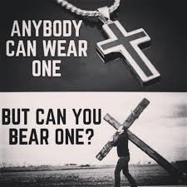
What’s the difference between
wearing a cross and bearing a cross?
R-2
S-05
Click in the while box and write your text
Notes:
Children discuss the question and explain what it means and give some examples from their own experience or an example they have heard about.

Slide 6
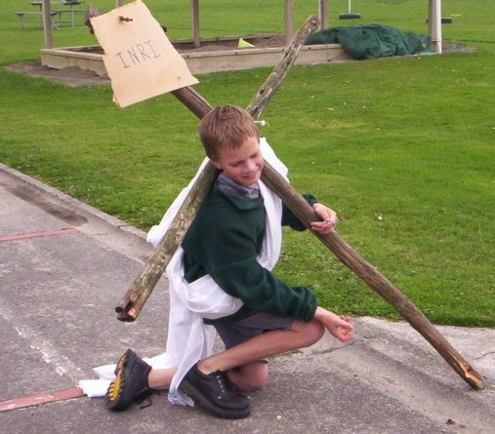
Carrying our crosses is like
sharing in the cross Jesus carried
Think about the hard things, the crosses that children have to carry each day – these are often things you don’t want to talk about like:
health issues you or someone in your family has
stress caused by work or other family challenges
difficulties in learning and relationships at home and at school
situations and experiences that make you feel sad, let down, worried, unimportant.
X
R-2
S-06
Click the I-button to reveal information
Notes:
Adapt Teaching and Learning Experience 2
Give children a chance to think about these ideas and remind them they are not being asked to share. Remind them to be sensitive to other children’s reactions as thinking about this topic can cause sadness and pain.
The examples on the worksheet (on Slide 8) do not relate to any one specifically – they are there to help children recognise some of the ‘crosses’ they may carry and the virtues and values they need to deal with them.

Slide 7
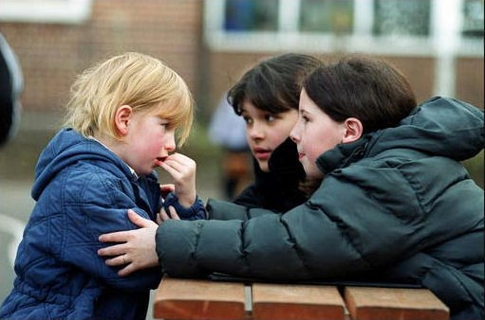
Crosses in people’s lives can be
different for different people
Everyone has times of feeling anxious and some people cope better with these feelings than others. What can you do to help people through these times?
What may be a cross for one person may not be for others. Name some examples of this.
The people others call on to help them carry a cross in their life have special virtues. They are kind and prepared to give their time to others when they need it – how can you become one of these people?
Some children talk about the hard things in their lives while others keep them to themselves. How could you recognise children who need a friend to offer to support them?
Some crosses children carry change as they grow older, others continue to be part of their lives. Can you share an example of this?
R-2
S-07
Click the pins on the right to reveal post-it notes.
Notes:
Look at the image and explain what you think is happening.
Explain what is meant by how people respond to crosses differently and why this could be. Talk about resilience and what this means and how it helps people cope with difficulties. Read each post-it note and respond to the questions.
Invite children to name the gospel values and virtues people need to help people with the difficulties they have in their lives. Let children’s suggestions lead into the next slide.

Slide 8
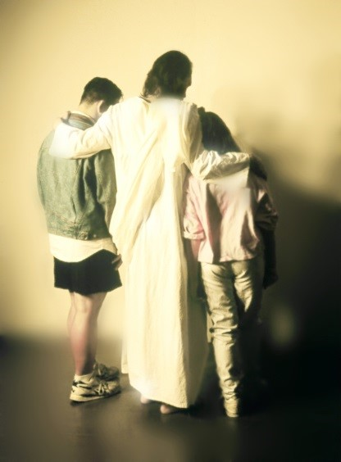
Gospel Values or Virtues needed to help people carry the crosses they have in their lives
I get angry and frustrated often so I am trying to …
I get bullied and I struggle to stand up for myself …
When everything just keeps going wrong I need …
When my parents keep arguing I try ...
The girl who sits next to me keeps wanting help …
Our family is facing a major change so we are trying to …
I really miss my dad now he doesn’t live with us …
Because of my asthma I miss school a lot so I need someone to …
It’s not much fun being different because of my disability I just wish …
Our family is a low income family so we …
Look at the list of Gospel Values and Virtues below
Use or adapt some of them in what you say to complete the sentences above. Highlight the ones you use.
gentleness tolerance self-discipline patience courage mercy
kindness generosity love and care compassion acceptance forgiveness
gratitude reconciliation peace maker inclusion resilience understanding
R-2
S-08
Click the worksheet button to go to the worksheet
Notes:
Children read the gospel values and virtues under the sentences and say what each one means.
Work through the sentences and let children suggest which value or virtue they would use to complete the sentence. They may need to adapt the word to the context – e.g. be patient.
Children record their choices on their worksheet and share them and explain their choices.

Slide 9
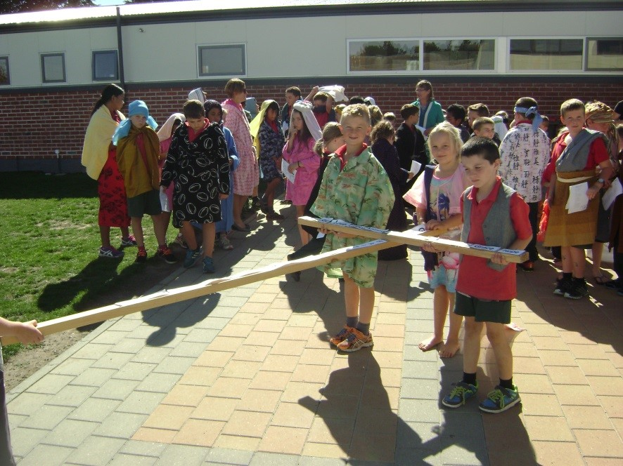
Being a follower of Jesus and taking up your cross
We are true followers of Jesus when we accept our crosses and deal with them with the virtues that are needed and help others to do the same. How can virtues help us to cope with hard things in our lives?
Spiritual strength and growth comes from pain and hardship and Jesus knows about this as his cross led him to his death. When our crosses are too hard for us to carry we can ask Jesus to help and he uses people who care about us to help us deal with what is hard in our lives.
Coping with hardship in your life helps to strengthen your character so you can live with compassion for people whose lives are also hard. We are able to understand others’ pain when we have experienced pain ourselves. Through this we develop empathy which is a great gift to have. Why?
Facing the hard things you have in your life each day is a sort of cross and Jesus asks you to do this like he did. Rather than complaining, put aside your problems and help others with theirs. How would doing this help you to be a stronger follower of Jesus?
When Jesus said, ‘Take up your cross and follow me.’ he didn’t mean a cross like you see the children carrying in the picture. What did he mean?
’
R-2
S-09
Click restart shape to restart Slide
Click top card to discard it
Notes:
Read each flip card and take time for children to make a comment or ask a question. Use the Children’s Home Activity on p 22 in the Teacher’s book or on the Resource Home page.

Slide 10
Check up
1)
Memorise Luke 9:23, reflect on the crosses you carry and name 3 ways you deal with them.
Name 3 virtues that people you know use to help others carry the crosses in their lives.
2)
Create an art work that illustrates the connection between the cross Jesus carried and the crosses people carry in the world today.
3)
4)
Write a prayer asking God for help to carry the crosses you have in your life and pray it often.
5)
Which activity do you think helped you to learn best in this resource?
6)
Questions I would like to ask about the topics in this resource are …
R-2
S-10
Click the worksheet button to go to the worksheet
Notes:
This formative assessment strategy will help teachers to identify how well children have achieved the Learning Intentions of the resource. Teachers can choose how they use the slide to assess each item.
A worksheet of this slide is available as an option for children to complete.
The last two items are feed forward for the teacher.
Recording the children’s responses to these items is recommended as it will enable teachers to adjust their learning strategies for future resources and target the areas that need further attention.

Slide 11
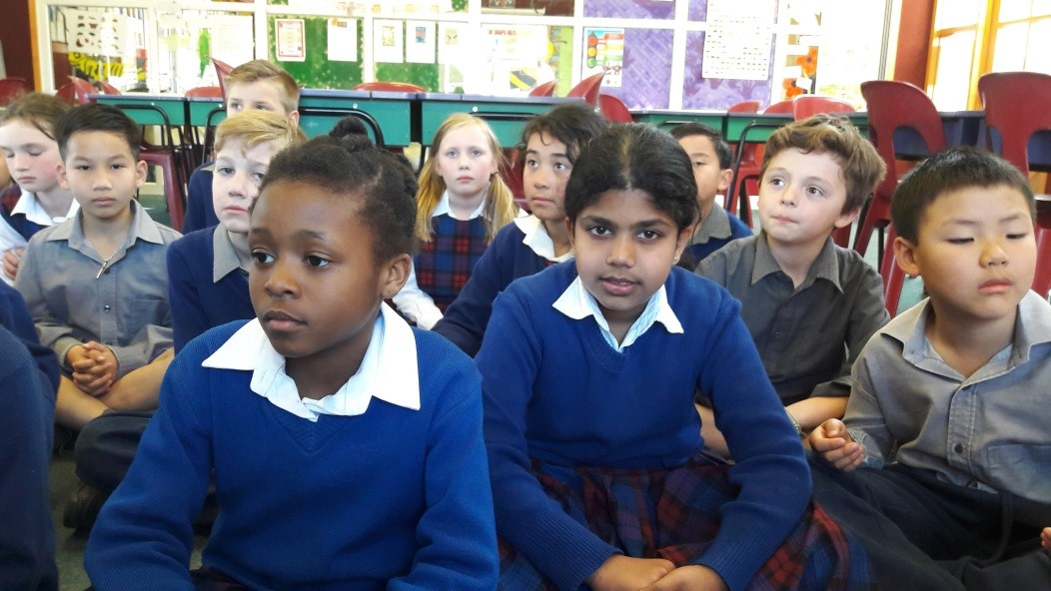
Time for Reflection
R-2
S-11
Click the audio button to stop reflective music
Click the audio button to play reflective music
Notes:
The MP3 is played to help create a reflective atmosphere and bring the children to stillness and silence as the teacher invites them to think about how being a follower of Jesus changes how they deal with difficulties in their lives and how good it is to know that Jesus helps them through these hard times. Remind them to remember that Jesus uses them to help others to carry their crosses and to be ready to hear Jesus when he asks them to do this.

Slide 12
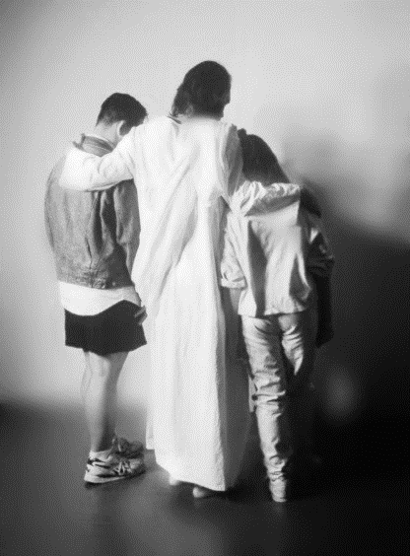
Gospel Values or Virtues needed to help people carry the crosses they have in their lives
Name:________________
Date:____________
I get angry and frustrated often so I am trying to …
I get bullied and I struggle to stand up for myself …
When everything just keeps going wrong I need …
When my parents keep arguing I try ...
The girl who sits next to me keeps wanting help …
Our family is facing a major change so we are trying to …
I really miss my dad now he doesn’t live with us …
Because of my asthma I miss school a lot so I need someone to …
It’s not much fun being different because of my disability I just wish …
Our family is a low income family so we …
Look at the list of Gospel Values and Virtues below
Use or adapt some of them in what you say to complete the sentences above. Highlight the ones you use.
gentleness tolerance self-discipline patience courage mercy
kindness generosity love and care compassion acceptance forgiveness
gratitude reconciliation peace maker inclusion resilience understanding
R-2
S-08
Worksheet
Click the up arrow to return to the presentation

Slide 13
Check up
Name:____________________________
Date:____________
1) Memorise Luke 9:23, reflect on the crosses you carry and name 3 ways you deal with them.
2) Name 3 virtues that people you know use to help others carry the crosses in their lives.
3) Create an art work that illustrates the connection between the cross Jesus carried and the crosses people carry in the world today.
4) Write a prayer asking God for help to carry the crosses you have in your life and pray it often.
5) Which activity do you think helped you to learn best in this resource?
6) Questions I would like to ask about the topics in this resource are …
R-2
S-10
Worksheet
Click the up arrow to return to the presentation

