Slide 1

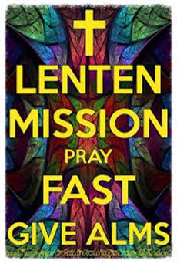
Lent – A time for Prayer, Fasting and Almsgiving
R-1
S-01
Notes:
Slide 1 Lent – A time of Prayer, Fasting and Almsgiving
Use this slide as a focussing strategy to introduce the lesson topic. Read the title together and invite students to share something they know about how people use prayer, fasting and almsgiving to change their heart and renew their faith in God.

Slide 2
Learning Intentions
The students will:
1)
  explain the purpose of prayer karakia, fasting and almsgiving
2)
identify ways people can share in the Lenten practices of prayer, fasting and almsgiving.
R-1
S-02
Click the borders to reveal text
Notes:
Slide 2 Learning Intentions
Read through the Learning Intentions with the class and identify some ideas/questions that might be explored in the lesson.

Slide 3
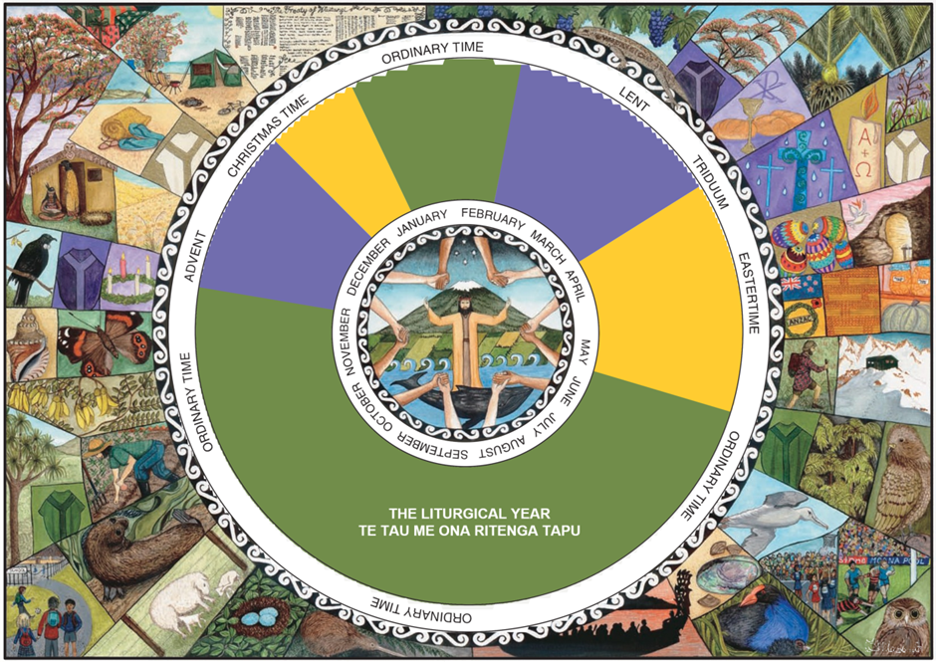
How much do you know about the Liturgical Year?
R-1
S-03
Click on the video button to play the video. Click on the worksheet button to go to the worksheet
Notes:
Slide 3 How much do you know about the Liturgical Year?
Adapt Teaching and Learning Experience 1
Print each student a worksheet to complete and from their scores, rate their knowledge of the Liturgical Year.
Watch the clip https://www.youtube.com/watch?v=akkQCnZAwWI
The Lenten Season 6:58
Students share something new they learned about Lent from the clip and how they would describe what the season of Lent is like.

Slide 4


When people receive ashes on Ash Wednesday they commit to:
using Lent as a time of prayer, fasting and giving to those in need.
Reflect on how you are going to do this during Lent and share your ideas.
keeping in mind the words ‘ Remember you are dust and to dust you will return’ or ‘Be faithful to the Gospel’.
Think about how you can recommit your lives to God whom you will meet face to face when you die.
Look for opportunities to do this and notice how you feel about God when you do this and hold the special feeling of being close to God in your heart until next time.
making God a bigger part of your life more intentionally through praying and recognising God’s presence in people and creation.
Invite others to share what they do to ‘have a change of heart’ and become a better person who is close to God.
recognising an attitude or behaviour that you want to change and thinking about how you can do this.
making a special effort to be kinder, more generous, unselfish and more aware of what is involved in living the commitment to Christ made at their baptism.
Write down some ideas you heard in the previous discussion that you think will help you to turn back to God during Lent this year.
Click the icons to reveal text.
R-1
S-04
Click the audio button to start ‘Ashes’
Click the audio button to stop ‘Ashes’
Notes:
Slide 4 When people receive ashes on Ash Wednesday they commit to:
Adapt Teaching and Learning Experience 2
Work through each item and share responses to the revealed text.
Sing using the MP3 ‘Ashes’

Slide 5
Recording my Lenten Journey
R-1
S-05
Click on the worksheet button to go to the worksheet
Notes:
Slide 5 Recording my Lenten Journey
Adapt Teaching and Learning Experience 4
Print a copy of the Living Lent worksheet for students to complete in their RE Learning Journals.
Explain this will be a record of how people have ‘lived’ Lent.
Take time to have a few minutes reflection to start or end the day when they can colour their cross for the day using the colours to denote what they are doing to live Lent each day.
They can use more than one colour on their crosses.
Make an enlarged copy of the worksheet and display it on the prayer focus as a reminder and refer to it at prayer time and during RE.

Slide 6
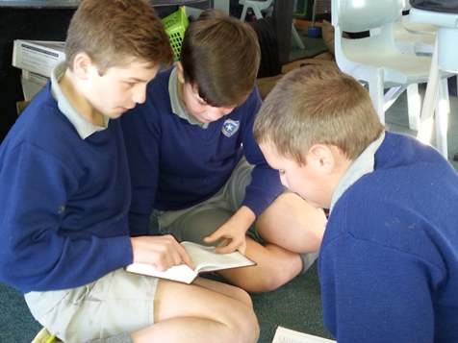
Exploring the Meaning of Fasting
Fasting from food can remind people not to take more than their share of the earth’s resources so that others may have their fair share.
Lent began as a way for Christians to remind themselves of the value of repentance – making up for sinfulness.
The austerity of the Lenten season was seen as similar to how people in the Old Testament fasted, did penance and repented in sackcloth and ashes.
Nowadays Catholics give up a special food or habits such as using technology, and any money saved is given to Caritas – fasting leads to almsgiving and turns our hearts and minds back to what God wants us to do.
Fasting means changing ways of behaving which cause hurt, conflict and take away freedom.
God is pleased when we repent of
our sinful habits.
Fasting is a spiritual discipline which involves giving up luxuries and pleasures as a form of penance.
It leads people to self-denial and appreciation of what they have and makes up to God for their sinful ways.
Listen to the Reading from Isaiah 58:6-7, 9-10.
Name the ways fasting is described by Isaiah.
How would these ways help people to turn back to God?
What is the purpose of fasting?
How do you describe fasting and how do young people of your age fast in Lent?
R-1
S-06
Click top card to discard it
Notes:
Slide 6 Exploring the Meaning of Fasting
Use the flip cards to generate conversations and questions about fasting.
Adapt Teaching and Learning Experiences 3 & 5

Slide 7

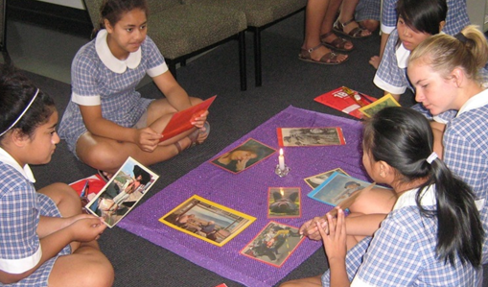

Praying in Lent
Prayer unites us to the Trinity – God the Father, Jesus, God the Son and the Holy Spirit. Through prayer our minds are opened to how we are living, how our relationships are which helps us to be able to see where we need to
change.
Prayer in Lent is very important because it helps us to recognise what we need to change and how we can turn our lives back to God.
It is through prayer that people have a relationship with God. Whether prayer is individual, in family, in class or community it helps us to be present to God and aware of God’s holy presence within us.
Praying in different ways, times and places in Lent helps us to fast and show love and mercy to others. Create a quiet Lenten Prayer space in your classroom to help people pray in Lent.
R-1
S-07
Click the pins on the right to reveal post-it notes.
Notes:
Slide 7 Praying in Lent
Adapt Teaching and Learning Experience 4
Read each post it note and create a question that each post it answers.
Invite students to bring things for the Lenten Prayer Space such as reflection and prayer prompts, prayer books, find you tubes that lead people to pray, Bibles, rosary beads, reflective music and ear phones and encourage children to make use of them each day. Encourage students to spend time praying in the space.

Slide 8
Understanding the meaning of almsgiving
Almsgiving used to mean giving money
Spending time with people who are
Offering practical help to those who
Almsgiving is a way of sharing
Almsgiving combines prayer and fasting because
1
2
3
4
5
…
…
a)
what we have with others who need help.
b)
it involves sacrifice which gives honour to God.
c)
alone and in need is a different form of almsgiving.
d)
but nowadays it can also mean giving oneself.
e)
can’t manage can be understood as giving alms.
R-1
S-08
Click the purple buttons on the left to reveal the correct statement match
Notes:
Slide 8 Understanding the meaning of almsgiving
Adapt Teaching and Learning Experience 4
ANSWERS 1) D, 2) C, 3) E, 4) A, 5)B
Work through and match the statements with the class then check them out using the floater.
Encourage the young people to decide on how they will give alms during Lent this year.

Slide 9
Check up
1)
Prayer is very important in Lent because …
2)
How do people of your age share in the Lenten practice of almsgiving?
3)
Write an explanation of fasting and explain why people are expected to fast in Lent.
4)
Give a one minute elevator pitch on how Lent enables Christians to recommit their lives to God through prayer, fasting and almsgiving.
5)
Which activity do you think helped you to learn best in this resource?
6)
Questions I would like to ask about the topics in this resource are …
Click in each caption space to reveal text
Click on the worksheet button to go to the worksheet.
R-1
S-09
Notes:
Slide 9 Check Up
This formative assessment strategy will help teachers to identify how well students have achieved the Learning Intentions of the resource.
Teachers can choose how they use the slide in their range of assessment options.
A worksheet of this slide is available for students in Years 5-8 to complete.
The last two items are feed forward for the teacher.
Recording the children’s responses to these items is recommended as it will enable teachers to adjust their learning strategies for future lessons and target the areas that need further attention.

Slide 10
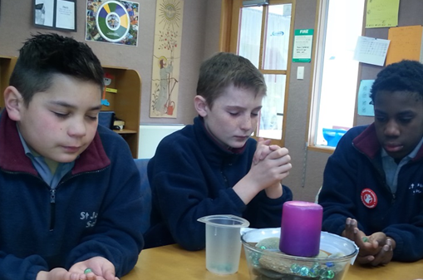

Time for Reflection
R-1
S-10
Click the audio button to stop reflective music
Click the audio button to play reflective music
Notes:
Slide 10 Time for Reflection
The MP3 is played to help create a reflective atmosphere and bring the young people to stillness and silence as the teacher invites them to reflect on the connections between the Lenten practices of prayer, fasting and almsgiving and how young people of your age can ‘live Lent’ by committing to use these practices and grow spiritually during Lent.

Slide 11



How much do you know about the Liturgical Year?
Highlight TRUE or FALSE
1)
2)
3)
4)
5)
6)
7)
8)
9)
10)
11)
12)
13)
14)
15)
The seasons in the Liturgical Year occur on the same dates every year.
There are 5 Penitential seasons in the Liturgical Year.
The major feast of the Liturgical Year is Easter.
The Liturgical Year is the Church’s way of retelling the life of Mary.
The longest season in the Liturgical Year is Ordinary Time.
Holy Week is the holiest week of the year because we celebrate the birth of Jesus.
Lent is the season to prepare people to celebrate Jesus’ death and resurrection.
Advent begins 6 weeks before Christmas.
The Church uses the Penitential seasons to help people prepare for important feasts.
The first day of Advent is Ash Wednesday.
The seasons of the Liturgical Year have special colours and symbols.
Lent and Advent help people prepare to celebrate Easter and Pentecost.
The national feast day for Aotearoa New Zealand celebrates Mary’s Assumption.
Christmas Day is a Holy Day of Obligation when people are expected to go to Mass.
In Penitential seasons people are expected to pray, fast and give to the needy.
TRUE FALSE
TRUE FALSE
TRUE FALSE
TRUE FALSE
TRUE FALSE
TRUE FALSE
TRUE FALSE
TRUE FALSE
TRUE FALSE
TRUE FALSE
TRUE FALSE
TRUE FALSE
TRUE FALSE
TRUE FALSE
TRUE FALSE
R-1
S-03A
Worksheet
Click on the worksheet button to go to the worksheet
Click the forward arrow to go to the next page
Notes:
Slide 3A How much do you know about the Liturgical Year? WORKSHEET
This worksheet relates to slide 3

Slide 12

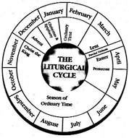
How much do you know about the Liturgical Year?
Highlight TRUE or FALSE
16)
17)
18)
19)
20)
21)
22)
23)
24)
25)
Any Scripture readings can be used during any Liturgical season.
Palm/Passion Sunday is the first day of Holy Week.
The Readings, hymns and prayers during Mass match the theme of the feast or season.
During Advent the Advent Wreath helps people to focus on the coming feast of Easter.
Green is the Liturgical colour for Ordinary Time which covers more than half of the year.
The Liturgical colour reflects what season or feast is being celebrated at Mass.
Links are made with the Liturgical Seasons and the natural seasons.
The CARITAS appeal reminds people to give to the poor during Ordinary Time.
The vestments the priests wear match the Liturgical feast or season.
The Triduum is 4 special days during Holy Week which have special rituals.
TRUE FALSE
TRUE FALSE
TRUE FALSE
TRUE FALSE
TRUE FALSE
TRUE FALSE
TRUE FALSE
TRUE FALSE
TRUE FALSE
TRUE FALSE
Record your score when you have finished.
Talk with a partner about your incorrect responses.
Repeat the worksheet later in the year and compare your scores.
Name: _______________
Date: _________
R-1
S-03B
Worksheet
Click the up arrow to return to the lesson
Notes:
Slide 3B How much do you know about the Liturgical Year? WORKSHEET
This worksheet relates to slide 3

Slide 13
Recording my Lenten Journey
Sunday | Monday | Tuesday | Wednesday | Thursday | Friday | Saturday
LIVING LENT
I want to use the season of Lent
to grow closer to Jesus through prayer, fasting and helping
those in need.
GREEN CROSS – For prayer RED CROSS – For kindness
PURPLE CROSS – For fasting
YELLOW CROSS – For change
Signed ______________________
Name: ________________
Date: _________
R-1
S-05
Worksheet
Click the up arrow to return to the lesson
Notes:
Slide 5 Recording my Lenten Journey WORKSHEET
This worksheet relates to slide 5

Slide 14

Check up
Name:____________________________
Date:____________
Prayer is very important in Lent because …
How do people of your age share in the Lenten practice of almsgiving?
Write an explanation of fasting and explain why people are expected
to fast in Lent.
Give a one minute elevator pitch on how Lent enables Christians to recommit their lives to God through prayer, fasting and almsgiving.
Which activity do you think helped you to learn best in this resource?
Questions I would like to ask about the topics in this resource are …
R-1
S-09
Worksheet
Click the up arrow to return to the lesson
Notes:
Slide 9 Check Up WORKSHEET
This worksheet relates to slide 9

