Slide 1
The First Days of Lent
R-1
S-01
Notes:
Slide 1 The First Days of Lent
Use this slide as a focussing strategy to introduce the lesson topic. Read the title together and invite students to share something they know about Lent as a time to turn back to God and living a more just and holy life.

Slide 2
Learning Intentions
The students will:
1)
recognise how Lent is a time to turn back to God Te Atua and strive to live a more just and holy life
2)
explain the meaning of one of the readings of the first days of Lent
R-1
S-02
Click the borders to reveal text
Notes:
Slide 2 Learning Intentions
Read through the Learning Intentions with the class and identify some ideas/questions that might be explored in the lesson.

Slide 3
Rapid Recall about the season of Lent
Record everything you know about the season of Lent
R-1
S-03
Click in the white box and write your text
Notes:
Slide 3 Rapid Recall about the season of Lent
Adapt Teaching and Learning Experience 1
Teacher or student type in what people know about the season of Lent.

Slide 4
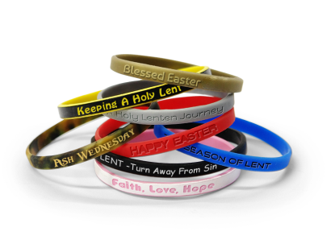
What can you add to your knowledge about Lent?
R-1
S-04
Click on the video button to play the video.
Notes:
Slide 4 What can you add to your knowledge about Lent?
Ash Wednesday and Lent in 2 minutes
https://www.youtube.com/watch?v=m3L3c23MfC0
Watch the clip and add any new ideas to Slide 3.
Put your ideas in categories and explain how each category relates to what people are expected to do during Lent.

Slide 5
Lent is a Journey the Pilgrim Church makes towards Easter
Our pilgrim journey involves
1
Turning our lives back to God
Growing in holiness
Making an inward journey in your heart
Striving to live as a better person
Bringing Jesus into your mind each day
Letting this season mean something to you
2
3
4
5
6
a)
- say how you can do this
d)
- share ways that might help this to happen
b)
- name 3 ways you can do this
e)
- suggest ways young people can do this
c)
- reflect on what changes you want to make this Lent
f)
- explain how people of your age can do this
R-1
S-05
Click the green buttons on the left to reveal the correct statement match
Notes:
Slide 5 Lent is a Journey the Pilgrim Church makes towards Easter
Answers 1) D, 2) A, 3) F, 4) B, 5) E, 6) C
Adapt Teaching and Learning Experience 2
Explain that the Lenten Journey is an inward journey that takes place in people’s hearts. It helps them to grow closer to Jesus. The quiet, reflective inward journey also helps people to notice others and reach outward to serve them especially those are in need of fair and just treatment. In helping others you too live a more just life as Jesus did and as God wants you to. This is another way of God calling you to become holy.
Discuss each item on the word float first and after each one, students do as the words suggest. Check your answers with the floater.

Slide 6
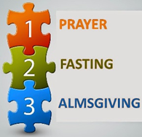
What is in your Lenten Pilgrim’s Backpack to help Lent make a difference in your life?
Lent
Lent
Lent
R-1
S-06
Click on the worksheet button to go to the worksheet
Notes:
Slide 6 What is in your Lenten Pilgrim’s Backpack to help Lent make a difference in your life?
Adapt Teaching and Learning Experience 4
Make copies of the worksheets for students to complete.
Use the ideas from Slide 5 to get students thinking about what needs to be in their backpack for them to make a Lenten Journey that will help them to live a more holy and just life and grow closer to God. Being closer to God means an increased awareness of God in their hearts and minds, noticing God’s goodness in the people around them and taking time to stand in awe of God’s creation. You could make a wall display of the completed worksheets and refer to them during Lent.

Slide 7
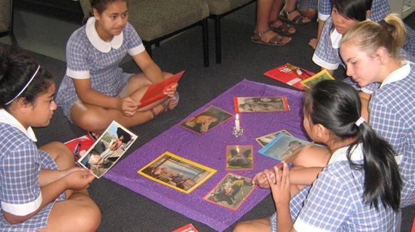
What does it mean to live a just and holy life?
R-1
S-07
Click on the worksheet button to go to the worksheet
Notes:
Slide 7 What does it mean to live a just and holy life?
Adapt Teaching and Learning Experience 3
Print a copy of the worksheet for each student to complete the Y chart.
When completed students share ideas on the charts and take time to capture the key ideas and include them in their summary statement. Add to RE Learning Journal.
Ideas to include: faithful to what Gods wants them to do, has a deep relationship with God through prayer, reads the stories of Jesus and lives his message, ‘fasts’ in Lent giving up favourite things, giving up words and actions that are unkind, speaks up for others to be treated with fairness, tries to change bad habits, shares what they have with others, giving alms as giving generously with their time, shares what they have, encourages others with positive words, a good pilgrim who keeps going even when times are hard.

Slide 8
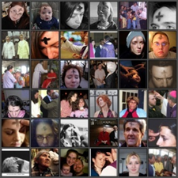
On Ash Wednesday the Church Community gathers to support one another as they...
renew their commitment to living as a follower of Jesus by increasing kind actions and words – share how people your age can do this.
spend time in prayer and being fair and loving people – reflect on an attitude you need to work on and how you can change it.
put into practice the ideas in their Lenten Backpack – say how you will encourage others to use the 40 days of Lent well.
grow closer to God to make a difference to their lives – can you think of what you want to change?
make a public commitment to grow in holiness – can you name 3 ways to do this?
are reminded of where the ashes come from – can you explain how the ashes are made?
begin their Lenten pilgrim journey together – how can you recognise Lenten pilgrims?
R-1
S-08
Click top card to discard it
Notes:
Slide 8 On Ash Wednesday the Church Community gathers to support one another as they...
Adapt Teaching and Learning Experiences 3 & 4
Use the flips charts to extend students’ thinking about what the community does in Lent – respond to the question on each card.
Students look at the image and make an observation about what you see. Share your observation.

Slide 9
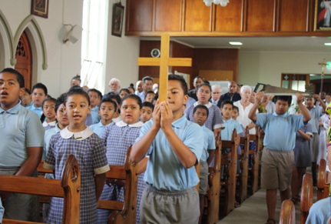
Scripture Readings from the First Days of Lent
Work in small groups and choose one of the Readings from the Teacher Resource.
Read and discuss the challenge your reading presents to Christians who hear God’s call to live just and holy lives.
Explain why this reading is appropriate for people to hear in the season of Lent.
Think about the message the reading has for people of your age in Lent.
Present the message to the rest of class and give examples of how you can live it out in Lent.
X
Click the I-button to reveal information
R-1
S-09
Click the audio button to start ‘A new heart for a new world’
Click the audio button to stop ‘A new heart for a new world’
Notes:
Slide 9 Scripture Readings from the First Days of Lent
Adapt Teaching and Learning Experience 3 & 4
Make copies of the Excerpts from the Readings: Ash Wednesday – Saturday (p 23) or in the Resource Documents for Yr 8 on the Resource Home page. Use the Readings in class prayer during Lent.
Work through the bullet points on the pop up.
Sing using the MP3 ‘New heart and new Spirit’

Slide 10
Check up
1)
Make a list of what you can do to live a holy and just life as a young person today.
2)
Make a fridge magnet to use at home to remind your family about using the 40 days of Lent to become a more loving and caring family.
3)
Present a reading from the first days of Lent and explain the challenge it offers you and how you respond.
4)
Share an example of a person you know who, by living a just and holy life, makes a difference in the world.
5)
Which activity do you think helped you to learn best in this resource?
6)
Questions I would like to ask about the topics in this lesson are …
Click in each caption space to reveal text
Click on the worksheet button to go to the worksheet.
R-1
S-10
Notes:
Slide 10 Check Up
This formative assessment strategy will help teachers to identify how well students have achieved the Learning Intentions of the resource.
Teachers can choose how they use the slide in their range of assessment options.
A worksheet of this slide is available for students in Years 5-8 to complete.
The last two items are feed forward for the teacher.
Recording the children’s responses to these items is recommended as it will enable teachers to adjust their learning strategies for future lessons and target the areas that need further attention.

Slide 11
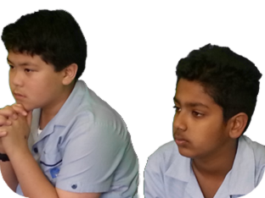
Time for Reflection
R-1
S-11
Click the audio button to stop reflective music
Click the audio button to play reflective music
Notes:
Slide 11 Time for Reflection
The MP3 is played to help create a reflective atmosphere and bring the young people to stillness and silence as the teacher invites them to reflect on their lives and the ways they try to treat people fairly especially when they stand up for others they see being treated unfairly. Recall how it feels when their actions result in fair treatment for others and how this helps them to feel they are following Jesus closely and are living a just and holy life.

Slide 12
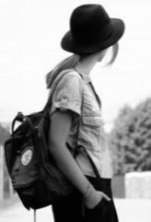
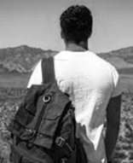
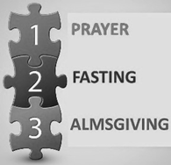
For my Lenten Journey I need …
Lent
Lent
Lent
Name:____________________________
Date:____________
R-1
S-06
Worksheet
Click on the worksheet button to go to the worksheet
Click the up arrow to return to the lesson
Notes:
Slide 6 For my Lenten Journey I need … WORKSHEET
This worksheet relates to slide 6

Slide 13
Living a just and holy life
Looks like
Feels like
Summary Statement
A holy and just person…
Sounds like
Name:____________________________
Date:____________
R-1
S-07
Worksheet
Click the up arrow to return to the lesson
Notes:
Slide 7 Living a just and holy life WORKSHEET
This worksheet relates to slide 7

Slide 14
Check up
Name:____________________________
Date:____________
Make a list of what you can do to live a holy and just life as a young person today.
Make a fridge magnet to use at home to remind your family about using the 40 days of Lent to become a more loving and caring family.
Present a reading from the first days of Lent and explain the challenge it offers you and how you respond.
Share an example of a person you know who ,by living a just and holy life, makes a difference in the world.
Which activity do you think helped you to learn best in this resource?
Questions I would like to ask about the topics in this resource are …
R-1
S-10
Worksheet
Click the up arrow to return to the lesson
Notes:
Slide 10 Check up WORKSHEET
This worksheet relates to slide 10

