Slide 1


A Reminder to Live Justly
R-2
S-01

Slide 2

Learning Intentions
The students will:
1)
identify the teaching of Moses, the prophet Isaiah and Jesus regarding living a just and holy life
2)
identify how this year’s CARITAS Lenten Appeal calls people to live just and holy lives
R-2
S-02
Click the borders to reveal text

Slide 3

Making Lent meaningful
Look closely at the collage, choose one image to use as a reminder that you can use the season of Lent to help you to live justly and become holy and closer to God. Share your chosen image and your thoughts.
R-2
S-03

Slide 4

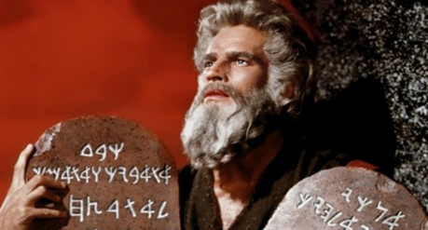
The Message of the Scripture Readings in Lent - Leviticus
Read Leviticus 19:1-2, 11-18. Listen for examples of:
God reminding people that God is holy and what God wants people to be and do. Laws about what people should and shouldn’t do. What does this reading remind you of?
The book of Leviticus was the first book studied by a Jewish child but is among the last books of the Bible to be studied by Christians.
Why might this be? What did Jesus do about the hundreds of laws the Jews lived by – see (Matt 22:35-40, Mark 12:28-31, Luke 10:25-28?
Holiness in ancient Israel had a different meaning from how we use it today. It was understood as the ‘god-ness’ of God.
What do you think ‘god – ness’ means and how does it relate to how you understand ‘holy’?
The most important message of Leviticus is about becoming holy as God is holy.
Why do you think Leviticus is read during Lent?
Leviticus contains detailed lists of laws regarding diet, sacrifice and social behavior. By keeping the law people would become holy.
What do you think about the idea that people become holy by keeping the law – does this still apply today?
Leviticus records God’s words spoken to Moses on Mount Sinai.
What other important words were spoken to Moses on Mount Sinai?
The Book of Leviticus is also known as the Torah, which is the Hebrew word meaning Law.
Leviticus is the third of five books in the Pentateuch which were the law books.
Do you know the names of the other books that are part of the Pentateuch?
R-2
S-04
Click top card to discard it

Slide 5

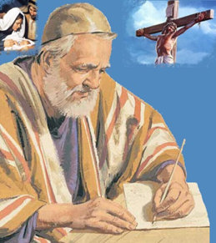

The Message of the Scripture Readings in Lent – Isaiah
Isaiah was a Hebrew prophet who was born in Jerusalem and was believed to have lived about 700 years before the birth of Christ. It is believed he wrote Chapters 1-39 in the book attributed to him.
Isaiah’s main preaching themes were overcoming evil, seeking justice tika, standing up for the powerless and needy, the importance of seeking repen-tance and becoming righteous
and holy.
Isaiah makes numerous prophecies about the Kingdom of God which is a very important theme in the book. Everything he writes leads up to the coming of the peaceful eternal reign of God and to ‘new heavens and a new earth’ that will not pass away.
Almost one-third of the chapters of the book of Isaiah, more than any other prophet, contain prophecies about the coming of the Saviour, Jesus Christ, both his first and Second Coming.
His prophecies foretell a time
of awesome and frightening events leading up to Christ’s Second Coming. Isaiah gives many warnings to Israel and Judah both for his own age
and for people today.
R-2
S-05
Click the pins on the right to reveal post-it notes.

Slide 6
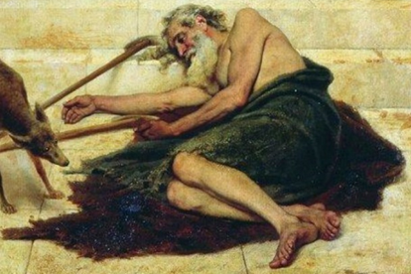
The Message of the Scripture Readings in Lent – Luke
In groups respond to the questions and present your ideas
to the class in an imaginative way.
Q1 What is the key message of the parable of
The Rich Man and Lazarus?
Q2 How does/will the message from the parable affect
the way you treat people?
Q3 What attitudes and actions is this parable challenging
in today’s world?
Q4 How is this parable connected to the work of CARITAS?
Q5 What have you learned from this parable and how
can you apply it in your life today?
Read the Lenten Parable
Luke 16:19-31
Click the video button to play the video ‘The Rich Man and Lazarus’
Click on the worksheet button to go to the worksheet.
R-2
S-06

Slide 7
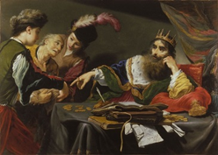
The Message of the Scripture Readings in Lent – Matthew
Look closely at and discuss
the artist Claude Vignon’s
portrayal of the parable.
Read the Lenten Parable Matthew 18:23-35 – The Unmerciful Servant
What is this parable really about?
Spend time thinking about the lesson Jesus is teaching through
this parable.
Click the video button to play the video
Click on the worksheet button to go to the worksheet.
R-2
S-07

Slide 8
Check up
1)
What messages are all the readings in this resource trying to get
across about how people who are disciples of Jesus should live their lives?
2)
Why are the Rich Man and Lazarus and the Unmerciful Servant useful parables to hear in Lent?
3)
Present 3 ways the CARITAS Lenten Appeal this year calls people to live just and holy lives.
4)
Name a situation in the world at present where people need to be treated justly and suggest ways young people of your age could do something about this.
5)
Which activity do you think helped you to learn best in this resource?
6)
Questions I would like to ask about the topics in this resource are …
Click in each caption space to reveal text
Click on the worksheet button to go to the worksheet.
R-2
S-08

Slide 9



Time for Reflection
R-2
S-09
Click the audio button to stop reflective music
Click the audio button to play reflective music

Slide 10



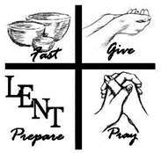


Sharing our Learning about LENT with family whānau
Make a poster with a backpack, or borrow an old backpack.
Label it BACKPACK FOR A PILGRIM ON A LENTEN JOURNEY.
Make large captions cards with all the ways young members of
the Church can use their Lenten journey to grow closer to God
and change something in their lives they know needs to be changed.
Use the backpack and the cards and prepare a presentation to share
with other classes to remind people of their own Lenten journey.
Make up an elevator pitch that lasts one minute to encourage people to use Lent as a time to pray, fast and give alms to the poor and to grow closer to God. Share it with your family and other classes. Record it to use as a resource next Lent.
Create a Power Point to share all you have learned about LENT with people in your parish
or Whānau. Prepare the Speaker Notes carefully and include questions to engage people in discussion. Practise it with classes in your school.
Start a campaign to encourage people to make good use of Lent this year.
Make posters, placards, flyers with ideas about how children and young people
can live justly and grow in holiness during Lent.
R-2
S-10A

Slide 11
Sharing our Learning about LENT with family whānau
Present the messages from the Scripture readings at assembly and
bring their messages in creative ways to the attention of children,
teachers and parents.
Prepare a reflective time to share with younger classes about ways children can stand up for fairness using scenarios they would be familiar with.
Make and share fridge magnets and bumper stickers with messages
that promote using the season of Lent meaningfully
– MAKE LENT 40 DAYS OF AWESOME PRAYER AND ACTION
Set up a debate on the topic – The messages of the prophets Moses and Isaiah are still meaningful for the world today.
Make up your own way of showing and sharing what you have learned
R-2
S-10B
Click on the worksheet button to go to the worksheet.

Slide 12
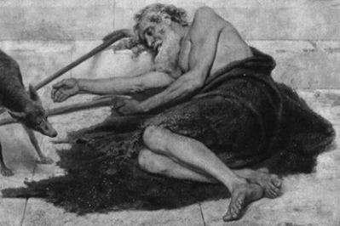
The Message of the Scripture Readings in Lent – Luke
Name:____________________________
Date:____________
In groups respond to the questions and present your ideas to the class in an imaginative way.
Read the Lenten Parable
Luke 16:19-31
Q1 What is the key message of the parable of The Rich Man and Lazarus?
Q2 How does/will the message from the parable affect the way you treat people?
Q3 What attitudes and actions is this parable challenging in today’s world?
Q4 How is this parable connected to the work of CARITAS?
Q5 What have you learned from this parable and how can you apply it in your life today?
R-2
S-06
Worksheet
Click on the worksheet button to go to the worksheet.
Click the up arrow to return to the lesson

Slide 13


Reflecting on the messages of the two Lenten Parables
The Rich Man and Lazarus
The Unforgiving Servant
Write or draw your response to these parables as they remind people to live justly and grow in holiness during Lent. Include in some way what you have learned from them.
Name:____________________________
Date:____________
R-2
S-07
Worksheet
Click on the worksheet button to go to the worksheet.
Click the up arrow to return to the lesson

Slide 14

Check up
Name:____________________________
Date:____________
What messages are all the readings in this resource trying to get across about how people who are disciples of Jesus should live their lives?
Why are the Rich Man and Lazarus and the Unmerciful Servant useful
parables to hear in Lent?
Present 3 ways the CARITAS Lenten Appeal this year calls people to live just and holy lives.
Name a situation in the world at present where people need to be treated justly and suggest ways young people of your age could do something about this.
Which activity do you think helped you to learn best in this resource?
Questions I would like to ask about the topics in this resource are …
R-2
S-08
Worksheet
Click the up arrow to return to the lesson

Slide 15


Sharing our Learning about LENT with family whānau
Make a poster with a backpack, or borrow an old backpack.
Label it BACKPACK FOR A PILGRIM ON A LENTEN JOURNEY.
Make large captions cards with all the ways young members of
the Church can use their Lenten journey to grow closer to God
and change something in their lives they know needs to be changed.
Use the backpack and the cards and prepare a presentation to share
with other classes to remind people of their own Lenten journey.
Make up an elevator pitch that lasts one minute to encourage people to use Lent as a time to pray, fast and give alms to the poor and to grow closer to God. Share it with your family and other classes. Record it to use as a resource next Lent.
Create a Power Point to share all you have learned about LENT with people in your parish
or Whānau. Prepare the Speaker Notes carefully and include questions to engage people in discussion. Practise it with classes in your school.
Start a campaign to encourage people to make good use of Lent this year.
Make posters, placards, flyers with ideas about how children and young people
can live justly and grow in holiness during Lent.
R-2
S-10A

Slide 16
Sharing our Learning about LENT with family whānau
Present the messages from the Scripture readings at assembly and
bring their messages in creative ways to the attention of children,
teachers and parents.
Prepare a reflective time to share with younger classes about ways children can stand up for fairness using scenarios they would be familiar with.
Make and share fridge magnets and bumper stickers with messages
that promote using the season of Lent meaningfully
– MAKE LENT 40 DAYS OF AWESOME PRAYER AND ACTION
Set up a debate on the topic – The messages of the prophets Moses and Isaiah are still meaningful for the world today.
Make up your own way of showing and sharing what you have learned
R-2
S-10B
Worksheet
Click the up arrow to return to the lesson

