Slide 1

Ordinary Time – the longest season in the Liturgical Year
R-1
S-01
Notes:
Use this slide as a focussing strategy to introduce the resource topic. Read the title together and invite children to share something they know about Ordinary Time and its place in the Liturgical Year.

Slide 2
Learning Intentions
The children will…
1)
develop an understanding of what Ordinary Time in the Church’s year means
2)
describe where Ordinary Time occurs in the Liturgical Year and how people can use it to grow closer to God
3)
name three gospel stories about Jesus’ ‘ordinary’ life that are read in Ordinary Time.
R-1
S-02
Click the boxes to reveal text.
Notes:
Read through the Learning Intentions with the class and identify some ideas/questions that might be explored in the resource.

Slide 3
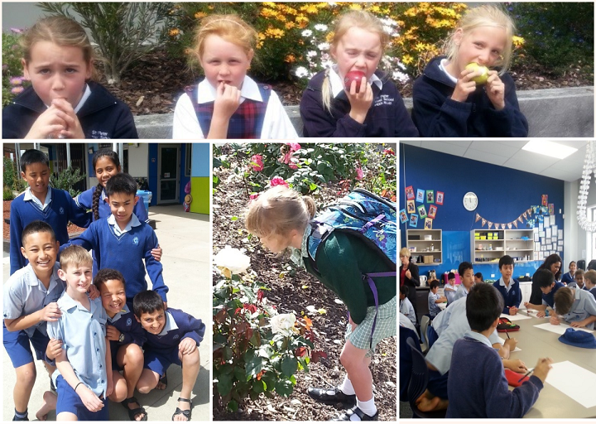
There are many ‘ordinary’ times in our lives
Share what you do on ordinary days at home and at school
R-1
S-03
Click the worksheet icon for worksheet
Notes:
Follow the message in the slide.
Children complete the worksheet and share it in groups.
Add it to RE Learning Journals.

Slide 4
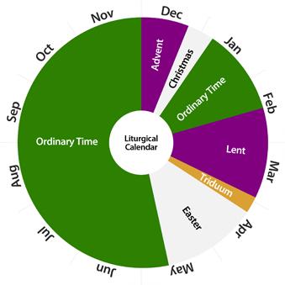
The Place of Ordinary Time in the Liturgical Year
Look at the Liturgical Calendar and make an observation about Ordinary Time.
Why does Ordinary time take up so much of the year?
What do both parts of Ordinary Time follow?
Why was green chosen for Ordinary Time?
How can followers of Jesus use Ordinary Time to grow closer to him?
Describe where the parts of Ordinary Time occur in the Liturgical Year.
X
R-1
S-04
Click the “i” button to reveal text.
Notes:
Read and respond to the questions on the pop up slide.
Invite children to close their eyes and name the seasons in the Liturgical Year starting with Advent. Check them with the calendar image.
The Triduum is the last days of Lent – it is celebrated in the liturgies for - the last part of Holy Thursday, Good Friday, Holy Saturday, and the first part of Easter Sunday. Triduum is Latin for 3 days.

Slide 5



Ordinary Time is the time that is not part of the major seasons in the Church’s year
Ordinary does not mean unimportant. After the high celebrations of the seasons of Christmas and Easter Christians need time to rest and reflect on the teachings Jesus taught in his ‘ordinary’ life.
Name some of the special events celebrated in the life of the Church and how they are celebrated.
Name some of the special events in the life of your family and how they are celebrated.
Ordinary Time is a time for quiet growth. The journey of faith, like the journey of life that Christians are on, passes through different seasons. Some include special events and others are just routine and ordinary.
What is good about ‘ordinary’ times in your family and in the Church?
How are they different from times of celebration?
What would happen if we didn’t have ‘ordinary’ times?
R-1
S-05
Click the pins on the right to reveal post-it notes.
Notes:
Use the text on the post it notes to generate discussion about what Ordinary Time means, how the pattern of Ordinary Time is like the pattern of our lives and name some of the times of celebration in our ‘ordinary’ lives and in our lives as Christians in the Church.

Slide 6
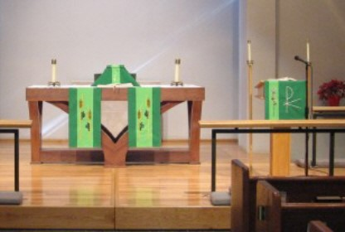
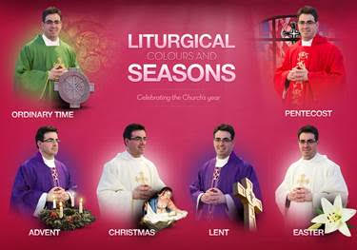
How the Church uses colour to mark the Liturgical seasons including Ordinary Time
The Church uses colour to show which season of the Liturgical Year it is celebrating. The colours reflect the mood of the season. The colours used in the Church match the colours on the Liturgical Calendar.
Name the colour for each season in the Liturgical Year.
After the celebrations of Christmas and Easter the mood of the Eucharist changes. The special symbols, decorations, hymns and prayers used to celebrate the season are no longer used.
Name some of the Christmas and Easter liturgical decorations that are removed when the seasons have ended.
The vestments that the priest wears also reflect the colour of the season that is being celebrated. The same colour is used for the altar cloths and the sanctuary decorations such as banners, flowers and symbols.
What colour vestments would priests wear most during the Liturgical Year? Why?
Reset
R-1
S-06
Click the “cards” to move through and “reset” to start over.
Notes:
Read the flip cards and make a comment or ask a question.
Respond to the coloured text.

Slide 7
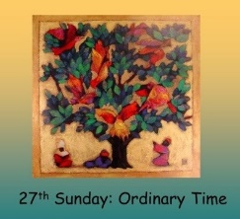
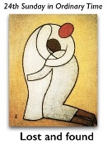
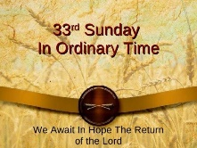
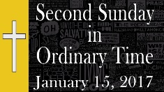
Ordinary Time is Ordered or Numbered Time
as the rhythm of life with times of celebration and ordinary times.
The rhythm of the Liturgical Year is the same
Ordinary Time is ordered or numbered time
On the Liturgical Calendar Ordinary Time is green
Sundays are the Lord’s Day which gives Christians the
On all Sundays Christians are invited to gather together to
Every Sunday is like Easter as it is the day Christians
that is celebrated in two parts, one long, one short.
which is the colour of growth and hope.
opportunity to celebrate the day Jesus rose every week.
celebrate and encourage each other on their
journey of faith.
remember and celebrate the day Jesus rose
from the dead.
opportunity to celebrate the day Jesus rose every week.
celebrate and encourage each other on their journey of faith.
that is celebrated in two parts, one long, one short.
remember and celebrate the day Jesus rose from the dead.
which is the colour of growth and hope.
as the rhythm of life with times of celebration and ordinary times.
R-1
S-07
Click the end of the sentences or the words on the list to complete the sentences.
Notes:
Explain that the Sundays and weeks in Ordinary Time are identified by their number which is in numerical order.
Remind children the Liturgical Year starts on the 1st Sunday in Advent and ends on the last Sunday in Ordinary Time which is the Feast of Christ the King.
Some of the Sundays in Ordinary Time are major Feasts in the Church so they do not have a number but they have a title such as Trinity Sunday, Feast of the Body and Blood of Christ.
Children name the correct statements to complete the sentences and check it with the floaters.
When completed children share something they have learned about Ordinary Time.
ANSWERS 1) F, 2) C, 3) E, 4) A, 5) B, 6) D

Slide 8
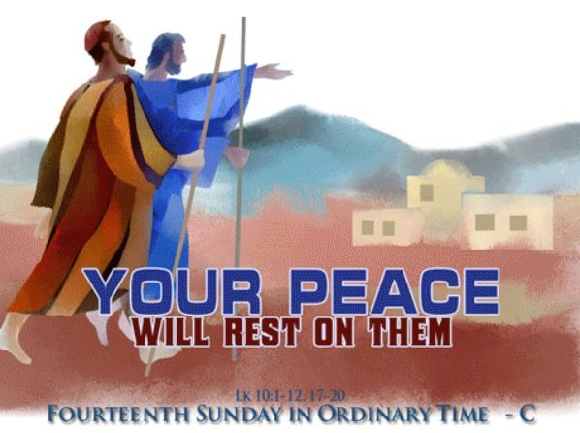
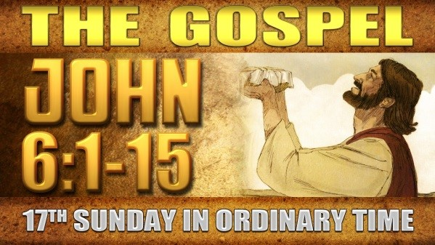
In Ordinary Time we listen to and learn from the stories of Jesus’ Ordinary Life
Find this story in Luke 10:1-12, 17-20 and read it.
Talk about what it is about and what message you would take from it in Ordinary Time.
Find the gospel reference in John’s gospel on the image.
Talk about what it is about and what message you would take from it in Ordinary Time.
R-1
S-8A
Click the pictures to reveal text.
Notes:
In Ordinary Time people pay particular attention to the Sunday gospels as they are stories about the ‘ordinary’ life of Jesus and the things he did that were the work God had sent him to do on earth. These stories tell how Jesus began to build God’s Kingdom on earth through his teaching, the ways he served people, his healing and his kindness to people especially those in need. Follow the directions on the revealed text. Share the messages you got for the stories. Use the stories in class prayer during Ordinary Time. These are important stories about Jesus that show people what sort of person he truly was and why we should strive to be like him.

Slide 9
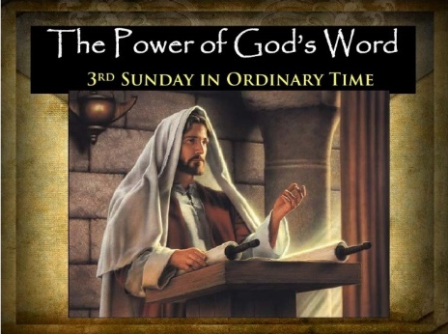
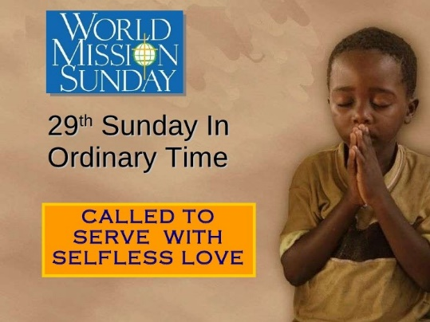
In Ordinary Time we listen to and learn from the stories of Jesus’ Ordinary Life
Find the gospel reference in Luke 4: 16-20
What message did you get from what Jesus read?
Can you think of a gospel about Jesus caring for the poor that could be read on Mission Sunday?
What month of the year is Mission Sunday and whom do we pray for on this special Sunday?
Mark where these Sundays occur in Ordinary Time in the Liturgical Year using their number on the worksheet.
R-1
S-8B
Click the pictures to reveal text and worksheet icon for worksheet.
Notes:
Slide 8B In Ordinary Time we listen to and learn from the stories of Jesus’ Ordinary Life
In Ordinary Time people pay particular attention to the Sunday gospels as they are stories about the ‘ordinary’ life of Jesus and the things he did that were the work God had sent him to do on earth. These stories tell how Jesus began to build God’s Kingdom on earth through his teaching, the ways he served people, his healing and his kindness to people especially those in need. Follow the directions on the revealed text. Share the messages you got for the stories. Use the stories in class prayer during Ordinary Time. These are important stories about Jesus that show people what sort of person he truly was and why we should strive to be like him. Complete the worksheet.
ANSWERS
The 2nd Sunday in Ordinary Time is in the month of January
The 22nd Sunday in Ordinary Time is in the months of August or September
The 14th Sunday in Ordinary Time is in the month of July
The 30th Sunday in Ordinary Time is in the month of October
The 19th Sunday in Ordinary Time is in the month of August
The 8th Sunday in Ordinary Time is in the months of February or March
The 27th Sunday in Ordinary Time is in the month of October
The 5th Sunday in Ordinary Time is in the month of February
The 32nd Sunday in Ordinary Time is in the month of November
The 25th Sunday in Ordinary Time is in the month of September
Write the answers at the end of the question
1) How many weeks are there in Ordinary Time? 33 or 34 weeks
2) What is the order of the Sundays in ‘Ordered’ Time? Numerical order
3) What is the first day of the Liturgical Year? The 1st Sunday of Advent
4) What is the last day of the Liturgical Year? The Feast of Christ the King
5)What is the greatest feast in the Liturgical Year? Easter Sunday – the day Jesus rose

Slide 10
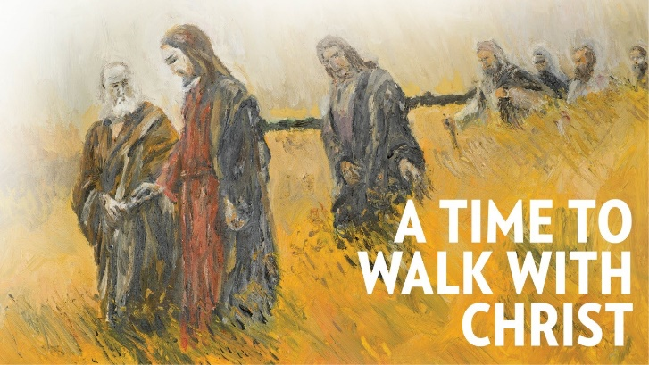
What children of your age can do during Ordinary Time to walk with Jesus
Use the sentence starters to share your ideas about what you can do to grow closer to Jesus in Ordinary Time
Spend some quiet time with Jesus each day and …
Read the Sunday gospel with your family and think about …
Take responsibility for some ordinary tasks at home such as …
Use Ordinary Time to do ordinary things …
Notice when others are being kind and tell them …
Read the stories of Jesus’ ordinary life and reflect on them during class prayer in Ordinary Time.
R-1
S-09
Notes:
Work through the items on the slide and encourage children to suggest ways they get to know Jesus better, become closer to him and share your ‘ordinary’ time with him as you grow to be a strong follower of him.

Slide 11
Check up
1)
Three things I have learned about Ordinary Time are…
2)
Explain to a younger child where Ordinary Time occurs in the Liturgical Year and what people can do during it to grow closer to God.
3)
The 3 gospel stories about Jesus’ ‘ordinary’ life that I like to read in Ordinary Time are…
4)
Which activity do you think helped you to learn best in this resource?
5)
Questions I would like to ask about the topics in this resource are…
R-1
S-10
Click the boxes to reveal text and worksheet icon for worksheet.
Notes:
This formative assessment strategy will help teachers to identify how well the children have achieved the Learning Intentions of the resource.
Teachers can choose how they use the slide in their range of assessment options.
A worksheet of this slide is available for children in Years 5-8 to complete.
The last two items are feed forward for the teacher.
Recording the children’s responses to these items is recommended as it will enable teachers to adjust their learning strategies for future resources and target the areas that need further attention.

Slide 12


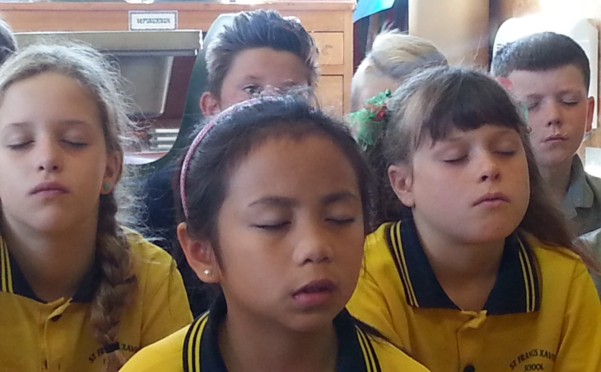

Time For Reflection
R-1
S-11
Click the audio button to stop reflective music
Click the audio button to play reflective music
Notes:
The MP3 is played to help create a reflective atmosphere and bring the children to stillness and silence as the teacher invites them to reflect on the ordinary times in their lives and how they can use them to grow closer to Jesus when they talk to him and read stories about his ordinary life. Think of something that could be a reminder to help you with this.

Slide 13
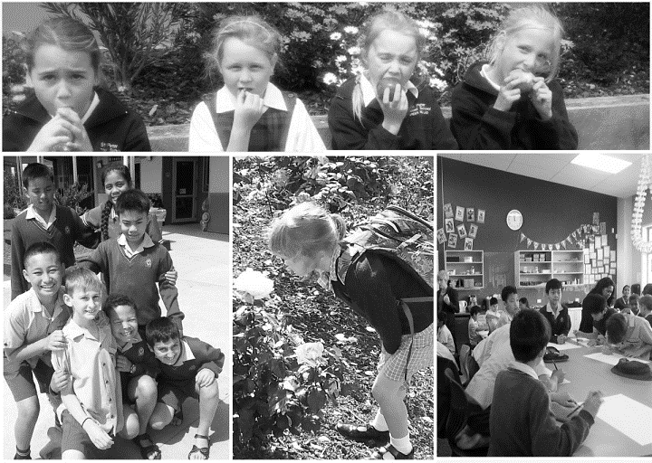
Ordinary Times in our lives
Name ____________________________ Date _______________
Look like
Feel like
Sound like
R-1
S-3
Worksheet
Click the up arrow to return to the presentation

Slide 14
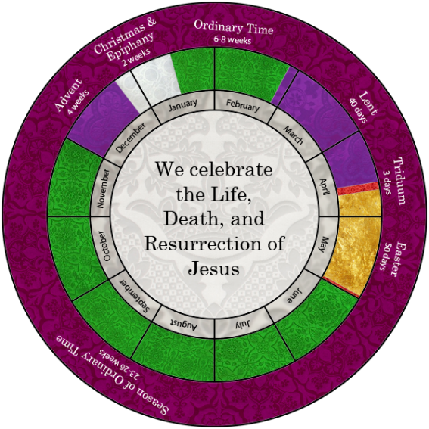
Where the Numbered Sundays occur in Ordinary Time
Name ____________________________ Date _______________
Name which month the following Sundays occur in Ordinary Time.
Use the Liturgical Calendar to help you locate them.
Write the number of the Sunday on the calendar to indicate which part of the month it occurs.
Write the answers at the end of the question
How many weeks are there in Ordinary Time?__________________
What is the order of the Sundays in ‘Ordered’ Time?_____________
What is the first day of the Liturgical Year?____________________
What is the last day of the Liturgical Year?_____________________
What is the greatest feast in the Liturgical Year?________________
The 1st Sunday in Ordinary Time is in the month of ___________________
The 22nd Sunday in Ordinary Time is in the months of ________________
The 14th Sunday in Ordinary Time is in the month of __________________
The 30th Sunday in Ordinary Time is in the month of __________________
The 19th Sunday in Ordinary Time is in the month of _________________
The 8th Sunday in Ordinary Time is in the months of _________________
The 27th Sunday in Ordinary Time is in the month of _________________
The 3rd Sunday in Ordinary Time is in the month of __________________
The 32nd Sunday in Ordinary Time is in the month of ________________
The 25th Sunday in Ordinary Time is in the month of ________________
R-1
S-8
Worksheet
Click the up arrow to return to the presentation
Notes:
The 2nd Sunday in Ordinary Time is in the month of January
The 22nd Sunday in Ordinary Time is in the months of August or September
The 14th Sunday in Ordinary Time is in the month of July
The 30th Sunday in Ordinary Time is in the month of October
The 19th Sunday in Ordinary Time is in the month of August
The 8th Sunday in Ordinary Time is in the months of February or March
The 27th Sunday in Ordinary Time is in the month of October
The 5th Sunday in Ordinary Time is in the month of February
The 32nd Sunday in Ordinary Time is in the month of November
The 25th Sunday in Ordinary Time is in the month of September
Write the answers at the end of the question
1)How many weeks are there in Ordinary Time? 33 or 34 weeks
What is the order of the Sundays in ‘Ordered’ Time? Numerical order
What is the first day of the Liturgical Year? The 1st Sunday of Advent
What is the last day of the Liturgical Year? The Feast of Christ the King
What is the greatest feast in the Liturgical Year? Easter Sunday – the day Jesus rose

Slide 15

Check up Worksheet
Name ____________________________ Date _______________
Three things I have learned about Ordinary Time are… - - -
Explain to a younger child where Ordinary Time occurs in the Liturgical Year and what people can do during it to grow closer to God.
The 3 gospel stories about Jesus’ ‘ordinary’ life that I like to read in Ordinary Time are… - - -
Which activity do you think helped you to learn best in this resource?
Questions I would like to ask about the topics in this resource are…
R-1
S-10
Worksheet
Click the up arrow to return to the presentation

