Slide 1
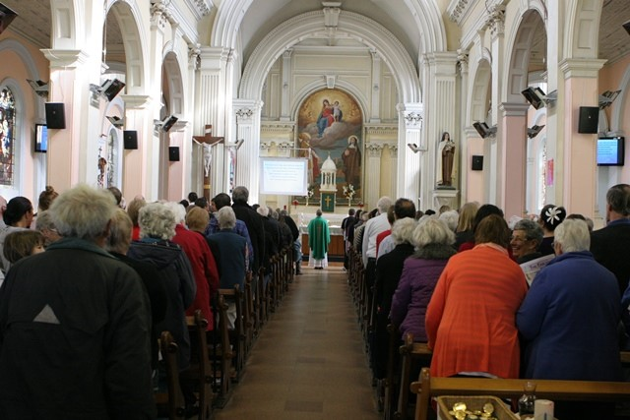
Sundays in Ordinary Time
R-1
S-01

Slide 2
Learning Intentions
The children will:
recognise the meaning of Ordinary Time in the Liturgical Year Te Tau me ona Ritenga Tapu
1)
explain why Sundays are so important in the Liturgical Year Te Tau me ona Ritenga Tapu
2)
R-1
S-02
Click the box to reveal the Learning Intention

Slide 3
What do we mean by Ordinary Time in the Liturgical Year Te Tau me ona Ritenga Tapu?
Green is the Liturgical colour for Ordinary Time because it is the colour of hope and growth.
In Ordinary Time we reflect on the life of Jesus and our call to discipleship throughout the year.
In Ordinary Time we have time to listen to and reflect on the gospels that feature the events of Jesus’ ‘ordinary life’.
Ordinary Time gives people time to come back to a more regular rhythm after the great celebrations of Easter and Christmas.
Many important feasts occur during Ordinary Time, e.g. Trinity Sunday, The Assumption and Christ the King. Often these are celebrated on a Sunday.
The Sundays in Ordinary Time are ordered or numbered time – the 1st Sunday, the 2nd Sunday in Ordinary Time. This does not mean these Sundays are less important. Ordinary Time highlights the celebration of the Eucharist Sunday after Sunday.
The days that are not included in the seasons of Advent, Christmas, Lent, Holy Week and Easter are ordinary days in Ordinary Time.
The rhythm of the Liturgical Seasons reflects the rhythm of life – time to celebrate, time to grow and reflect.
R-1
S-03
Click top card to reveal others
Click the reset button to restart

Slide 4
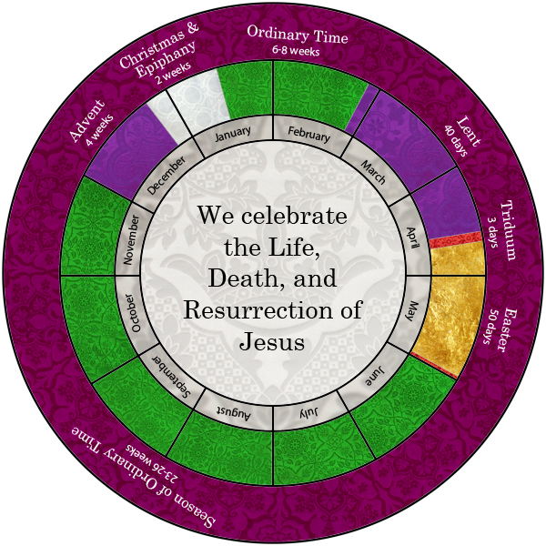
Ordinary Time is the longest season in the Liturgical Year
There are 34 weeks in Ordinary Time in the Liturgical Year which are divided into 2 blocks. The first block starts after the Christmas season and lasts until Ash Wednesday when the season of Lent begins, usually 6-8 weeks.
The Liturgy in Ordinary Time focusses on the ‘ordinary’ life of Jesus. We listen and reflect on the stories about him doing his work – teaching and healing in the miracle and parable stories, and the time he spent alone and with his friends. Does this sound like a familiar pattern of life?
Ordinary Time allows us some space to think about our personal call to follow Jesus and how we are living this out in our ‘ordinary’ lives.
The second block is the longer one which starts after the Feast of Pentecost until the Feast of Christ the King, usually 23-26 weeks.
The pattern of the Liturgical Year is the same as the pattern of our lives. We have times of celebration but most of the time is Ordinary Time when we do ordinary routine things everyday like getting up, going to school, family time and time to eat and rest.
R-1
S-04
Click the pins on the right to reveal post-it notes.

Slide 5
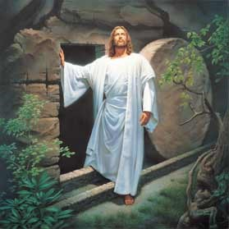
Why Sunday is a very important
day in life of the Church
From the beginning of the Church the early
Christians came together to worship God with praise and thanks.
Sunday is known as the chief
or original feast of the Church
The first Christians
gathered on Sunday because this was the day Jesus rose.
Each Sunday is like celebrating
Easter Sunday over and over again every week.
Sunday Eucharist brings the community
together to celebrate the Risen Lord among them.
Easter Sunday over and over again every week.
B) gathered on Sunday because this was the day Jesus rose.
C) together to celebrate the Risen Lord among them.
D) or original feast of the Church
E) Christians came together to worship God with praise and thanks.
R-1
S-05
Click the statements at the bottom to reveal the correct statement match
Notes:
ANSWERS
1) E, 2) D, 3) B, 4) A, 5) C

Slide 6
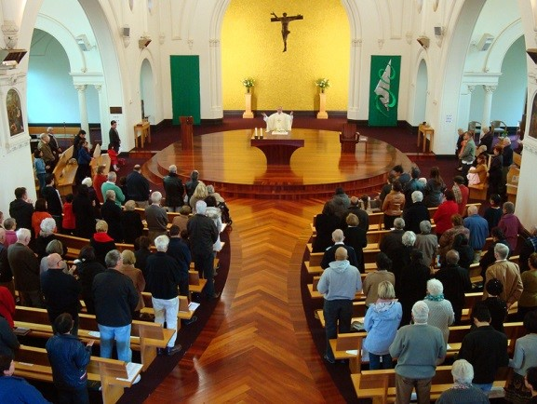
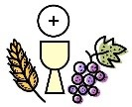
Sunday is the day Catholics
celebrate Eucharist as a community
Why is Sunday called the Lord’s Day and the chief feast of the year?
When did Christians first start gathering together for the Eucharist on Sunday?
Why are Scripture readings included in the celebration of the Eucharist?
What are the advantages of people coming together to pray and give thanks to God?
How does the Eucharist help people on their faith journey?
R-1
S-06
Click the small pictures to reveal text
Notes:
Responses to questions
1) Sunday is the Day of the Resurrection of Jesus and it reminds us regularly that the risen Lord is present among us – in his Word, in his body and blood, and in each other.
2) The earliest reference to the Eucharistic gathering is in the Acts of the Apostles (Acts 20:7).
3) The Scripture is read to make present the life, death and resurrection of Jesus for the people to listen to. As people hear the stories of the life of Jesus they grow in understanding of what their call to holiness is and this influences how they live their lives.
4) Worshiping God at Eucharist on Sunday fulfills the 3rd Commandment to keep Holy the Sabbath day. When the people give praise and thanks to God for all God’s goodness to them as a community, their faith in God is renewed through the power of the Holy Spirit. They develop a sense of belonging to their parish community and become involved in parish life.
5) Gathering with other members of the community encourages people as they share their faith journey together. They draw strength from the Eucharist to go out into the world and share their faith with others as they do their part to build God’s kingdom on earth.

Slide 7
Check up
1)
Write 3 things you have learned about Ordinary Time.
2)
Why is so much of the Liturgical Year in Ordinary Time?
3)
Give 3 reasons why Sunday is the chief and original feast in the year.
4)
Explain to someone in your class why it is important to go to Eucharist on Sunday.
5)
Which activity do you think helped you to learn best in this resource?
6)
Questions I would like to ask about the topics in this resource are …
R-1
S-07
Click the worksheet button to go to the worksheet
Notes:
This formative assessment strategy will help teachers to identify how well children have achieved the Learning Intentions of the resource.
Teachers can choose how they use the slide to assess each item.
A worksheet of this slide is available as an option for children to complete.
The last two items are feed forward for the teacher.
Recording the children’s responses to these items is recommended as it will enable teachers to adjust their learning strategies for future resources and target the areas that need further attention.

Slide 8
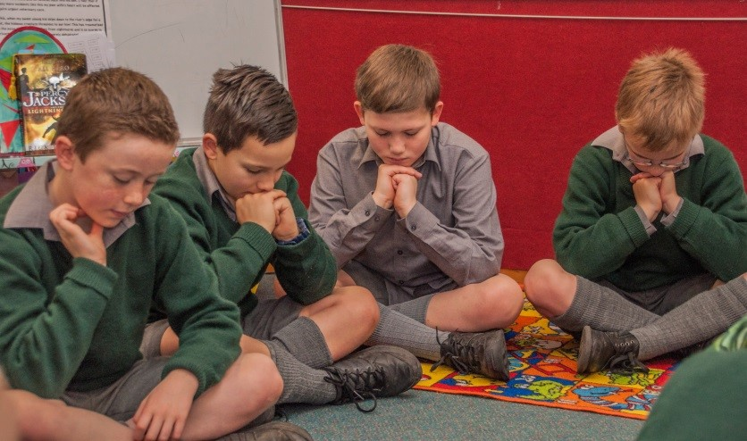
Time for Reflection
R-1
S-08
Click the audio button to stop reflective music
Click the audio button to play reflective music
Notes:
The MP3 is played to help create a reflective atmosphere and bring the children to stillness and silence as the teacher invites them to reflect on the rhythm of your life and what you like about ordinary times in your life when there is nothing special going on. Think about using these times to enrich your life by being a good friend to someone in need and going to Eucharist to spend time with Jesus.

Slide 9
Check up
Name:____________________________
Date:____________
1) Write 3 things you have learned about Ordinary Time.
2) Why is so much of the Liturgical Year in Ordinary Time?
3) Give 3 reasons why Sunday is the chief and original feast in the year.
4) Explain to someone in your class why it is important to go to Eucharist on Sunday.
5) Which activity do you think helped you to learn best in this resource?
6) Questions I would like to ask about the topics in this resource are …
R-1
S-07
Worksheet
Click the up arrow to return to the presentation

