Slide 1
Celebrating Sundays in Ordinary Time
R-1
S-01
Notes:
Slide 1 Celebrating Sundays in Ordinary Time
Use this slide as a focussing strategy to introduce the resource topic. Read the title together and invite students to share something they know about Ordinary Time – how during this time, we use it to grow closer to Jesus and how we celebrate Sundays in this season.

Slide 2
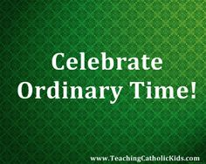
Learning Intentions
The students will:
1)
explain the meaning of Ordinary Time and when it is celebrated in the Church’s Liturgical Year
2)
recognise the importance of Sunday as the Lord’s Day
R-1
S-02
Click the borders to reveal text
Notes:
Slide 2 Learning Intentions
Read through the Learning Intentions with the class and identify some ideas/questions that might be explored in the resource.

Slide 3
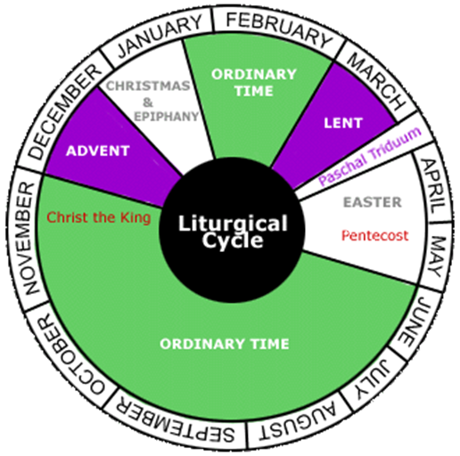
What I know about the Liturgical Year
Complete your worksheet and share what you know.
Watch the clip and add to the worksheet.
Click the video button to watch ‘Liturgical Calendar Saints and Seasons’ Click on the worksheet button to go to the worksheet.
R-1
S-03
Notes:
Slide 3 What I know about the Liturgical Year
Print of copies of the worksheet for the students to complete and add to after they have viewed the clip.
Follow the directions on the slide. Note Mardi Gras is not usually celebrated in New Zealand but is a big celebration in Central and South America and Mexico. Celebrations can start from early January and culminate on Shrove Tuesday - Mardi Gras - the day before Ash Wednesday. The time between these days is known as carnival season.
Watch the clip
https://www.youtube.com/watch?v=SvVnqDsv07c Liturgical Calendar Saints and Seasons 2:57 minutes

Slide 4
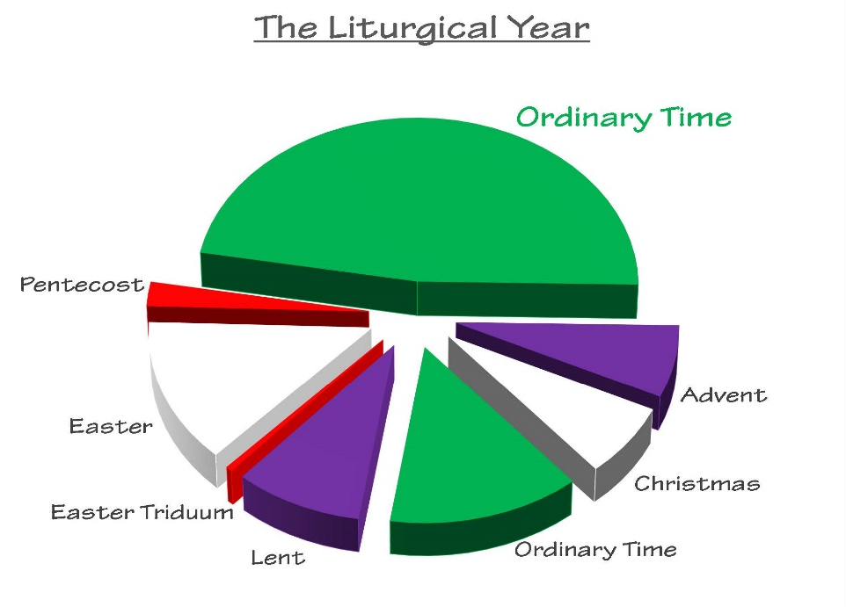
Ordinary Time in the Liturgical Year
1
The rhythm of the Liturgical Year reflects
Ordinary Time is ordered or numbered time
On the Liturgical Calendar Ordinary Time is green
Sundays in Ordinary Time are numbered and are given
On all Sundays Christians are invited to gather together to
Every Sunday is like Easter as it is the day Christians
2
3
4
5
6
a)
special emphasis as the Lord’s Day when Eucharist is shared.
b)
celebrate and encourage each other on their journey of faith.
c)
that is celebrated in two segments, one long, one short.
d)
celebrate and recall the day of Christ’s resurrection.
e)
showing it is a time of growth, spiritual maturing and hope.
f)
the rhythm of life with times of celebration and quiet times.
R-1
S-04
Click the green buttons on the left to reveal the correct statement match
Notes:
Slide 4 Ordinary Time in the Liturgical Year
Adapt Teaching and Learning Experiences 2&3.
Students suggest a statement that completes correctly each sentence. Check answers with the floater.
ANSWERS 1) F, 2) C, 3) E, 4) A, 5) B, 6) D
Students share 2 new things they learned about the importance of Sunday as the Lord’s Day and how it should be celebrated and why.

Slide 5
Ordinary Time in a nutshell
How is Ordinary Time in the Church’s Calendar and ordinary time in your life similar?
Ordinary Time is the period in the Church calendar outside of other major seasons. It is the longest season in the year - 33 or 34 weeks.
What can Christians of your age do in Ordinary Time to help yourself grow in understanding and appreciation of your faith.
If you went into a church how would you know it was Ordinary Time? If you went to Mass how would you know it was Ordinary Time?
R-1
S-05
Click the pins on the right to reveal post-it notes.
Notes:
Slide 5 Ordinary Time in a nutshell
Read the Post it notes and the facts about Ordinary Time.
Make up a quick fire quiz to share.
Share what you have learned about Ordinary Time in a nutshell with a younger child. Discuss your responses to the questions on the Post it notes.

Slide 6
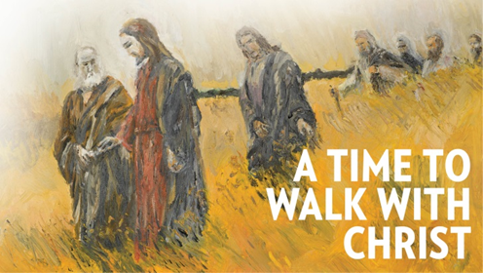
Ordinary Time is a time to grow closer to Jesus and his friends
The last Sunday in Ordinary Time each year is the Feast of Christ the King. This feast reminds us that in time Christ will be the King of his kingdom of justice, peace and love on earth and we have helped to build this by living as he lived, by being of service to others as part of our ordinary lives.
When we use Ordinary Time to pay attention to the Sunday Scripture readings and the messages they can teach us, we can bring them to prayer and ask Jesus to show us what he wants us to do because we are his hands here on earth. This is how we can do our part to build the Kingdom of God on earth.
The Second Reading is taken from the letters of the Apostles Paul and James. These readings are arranged so that we can get a good sense of important messages from them. These readings are not linked to the Gospel but they do have useful messages for us today.
The First Reading at Mass is carefully chosen from the Hebrew Scriptures (the Old Testament) so that important passages are selected to bring out a connection with the Sunday gospels.
On the Sundays in Ordinary Time the gospels are laid out so that we can read through, in a 3 year cycle, Mark’s, Matthew’s and Luke's gospels, one after another, taking us through the life of Jesus, as presented in the three gospels.
We get to know our friends as we listen to stories about their lives and this helps us to feel closer to them and we grow to love them more. It is the same with Jesus. Ordinary Time is a good opportunity to read the stories in the gospels about Jesus’ ordinary life and grow closer to him.
During Ordinary Time we try to focus more on developing our relationship with Jesus through prayer. We try to set aside a regular time to spend with him each day and talk to him just as we talk to a good friend.
The Feasts during Ordinary Time highlight people and events that help us to grow in understanding of holy people and special events that highlight their holiness. As we celebrate these we are drawn closer to Jesus.
R-1
S-06
Click the top card to discard it and reveal the image
Notes:
Slide 6 Ordinary Time is a time to grow closer to Jesus and his friends
Students read a flip card and either make up a question or explain the text in their own words. Notice what is happening to the image and read the text on it. What can you do to grow closer to Jesus in Ordinary Time?

Slide 7
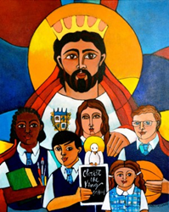
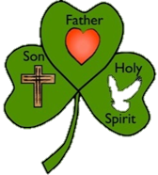
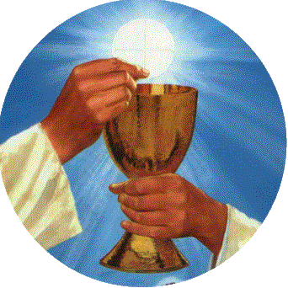
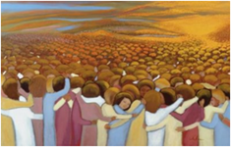
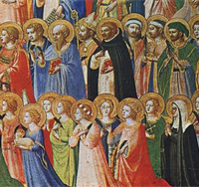
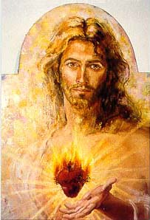
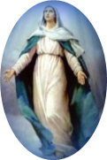
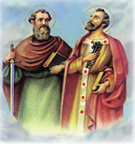
Major Feasts which occur in Ordinary Time
Feast of Christ the King celebrated on the last Sunday of the Liturgical Year
Feast of the Holy Trinity celebrated on the Sunday after Pentecost
Feast of All Souls celebrated on November 2
Feast of Corpus Christi - the Body of Christ celebrated on the Sunday after the Holy Trinity
Ordinary
Time
Feast of All Saints celebrated on November 1
Feast of the Sacred Heart of Jesus celebrated on Friday after Trinity Sunday
The Feast of the Assumption of Mary celebrated on August 15 - patronal feast of Aotearoa New Zealand
Feast of Saints Peter and Paul celebrated on June 29
R-1
S-07
Click the individual images to reveal text
Notes:
Slide 7 Major Feasts which occur in Ordinary Time
Start with the Feast of the Holy Trinity (the Shamrock) and work clockwise around the circle.
Name the feasts you have celebrated already this year. Give reasons for your response. Say something you know or want to know about each feast.

Slide 8
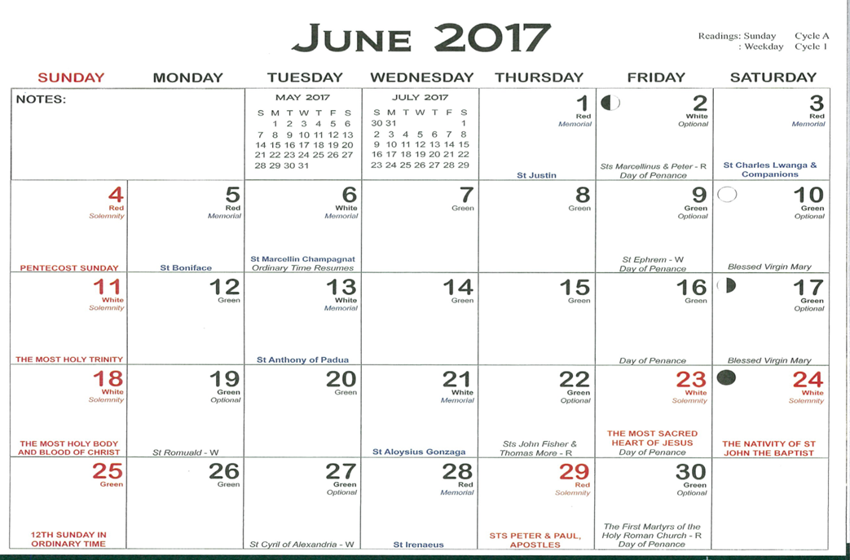
Using the Columban Calendar
The Columban Calendar is an excellent resource to help you locate Feasts and Seasons in the Liturgical Year. Having one at home and in your classroom is very helpful and very interesting.
Look closely and locate the Feasts in Ordinary Time mentioned on Slide 8.
Note how the Sunday in Ordinary Time is named – remember Ordinary Time is ordered or numbered Time. How many more Sundays in Ordinary Time are there?
Note what date Ordinary Time resumes after Pentecost which is part of the Easter season.
Note how Fridays are described and what that means.
Note the colours on certain days and research what they mean.
R-1
S-08
Notes:
Slide 8 Using the Columban Calendar
Show the class your Columban Calendar.
Work through each item on the slide.
There are approximately 24 more Sundays in Ordinary Time.
Ordinary Time resumes on the Sunday after Pentecost.
Friday is traditionally a day of Penance which means a day of fasting.
Research why the titles and dates of some feasts are red.

Slide 9
Growing in our Christian life in Ordinary Time
Look at the koru in the image. Imagine this is a symbol of your relationship with Jesus.
How can you use Ordinary Time to open yourself up to him so you can grow closer to him?
Ordinary Time is a time to grow and change and live your Christian life more fully.
Take time to read the stories in the Scriptures of Jesus’ ordinary life and listen to what he is saying to you as you read each one. Keep his messages in your heart and think about how you can put them into action in your life.
In your ordinary life are there people who need your help or caring attention? Talk to Jesus and ask him how you can show his face and hands to help these people.
R-1
S-09A
Click the icons to reveal text
Notes:
Slide 9A Growing in our Christian life in Ordinary Time
Work through each koru item.
Students could record some of the ideas in their RE Learning Journal to help them use Ordinary Time well.

Slide 10
Growing in our Christian life in Ordinary Time
Create some memos to remind yourself to spend a moment with Jesus.
They could be when you feel the warmth of the sun on your face, when you hear the kind words of a friend, when you enjoy a warm drink – all of these can remind you of the nearness of Jesus.
Try to use this Ordinary Time to become more active in your life as a follower of Jesus. Start today!
Notice signs of plants growing and let them remind you to let Jesus become a bigger focus in your life. Remember he is with you always – he is right there in your heart waiting for your attention.
R-1
S-09B
Click the icons to reveal text
Notes:
Slide 9B Growing in our Christian life in Ordinary Time
Work through each koru item.
Students could record some of the ideas in their RE Learning Journal to help them use Ordinary Time well.

Slide 11
Check up
1)
Make a poster with 5 important things you have learned about Ordinary Time and share it with your family and parish.
2)
Explain to a younger child using a Liturgical Calendar what Ordinary Time is and what they can do during this time. Record the questions the child asked and how you answered them.
3)
Make a list in your RE Learning Journal of ways you are going to use Ordinary Time to grow closer to Jesus and become more active in your Christian life - include celebrating the Lord’s Day in your part of the Christian community at Eucharist.
4)
Why is it important for Christians to celebrate together on Sunday, the Lord’s Day?
5)
Name 5 of the Feast days and when they occur in Ordinary Time.
6)
Which activity do you think helped you to learn best in this resource?
7)
Questions I would like to ask about the topics in this resource are …
Click in each caption space to reveal text
Click on the worksheet button to go to the worksheet.
R-1
S-10
Notes:
Slide 10 Check Up
This formative assessment strategy will help teachers to identify how well students have achieved the Learning Intentions of the resource.
Teachers can choose how they use the slide in their range of assessment options.
A worksheet of this slide is available for students in Years 5-8 to complete.
The last two items are feed forward for the teacher.
Recording the students’ responses to these items is recommended as it will enable teachers to adjust their learning strategies for future resources and target the areas that need further attention.

Slide 12
Time for Reflection
R-1
S-11
Click the audio button to stop reflective music
Click the audio button to play reflective music
Notes:
Slide 11 Time for Reflection
The MP3 is played to help create a reflective atmosphere and bring the young people to stillness and silence as the teacher invites them to reflect on using Ordinary Time to read the stories of Jesus’ ordinary life and spend some time thinking about how he lived and how he wants them to follow his way of living. Use the koru as a symbol to help them reflect on their growth and openness in their relationship with Jesus.

Slide 13
What I know about the Liturgical Year
Name:________________________
Date:________
1 | 2 | 3
4 | What I know about the Liturgical Year | 5
6 | 7 | 8
R-1
S-03
Click the worksheet button to go to the lesson
Notes:
(32) Share what I know template
The Share what I know slide should have a worksheet version to match.

Slide 14
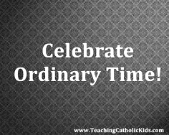
Check up
Name:____________________________
Date:____________
Make a poster with 5 important things you have learned about Ordinary Time and share it with your family and parish.
Explain to a younger child using a Liturgical Calendar what Ordinary Time is and what they can do during this time. Record the questions the child asked and how you answered them.
Make a list in your RE Learning Journal of ways you are going to use Ordinary Time to grow closer to Jesus and become more active in your Christian life - include celebrating the Lord’s Day in your part of the Christian community at Eucharist.
Why is it important for Christians to celebrate together on Sunday, the Lord’s Day?
Name 5 of the Feast days and when they occur in Ordinary Time.
Which activity do you think helped you to learn best in this resource?
Questions I would like to ask about the topics in this resource are …
R-1
S-10
Worksheet
Click the up arrow to return to the lesson

