Slide 1
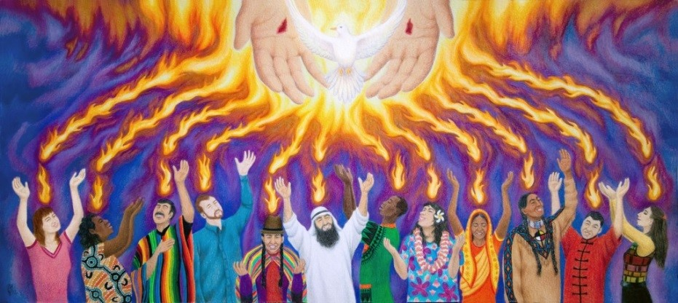
The Holy Spirit Te Wairua Tapu comes at Pentecost
R-1
S-01
Notes:
Use the Bible story about Pentecost during class prayer this week.
Look at the image and invite children to describe what it is about.

Slide 2
Learning Intentions
The children will…
1)
recall the Pentecost story
2)
identify who was present when the Holy Spirit came
R-1
S-02
Click the boxes to reveal text.
Notes:
Read through the Learning Intentions with the class and identify some ideas/questions that might be explored in the resource about the Holy Spirit and the Feast of Pentecost.

Slide 3
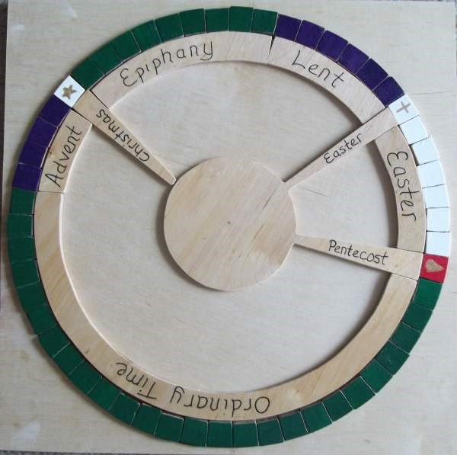
The Feast of Pentecost on the Liturgical Calendar
Look closely at the Liturgical Calendar and use the pointer.
Say the names of the feasts and seasons starting with Advent – stop when you get to Pentecost.
Pentecost is the feast that celebrates when the Holy Spirit comes to the apostles.
Red is the colour for the Holy Spirit.
What do you know about the feast of Pentecost?
Ordinary Time
Lent
Christmas
Advent
Easter
Pentecost
R-1
S-03
Click the red button to move the pointer around the calendar
Notes:
Talk about what a Liturgical Calendar is.
Adapt Teaching and Learning Experience 1
Work through the text using the pointer.
Retell the story of the Ascension and connect it to Pentecost.
Explain what a feast is - a special day to celebrate a very holy person or a special holy event. Can you think of a reason why red would be the colour for Pentecost?

Slide 4
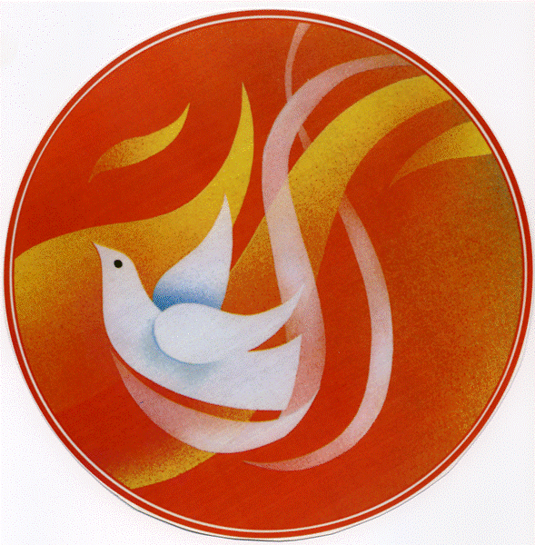
Pentecost is the day the Holy Spirit came to the apostles
The Holy Spirit is the Spirit of God and Jesus.
The Māori name for the Holy Spirit is Te Wairua Tapu.
The Holy Spirit lives in people helping them to be kind and good like Jesus.
We cannot see the Holy Spirit so we use symbols for it like or or a
At Pentecost the Holy Spirit came to the apostles and filled them with courage and love.
R-1
S-04
Click the icons to reveal text.
Notes:
Read and talk about the slide title.
Read through each piece of text and talk about what it means.
Adapt Teaching and Learning Experience 3

Slide 5
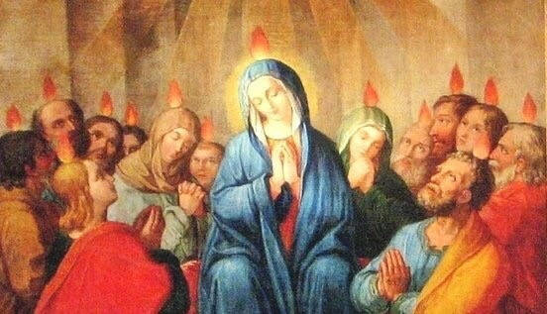
Who was present in the upstairs room when the Holy Spirit came?
This is a guessing game. You can only answer YES or NO
Jesus was there waiting at the table in the room. YES NO
Some children were there waiting for the Holy Spirit to come. YES NO
Thomas and Matthew were amazed when the tongues of fire rested on them. YES NO
Just one apostle was waiting for the Holy Spirit. YES NO
Over a hundred followers of Jesus were present when the Holy Spirit came. YES NO
Mary, the mother of Jesus was there waiting with the apostles. YES NO
Only men were present when the Holy Spirit came with the rushing wind. YES NO
Jesus’ friends Peter, James and Andrew waited with Mary for the Holy Spirit. YES NO
Many mothers and fathers who followed Jesus received the Holy Spirit that day. YES NO
Jesus’ best friend John heard the wind and was filled with Holy Spirit too. YES NO
R-1
S-05
Click the correct answer for confirmation.
Notes:
Use the guessing game to introduce the Pentecost story.
Remind the children the Holy Spirit came in the same room as Jesus and his friends had their Last Supper together.
ANSWERS
NO, 2) YES, 3) YES, 4) NO, 5) YES, 6) YES, 7) NO, 8) YES, 9) YES, 10) YES

Slide 6
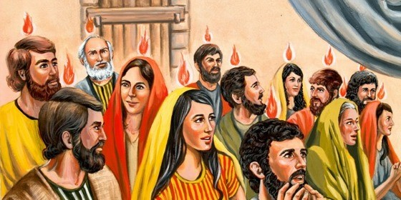
The story of Pentecost
Pentecost happened after Jesus
The apostles were together
They were feeling lonely
Then suddenly they heard a great
The Holy Spirit filled them and little
went back to God his Father in heaven.
in a big upstairs room in Jerusalem.
and scared without Jesus.
sound of rushing wind.
tongues of fire rested on each of them.
a) tongues of fire rested on each of them.
b) sound of rushing wind.
c) in a big upstairs room in Jerusalem.
d) went back to God his Father in heaven.
e) and scared without Jesus.
R-1
S-06
Click the end of the sentences or the items on the list to complete the sentences.
Click the video icon for a video - The Holy Spirit Comes.
Notes:
Note what is happening in the image.
Watch the clip https://www.youtube.com/watch?v=IqG_lvZhU-A
The Holy Spirit Comes – Animated version
2:57 minutes
Adapt Teaching and Learning Experiences 5,6 &7.
Read the text and complete the sentences and check it out with the floaters.
ANSWERS 1)D, 2) C, 3) E, 4) B, 5) A
How did Jesus’s followers know the Holy Spirit had come?

Slide 7
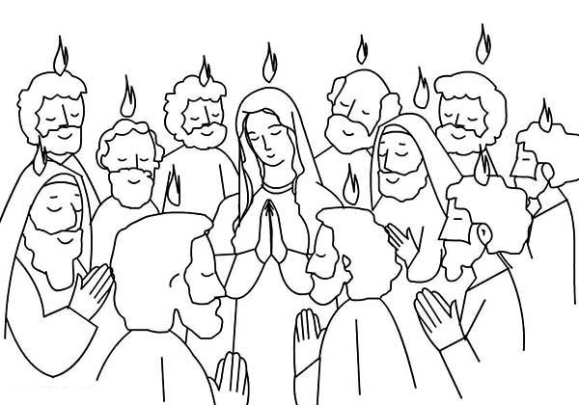
After the Holy Spirit came the apostles changed
The Holy Spirit changed the apostles
BEFORE PENTECOST FROM | AFTER PENTECOST TO
frightened to go out | noisy and excited
sad without Jesus | brave and full of courage
quiet and worried | happy and filled with the Holy Spirit
Draw a line to show how the apostles changed after Pentecost
Draw the symbols for the Holy Spirit in the frames -
The Holy Spirit is like fire.
The Holy Spirit is like a dove.
The Holy Spirit is like wind.
R-1
S-07
Click the yellow button for answers.
Click the worksheet icon to open worksheet.
Notes:
Use the text as a starter to talk about how the followers of Jesus felt before the Holy Spirit came and how they changed after the Holy Spirit came. Explain that we cannot see the Holy Spirit but we can see where it has been. We use symbols to help us understand what the Holy Spirit is like.
Children complete the worksheet and check it using the floaters.
Explain that the Holy Spirit makes children brave and helps them to understand what is going on.

Slide 8
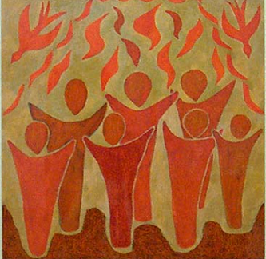
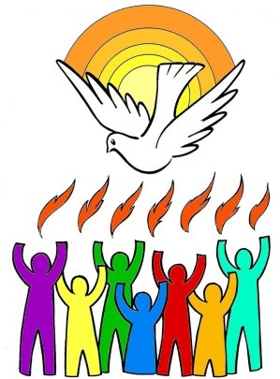
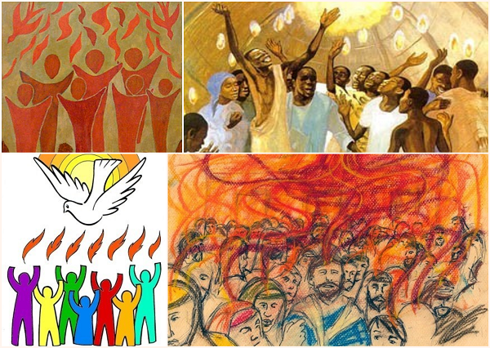
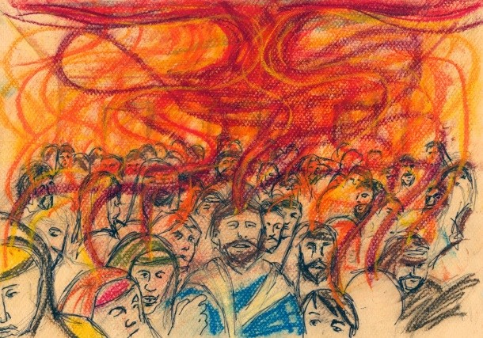
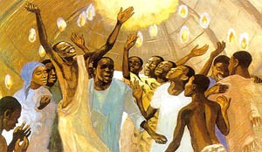
Telling the story of Pentecost in pictures
Look at each picture of the Pentecost story.
Tell the story of Pentecost around your class circle – don’t forget to make the sound of the rushing wind and the excited people.
Choose your favourite picture and tell a friend what you like about it.
Look at how the artist used colours and shapes to show the people filled with the Holy Spirit.
Create your own Pentecost art work to share with your family and tell them the story.
R-1
S-08
For a closer look at the pictures click each one, then click the picture to see the others.
Notes:
Follow the text on the screen.
Refer to the title mage on slide 1 – how would you explain it now?
Imagine what it would have been like for the followers of Jesus when the Holy Spirit came.

Slide 9
Check Up
1)
The Pentecost story is about …
2)
3 things that happened when the Holy Spirit came are …
3)
The Holy Spirit is the Spirit of …
4)
What did the followers of Jesus see and hear at Pentecost?
5)
Which activity do you think helped you to learn best in this resource?
6)
Questions I would like to ask about the topics in this resource are…
R-1
S-09
Click the boxes to reveal text.
Notes:
This formative assessment strategy will help teachers to identify how well the children have achieved the Learning Intentions of the resource.
Teachers can choose how they use the slide in their range of assessment options.
A worksheet of this slide is available for children in Years 5-8 to complete.
The last two items are feed forward for the teacher.
Recording the children’s responses to these items is recommended as it will enable teachers to adjust their learning strategies for future resources and target the areas that need further attention.

Slide 10
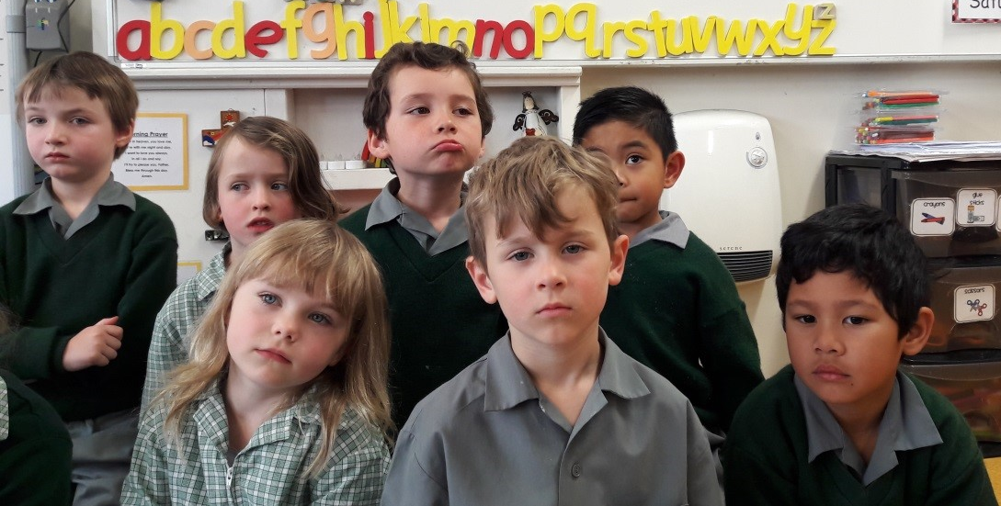
Time For Reflection
R-1
S-10
Click the audio button to stop reflective music
Click the audio button to play reflective music
Notes:
The MP3 is played to help create a reflective atmosphere and bring the children to stillness and silence as the teacher invites them to imagine they can hear the rushing wind of the Holy Spirit and feel the Spirit of Jesus filling their heart with love to share with everyone they meet.

Slide 11
After the Holy Spirit came the apostles changed
The Holy Spirit changed the apostles
BEFORE PENTECOST FROM | AFTER PENTECOST TO
frightened to go out | noisy and excited
sad without Jesus | brave and full of courage
quiet and worried | happy and filled with the Holy Spirit
Draw a line to show how the apostles changed after Pentecost
Draw the symbols for the Holy Spirit in the frames -
The Holy Spirit is like fire.
The Holy Spirit is like a dove.
The Holy Spirit is like wind.
Name ____________________________ Date _______________
R-1
S-7
Worksheet
Click the up arrow to return to the lesson
Notes:
Use the text as a starter to talk about how the followers of Jesus felt before the Holy Spirit came and how they changed after the Holy Spirit came. Explain that we cannot see the Holy Spirit but we can see where it has been. We use symbols to help us understand what the Holy Spirit is like.
Children complete the worksheet and check it using the floaters.
Explain that the Holy Spirit makes children brave and helps them to understand what is going on.

