Slide 1
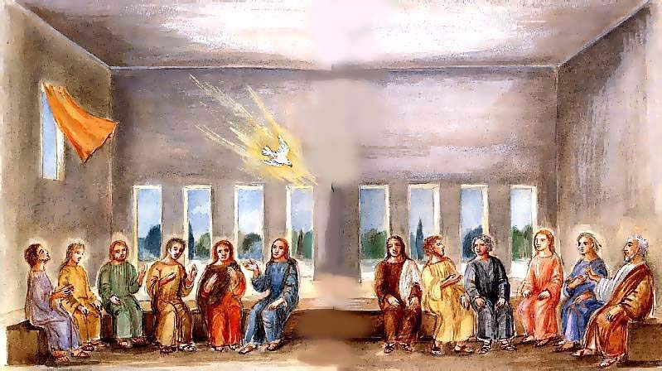
The Holy Spirit Te Wairua Tapu
comes in wind and fire
R-1
S-01
Notes:
Read the Bible story about Pentecost during class prayer this week.

Slide 2
Learning Intentions
The children will:
1)
recognise how the Holy Spirit Te Wairua Tapu came
as wind and fire
2)
identify how the actions of wind and fire are like the Holy Spirit
R-1
S-02
Click the borders to reveal text

Slide 3

What we know already about the feasts and seasons in the Liturgical Year
Recall the feast of the Ascension and point to where it comes on the calendar.
Look closely at the Liturgical Calendar and find the season of Advent.
Move from there around the calendar and say the names of the feasts and seasons.
Stop when you get to Pentecost.
What do you know about the feast of Pentecost? – look below the calendar for a clue!
R-1
S-03
Press the red button on the bottom right hand corner of the calendar to advance arrow to the next season

Slide 4
The story of Pentecost
Who are the people in the picture?
Where is Jesus?
What do you think they are
talking about?
What is happening in the picture?
What is just about to happen?
X
R-1
S-04
Click the I-button to reveal questions. Click on the video button to play ‘The Holy Spirit Comes.’
Notes:
Watch the clip
https://www.youtube.com/watch?v=IqG_lvZhU-A
Animated
The Holy Spirit Comes (includes some miracles that happened after Pentecost)
2:57 minutes
Responses to the questions
1) The 12 apostles and Jesus’ mother Mary – she was his first follower.
2) Jesus is not there because he has returned to God his Father in heaven – revise Ascension story.
3) Jesus told them he would send his Spirit – they are wondering when he will come.
4) The picture shows the signs of the Holy Spirit coming - you can see are the dove and the mighty wind moving the curtain.
5) The apostles can hear the sound of the wind and soon the tongues of fire will come and rest on them.

Slide 5
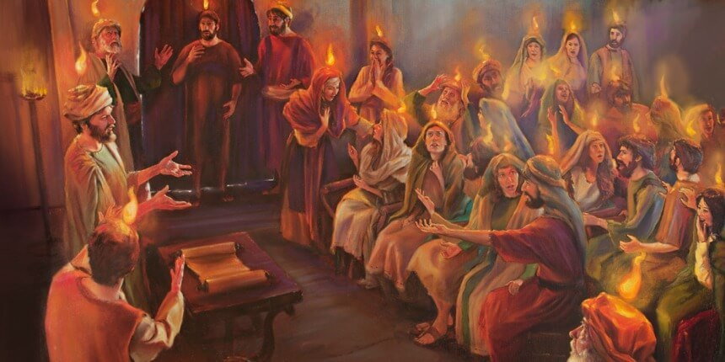
At Pentecost the Holy Spirit came and filled the Apostles’ hearts
1)
2)
3)
4)
5)
6)
The apostles could not see the Holy Spirit
but they could see and hear signs of it.
The Holy Spirit sounded like a
mighty wind blowing all around them.
What seemed to be tongues of
fire appeared and rested on each of them.
You can’t touch wind or fire but you
can see by their actions what they do.
When the Holy Spirit fills people’s
hearts they are full of love and energy.
The Holy Spirit cannot
be seen or touched.
a) fire appeared and rested on each of them.
b) hearts they are full of love and energy.
c) can see by their actions what they do.
d) but they could see and hear signs of it.
e) mighty wind blowing all around them.
f) be seen or touched.
R-1
S-05
Click a sentence ending from the blue box to correctly position it.
Notes:
ANSWERS
1) D, 2) E, 3) A, 4) C, 5) B, 6) F

Slide 6


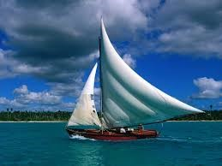
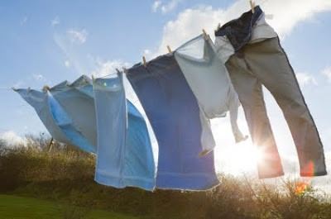
How are the actions of wind like the
Holy Spirit Te Wairua Tapu?
The wind goes where it likes but you cannot see it.
Just like the Holy Spirit Te Wairua Tapu.
When the wind blows you know it is there because you can see the signs of what it is doing.
Just like the Holy Spirit Te Wairua Tapu.
The wind has energy to move things along to new places.
Just like the Holy Spirit Te Wairua Tapu.
The wind changes things but you don’t see it happening.
Just like the Holy Spirit Te Wairua Tapu.
Think of the coming of the Holy Spirit at Pentecost next time you are out in the wind.
R-1
S-06
Click images to reveal text.

Slide 7
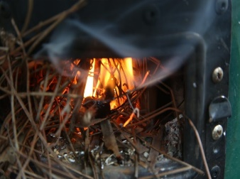
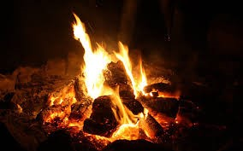
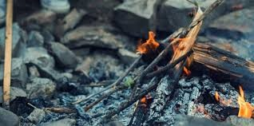
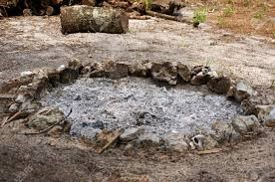
How is fire a sign of the Holy Spirit Te Wairua Tapu?
A fire starts off little and grows into something big and powerful.
It feels good and warm inside – like the Holy Spirit Te Wairua Tapu.
You cannot touch a fire but you can recognise where it is.
It is the same with the Holy Spirit Te Wairua Tapu.
When a fire goes out it becomes cold and dies.
This happens to the Holy
Spirit in people too if they
don’t let it act in their lives.
A fire dies down if people do not pay attention to it.
This happens to the Holy Spirit in people too.
Think of the day of Pentecost when the Holy Spirit came next time you are near a fire.
Tell someone the story of Pentecost and read the story from the Bible at bedtime.
R-1
S-07
Click on a section of text to reveal an image

Slide 8


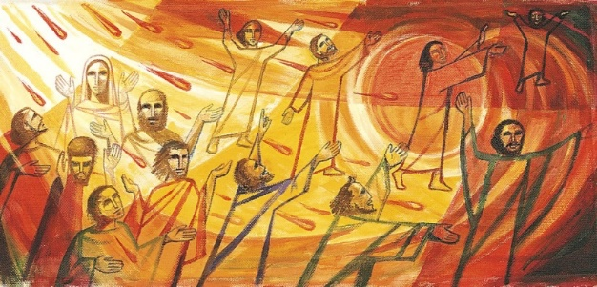
How did the Holy Spirit change the apostles?
Before Pentecost the apostles felt lonely and frightened because Jesus had gone back to heaven to be with God his Father.
They went out into the streets and started telling people about how Jesus died, rose, returned to heaven and sent his Holy Spirit into them.
They told the people to tell God they were sorry for the things that had done wrong and to get baptised so they could also have the Holy Spirit Te Wairua Tapu in their hearts.
After the Holy Spirit came to them like the wind and tongues of fire they felt brave and strong.
They stayed together in the upstairs room where they had eaten the Last Supper with Jesus.
R-1
S-08
Click the pins on the right to reveal post-it notes.

Slide 9
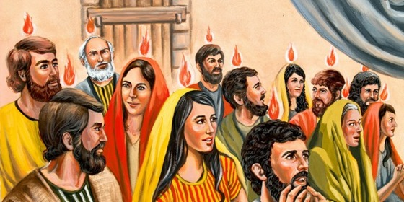
The Holy Spirit helps people to love and care for others as Jesus did
H | J | B | E | S | P | I | R | I | T
E | E | E | S | F | O | L | L | O | W
L | S | I | P | E | R | O | O | L | S
P | U | N | E | V | I | V | L | O | A
S | S | G | C | O | P | I | A | N | D
T | W | H | I | T | E | N | R | E | K
O | H | B | A | H | O | G | E | L | I
T | E | T | L | E | P | B | F | Y | N
K | N | H | L | R | L | Y | T | S | D
T | H | E | Y | S | E | H | O | L | Y
The Holy Spirit helps people to follow Jesus by being kind and loving to others especially when they are sad or lonely.
R-1
S-09
Click the words in the sentence to reveal its position in the Word Find.

Slide 10

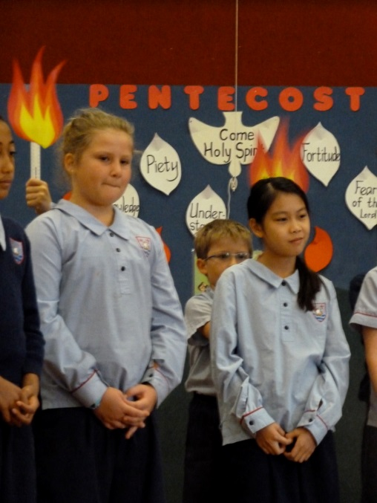
How can children of your age show the
Holy Spirit is in your heart?
Complete the sentences with examples
I show the Holy Spirit is in my heart when …
I see someone who is sad I …
I show someone how to …
I speak kindly to …
I help someone to …
I ask the Holy Spirit to help me to …
R-1
S-10
Click the audio button to stop ‘Holy Spirit Song’
Click the audio button to play ‘Holy Spirit Song’
Notes:
Sing using the MP3 ‘Holy Spirit Song’

Slide 11
Check Up
1)
The apostles thought the Holy Spirit sounded like ____ and looked like ____
2)
How are the actions of wind and fire like the Holy Spirit Te Wairua Tapu?
3)
Draw the Holy Spirit coming down to the apostles at Pentecost and share your picture with your family. Show the signs of wind and fire in the picture.
4)
Which activity do you think helped you to learn best in this resource?
5)
Questions I would like to ask about the topics in this resource are …
R-1
S-11
Click the borders to reveal text

Slide 12
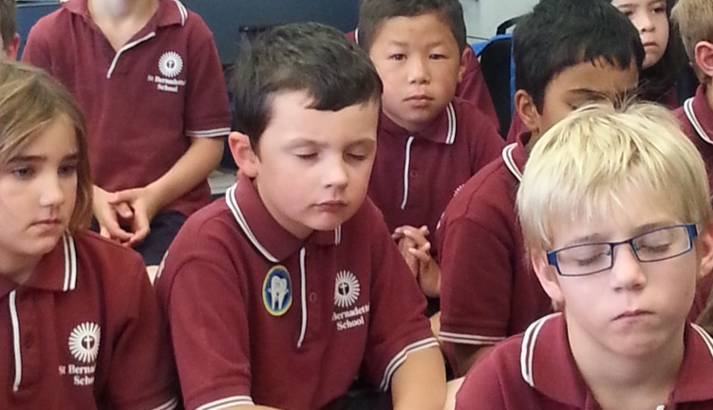

Time for Reflection
R-1
S-12
Click the audio button to stop reflective music
Click the audio button to play reflective music
Notes:
The MP3 is played to help create a reflective atmosphere and bring the children to stillness and silence as the teacher invites them to remember something they have done yesterday or today that shows that the Holy Spirit is in their heart helping them to do the kind things Jesus did when he lived on earth to help others.

Slide 13
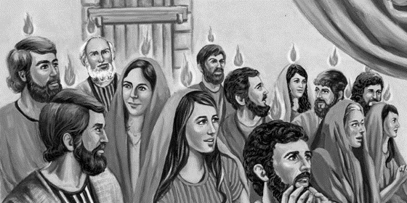
The Holy Spirit helps people to love and care for others as Jesus did
H | J | B | E | S | P | I | R | I | T
E | E | E | S | F | O | L | L | O | W
L | S | I | P | E | R | O | O | L | S
P | U | N | E | V | I | V | L | O | A
S | S | G | C | O | P | I | A | N | D
T | W | H | I | T | E | N | R | E | K
O | H | B | A | H | O | G | E | L | I
T | E | T | L | E | P | B | F | Y | N
K | N | H | L | R | L | Y | T | S | D
T | H | E | Y | S | E | H | O | L | Y
Name______Date______
The Holy Spirit helps people to follow Jesus by being kind and loving to others especially when they are sad or lonely.
R-1
S-09
Worksheet
Click the up arrow to return to the lesson
Notes:
Find each word in the sentence below on the matrix and highlight it in the sentence and in the Word Find.
The Holy Spirit helps people to follow Jesus by being kind and loving to others especially when they are sad or lonely.

