Slide 1
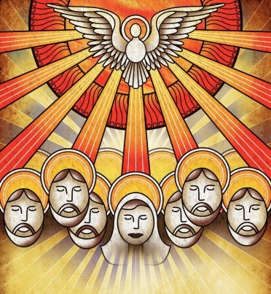
The Mother of Jesus was Present at Pentecost
R-1
S-01
Notes:
Use this slide as a focussing strategy to introduce the resource topic. Read the Bible story about Pentecost during class prayer this week.

Slide 2
Learning Intentions
The children will…
1)
recall the people present at the first Pentecost
2)
recognise that Mary was in the upper room, praying with the other apostles when the Holy Spirit Te Wairua Tapu came
R-1
S-02
Click the boxes to reveal text.
Notes:
Read through the Learning Intentions with the class and identify some ideas/questions that might be explored in the resource about the events of the Feast of the first Pentecost and who was present.

Slide 3
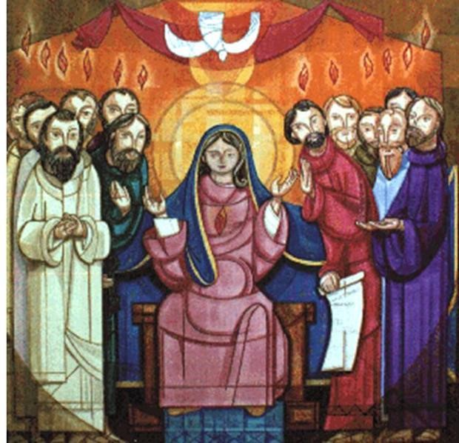
Rapid recap on Pentecost
Pentecost
When?
Where?
Why?
Who was present?
What happened?
What were the outcomes?
X
R-1
S-03
Click the “i” button to reveal text.
Notes:
Recap the events of the day of the Ascension to get the context to lead into learning about the Feast of Pentecost.
Children answer the questions on the slide.
Record them in their RE Learning Journal.

Slide 4
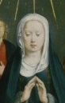
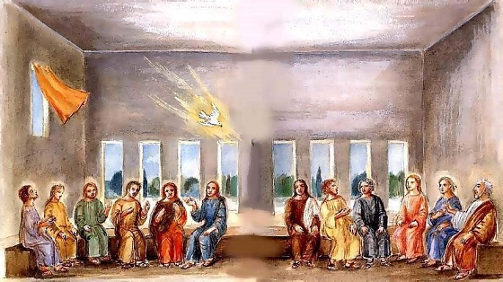
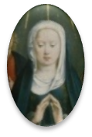
How come Mary the Mother of Jesus was present at Pentecost?
Mary was Jesus’ mother and she was also his first disciple.
Mary knew the apostles well and was part of their group.
Throughout her life Mary supported Jesus as he carried out his mission.
Mary was present at the ‘birth’ of the Church and now she is known as the ‘Mother of the Church’.
R-1
S-04
Click the icons to reveal text.
Notes:
Use the text to help children explore Mary’s role in Jesus’ life and how she supported the work God asked him to do.
How is your mother like this for you?

Slide 5
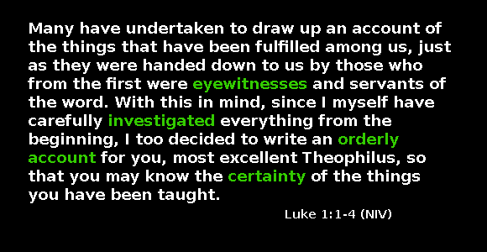
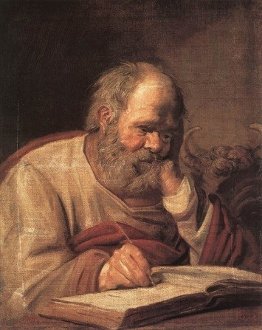
St Luke records the beginnings of the Church in the first verses of his Gospel
3 Questions to ponder after you have read what Luke wrote
What sort of person do you think Luke was?
Why do you think St Luke started his gospel like this?
Who was Theophilus ?
R-1
S-05
Click the yellow button to advance the arrow
Notes:
Remind children about who the author of the Acts of the Apostles was and what other writing he did. Read the reading from Luke using the pointer, then work through the questions.
Ideas related to question responses
Luke was a Greek doctor, born in Antioch, he was a disciple of Paul and the author of a gospel and the Acts of the Apostles. In his writing, he was concerned with checking that what was recorded about the activities of the Early Christians was right. His work involved orderly investigation of the events and being sure about what he was doing.
Luke wanted people who read his gospel to feel that it was a true account of what happened. He was conscious that there were many accounts by eye witnesses of the events that happened in the Early Church including Pentecost. Luke was not an eye witness but he wanted to be certain that the stories that were passed on were accurate.
There is much debate about who Theophilus was. Some say he was Luke’s lawyer, others say he was a Jew or a Roman official. Others believe he wasn’t a person but his name ‘Friend of God’ was just a title that could be applied to anyone who fits the description. Whoever he was, Luke dedicated his gospel and the Acts of the Apostle to him.

Slide 6
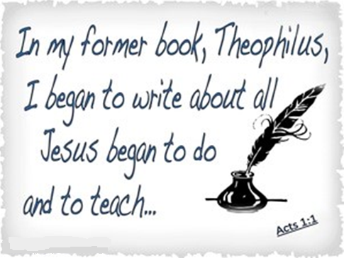
St Luke makes the connection between his Gospel and the Acts of the Apostles
Continue to read from the Acts of the Apostles what is started on the image
Pay special attention to:
The Ascension story Acts 1:6-11
Who was present in the upper room Acts 1:12-14
What did they do and what were they waiting for? Acts 2:1- 4
R-1
S-06
Notes:
Follow the directions on the slide.
How would you describe the author of the Acts of the Apostles?
In groups research Luke and /or his friend Theophilus – find out more about them. Find images of what they could have looked like and using the results of your research create presentations to share with your school. Make up a rap about them.

Slide 7

Mary was in the upper room praying with the apostles when the Holy Spirit came
Mary was filled with the Holy Spirit at the birth of Jesus and at the birth of the
Mary was the model of prayer for the followers of Jesus in the
Mary was a teacher, friend and advisor to the
The Pentecost story in Acts is the last mention of Mary in the
The gospel that features Mary most is the gospel written by
Church.
Early Church.
apostles and disciples.
Scripture.
St Luke.
apostles and disciples
Scripture
Early Church
St Luke
Church
Click the end of the sentences or the items on the list to complete the sentences.
Click the video icon for a video “Day of Pentecost” and worksheet icon for worksheet.
R-1
S-07
Notes:
Watch the clip: https://www.youtube.com/watch?v=7TyCwUrR_OM
Day of Pentecost (4:39 minutes)
ANSWERS 1) Church, 2) Early Church, 3) apostles and disciples, 4) Scripture, 5) St Luke

Slide 8
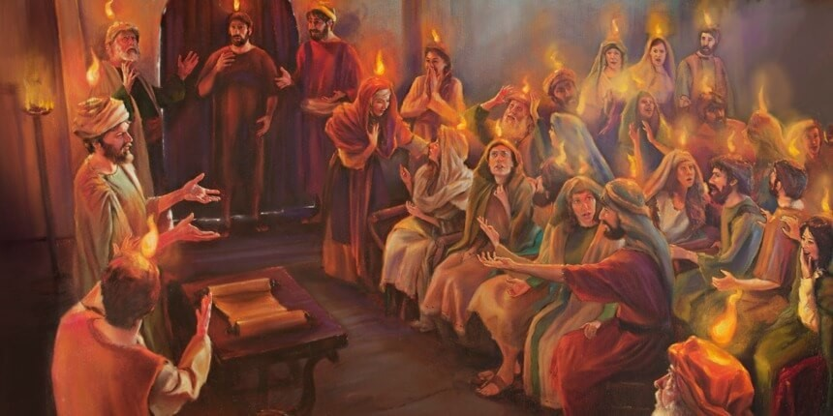
Mary is present in the Church today
I | S | G | J | E | S | U | S | E | S
R | I | E | H | T | T | H | E | Y | A
E | R | U | C | M | F | E | S | A | T
T | W | S | R | A | O | H | R | D | N
J | I | R | U | R | N | T | E | O | E
E | T | E | H | Y | T | D | H | T | S
S | H | T | C | H | U | I | T | E | E
O | E | S | T | I | L | L | O | Y | R
S | L | I | N | L | P | S | R | A | P
M | E | S | U | A | C | E | B | S | I
Mary is still present with the brothers and sisters of Jesus in the Church today because she is their mother.
R-1
S-08
Click the words in the sentence to reveal them in the word-find
Click the worksheet icon for the worksheet
Notes:
Find each word in the sentence below on the matrix and highlight it in the sentence and in the Word Find.
Mary is still present with the brothers and sisters of Jesus in the Church today because she is their mother.
Compare how your mother cares for you with how Mary cares for the Church.
Children complete their word find worksheet and check it out on the screen. Add to RE learning journal.

Slide 9

Check Up
1)
Name 5 people who were present when they Holy Spirit came at Pentecost.
2)
What parts of the New Testament did St. Luke write?
3)
How do we know Mary was present at the birth of Jesus and the birth of the Church?
4)
What activity was an important part of the early disciples’ life together?
5)
Which activity do you think helped you to learn best in this resource?
6)
Questions I would like to ask about the topics in this resource are…
R-1
S-09
Click the boxes to reveal text.
Notes:
This formative assessment strategy will help teachers to identify how well the children have achieved the Learning Intentions of the resource.
Teachers can choose how they use the slide in their range of assessment options.
A worksheet of this slide is available for children in Years 5-8 to complete.
The last two items are feed forward for the teacher.
Recording the children’s responses to these items is recommended as it will enable teachers to adjust their learning strategies for future resources and target the areas that need further attention.

Slide 10


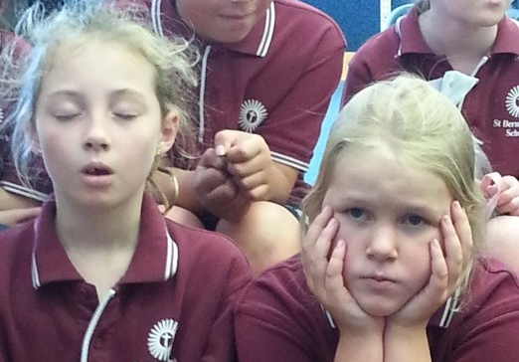

Time for Reflection
R-1
S-10
Click the audio button to stop reflective music
Click the audio button to play reflective music
Notes:
The MP3 is played to help create a reflective atmosphere and bring the children to stillness and silence as the teacher invites them to talk to Mary the mother of Jesus about what it was like being filled with the Holy Spirit and seeing the Church being born in the hearts and lives of the first disciples. Recall how they can learn from the first disciples especially in the ways they shared what they had with everyone.

Slide 11
Mary’s special place in the Pentecost story
Name ____________________________ Date _______________
Mary, Mother of the Church
Pray for us
First read the extract from Acts 1:12-14
Then the apostles returned to Jerusalem from the hill called the Mount of Olives, a Sabbath day’s walk from the city. When they arrived, they went upstairs to the room where they were staying. Those present were Peter, John, James and Andrew; Philip and Thomas, Bartholomew and Matthew; James son of Alphaeus and Simon the Zealot, and Judas son of James. They all joined together constantly in prayer, along with the women and Mary the mother of Jesus, and with his brothers.
In the frame create an art work that expresses what happened at the first Pentecost.
Include each of the apostles and those mentioned in the last verse.
Include ideas you saw on the clip about when the Holy Spirit came.
R-1
S-7
Worksheet
Click the up arrow to return to the lesson
Notes:
Please note the Judas mentioned in the list is not Judas Iscariot who betrayed Jesus. The Judas referred to was often known as Thaddeus.
Encourage the children to share their worksheet with their families at Pentecost.
Adapt Teaching and Learning Experiences 4 & 5.

Slide 12
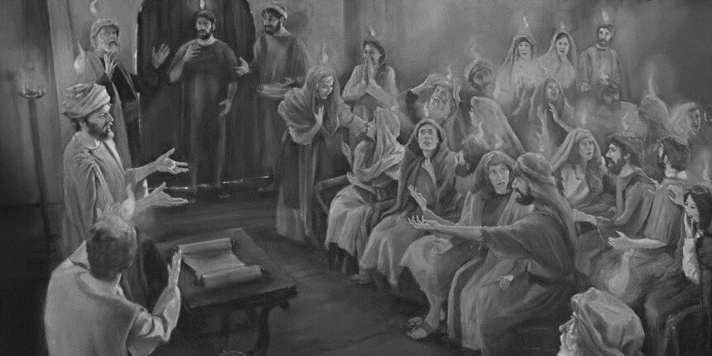
Mary is present in the Church today
Name ____________________________ Date _______________
I | S | G | J | E | S | U | S | E | S
R | E | I | H | T | T | H | E | Y | A
E | R | U | C | M | F | E | S | A | T
T | W | S | R | A | O | H | R | D | N
J | I | R | U | R | N | T | E | O | E
E | T | E | H | Y | T | D | H | T | S
S | H | T | C | H | U | I | T | E | E
O | E | S | T | I | L | L | O | Y | R
S | L | I | N | L | P | S | R | A | P
M | E | S | U | A | C | E | B | S | I
Find each word in the sentence below on the Word Find - highlight it in the sentence and in the Word Find.
Mary is still present with the brothers and sisters of Jesus in the Church today because she is their mother.
R-1
S-8
Worksheet
Click the up arrow to return to the lesson
Notes:
Find each word in the sentence below on the matrix and highlight it in the sentence and in the Word Find.
Mary is still present with the brothers and sisters of Jesus in the Church today because she is their mother.

