Slide 1
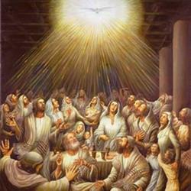
Pentecost – the Spirit changes the Apostles
R-1
S-01
Notes:
Use this slide as a focussing strategy to introduce the resource topic.
Read the title together and invite children to share something they know about the Feast of Pentecost. Read the Bible stories about Pentecost during class prayer this week.

Slide 2
Learning Intentions
The children will:
1)
identify who were the foundation members of the Church
2)
recognise the effects of the Spirit in the lives of the foundation members of the Church
R-1
S-02
Click in each caption space to reveal text
Notes:
Read through the Learning Intentions with the class and identify some ideas/questions that might be explored in the lesson.

Slide 3
What do you know about Pentecost?
Circle TRUE or FALSE
TRUE | FALSE
TRUE | FALSE
TRUE | FALSE
TRUE | FALSE
TRUE | FALSE
TRUE | FALSE
TRUE | FALSE
TRUE | FALSE
TRUE | FALSE
TRUE | FALSE
PENTECOST is the feast that celebrates the coming of the Holy Spirit.
The Liturgical colour for PENTECOST is green.
PENTECOST is the last feast in the Easter season.
Jesus was present with the apostles at PENTECOST.
When the Holy Spirit came it sounded like rain on the roof.
The Holy Spirit is the Spirit of Jesus.
The apostles were gathered in the temple when the Holy Spirit came.
Mary, Jesus’ mother, was present at PENTECOST.
The feast of the Ascension comes after PENTECOST.
The Holy Spirit took away the apostles’ fear.
R-1
S-03A
Notes:
Children complete the PENTECOST Quiz on the worksheet. This can be used as a pre-test that will identify areas that need to be highlighted when using the resource.
ANSWERS:
1) TRUE, 2) FALSE, 3) TRUE, 4) FALSE, 5) FALSE, 6) TRUE, 7) FALSE, 8) TRUE, 9) FALSE, 10) TRUE, 11) TRUE, 12) TRUE, 13) FALSE, 14) TRUE, 15) TRUE, 16) TRUE, 17) TRUE, 18) FALSE, 19) TRUE, 20) TRUE

Slide 4
What do you know about Pentecost?
Circle TRUE or FALSE
TRUE | FALSE
TRUE | FALSE
TRUE | FALSE
TRUE | FALSE
TRUE | FALSE
TRUE | FALSE
TRUE | FALSE
TRUE | FALSE
TRUE | FALSE
TRUE | FALSE
PENTECOST means fifty because it happened 50 days after Easter.
PENTECOST is known as the birthday of the Church.
After PENTECOST the apostles hid away and did not speak about Jesus.
There were about 120 people when the Holy Spirit came at PENTECOST.
The first disciples of Jesus were the first members of the Church.
PENTECOST fulfilled the promise Jesus made to always be with his friends.
PENTECOST made it possible for Jesus to live in people through his spirit.
After PENTECOST the apostles forgot about Jesus.
Prayer was a very important part of the life of the early Church members.
Red vestments symbolise the tongues of fire that appeared at PENTECOST.
R-1
S-03B
Click the worksheet button to go to the worksheet
Notes:
Children complete the PENTECOST Quiz on the worksheet. This can be used as a pre-test that will identify areas that need to be highlighted when using the resource.
ANSWERS:
1) TRUE, 2) FALSE, 3) TRUE, 4) FALSE, 5) FALSE, 6) TRUE, 7) FALSE, 8) TRUE, 9) FALSE, 10) TRUE, 11) TRUE, 12) TRUE, 13) FALSE, 14) TRUE, 15) TRUE, 16) TRUE, 17) TRUE, 18) FALSE, 19) TRUE, 20) TRUE

Slide 5
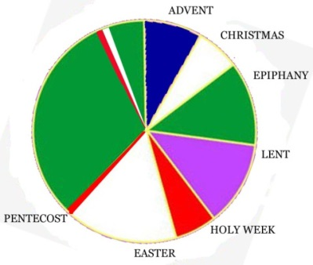
Pentecost in the Liturgical Year
Pentecost follows the feast of the …
Pentecost is celebrated 50 days after …
Pentecost is followed by …
The Liturgical colour for Pentecost is …
Pentecost marks the Church’s …
X
R-1
S-04
Click the I-button to reveal information. Click the video button to play the video ‘What is Pentecost’.
Notes:
Work through items on the I pop up to help children to position Pentecost correctly in the Liturgical Year.
1) The Feast of the Ascension, 2) The season of Easter 3) Ordinary Time, 4) Red, 5) Birthday.
Watch the clip: https://www.youtube.com/watch?v=8yX-lTO4SA0
‘What is Pentecost?’ - 8 minutes. Take time to respond to children’s comments and questions about the material in the clip.

Slide 6
The Events of the Day of Pentecost
About 10 days before Pentecost day Jesus had returned to God, his Father in heaven, the disciples were filled with fear. They missed Jesus and although he had promised he would send his Spirit to be with them they did not know when this would happen.
The disciples stayed together in the upper room praying and reminding each other of Jesus’ words and actions. They had no idea what would happen when the Spirit came. The only thing they knew for certain was that Jesus would keep his promise.
The morning of the tenth day after the Ascension dawned as usual. The disciples of Jesus were altogether and just before nine o’clock they heard the rush of a violent wind that filled the entire house.
This was followed by divided tongue shapes as of fire that appeared among them and settled slowly on each of them. All of the disciples were filled with the Holy Spirit and they began to speak in other languages as the Holy Spirit enabled them to. Read on from Acts 2:5 to hear the rest of the story about the events of Pentecost Day
R-1
S-05
Click an images to reveal a text line
Notes:
Read each text reveal and discuss the events in each stage of the Pentecost story. Think about the sort of people the disciples were and how they would have felt and reacted as each stage of the event unfolded. Continue to read the Acts of the Apostles 2:5 as the day of Pentecost continued.

Slide 7
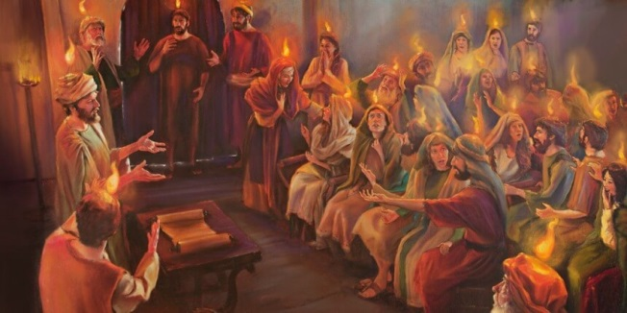
A Disciple’s version of what happened when the Holy Spirit came
After viewing the Pentecost clip imagine you are one of the disciples who experienced the coming of the Holy Spirit.
Name who you are and write a descriptive account of your experience of what happened in the upper room including how you felt, how you recognised what was happening, what the reactions of the other disciples were and how you were affected by the Pentecost experience. These accounts could be made into a book for the class to read and share.
You may also like to use your personal accounts to create a script for a play you could present to your school and/or parish. Your plays could be filmed and used as a resource for younger children to learn about Pentecost.
You may also consider recording your experience in an interview format to share.
R-1
S-06
Click the video button to play the video ‘Day of Pentecost’.
Notes:
Preview the clip before you show the class.
Watch it then work through the follow-up ideas on the slide.
Watch the clip: Note the Scripture references to the Acts of the Apostles on the screen - https://www.youtube.com/watch?v=FIJrk9-dtRE ‘Day of Pentecost’ 9:32. Adapt Teaching and Learning Experience 4.
You may like to use the clip in prayer time and let the children use their Bibles to follow the text. Allow time for comments, questions and prayer to the Holy Spirit.

Slide 8
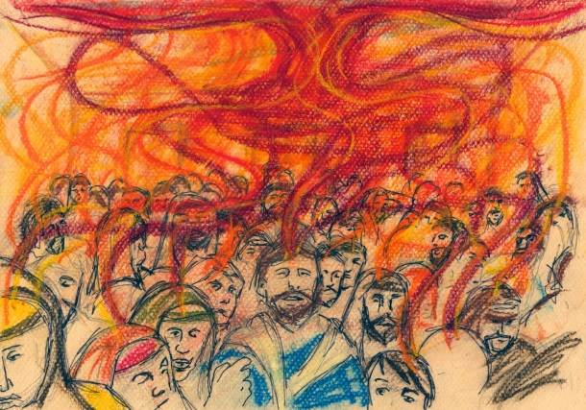
The effects of the Holy Spirit in the lives of the Foundation Members of the Church
Although Jesus was not physically present with the disciples they knew his Spirit was alive in their hearts helping them to understand more deeply what they had to do and as their faith grew stronger they grew in confidence and many more people became followers of Jesus.
The Holy Spirit replaced their fear with courage and strength so they could begin the work of the Church to spread the good news rongo pai of God’s love for all people just as Jesus had taught them.
They were expected to carry on the teachings of Jesus, baptise people as he did and perform miracles as he did. This they could do only because of the power of the Holy Spirit within them.
This meant they would have to live their faith publicly, not behind closed doors but out and about among the people despite their fears of being persecuted because they had been followers of Jesus who was crucified.
They began to realise what Jesus meant when he spoke about how he wanted them to carry on his work of building God’s Kingdom Te Rangatiratanga here on earth.
The first disciples who experienced the coming of the Holy Spirit did not understand fully what was happening at the time. Their understanding of what it meant for them to be filled with the Holy Sprit grew gradually over the days and weeks that followed.
R-1
S-07
Click top card to discard it
Notes:
Adapt Teaching and Learning Experiences 2 & 3.
Discuss what a ‘foundation member’ means. In your opinion what would be good about being a foundation member of something and what would be hard about it?
Read the flip cards and after each one invite children to put in their own words what it said. Children make up questions to ask and answer.

Slide 9
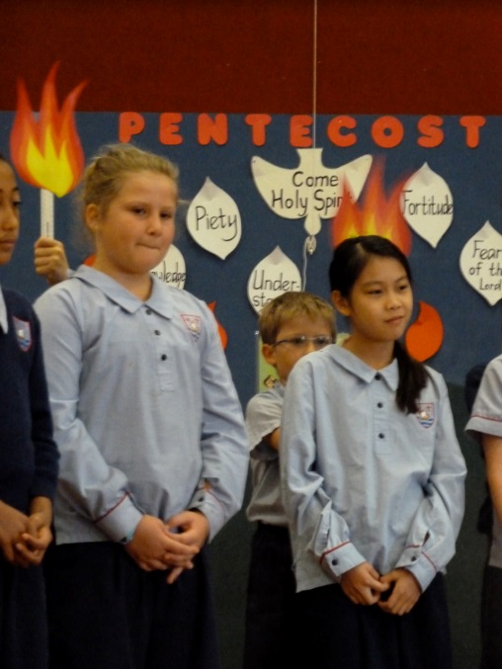
How do children of your age recognise the Holy Spirit working in your lives?
The first members of the Church recognised the Holy Spirit alive in their hearts after Pentecost because they were able to put into action what Jesus had taught them. Can you recognise the Holy Spirit alive in your heart for the same reason?
The first members of the Church lived and prayed together and they were guided by the Holy Spirit to make good choices. How do you recognise the ways the Holy Spirit guides your actions and choices? The Holy Spirit uses the voices of the wise people in your life so it is good to listen to them!
The strength of the Holy Spirit helped the first Christians to spread the good news of Jesus. Their kind words and encouragement attracted people to join their group. Can you recognise how the Holy Spirit helps you to use words of kindness and encouragement to people in your class?
The first followers of Jesus had a deep friendship with him and they spent time listening to him, helping him to do his work and learning from him. How do you spend time with Jesus getting to know him, listening to him, learning from him and living as he did?
R-1
S-08
Click the pins on the right to reveal post-it notes.
Notes:
Read the black text together. Read and reflect on the questions and share how you experience the Holy Spirit alive in your hearts guiding you, inspiring you, listening to you, encouraging you and how you respond to this.

Slide 10
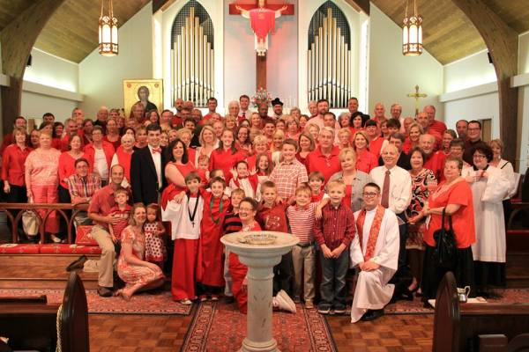
The Church celebrates Pentecost Sunday
On Pentecost Sunday the Church
The priest and the people wear red to
The story of the first Pentecost
Sometimes the prayers are said in
The Holy Spirit is present in
At Pentecost everyone is full of joy because
the Holy Spirit now lives in the hearts of all who follow Jesus.
celebrates the Holy Spirit being poured out on it for all time.
different languages to remind people about the first Pentecost.
remind them of the fire of the Spirit that fills all followers of Jesus.
is the read during the Liturgy of the Word on Pentecost Sunday.
the hearts of the people and guides the choices they make.
R-1
S-09A
Drawing Tool
Match the statements on the left with the ones on the right using the drawing tool. Click on the worksheet button to go to the worksheet.
Notes:
Create a flyer to be handed out in your parish community advertising Eucharist on Pentecost Sunday stating 3 things people could do to highlight the celebration of the Coming of the Holy Spirit. Children complete worksheet and check their responses using the floaters on Slide 9B.

Slide 11
The Church celebrates Pentecost Sunday
1
On Pentecost Sunday the Church
The priest and the people wear red to
The story of the first Pentecost
Sometimes the prayers are said in
The Holy Spirit is present in
At Pentecost everyone is full of joy because
2
3
4
5
6
a)
the hearts of the people and guides the choices they make.
b)
the Holy Spirit now lives in the hearts of all who follow Jesus.
c)
celebrates the Holy Spirit being poured out on it for all time.
d)
remind them of the fire of the Spirit that fills all followers of Jesus.
e)
is read during the Liturgy of the Word on Pentecost Sunday.
f)
different languages to remind people about the first Pentecost.
R-1
S-09B
Click the numbered buttons on the left to reveal the correct statement match
Notes:
Use floaters to check answers.
ANSWERS:
1 - C, 2 - D, 3 - E, 4 - F, 5 - A, 6 –B

Slide 12
Check Up
1)
Name 5 people who were present at the first Pentecost.
2)
Who were the first members of the Church and what were they expected to do?
3)
What effects did the coming of the Holy Spirit have on the first disciples?
R-1
S-10A
Notes:
This formative assessment strategy will help teachers to identify how well children have achieved the Learning Intentions of the resource.
Teachers can choose how they use the slide in their range of assessment options.
A worksheet of this slide is available for children in Years 5-8 to complete.
The last two items are feed forward for the teacher.
Recording the children’s responses to these items is recommended as it will enable teachers to adjust their learning strategies for future resources and target the areas that need further attention.

Slide 13
Check Up
4)
I recognise the effects of the Holy Spirit in my life when …
5)
Which activity do you think helped you to learn best in this resource?
6)
Questions I would like to ask about the topics in this resource are …
R-1
S-10B
Click the worksheet button to go to the worksheet
Notes:
Children could repeat the worksheet with PENTECOST QUIZ on Slide 3 as a post test.

Slide 14
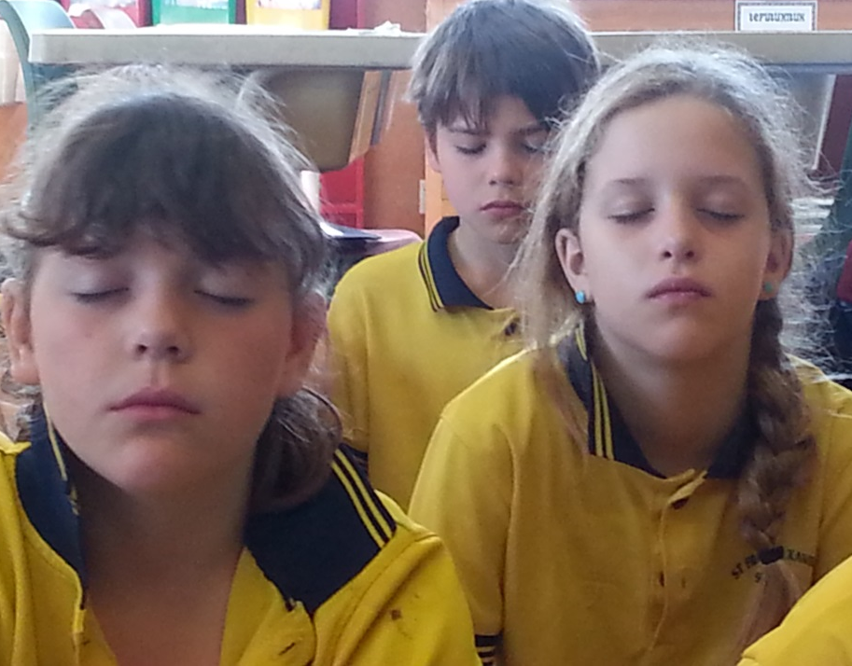
Time for Reflection
R-1
S-11
Click the audio button to stop reflective music
Click the audio button to play reflective music
Notes:
The MP3 is played to help create a reflective atmosphere and bring the children to stillness and silence as the teacher invites them to think about a time when they felt the Holy Spirit in their heart filling them with love for someone. Remember how it felt and how they shared their love. Talk to Jesus about this and ask him to help them notice when this happens and to help them pass on this love to someone who needs it.

Slide 15
What do you know about Pentecost?
Name:_____________ Date:_____________
Circle TRUE or FALSE
PENTECOST is the feast that celebrates the coming of the Holy Spirit.
The Liturgical colour for PENTECOST is green.
PENTECOST is the last feast in the Easter season.
Jesus was present with the apostles at PENTECOST.
When the Holy Spirit came it sounded like rain on the roof.
The Holy Spirit is the Spirit of Jesus.
The apostles were gathered in the temple when the Holy Spirit came.
Mary, Jesus’ mother, was present at PENTECOST.
The feast of the Ascension comes after PENTECOST.
The Holy Spirit took away the apostles’ fear.
TRUE | FALSE
TRUE | FALSE
TRUE | FALSE
TRUE | FALSE
TRUE | FALSE
TRUE | FALSE
TRUE | FALSE
TRUE | FALSE
TRUE | FALSE
TRUE | FALSE
PENTECOST means fifty because it happened 50 days after Easter.
PENTECOST is known as the birthday of the Church.
After PENTECOST the apostles hid away and did not speak about Jesus.
There were about 120 people when the Holy Spirit came at PENTECOST.
The first disciples of Jesus were the first members of the Church.
PENTECOST fulfilled the promise Jesus made to always be with his friends.
PENTECOST made it possible for Jesus to live in people through his spirit.
After PENTECOST the apostles forgot about Jesus.
Prayer was a very important part of the life of the early Church members.
Red vestments symbolise the tongues of fire that appeared at PENTECOST.
TRUE | FALSE
TRUE | FALSE
TRUE | FALSE
TRUE | FALSE
TRUE | FALSE
TRUE | FALSE
TRUE | FALSE
TRUE | FALSE
TRUE | FALSE
TRUE | FALSE
R-1
S-03
Worksheet
Click the up arrow to return to the presentation
Notes:
This worksheet relates to slides 3A and 3B.

Slide 16
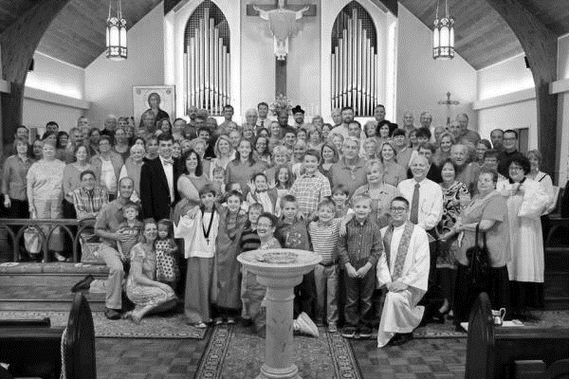
The Church celebrates Pentecost Sunday
Name:_____________ Date:_____________
On Pentecost Sunday the Church
The priest and the people wear red to
The story of the first Pentecost
Sometimes the prayers are said in
The Holy Spirit is present in
At Pentecost everyone is full of joy because
the Holy Spirit now lives in the hearts of all who follow Jesus.
celebrates the Holy Spirit being poured out on it for all time.
different languages to remind people about the first Pentecost.
remind them of the fire of the Spirit that fills all followers of Jesus.
is the read during the Liturgy of the Word on Pentecost Sunday.
the hearts of the people and guides the choices they make.
R-1
S-09
Worksheet
Click the up arrow to return to the presentation
Notes:
This worksheet relates to slide 9A.

Slide 17
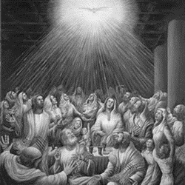
Check Up
Name:____________________________
Date:____________
1)
Name 5 people who were present at the first Pentecost.
2)
Who were the first members of the Church and what were they expected to do?
3)
What effects did the coming of the Holy Spirit have on the first disciples?
4)
I recognise the effects of the Holy Spirit in my life when …
5)
Which activity do you think helped you to learn best in this resource?
6)
Questions I would like to ask about the topics in this resource are …
R-1
S-10
Worksheet
Click the up arrow to return to the presentation
Notes:
This worksheet relates to slide 10.

