Slide 1
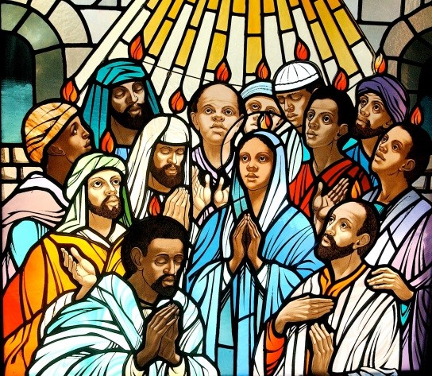
Pentecost then – Pentecost Today
R-1
S-01
Notes:
Read the Bible stories about Pentecost during class prayer this week.

Slide 2
Learning Intentions
The children will:
1)
recall the story of the first Pentecost in the life of the Church
recognise ways the Holy Spirit Te Wairua Tapu gives life to the Church today
2)
R-1
S-02
Click the box to reveal the Learning Intention

Slide 3
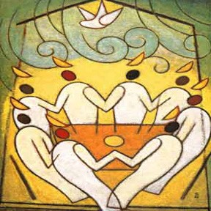
Make a mind map about the First Pentecost
What I know about the First Pentecost
R-1
S-03
Click the worksheet button to go to the worksheet
Notes:
Children complete their Mind map and share it. If they cannot fill all the spaces they can add to it after the clip on the next slide. They could make notes of the new things they learned as they watch the clip and add them in.

Slide 4
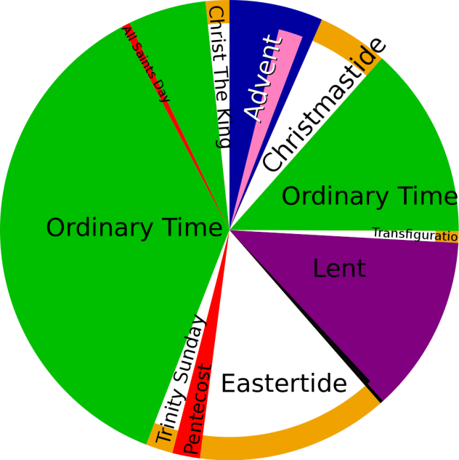
Pentecost in the Liturgical Year
Look at the Liturgical Calendar and make a comment or ask a question about it.
Construct one sentence to describe where the Feast of Pentecost comes.
Give a reason why Trinity Sunday might be placed directly after Pentecost.
What feast that is related to Pentecost is not marked on the calendar?
What seasons does Pentecost come between?
X
R-1
S-04
Click the I-button to reveal information

Slide 5
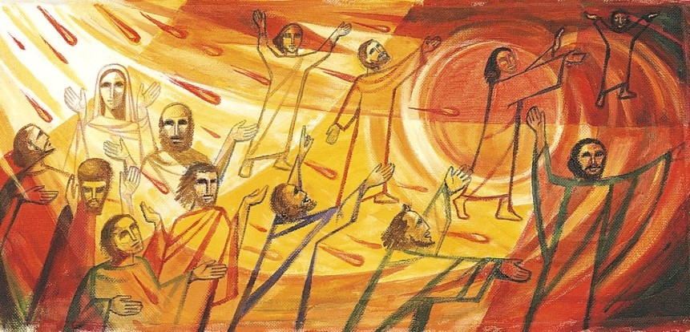
Brush up on your Pentecost knowledge
In groups make your own version of PENTECOST boxofquestions and record them to share
R-1
S-05
Click the video button to play ‘What is Pentecost’ video
Notes:
Watch the clip
https://www.youtube.com/watch?v=lhHzOqNy6gs
What is Pentecost? – boxofquestions 2:11 minutes
Note: The next 2 clips follow on from the Pentecost clip and may also be of use for this topic as revision.
Who is the Holy Spirit 1:21 minutes
How does the Holy Spirit help me 1:27 minutes

Slide 6
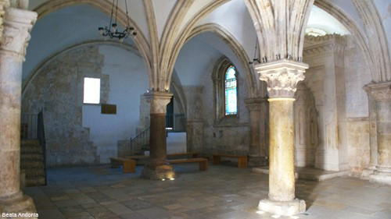
The room that is the site where it is believed
several significant events in Jesus’ life took place
The ‘Cenacle’ which means dining room, also known as the ‘Upper Room’, is a room in Jerusalem traditionally held to be the site of the Last Supper.
The Cenacle is also considered the site where other significant events described in the New Testament took place, such as:
preparation for the celebration of Jesus' final Passover meal
Jesus washed his disciples' feet
the disciples gathered after the Ascension of Jesus
Jesus appeared after his resurrection
the descent or coming down of the Holy Spirit upon the disciples on the day of Pentecost.
the election of Saint Matthias as the apostle to replace Judas Iscariot
R-1
S-06
Click the small pictures to reveal text
Notes:
Introduce the idea that many of the places that are connected with Jesus’ life and ministry are now what is known as sacred sites. Many of them have shrines or chapels built on them to mark the place. Many of these places are visited by pilgrims who come to remember Jesus and to pray and recall his life. Children may like to research some of these places and share their findings.

Slide 7
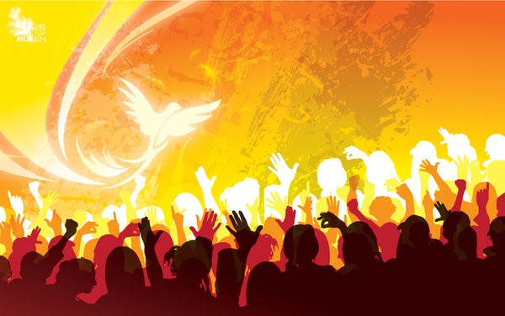
Through the power of the Holy Spirit Te Wairua Tapu
the work of the Church continues today
But the Spirit who came at Pentecost was sent to the members of the Church for all time. It is through the same power of the same Holy Spirit sent at Pentecost that the Church today is able to continue to spread the gospel.
When the Church was established by Jesus the work God had sent him to do was done. It now became the disciples’ work to open the Church up to all nations through their teaching and preaching. The Holy Spirit empowered them so the Church could become known throughout the world.
It is the same Holy Spirit who is confirmed in people at the Sacrament of Confirmation to help them grow strong in their belief in Jesus and do their part to carry on his work in the Church today.
The first members of the Church became the first missionaries sent to carry on the work Jesus began and to follow his last command to them to make disciples of all people - Gentiles as well as Jews.
Pentecost celebrated the coming of the Spirit on the disciples of Jesus who were the first to take over his mission which he passed on to them. His mission became the mission of the Church when it was born at the first Pentecost.
Click the video button to play ‘Pentecost Parody – We didn’t start the fire’ video
R-1
S-07
Click the pins on the right to reveal post-it notes.

Slide 8
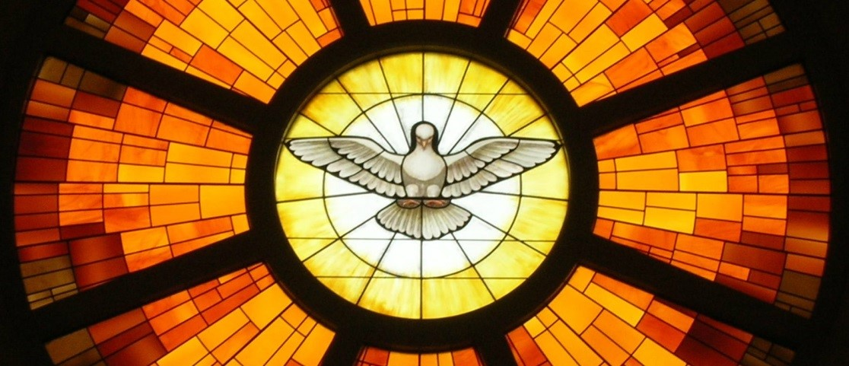
Te Wairua Tapu of Jesus pours out gifts
on people to build up the Church
The Holy Spirit in people gives life to the Church, helps it to grow, keeps it going and makes it holy and connected to God. The Pope and the bishops are guided by the Holy Spirit to lead the people of God. Children of your age can ask the Holy Spirit to guide you to make good choices.
The Spirit pours out gifts on people to use to build up the Church and make the world a better place. This is how the Spirit is present in the world through the gifts that are shared with people. What gifts do you recognise in the people around you that show the Spirit is present in them?
The gifts of the Spirit are passed on to everyone who becomes a follower of Jesus through the Sacrament of Baptism. People are encouraged to use their gifts to build God’s kingdom on earth. What gifts have you been given that you can use to help build up the Church?
The Holy Spirit is God’s gift to the world and it is the Spirit of Jesus that fills people with Jesus’ love, kindness, gentleness, truth, goodness, generosity.
Can you name some other gifts of Jesus that the Spirit also gives?
The gifts people need are the same gifts Jesus used to lay the foundations of the Church while he lived on earth.
What gifts do you think helped Jesus to gather and train his first apostles?
The Holy Spirit gives people the gifts they need to do the work of the Church. Name 3 gifts people need to do the work of the Church.
Click the audio button to stop ‘Send us your Spirit’
Click the audio button to play ‘Send us your Spirit’
R-1
S-08
Click top card to reveal others
Click the reset button to restart
Notes:
Sing using the MP3 ‘Send us your Spirit’

Slide 9
Signs that the Holy Spirit Te Wairua Tapu
is alive in the Church today
Make a collage of all the people you know, including yourselves, who are signs that the Holy Spirit is alive in the Church today. Display your collage in your school and parish.
R-1
S-09

Slide 10
Check up
1)
Make a comic strip of the Pentecost story to share with a younger child.
2)
Explain the connection between the Holy Spirit that came at Pentecost and the Holy Spirit in the Church today.
3)
How is the Holy Spirit present in the Church and the world today?
4)
How can you recognise the Holy Spirit working in yourself and other people today?
5)
Which activity do you think helped you to learn best in this resource?
6)
Questions I would like to ask about the topics in this resource are …
R-1
S-10
Click the worksheet button to go to the worksheet
Notes:
This formative assessment strategy will help teachers to identify how well children have achieved the Learning Intentions of the resource.
Teachers can choose how they use the slide to assess each item.
A worksheet of this slide is available as an option for children to complete.
The last two items are feed forward for the teacher.
Recording the children’s responses to these items is recommended as it will enable teachers to adjust their learning strategies for future resources and target the areas that need further attention.

Slide 11
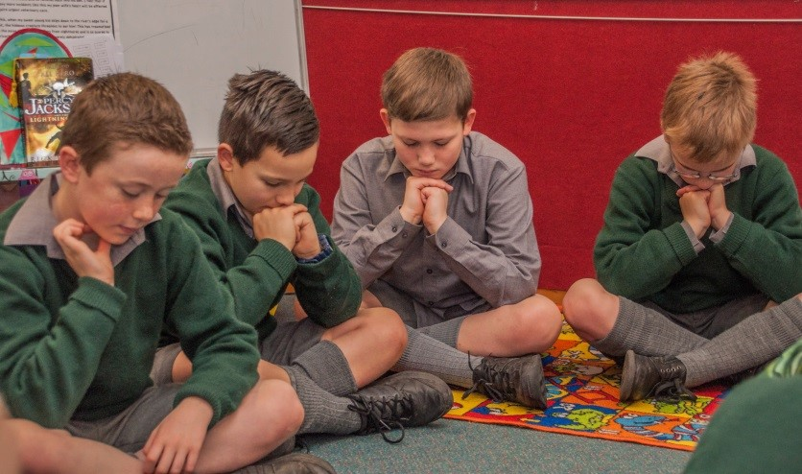
Time for Reflection
R-1
S-11
Click the audio button to stop reflective music
Click the audio button to play reflective music
Notes:
The MP3 is played to help create a reflective atmosphere and bring the children to stillness and silence as the teacher invites them to recognise the ways they feel the Spirit of Jesus working in their heart and recall experiences when the Holy Spirit has prompted them to act with kindness when they see someone in need.

Slide 12
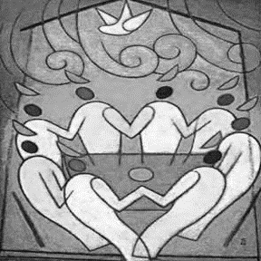
Make a mind map about the First Pentecost
Name:____________________________
Date:____________
What I know about the First Pentecost
Worksheet
R-1
S-03
Click the up arrow to return to the presentation

Slide 13
Check up
Name:____________________________
Date:____________
1) Make a comic strip of the Pentecost story to share with a younger child.
2) Explain the connection between the Holy Spirit that came at Pentecost and the Holy Spirit in the Church today.
3) How is the Holy Spirit present in the Church and the world today?
4) How can you recognise the Holy Spirit working in yourself and other people today?
5) Which activity do you think helped you to learn best in this resource?
6) Questions I would like to ask about the topics in this resource are …
R-1
S-10
Worksheet
Click the up arrow to return to the presentation

